Slide 1
Application Delivery Fundamentals 2.0:
Java
Module 14: Design Patterns
Notes:
Module Duration: 1 hour 30 minutes
Faculty Notes:
N/A
Participant Notes:
N/A

Slide 2
Agenda
What are software design patterns
Creational patterns
Structural patterns
Behavioral patterns
Concurrency patterns
  Mentioned for full set, but will not be reviewed
Notes:
Faculty Notes:
Review the agenda with the participants.
Participant Notes:
N/A

Slide 3
Design Patterns – A Definition
Design patterns:
  Are re-usable solutions to commonly occurring design problems.
  Are best practices or methodologies rather than frameworks (which are products).
  Adhere to the principles of high cohesion and low coupling.
Notes:
Faculty Notes:
Review the slide content and Participant Notes with the participants.
Participant Notes:
The term ‘Design Pattern’ comes from the book ‘Design Patterns - Elements of Reusable Object-Oriented Software’ written by a group called the Gang of Four.

Slide 4
Design Pattern Characteristics
Design patterns typically have:
  An industry-standard name and description.
  A specification that describes the pattern’s purpose, areas of application, and any trade-offs or constraints.
31
Notes:
Faculty Notes:
Review the slide content with the participants.
Participant Notes:
N/A

Slide 5
Software design patterns
There are different kinds of software design patterns:
  Algorithm strategy patterns
  address application algorithmic characteristics on a computing platform
  Computational design patterns
  address computational identification
  Execution patterns patterns
  address lower-level application execution
  Implementation strategy patterns
  address source implementation and support — program organization and common data structures
  Structural design patterns
  address global structures of applications being developed

Slide 6
Design Patterns
Gang of Four Patterns Catalog
Creational Patterns | Structural Patterns | Behavioral Patterns
Singleton Abstract Factory Builder Prototype Factory | Adapter Bridge Composite Decorator Facade Flyweight Proxy | Chain of Responsibility Command Interpreter Iterator Mediator Memento Observer State Strategy Template Method Visitor
33
Notes:
Faculty Notes:
Review the slide content with the participants.
Participant Notes:
N/A

Slide 7
Creational patterns
Abstract factory
Factory method
Builder
Lazy initialization
Prototype
Singleton

Slide 8
Factory method
The use of the ‘new’ keyword directly requires the client object to know the actual class being instantiated. The factory pattern:
Can be used to hide this detail by delegating to a method the responsibility of creating objects.
Can control how instances are being created based on the rules of the factory method.

Slide 9

Factory method

Slide 10
Builder Pattern
The builder pattern is an object creation pattern where complex objects is constructed in several steps (usually starting with "nullified" object, and then filling in its structures).
Builder pattern is used when creation of complex object leads to an exponential list of constructors (which is anti-pattern)
CarBuilder carBuilder = new CarBuilder();
carBuilder.setSeats(2);
carBuilder.setSportsCar();
carBuilder.setTripComputer();
carBuilder.unsetGPS();
Car car = carBuilder.getResult();

Slide 11
Lazy initialization
Lazy initialization is delaying of creation of an object (especially large static objects) until the first time it is needed
class LazyDemo {
static Object megaObject;
public Object getMegaObject() {
if (megaObject == null) { // not thread safe!
megaObject = new MegaObject();
}
return megaObject;
}
}
For thread safe construction synchronized methods/blocks of code should be used, look also at Singleton pattern

Slide 12

Singleton Pattern
The Singleton Pattern:
  Is a creational pattern that restricts the creation of instances of a class to just one instance.
  Is used in situations where it might be more efficient to just have a single instance of the object rather several instances of the same object whose states need to be coordinated.
https://en.wikipedia.org/wiki/Singleton_pattern
34
Notes:
Faculty Notes:
Review the slide content and Participant Notes with the participants.
Share your examples of the use of the Singleton pattern with participants – such as an MS desktop icon. (See Faculty Guide for details of example).
Participant Notes:
The Singleton Pattern:
Ensures that a class has only one instance and provides a global point of access to it
Controls object creation, limiting the number to one
Example: A Logger class needs to log information coming from various parts of the application into one single file.

Slide 13
Structural patterns
Adapter
Composite
Decorator
Facade
Proxy

Slide 14
Adapter Patterns
The adapter pattern:
Is used to solve the problem of two objects with incompatible interfaces that need to work together
Allows the client object to be decoupled from the adapted object

Slide 15

Adapter Patterns

Slide 16
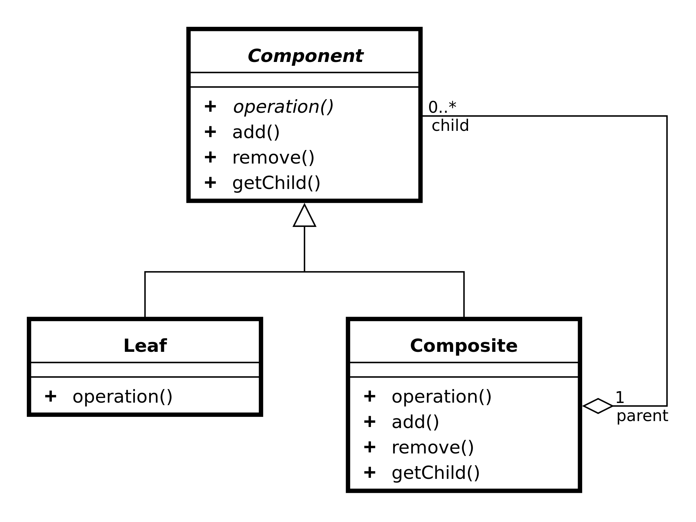
Composite pattern
Compose objects into tree structures to represent part-whole hierarchies. Composite lets clients treat individual objects and compositions of objects in the same way.

Slide 17
Decorator pattern
The decorator pattern:
Allows you to dynamically add a behavior to an object or group of objects.
This is achieved by designing a new decorator class that wraps the original class’ object.
38
Notes:
Faculty Notes:
Review the slide content and Participant Notes with the participants.
Participant Notes:
Examples include:
A Window class could be decorated with horizontal and vertical scroll bars. (We would need to create two decorator classes for each type of scroll bar which, which in turn, would take Window class as its parameter.
A ChristmasTree class would need to be wrapped with different decorators like StarDecorator, BallDecorator, and so on.

Slide 18
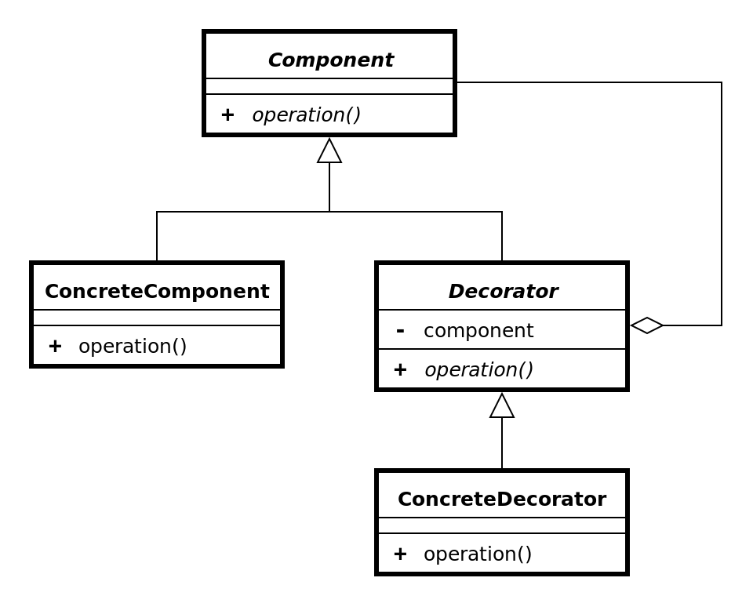
Decorator pattern

Slide 19
Behavioral patterns
Iterator
Strategy
Observer

Slide 20
Iterator pattern
Iterator is used to traverse a container and access the container's elements. The iterator pattern decouples algorithms from containers; in some cases, algorithms are necessarily container-specific and thus cannot be decoupled.
Java has Iterator and Iterable interfaces for this
Can be traversed using the enhanced for loop syntax
The Collection interface from the Java collections framework extends Iterable.

Slide 21
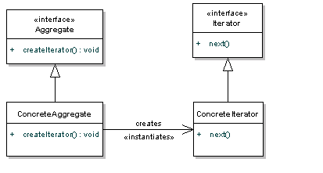
Iterator pattern

Slide 22
Strategy pattern
Strategy pattern a software design pattern that enables an algorithm's behavior to be selected at runtime. The strategy pattern.
  defines a family of algorithms,
  encapsulates each algorithm, and
  makes the algorithms interchangeable within that family.

Slide 23

Strategy pattern

Slide 24

Observer pattern
Also called publish/subscribe
One-to-many dependency between objects where change in one object results changes in all dependent objects
  Avoids "Busy waiting" in distributed systems
  Do not confuse with simple shared structure

Slide 25
Concurrency patterns
Active object
Double-checked locking
Monitor object
Reactor
Thread-specific storage
Etc.

Slide 26
Design pattern weaknesses
Without good understanding of problem, incorrect design pattern can be chosen
Too much of pattern usage may unnecessarily increase complexity
The design patterns can be a sign of missing features in given programming language
  Too much patterns in code is anti-pattern, why not to develop some kind of DSL language for this problem?
  Much of what looks like "pattern" is actually "anti-pattern"
https://en.wikipedia.org/wiki/Anti-pattern#Software_engineering

Slide 27
Questions and Comments
Copyright © 2011 Accenture All Rights Reserved.
Notes:
Faculty Notes:
Review the slide content with the participants.
Participant Notes:
N/A

