Slide 1
Maven
Building Tool
Notes:
<skaitlis>

Slide 2
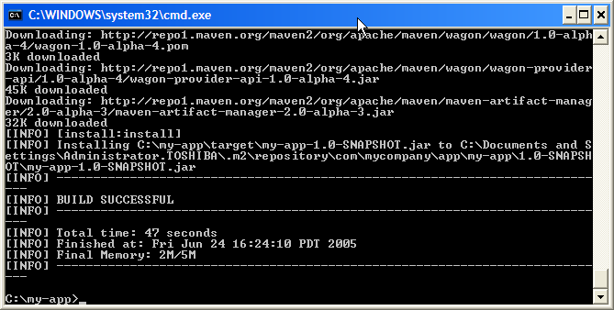
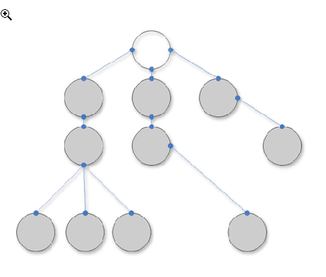
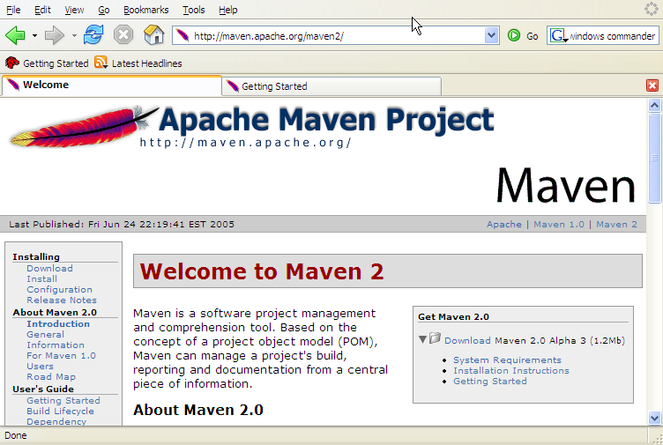
What is Maven?
A build tool
A dependency management tool
A documentation tool
Notes:
<skaitlis>

Slide 3

Making your builds boring…
Building projects should be easy and standardized. You should not be spending a substantial amount of your project time on builds. Builds should just work!
Notes:
<skaitlis>

Slide 4

Apply patterns to project build infrastructure
Maven is really a process of applying patterns to a build infrastructure in order to provide a coherent view of software projects.
Provides a way to help with managing:
  Builds
  Documentation
  Reporting
  Dependencies
  Software Configuration Management
  Releases
  Distribution
Notes:
<skaitlis>

Slide 5
Objectives
Make the development process visible or transparent
Provide an easy way to see the health and status of a project
Decreasing training time for new developers
Bringing together the tools required in a uniform way
Preventing inconsistent setups
Providing a standard development infrastructure across projects
Focus energy on writing applications
Notes:
<skaitlis>

Slide 6
Benefits
Standardization
Fast and easy to set up a powerful build process
Greater momentum vs. Ant – it is now becoming legacy and not moving fast ahead
Dependency management (automatic downloads)
Project website generation, Javadoc
Repository management
Notes:
<skaitlis>

Slide 7
Installation and Setup
Download Maven from http://maven.apache.org/
Unzip the distribution
Create environment variable M2_HOME, which points to Maven directory, e.g. c:\tools\apache-maven-3.0.4
Add Maven’s bin directory to System Variable Path
Ensure JAVA_HOME is set to JDK
Run mvn –version to test install
C:\Users\alina.vasiljeva>mvn -version
Apache Maven 3.0.4 (r1232337; 2012-01-17 10:44:56+0200)
Maven home: C:\tools\apache-maven-3.0.4\bin\..
Notes:
<skaitlis>

Slide 8
What can you do with Maven?
Create new project from template (i.e. archetype)
Result will be following:
C:\Temp> mvn archetype:create
-DgroupId=com.mycompany.app -DartifactId=my-app
Notes:
<skaitlis>

Slide 9
What can you do with Maven?
C:\Temp\my-app> mvn compile
C:\Temp\my-app>mvn compile
[INFO] Scanning for projects...
[INFO]
[INFO] ------------------------------------------------------------
[INFO] Building my-app 1.0-SNAPSHOT
[INFO] ------------------------------------------------------------
.............
[INFO] Compiling 1 source file to C:\Temp\my-app\target\classes
[INFO] ------------------------------------------------------------
[INFO] BUILD SUCCESS
[INFO] ------------------------------------------------------------
[INFO] Total time: 5.187s
[INFO] Finished at: Mon Sep 12 19:25:25 EEST 2011
[INFO] Final Memory: 8M/121M
[INFO] ------------------------------------------------------------
Notes:
<skaitlis>

Slide 10
What can you do with Maven?
C:\Temp\my-app> mvn package
[INFO] ......
[INFO] --- maven-resources-plugin:2.4.3:resources (default-resources) @ my-app ---
[INFO] Using 'UTF-8' encoding to copy filtered resources.
[INFO] skip non existing resourceDirectory C:\Temp\my-app\src\main\resources
[INFO]
[INFO] --- maven-compiler-plugin:2.3.2:compile (default-compile) @ my-app ---
[INFO] Nothing to compile - all classes are up to date
[INFO]
[INFO] --- maven-resources-plugin:2.4.3:testResources (default-testResources) @ my-app ---
[INFO] Using 'UTF-8' encoding to copy filtered resources.
[INFO] skip non existing resourceDirectory C:\Temp\my-app\src\test\resources
[INFO]
[INFO] --- maven-compiler-plugin:2.3.2:testCompile (default-testCompile) @ my-app ---
[INFO] Nothing to compile - all classes are up to date
[INFO]
[INFO] --- maven-surefire-plugin:2.7.2:test (default-test) @ my-app ---
[INFO] Surefire report directory: C:\Temp\my-app\target\surefire-reports
-------------------------------------------------------
T E S T S
-------------------------------------------------------
Running com.mycompany.app.AppTest
Tests run: 1, Failures: 0, Errors: 0, Skipped: 0, Time elapsed: 0.015 sec
Results :
Tests run: 1, Failures: 0, Errors: 0, Skipped: 0
[INFO]
[INFO] --- maven-jar-plugin:2.3.1:jar (default-jar) @ my-app ---
[INFO] ------------------------------------------------------------------
[INFO] BUILD SUCCESS
[INFO] ------------------------------------------------------------------
[INFO] Total time: 2.345s
[INFO] Finished at: Mon Sep 12 19:27:39 EEST 2011
[INFO] Final Memory: 6M/121M
[INFO] ------------------------------------------------------------------
Notes:
<skaitlis>

Slide 11
Maven Architecture
Plugin
e.g. jar
Projects
to build
Maven Core
Plugin
e.g. surefire
Plugin
e.g. release
Local machine
Remote repository or local install
Notes:
<skaitlis>

Slide 12
Project Object Model
Maven is based on the concept of a Project Object Model
Maven features such as:
  builds
  dependency management
  documentation creation
  site publication
  distribution publication
are all controlled from the declarative file
File is named pom.xml and is located in the project root
Notes:
<skaitlis>

Slide 13
Common project metadata format
POM = Project Object Model = pom.xml
Contains metadata about the project
  Dependencies, Location of directories, Developers/Contributors, Issue tracking system, Repositories to use, etc
Example:
<project>
<modelVersion>4.0.0</modelVersion>
<groupId>org.codehaus.cargo</groupId>
<artifactId>cargo-core-api-container</artifactId>
<version>0.7-SNAPSHOT</version>
<name>Cargo Core Container API</name>
<packaging>jar</packaging>
<dependencies/>
<build/>
[…]
Minimal POM
Notes:
<skaitlis>

Slide 14
Super POM
The Super POM is Maven's default POM
All POMs extend the Super POM unless explicitly set
The configuration specified in the Super POM is inherited by the POMs you created for your projects
Super POM snippet can be found here:
http://maven.apache.org/guides/introduction/introduction-to-the-pom.html
Notes:
<skaitlis>

Slide 15
Standard directory organization
Having a common directory layout would allow for users familiar with one Maven project to immediately feel at home in another Maven project.
src/main/java
Application/Library sources
src/main/resources
Application/Library resources
src/main/filters
Resource filter files
src/main/assembly
Assembly descriptors
src/main/config
Configuration files
src/main/webapp
Web application sources
src/test/java
Test sources
src/test/resources
Test resources
src/test/filters
Test resource filter files
src/site
Site
LICENSE.txt
Project's license
README.txt
Project's readme
Notes:
<skaitlis>

Slide 16
Common way to build applications
M2
generate-
sources
mojo
compile
mojo
test
mojo
package
plugins
integration-
test
user
mojo
install
mojo
e.g. mvn install
deploy
bindings
Well-known phases
MOJO – Maven 2 Plugins Project
http://mojo.codehaus.org/
Notes:
<skaitlis>

Slide 17
Overview of common Goals
validate - validate the project is correct and all necessary information is available
compile - compile the source code of the project
test - test the compiled source code using a suitable unit testing framework. These tests should not require the code be packaged or deployed.
package - take the compiled code and package it in its distributable format, such as a JAR
integration-test - process and deploy the package if necessary into an environment where integration tests can be run
install - install the package into the local repository, for use as a dependency in other projects locally
deploy - done in an integration or release environment, copies the final package to the remote repository for sharing with other developers and projects
Notes:
<skaitlis>

Slide 18
Dependency management
Iedomāsimies, ka Jūs vēlāties savā projektā izmantot jaunu bibliotēku, piemērām, log4j.jar
Viens veids kā to izdarīt:
  izveidot direktoriju \my_project\lib
  iekopēt tur bibliotēkas failu \my_project\lib\log4j.jar
  pievienot JAR failu projekta CLASSPATH
  to visu iečekot Subversion repozitorijā
Maven piedāvā savu variantu...
Notes:
<skaitlis>

Slide 19
Add a dependency
Add a new dependency in pom.xml
<project>
<modelVersion>4.0.0</modelVersion>
<groupId>com.web.music</groupId>
<artifactId>my_project</artifactId>
<packaging>jar</packaging>
<version>1</version>
<name>my_project</name>
<dependencies>
<dependency>
<groupId>log4j</groupId>
<artifactId>log4j</artifactId>
<version>1.2.17</version>
</dependency>
</dependencies>
<build/>
</project>
Notes:
<skaitlis>

Slide 20
Dependency resolution
Palaiž kādu Maven komandu, piemērām,
mvn compile
Sākumā Maven meklē atkarību lokālajā repozitorijā
Ja bibliotēka nav atrasta, tad Maven mēģina to ielādēt to no attālināta repozitorija
Rezultātā, bibliotēka ir ielādēta lokālajā repozitorijā, no kurienes arī tiek turpmāk lasīta
Notes:
<skaitlis>

Slide 21
Maven console output
C:\Temp\my-app>mvn compile
[INFO] Scanning for projects...
[INFO]
[INFO] ------------------------------------------------------------------------
[INFO] Building my-app 1.0-SNAPSHOT
[INFO] ------------------------------------------------------------------------
...
Downloading: http://repo1.maven.org/maven2/log4j/log4j/1.2.17/log4j-1.2.17.jar
Downloaded: http://repo1.maven.org/maven2/log4j/log4j/1.2.17/log4j-1.2.17.jar (359 KB at 49.4 KB/sec)
[INFO] Not writing settings - defaults suffice
[INFO] Wrote Eclipse project for "my-app" to C:\Temp\my-app.
[INFO]
[INFO] ------------------------------------------------------------------------
[INFO] BUILD SUCCESS
[INFO] ------------------------------------------------------------------------
[INFO] Total time: 9.302s
[INFO] Finished at: Mon Sep 12 19:34:32 EEST 2019
[INFO] Final Memory: 9M/153M
[INFO] ------------------------------------------------------------------------
Notes:
<skaitlis>

Slide 22
Dependency management
« any version after 1.0 »
A
B
<dependencies>
<dependency>
<groupId>com.acme</groupId>
<artifactId>B</artifactId>
<version>[1.0,)</version>
<scope>compile</scope>
</dependency>
</dependencies>
C
Artifact
Repository
(Local)
Artifact
Repositories
(Remote)
Build C
Look for A & B
Look for A & B
Notes:
<skaitlis>

Slide 23
Dependency management
Transitive dependencies
  Possibility to exclude some dependencies
  Need good metadata
  Ideally projects should be split
SNAPSHOT handling
  Always get latest
Automatic dependency updates
  By default every day
A
Only need to include A
B
C
D
Notes:
<skaitlis>

Slide 24
Artifact repositories
Are used to store all kind of artifacts
  JARs, EARs, WARs, NBMs, EJBs, ZIPs, plugins, …
All project interactions go through the repository
No more relative paths!
Easy to share between team
Local
Artifact
Repository
Remote
Artifact
Repository
e.g. http://repo1.maven.org/maven2
<repositories>
<repository>
<id>central</id>
<name>Maven Repository Switchboard</name>
<layout>default</layout>
<url>http://repo1.maven.org/maven2</url>
<snapshots>
<enabled>false</enabled>
</snapshots>
</repository>
</repositories>
Notes:
<skaitlis>

Slide 25
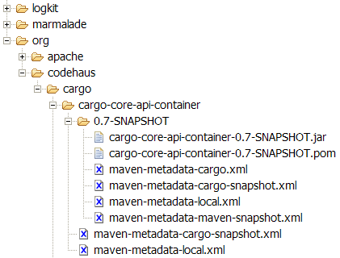
Inside repository
Hierarchical structure
Automatic plugin download
Plugins are read directly from the repository
Configurable strategies for checking the remote repositories for updates
  Daily check by default for plugin and ranges updates
Remote repositories contain metadata information
  Releases, latest, and more to come
Notes:
<skaitlis>

Slide 26
Repositories for auto-downloads
Repository usage is transparent to Maven
By default, Maven looks up repo1.maven.org/maven2
Override in the pom.xml (example below with the Eclipse plugin)
<project>
...
<repositories>
<repository>
<id>m2 plugin</id>
<url>m2eclipse.codehaus.org</url>
</repository>
</repositories>
...
</project>
Plugins available to use CVS with the project source
Notes:
<skaitlis>

Slide 27
Repository Example
<!-- JBoss Maven repository, required for persistence libraries -->
<repositories>
<repository>
<id>jboss-public-repository-group</id>
<name>JBoss Public Repository Group</name>
<url>
http://repository.jboss.org/nexus/content/groups/public-jboss
</url>
<layout>default</layout>
<releases>
<enabled>true</enabled>
<updatePolicy>never</updatePolicy>
</releases>
<snapshots>
<enabled>true</enabled>
<updatePolicy>never</updatePolicy>
</snapshots>
</repository>
</repositories>

Slide 28
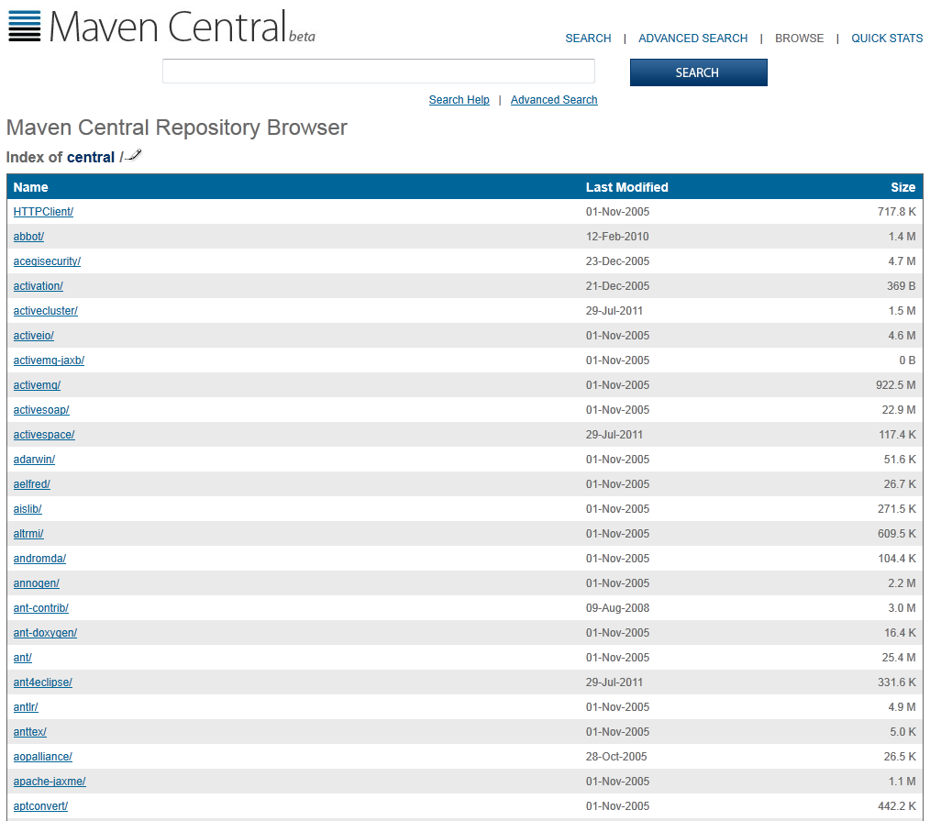
How to find required dependency?
Go to http://search.maven.org/#browse
Find a folder with
required dependency,
e.g.
/log4j/log4j/
Notes:
<skaitlis>

Slide 29
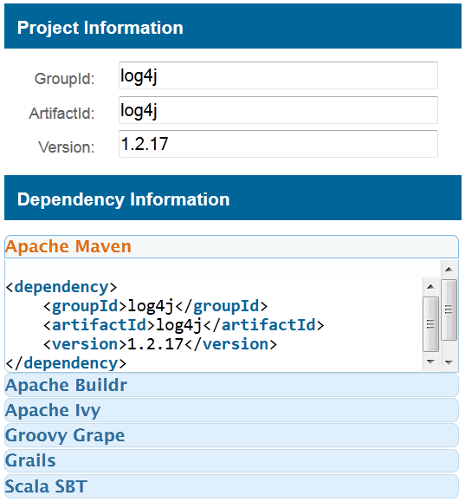
How to find required dependency?
Easier with Maven
plugin for Eclipse!..
Notes:
<skaitlis>

Slide 30
The local repository
What does Maven do with all the dependencies?
→ C:\Documents and Settings\<username>\.m2
Advantages: No need to keep anything in the repo other than your own source code, saves space in the repo and rebuild / transfer time
Can download dependencies from a local intranet repo instead of repo1.maven.org, etc
Eclipse needs to know the path to the local Maven repository. Therefore the classpath variable M2_REPO has to be set:
  Java > Build Path > Classpath Variables
Notes:
<skaitlis>

Slide 31
Installing JARs to local repository
Sometimes you need to put some specific JARs in your local repository for use in your builds
The JARs must be placed in the correct place in order for it to be correctly picked up by Maven
To install a JAR in the local repository use the following command:
Now can include
dependency in
pom.xml:
mvn install:install-file -Dfile=<path-to-file> -DgroupId=<group-id> \
-DartifactId=<artifact-id> -Dversion=<version> -Dpackaging=jar
<dependency>
<groupId><group-id></groupId>
<artifactId><artifact-id></artifactId>
<version><version></version>
</dependency>
Notes:
<skaitlis>

Slide 32
Integration with Eclipse
To be able to use Maven with Eclipse you will need to perform several steps:
  Set M2_REPO classpath variable
  Generate Eclipse project files
http://maven.apache.org/guides/mini/guide-ide-eclipse.html
There also exists a plugin for Eclipse, which allows to execute Maven goals directly from Eclipse
Notes:
<skaitlis>

Slide 33
Setting the M2_REPO variable
Eclipse needs to know the path to the local Maven repository
Therefore the classpath variable M2_REPO has to be set. Execute the following command
(close Eclipse before):
You can also define a new classpath variable inside Eclipse. From the menu bar, select
Window > Preferences > Java > Build Path > Classpath Variables
mvn -Declipse.workspace=<path-to-eclipse-workspace> eclipse:add-maven-repo
Notes:
<skaitlis>

Slide 34
Generating Eclipse project files
To generate the Eclipse project files from your POM execute the following command:
mvn eclipse:eclipse
Command generates the following Eclipse configuration files:
  .project and .classpath files
  .setting/org.eclipse.jdt.core.prefs with project specific compiler settings
  various configuration files for WTP (Web Tools Project)
Notes:
<skaitlis>

Slide 35
Maven Plug-in for Eclipse
Project home page
http://eclipse.org/m2e/
Can be installed directly from Eclipse
Help → Install New Software
Notes:
<skaitlis>

Slide 36
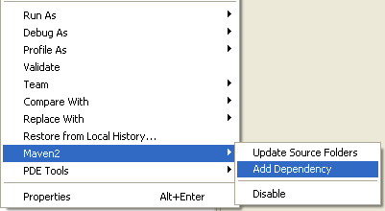
Using Maven from Eclipse
Enable Maven:
  right click on the project → Maven 2 → Enable
Add dependency:
  right click on the project
  → Maven 2 → Add Dependency
Executing goals:
  right click pom.xml and ‘Run As → Maven2 build’ to set a goal
It’s possible to debug during the build process
Notes:
<skaitlis>

Slide 37
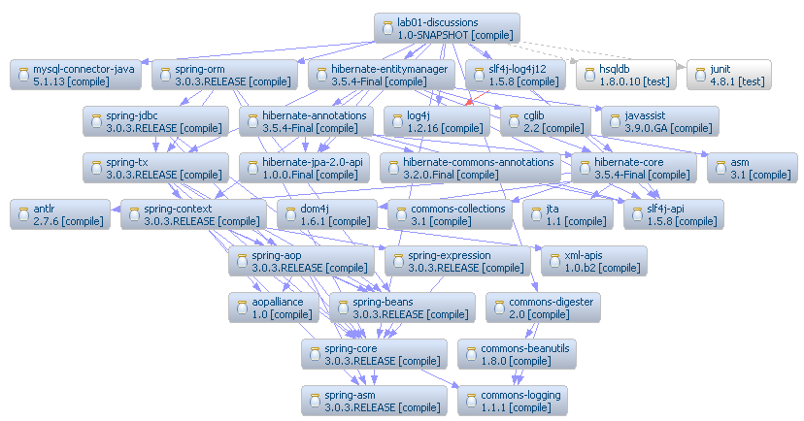
Example of Dependency Graph

Slide 38
Configuring a proxy
Configure a proxy to use for some or all of your HTTP requests in Maven 2.0 in ${user.home}/.m2/settings.xml:
<settings>
.
<proxies>
<proxy>
<active>true</active>
<protocol>http</protocol>
<host>proxy.somewhere.com</host>
<port>8080</port>
<username>proxyuser</username>
<password>somepassword</password>
<nonProxyHosts>www.google.com|*.somewhere.com</nonProxyHosts>
</proxy>
</proxies>
.
</settings>
http://maven.apache.org/guides/mini/guide-proxies.html
Notes:
<skaitlis>

Slide 39
Creating project website
Execute mvn site goal
Maven will start downloading and creating things left and right
Eventually in the \target dir you end up with a \site dir, with an apache-style project website
Javadoc, various reports, and custom content can be added
Notes:
<skaitlis>

Slide 40
Website features
Continuous Integration
Dependencies (JUnit is listed)
Issue Tracking
Mailing Lists
Project License
Project Team
Source Repository
Notes:
<skaitlis>

Slide 41
Using Maven Plugins
Maven is - at its heart - a plugin execution framework
Whenever you want to customise the build for a Maven project, this is done by adding or reconfiguring plugins
To see the most up-to-date list browse the Maven repository at http://repo1.maven.org/maven2/, specifically the org/apache/maven/plugins subfolder
Notes:
<skaitlis>

Slide 42
Using Maven Plugins
Plugins in Maven 2.0 look much like a dependency
For example, configure the Java compiler
to allow
JDK 6.0
sources
...
<build>
<plugins>
<plugin>
<groupId>org.apache.maven.plugins</groupId>
<artifactId>maven-compiler-plugin</artifactId>
<configuration>
<source>1.6</source>
<target>1.6</target>
</configuration>
</plugin>
</plugins>
</build>
...
Notes:
<skaitlis>

Slide 43
More stuff
Automatically generate reports, diagrams, and so on through Maven / the project site
Internationalization – create different language project websites
Create projects within projects (more pom.xml files inside sub dirs\jars), with different build stats and so on
Maven can make .war files, EJBs, etc.
Notes:
<skaitlis>

Slide 44
Good things about Maven
Build best practices enforcement
Automated build of application
Works well with distributed teams
All artifacts are versioned and are stored in a repository
Build process is standardized for all projects
A lot of goals are available
It provides quality project information with generated site
Easy to learn and use
Makes the build process much easier at the project level
Promotes modular design of code
Standardization
Reuse
Dependency management
Build lifecycle management
Large existing repository
IDE aware
One directory layout
A single way to define dependencies
Setting up a project is really fast
Transitive dependencies
Common build structure
Use of remote repository
Web site generation
Notes:
<skaitlis>

Slide 45



Alternatives
There are also alternative build tools
An up-and-coming star in the build world.
Groovy, Ant and Ivy combined.
Ruby Java building with Maven repositories
The agile dependency manager from Apache
http://www.streamhead.com/maven-alternatives/

Slide 46
References
Maven Home
http://maven.apache.org/
Maven Getting Started Guide
http://maven.apache.org/guides/getting-started/index.html
Steps for creating a Maven-based Website
http://www.javaworld.com/javaworld/jw-02-2006/jw-0227-maven_p.html
Maven 2 Plugins Project
http://mojo.codehaus.org/
Maven Integration for Eclipse
http://eclipse.org/m2e/
Notes:
<skaitlis>

