Slide 1
Introduction to
Java

Slide 2
Agenda
Java design principles
Main Java benefits
What is Java technology stack
Java Virtual Machine
Execution of Java programs

Slide 3
Java language principles
It is object-oriented language
http://en.wikipedia.org/wiki/Object-oriented_programming
  i.e. "Nouns over verbs"
  All code is structured into packages, which contain classes
  Two types of data
    Primitive types
    Objects
Network savvy
  Code and data can be easily transferred through the network
  Easy to write client/server or multi-tier (e.g. three-tier for web-) applications
Safe
  Each Java application is executed in separate "sandbox", which cannot interact with other machines (if it is not designed to)
  Features for code access control
"Write once run everywhere" — applications can be executed in any operating system or hardware platform using Java Virtual Machine (JVM) http://en.wikipedia.org/wiki/Java_virtual_machine

Slide 4
Java language principles
Standardized error handling
  Errors rise Exceptions which are handled in coherent way
High performance
  Java performance can be scaled by increasing of Java Virtual Machine resources
Dynamic execution
  Classes are loaded when needed for execution
  Executable components can be gathered through the network
Interchangeable implementations
  Using standardized API, it is possible to use different implementations of the same libraries
  http://www.oracle.com/technetwork/topics/newtojava/overview/index.html

Slide 5
What is Java technology?
It was developed by Sun Microsystems, which now is bought by Oracle
Java technology consists of:
  Java programming language
  Java standard API and other built-in libraries
  Java development tools
All this is bundled as two types of packages:
  JRE — Java Runtime Environment for execution of compiled stand-alone applications, applets, servlets, etc.
  JDK — Java Development Kit for compilation, debugging and execution of applications
All this is open source
  Developed openly in Java Community Process
  No royalties to develop, run or use
  But it still is trademarked and specific implementation is copyrighted
    Need to care, if you want to distribute "Your/modified Java" see more at: http://en.wikipedia.org/wiki/Oracle_America,_Inc._v._Google,_Inc.

Slide 6

Java Platform Tools
http://docs.oracle.com/javase/7/docs/index.html

Slide 7
What Oracle says
Get started quickly
Although the Java programming language is a powerful object-oriented language, it's easy to learn, especially for programmers already familiar with C or C++.
Write less code
Comparisons of program metrics (class counts, method counts, and so on) suggest that a program written in the Java programming language can be four times smaller than the same program written in C++.
Write better code
The Java programming language encourages good coding practices, and automatic garbage collection helps you avoid memory leaks. Its object orientation, its JavaBeans™ component architecture, and its wide-ranging, easily extendible API let you reuse existing, tested code and introduce fewer bugs.
Develop programs more quickly
The Java programming language is simpler than C++, and as such, your development time could be up to twice as fast when writing in it. Your programs will also require fewer lines of code.
Avoid platform dependencies
You can keep your program portable by avoiding the use of libraries written in other languages.
Write once, run anywhere
Because applications written in the Java programming language are compiled into machine-independent bytecodes, they run consistently on any Java platform.
Distribute software more easily
With Java Web Start software, users will be able to launch your applications with a single click of the mouse. An automatic version check at startup ensures that users are always up to date with the latest version of your software. If an update is available, the Java Web Start software will automatically update their installation.

Slide 8
What developers say
The Java Compiler — focus on code, not compilation only necessary parameter usually is -cp
The Core API — besides built-in libraries many thousands of third-party libraries
Open-Source — open standards and implementations encourage communities to give back
The Java Memory Model — garbage collection, concurrency, debugging API
High-Performance JVM — built in and refined concurrency provides highly scalable solutions
Bytecode — openly defined bytecode allows:
  compile into Java bytecode from other languages (Scala, Groovy, Clojure, Jython etc.)
  third-party tools to "hack" code for debugging testing purposes
Intelligent IDEs — NetBeans, Eclipse, IntelliJ IDEA are all mature and feature rich
Profiling Tools — open API for testing and debugging
Backwards Compatibility — no "Flag day" incompatibilities between different versions, well defined lifecycle of features
Maturity With Innovation — Groovy, Scala, Clojure are most modern languages on top of Java infrastructure
Source: 10 Reasons Why Java Now Rocks More Than Ever

Slide 9








Why Java didn't take the world
At beginning Java applications were slow and less responsive comparing to native applications
Because Windows did take the world
And because Microsoft leaved Java consortium and started to work on
C# and .Net framework

Slide 10
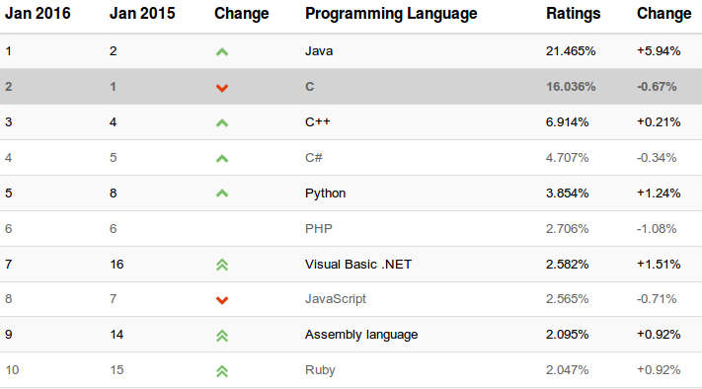
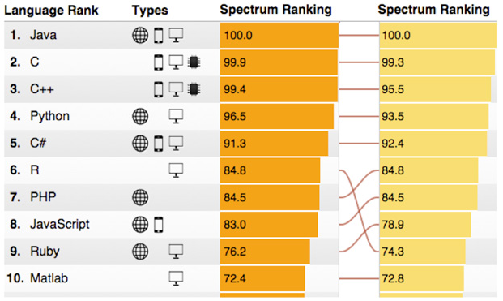
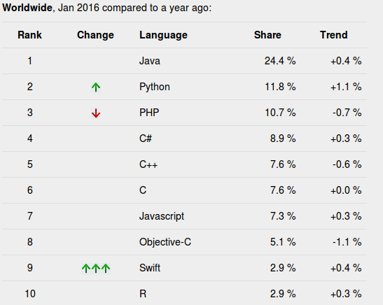
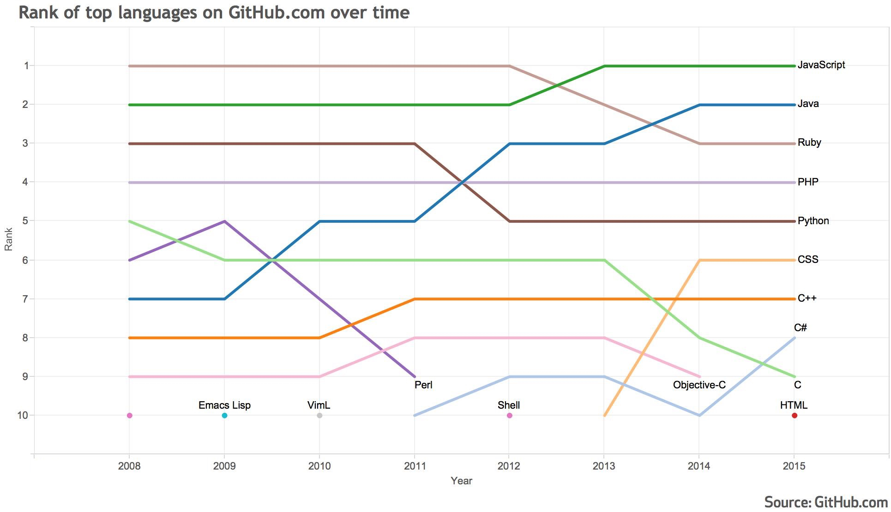
Top programming languages
http://www.tiobe.com/index.php/content/paperinfo/tpci/index.html
http://spectrum.ieee.org/computing/software/the-2015-top-ten-programming-languages
http://pypl.github.io/PYPL.html
https://github.com/blog/2047-language-trends-on-GitHub

Slide 11
What is JDK
When Java Development Kit is installed Java provides following features:
Development Tools:
  javac compiler
  java interpreter of bytecode
  javadoc document generation tool
  jar class file archiver
  jdb debugger
  All these are included in Integrated Development Environments (IDEs)
Application Programming Interface (API):
  Provides the core functionality of the Java programming language from basic objects, to networking and security, to XML generation and database access, and more. See more at Java Platform Standard Edition 8 Documentation.
Deployment Technologies
  provides standard mechanisms as war and jar files, Java Web Start and Java Plug-In execution etc.
User Interface Toolkits
  The JavaFX, Swing, and Java 2D toolkits make it possible to create sophisticated Graphical User Interfaces (GUIs).
Integration Libraries
  e.g. Java IDL API, JDBC API, Java Naming and Directory Interface (JNDI) API, Java RMI, and Java Remote Method Invocation over Internet Inter-ORB Protocol Technology (Java RMI-IIOP Technology) etc.

Slide 12

Java Virtual Machine (JVM)
A Java virtual machine (JVM) is an abstract computing machine. There are three notions of the JVM:
  Formal specification is a book that formally describes what is required of a JVM implementation. Having a single specification ensures all implementations are interoperable.
  Actual implementation is a computer program that meets the requirements of the JVM specification in a compliant and preferably performant manner.
  Specific instance of the JVM is a process that executes a computer program compiled into Java bytecode.
JVM reads compiled byte-code file (.class) file which is platform independent
Most of code checks are performed during compilation time of *.java files

Slide 13

Execution of Java program
Source code is plain text with .java extension.
Source files are compiled into .class files, which contain instructions for Java Virtual Machine
java launcher tool then
runs application inside
instance of the
Java Virtual Machine.

Slide 14

What JVM provides
The JVM performs following operations:
  Loads code
  Verifies code
  Executes code
  Provides runtime environment
JVM provides definitions for the:
  Memory area
  Class file format
  Register set
  Garbage-collected heap
  Fatal error reporting etc.

Slide 15
JVM internal structure
Classloader
  Classloader is a subsystem of JVM that is used to load class files.
Class(Method) Area:
  stores per-class structures such as the runtime constant pool, field and method data, the code for methods.
Heap
  is the runtime data area in which objects are allocated.
Stack
  holds local variables and partial results in frames, plays a part in method invocation and return.
  Each thread has a private JVM stack, created at the same time as thread.
  A new frame is created each time a method is invoked. A frame is destroyed when its method invocation completes.
Program Counter (PC) Register
  contains the address of the Java virtual machine instruction currently being executed.
Native Method Stack
  contains all the native methods used in the application.
Execution Engine contains
  A virtual processor
  Interpreter: Read bytecode stream then execute the instructions.
  Just-In-Time(JIT) compiler — compiles parts of the byte code that have similar functionality at the same time, and hence reduces the amount of time needed for compilation.

Slide 16

Execution of Java program
Java source code is compiled into bytecode
Java bytecode interpreter (JVM) is started and classloader loads class with
  public static void main(String [] args) method
  All keywords before method are mandatory
The main() method then calls everything else

Slide 17
Classpath
Classpath instructs the namespace wher compiler need to search for *.java file
Classpath can be set as environment variable
  CLASSPATH="~/MyFolder"
  export $CLASSPATH
or as a parameter for virual macine
  java -cp MyFolder MyClass
Default value is "." — which means that path is current folder

Slide 18
Package naming conventions
All packages are named in lowercase letters.
  Structure priority starts from higher to lower.
  As separators in package structure dots are used.
  Usually package structure represents folder structure of source code and class files.
Example:
lv.mydomain.myproject.dao

Slide 19
Setup and execution
Install Eclipse with command in terminal:
sudo apt-get install eclipse
Check, where Java runtime is located
which java
Check which Java version is used
java -version
Run program:
cd ~/workspace/Name_Surname/
javac -cp bin ./src/main/java/org/activity02/Hello.java
java -cp bin main.java.org.activity02.Hello

Slide 20
Which Java IDE?
Nobody writes Java code in text editor
There are many Integrated Development Environments (IDEs) for Java, which make esasier to deal with classpath and dependencies, compilation, running and debugging, etc.
Most prominent Java IDEs are:
  NetBeans
  Eclipse
  IntelliJ IDEa
We will use Eclipse, because:
  It supports several projects
  Better looking fonts
  Many useful plugins
  (and teacher knows it)

