Slide 1
Software Project Management

Slide 2
Code-and-Fix
A.k.a "Cowboy coding"
This model starts with an informal general product idea and just develops code until a product is ”ready” (or money or time runs out). Work is in random order.
Corresponds with no plan! (Hacking!)
Works for solo projects
Doesn't work non-trivial software development projects

Slide 3

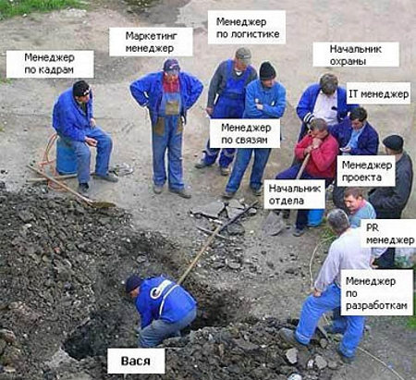
Why it happens?

Slide 4
Dealing with Brook's law
"Adding manpower to a late software project makes it later"
  Fred Brooks, 1975 "The Mythical Man-Month"
Main reasons:
  It takes some time for the people added to a project to become productive
  Communication overheads increase as the number of people increases, due to combinatorial explosion.

Slide 5
Brief History of Methodologies
SCRUM
(Ken Schwaber)
Incremental, user driven
AGILE e.g. XP
(Kent Beck)
Incremental, user driven, low process
RUP (Rational)
Object oriented, iterative, time-boxed, user driven
RAD
(James Martin)
Prototyping, iterative, time-boxed, user driven
RUP
SPIRAL MODEL
(Barry Boehm)
Iterative
RAD
The Agile Manifesto
Beck, Kent et al.
WATERFALL (Royce)
Requirements, design
implementation, verification & maintenance
V-MODEL (Anon)
Aligns testing to
Waterfall development
Spiral Model
Disciplined agile delivery
Scott Ambler et al.
Waterfall
V-Model
1960
1970
1980
85
91
98
99
01
12
Notes:
<skaitlis>

Slide 6
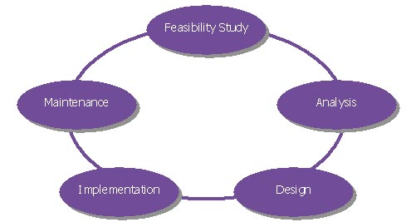
Systems development life cycle
The systems development life cycle is process for planning, creating, testing, and deploying information systems.
You are usually here

Slide 7
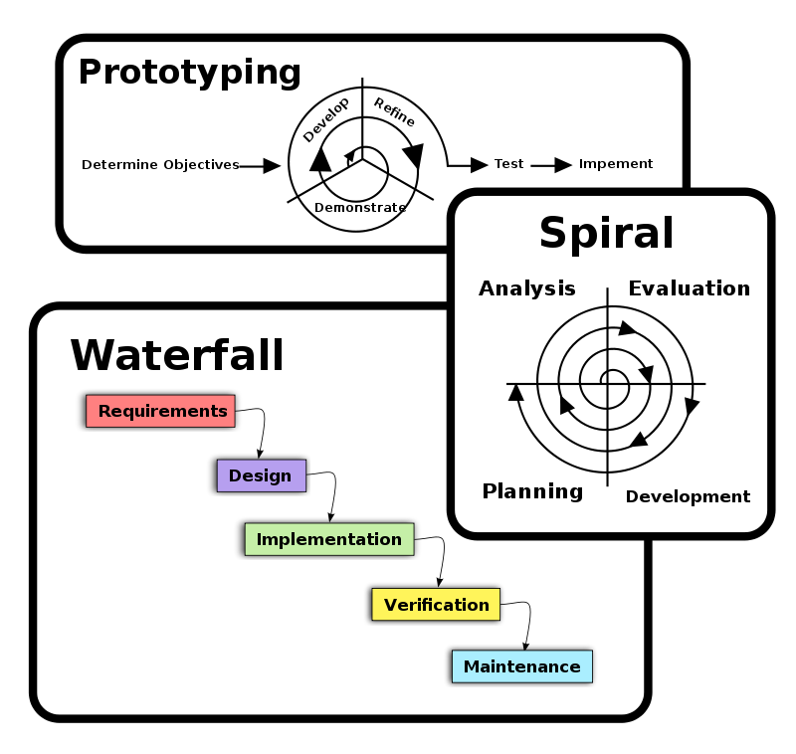
Main software development methodologies

Slide 8

Waterfall Model
Requirements – defines needed information, function, behavior, performance and interfaces.
Design – data structures, software architecture, interface representations, algorithmic details.
Implementation – source code, database, user documentation, testing.

Slide 9

Why waterfall
Each next phase is much more expensive

Slide 10

V-model
The V-model is an extension of the waterfall model.
Show the relationships between development phases and test phases
Time and project completeness vs. level of abstraction
Notes:
<skaitlis>

Slide 11

Iterative and Incremental Development
Iterative and incremental development is any combination of both iterative design or iterative method and incremental build model for development.

Slide 12
Prototyping
Requirement gathering is difficult
  software is developed because the present situation is unsatisfactory
  however, the desirable new situation is as yet unknown
Prototyping is used to obtain the requirements of some aspects of the system
Prototyping should be a relatively cheap process
  use rapid prototyping languages and tools
  not all functionality needs to be implemented
  production quality is not required
Notes:
Of the old-fashioned push down telephone,about 2000 prototypes were developed: with different arrangements of the keys, different sizes of the keys, different weights of the receiver, etc.

Slide 13
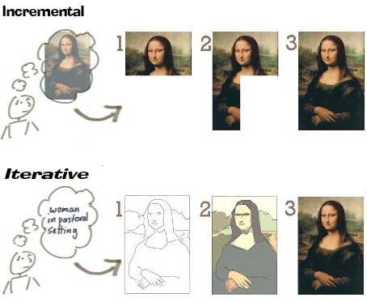
Incremental vs. Iterative

Slide 14
The Agile Manifesto
Individuals and interactions over processes and tools
Working software over comprehensive documentation
Customer collaboration over contract negotiation
Responding to change over following a plan
Notes:
Agility: readiness for motion”, “nimbleness” (= behendigheid”)

Slide 15
Agile principles
Active user involvement is imperative
The team must be empowered to make decisions
Requirements evolve but the timescale is fixed
Capture requirements at a high level; lightweight & visual
Develop small, incremental releases and iterate
Focus on frequent delivery of products
Complete each feature before moving on to the next
Apply the 80/20 rule
Testing is integrated throughout the project life-cycle – test early and often
A collaborative & cooperative approach between all stakeholders is essential
Notes:
<skaitlis>

Slide 16
Some Agile Methods
Adaptive Software Development (ASD)
Feature Driven Development (FDD)
Dynamic Software Development Method (DSDM)
Rapid Application Development (RAD)
Scrum
Kanban
Extreme Programming (XP)
Rational Unify Process (RUP)
Disciplined agile delivery (DAD)

Slide 17
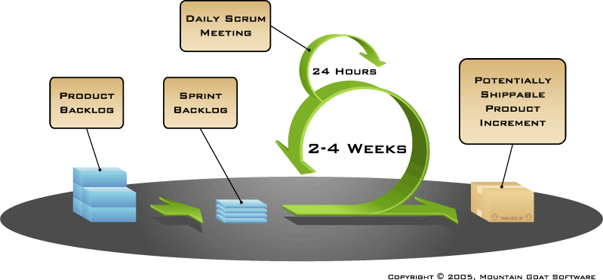
Scrum
Scrum is an iterative and incremental agile software development framework
A flexible, holistic product development strategy
Development team works as an atomic unit
Opposing to sequential approach

Slide 18
Scrum roles
Product Owner — holds the vision for the product
Scrum Master — helps the team best use Scrum to build the product
Development team — builds the product

Slide 19
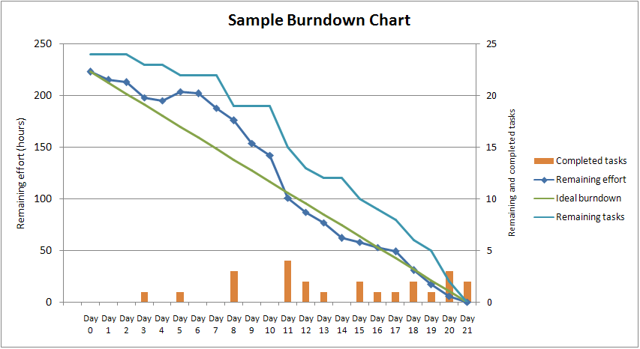
Scrum artifacts
Product increment — an integrated, shippable subset of the product
Product backlog — the list of ideas for the product, in order of priority
Sprint backlog — the detailed plan for development during the next sprint

Slide 20
Scrum activities
Product backlog refinement
Sprint planning
Daily Scrum
Sprint review
Sprint retrospective

Slide 21

Kanban (lean, just-in-time — JIT)
Usually is used for software maintenance

Slide 22
Lean principles
Eliminate waste
Amplify learning
Decide as late as possible
Deliver as fast as possible
Empower the team
Build integrity in
See the whole

Slide 23

Disciplined agile delivery
People-first
Learning-oriented
Hybrid
Full delivery life-cycle
Process goal driven
Solution focused
Risk-value life-cycle
Enterprise aware

Slide 24
Traditional PM versus Agile Methods
Traditional PM approach
  Concentrates on thorough, upfront planning
  of the entire project.
  Requires a high degree of predictability to be effective.
Agile PM approach
  Relies on incremental, iterative development cycles
  to complete less-predictable projects.
  Is ideal for exploratory projects in which requirements need to be discovered and new technology tested.
  Focuses on active collaboration between the project team and customer representatives.
Notes:
<skaitlis>

Slide 25
Traditional PM vs Agile PM
Traditional | Agile
Design up front | Continuous design
Fixed scope | Flexible
Deliverables | Features/requirements
Freeze design as early as possible | Freeze design as late as possible
Low uncertainty | High uncertainty
Avoid change | Embrace change
Low customer interaction | High customer interaction
Conventional project teams | Self-organized project teams
Notes:
<skaitlis>

Slide 26
Accenture Delivery Methods
Provide a strong foundation upon which we can deliver reliable, end-to-end solutions;
Ensure that projects are delivered on time and at the lowest cost to clients;
Reduce the risk associated with solution delivery;
Drive consistency and best practice;
Provide a simple yet comprehensive approach;
Allow the ‘reuse’ of previously conceived solutions thereby freeing up;
Time to focus on the ‘value add’ component;
Multi-site working.

Slide 27
Accenture Delivery Tools
Accenture Delivery Tools support Accenture Delivery Methods, building on proven templates to improve productivity and reduce risk.
Whether a client's requirements are driven by budget, function or other requirements, we can draw on a broad and powerful set of technology tools to craft the right solution that helps clients achieve high performance.
  Cost and time savings — Delivery teams can start the project running because the tools have been integrated into Accenture Delivery Methods, enabling rapid development of the outputs the methods require.
  Risk reduction — Our practices, guidelines and templates are all based on what we know works. We have also developed the tools to track requirements throughout an implementation so that clients understand what their problems are.

Slide 28

Accenture Delivery Technology Stack

Slide 29

PM Stages, Activities, Work streams

Slide 30
Quality assurance in V-model
At the end of each stage, quality of deliveries are checked
  Verification — process where deliveries are checked do pass general rules (overall design, language rules, consistency, coverage, etc.)
    General question "Are you building it right?"
    "Ugly, but consistent" can pass verification
  Validation — process where deliveries are checked against particular requirements
    General question "Are you building the right thing?"
    "Good enough for us" can pass validation

Slide 31

V-model stage dependencies
Testing of deliveries is done depending on technology stack

Slide 32

Accenture Delivery Methods for Agile Development

Slide 33
Quality
Quality is conformance to requirements.
  The requirements may not fully represent user expectations
In general, software quality means
  Absence of system crashes
  Correspondence between the software and the user expectations
  Performance to specified requirements
  Quality must be controlled because it lowers production speed, increases maintenance costs and can adversely affect business

Slide 34
Capability Maturity Model (CMM)
A bench-mark for measuring the maturity of an organization’s software process developed by Carnegie Mellon University
CMM defines 5 levels of process maturity based on certain Key Process Areas (KPA)
Capability Maturity Model Integration (CMMI) is a process improvement methodology

Slide 35
CMM Levels
Level 5 – Optimizing (< 1%)
  process change management
  technology change management
  defect prevention
Level 4 – Managed (< 5%)
  software quality management
  quantitative process management
Level 3 – Defined (< 10%), comparable to ISO 9000 and ISO 10006:2003
  peer reviews
  inter group coordination
  software product engineering
  integrated software management
  training program
  organization process definition
  organization process focus
Level 2 – Repeatable (~ 15%)
  software configuration management
  software quality assurance
  software project tracking and oversight
  software project planning
  requirements management
Level 1 – Initial (~ 70%)

Slide 36
Top-down vs Bottom-up
Top-down is from abstract to concrete — from the highest-level specification describing the project as a whole, or the application logic, downwards to individual operations.
Bottom-up is from concrete to abstract — working up from the specific operations in the problem domain that you know you will need to perform.

Slide 37


Top-down and Bottom-up
Any non-trivial project needs both

Slide 38
Software engineering roles
Manages
Solves organization
related
problems
Chief information officer
Chief executive officer
Group/Department lead/manager
Group/Department lead/manager
Solves
people related
problems
Teamlead
Project manager
Teamlead
Senior ...
Senior ...
DB/Net/Domain admin
Operates
Systems Architect
Configuration manager
Develops
Network admin
Systems analyst
Business analyst
DevOps
Functional analyst
Solves technology related problems
Developer
Quality assurance
Technical support
Coder
Tester
Subject matter expert
Does
Techology/Backoffice
Business/Frontoffice/Client

Slide 39
What are essential roles
In almost any software engineering project essential roles are:
  Developer
  Tester/quality assuer
  Configuration manager
Optonal role for small projects, but essential for larger teams is:
  Teamleader (more as a coordinator, not "manager")

Slide 40
Notes about volunteer projects
All before mentioned applies to paid workers
If you work with some free/open-source project volunteers:
  Problem with concurrency and workload still holds
  You have just "carrot", but miss "stick" part for managing
In open source projects you'll spend much more effort on:
  Recruiting
  Communication
  Collaboration management

