Slide 1

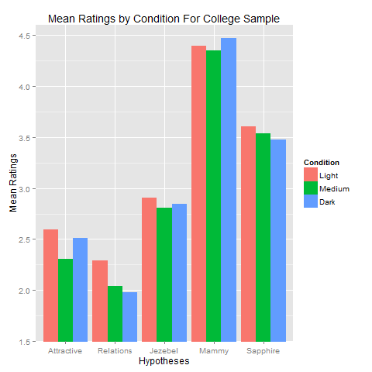
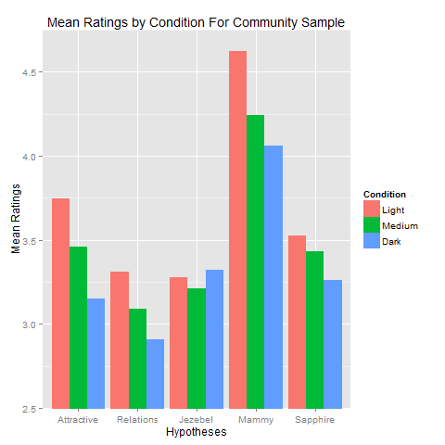

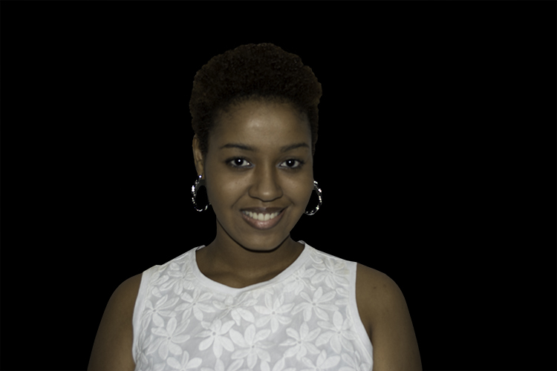
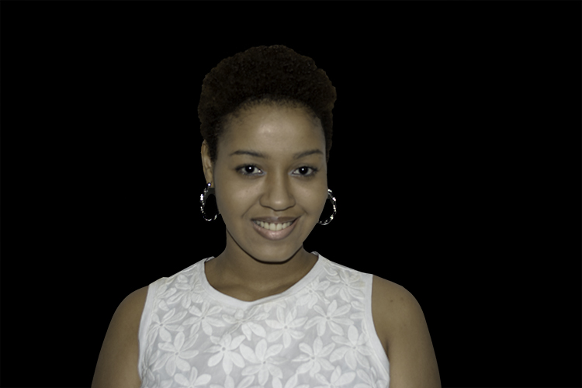
Too Black? The Skin Tone Bias and Desirability of Black Women
Jason E. Piccone & Melanie Milo
Nova Southeastern University, College of Psychology and Neuroscience
Abstract
Black women experience an unfavorable mating situation where Black men are unavailable and men of other ethnicities are less likely to partner with them. The skin-tone bias is one explanation for this, as men tend to attribute more positive attributes and greater physical attraction to Black women with lighter skin tones. In addition, skin tone is associated with three persistent stereotypes: the sexually promiscuous Jezebel, the benign and loyal Mammy, and the emasculating and hostile Sapphire. In this within subjects study, 98 college and 59 community males rated photos of Black women manipulated to be of light, medium, or dark skin tone. Results indicate that lighter skin toned Black women are generally preferred as potential mates.
Results
• H1 – Attraction: Participants found lighter toned Black women more attractive (M = 3.03) compared with medium (M = 2.74, p = .134) and dark toned (M = 2.75, p = .077) women , F (2, 294) = 3.71, p = .026, η²_{g} = .010.
• H2 – Relations: Participants were more willing to engage in relations with lighter toned Black women (M = 2.67, SD = 1.68) than dark skin toned Black women (M = 2.31, SD = 1.60, p < .05), and medium toned Black women (M = 2.45, SD = 1.67, p > .05), F (2, 286) = 5.76, p = .004, η²_{g} = .013.
• H3, H4, and H5 were not supported.
• As can be seen in the figures, the community sample found the women across all conditions more desirable, and more in line with the hypotheses.
• Black participants demonstrated a preference (attraction, desire for relationships) for the lighter skin-toned Black women. In addition, Black college men demonstrated a greater skin-tone bias than the community sample.
Hypotheses
H1: Participants will rate darker skin-toned Black women as less physically attractive than lighter skin-toned Black women.
H2: Participants will be less willing to engage in all forms of relationships with darker skin-toned Black women.
H3: In line with the concept of the Jezebel, participants will rate light skin-toned Black women as more seductive and promiscuous.
H4: Participants will view the dark skin-toned Black women in congruence with the Mammy stereotype and will thus rate them higher on kind/understanding and faithful.
H5: In accordance with the Sapphire stereotype, medium skin toned Black women will be viewed as aggressive and less emotionally stable.
Discussion
Our findings are consistent with others (e.g., Hill, 2002; Keenan, 1996; Wade & Bielitz, 2005) who found a preference for lighter skin toned Black women. The hypotheses regarding the three stereotypes of the Sapphire, Mammy, and Jezebel were not supported. This study also demonstrates significant differences in perceptions of Black women between community and college samples, with the community sample finding the women more desirable and demonstrating a more pronounced skin-tone bias. One of the more striking findings is that a reverse trend was found for Black men: the college sample displayed more of a skin-tone bias than the community sample. Franklin (2000) reviews the strained relationship between Black men and women and makes a thoughtful call for a healing of this relationship. This healing will be further impeded if indeed young Black men with the brightest futures are the most discriminating against darker skin tones.
References
Franklin, D. (2000). What's Love Got to Do With It? Understanding and Healing the Rift Between Black Men and Women.
Simon & Schuster: New York.
Hill, M. E. (2002). Skin color and the perception of attractiveness among African-Americans: Does gender make a
difference? Social Psychology Quarterly, 65(1), 77-91. http://dx.doi.org/10.2307/3090169
Keenan, K. L. (1996). Skin tones and physical features of blacks in magazine advertisements. Journalism and Mass
Communication Quarterly, 73, 905-912. http://dx.doi.org/10.1177/107769909607300410
Wade, T. J., & Bielitz, S. (2005). The differential effect of skin color on attractiveness, personality evaluations, and
perceived life success of African-Americans. Journal of Black Psychology, 31(3), 215-236.
http://dx.doi.org/10.1177/0095798405278341
* Data and scripts are available at: https://github.com/JPico6/SkinToneBiasStudy
Method
Participants
98 college and 59 community males, ages 18-38.
Materials
Stimulus photos. Color photographs of volunteers’ heads and shoulders were taken in a standardized manner. Six of the women were Black and three were Caucasian. Each photograph of the Black women was digitally altered to appear both darker and lighter.
Rating questions. Participants rated each photo on 10 questions: three regarding their willingness to engage in relations with the women (sex, date, marry), attractiveness, the Mammy stereotype (kind and understanding, faithful to partners), the Sapphire (emotionally stable, aggressive), and the Jezebel (promiscuous and seductive).
Procedure
Participants completed the study online. After consenting to participate, participants indicated their age range and ethnicity and then began the evaluation trials. Each participant viewed three of the Black women (one from each of the three skin tone conditions), who were randomly drawn from the total pool. In addition, the three photographs of the White women were interspersed throughout the survey to reduce the likelihood of hypothesis guessing.

