Slide 1


ToDo Management
Migration Info
2020.12.31

Slide 2

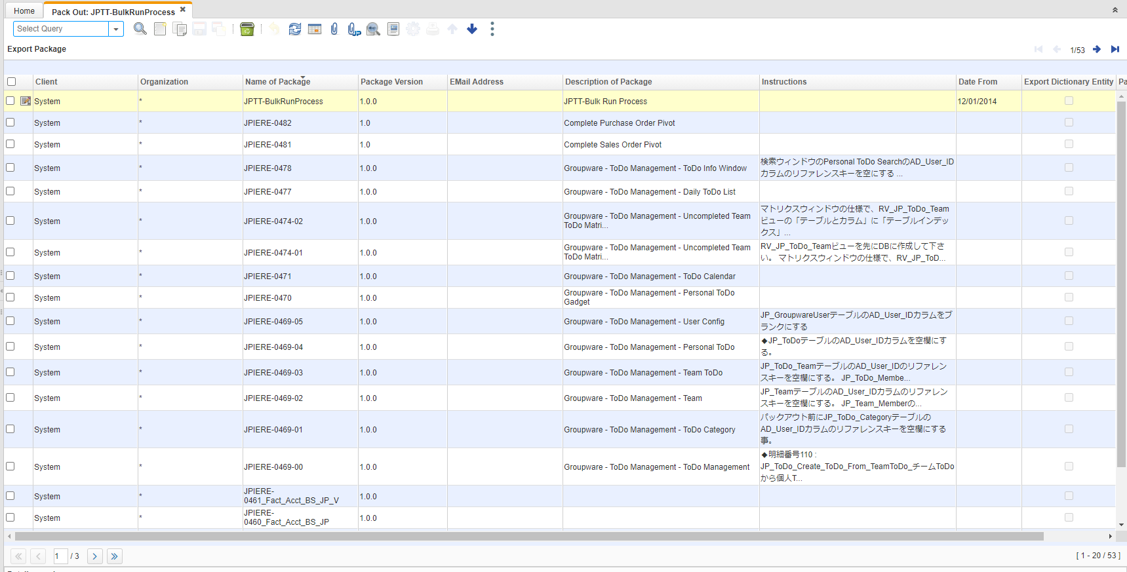
【Migration Info】
JPIERE-0469～0480 : ToDo Management Migration Info
About To-Do Management at JPIERE-0469～0480.Please pack out from JPiere to pack in your System。

Slide 3
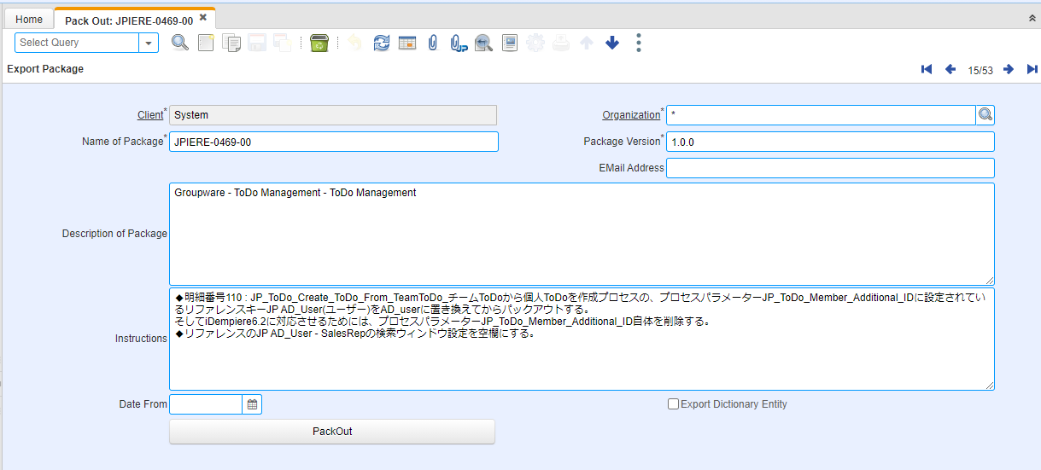
【Migration Info】
Please read instructions fields before pack out.
Please Translate from Japanese into your language.

Slide 4
【Migration Info】
When packing in, please do so in the order of decreasing number.
JPIERE-0469-00 *Mandatory
JPIERE-0469-01 *Mandatory
JPIERE-0469-02 *Mandatory
JPIERE-0469-03 *Mandatory
JPIERE-0469-04 *Mandatory
JPIERE-0469-05 *Mandatory
JPIERE-0470 *Mandatory
JPIERE-0471 *Mandatory
JPIERE-0474-01 *optional
JPIERE-0474-02 *Mandatory
JPIERE-0477 *Mandatory
JPIERE-0478 *optional

