Slide 1
In-browser storage and me
Jason Casden
North Carolina State University Libraries
Code4Lib 2012

Slide 2
“What we really want is
a lot of storage space
on the client
that persists beyond a page refresh
and isn’t transmitted to the server”
- Mark Pilgrim, Dive Into HTML5
http://diveintohtml5.info/storage.html

Slide 3
Themes
“A lot of space”
Reasonably large amounts of various types of data
Caching binary content
Network independence
Performance
Offline use
Security
Persistence
Data stability
Local customization
Ability to easily resume a session

Slide 4
Potential library uses

Slide 5
Potential library uses
Staff-facing apps
Barcode scan
Stacks tools
Mobile data collection tools
Caching (geotagged) collections data
Catalog shopping cart

Slide 6
In-browser storage IRL (Suma)

Slide 7
Suma
Replace and dramatically improve the entire workflow for collecting and analyzing data about the use of physical spaces and services.

Slide 8
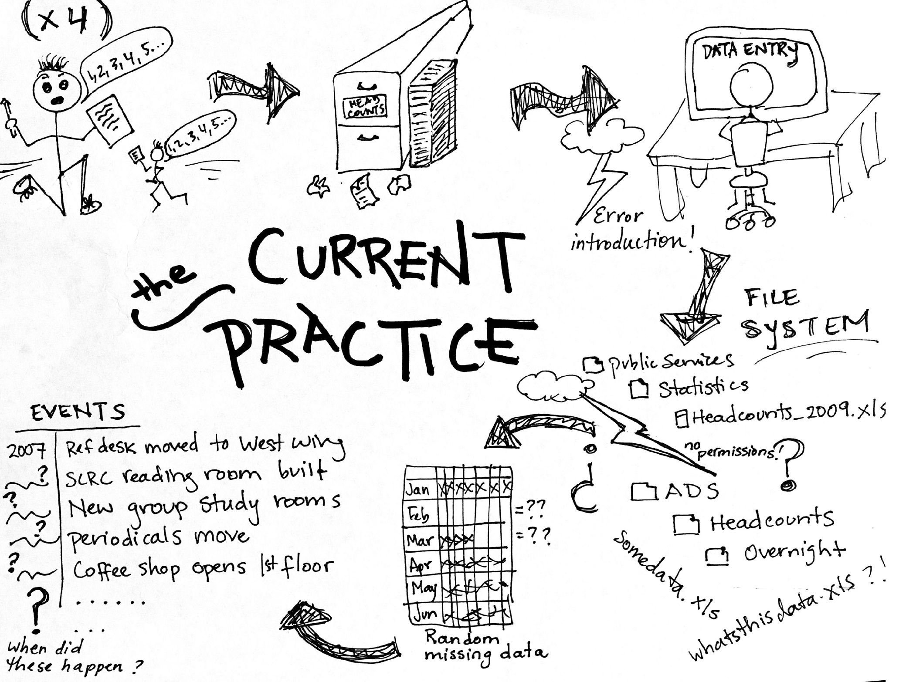
Illustration by Joyce Chapman

Slide 9
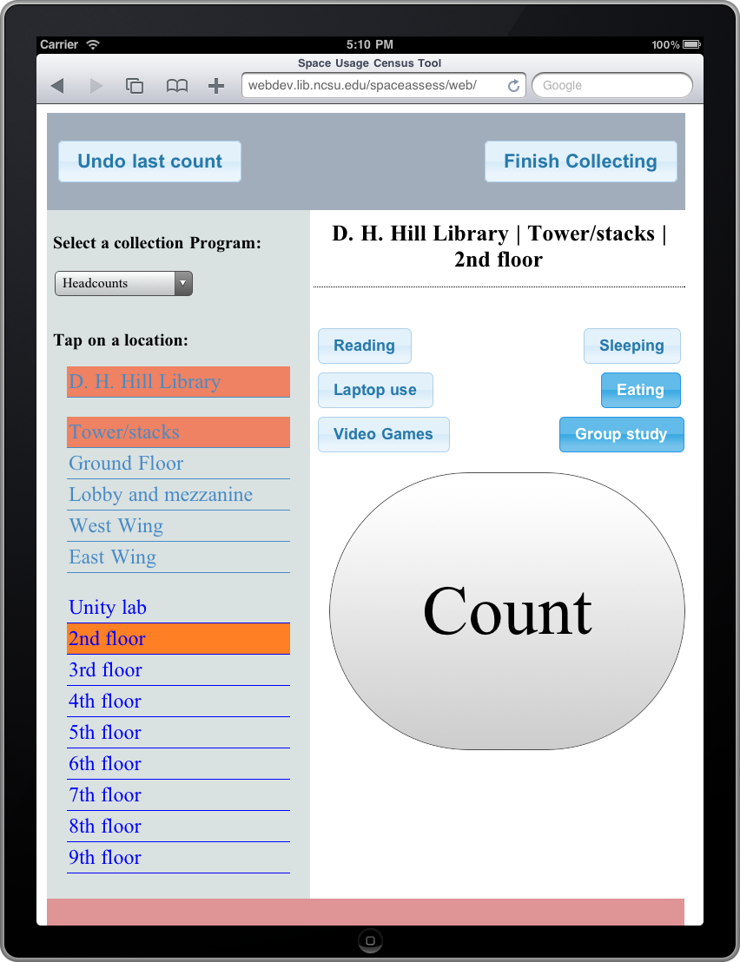

Slide 10
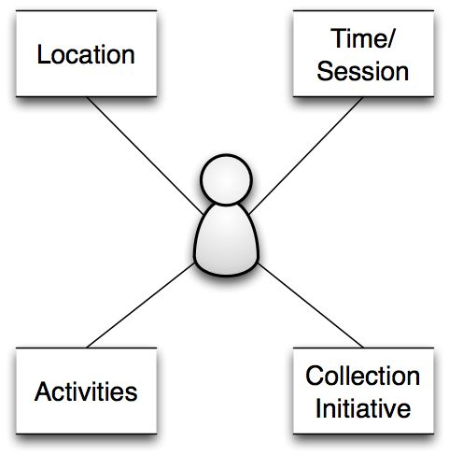
What is the data?

Slide 11
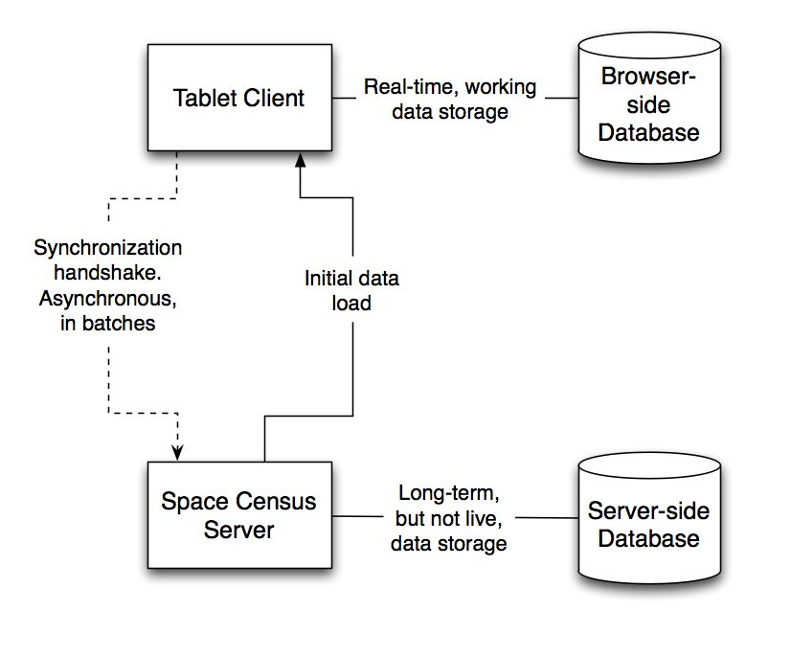
Data synchronization

Slide 12
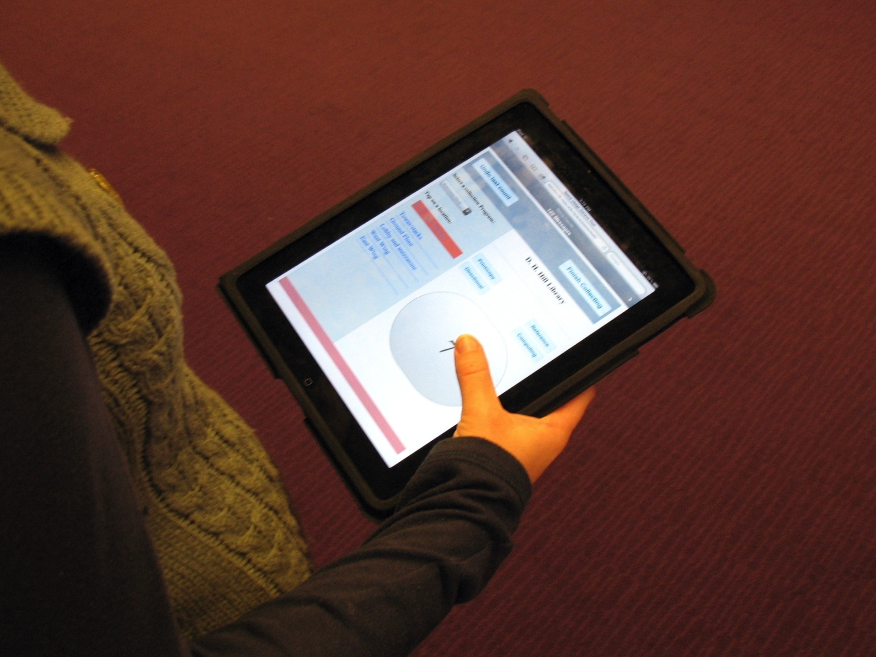
Joyce Chapman, Suma team member.

Slide 13
How many Sumas can I put you down for?
https://github.com/cazzerson/suma

Slide 14
Other attempts
Cookies
Plugins
Flash
Silverlight
Java
Google Gears
etc.
window.name
Browser-specific features
IE's userData
Mozilla globalStorage
Filesystem features used by TiddlyWiki

Slide 15
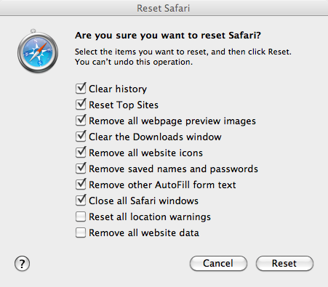
Persistence?

Slide 16
“A lot of storage space”
5MB is the magic number
Can sometimes be increased
Some differences between browsers

Slide 17
Presentation scope
No SessionStorage
No in-memory storage
No ApplicationCache

Slide 18
Current options

Slide 19
Web Storage
aka localStorage, DOM Storage

Slide 20
Main features
W3C Candidate Recommendation (split from HTML5)
Named key-value store
Widespread browser support
Simple API
http://www.w3.org/TR/webstorage/

Slide 21
Limitations
Performance can be poor
No indexing
Need to fake relational or object store features
Values are strings
JSON.stringify/JSON.parse
Base64 encoding for binary data
No transactions

Slide 22

Code

Slide 23
Browser support
Firefox 3.5+
Chrome 4.0+
Safari 4.0+
Opera 10.5+
IE 8.0+
iOS Safari 3.2+
Firefox mobile
Opera Mobile 11.0+
Android Browser 2.1+

Slide 24
Web SQL Database
aka WebDB

Slide 25
Main features
W3C Working Draft
Basically, it's SQLite
Very solid mobile support
Good performance
Indexing
Transactions
Asynchronous API features

Slide 26
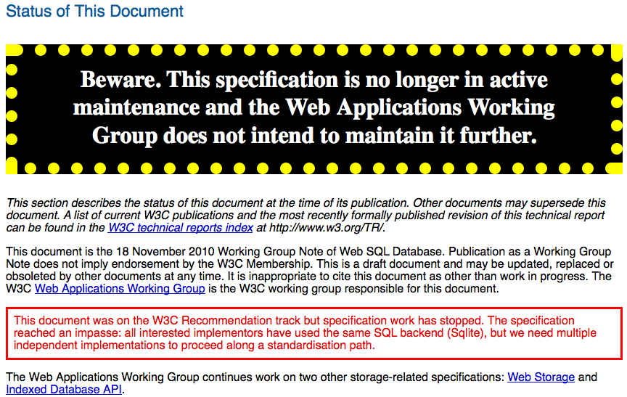
…this is awkward.
http://www.w3.org/TR/webdatabase/

Slide 27
Limitations
Deprecated
No Mozilla or IE support
Requires SQL/RDBMS experience

Slide 28
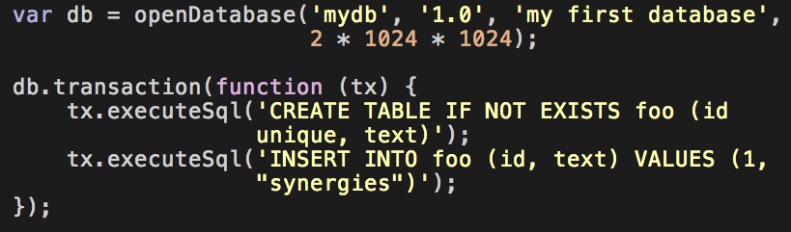
Code
http://html5doctor.com/introducing-web-sql-databases/

Slide 29
Browser support
Chrome 4.0+
Safari 3.1+
Opera 10.5+
iOS Safari 3.2+
Opera Mobile 11.0+
Android Browser 2.1+

Slide 30
Indexed Database API
aka IndexedDB, WebSimpleDB

Slide 31
Main features
W3C Working Draft
Object store (NoSQL)
Flexible data schema
Transactions
Indexed fields
Asynchronous API
http://www.w3.org/TR/IndexedDB/

Slide 32
Limitations
Limited browser support
Young, changing spec [see: setVersion()]
Somewhat complex API

Slide 33
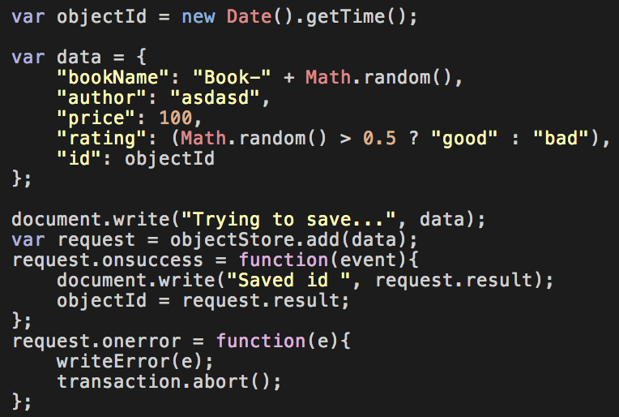
Code
http://nparashuram.com/trialtool/index.html#example=/IndexedDB/trialtool/moz_indexedDB.html

Slide 34
Browser support
Firefox 4.0+
Chrome 11.0+
Firefox Mobile 6.0+
IE 10.0+ (forthcoming)

Slide 35
File API: Writer

Slide 36
Main features
W3C Working Draft
Sandboxed filesystem
Great for fairly large data storage
Binary data management
Asynchronous API
http://www.w3.org/TR/file-writer-api/

Slide 37
Limitations
Very limited browser support
No indexing
Spec still being sorted out (see: “File API: Directories and System”)

Slide 38
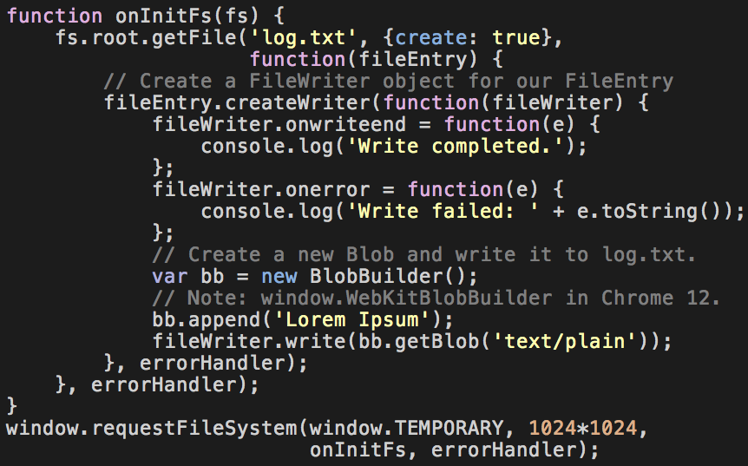
Code
http://www.html5rocks.com/en/tutorials/file/filesystem/

Slide 39
Browser support
Chrome 13.0+ (partial support from 8.0)

Slide 40
What to do NOW?

Slide 41
Web (DOM) Storage
Pretty much universally supported.

Slide 42
Web SQL DB
Do you need to support all browsers?

Slide 43
IndexedDB API
The future?

Slide 44
Libraries
The solution to the browser problem?

Slide 45
lawnchair

Slide 46
lawnchair
Collection of objects
Adapters for:
Web Storage
IndexedDB
Web SQL Database
window.name
Google Gears
IE userData
BlackBerry persistent store
In-memory store

Slide 47
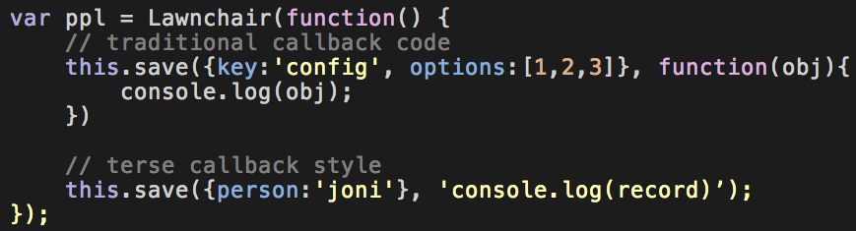
lawnchair
http://westcoastlogic.com/lawnchair/saving/

Slide 48
lawnchair
persistence.js

Slide 49
persistence.js
Asynchronous JavaScript object-relational mapper
Adapters for:
Web SQL Database
Google Gears
In-memory storage with explicit Web Storage commit/read
Server-side support for node.js and MySQL
“Experimental support for QT 4.7 Declarative UI framework (QML)”

Slide 50
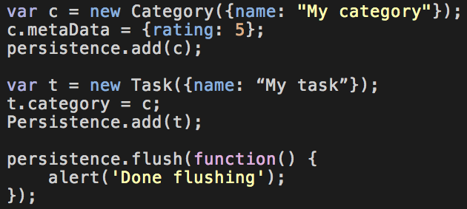
persistence.js
https://github.com/zefhemel/persistencejs

Slide 51
lawnchair
persistence.js
persistJS

Slide 52
lawnchair
persistence.js
persistJS
amplify.store

Slide 53
lawnchair
persistence.js
persistJS
amplify.store
localStorageDB

Slide 54
lawnchair
persistence.js
persistJS
amplify.store
localStorageDB
https://github.com/axemclion/IndexedDB

Slide 55
lawnchair
persistence.js
persistJS
amplify.store
localStorageDB
https://github.com/axemclion/IndexedDB
realStorage

Slide 56
lawnchair
persistence.js
persistJS
amplify.store
localStorageDB
https://github.com/axemclion/IndexedDB
realStorage
YUI3 CacheOffline

Slide 57
lawnchair
persistence.js
persistJS
amplify.store
localStorageDB
https://github.com/axemclion/IndexedDB
realStorage
YUI3 CacheOffline
dojox.storage

Slide 58
lawnchair
persistence.js
persistJS
amplify.store
localStorageDB
https://github.com/axemclion/IndexedDB
realStorage
YUI3 CacheOffline
dojox.storage
DomSQL

Slide 59
lawnchair
persistence.js
persistJS
amplify.store
localStorageDB
https://github.com/axemclion/IndexedDB
realStorage
YUI3 CacheOffline
dojox.storage
DomSQL
Impel

Slide 60
lawnchair
persistence.js
persistJS
amplify.store
localStorageDB
https://github.com/axemclion/IndexedDB
realStorage
YUI3 CacheOffline
dojox.storage
DomSQL
Impel
ActiveJS ActiveRecord

Slide 61
lawnchair
persistence.js
persistJS
amplify.store
localStorageDB
https://github.com/axemclion/IndexedDB
realStorage
YUI3 CacheOffline
dojox.storage
DomSQL
Impel
ActiveJS ActiveRecord
JazzRecord

Slide 62
lawnchair
persistence.js
persistJS
amplify.store
localStorageDB
https://github.com/axemclion/IndexedDB
realStorage
YUI3 CacheOffline
dojox.storage
DomSQL
Impel
ActiveJS ActiveRecord
JazzRecord
picnet.data.DataManager

Slide 63
lawnchair
persistence.js
persistJS
amplify.store
localStorageDB
https://github.com/axemclion/IndexedDB
realStorage
YUI3 CacheOffline
dojox.storage
DomSQL
Impel
ActiveJS ActiveRecord
JazzRecord
picnet.data.DataManager
ShinyCar

Slide 64
lawnchair
persistence.js
persistJS
amplify.store
localStorageDB
https://github.com/axemclion/IndexedDB
realStorage
YUI3 CacheOffline
dojox.storage
DomSQL
Impel
ActiveJS ActiveRecord
JazzRecord
picnet.data.DataManager
ShinyCar
lscache

Slide 65
lawnchair
persistence.js
persistJS
amplify.store
localStorageDB
https://github.com/axemclion/IndexedDB
realStorage
YUI3 CacheOffline
dojox.storage
DomSQL
Impel
ActiveJS ActiveRecord
JazzRecord
picnet.data.DataManager
ShinyCar
lscache
Kizzy

Slide 66
lawnchair
persistence.js
persistJS
amplify.store
localStorageDB
https://github.com/axemclion/IndexedDB
realStorage
YUI3 CacheOffline
dojox.storage
DomSQL
Impel
ActiveJS ActiveRecord
JazzRecord
picnet.data.DataManager
ShinyCar
lscache
Kizzy
Artemia

Slide 67
lawnchair
persistence.js
persistJS
amplify.store
localStorageDB
https://github.com/axemclion/IndexedDB
realStorage
YUI3 CacheOffline
dojox.storage
DomSQL
Impel
ActiveJS ActiveRecord
JazzRecord
picnet.data.DataManager
ShinyCar
lscache
Kizzy
Artemia
microcache.js

Slide 68
lawnchair
persistence.js
persistJS
amplify.store
localStorageDB
https://github.com/axemclion/IndexedDB
realStorage
YUI3 CacheOffline
dojox.storage
DomSQL
Impel
ActiveJS ActiveRecord
JazzRecord
picnet.data.DataManager
ShinyCar
lscache
Kizzy
Artemia
microcache.js
Store.js

Slide 69
Thanks!
jason_casden@ncsu.edu
@cazzerson
Slides: go.ncsu.edu/c4l12casden
Suma: github.com/cazzerson/suma

