Slide 1
Edge Cases
Digitizing and delivering undescribed items within encoded archival descriptions

Slide 2
Archives Online @ IU
Since 2002
27 repositories and around 1000 public finding aids
Web-based Submission/Workflow tool
XTF-based delivery site

Slide 3
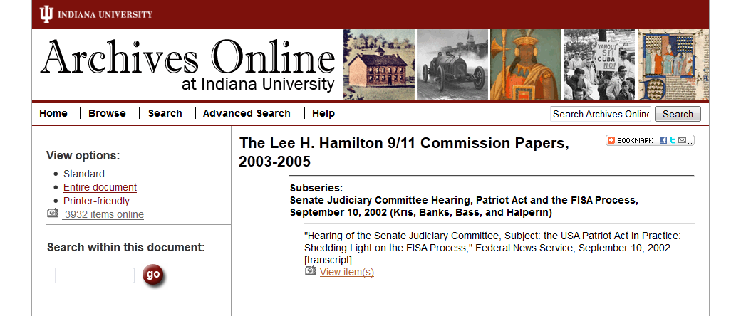
Existing digitization workflow
Large batch of items digitized
Processed into our repository
Given purl-resolvable landing pages
DAO links added to finding aid by XSLT

Slide 4
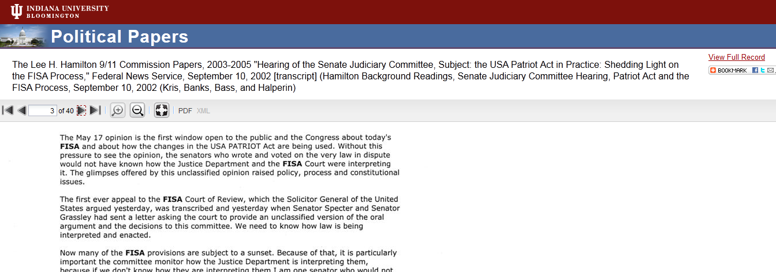
Existing Workflow Shortcomings
Too much overhead when only a small number of items are digitized
Does not support the digitization of undescribed items

Slide 5

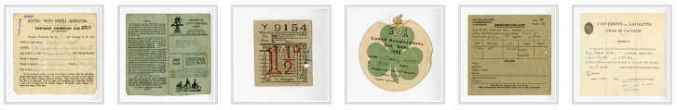
New Workflow Goals
As automatic as possible
Recreate the experience of opening a folder and flipping through the content
Preserves order of undescribed items

Slide 6
Development and Design Team
Jenn Riley
Randall Floyd
David Jiao
Julie Hardesty
Dot Porter
Mike Durbin

Slide 7
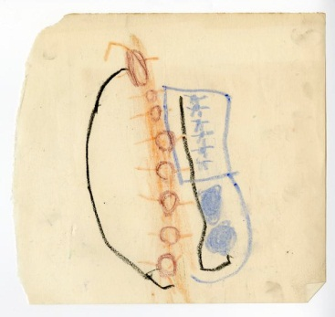
New Workflow: Digitization
One or more items are selected for digitization
The item’s parent component in the EAD and relative order to other digitized items is encoded into the collection spreadsheet along with the newly digitized item’s identifier
The material is scanned, and page ordering is encoded in filenames
The updated spreadsheet and master files are placed in a drop-box for automatic processing

Slide 8
New Workflow: Processing and Automatic Quality Control
Digitized image files are run through quality control checks to determine that they meet the digitization standards
Upon failure, an email is sent to collection manager
Master files are moved off to archival storage, extracted metadata (MIX) as well as derivative images as passed off to another drop-box to be ingested into our Fedora repository.
QC

Slide 9
New Workflow: Fedora Ingest
Objects are stored to Fedora
Collection Level Object
Latest version of the spreadsheet
Latest version of the EAD*
Archival Component Level Object
METS (struct map, drives our page-turning application)
Item Level Objects
PDF
METS
Page Level Objects
Image derivatives
Master image link
MIX metadata
An e-mail is sent to the collection manager
List updated archival component objects
Lists ingested items
Includes reports of any problems/inconsistencies between the spreadsheet and digitized files

Slide 10
New Workflow: Publication
References are added to the EAD file
XTF reindexes the EAD file and transforms those references into links to display the components

Slide 11
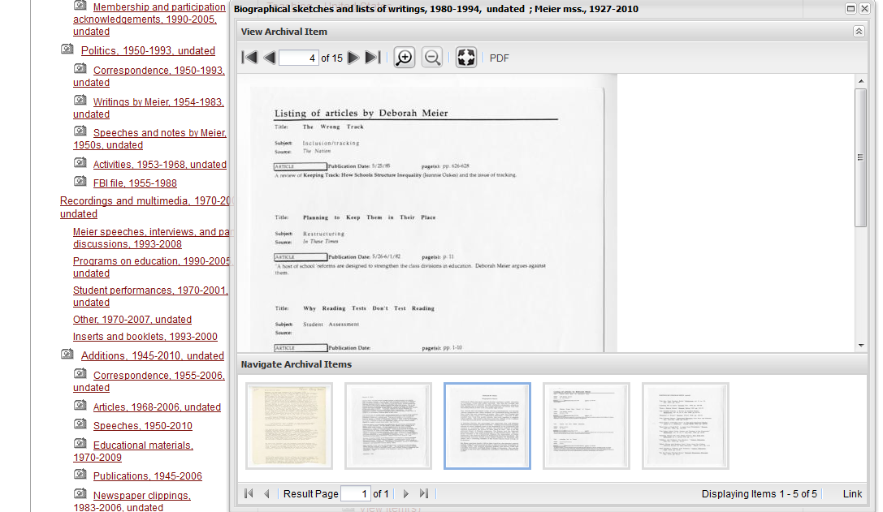

Slide 12
Thanks! Questions?
Archives Online @ IU http://webapp1.dlib.indiana.edu/findingaids/

