Slide 1
Finding Movies with FRBR & Facets
Kelley McGrath
University of Oregon
kelleym@uoregon.edu
Notes:
I want to talk about a project that I’ve been involved in that uses the FRBR model and faceted navigation to try to make it easier to find videos in libraries.

Slide 2
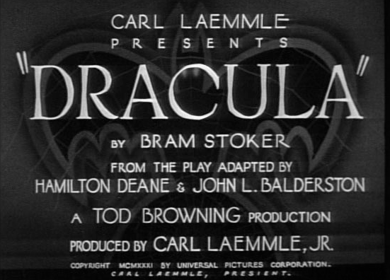
Users are looking for movies
Notes:
Typical library users are really looking for movies, either a particular movie, such as the 1931 English-language Dracula, or a category of movies, such as early horror films or documentaries on the history of horror films.

Slide 3
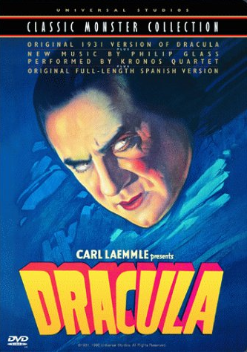


Libraries describe publications
Notes:
Libraries, however, catalog publications. For example, a catalog record might represent the set of DVDs issued by Warner Bros. Home Entertainment beginning in 2008 and with a particular ISBN.

Slide 4
Libraries describe publications
Dracula [videorecording] / Columbia Pictures ; directed by Francis Ford Coppola …
2-disc special ed.
Culver City, Calif. : Columbia TriStar Home Entertainment, c2005.
2 videodiscs (ca. 130 min.) : sd., col. ; 4 3/4 in. + 1 booklet.
Horror film series
Notes:
The heart of the description in a catalog record reflects this emphasis on publications. The parts in yellow could be interpreted as describing the movie, but everything else here clearly describes the publication—the edition statement, the publication statement, much of the physical description and the series statement. Most of the information about the movie is in notes and much of it is not even required by cataloging rules. The information about the movie and the publication is all jumbled up so it’s hard to pick out the data elements that relate to the movie.

Slide 5
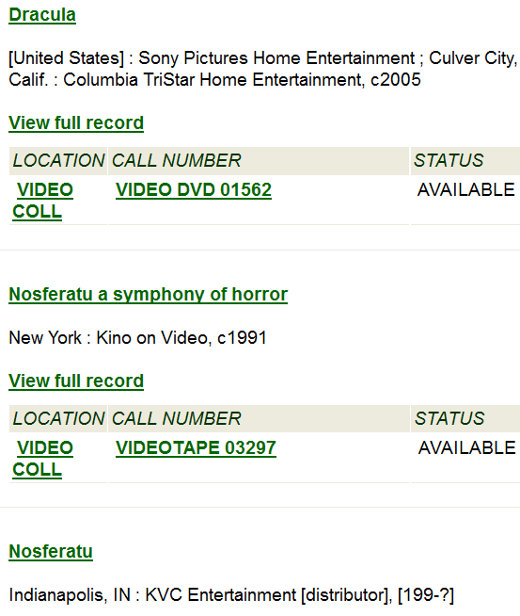
Libraries describe publications
Notes:
Library hit lists also reflect the emphasis on publications. The information that is given to help identify a title usually describes the publication, as in this example. The date of publication, which is the date that displays here and is the one used for sorting and limiting in library catalogs, goes with the DVD and not the movie. Because the hits are for publications, there can be more than one for the same movie. Can you tell what movies are in this list or if the different hits represent the same or different movies?

Slide 6


Users care about versions
日本語
Rg1024: open clip art library
Notes:
Users do care about what I think of as versions. They have preferences or requirements as to how they want to access a particular movie. If I don’t have a Blu-ray player, it does me no good to borrow a Blu-ray disc. If I just bought a Blu-ray player, maybe all I want to look at are Blu-rays so I can try one. If I don’t speak Japanese, I don’t want to borrow a video in Japanese with no English subtitles. Maybe I only want to see the director’s cut or the unrated version of a movie.

Slide 7
Prototype: Movies & Versions
Funded: OLAC (Online Audiovisual Catalogers)
Developed by Chris Fitzpatrick
Small scale (limited data, few fields and records, simplified data model)
http://blazing-sunset-24.heroku.com
Notes:
We built a prototype discovery interface that focuses on movies and versions rather than publications to see what that might look like.

Slide 8
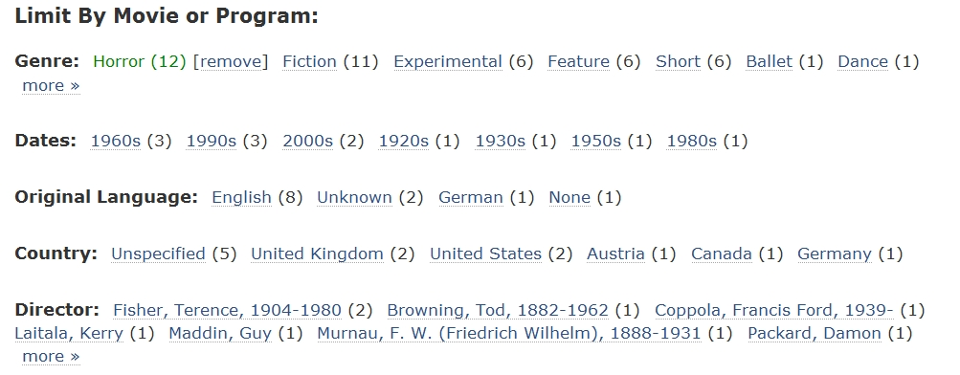
Movie (mostly work) facets
Notes:
In addition to a search box, we provide facets for important attributes of movies like genre and original date. This supports browsing of movies from many angles.

Slide 9
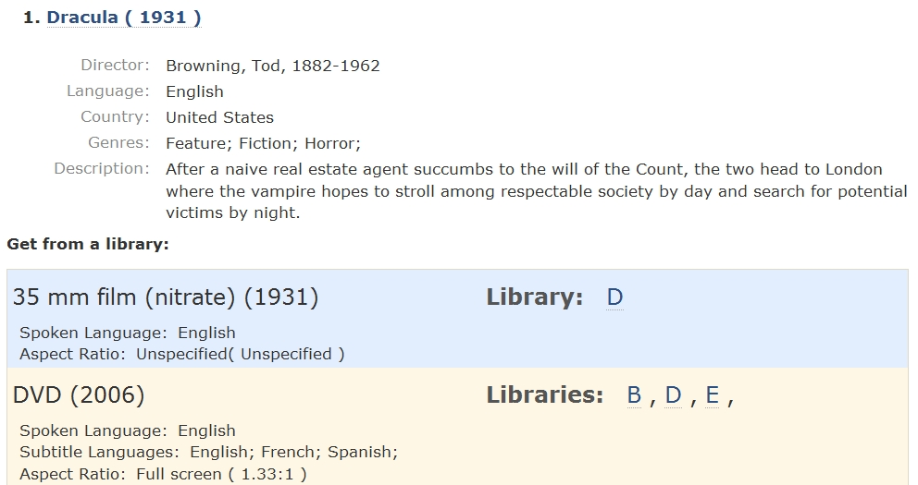
Hit List
Results focused on movie (work)
Fulfillment options
below (expression,
manifestation, item)
Notes:
Our hit list features only one hit per movie and includes enough information to identify the movie. We also clearly present version information that is important for decision-making to enable easy selection.

Slide 10
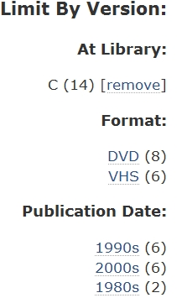
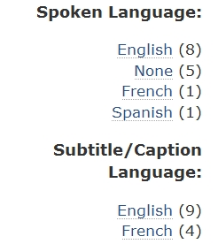
Version (expression/manifestation/ item) facets
Notes:
We also include version-related facets, such as format and soundtrack and subtitle options.

Slide 11
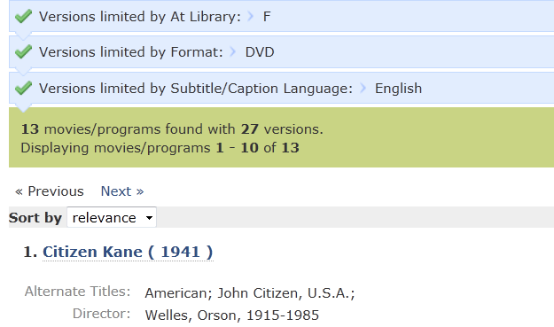
Movie-version interaction
Notes:
The records and facets for movies and versions interact. This allows users to explore from the top down, say starting with horror films, or from the bottom up with Blu-rays at their local library. With each selection, the resulting movies and versions are appropriately narrowed.

Slide 12
Prototype
Prototype http://blazing-sunset-24.heroku.com
Sample searches and use cases http://blazing-sunset-24.heroku.com/page/samples
Code http://github.com/cfitz/olac
Notes:
Because there isn’t a lot of data in prototype, I recommend checking out the sample searches to get a fuller sense of possibilities. We’re hoping to build on the prototype and eventually create a functional system. Let me know if you’re interested in contributing to this project.

Slide 13
More Info
OLAC Moving Image Work-Level Records Task Force Reports http://www.olacinc.org/drupal/?q=node/27
OLAC discussion group (lit review) http://www.olacinc.org/drupal/?q=node/434
McGrath & Bisko. “Identifying FRBR Work-Level Data in MARC Bibliographic Records for Manifestations of Moving Images” http://journal.code4lib.org/articles/775

