Slide 1

Discovering Digital Library User Behavior with Google Analytics
Kirk Hess
University of Illinois Urbana-Champaign
Hi #code4lib!

Slide 2
Add Event Tracking
Collect Data
Export data using API
Analyze Data

Slide 3
Why Google Analytics?
Urchin--
http://google.com/analytics/
JavaScript-based
Small tracking image (visible via Firebug)
= mostly users not bots
Works across domains
Easy to integrate with existing systems
Low cost
API
AWStats++

Slide 4
Add Tracking
Tracker Code
jQuery: Event Injection

Slide 5
Examples: Tracking code
<script type="text/javascript">
var _gaq = _gaq || [];
_gaq.push(['_setAccount', 'UA-XXXXXXXX-1']);
_gaq.push(['_setAllowLinker', true]);
_gaq.push(['_setDomainName', 'illinoisharvest.grainger.uiuc.edu']);
_gaq.push(['_setAllowHash', false]);
_gaq.push(['_trackPageview']);
(function() {
var ga = document.createElement('script'); ga.type = 'text/javascript'; ga.async = true;
ga.src = ('https:' == document.location.protocol ? 'https://ssl' : 'http://www') + '.google-analytics.com/ga.js';
var s = document.getElementsByTagName('script')[0]; s.parentNode.insertBefore(ga, s);
})();
</script>

Slide 6
<script type="text/javascript">
if (typeof jQuery != 'undefined') {
jQuery(document).ready(function($) {
var filetypes = /\.(pdf|txt|dijv|xml)$/i;
var baseHref = '';
if (jQuery('base').attr('href') != undefined)
baseHref = jQuery('base').attr('href');
jQuery('a').each(function() {
var href = jQuery(this).attr('href');
if (href && (href.match(/^https?\:/i)) && (!href.match(document.domain))) {
jQuery(this).click(function() {
var extLink = href.replace(/^https?\:\/\//i, '');
_gaq.push(['_link', href]);
_gaq.push(['_trackEvent', 'External', 'Click', extLink]);
if (jQuery(this).attr('target') != undefined && jQuery(this).attr('target').toLowerCase() != '_blank') {
setTimeout(function() { location.href = href; }, 200);
return false;
}
});
}
else if (href && href.match(filetypes)) {
jQuery(this).click(function() {
var extension = (/[.]/.exec(href)) ? /[^.]+$/.exec(href) : undefined;
var filePath = href;
_gaq.push(['_trackEvent', 'Download', 'Click-' + extension, filePath]);
if (jQuery(this).attr('target') != undefined && jQuery(this).attr('target').toLowerCase() != '_blank') {
setTimeout(function() { location.href = baseHref + href; }, 200);
return false;
}
});
}
});
});
}
</script>
jQuery:
Push event code on to any links
https://github.com/kirkhess/Google-Analytics-Event-Analysis

Slide 7
Collect Data
A few months later…

Slide 8
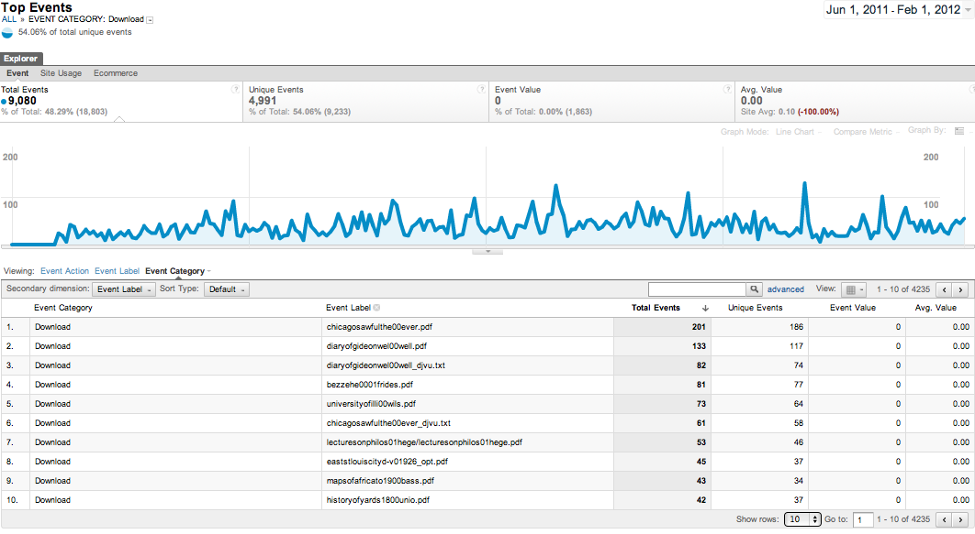

Slide 9
Google Analytics Interface
Heat Map
Content Drill Down
Visitor Flow
Events

Slide 10

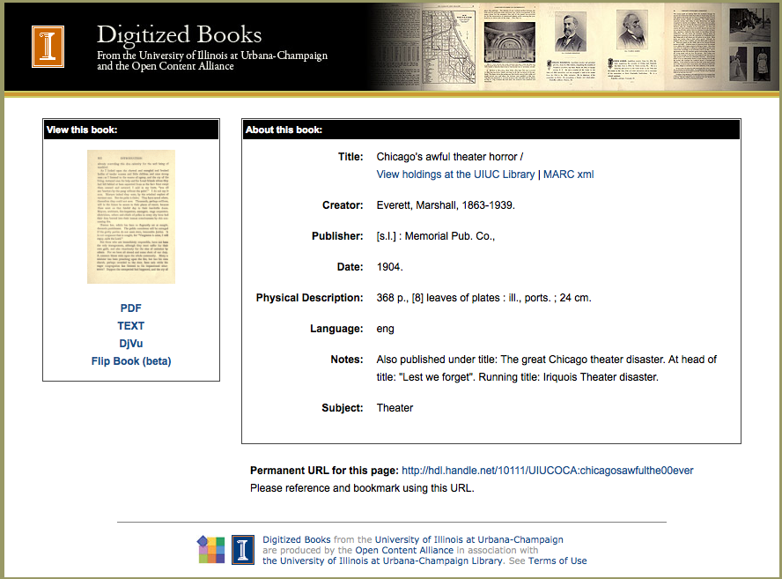
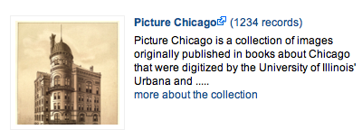
Chicago:
Awful?
Discuss

Slide 11
Export data using API
Google Analytics API
Java or Javascript
Export any field into a database for further analysis

Slide 12
public class GoogleAnalyticsIngest {
// Credentials for Client Login Authorization.
private static final String CLIENT_USERNAME = "kirk.hess@gmail.com";
private static final String CLIENT_PASS = "zzzzzzzz";
// Table ID constant
private static final String TABLE_ID = "ga:12345678";
public static void main(String args[]) {
try {
// Service Object to work with the Google Analytics Data Export API.
AnalyticsService analyticsService = new AnalyticsService("gaExportAPI_acctSample_v2.0");
// Client Login Authorization.
analyticsService.setUserCredentials(CLIENT_USERNAME, CLIENT_PASS);
// Get data from the Account Feed.
getAccountFeed(analyticsService);
// Access the Data Feed if the Table Id has been set.
if (!TABLE_ID.isEmpty()) {
// Get profile data from the Data Feed.
getDataFeed(analyticsService);
...
}

Slide 13
Analyze Data
Which items are popular?
How many times was an item viewed?
Downloaded?
Effective Collection Size

Slide 14
19th Century British Novels Collection: Events
Most items are never used
7808

Slide 15
Next steps
Change site design
Change search weighting
Allow users to sort by popularity
Recommender system
Add new tracking/new repositories
Analyze webstats

Slide 16
Code: https://github.com/kirkhess/Google-Analytics-Event-Analysis

