Slide 1

Introducing Macaw
Metadata Collection Tool for
Book-like things
Joel Richard, richardjm@si.edu
Code4Lib Lightning Talk, Feb 2012

Slide 2



+
+
Joel Richard, richardjm@si.edu
Code4Lib Lightning Talk, Feb 2012

Slide 3

+
+
Joel Richard, richardjm@si.edu
Code4Lib Lightning Talk, Feb 2012

Slide 4
?
Joel Richard, richardjm@si.edu
Code4Lib Lightning Talk, Feb 2012

Slide 5
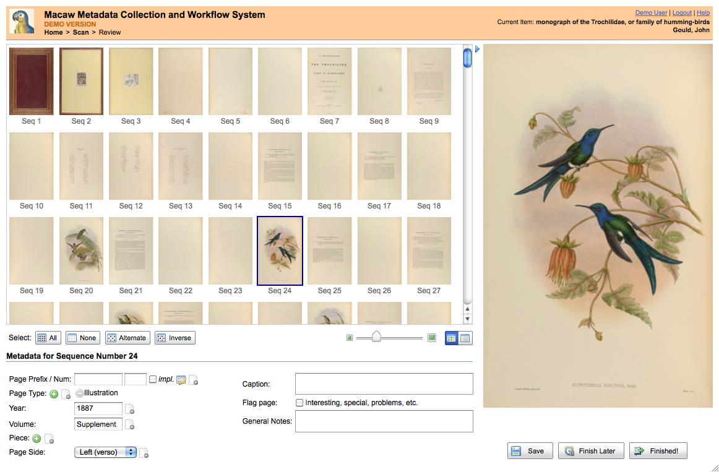
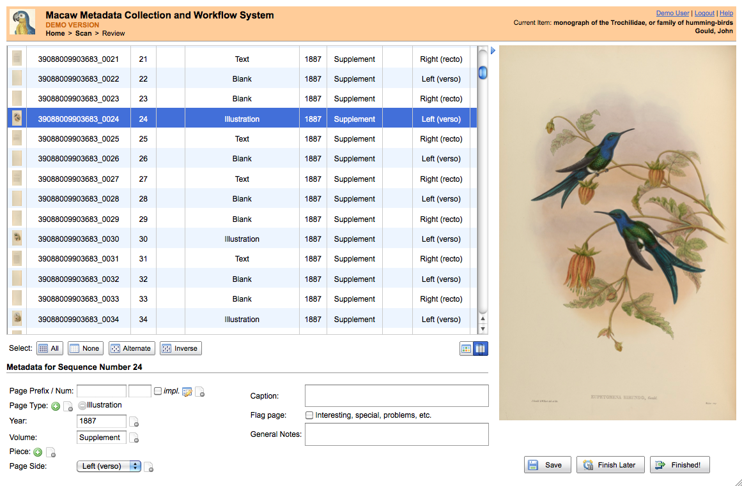

Macaw
Metadata Collection and Workflow
Joel Richard, richardjm@si.edu
Code4Lib Lightning Talk, Feb 2012

Slide 6


Z39.50
CSV
Page Prefix, Page Number, Page Type, Year, Volume, Issue, Number, Part, Recto/Verso, Caption, Notes
Joel Richard, richardjm@si.edu
Code4Lib Lightning Talk, Feb 2012

Slide 7







Macaw is hosted at
http://code.google.com/p/macaw-book-metadata-tool/
✔
June 2012
5 min
Joel Richard, richardjm@si.edu
Code4Lib Lightning Talk, Feb 2012

