Slide 1
How people search the library from a single search box
Cory Lown
NCSU Libraries
Code4Lib 2012

Slide 2
1. Academic library search environment
2. Search stats at NCSU
3. Collecting data

Slide 3
1. Academic library search environment

Slide 4
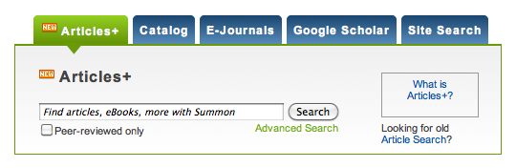
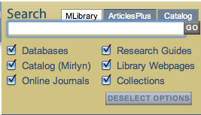


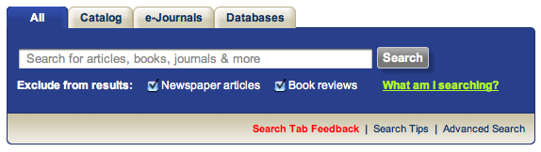

Slide 5
73% of searches from the home page start from the default tab
Notes:
Journal of Web Librarianship, 5:80–95, 2011
Copyright © Taylor & Francis Group, LLC
ISSN: 1932-2909 print / 1932-2917 online
DOI: 10.1080/19322909.2011.568822
The North Carolina State University Libraries
Search Experience: Usability Testing Tabbed
Search Interfaces for Academic Libraries

Slide 6
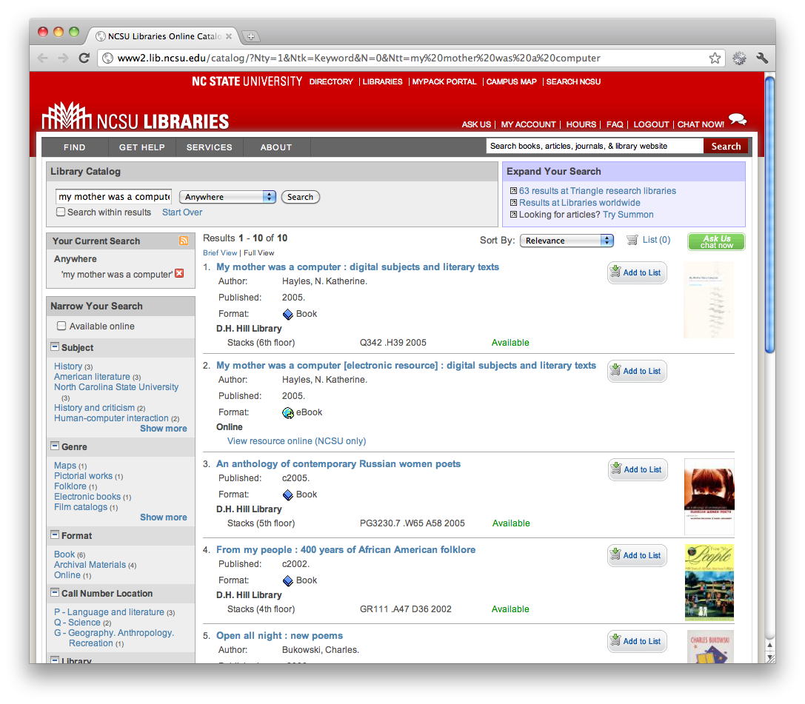

Slide 7
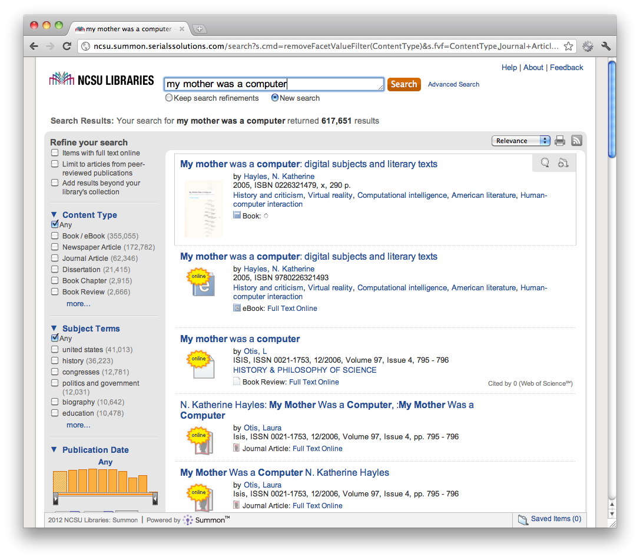

Slide 8
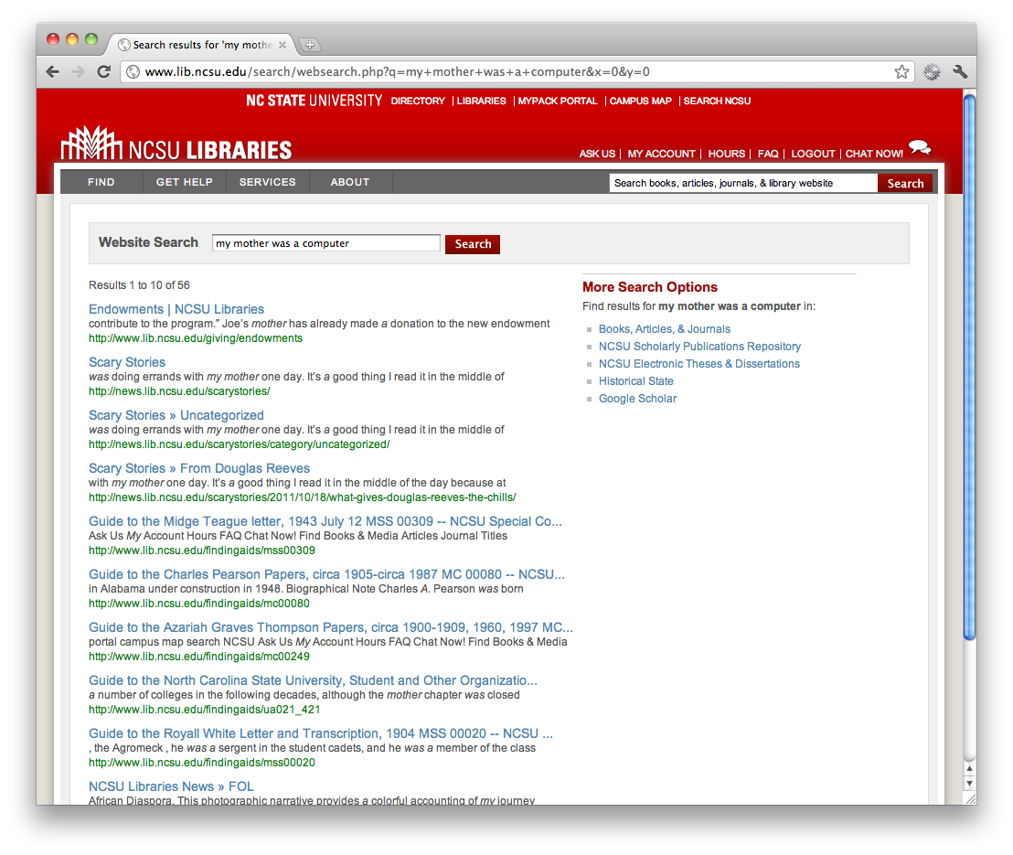

Slide 9
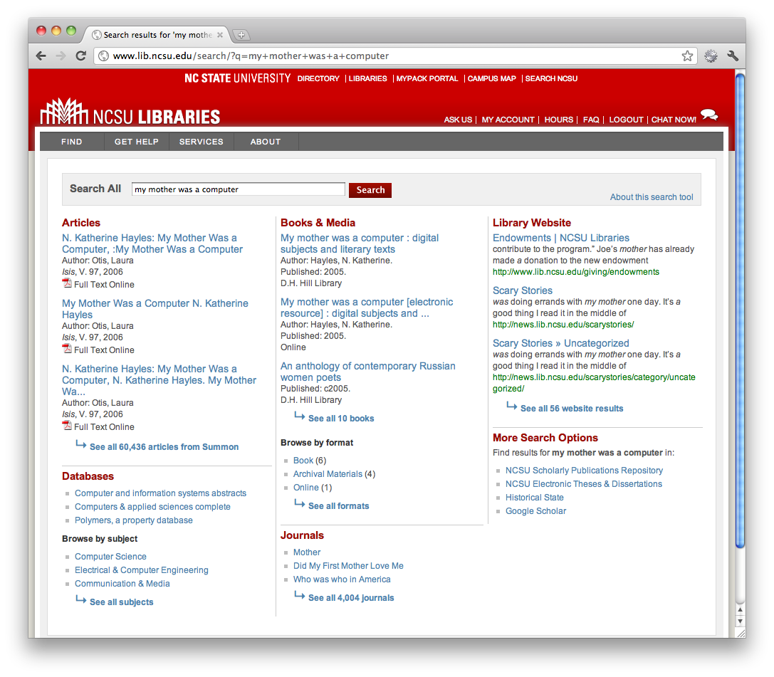

Slide 10
Journal Articles, Catalog, Journal Titles, Database Titles, Library Website,

Slide 11
Best Bets, Spelling Suggestions, Loaded Links, FAQs, Smart Subjects,

Slide 12
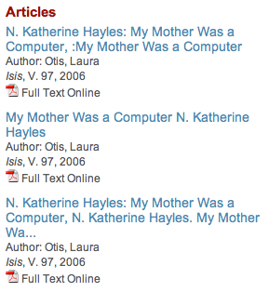

Slide 13


Slide 14
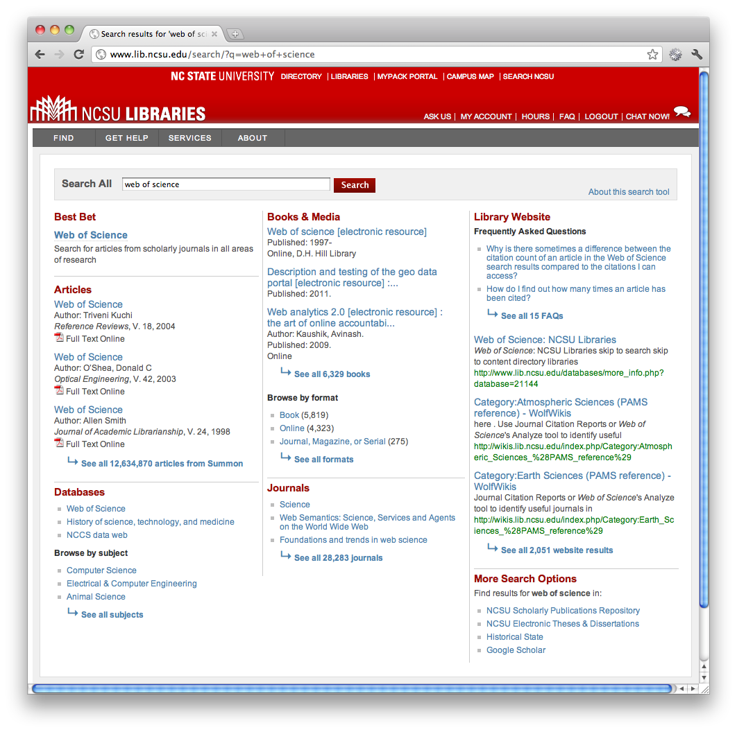

Best Bets

Slide 15
Part 2: Search stats at NCSU

Slide 16
Fall 2010 and Spring 2011

Slide 17
739,180 Searches 655,388 Click-throughs

Slide 18
7.8%
35.2%
41.5%
5.5%

Slide 19
Article and Catalog results are really important.

Slide 20
23% of searchers are doing something else. Journal titles, databases, website results, etc.

Slide 21
For Articles, people use one of the first 3 results about 70% of the time.
The other 30% use the “See All Results” link to see the full Summon results interface.

Slide 22
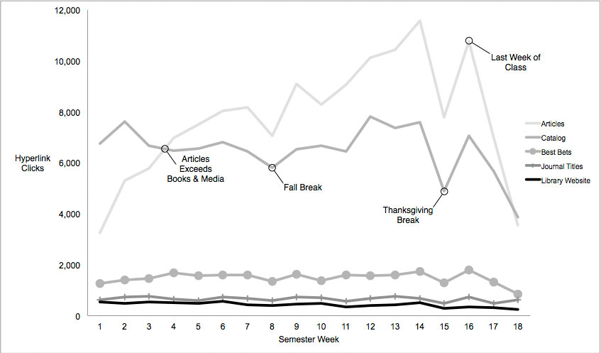
Fall 2010

Slide 23
Fall 2010 – Catalog

Slide 24
Fall 2010 - Articles

Slide 25
web of science, citation builder, refworks, jstor, google scholar, pubmed, petition, ieee, naxos, etd, course reserves, science, gis, tripsaver, academic search premier, harvard business review, eric, citation, thesis

Slide 26
web of science, citation builder, refworks, jstor, google scholar, pubmed, petition, ieee, naxos, etd, course reserves, science, gis, tripsaver, academic search premier, harvard business review, eric, citation, thesis

Slide 27
web of science, citation builder, refworks, jstor, google scholar, pubmed, petition, ieee, naxos, etd, course reserves, science, gis, tripsaver, academic search premier, harvard business review, eric, citation, thesis

Slide 28
web of science, citation builder, refworks, jstor, google scholar, pubmed, petition, ieee, naxos, etd, course reserves, science, gis, tripsaver, academic search premier, harvard business review, eric, citation, thesis

Slide 29
web of science, citation builder, refworks, jstor, google scholar, pubmed, petition, ieee, naxos, etd, course reserves, science, gis, tripsaver, academic search premier, harvard business review, eric, citation, thesis

Slide 30
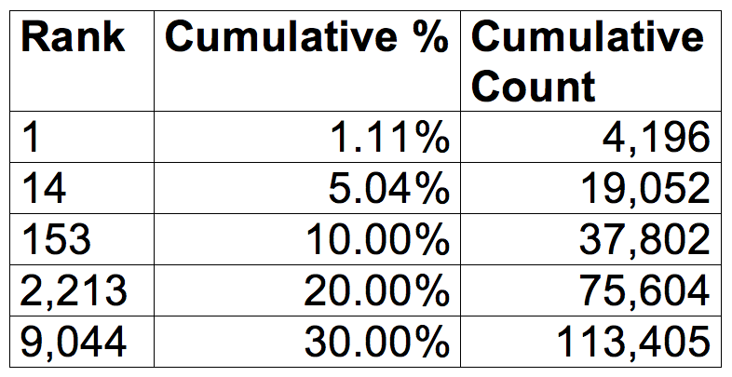
Query Distribution Spring 2011
Notes:
Redo these so that the Count is the cumulative count.

Slide 31
Query Distribution Spring 2011
Notes:
Redo these so that the Count is the cumulative count.

Slide 32
Query Distribution Spring 2011
Notes:
Redo these so that the Count is the cumulative count.

Slide 33
Query Distribution Spring 2011
Notes:
Redo these so that the Count is the cumulative count.

Slide 34
Main points

Slide 35
Single/default search signals confidence to people that our search tools will just work.

Slide 36
Important to consider what the default search box doesn’t search.

Slide 37
Dynamic results drive traffic.

Slide 38
Make sure the most frequent queries provide great results.

Slide 39
Part 3: Collecting data

Slide 40
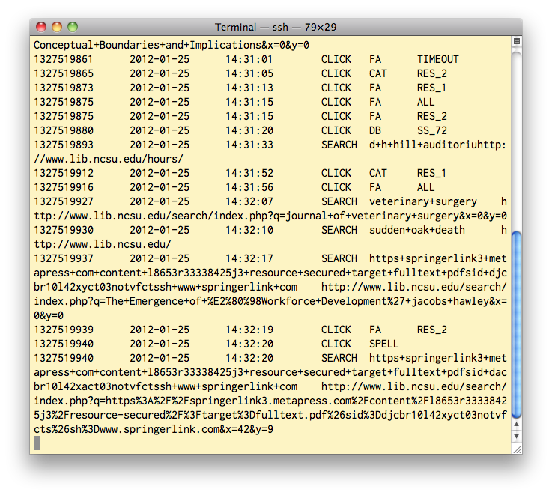

Slide 41
Timestamp Date Time Action (SEARCH) Query (john+muir) Referrer URL
Tracking Searches

Slide 42
Timestamp Date Time Action (CLICK) Category (CAT) Link (RES_1)
Tracking Click-throughs

Slide 43
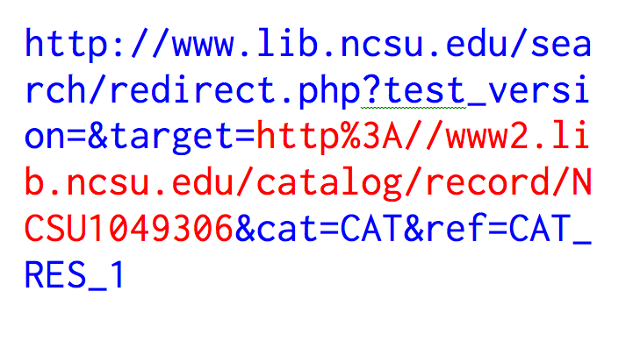

Slide 44
Alternative: Event tracking in Google Analytics

Slide 45
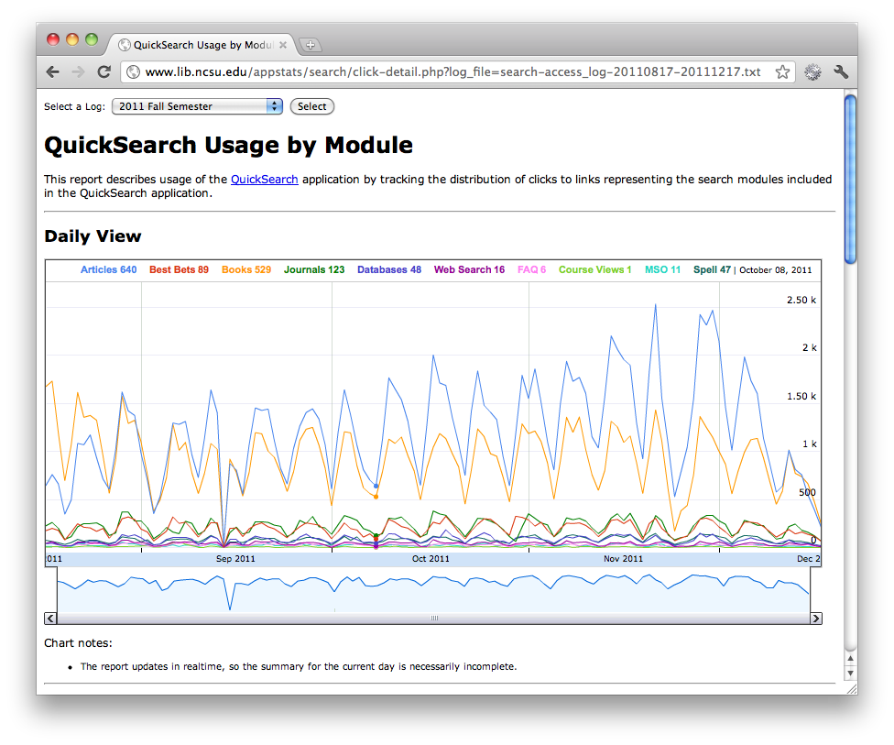

Slide 47
Thanks.

Slide 48
Cory Lown NCSU Libraries cwlown@ncsu.edu @cowilo C&RL Article Preprint http://go.ncsu.edu/librarysearch

