Slide 1
Adding Publicly-Accessible Hathi Trust Items to your Solr-based Discovery System.
Robert Haschart
University of Virginia

Slide 2
Assumptions:
Solr-based index (Generally Blacklight or Vu-Find)
SolrMarc used for indexing
Only want publicly-accessible items
MARC record based with one Solr record per Title
Simply provide a link to the full-text in Hathi Trust
Possible multiple links when more than one item per title

Slide 3
Step 1:
Download list of Hathi-items (~550MB)
http://www.hathitrust.org/files/hathifiles/hathi_full_20120201.txt.gz
Extract sorted list of record numbers that have a publically-accessible item
Download MARC records for those record numbers
1.34 million records (~ 1.5 GB)

Slide 4
Step 2:
Tweak your SolrMarc index specification
id = 001, first
format_facet = custom, getHathiFormat("getformat_mixin_map.properties")
digital_collection_facet = "Hathi Trust Digital Library“
shadowed_location_facet = "VISIBLE"
location_facet = "Internet materials"
library_facet = "Hathi Trust Digital Library"
source_facet = "Hathi Trust Digital Library"
url_display = custom, getHathiURL("http://hdl.handle.net/2027/", "%")
oclc_text = 035a, (pattern_map.hathi_oclc_num)
pattern_map.hathi_oclc_num.pattern_0 = .*\\(OCoLC\\)ocm(.*)=>$1

Slide 5
Step 3:
Add all Hathi records to your index
Adjust interface code to display records correctly
(Repeat step 2 and 3 as necessary)

Slide 6
Step 4:
Download daily updates
http://www.hathitrust.org/files/hathifiles/hathi_upd_20120207.txt.gz
Determine what to add/update/delete
Add/update/delete records into index
Merge updates into local record dump

Slide 7
Not Addressed
Combining Hathi items with local items
Including locally-accessible copyright protected items
Making scripts to accomplish all the above freely available through Git

Slide 8
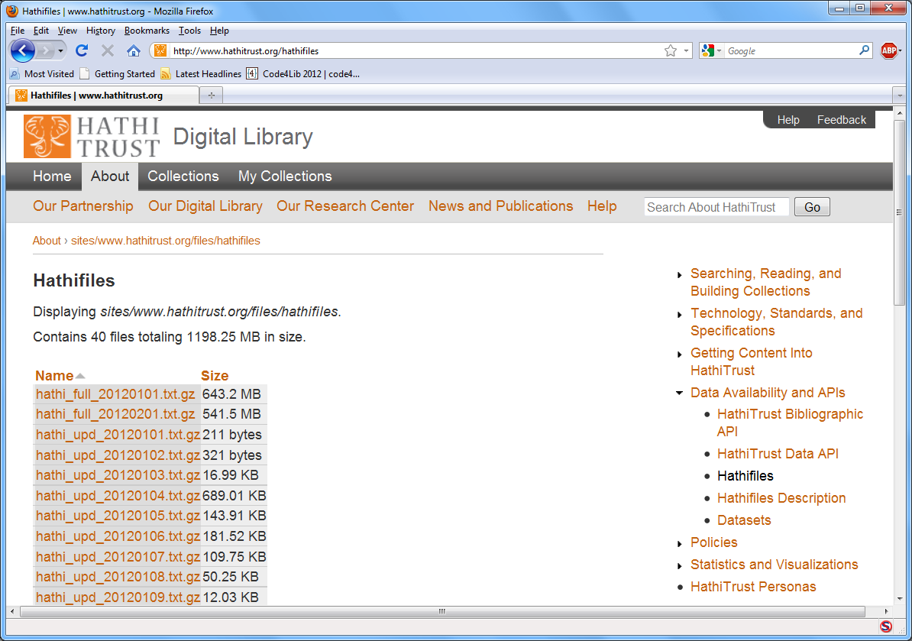

Slide 9
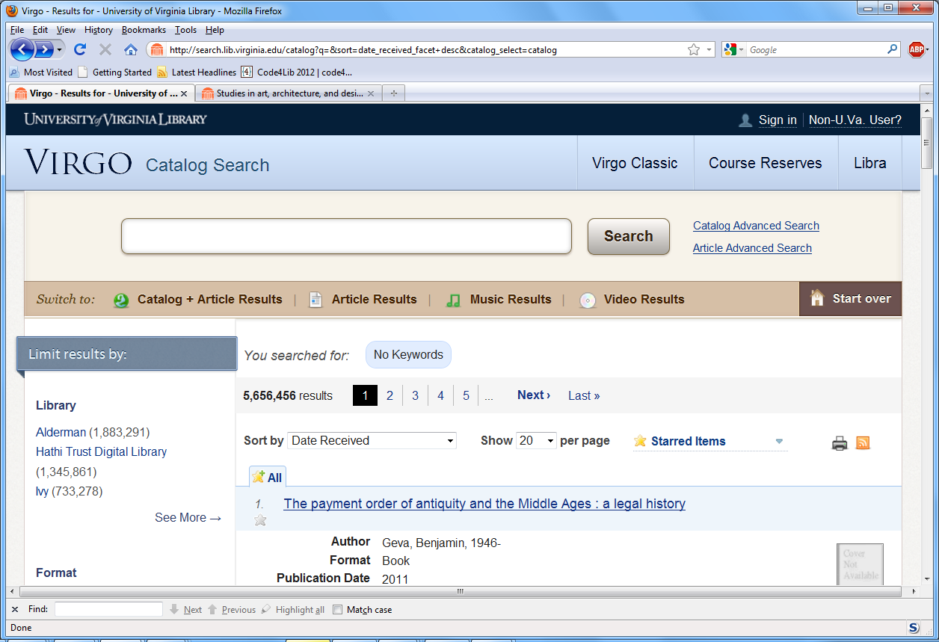

Slide 10
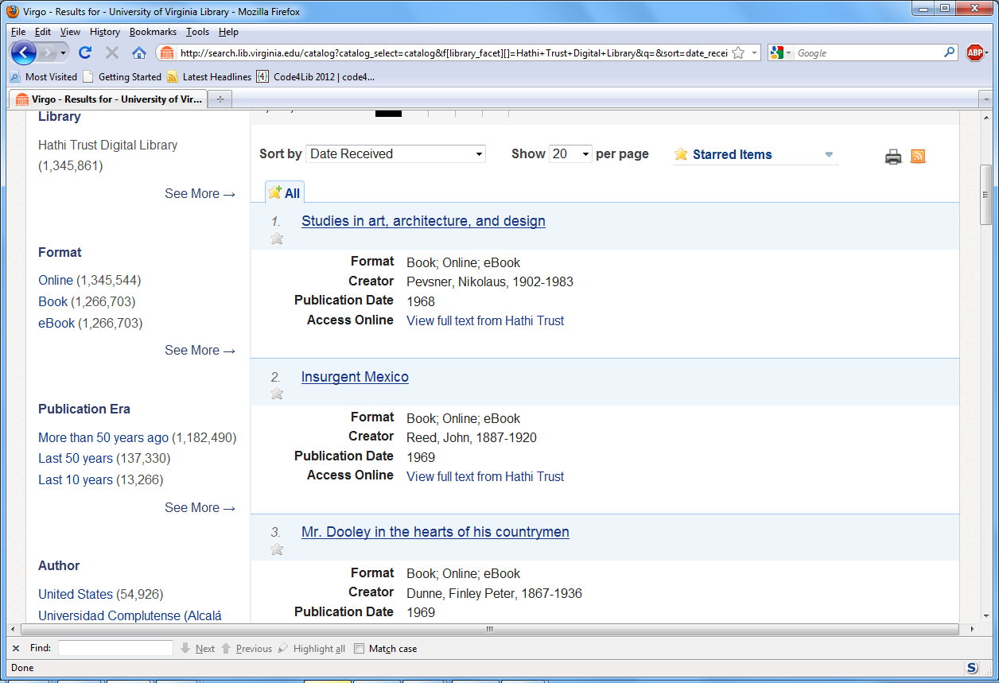

Slide 11
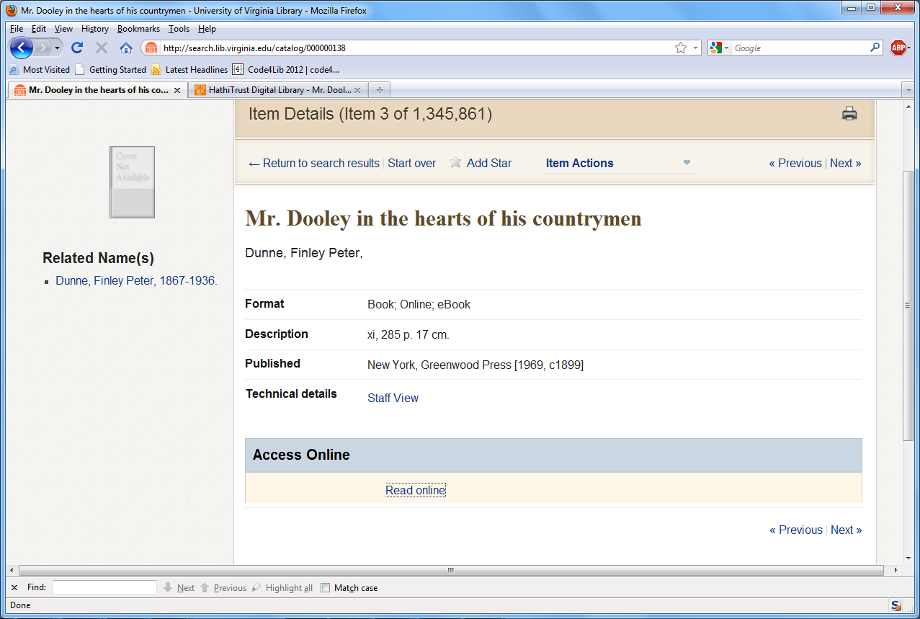

Slide 12
