Slide 1
Your UI Can Make or Break the Application
(to the user, anyway)
Robin Schaaf
Sr. Applications Developer
University of Notre Dame

Slide 2

Purdue University, BS
Computer Technology
Graduated 2001
Depaul University, MS
Human Computer Interaction
Expected Graduation ????
Hesburgh Libraries - 4 years

Slide 3
“This sucks.
Go fix it.”
-My employer

Slide 4
“Pretty.”
“Fun to use.”
-CORAL Users

Slide 5
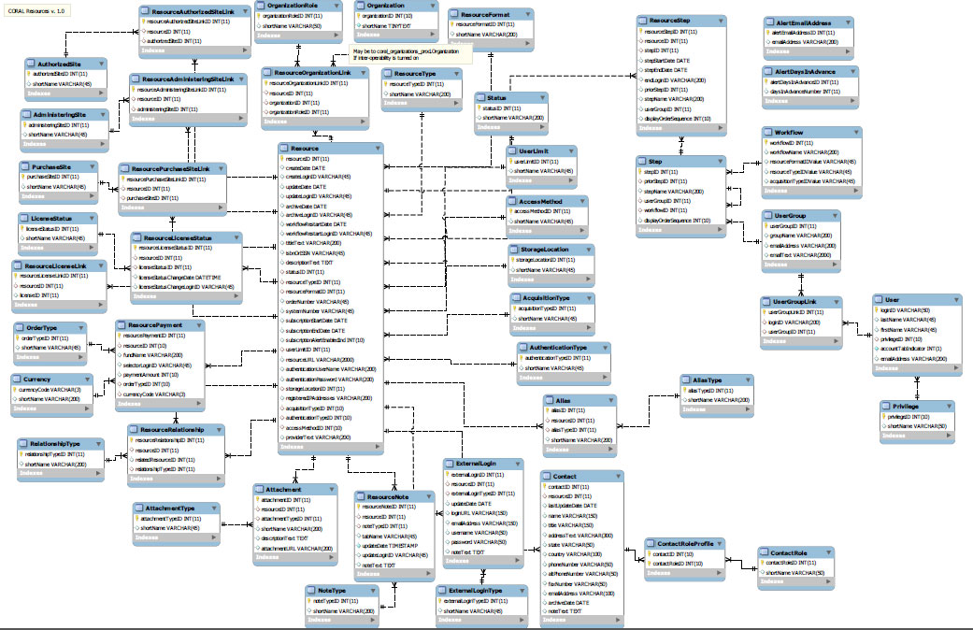

Slide 6
“Don’t make me think.”
-Steve Krug, usability expert
“If your system has a bad interface no one will use it.”
-Yukihiro Matsumoto, creator of Ruby

Slide 7
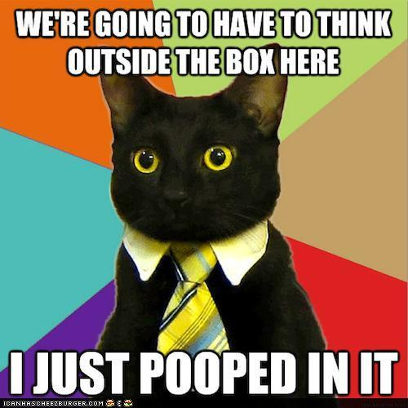

Slide 8
Prototyping
Fail early and fail fast
User Involvement
Screenshots along with requirements?
Creates user buy-in
Warning: Don’t make demos look done!

Slide 9
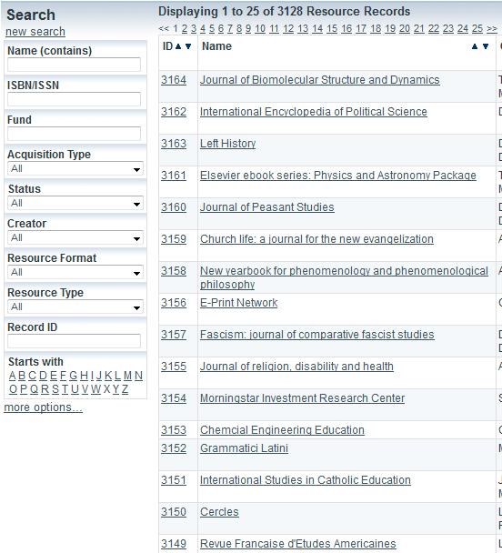
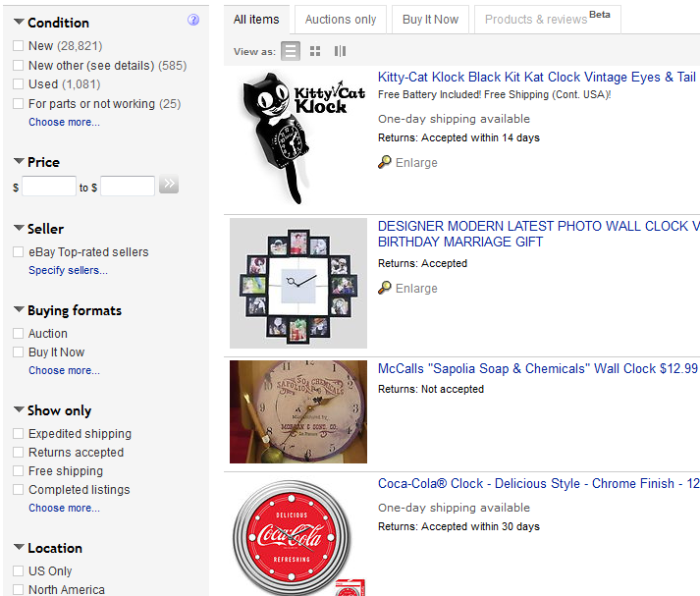
A few tips…
Don’t be afraid to “borrow” ideas
CORAL Search page
Ebay’s Search page

Slide 10
Help the user be successful
- Stick with familiar designs (“borrow”)
- Use simple language
- Keep labels / functionality consistent
- Give instant feedback
-- provide inline validation
-- some feedback with ajax

Slide 11
Helpful Sites
Designmodo.com
Thinkvitamin.com
Ajaxload.info (spinner generator)
Uxdesign.smashingmagazine.com
Questions?
Robin.Schaaf.4@nd.edu

