Slide 1

Welcome to North Carolina!

Slide 2
Code4Lib 2014 Facts
351 attendees
223 organizations
33 states
10 countries
$57,750 in Sponsorships / Scholarships
approximately 45% of the budget
9 scholarships awarded

Slide 3
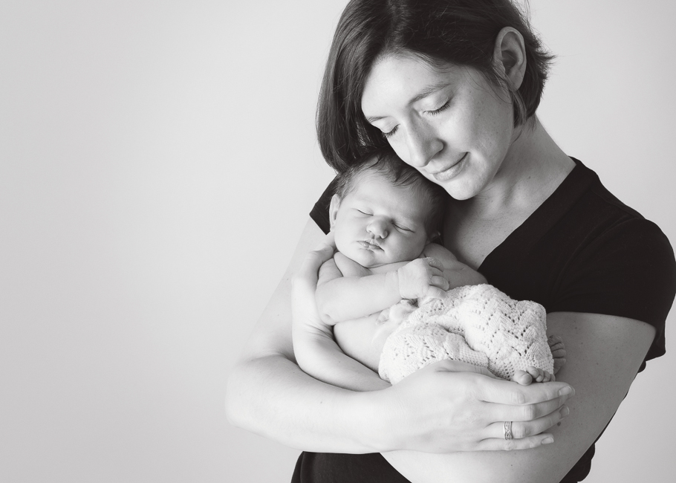
Collaboration = success

Slide 4



It takes a Research Triangle…
Will Sexton
Ann Elsner
Adam Constabaris Emily Lynema
Andreas Orphanides Jason Casden
Bret Davidson Jason Raitz
Charlie Morris Jason Ronallo
Cory Lown Kevin Beswick
Steve Morris
Jeff Campbell
Tim McGeary
Tim Shearer

Slide 5
… and even more volunteers
Roy Tennant, OCLC
Shaun Ellis, Princeton
Sarah Shealy, Richland Library
Josh Wilson, State Library of North Carolina
Bohyun Kim, University of Maryland-Baltimore
Santi Thompson, University of Houston
Peter Murray, LYRASIS
Riley Childs, Library Tech Cast, RileyChilds.net
Cary Gordon, The Cherry Hill Company

Slide 6

Special thanks to:
Deborah Smith and Jennifer Cummings
Contract negotiations
Facility planning
Online and on-site Registration
Sponsorship invoice
… and so much more!

Slide 7

Platinum Sponsor

Slide 8





Gold Sponsors

Slide 9
Silver Sponsors
Ebsco
IndexData
Innovative Interfaces, Inc
Microsoft Research
University of Pennsylvania Library

Slide 10
Bronze Sponsors
Kuali OLE
Nashville Public Library
Princeton University Library
Proquest
UC – San Diego Library

Slide 11
Contributing Sponsors
The Cherry Hill Company
DuraSpace
GitHub
User Friendly Consulting, Inc.

Slide 12
Table Sponsors
Blacklight
DuraSpace
Ebsco
Innovative Interfaces, Inc
LucidWorks
Microsoft Research
Proquest
University of Pennsylvania Libraries
User Friendly Consulting, Inc.

Slide 13
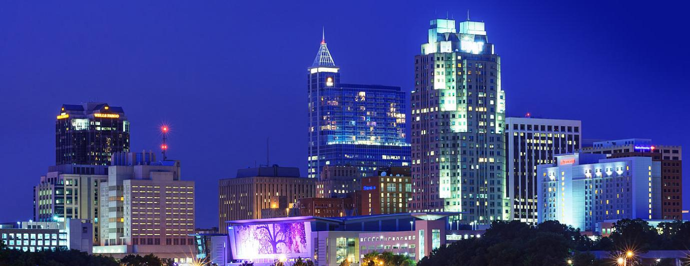
Social Activities
http://wiki.code4lib.org/index.php/ 2014_Social_Activities

Slide 14


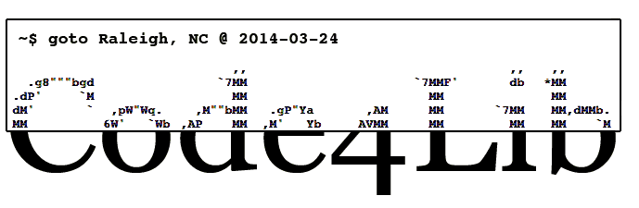
#c4l14

Slide 15
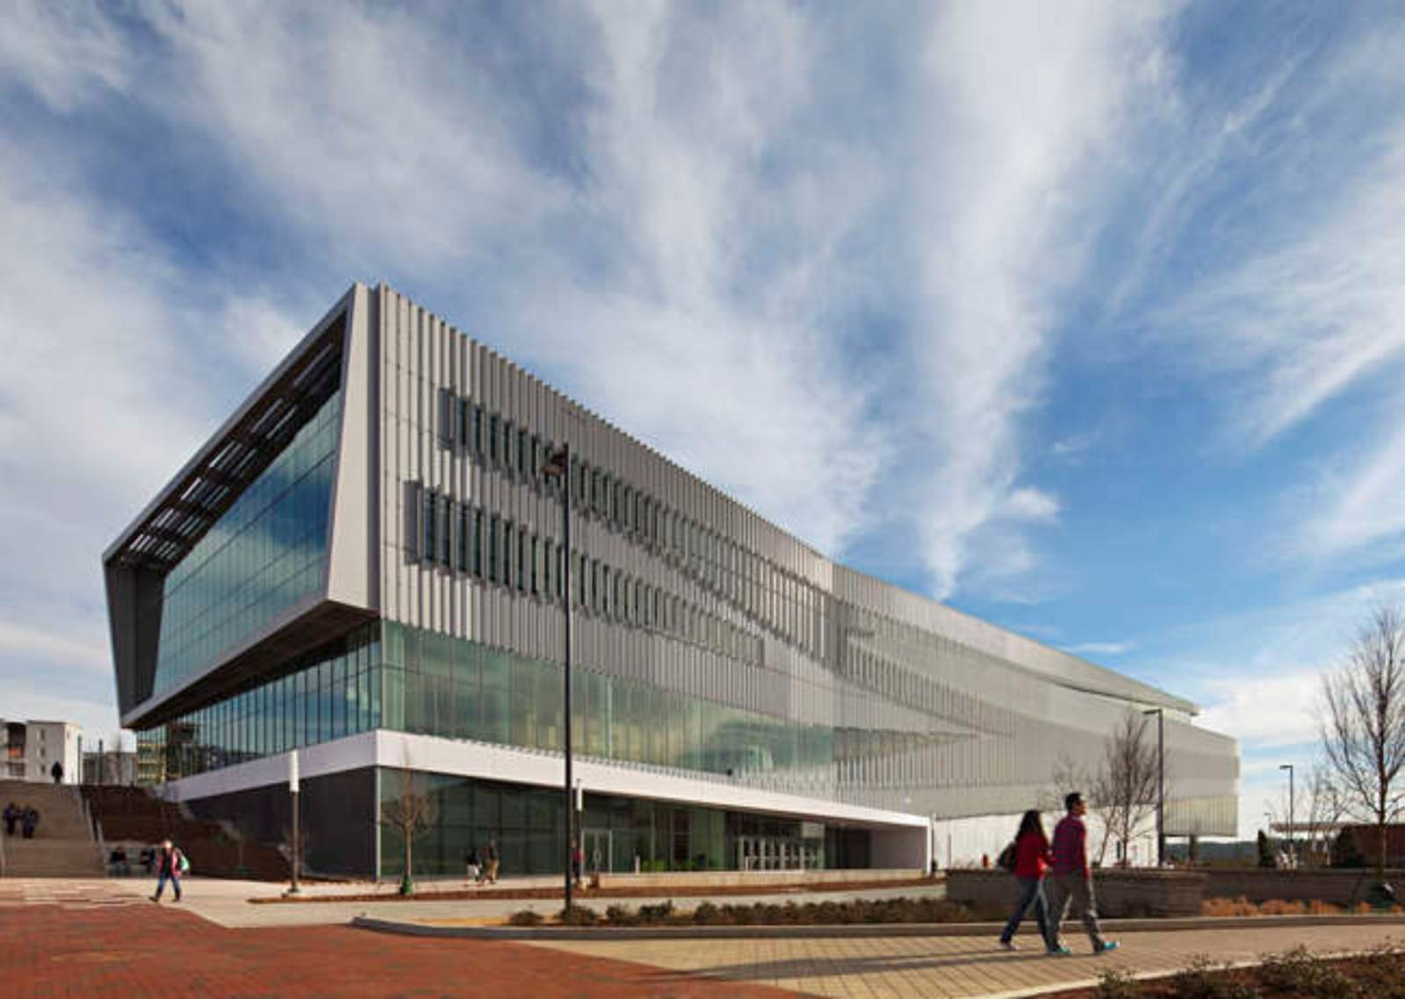
Hunt Library Reception
3 rotating shuttles
5:00pm: Shuttles @
Salisbury St entrance
(5:45pm last shuttle)
6:45pm: Shuttles will starting returning
(7:30pm last shuttle)

