Slide 1

A Static Rank Framework for Lucene/Solr
Mike Schultz
mike.schultz@gmail.com

Slide 2
Static Rank for Solr/Lucene
Dynamic Rank
Why Static Rank
Combining Scores
Static Rank Components

Slide 3
Multiple Fields / Multiple Types
PubDate
Continuous (Date, Int, Float, …)
IsNews
MediaType
TextBody

Slide 4
Multiple Fields / Multiple Types
PubDate
Continuous (Date, Int, Float, …)
IsNews
Boolean (True, False)
MediaType
TextBody

Slide 5
Multiple Fields / Multiple Types
PubDate
Continuous (Date, Int, Float, …)
IsNews
Boolean (True, False)
MediaType
Enum (Book, CD, DVD, Cassette)
TextBody

Slide 6
Multiple Fields / Multiple Types
PubDate
Continuous (Date, Int, Float, …)
IsNews
Boolean (True, False)
MediaType
Enum (Book, CD, DVD, Cassette)
TextBody
Text (Natural Language)

Slide 7
Dynamic Rank
PubDate
IsNews
MediaType
TextBody
TF * IDF
Dynamic Score
Query

Slide 8
Dynamic Rank
PubDate
Query Dependent = F(Q,D)
IsNews
MediaType
TextBody
TF * IDF
Dynamic Score
Query

Slide 9
Dynamic Rank
PubDate
Query Dependent = F(Q,D)
Huge dynamic range (0.001-1502.3)
IsNews
MediaType
TextBody
TF * IDF
Dynamic Score
Query

Slide 10
Dynamic Rank
PubDate
Query Dependent = F(Q,D)
Huge dynamic range (0.001-1502.3)
Not comparable across queries
IsNews
MediaType
TextBody
TF * IDF
Dynamic Score
Query

Slide 11
Dynamic Rank
PubDate
Query Dependent = F(Q,D)
Huge dynamic range (0.001-1502.3)
Not comparable across queries
Not easily normalized
IsNews
MediaType
TextBody
TF * IDF
Dynamic Score
Query

Slide 12
Why Static Rank?
PubDate
Static Rank
System
IsNews
Static Score
MediaType
TextBody
Query

Slide 13
Why Static Rank?
PubDate
Static Rank
System
IsNews
Static Score
MediaType
All (dynamic) things equal, I want
Newer over older
TextBody
Query

Slide 14
Why Static Rank?
PubDate
Static Rank
System
IsNews
Static Score
MediaType
All (dynamic) things equal, I want
Newer over older
CD over cassette
TextBody
Query

Slide 15
Why Static Rank?
PubDate
Static Rank
System
IsNews
Static Score
MediaType
All (dynamic) things equal, I want
Newer over older
CD over cassette
Arbitrary feature A over arbitrary feature B
TextBody
Query

Slide 16
Static Rank
PubDate
Static Rank
System
IsNews
Static Score
MediaType
Query Independent = F(D)
i.e. static across queries
TextBody
Query

Slide 17
Static Rank
PubDate
Static Rank
System
IsNews
Static Score
MediaType
Query Independent = F(D)
i.e. static across queries
More easily bounded
TextBody
Query

Slide 18
Combined Rank
PubDate
Static Rank
System
IsNews
MediaType
Custom Query
Combined Score
TextBody
TF * IDF
Query

Slide 19
Framework - Requirements
Intuitive, hand-tunable, debuggable
Custom Query
Combined Score

Slide 20
Framework - Requirements
Intuitive, hand-tunable, debuggable
Query-time only, no re-indexing
Custom Query
Combined Score

Slide 21
Framework - Requirements
Intuitive, hand-tunable, debuggable
Query-time only, no re-indexing
Minimal parameters
Custom Query
Combined Score

Slide 22
Framework - Requirements
Intuitive, hand-tunable, debuggable
Query-time only, no re-indexing
Minimal parameters
Static Rank should boost / demote
But not too much!
Docs should stay in their own dynamic rank “neighborhood”.
Custom Query
Combined Score

Slide 23
Combining Scores - Approaches
Addition?
Dynamic(0.0001) + Static(0.3) = 0.3001
Dynamic(1542.1) + Static(0.3) = 1542.4
Difficult to get right across queries
Custom Query
Combined Score

Slide 24
Combining Scores - Approaches
Multiplication?
Dynamic(50.0) * Static(0.3) = 15.0
Dynamic(10.0) * Static(2.0) = 20.0
Could work, but awkward
Custom Query
Combined Score

Slide 25
Combining Scores - Approaches
Bound StaticScore: -1.0 to 1.0
CScore = DScore*(100+S%*SScore)
At most, staticRank will boost/demote dynamicScore by S%
CScore = 0.014 * (100+30*0.5)
CScore = 145.3 * (100+30*-0.5)
Linear Query
Combined Score

Slide 26
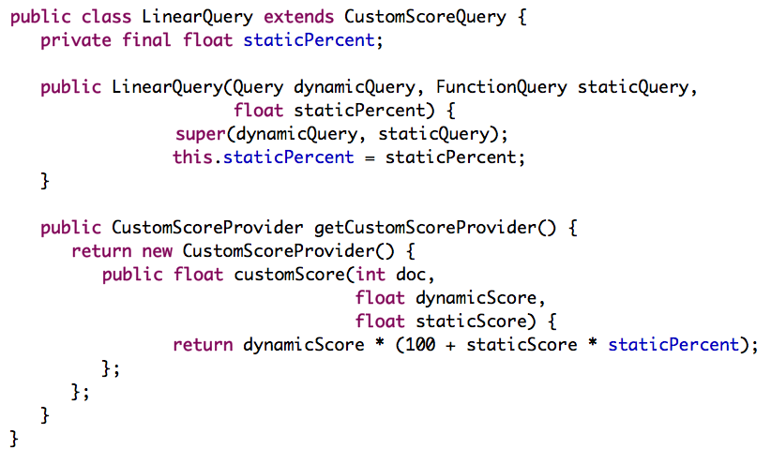
LinearQuery

Slide 27
Static Rank
PubDate
Static Rank
System
IsNews
Static Score
MediaType
TextBody
Query

Slide 28
Static Rank
PubDate
Static Rank
System
IsNews
Static Score
MediaType
Extend solr.ValueSource/Parser
TextBody
Query

Slide 29
Static Rank
PubDate
Static Rank
System
IsNews
Static Score
MediaType
Extend solr.ValueSource/Parser
Uses field cache for inputs
TextBody
Query

Slide 30
Static Rank
PubDate
Static Rank
System
IsNews
Static Score
MediaType
Extend solr.ValueSource/Parser
Uses field cache for inputs
Extremely fast
TextBody
Query

Slide 31
Static Rank
PubDate
IsNews
MediaType

Slide 32
Static Rank
AgoValueSource
PubDate
years
ago
IsNews
MediaType

Slide 33
Static Rank
AgoValueSource
MuxValueSource
PubDate
years
ago
T
years
ago
0
F
IsNews
MediaType

Slide 34
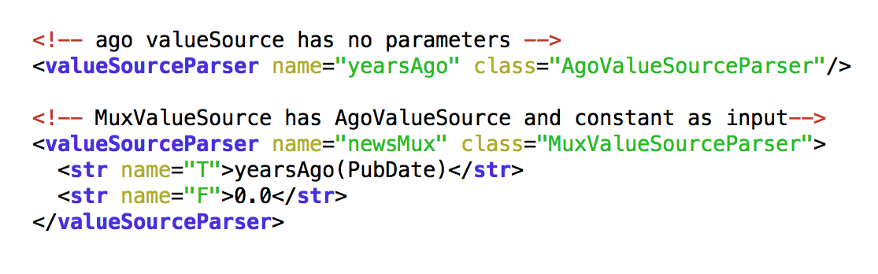
MuxValueSource Config

Slide 35
Static Rank
AgoValueSource
MuxValueSource
PubDate
years
ago
T
years
ago
0
F
IsNews
EnumValueSource
MediaType

Slide 36
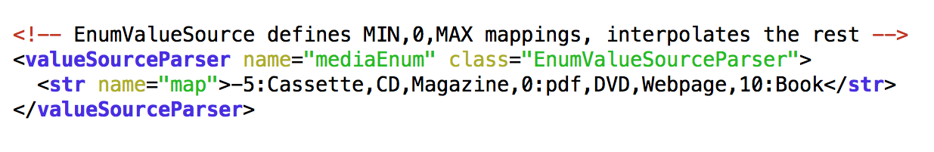
EnumValueSource Config
Maps Fixed-Vocabulary to YEARS AGO
A hierarchy and 3 values: MIN,0,MAX
All things equal (dynamically), DVD = +3.3 years

Slide 37
Static Rank
AgoValueSource
MuxValueSource
PubDate
years
ago
T
SumValueSource
years
ago
0
F
years
ago
1
IsNews
?
-1
EnumValueSource
MediaType
years
ago

Slide 38
Mapping YearsAgo to -1.0 – 1.0
Step Function: if > 10 years-ago = -1, else = +1
1 parameter
Too abrupt

Slide 39
Mapping YearsAgo to -1.0 – 1.0
Step Function: if > 10 years-ago = -1, else = +1
1 parameter
Too abrupt
Linear
No parameters (fixed)
Too gradual over 2000+ years

Slide 40
Mapping YearsAgo to -1.0 – 1.0
Step Function: if > 10 years-ago = -1, else = +1
1 parameter
Too abrupt
Linear
No parameters (fixed)
Too gradual over 2000+ years
Sigmoid
2 parameters
Smooth over entire range
Easy to calculate

Slide 41
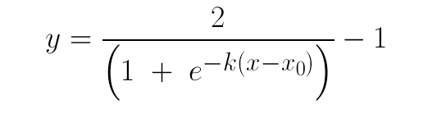
Sigmoid
Slope

Slide 42
Sigmoid
Slope
x-intercept (year)

Slide 43
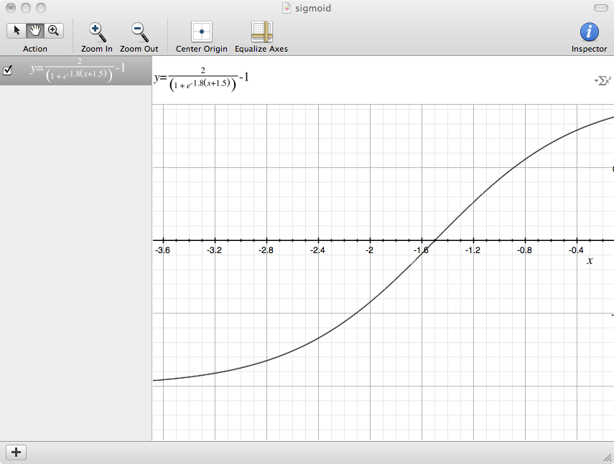
1.0
x0 = 1.5 years ago
Years-ago
-1.0

Slide 44
Static Rank
AgoValueSource
MuxValueSource
PubDate
years
ago
T
SumValueSource
years
ago
0
F
1
IsNews
-1
EnumValueSource
MediaType
years
ago
SigmoidValueSource

Slide 45
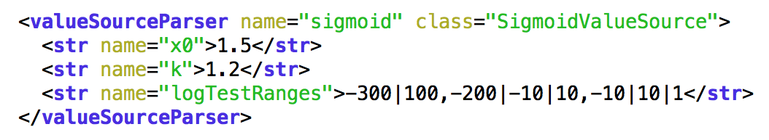
SigmoidValueSource Config

Slide 46
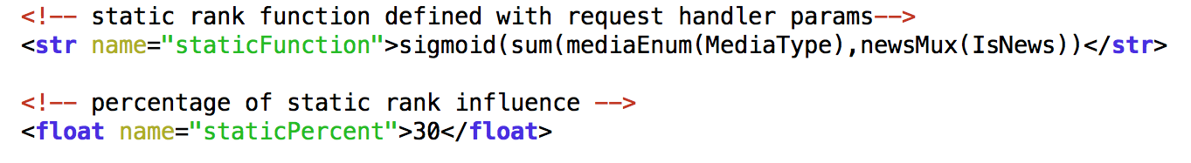
Static Rank Config

Slide 47
Conclusion
solr.ValueSource/Parser - fast and flexible

Slide 48
Conclusion
solr.ValueSource/Parser - fast and flexible
CScore = DScore * (100 + S% * SScore)
-1.0 < SScore < 1.0

Slide 49
Conclusion
solr.ValueSource/Parser - fast and flexible
CScore = DScore * (100 + S% * SScore)
-1.0 < SScore < 1.0
“Time” as a common currency for static features

