Slide 1
All Tiled Up
Mike Graves
MIT Libraries
mgraves@mit.edu

Slide 2
71

Slide 3
c. 200 BC

Slide 4
Spoiler Alert!
The world is round.

Slide 5
Spherical Mercator
Web Mercator
EPSG 900913
EPSG 3785
EPSG 3857

Slide 6
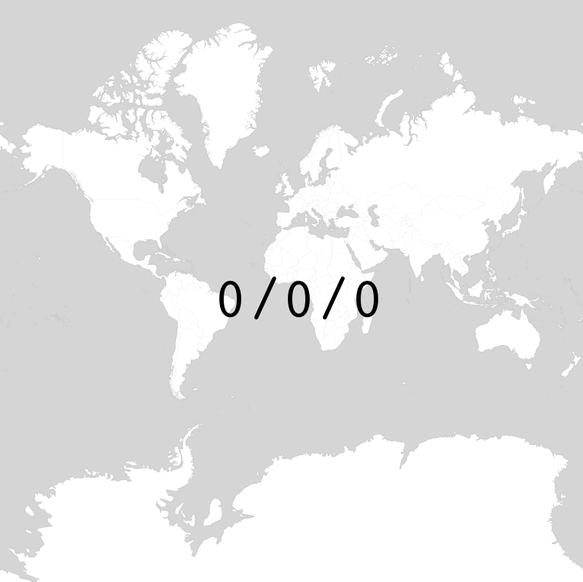

Slide 7
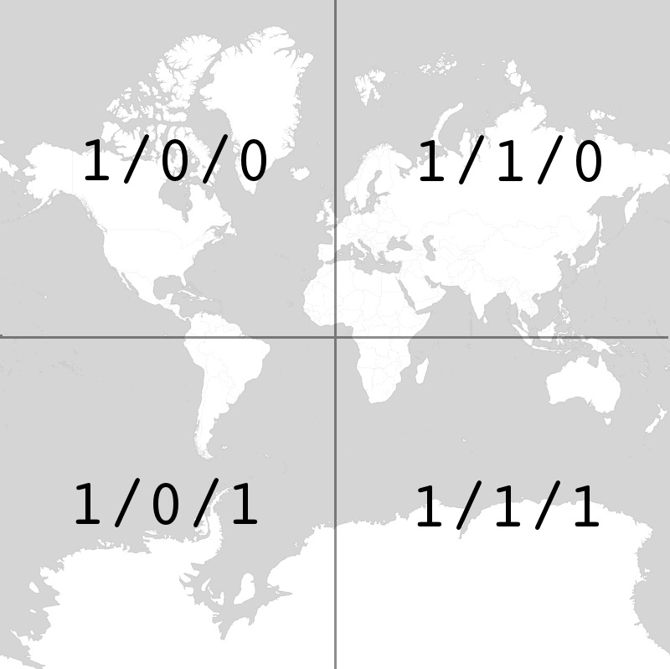

Slide 8
Web GIS Stack
Tile Cache
OGC Endpoint
Geodatabase

Slide 9
MBTiles
https://github.com/mapbox/mbtiles-spec

Slide 10
metadata
name
value
tiles
zoom_level
tile_column
tile_row
tile_data

Slide 11
TileMill
https://github.com/mapbox/tilemill

Slide 12
Leaflet
var map = L.map('map').setView([35.81, -78.64], 1);
L.tileLayer('http://example.com/mymap/{z}/{x}/{y}.png', {
tms: true
}).addTo(map);

Slide 13
https://github.com/mapbox/mbtiles-spec/wiki/Implementations#others

Slide 14
The Dre Gambit (™)
/var/www/mymap/1/0/0.png
/var/www/mymap/1/0/1.png
/var/www/mymap/1/1/0.png
/var/www/mymap/1/1/1.png

Slide 15
tl;dr
Load your georectified map into TileMill
Export to MBTiles
Make your tiles accessible on the Web
Point your web mapping library at your tiles

Slide 16
vector data

Slide 17
lots of data

Slide 18
changing data

Slide 19
We Want Your Data
(in a totally constitutionally legal way)

