Slide 1
De-sucking the Library User Experience
Jeremy Prevost
Galter Health Sciences Library
Presented at Code4Lib 2013
Notes:
Disclaimer: all opinions expressed are my own and should not be blamed on my institution.

Slide 2

Libraries hate library users
http://www.flickr.com/photos/smemon/5683562879/

Slide 3
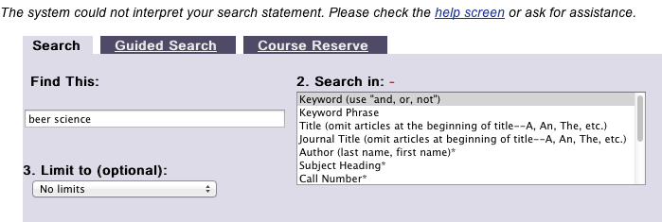
If we didn't...
our websites wouldn't suck!
Notes:
“The system could not interpret your search statement. Please check the help screen or ask for assistance.”
To a user, this just plain sucks.
If you at least kinda think some of your users are okay and all...

Slide 4
De-suck the Library User Experience!
Notes:
I’m going to show some examples of how we’ve improved our user experience by creating an integrated website using vendor supplied APIs where possible.

Slide 5

Northwestern vs Northwestern
http://www.imdb.com/title/tt0137523/
Notes:
The examples I’ll be using compare the user experience of two different ways of accessing the same information and services at Northwestern.
One uses vendor supplied interfaces that have been customized in a traditional sense. (logos, wording, etc)
The other is a completely custom interface using vendor supplied APIs.
No disrespect intended to those who’s hard work has gone into configuring and maintaining the examples I poke fun at. I’m really placing most of the blame on the vendors.

Slide 6
Discovery!

Slide 7
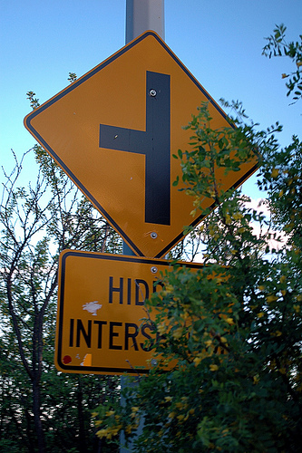
Discovery!
If a user can't find it…
why do you own it?
http://www.flickr.com/photos/sahlgoode/4639229188/
Notes:
We spend a lot of money to acquire access rights for content.
Make it easy to find.

Slide 8
Discovery!
Good
It’s works like Google
Bad
You need to know how it works to make it work
You need to already know what you have in order to find it
Notes:
Google: you type stuff, you get results… usually pretty darn good results
Bad: if you need to know the source was a MARC record and what that means and how the frontend system would work because of that, that’s bad.
Bad: If you can only find known items and can’t discover new content, that’s bad.

Slide 9
Discovery!
Live examples:
We want a book about the science of beer making.
Ex Libris Voyager
vs
Ex Libris Primo
Skip
Notes:
I’m not a shill. If I had an actual say in the discussion, we’d be using open source products and not paying Ex Libris another dime for either of these.
This search was also used specifically because it points out the problem with traditional searching vs modern discovery.

Slide 10
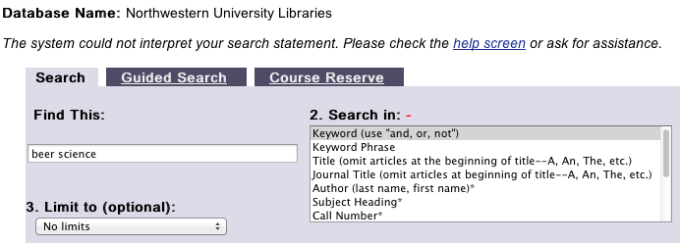
Discovery!
Attempt 1: search for beer science
Notes:
The system could not interpret your search statement.

Slide 11
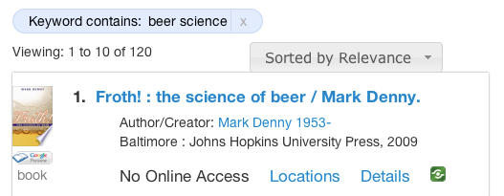
Discovery!
Attempt 1: search for beer science
Notes:
That seems like a better result. The user of the modern search solution is probably done. The traditional catalog searcher is not.

Slide 12
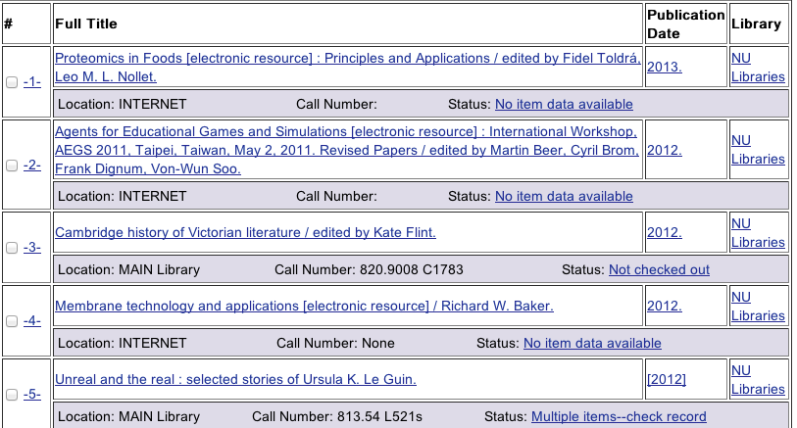
Discovery!
Attempt 2: search for beer AND science
Notes:
Uh… nope. I got results, but they are not what I want at all.

Slide 13
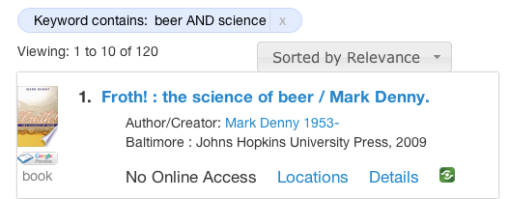
Discovery!
Attempt 2: search for beer AND science
Notes:
Still works… let’s give the traditional user another shot though.

Slide 14
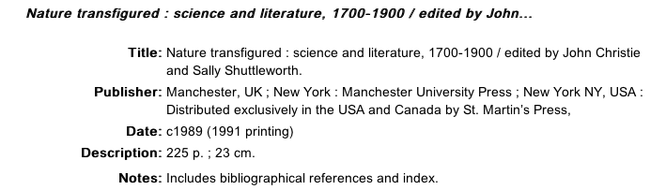
Discovery!
Attempt 3: keyword phrase for beer science
Notes:
Argh! Just one more try. We’ll get it. We promise!

Slide 15
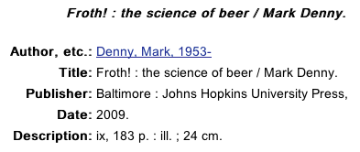
Discovery!
Attempt 4: keyword phrase for science of beer
Notes:
Woohoo!

Slide 16
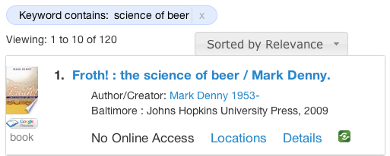
Discovery!
Attempt 4: keyword phrase for science of beer
Notes:
And just to confirm that search also works on the modern platform.

Slide 17
Discovery!
De-sucked!
Notes:
NOTE: there is a bug in the version of Primo we are running that make the ! Screw up a direct title search for this item. That has been fixed in a patch we have not yet applied... So if you DO know the exact item for this ONE instance the traditional catalog does win.

Slide 18
Get it!

Slide 19

Get it!
Okay, I found something…
http://www.meh.ro/wp-content/uploads/2010/11/meh.ro5772.jpg
…now may I please have it?
Skip

Slide 20
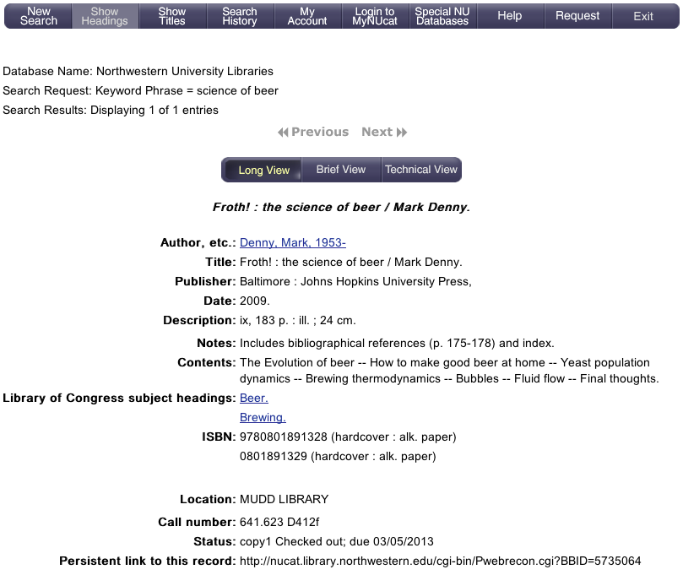
Get it!
Notes:
The link is hidden in the main navigation of the page rather than near the availability status of the item.

Slide 21
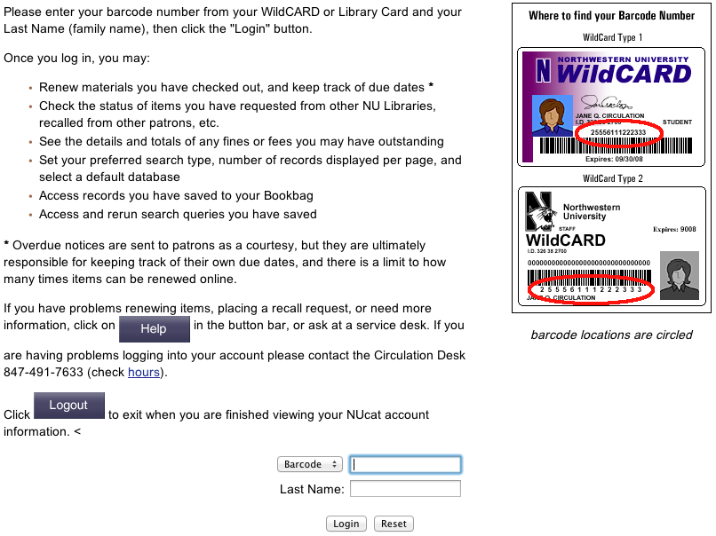
Get it!
Notes:
That’s a lot of information I’m unlikely to read.
The barcode needs an additional graphical explanation in order to be used… which might be a hint it’s not user friendly.
Let's assume we read that and can find our id and type medium long strings of numbers.
Super not secure.
Two pieces of information that any library staff (or anyone that finds your id) can view.

Slide 22
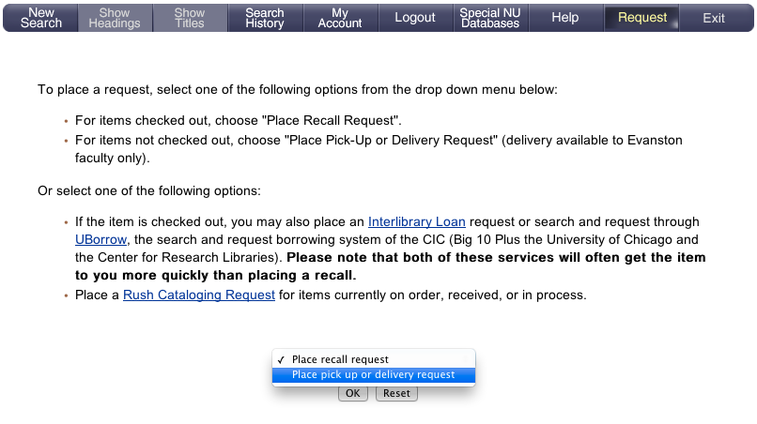
Get it!
Notes:
More directions.
But I just want to pick it up, so that’s what I’ll choose.

Slide 23
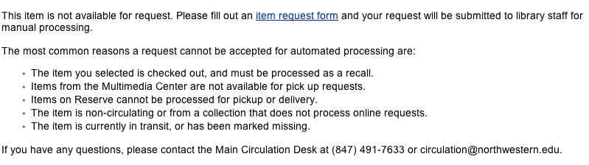
Get it!
Notes:
Did that work? I guess… there’s lots of text but there has been on every page since I started this process.
No alert tells me it didn’t work, but if I actually read the text, it tells me it didn’t work and lists reasons why maybe it didn’t work rather than specifically why it didn’t. It’s checked out and I can’t put in a pickup request for a recalled item because for some reason that’s the end users responsibility to figure out.
Lots more information that basically tells the user that the options on the previous screen were not valid. Yay?
If we had chosen recall it would have worked of course…. But why why there an option that wasn’t valid for the current situation? Lazy coders.

Slide 24
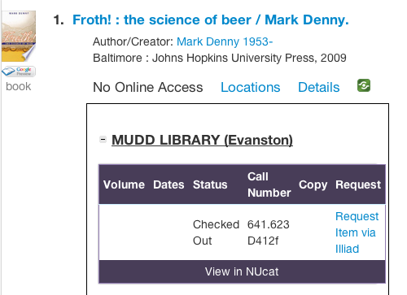
Get it!
Notes:
No option to pick up because we don't hate our users.
No option to recall because we don't hate the user that already has it either.
Request via Illiad... this is our preferred method of obtaining checked out items for users as it's generally as quick as a recall and both users get what they want.

Slide 25
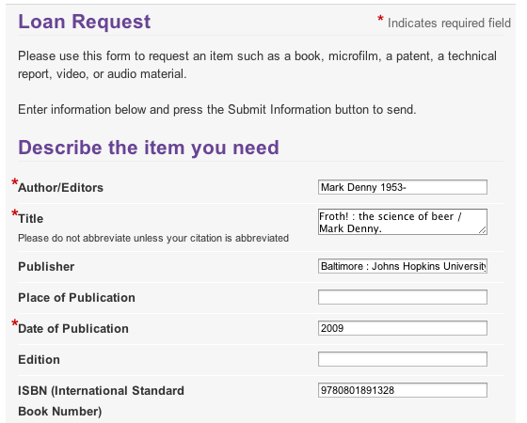
Get it!
Notes:
Request via Illiad... this is our preferred method of obtaining checked out items for users as it's generally as quick as a recall and both users get what they want.
Click the link. Pre-populated form.
De-suck success for checked out item.

Slide 26
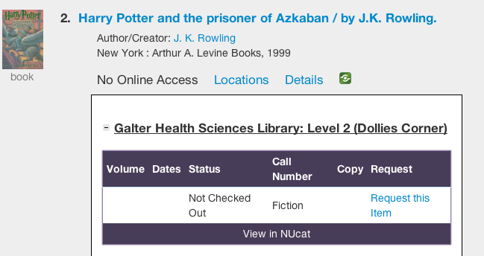
Get it!
Notes:
Two clicks to request the item.

Slide 27
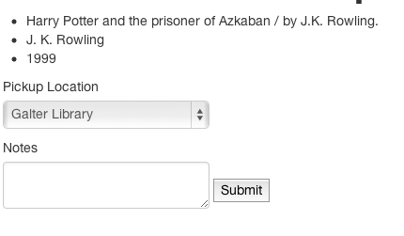
Get it!
Notes:
No problems with finding our barcode. (We store that locally when a patron registers with our site... we cheat a bit there... but registration is one form
now too and the barcode is pulled based on some LDAP queries on the user's NetID to find the EmplID/StudentID which then queries Voyager to get the barcode).
De-suck success for available items.
Quick note: the traditional vendor supplied interface requires the user to re-type the barcode again if we tried to get that same item. Super suck!

Slide 28
Renew It!
Notes:
We integrated renewals as well. I won’t show that as other than the barcode/lastname shenanigans the vendor supplied solution isn’t horrible and we’ve got limited time.

Slide 29
Consistency!

Slide 30
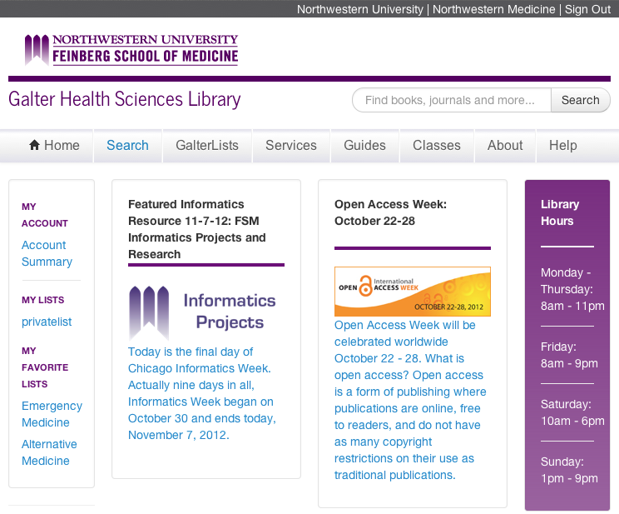
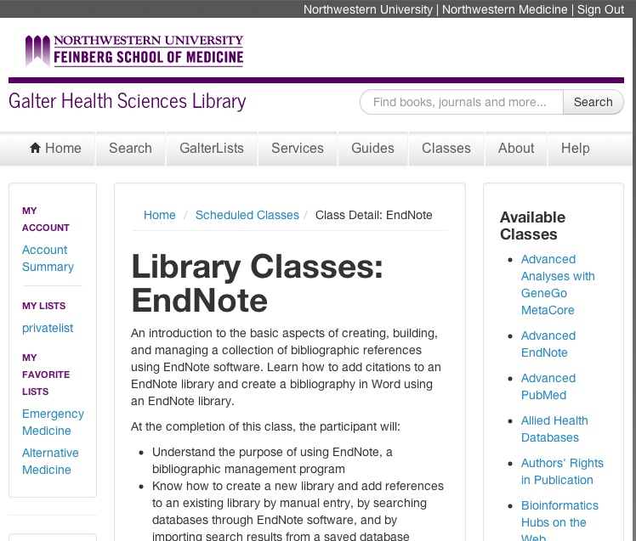
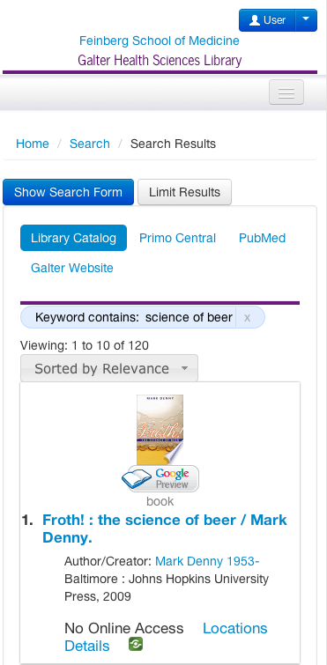
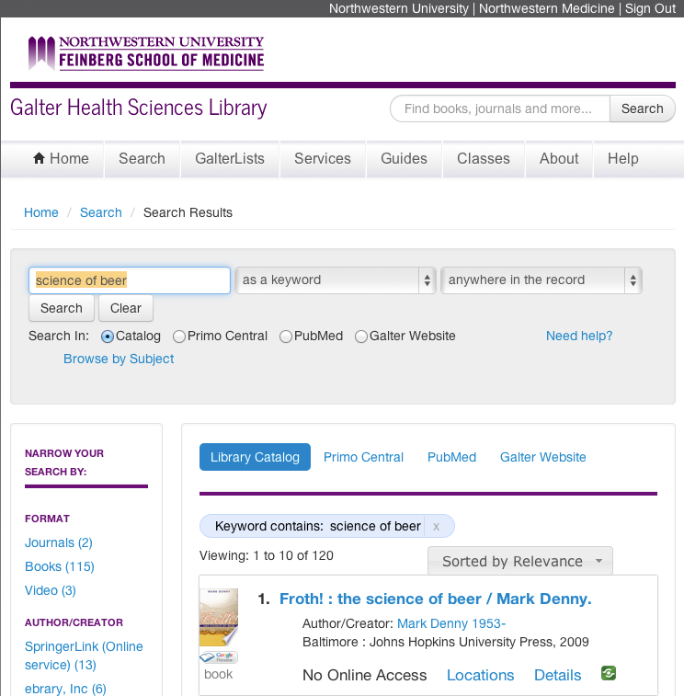

Consistency!
Notes:
Why is our renewal better if the old one wasn’t horrible?
We have a single website that integrates discovery, account information (renewals / requests), guides, and our custom lists of resources users can manage themselves.
Clockwise from top left: Home, class description/sign up, mobile discovery, discovery, guides… not shown: lists, user accounts, more…
This integration is important for a consistent user experience. Amazon Electronics isn’t a different interface and account than Amazon Books.

Slide 31
Mobile!

Slide 32
Mobile!
  87% of adults have cell phones
  55% access the internet via cell
  31% of current cell internet users mostly go online via cell
  That works out to 17% of all adult cell owners who are “cell-mostly internet users”
  Source: http://pewinternet.org/Commentary/2012/February/Pew-Internet-Mobile.aspx
Notes:
Mobile is growing. User expectations for mobile are getting higher. Libraries don’t need apps. They just need mobile interfaces.

Slide 33
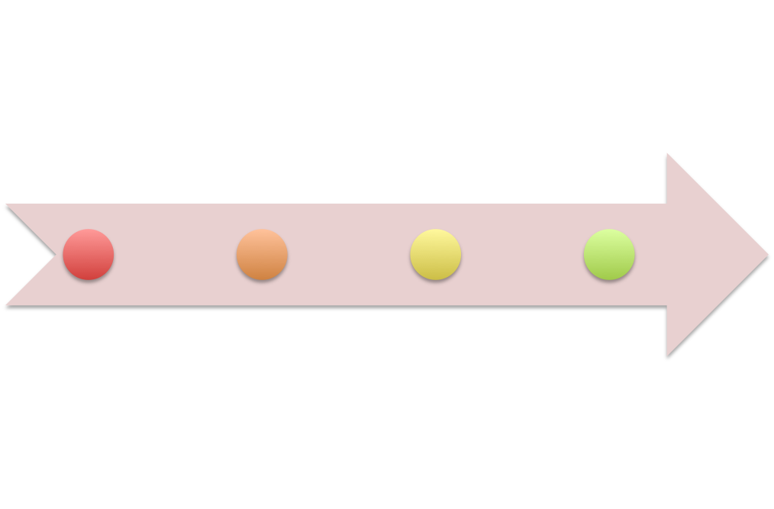
Mobile!
1999 – 2007: No mobile
April 2010: jQuery Mobile
June 29, 2007: iPhone
March 2013: Responsive Design
Notes:
1999-2007: Philosophy: if we just ignore it, it'll solve itself.
iOS: solved mobile!
fixes mobile with no work at all (assuming pinch and zoom was acceptable)
Alas, eventually pinch and zoom was no longer acceptable.
jQuery Mobile: Good enough. New views for our app, but all business logic (model, controllers) was the same.
Two things:
1. Updating two views every time functionality changed sucked and we sucked at doing it.
2. jQuery Mobile isn't awesome on tablets… and tablet usage is non-trivial.
Responsive: One view to rule them all and in the media query bind them.
Bootstrap. Still in progress, but it's what we've been seeing for all of the demos as a few of these features are not live yet.
Again, we reused our exisiting model and controller and are just replacing the views. MVC is really great for website development.
Optimized for desktop, 10" tablets, 7" tablets, phones. Additional media queries would allow for targeting new format devices.

Slide 34

Libraries hate library users
Libraries don’t hate library users! ! ! !
Image source: http://stuffpoint.com/facebook/image/162779/facebook-like-button-picture/
Notes:
... so let's keep de-sucking the library user experience.
Make your sites something you personally actually enjoy using as a good start.

Slide 35
Thanks!
Jeremy Prevost
  j-prevost@northwestern.edu

