Slide 1
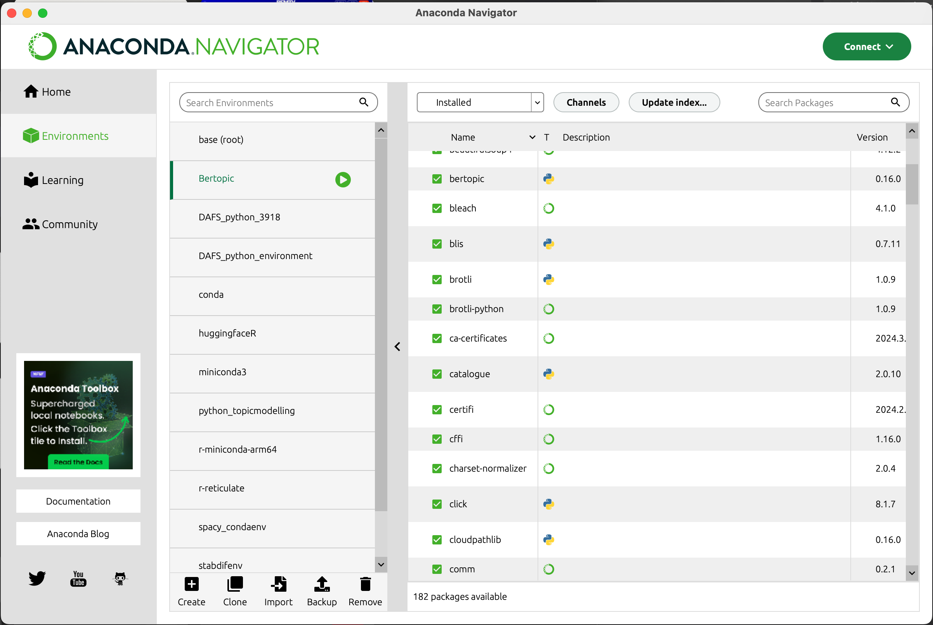
These are existing environments.
1. Click here to see the existing environments
These are packages installed in the enviroment
2. Click here to create a new environment

