Slide 2
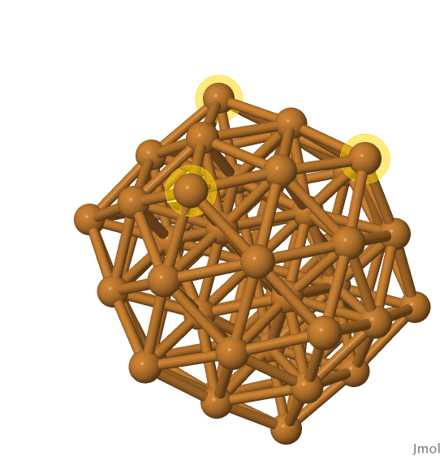
C
xy-plane
B
A

Slide 3
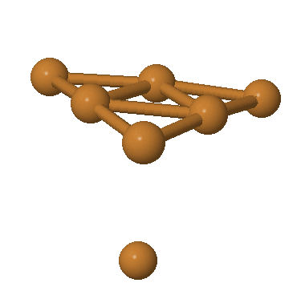
B
A
xz-plane

Slide 4
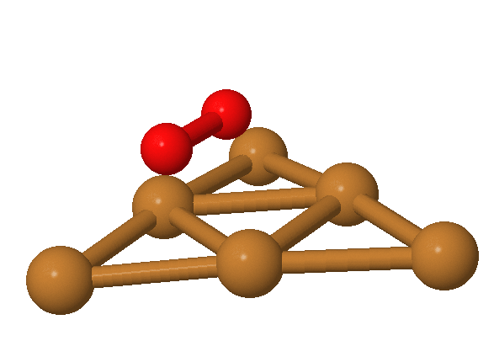
(2.30, 1.72, 1.60)
(1.54, 0.45, 1.60)
(0, 0, 0)

