Slide 1


The Effects of “Sign in” Button Location and Color on Online Shopping Platforms
Chun Zhou
Weijia Suo
Yuxuan Mei
Ji Qi
Qianru Ai

Slide 2
Table of Contents
01
Prior Research
05
Analysis
02
Introduction
06
Limitations
03
Experiment Design
07
Conclusions
04
Balance Check
08
Bibliography

Slide 3

01
Prior Research

Slide 4
01
Prior Research
E-commerce industry is growing fast
E-commerce enterprises like Amazon, Alibaba and Ebay “receive valuations two to four times higher … than companies with other business models. ” (Libert, Wind, and Fenley 2014)
2020 Covid 19 period drives E-commerce growth even more. Amazon’s founder Jeff Bezos was ranked as the second richest in the world. (Forbes)

Slide 5
01
Prior Research
Website button design affects membership generated revenue
Most online shopping platform firms generate revenue from three sources: pay-per-click search advertising, pay-per-impression display advertising and membership fees (Ju-Yeon, Eric and Jisu 2018)
Membership tier has a positive effect n content generating, review rating and review delay, hence improve customer experience. (Dongpu, Yili and Kanliang 2018)
Shopping website button design is crucial for membership tier and user sign in. The effects of button design characteristics (button size, button spacing, visual feedback and button shape) on users’ performance, mental workload and preference (Da, Juan, and Shuang 2018).

Slide 6
02
Introduction

Slide 7
02
Research Introduction
Research Question
Hypothesis
Implications
Does position and color of the sign in button affect users’ performance
Placing the sign in button at the center of the screen with bright color will optimize users’ time spent to locate button
Useful to e-commerce business, consumers, scholars, stakeholders and investors to generate membership related revenue and provide better service.

Slide 8
About Experiment
03
About our method
Created Treatments
Conducted Experiment
Recruited & Randomized Subjects
Posted on social media, texted friends/classmates to randomize 77 volunteers
Create one control and three treatment arms different in location and color
Posted experiment on Amazon Mechanical Turk and collected results for 169 participants
Created Websites
Conducted Pilot
Created a virtual shopping websites for users to fill in personal demographics and click sign in button
Piloted the experiment and made changes to randomization

Slide 9
03
Experiment Design

Slide 10
Control & Treatment
03
Experiment Design
Color
Simple Font
&
Top left
Simple Font
&
Middle Right
Colorful Font
&
Top left
Colorful Font
&
Middle Right
Location
Control
Arm 1
Arm 2
Arm 3

Slide 11
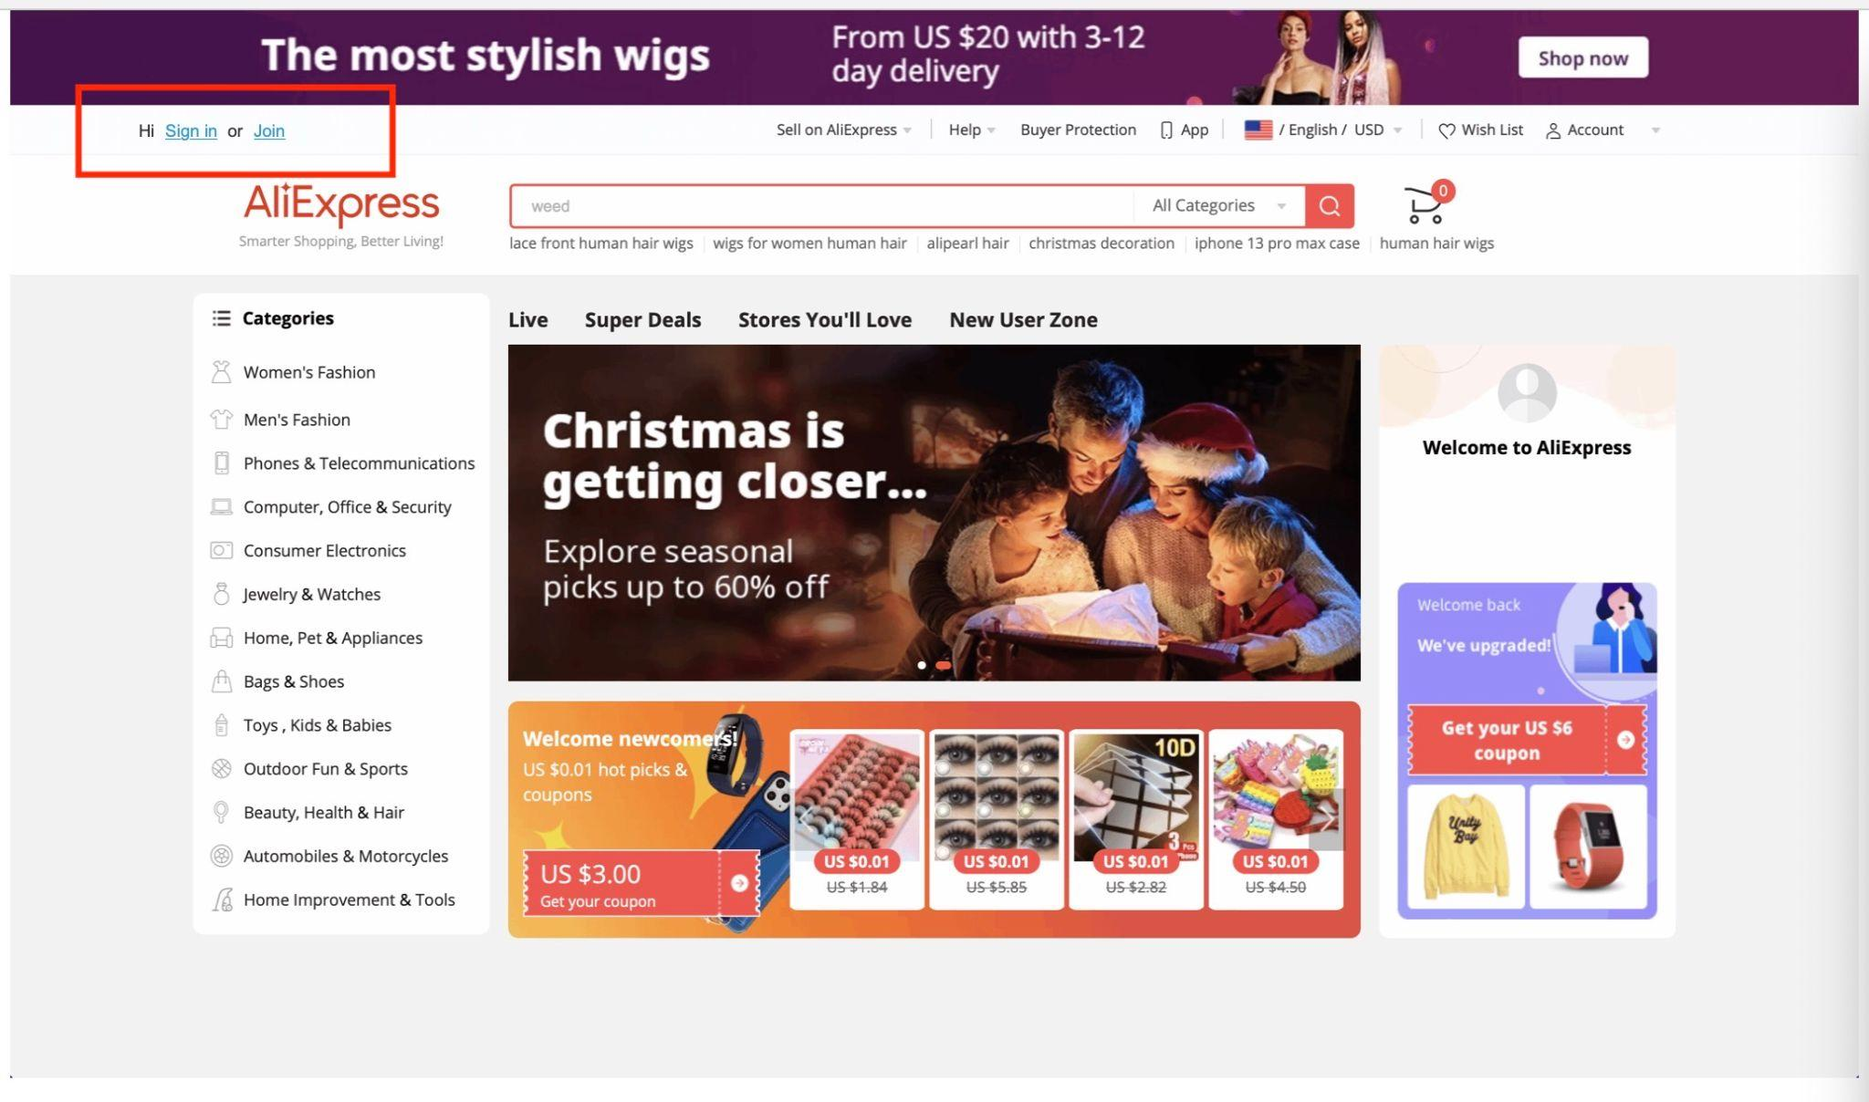
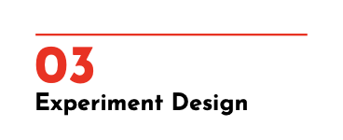
Control

Slide 12
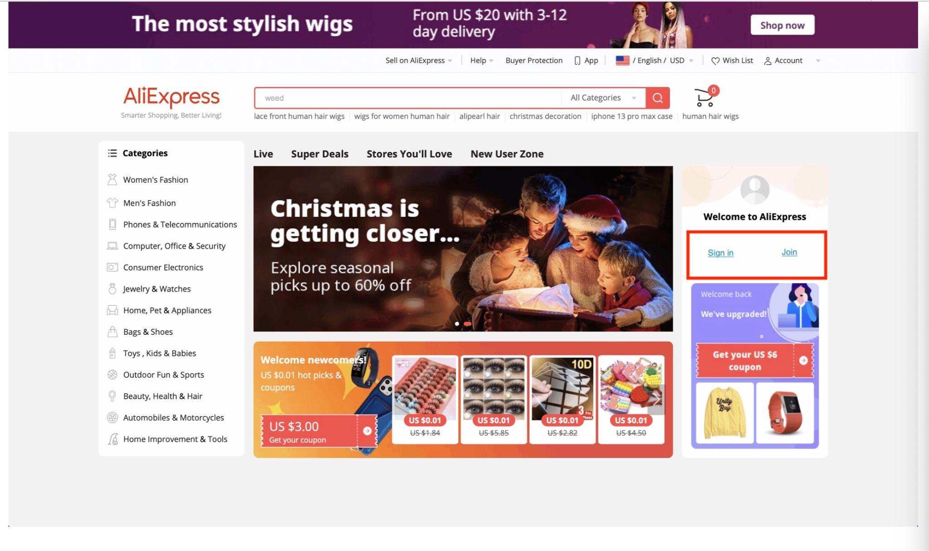
Arm 1

Slide 13
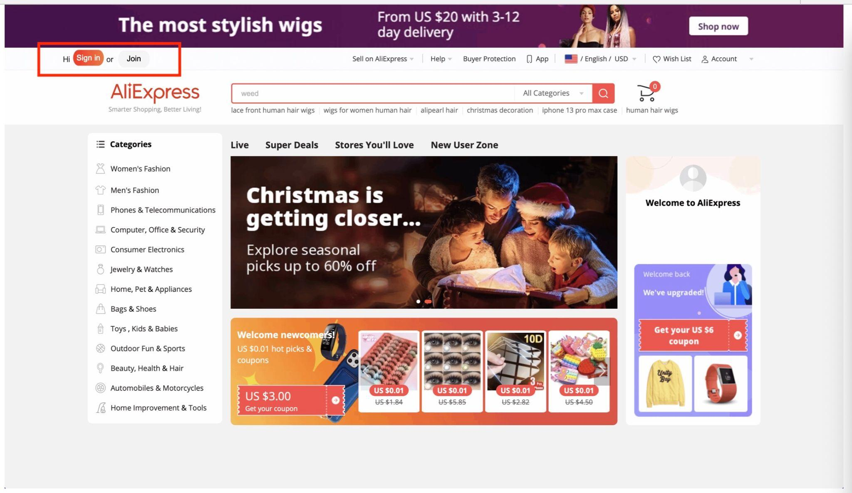
Arm 2

Slide 14
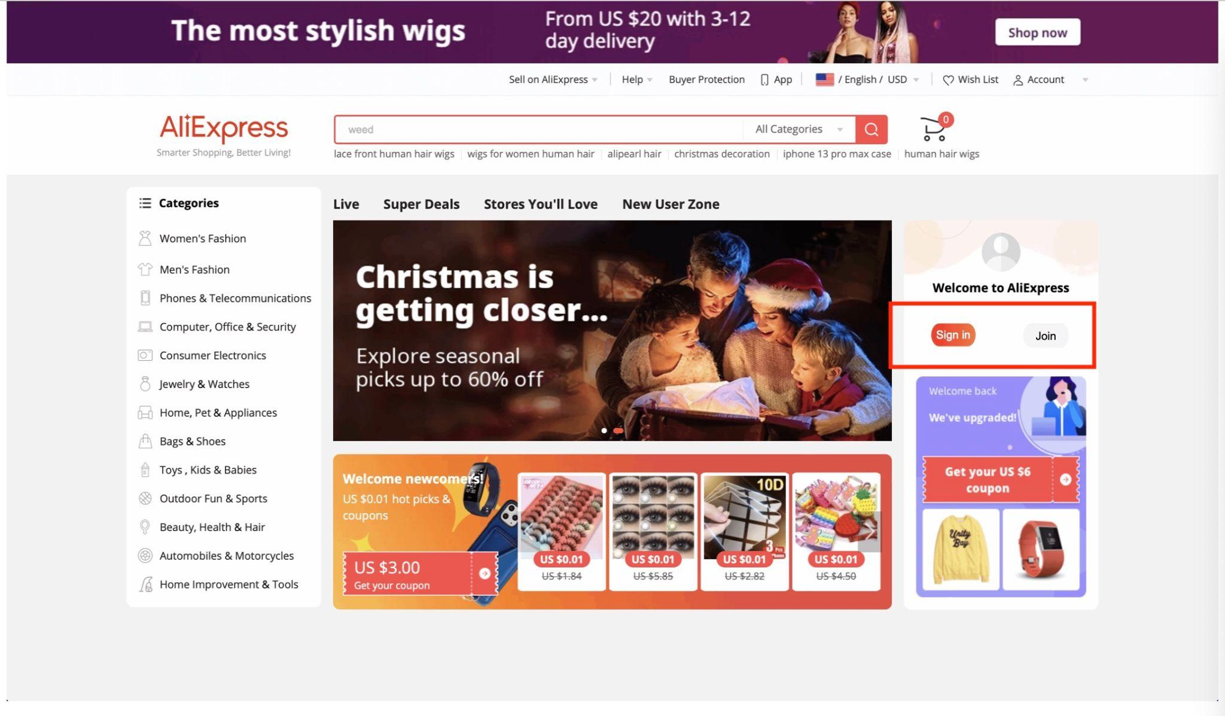
Arm 3

Slide 15
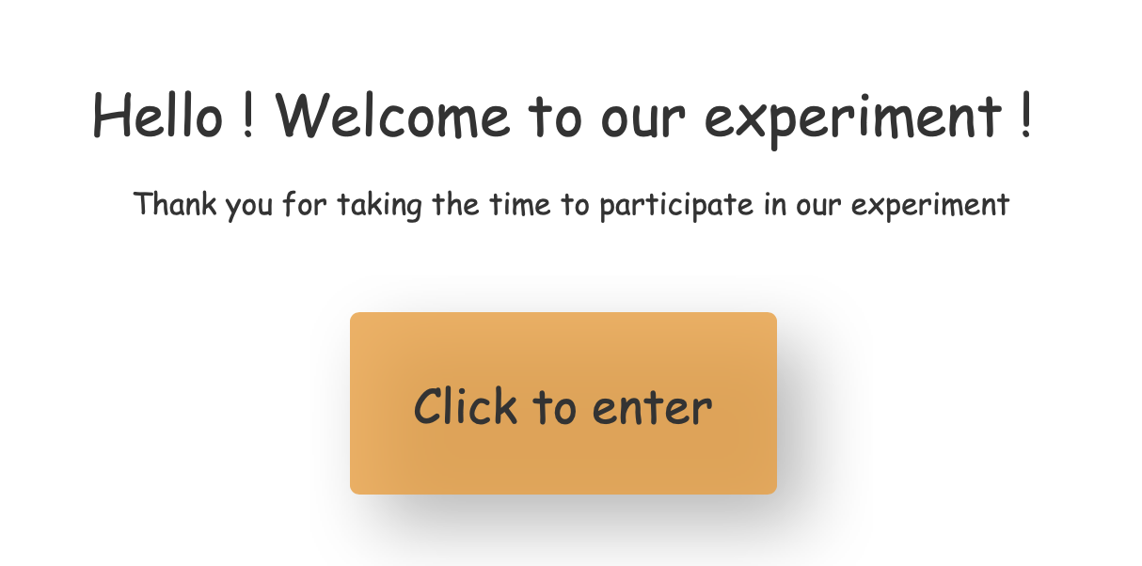
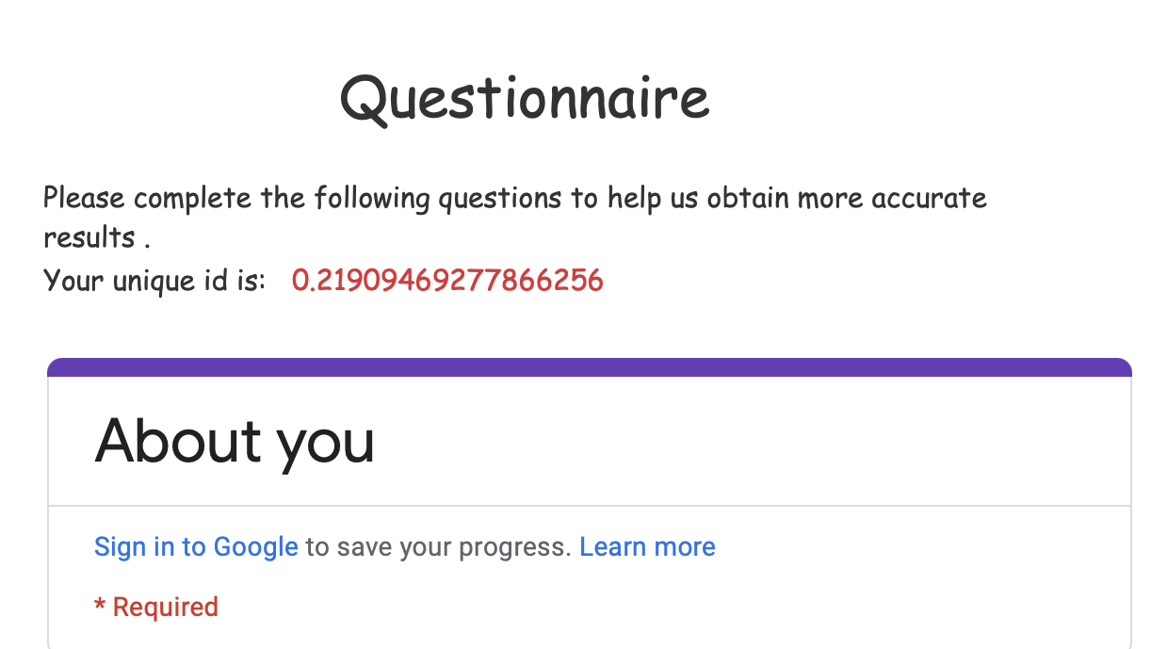
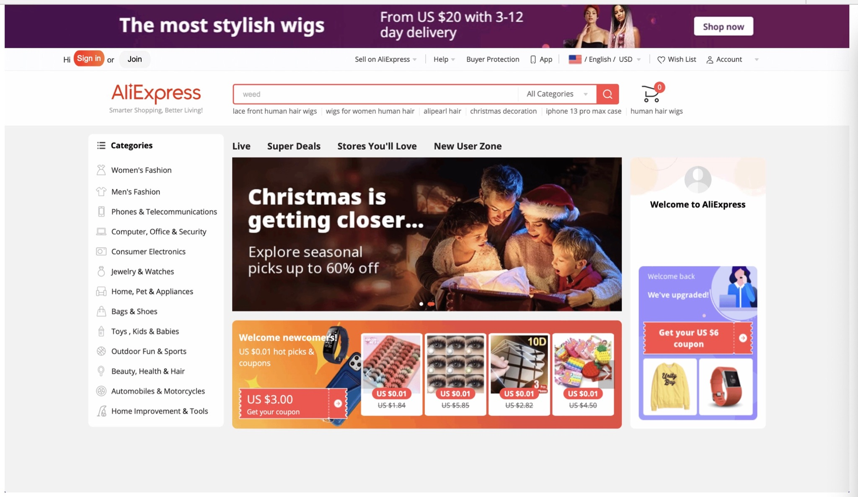
How does it work?
03
Experiment Design
Assign page based on random number
Assign a 17 decimal places random number between 0-1.
The result is used for balance check.
Age group
Gender
Highest degree
Visit shopping websites frequency
Click the signin button and finished the experiment.
Visit time will be recorded.

Slide 16
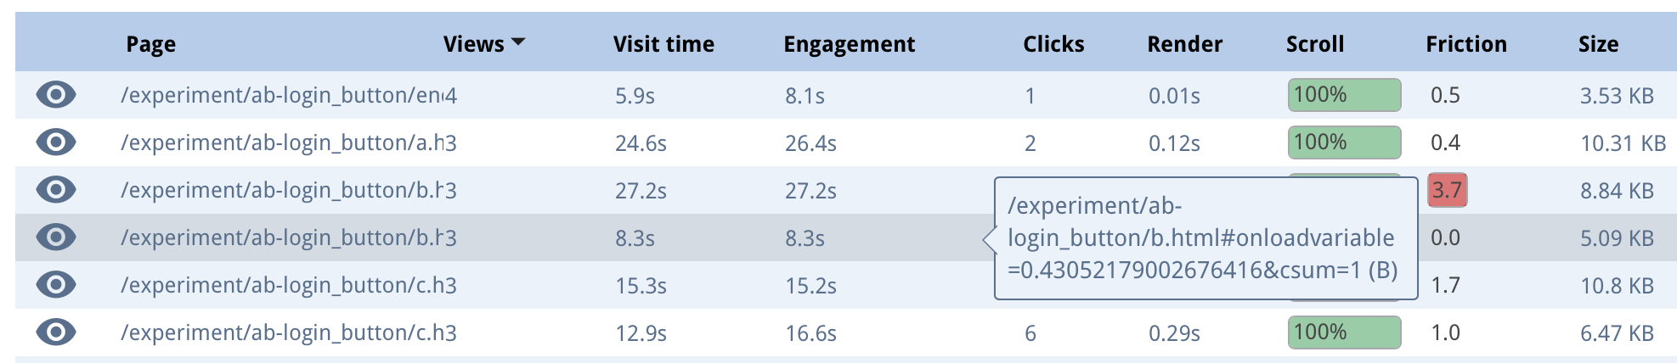
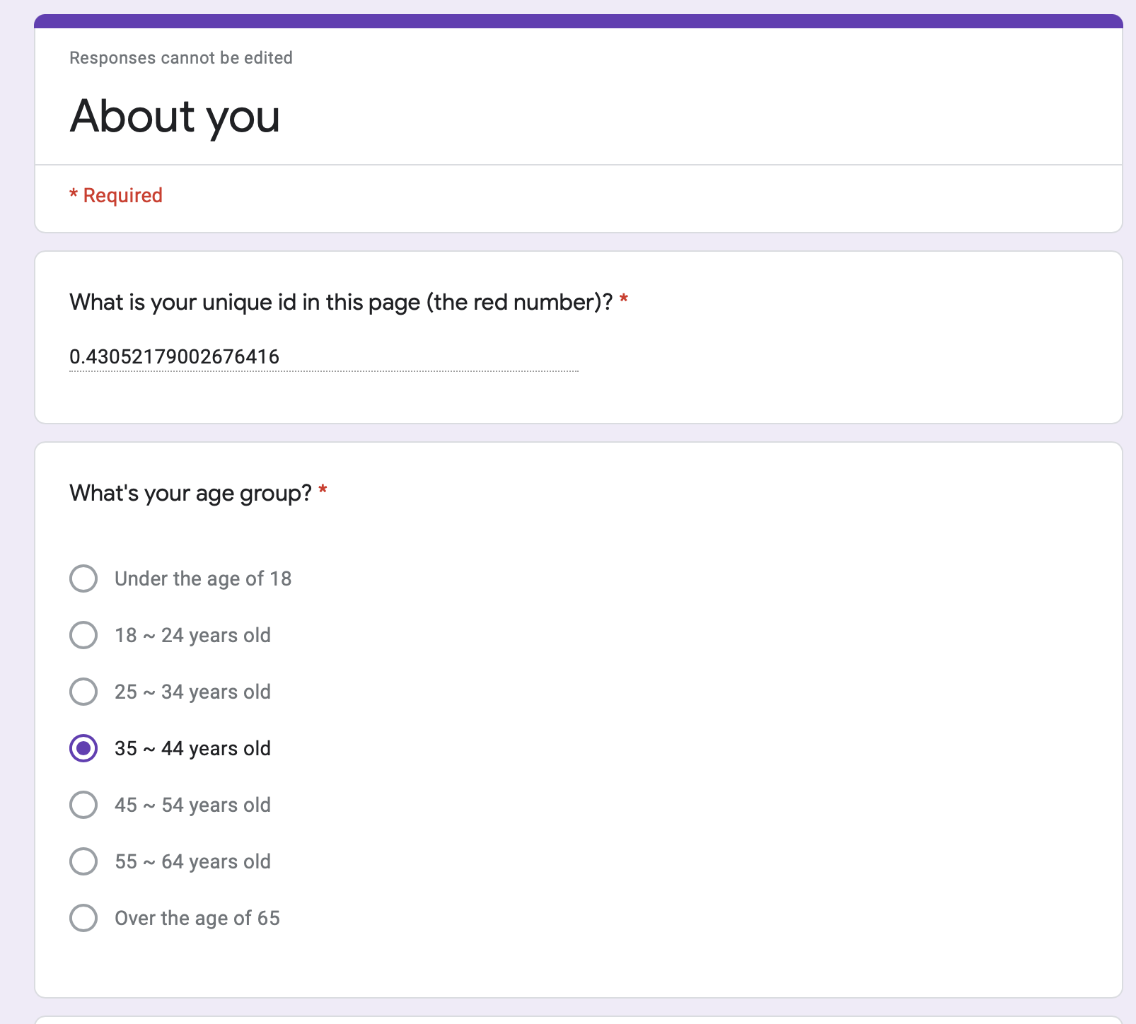
How does it work?
03
Experiment Design
Merge two tables and clean up the data

Slide 17
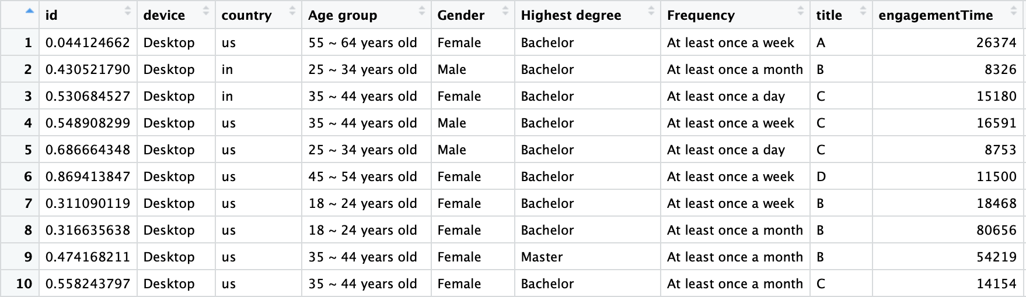
Cleaned Dataset
Balance check
Groups
Outcome
03
Experiment Design

Slide 18
04
Balance Check

Slide 19
04
Balance Check
Prop.test (p = 0.25)
Group | Sample size | p-value
Control | 40 | 0.7559
T1 | 51 | 0.1428
T2 | 30 | 0.0369
T3 | 48 | 0.3510
Total number of observations = 169
E(size) = 42
Reject for Treatment Arm 2
Randomization impacted by uncompleted experiments

Slide 20
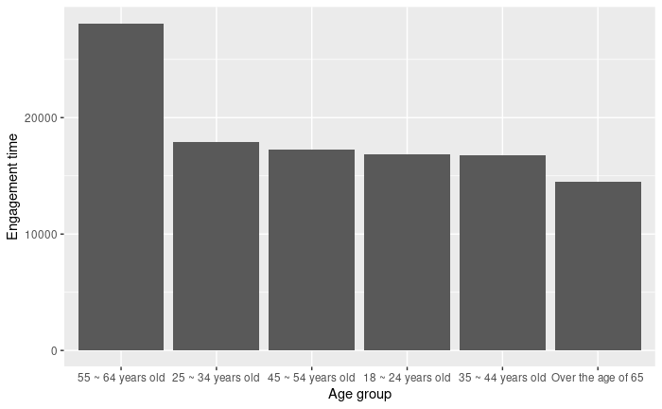
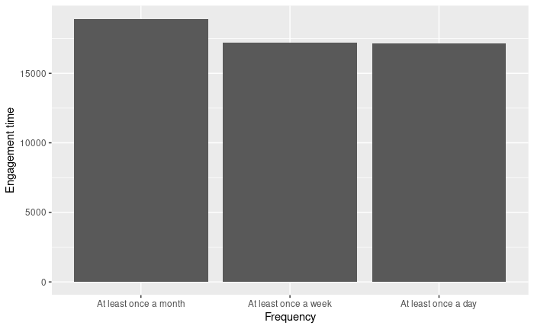
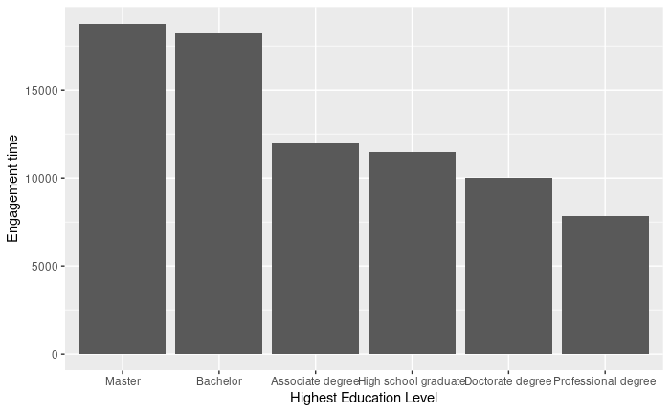
04
Balance Check
Pre-experimentation Characteristic
Educational level
Age
Visiting frequency
Master and Bachelor Degree related with high engagement time
55-64 years old related with high engagement time
Short engagement time by participants over the age of 65 (very surprising)
No obvious correlation

Slide 21
05
Analysis

Slide 22
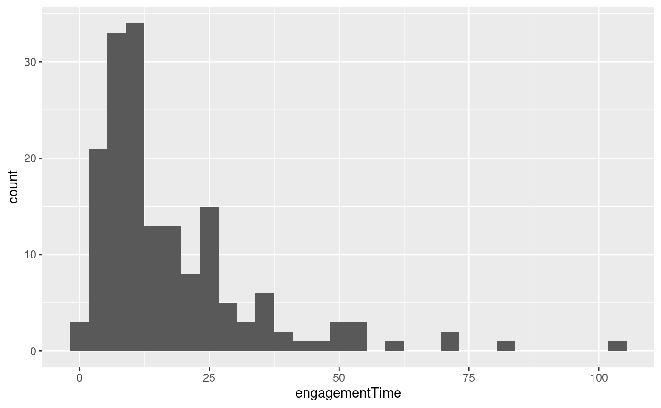
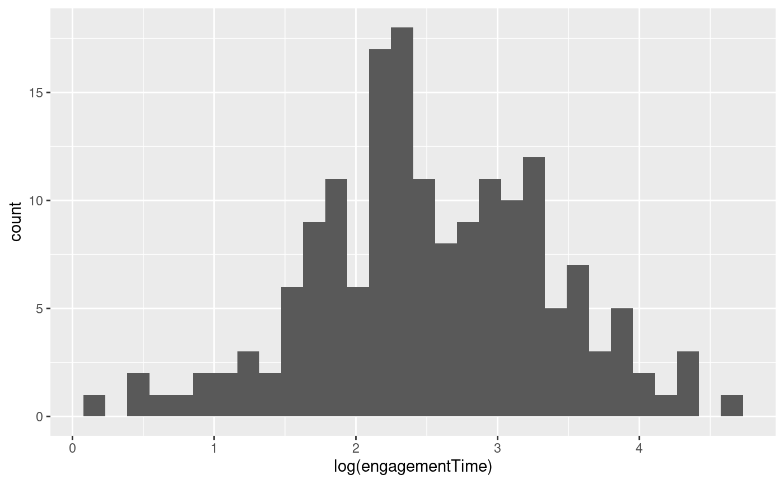
Distribution of Engagement time

Slide 23
Average Treatment Effect
Treatment 1 (right-hand side): increased by 0.778%
Treatment 2 (highlighting the color): decreased by 4.45%
Treatment 3 (both): decreased by 0.539%
P-values > 0.8 (not significant)
Large Standard Error (20X Coefficient)
Predictor | Coefficient | SE | T-Stat | P-Value
(Intercept) | 2.539 | 0.144 | 17.679 | 0.000
Treatment 1 | 0.008 | 0.180 | 0.043 | 0.966
Treatment 2 | -0.044 | 0.210 | -0.212 | 0.832
Treatment 3 | -0.005 | 0.189 | -0.029 | 0.977

Slide 24
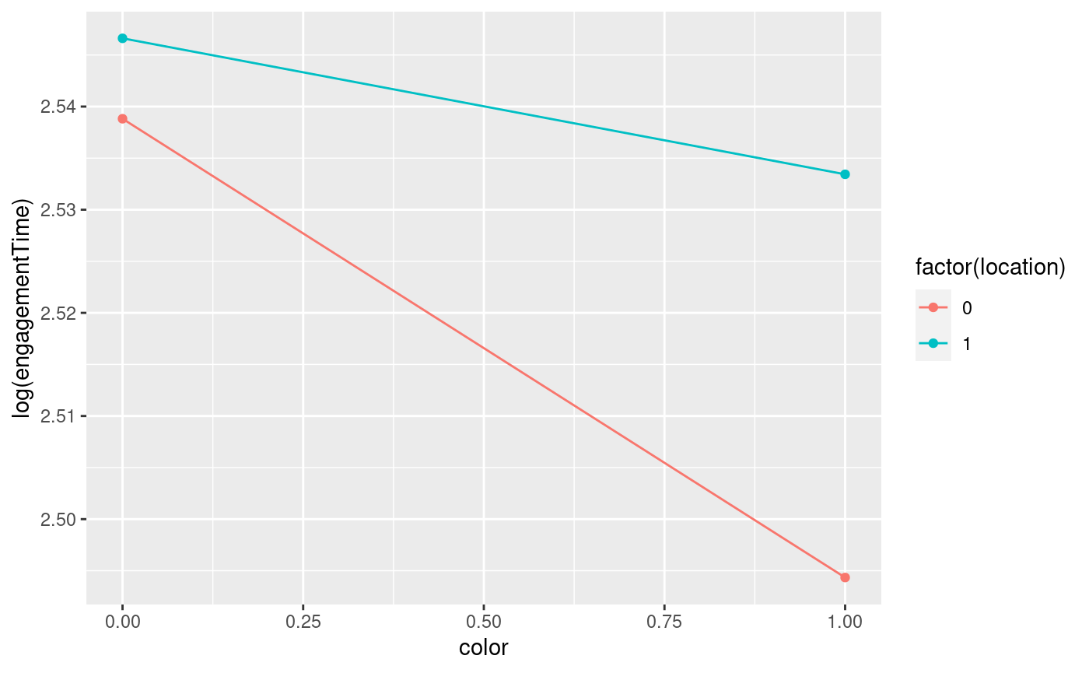
2 X 2 Factorial Design
Factor 1: ‘color’ (1 vs. 0)
Factor 2: ‘location’ (1 vs. 0)
No Interaction effect (roughly parallel lines)
Coefficients of location = arm 1
Coefficients of color = arm 2
Coefficients of color + location +interaction = arm 3
P-values > 0.8 (not significant)
Predictor | Coefficient | SE | T-Stat | P-Value
(Intercept) | 2.539 | 0.144 | 17.679 | 0.000
color | -0.044 | 0.210 | -0.212 | 0.832
location | 0.008 | 0.180 | 0.043 | 0.966
color:location | 0.031 | 0.266 | 0.118 | 0.906

Slide 25
06
Limitation

Slide 26
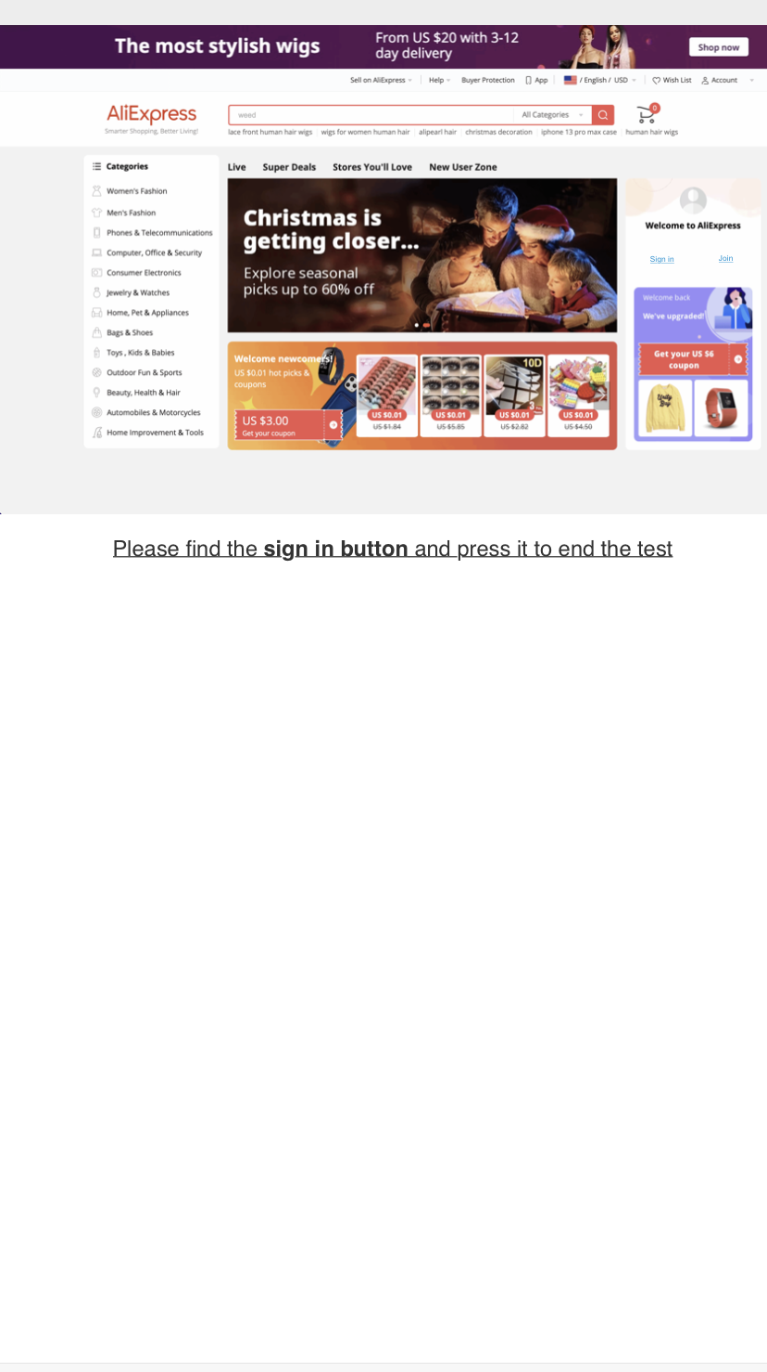
06
Limitation
Predictor | Coefficient | SE | T-Stat | P-Value
Intercept | 2.566 | 0.137 | 69.153 | 0.000
Any Treatment | -0.008 | 0.157 | -0.054 | 0.957
Device (phone/PC) | -0.357 | 0.500 | -0.714 | 0.476
Any Treatment * Device | -0.088 | 0.585 | -0.150 | 0.881
-0.008 - 0.088 = -0.096
Even though the CATE is roughly 0, there are still factors that may allow the use of cell phones to have some impact on the experiment.
The size of website
Inaccurate engagement time

Slide 27
07
Conclusions

Slide 28
07
Conclusion
Results
No significant difference across control and 3 treatment arms
Small sample size
To get Cohen’s D of 0.1, we need 1570 samples
Outcome has high SD
Did not find any useful covariates in our dataset

Slide 29
07
Conclusion
Further Exploration
Collect more data
Enough power - 1570 samples
More information: Coffee, health condition...
Create new treatment arms
Papers about users' web browsing habits

Slide 30
08
Bibliography
Libert, Barry, Yoram (Jerry) Wind and Megan Beck Fenley (2014), What Airbnb,Uber, and Alibaba Have in Common, (accessed July 6, 2015), [available at https://hbr.org/2014/11/what-airbnb-uber-andalibaba- have-in-common]
Ju-Yeon, Eric, Jisu and Robert W. Palmatier, The effect of Online shopping platform strategies on search, display and membership revenues., Journal of Retailing 94 (3,2018) 247-264.
Dongpu, Yili, and Kanliang et.al, Effects of membership tier on user content generation behaviors: evidence from online reviews, Electron Commer Res (2018) 18:457-483.https://doi.org/10.1007/s10660-017-9266-7
Da, Juan, and Shuang et.al, Effects of button design characteristics on performance and perceptions of touch screen use, International Journal of Industrial Ergonomics 64 (2018) 59-68

Slide 31
Thanks!
Do you have any questions?

