Slide 1




IEEE Quantum Week 2023 @ Seattle
A Novel Spatial-Temporal Variational Quantum Circuit to Enable Quantum Deep Learning on NISQ Devices
Jinyang Li, Zhepeng Wang, Zhirui Hu, Prasanna Date, Ang Li, Weiwen Jiang
Notes:
Hello, everyone! Here is the report of our paper A Novel Spatial-Temporal Variational Quantum Circuit to Enable Quantum Deep Learning on NISQ Devices. And I am Jinyang Li from George mason university.

Slide 2
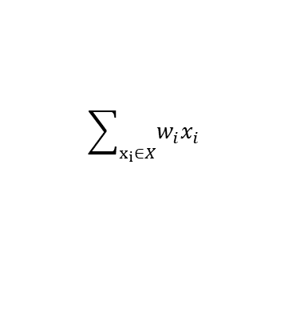
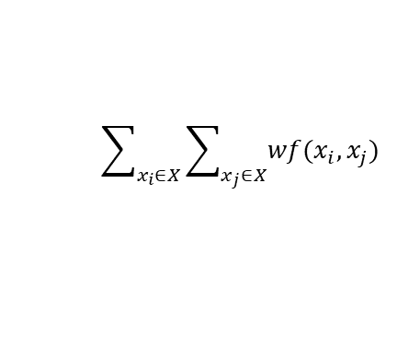
Shallow Learning vs. Deep Learning
X
X
X₁
X₂
X₁
X₂
$$\sum_{x_{i}∈X}{\sum_{x_{j}∈X}{wf(x_{i},x_{j})}}$$
Deep Learning
f represents the possible polynomial terms
$$\sum_{x_{i}∈X}{w_{i}x_{i}}$$
Single Layer Network
Non-linearity is the key to achieve deep learning
[Ref] Nonlinear computation in deep linear networks - OpenAI
Notes:
So, at the beginning, let’s talk a little bit about the shallow learning v.s. deep learning. So the figure on the left is a neural network with multiple layers but no nonlinear functions between layers. So If we have a neural network with no nonlinear activation functions, the entire network essentially becomes a series of linear transformations. This means that regardless of how many layers we have, the whole neural network can be reduced to a single linear transformation. And it can be generally considered as a simple summation of weights times features. While if we look at the right figure, also a neural network with multiple layers, but different thing here is that we have two quadratic nonlinear functions there, and these are the key to deep learning as we can not simply treat it as a single layer network anymore.

Slide 3
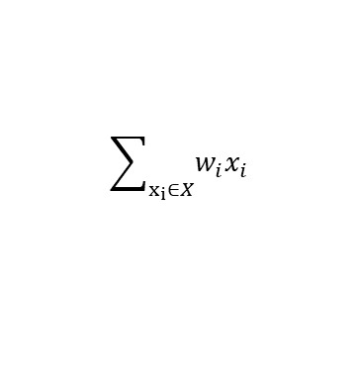
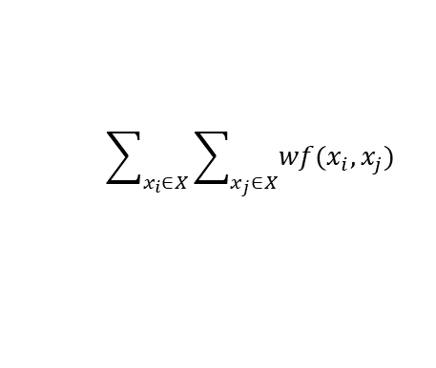
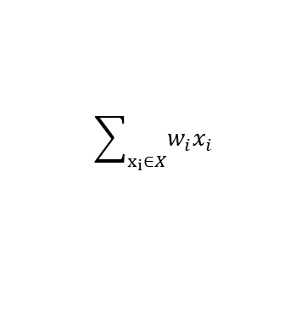
Current Learning on Quantum?
Design1
Design2
Expected Quantum Deep Learning
Amp. Enc.
U(𝜃)
M
Amp. Enc.
U(𝜃)
U(𝜃)
U(𝜃)
M
M
M
M
M
M
M
︖
X₁
X₂
…
X_{i}
X₁
X₂
…
X_{i}
U(𝜃)
U(𝜃)
U(𝜃)
U(𝜃)
$$\sum_{x_{i}∈X}{w_{i}x_{i}}$$
$$\sum_{x_{i}∈X}{w_{i}x_{i}}$$
$$\sum_{x_{i}∈X}{\sum_{x_{j}∈X}{wf(x_{i},x_{j})}}$$
Single Layer Network
Single Layer Network
How to Enable Deep Learning on Quantum?
Notes:
Then, here we can see different designs of quantum neural network, both the design1 and design2 can be treated as the multiplication of the unitary matrix and statevector, While this makes no difference from the previous shallow neural network we talked in the last slide, and they are still just a linear transformation. However, what we really expect is to achieve the quantum deep learning, but how to make it happen still remains unclear.

Slide 4
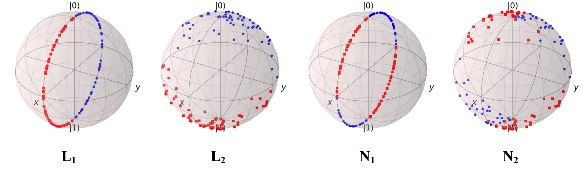
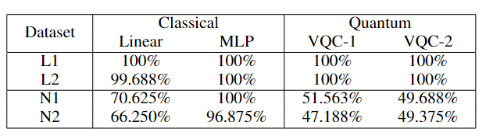
Can Existing VQC Always Woks Well?
Notes:
So, here we can see that for the two linear datasets, L1 and L2, all models perform well with an accuracy close to 100%, but when it comes to the datasets that are not linearly separable, the linear model and the two vqc designs can not make accurate predictions anymore.
This reflects our thinking that the VQC is equivalent to the linear network.

Slide 5
Outline
Introduction
Non-linearity Challenge and Beyond
Method
Experiments
Conclusion
Notes:
Okay, so now that we have some preliminary ideas about what this paper cares about, let’s make it more clear about the existing challenges in the following slides.

Slide 6
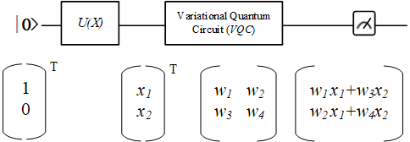
Existing Challenges
C1: The lack of Non-linearity in Quantum Learning
Fig: A simple example of quantum circuit with matrix representation
Notes:
The first one, which is the most concerned one is the lack of non-linearity in the quantum learning. This is kind of straightforward, we can see that here is a simple example of quantum circuit with matrix representation and we have the data x1 and x2 encoded to the statevector using amplitude encoding. Then it gets passed to the parameterized circuit, which is basically a matrix, and the result is the multiplication of the vector and the matrix. This process is indeed a linear transformation of the input data, which barely has the potential to solve more complicated datasets as the lack of non-linearity.

Slide 7
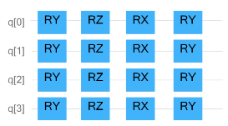
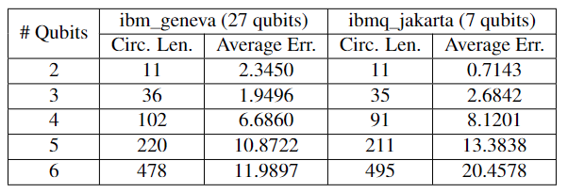
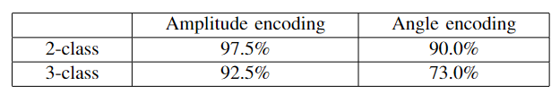
Existing Challenges
C2: Low Fidelity in Data Encoding Methods
Amplitude Encoding results in more errors from noise.
Angle Encoding causes information loss.
Notes:
Then the next existing challenge is the low fidelity in data encoding methods. The two most popular encoding methods, angle encoding and amplitude encoding. Although amplitude encoding can express 2n data with n qubits, it has to be decomposed into more basic gates when deploying in the real quantum device, therefore resulting in more errors as the encoding circuit’s length increases. For random data from MNIST, we tried different ways of amplitude encoding, ranging from 4-dimension data encoded in 2 qubits to 64-dimension data encoded in 6 qubits, and tested them on real quantum devices to see how many errors can be raised during the encoding circuit. As shown in the table, as the number of encoding qubits increases, the circuit length starts growing which increases the average errors due to noise. While for angle encoding, due to the scalability, we normally have to use multiple gates in one qubit wire to encode multiple data such as shown in the figure. And such a method might cause information loss. To prove it, we use 8×8 input data from MNIST to do both a two-classification task and a three-classification task by using amplitude encoding and angel encoding separately. While based on the test result shown in Table, angle encoding can only achieve 90.0% accuracy while amplitude encoding can reach up to 97.5%., and the difference in the accuracy due to information loss should be more intuitive on the three-classification task.

Slide 8
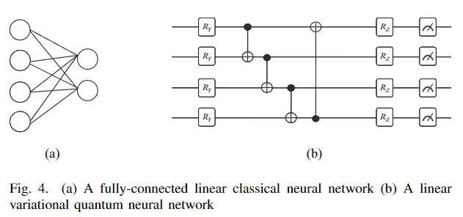
Existing Challenges
C3: The Lack of Spatial Features Extraction
Notes:
The next challenge is the Lack of Spatial Features Extraction from the Existing Quantum Neural Network Designs. The existing VQC circuit is similar to a fully-connected layer given that it involves all qubits in the computation at the same time.
While motivated by that, we feel it necessary to introduce a new pattern of designing computation circuits, which can involve the concept of ’layer’ to extract the features from input data gradually instead of computing the encoded data as a whole and ignoring the spatial information. And we will hold it for now and discuss it later.

Slide 9
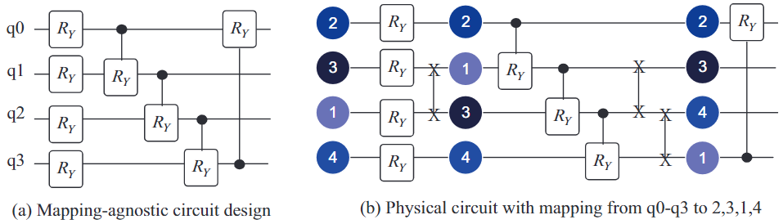
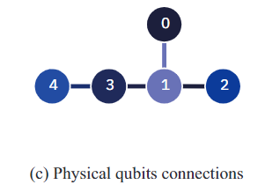
Existing Challenges
C4: Topology-Agnostic Design Brings Extra SWAP Gates to be Vulnerable to Quantum Noise
Notes:
Then, last challenge is that Topology-Agnostic Design Brings Extra SWAP Gates to be Vulnerable to Quantum Noise. We can see that if don’t consider the mapping for the quantum circuit design like the design in figure a, the possible corresponding physical circuit will be like figure b under the physical qubits connections shown in figure c , where there are 3 extra swap gates and therefore resulting more noises side effect.

Slide 10
Outline
Introduction
Non-linearity Challenge and Beyond
Method
Experiments
Conclusion
Notes:
Now, we have talked about the existing challenges, it is time to explore the method we have in this paper.

Slide 11
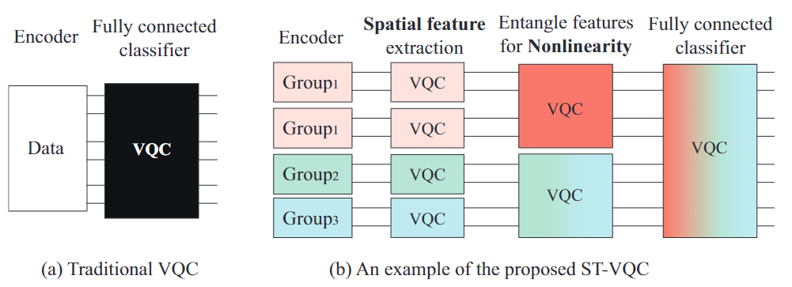
Framework Overview
Naive Design
Proposed Design
ST-VQC
C₃
C₂
C₁
C₄
C₁: Lack of Nonlinearity
C₃: Lack of Spatial Features Extraction
C₂: Low Fidelity
C₄: Topology-Agnostic Design
Notes:
So, here is the overview of our proposed method, we can see that the left figure is a simple design of quantum learning model which consists of a data encoder and a single VQC that works similar to a fully connected classifier. While on the right side is our design namely ST-VQC. In our design, we have two main parts, the encoder and the processer which refers to the computation part. Here these components address the challenges illustrated before.

Slide 12
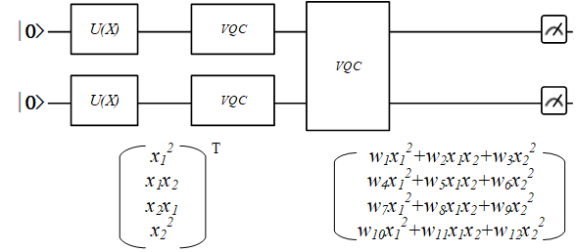
ST-Encoder: Bringing Nonlinearity into Quantum Circuit
Feed nonlinearity by duplicating data
Notes:
So, let’s first focus on the encoder namely ST-Encoder. In order to feed the non-linearity into the quantum learning, we were thinking that we can duplicate the input data to create high-order polynomials, and therefore naturally bring in non-linearity function which is supposed to work similar to the Power of 2 function, just like shown in the quantum circuit with a duplicate of input data and extra VQC to entangle them.

Slide 13
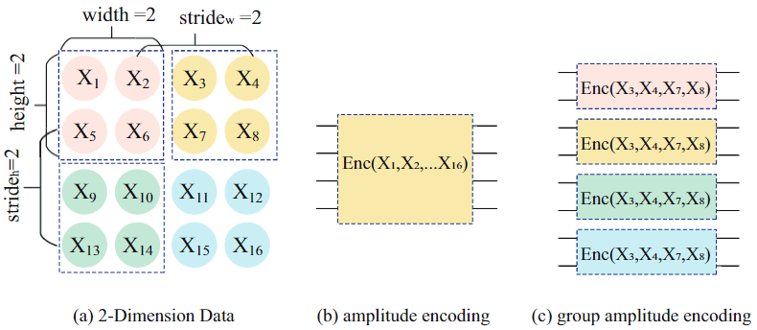
ST-Encoder: Tradeoff between Angle and Amplitude Enc.
Group Encoding
Notes:
And after that, our idea is to make a trade-off between the amplitude encoding and angle encoding, which is the group encoding. We collect the location-close data to groups, and map each group with n data to log2 n qubits using amplitude encoding. As shown in this figure, we are going to encode a 4 × 4 data. If we apply amplitude encoding, it requires 4 qubits to map all data to the amplitudes, and 16 qubits if using angle encoding. If we create 4 groups with 2x2 data, where each group with 4 data can be encoded into 2 qubits, so it needs 8 qubits in total.

Slide 14
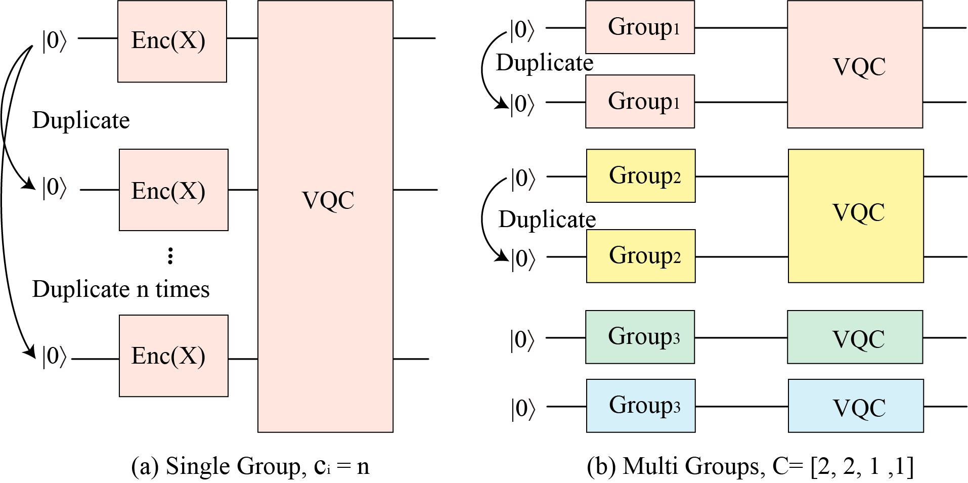
ST-Encoder: Non-linearity based on Group Encoding
Group Encoding-based Non-linear Data Encoder
Notes:
Here is a figure that can better illustrate the ST-Encoder. We can duplicate the data for a single group of data like shown in figure a, or if there are multiple data groups, we can choose the number of duplications for each of them, as show in this example figure b, we have the duplicates for both group1 and group2.

Slide 15
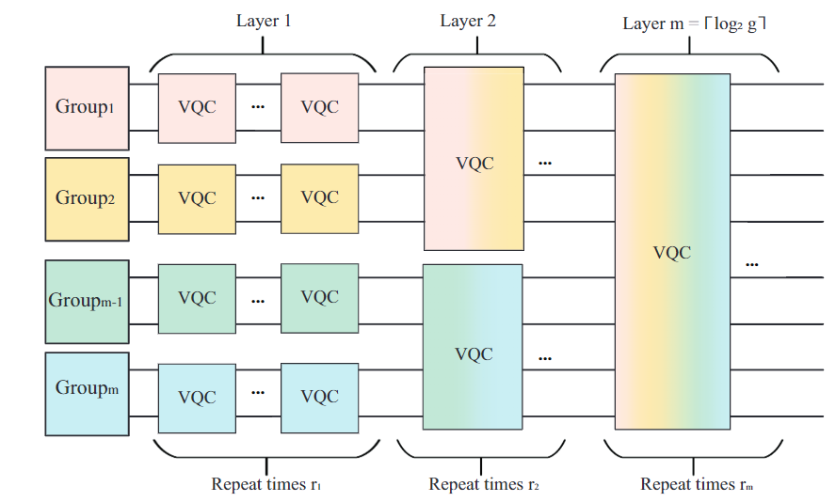
ST-Processor: Spatial Feature Extraction
Local Spatial & Cascaded Temporal Logical Circuit
Notes:
Now, let’s move to the computation circuit part, the ST-Processor. Here, we can see that for the data encoded by the nonlinear data encoder, we will first extract the local spatial information with a VQC on each group. Then, we will gradually enlarge the VQC to involve more qubits. Along with the merge of groups, the non-linearity will be created, and we regard a new layer starting. Finally, we will have a VQC to cover all qubits.

Slide 16
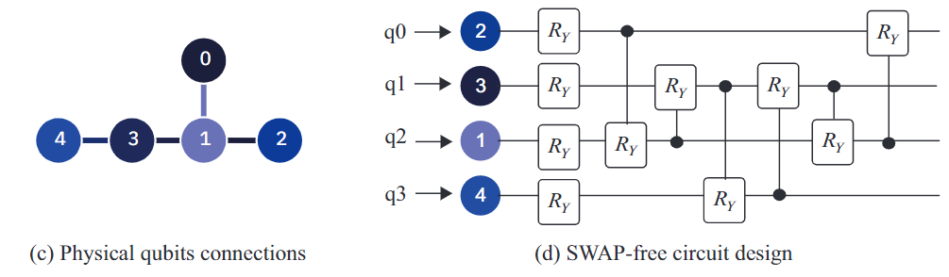
ST-Processor: SWAP Reduction from VQC Design
SWAP-Free Physical Circuit Design
Notes:
Then, for the last part of our proposed method, if we look at the physical qubits connections and use the swap-free circuit design in the ST-processor, we can avoid the extra swap gates and reduce the impact of noise. Here we will follow the path q0-q2-q1-q3, if we recall the original design, we will first apply the first 2qubit gate on q0 and q2, then q2 and q1, then q1 and q3. After that, we will apply 3 more gates in reverse direction.

Slide 17
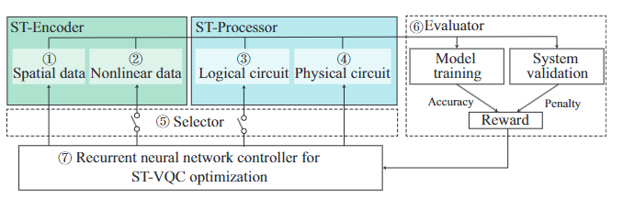
Put All Together: Design Space Exploration
Design Hyperparameters
[ST-Encoder]
Width, Height, Stride
# of duplicate for each data group
[ST-Processor]
# of repeats for each layer
Path
ST-Encoder
ST-Processor
Notes:
Lastly, we will have a optimization method that take advantage of the design hyperparameters in both the ST-Encoder and ST-Processor to search for the high-quality solutions based on the ST-VQC design.

Slide 18
Outline
Introduction
Non-linearity Challenge and Beyond
Method
Experiments
Conclusion
Notes:
Then, it is time to look at the experimental results.

Slide 19
Experimental Setup
Dataset
MNIST-2
Synthetic Nonlinear Dataset
Training and Testing
Experiments are trained with batch size 128 for 20 epochs using Adam with
an initial learning rate of 0.005
Experiments on MNIST-2 are tested on ibm_cario with 27 qubits.
Experiments on synthetic dataset are tested on ibmq_lima with 5 qubits.
Baselines
MNIST-2: We use different models as the baselines including Amplitude encoding and
Angle encoding with different settings.
Synthetic dataset: We use Linear Classifier and Multi-layer Perceptron (MLP)
Notes:
First, let’s go through about the experimental setup, we use the MNIST-2 dataset and the synthetic nonlinear dataset. Just to clarify, we create the synthetic dataset based on the quantum rotation. So it is on the Bloch Sphere. To be more detailed, we use the parameterized rotation gates RY gate and U3 gate to adjust the quantum state of one qubit. The points will then be constrained to the specific areas on the surface of the Bloch Sphere by limiting the values of rotation gates θ. After that, we control the distribution of the points and labels or classes to create linear separable and non-linear separable datasets.
Then it is the training and testing setting and the baselines we have in the experiments.

Slide 20
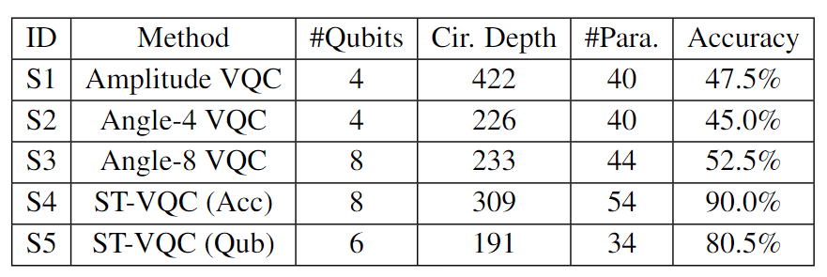
Result
Tab: Evaluation of different designs for MNIST-2 on ibm_cairo quantum processor
ST-VQC can reach an accuracy of 90% on the real quantum device
The design with objective for minimizing qubits obtains an accuracy of 80.5% with 6 qubits.
Notes:
This is the main result of our proposed method on MNIST-2 dataset, we can see that ST-VQC can reach an accuracy of 90% on the real quantum device, while the design with fewer qubits(6) also obtains an accuracy of 80.5%, both design outperform other quantum learning model designs.

Slide 21
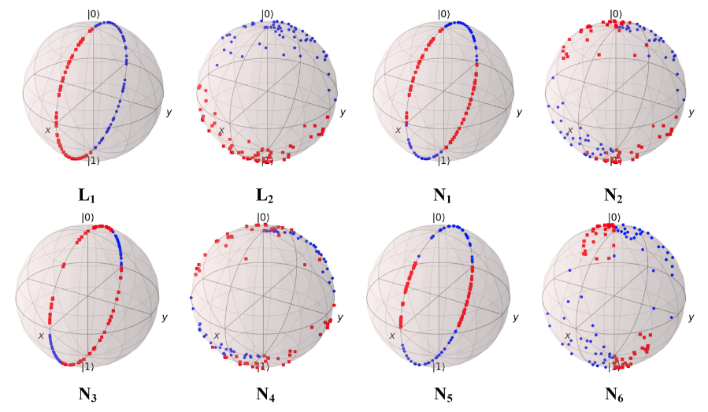
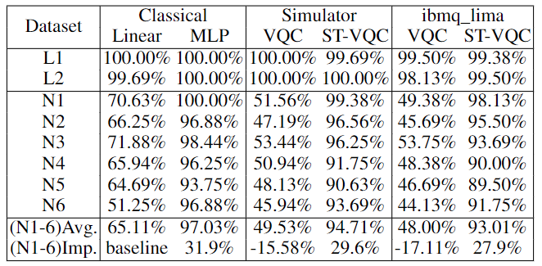
Result
Synthetic Datasets: L1 and L2 refer to linearly separable datasets. N1, N2, N3, N4, N5, and N6 refer to datasets with non-linearity.
ST-VQC has a small accuracy drop on real quantum devices
Its accuracy is comparable to that of MLP and much higher than the baseline model and VQC.
Notes:
And here is the result on the synthetic datasets, we can see that on average of all datasets, the ST-VQC has a small accuracy drop on real quantum devices, and its accuracy is close to that of MLP and much higher than the baseline and the other VQC model.

Slide 22
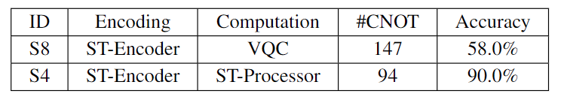
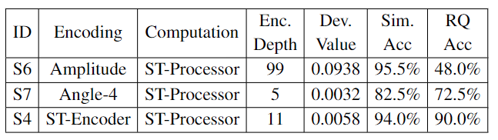
Ablation Experiments
Effectiveness of ST-Processor, compared with VQC
Effectiveness of ST-Encoder
Notes:
Here we separately evaluate the ST-Encoder and ST-Processor, and the result shown in the tables have further indicated the importance of both the components.

Slide 23
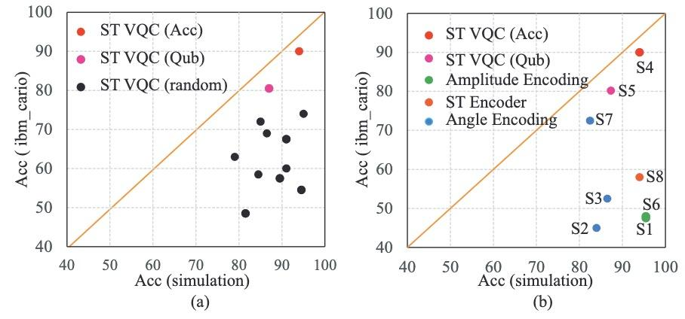
Result
Fig: Evaluation of ST-VQC on ideal quantum simulator vs real quantum computer
ST-VQC with system-level optimization can find circuit that are more robust to noise.
Notes:
Then this is the last experiment results, the evaluation of ST-VQC on ideal quantum simulator compared with real quantum computer. And the result figure a here shows that both red and pink points are closest to the solid orange line, which indicates that the accuracy of the corresponding circuit design on real quantum computers is closest to that on the ideal quantum simulator. While from the comparison results with existing VQCs in figure b, we can see that although solutions S1, S6, and S8 can achieve high simulation accuracy, they suffer from a significant accuracy drop after deploying to the real quantum computers. And this reveals the importance of our ST-VQC with system-level optimization.

Slide 24
Outline
Introduction
Non-linearity Challenge and Beyond
Method
Experiments
Conclusion

Slide 25
Conclusion
Challenges
The lack of nonlinearity
The low encoding fidelity
The naïve computation circuit design
Key idea
Feeding nonlinearity by duplicating input data and structured computation circuit design.
Techniques
ST-Encoder: Overcome the lack of nonlinearity, and improve encoding fidelity.
ST-Processor: Extract spatial features and integrate the nonlinearity gradually.
Optimizer: Optimization technique to identify the hyperparameters in each design component.
Results
ST-VQC can outperform existing VQC on actual quntum devices
Notes:
In conclusion, our paper’s dealing with the challenges in the lack of nonlinearity, the low encoding fidelity, and the naïve computation circuit design.
And our key idea is to feed the nonlinearity by duplicating the input data and following the structured computation circuit design.
The two main components in our design is the ST-Encoder and the ST-Processor, we also have a optimizer to help identify the hyperparameters in each design component.
The result shows that ST-VQC can achieve a accuracy of 90% on MNIST-2 dataset, and also outperforms the baseline models on a non-linear synthetic dataset.

Slide 26
jli56@gmu.edu
Thank you!

