Slide 1




IEEE Quantum Week 2023 @ Seattle
Toward Consistent High-fidelity Quantum Learning
on Unstable Devices via Efficient In-situ Calibration
Zhirui Hu, Robert Wolle, Mingzhen Tian, Qiang Guan, Travis Humble, Weiwen Jiang
Notes:
Firstly, I will explain this title.

Slide 2
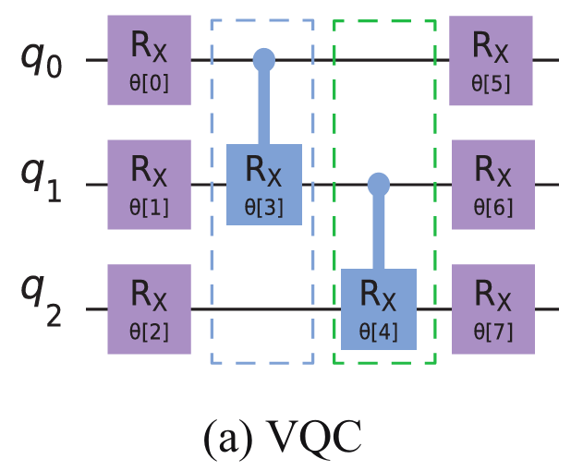
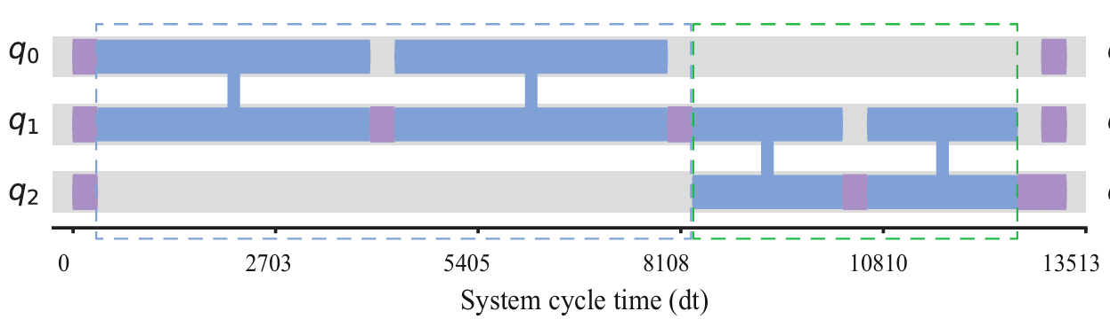
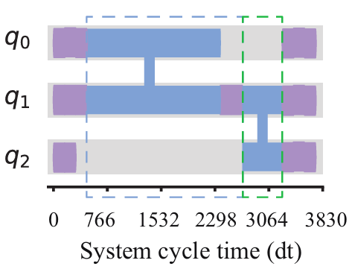
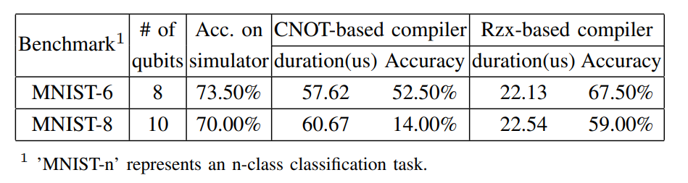
Toward Consistent High-fidelity Quantum Learning on Unstable Devices via Efficient In-situ Calibration
Transpile
CNOT-based
CNOT-based pulse schedule
Transpile
Rzx-based
Performance of classification task
Rzx-based Pulse Schedule
Use Rzx gate as the 2-qubit gate for quantum learning directly
Notes:
Accuracy of real-world of learning applications

Slide 3
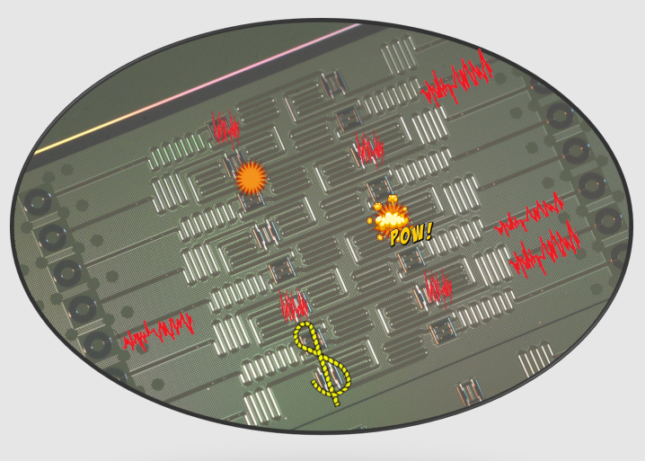
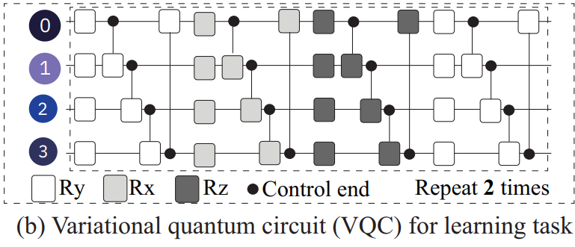
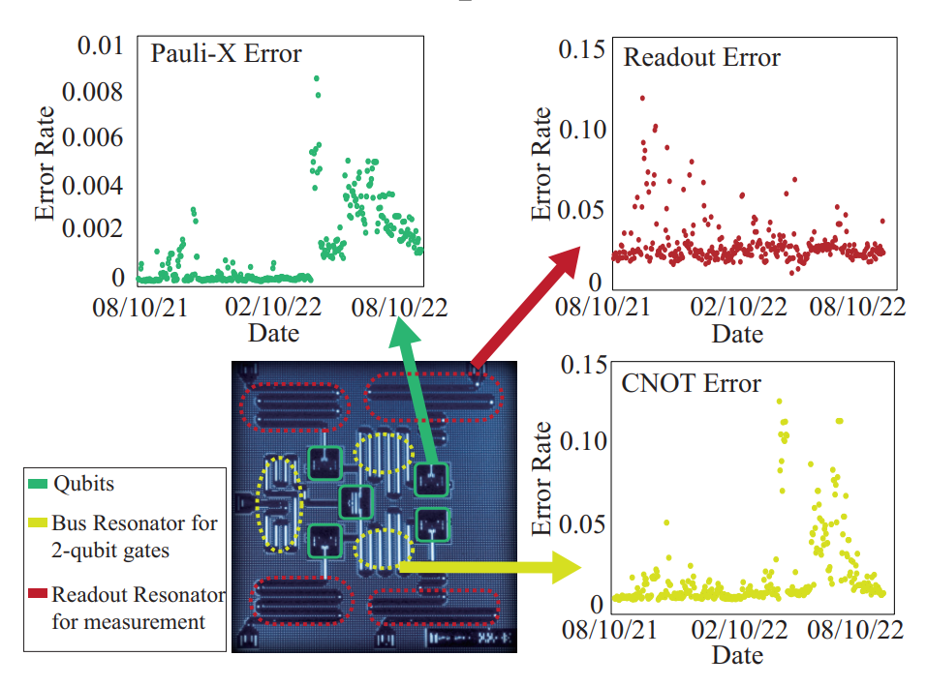
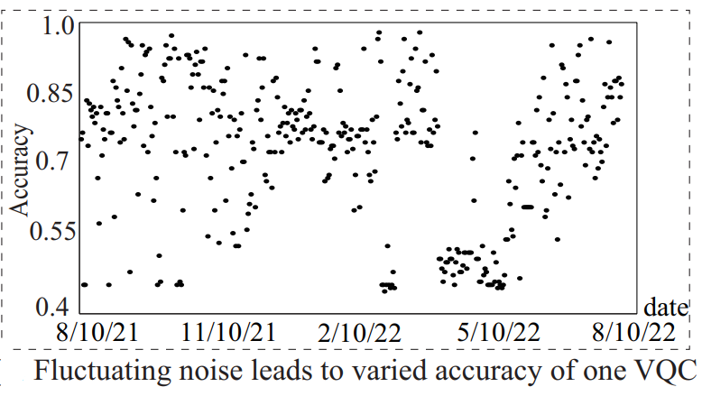
Toward Consistent High-fidelity Quantum Learning on Unstable Devices via Efficient In-situ Calibration
Source of Fluctuating Noise:
Johnson noise: relevant to temperature
The carrier pulse of the oscillator may have fluctuations on amplitude or phase.
Randomly fluctuating on electric and magnetic fields
(Unpredictable)
Fluctuating noise, fluctuating performance
[ref] A Quantum Engineer’s Guide to Superconducting Qubits
Notes:
The second thing is what is Unstable Devices, which is also the reason of why we should do efficient calibration:
The main reason is that the noise is fluctuation. Here, I list some fluctuating noise source, which is from xxx.
These reason tells us that the noise is unpredictable and fully modeled. We can not use a function with time to predict the noise.
To describe such kinds of fluctuating noise on a time scale of days, we record such fluctuating noise on IBM device for one year, and use a Classification task to benchmark such noise. We can see that in some days, the noise becomes heavy, and the accuracy drops.

Slide 4
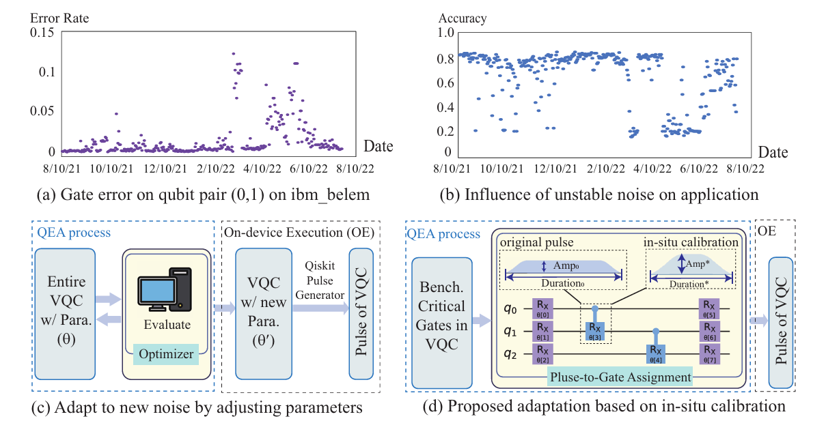
Toward Consistent High-fidelity Quantum Learning on Unstable Devices via Efficient In-situ Calibration
Existing approach: parameter shift before using
Proposed in-place pulse calibration
× High Timing Cost (e.g., days of training)
√ Low Timing Cost
[ref] Qoc: quantumon-chip training with parameter shift and gradient pruning
Notes:
To overcome the fluctuating noise, one Existing idea is to adapt the parameterized circuit on real quantum device by parameter shift. However, the time complexity of gradient calculation on real quantum devices during parameter shift depends on the number of parameters. So when the circuit becomes large, we can not use such method to update parameters. In our work, we use an efficient method to calibrate pulse efficiently.

Slide 5
Outline
Introduction
Background
Motivation
Method
Experiments
Conclusion

Slide 6
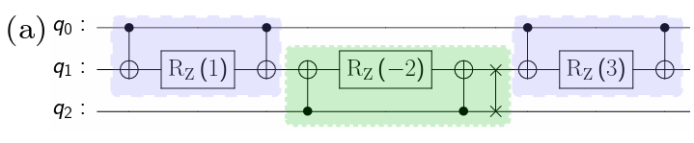
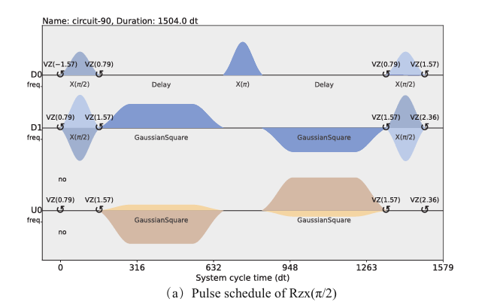
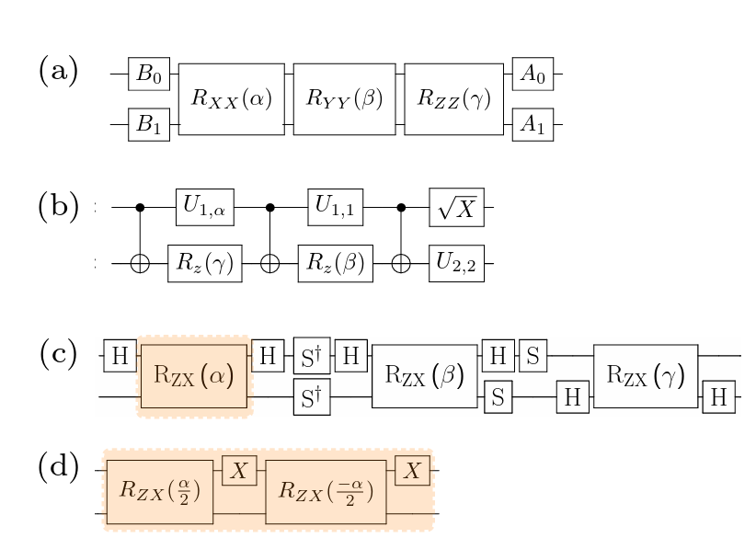
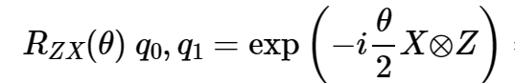
Transpiling Logical Circuits to Rzx Pulse
Transpilation Process
Rzx Pulse
(b)
(a) Decompose a circuit to multiple SU(4)
(b) KaK( Cartan) decomposition for arbitary SU(4)
(c) Decompose (a) into the hardware-native RZX gates
[ref] Pulse-efficient circuit transpilation for quantum applications on cross-resonance-based hardware
Notes:
Before our paper, I will first introduce the background.
Here is a very famous paper from IBM. XX
RZX gate is used in PE Compiling, which is first put forward by IBM.
Here is the compiling Process. XX
Our work is after such transpiliation process.
The right figure shows the pulse scheduler of RZX gate. To mitigate some unwanted hamitonian, IBM use a pair of symmetry cross-resonance pulse and some single-qbit pulse to build up rzx gate, and the time-independent hamitonian is XZ.

Slide 7
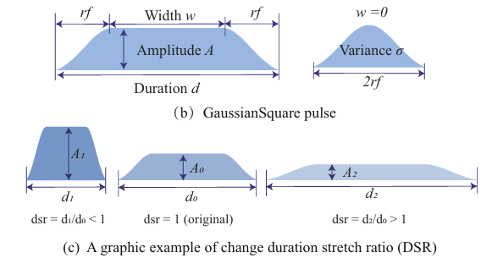
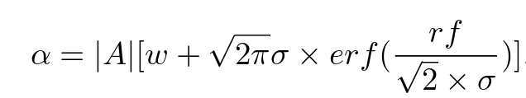

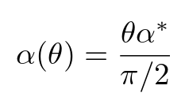

Rzx Pulse Generation
$R_{ZX}\left(\frac{π}{2}\right)=CR\left(\frac{π}{4}\right)X$ $CR\left(\frac{π}{4}\right)X$
Cross-resonance (CR) pulse:
Pulse area:
Stretch
[ref] Pulse-efficient circuit transpilation for quantum applications on cross-resonance-based hardware
Notes:
The cross-resonance pulse is gaussian- suquare shape, which is made up of a retangle and a gaussian function. when the area is smaller than a value, the shape will be a gaussian function.
And the area can be calculated as follows. Approximately, the pulse area is linear with the parameter in RZX gate.
Note that CNOT gate can be built from RZX gate with theta = pi over 2 and single qubit gates, So the calibration of Rzx gate when theta = pi/2 is the same as CNOT. IBM put forward that rzx gate with other parameters can be get by equally stretch the pulse area, which will lyapproximately not change the hamitonian.

Slide 8
Outline
Introduction
Background
Motivation
Method
Experiments
Conclusion

Slide 9
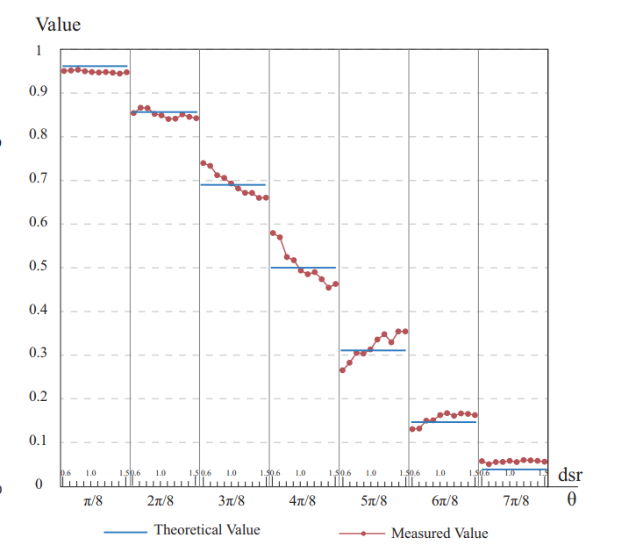
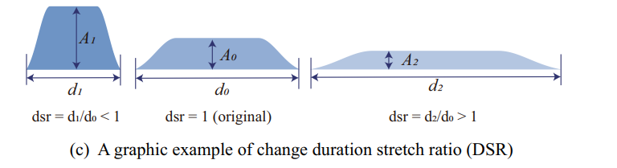

Motivation 1: Efficient Calibration: Control Error & Duration Trade-off
Theoretically
Practically
Same gate function
if keep fixed pulse area
Duration Stretch Ratio: $dsr = \frac{new duration}{original duration}$
Measured Rzx output of |00> with (θ, dsr) changes
(Results obtained on actual IBM processors)
Notes:
Because the pulse area represents the parameter in RZX gate, we want to change the width and amplitude together and further make the duration short. We define the duration stretch ration as the departure of new duration and original duration.
We change the dsr at some specific points, and observe the difference of measured value (in red points) and reference value in blue line, which is without noise, which is shown in the right picture. We measure the probability of output state |00>, where the reference value is cos(theta). We found that when the dsr is far from 1, the difference of measured value and reference value is obvious, which means that when we change the durating, the control noise will increase.
This motivate us to make a trade-off between individual gate error and total circuit fidelity, in other words, we want to design a algorithm to make control noise and circuit duration trade-off.

Slide 10
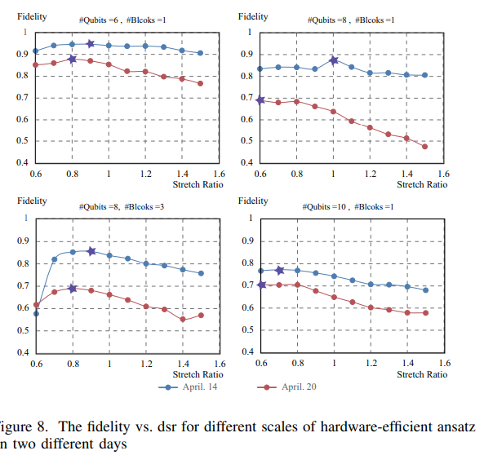
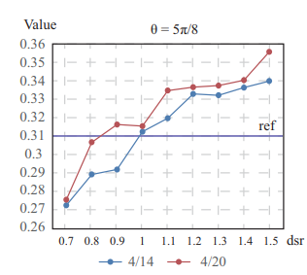
Motivation 1: Efficient Calibration: Control Error & Duration Trade-off
Circuit Level
Gate Level
The fidelity of random initialized hardware-efficient ansatz as dsr change.
The optimal dsr for individual gate is also different on the two days

Slide 11
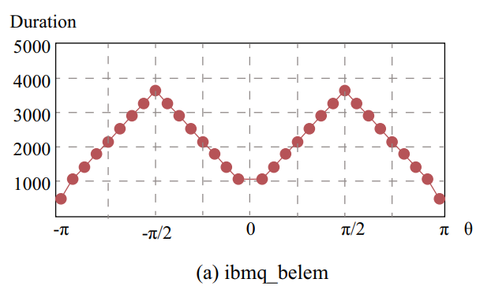
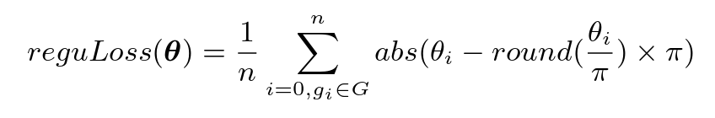
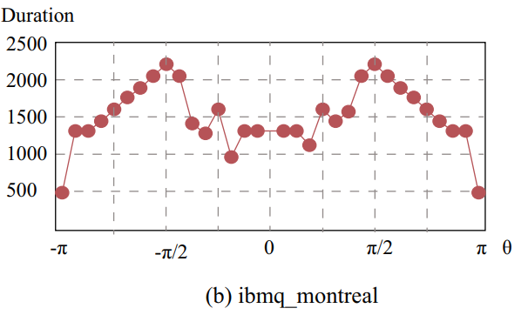
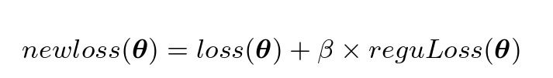

Motivation2: Duration-aware Circuit Optimization
Variational Quantum Algorithm:
Problem cost function: $loss(θ)$
Objective: min $loss(θ)$
Duration-aware Variational Quantum Algorithm:
min
Duration of Rzx(θ) as θ changes from $−π$to $π$
Notes:
For variational algorithm, we can also reduce the duration on gate level.
Based on the Observation that the lower duration will lead to high fidelity, we propose a duration-aware circuit optimization method. We record the duration change of rzx gate as the parameter change on two backend. We found that when the parameters near 0, pi , -pi, the duration is short.
So we expect that the parameters is near 0,-pi, pi.
The original VQA is to find the optimal paramters while minimize a problem-oriented loss function. we add a regulization noise during optimization, which makes the duration shorter. Note that this is a soft regulization, we don’t make the paramters be a exact value.

Slide 12
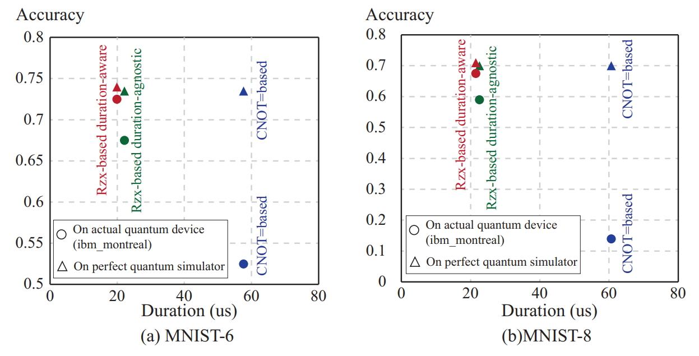
Motivation2: Duration-aware Circuit Optimization
Large acc. drop
Small acc. drop
Purple: CNOT-based Compiling
Green: Rzx-based Duration-agonist optimization
Red: Rzx-based Duration-aware optimization
Notes:
Here, we show the performance of three kinds of method on real quantum devices.
Purple xxx Green xxx, Blue xxx.
We can see that the CNOT-based methods gets the most accuracy drop and Rzx-based Duration-aware optimization gets the smallest accuracy drop,which shows the effectiveness of Duration-aware Circuit optimization

Slide 13
Outline
Introduction
Background
Motivation
Method
Experiments
Conclusion

Slide 14
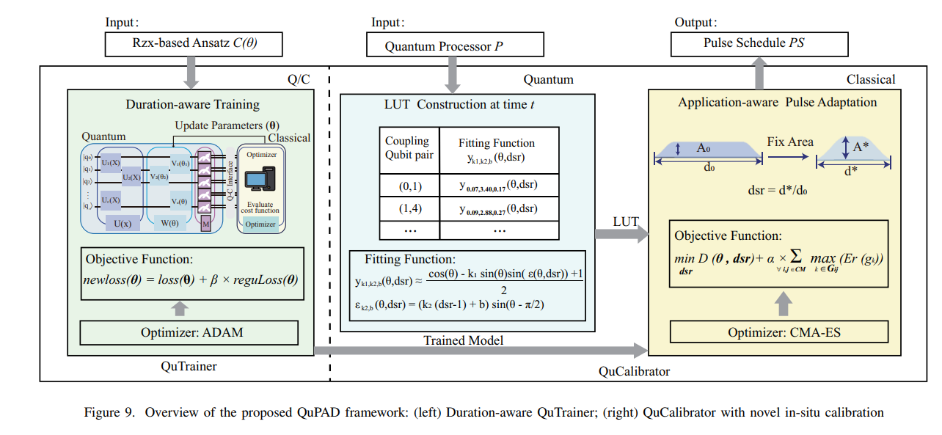
Framework
QuTrainer
QuCalibrator
QuTrainer: Duration-aware Circuit Optimization
QuCalibrator: CMA-ES optimization to make control-noise and duration trade-off
Notes:
Overall, our framework has two components, one is QuTrainer, which is to do Duration-aware training to get shorter pulse. The next part is to QuCalibrator. The main algorithm is to leverage CMA-ES optimization to make control-noise and duration trade-off.

Slide 15

QuTrainer: Duration-aware Circuit Optimization
Variational Quantum Algorithm:
Problem cost function: $loss(θ)$
Objective: min $loss(θ)$
Duration-aware Variational Quantum Algorithm:
min
Notes:
As I mentioned before. In this components, we add a regulization noise during optimization, which makes the duration shorter. Note that this is a soft regulization, we don’t make the paramters be a exact value.

Slide 16
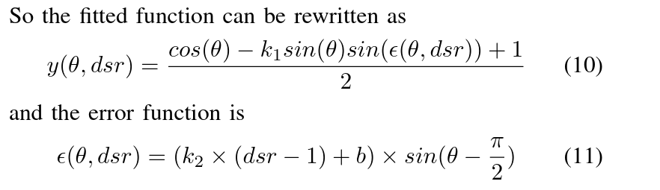
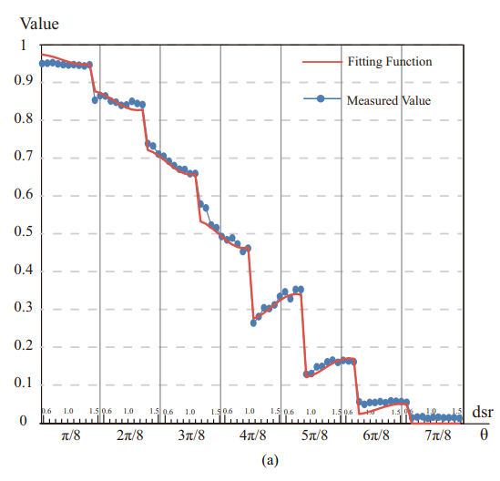
LUT Construction: Mapping from (θ, dsr) to Control Error
Notes:
However, my background is limited. I don’t know why the curve is like this. I guess it is because the non-linearity of hamitonian as amplitude change.

Slide 17
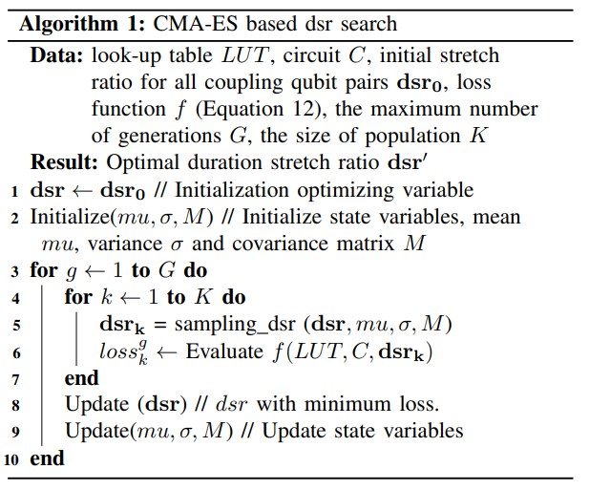
CMA-ES based Calibration:Duration & Control Error Trade-Off
The sum of max estimated
gate error rate for each qubit pairs
The duration of total circuit at (θ, dsr)
Notes:
At last, we will use CMA-ES based optimizer to optimize dsr. The loss function has two parts. The first part is The duration of total circuit at (θ, dsr), and the second part is The sum of max estimated gate error rate for each qubit pairs. By minimizing the loss function, we will achive the duration & control error trade-off.

Slide 18
Outline
Introduction
Background
Motivation
Method
Experiments
Conclusion

Slide 19
Experimental Setup
Benchmark
Machine Learning Task: MNIST-6 class
VQE Task: LiH
Environment Setting
Openpulse on ‘ibmq kolkata’ & ‘ibmq montreal’
Intel Core i5-11300H (3.10GHz, 16GB RAM)
Evaluations
Original VQC
QuTrainer
QuTrainer + QuCalibrator (QuPad)
Notes:
montreal

Slide 20
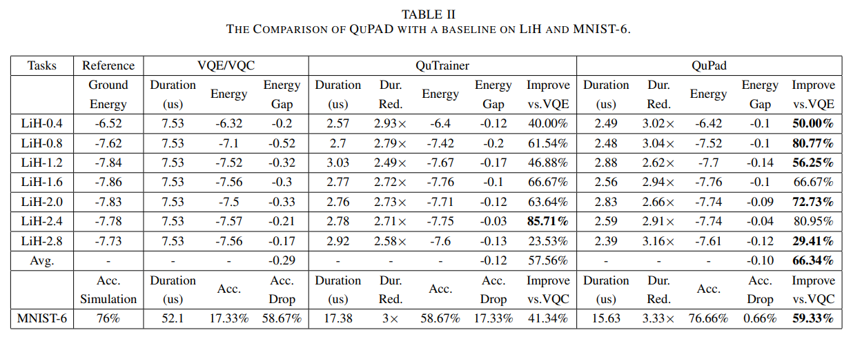
Main Results: Development Fidelity on Actual Quantum Devices
Duration Reduction
Fidelity Increase
Notes:
This table Main Results: Development Fidelity on Actual Quantum Devices. Overall, the QuTrainer outperforms original methods and QuPad outperforms QuTrainer.
Specifically, on VQE task, the QuTrainer has more significant improvement than QuCalibrator. This is because the total duration of VQE is short and the control noise is the domain noise. So we don’t need to calibrate it again. However, on MNIST task, the improvement on both QuTrainer and QuCalibrator is remarkable. This is because the duration of MNIST is long and it will integrate more decoherence. So, the trade-off between control noise and duration becomes important on long circuits.

Slide 21
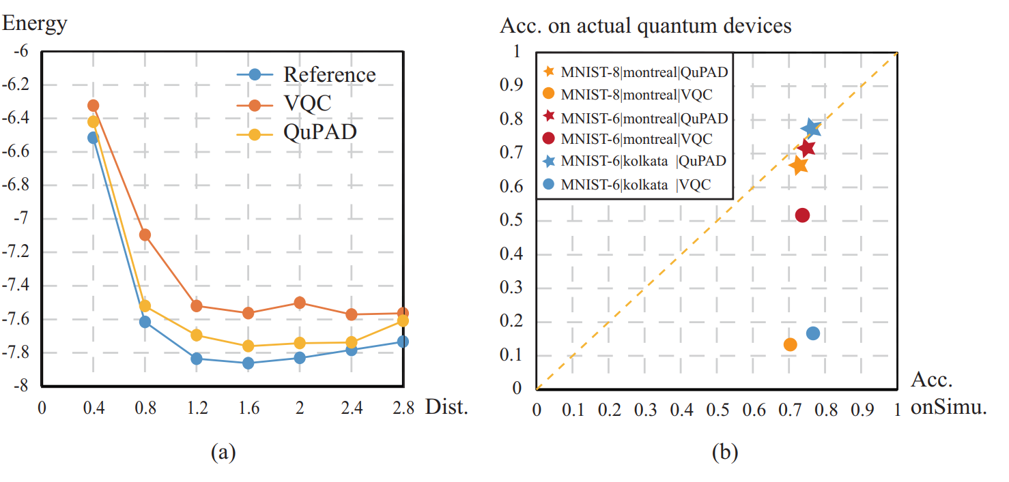
Main Results: Development Fidelity on Actual Quantum Devices
High fidelity
Acc. on perfect simulator
Notes:
Here, we visualize the accuracy of MNIST task on actual quantum devices and Simulation. Our method makes the lower accuracy drop.
We also compare ground state of VQE at different distance of atomes at the left figure. We can see that our proposed QuPAD is more accurate than baseline.

Slide 22
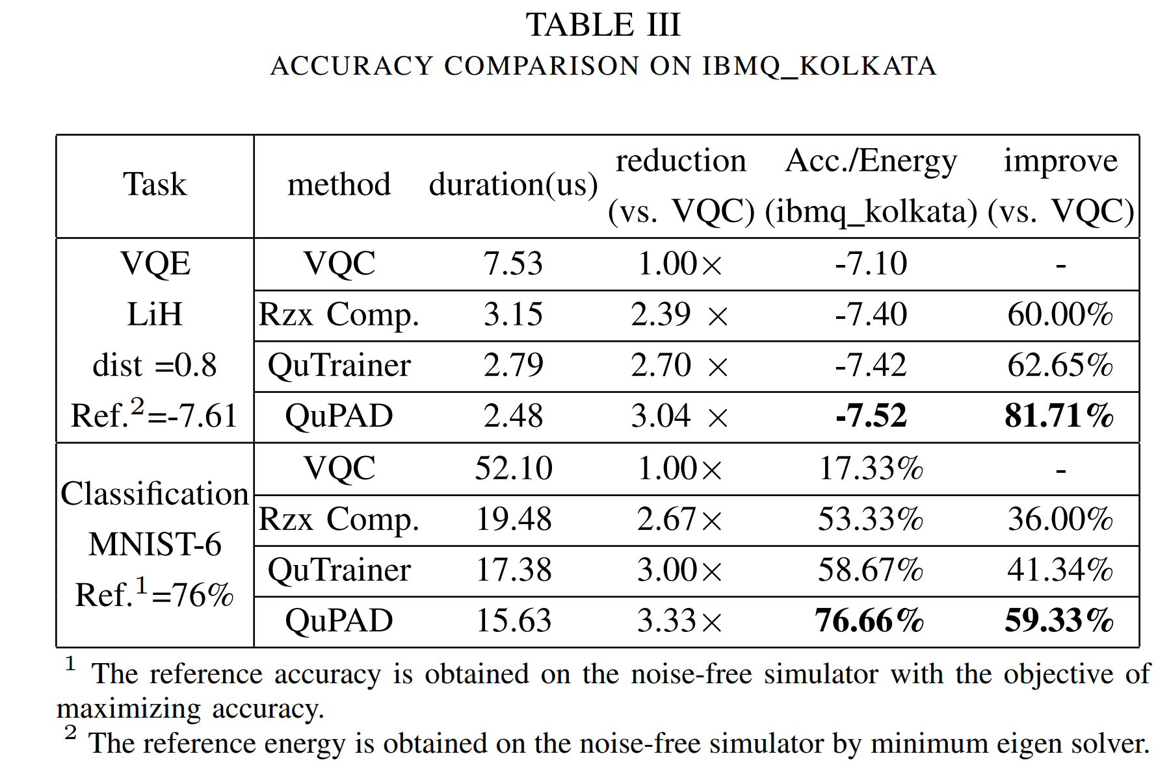
Evaluation: Benefits Breakdown
Notes:
We did ablation study on each step. Overall, each step has a improvement over the last step. The importance of each step depends on the applications, ansatz, and also the backends. Stack these techniques together, we makes no accuracy drop of MNIST-6 on real quantum device.

Slide 23
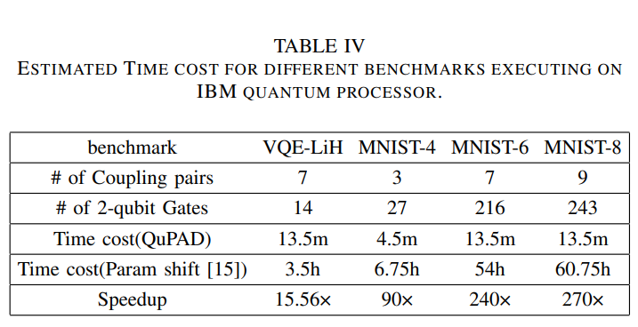
Evaluation: Timing Efficiency
Time complexity Comparison
O(min(Ec, Eq)×S ×n1 ×n2)
≪
O(N1 × Np × S × L × e),
Ec, Ep: the number of coupling qubit pairs in circuit C and quantum processor P
Np : the number of tuning parameters in circuit C
S: the number of circuit samples
L: circuit length
n1, n2, N1, e: given constant number
min(Ec, Eq) ≪ N1 × L
Notes:
At last, we compare the time cost with parameter shift methods. We can see that our calibration outperforms the parameter shift methods by over hundreds of time. This is because the overhead of parameter shift method grows linearly as the number of parameters increases. However, our method only grows linearly as the number of coupling qubit pairs increase.

Slide 24
Conclusion
Problem
How to achieve practical learning on unstable device and fidelity NISQ devices?
Key idea
Efficient Calibration and Adaptation for both 2-qubit gate and pulse.
Techniques
QuTrainer: Duration-aware training to get shorter pulse
QuCalibrator: CMA-ES optimization to make control-noise and duration trade-off
Results
QuPAD outperforms baselines with the high performance and low calibration cost.

Slide 25
Thanks for Your Attention! Q&A (zhu2@gmu.edu)
Reference
N. Earnest, C. Tornow, and D. J. Egger, “Pulse-efficient circuit transpilation for quantum applications on cross-resonance-based hardware,” Physical Review Research, vol. 3, no. 4, p. 043088, 2021.
J. P. Stenger, N. T. Bronn, D. J. Egger, and D. Pekker, “Simulating the dynamics of braiding of majorana zero modes using an ibm quantum computer,” Physical Review Research, vol. 3, no. 3, p. 033171, 2021
Z. Liang, H. Wang, J. Cheng, Y. Ding, H. Ren, Z. Gao, Z. Hu, D. S. Boning, X. Qian, S. Han, et al., “Variational quantum pulse learning,” in 2022 IEEE International Conference on Quantum Computing and Engineering (QCE), pp. 556–565, IEEE, 2022.
Hu, Z., Dong, P., Wang, Z., Lin, Y., Wang, Y., & Jiang, W. (2022, October). Quantum neural network compression. In Proceedings of the 41st IEEE/ACM International Conference on Computer-Aided Design (pp. 1-9).
Hu, Z., Lin, Y., Guan, Q., & Jiang, W. (2023). Battle Against Fluctuating Quantum Noise: Compression-Aided Framework to Enable Robust Quantum Neural Network. arXiv preprint arXiv:2304.04666 (Accepted by DAC).

