Slide 1
CITIZEN BANK POC BLOCK DIAGRAM EVOLUTION
Zenlabs team

Slide 2
Tasks to be performed (Week 1-26/05/2023)
Create a got repository to store all the articfacts of the poc to be accessible to the whole team
Designing the new Network and configuring it.
Designing the block diagram to represent the technical aspects of the merchant onboarding functionality for the previous poc and analysing it.

Slide 3

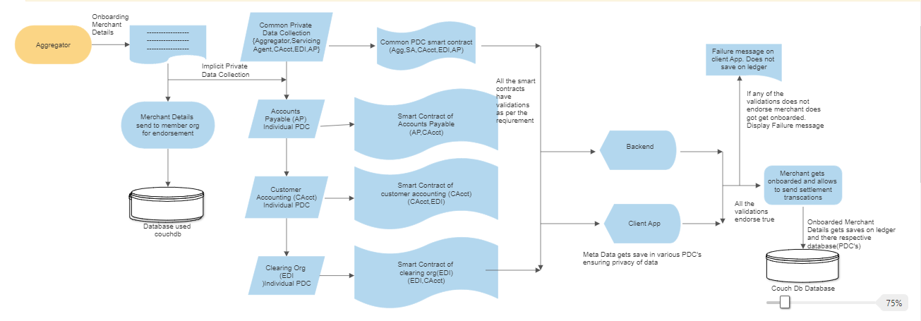
INITIAL VERSION OF BLOCK DIAGRAM of citizen bank poc(version1):

Slide 4
FEEDBACK/COMMENTS(VERSION1) 26/05/2023:
The designed block diagram mainly focused on the control flow/processing aspects of the POC.
The block diagram should be designed in a way that it depicts all the technical components and implementation of the functionality of the POC
Elaborate the block diagram which is in high level ,abstract each block to low level.
The higher the level the,the less detail.The lower the level, the more detail.

Slide 5
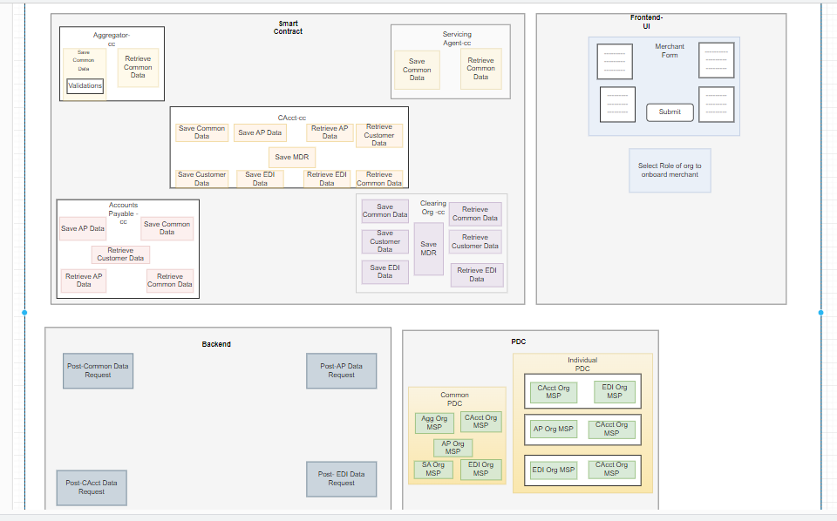
Version2 of the block diagram of citizen bank poc(06/06/2023):

Slide 6
FEEDBACK/COMMENTS(VERSION2 of citizen bank poc )06/06/2023:
The front end block in the block diagram is very much abstract and needs to be more detailed.
Each block/section in the Block Diagram needs to be consistent and should depict same type of information/detail.

Slide 7
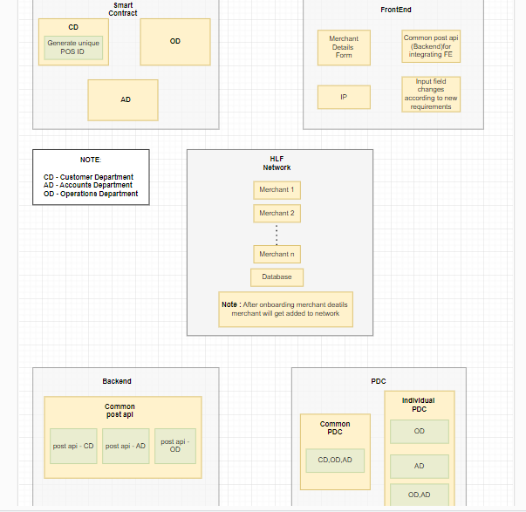
Version1 block diagram of the cards poc(07/06/2023):

Slide 8
FEEDBACK/COMMENTS(VERSION1 of cards poc) 07/06/2023:
The block diagram should mainly focus on the technical functionality of implementing the POC.
Each block/section should depict the all technical aspects of the respective block/section to the required level of abstraction

Slide 9
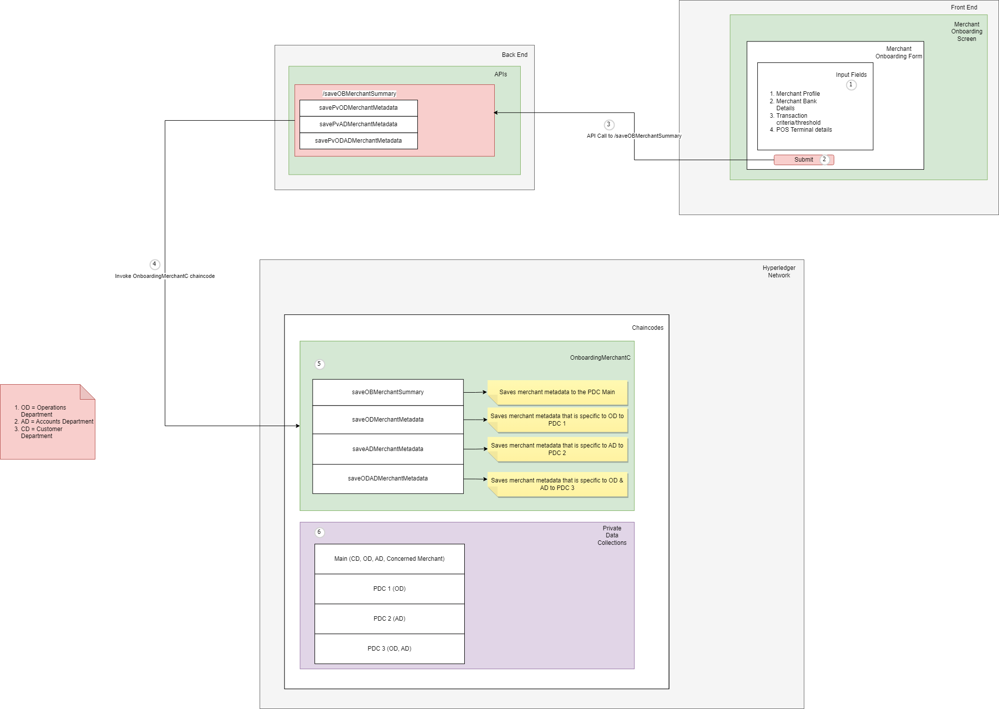
VERSION3 OF THE BLOCK DIAGRAM of citizen bank poc(09/06/2023):

Slide 10
FEEDBACK/COMMENTS(VERSION3 OF Citizen bank POC) 07/06/2023:
The Block Diagram provides good detail of the POC.
The Front End block/section in the block diagram can be more detailed and other than the functional aspects any other technical aspects can be added which have greater significance.

Slide 11
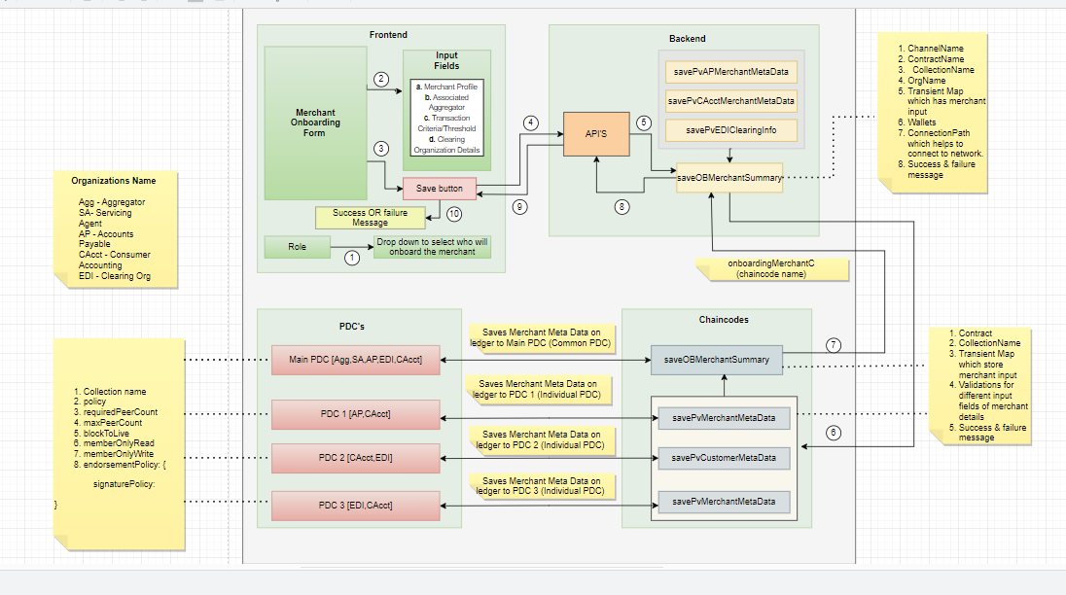
VERSION4 OF THE BLOCK DIAGRAM of citizen bank poc(12/06/2023):

Slide 12
FEEDBACK/COMMENTS(VERSION4 of citizen bank poc) 12/06/2023:
The Block Diagram doesn't need too many details.
The Front End block/section should be more detailed(missing some of the key aspects).
The block diagram should comprise of overall aspects of the MOB(merchant Onboarding)of the current POC.
Avoid repetition of components in various blocks/sections of the block diagram.
Avoid ambiguity in the backend block(use of API's is ambiguous

Slide 13
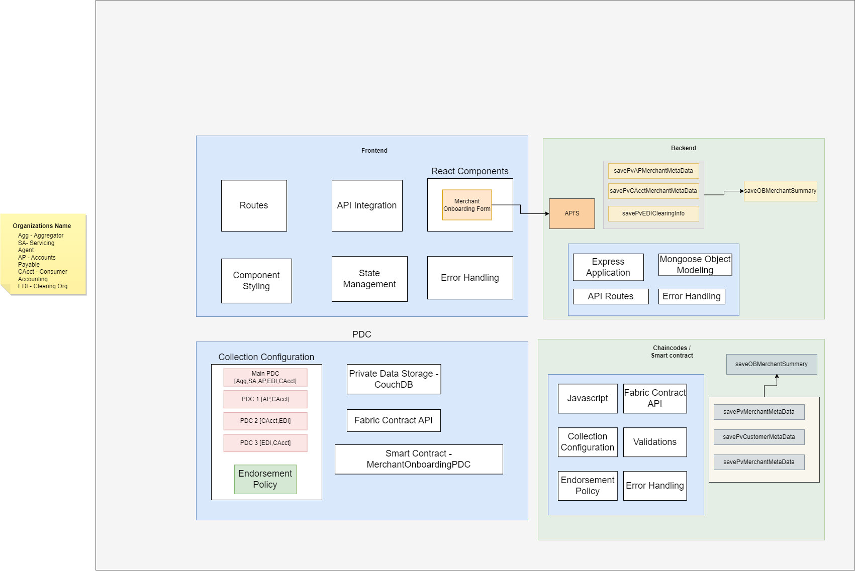
VERSION2 BLOCK DIAGRAM OF THE CARDS POC(12/06/2023):

Slide 14
FEEDBACK/COMMENTS(VERSION2 OF CARDS POC) 12/06/2023:
The Block Diagram doesn't need too many details.
There isn't a need to depict flow chart in the block diagram.
The Front End block/section should be more detailed(missing some of the key aspects).
The block diagram should comprise of overall aspects of the MOB(merchant Onboarding)of the current POC.
Avoid repetition of components in various blocks/sections of the block diagram.
Avoid ambiguity in the backend block(use of API's is ambiguous

Slide 15
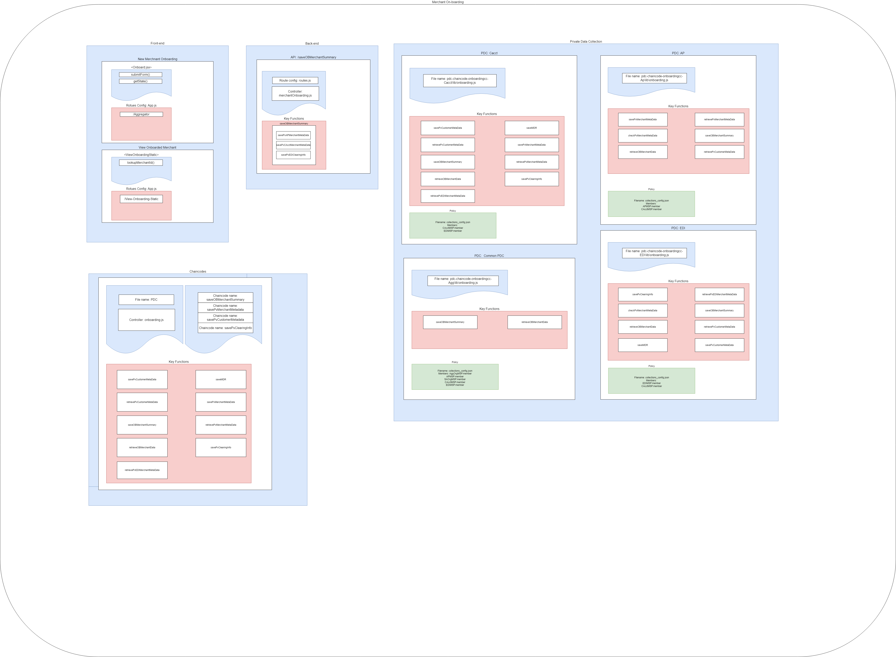
VERSION5 OF THE BLOCK DIAGRAM of citizen bank poc(19/06/2023):

Slide 16
FEEDBACK/COMMENTS(VERSION5 OF CITIZEN BANK POC) 12/06/2023:
Ensure that there are no spelling mistakes or incorrect case (lower/upper) in the names or labels of any block.
In the Front-end section need not duplicate the routes-config for each logical FE component. it can be represented as a whole for the front-end.
The Back End section can be more elaborative to the least abstraction level.
The chain code block/section needs to be represented well,elaborate functions associated with chaincodes,place the controller in a right position and explain it,specify the file name properly(pdc).

Slide 17
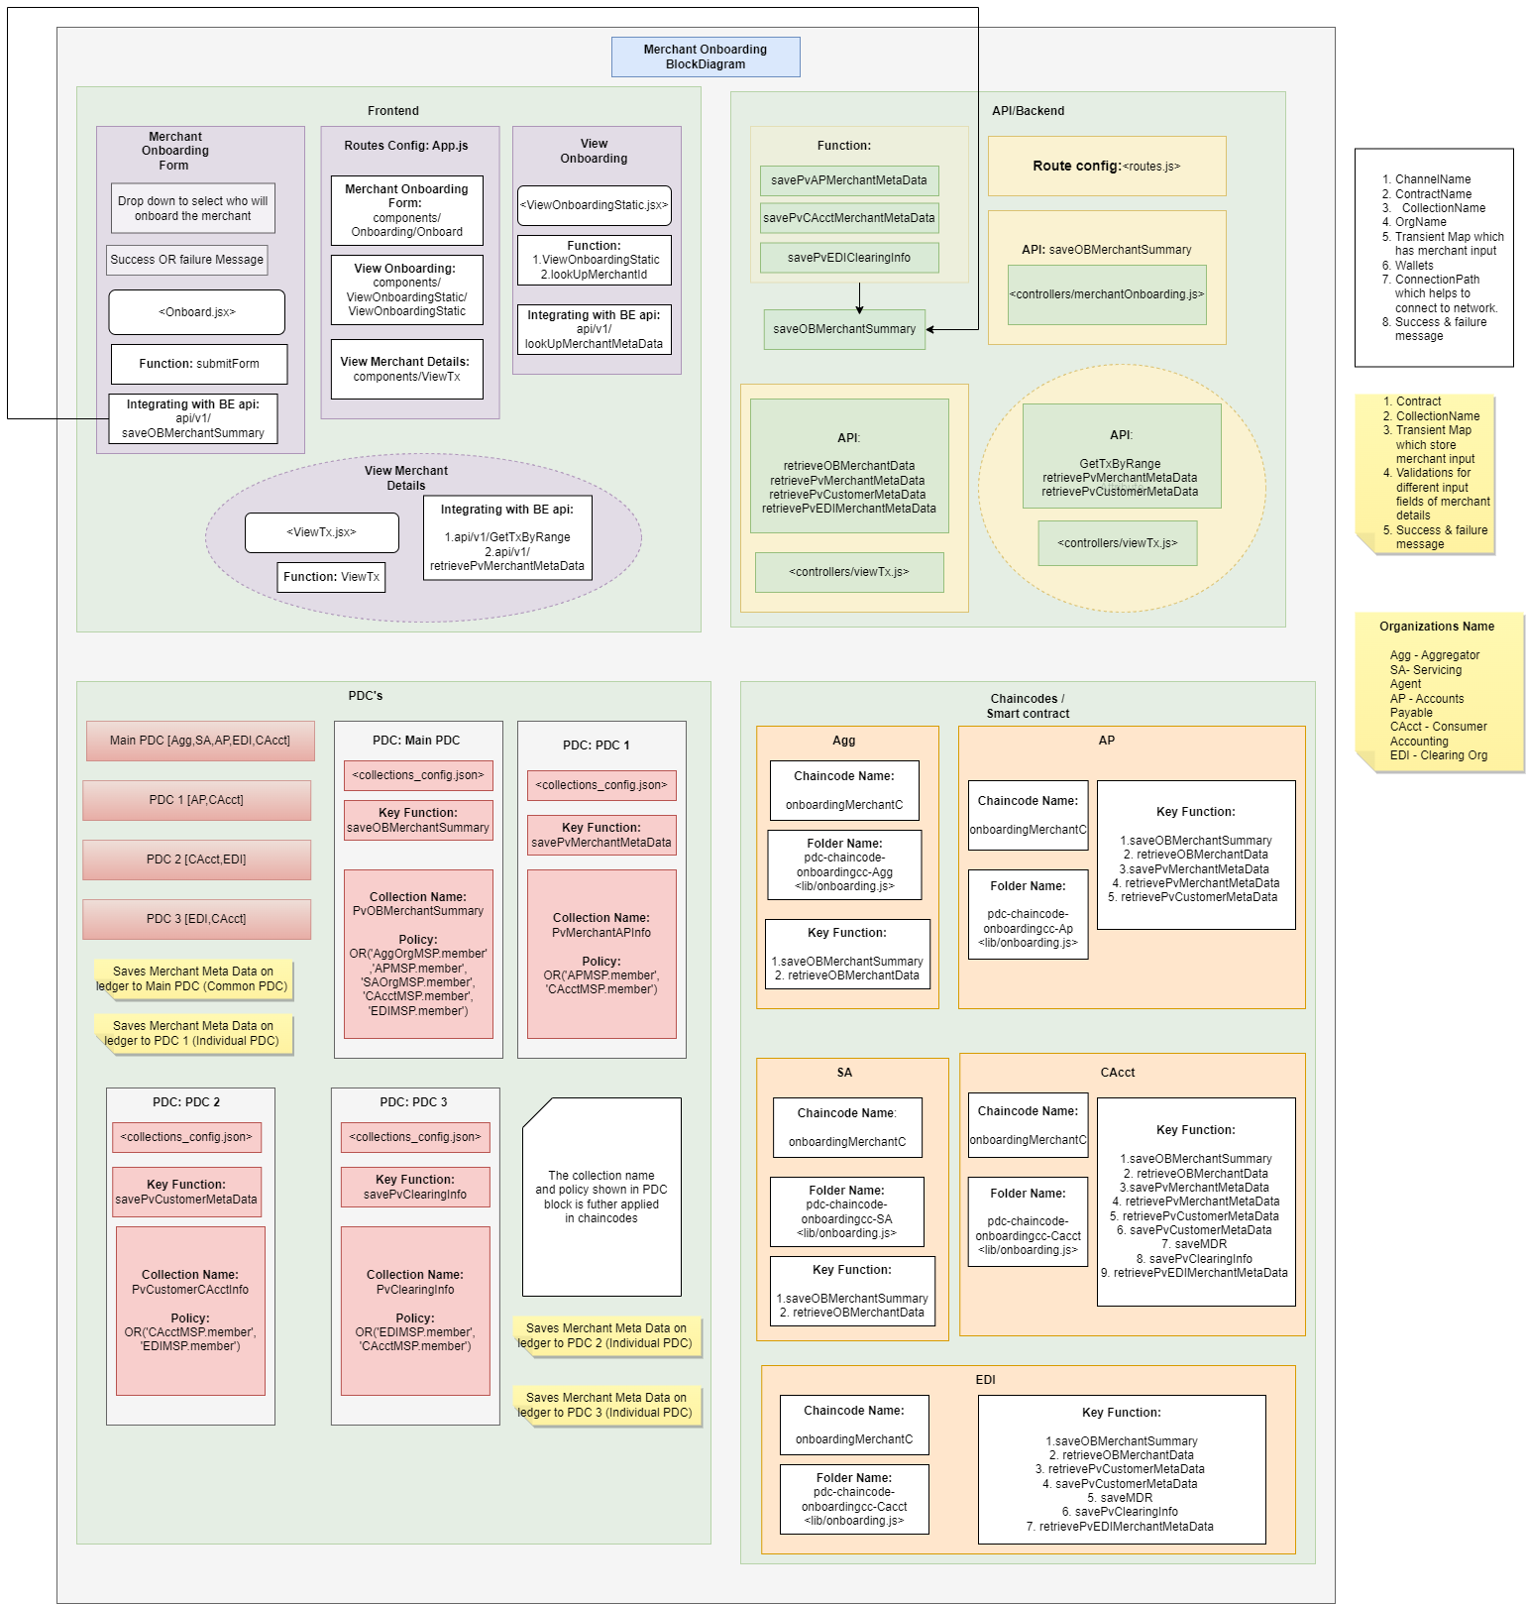
Final version of the block diagram of citizen bank poc(21/06/2023):

