Slide 1


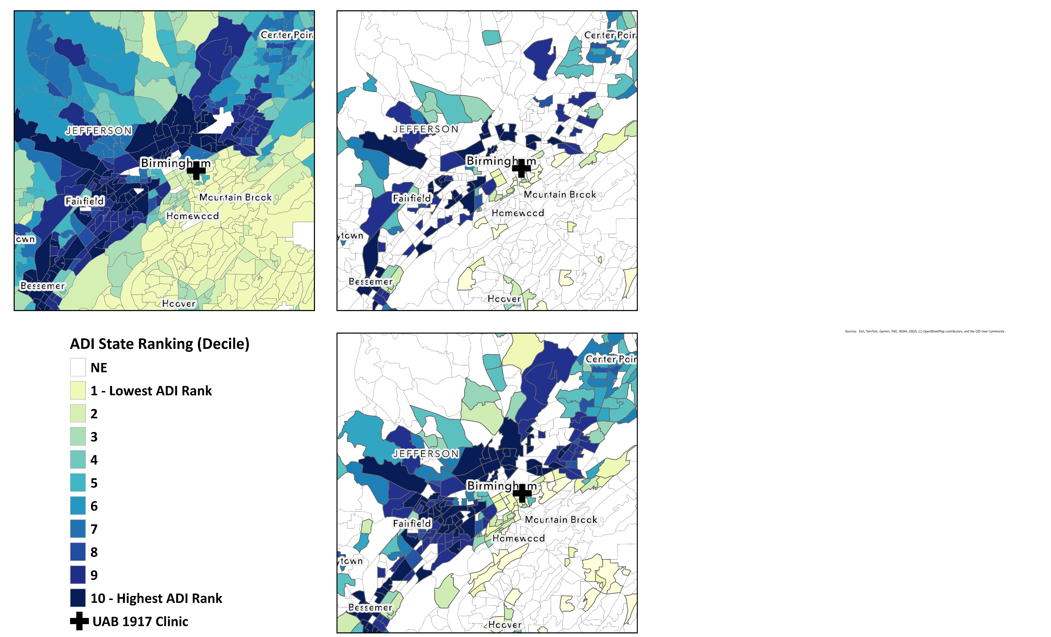

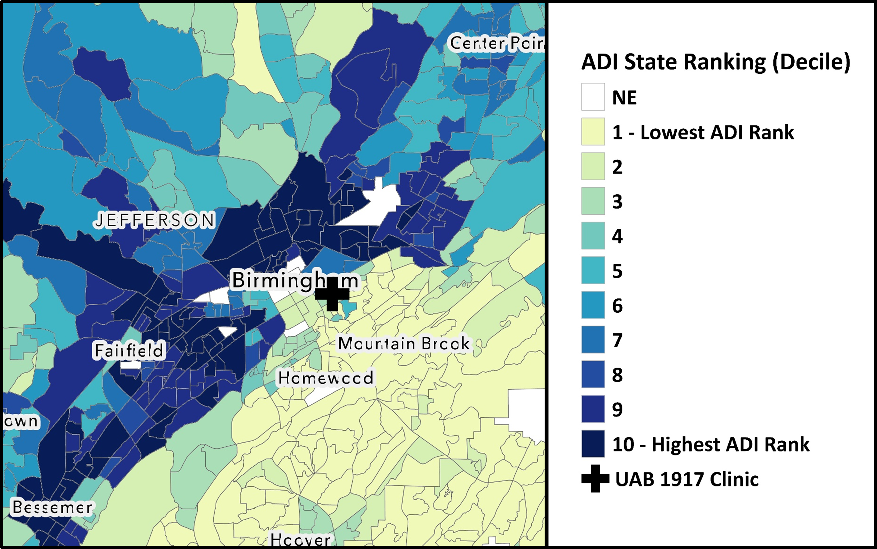
Neighborhood Deprivation and HIV Retention-in-Care in a Southern Metropolitan Setting
John R. Bassler ¹, Yookyong Lee ², Dylan B. Yates ³, Audrey Hai ³, James H. Willig ¹, James L. Raper ¹, and D. Scott Batey ³
915
Background
The environment in which people with HIV (PWH) reside plays a complex and influential role in shaping outcomes along the HIV Care Continuum. In this study, we investigated the Area Deprivation Index (ADI)—a comprehensive metric of neighborhood-level disadvantage which ranks geographic areas based on cumulative socioeconomic adversity—as a potential determinant of retention-in-care (RiC) among PWH.
Conclusions
For PWH newly established in HIV Care, neighborhood disadvantage (ADI ≥9) is significantly associated with lower rates of RiC, compared to neighborhoods with the lowest levels of neighborhood deprivation (ADI ≤2)
To advance equity in HIV care, targeted efforts are needed to disrupt the compounding effects of environmental disadvantage on care engagement and long-term health trajectories
Figure 2a. ADI, Previously Established PWH
Figure 1. Area Deprivation Index, Birmingham, AL, USA
Results
Total, N =3,692
The cohort consisted mostly of young Black men (<50 years) and diagnosed with HIV from 2010 to 2015
36.7% (n = 1,356) live in highly disadvantaged neighborhoods (ADI ≥ 9)
33.8% (n = 1,247) were previously established in HIV care
66.2% (n = 2,445) were newly established in care
Figure 2b. ADI, Newly Established PWH
Submission ID
2121565
Table 1. Multivariable analysis of RiC, stratified patient status at initial clinic visit
 | Previously Established |  | Newly Established
 | Frequency (Col. %) | Multivariable aOR (95% CI) | Frequency (Col. %) | Multivariable aOR (95% CI)
Neighborhood Deprivation |  | .66 |  | .0068
Low (ADI: 1-2) | 246 (19.7%) | Reference | 400 (16.4%) | Reference
Intermediate (ADI: 3-8) | 553 (44.3%) | 1.27 (0.77, 2.09) | 1137 (46.5%) | 0.63 (0.43, 0.93)
High (ADI: 9-10) | 448 (35.9%) | 1.16 (0.66, 2.04) | 908 (37.1%) | 0.55 (0.37, 0.82)
Methods
Observational cohort of PWH who:
Initiated HIV care between 2010 and 2022 at a university-affiliated clinic
Live within the Birmingham, Alabama Metropolitan Statistical Area (BMSA)
Neighborhood disadvantage was assessed using ADI, which ranks disadvantage of Alabama census block groups on a scale from 1 (least) to 10 (most), operationalized as tertiles (1-2 Low, 3-8 Intermediate, 9-10 High)
RiC, defined as completing at least two HIV care visits, ≥90 days apart, within 12-months of their initial clinic visit
Statistical Analysis:
Logistic regression via GEE, accounting for clustering at the census block group level
Stratified by patient status at initial clinic visit: previously established (virally suppressed, VL<200 copies/mL, at initial visit) or newly established (viremic at initial visit)
Regression Analysis
Previously established PWH (Table 1)
ADI was not significantly associated with RiC (p = .66)
Newly established PWH (Table 1)
ADI was significantly associated with RiC (p = .0068)
PWH in highly disadvantaged neighborhoods were significantly less likely to be retained in care, compared to Low ADI (aOR: 0.55; 95% CI: 0.37, 0.82)
Regardless of patient status at initial clinic visit, age was a significant predictor of RiC (both p <.001) and PWH ≥50 years were more likely to be RiC
Author Contact Information
John R. Bassler jbassle1@uab.edu
Yookyong Lee yoolee@uab.edu
Dylan B. Yates dyates@tulane.edu
Audrey Hai ahai@tulane.edu
D. Scott Batey dsbateu@tulane.edu
Acknowledgements
This research was supported by the University of Alabama at Birmingham College of Arts and Sciences Interdisciplinary Team Award.
1. Department of Medicine, The University of Alabama at Birmingham, Birmingham, AL
2. Department of Social Work, The University of Alabama at Birmingham, Birmingham, AL
3. School of Social Work, Tulane University, New Orleans, LA
Notes:
Poster Development Guide
Formatting Notes
To Edit In PowerPoint: Click View > Guides to make editing easier. Keep text within guides
If you wish, you may change the background colors, but use a light color or white for the overall background of the poster and a bold color for the main findings section
Author list: Don’t split names onto two lines (e.g., “John [line break] Smith”). If that happens, use a new line. Bold the name of the presenting author
Font Size: Do not drop below font size 36 in the main information sections (Background, Methods, Results, Conclusions). If you have extra space, increase the font size, but maintain some white space to make it easier for attendees to read your text
Use of Color: To keep attendees focused on your main findings and important details in your graphs and figures, do not use color in the sidebars
Print Size: Using this template, the optimal print size is 54 inches (width) x 36 inches (height) or 60 inches x 40 inches (137.2 cm x 91.4 cm or 152.4 cm x 101.6). Printing the poster in a smaller size may save some cost, but the 54” x 36” size will maintain the suggested font size and layout in the final printed version of the poster (and maintain the effectiveness of the poster design).
Poster Board Dimensions: Regardless of whether you use this template, the size of the board for displaying your poster at CROI is 96 inches (width) x 48 inches (height). The maximum size of a poster is 93 inches (width) x 45 inches (height). The minimum size for a poster is 36 inches (width) x 24 inches (height) so attendees can see the poster at a minimum of 10 feet away
Poster Content Requirements
Poster Number: The poster number should be displayed in the upper right corner (0000 in the template). This is not the abstract number you had during submission but a number you will be assigned and sent to you by email which notes the position of the poster in the poster hall. This number will be sent to you after late-breaking abstracts have been accepted in January
Poster Title: The title should be the same as the title submitted with the abstract
QR Codes are not allowed by CROI

