Slide 1
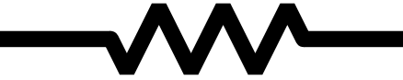
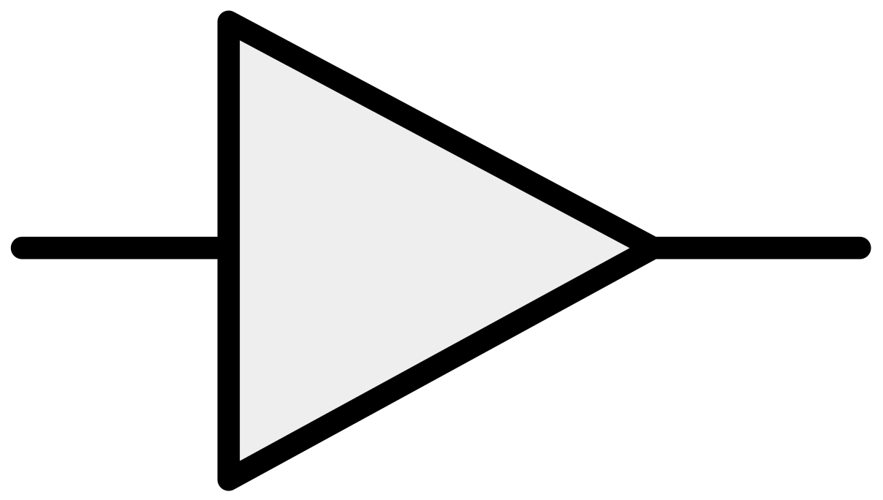
Attenuate Variety
Amplify Variety
Engineering Resilience
Systems Resilience
Complex Adaptive
System Resilience
Antifragile
Top-down C&C
Micro-management
Redundancy
Modularity
Loosely coupled
Diversity
Non-monotonicity
Emergence
Self-organization
Insert low-level stress
Network-connections
Fail Fast
Resources to invest
Seneca’s barbell
Insert randomness
Reduce naive intervention
Skin in the game
Learning Organization Personal mastery, Shared mental models, Building shared vision,
Team learning, Systems thinking.

Slide 2
Attenuate Variety
Amplify Variety
Engineering Resilience
Systems Resilience
Complex Adaptive
System Resilience
Antifragile
Top-down C&C
Micro-management
Redundancy
Modularity
Loosely coupled
Diversity
Optionality*
Non-monotonicity
Emergence
Self-organization
Insert low-level stress
Network-connections
Fail Fast
Resources to invest
Seneca’s barbell
Insert randomness
Reduce naive intervention
Skin in the game
Learning Organization Personal mastery, Shared mental models, Building shared vision,
Team learning, Systems thinking.
* Reinstated for research of success factors

