Slide 1

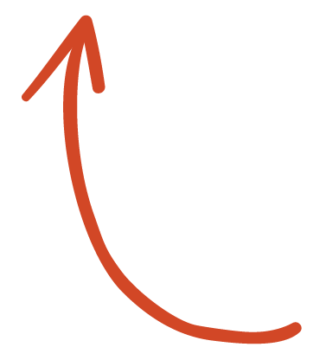
Here's your outline to get started
Key facts about your topic
k-means clustering is a method of vector quantization, originally from signal processing, that is popular for cluster analysis in data mining. k-means clustering aims to partition n observations into k clusters in which each observation belongs to the cluster with the nearest mean, serving as a prototype of the cluster. This results in a partitioning of the data space into Voronoi cells.
See more: Open the Notes below for more information.
Notes:
QuickStarter has created an outline to help you get started on your presentation. Some slides include information here in the notes to provide additional topics for you to research.

Slide 2
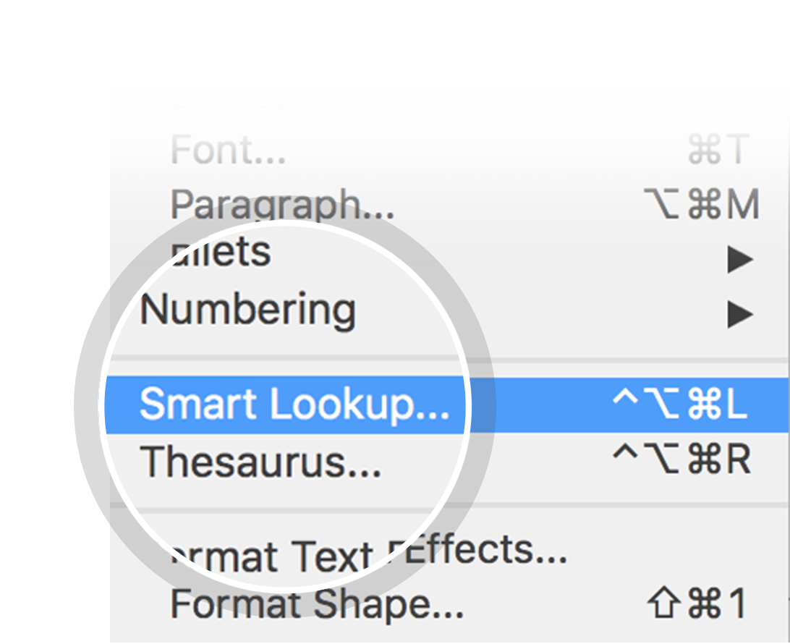
Related topics to research
K-means++
BIRCH
David Mount
Hugo Steinhaus
Hoshen–Kopelman algorithm
Use Smart Lookup to learn more
1
Highlight one of the related topics
Right-click on the topic
Choose "Smart Lookup"
2
3

Slide 3
k-means clustering

Slide 4
Contents
Algorithms
Relation to other statistical machine learning algorithms
Similar problems
Software implementations

Slide 5
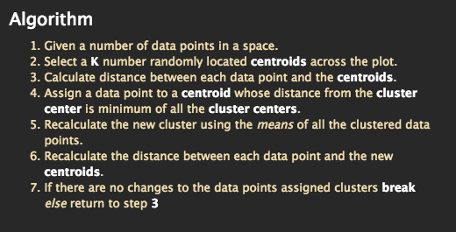
K-Means
K-Means is unsupervised learning algorithm.
Classifies a given dataset into a K number of clusters.
Notes:
Consider talking about:
Standard algorithm
Complexity
Hartigan-Wong method

Slide 6
Common uses
Image Segmentation
News Article Clustering
Clustering Languages
Anomaly Detection
Species clustering
Notes:
Consider talking about:
Gaussian mixture model
Principal component analysis
Mean shift clustering
Independent component analysis
Bilateral filtering

Slide 7
Software implementation
MGdrivE. Mosquito dataset was used for the implementation.
Developed on
Python 3.7
Jupyter Notebook
Libraries
Numpy mean function
Pandas read csv function
Matplotlib for plotting
Notes:
Consider talking about:
Free Software/Open Source
Proprietary

Slide 8
Works cited
Mubaris NK, “K-means” https://mubaris.com/posts/kmeans-clustering/
“K-means clustering algorithm” https://sites.google.com/site/dataclusteringalgorithms/k-means-clustering-algorithm

