Slide 1
Objectives
Explain the concept of a relational database
Define the terms flat file, entity, attribute, primary key, foreign key, secondary key, entity relationship modelling, referential integrity
Produce an entity relationship model for a simple scenario involving multiple entities

Slide 2
A simple database
The simplest kind of database is a flat file, consisting of information about a single entity
Definition: An entity is a category of object, person, event or thing of interest about which data needs to be recorded
For example you might hold data about club members or concert venues

Slide 3
Database design
Most databases hold data about several entities
Suppose you are going to design a new system for a company selling subscriptions for online revision guides
Where do you start?

Slide 4
Looking at the data
One of the first things you need to do is look at the data
What entities are there in a system that will keep records of subscriptions for revision guides?

Slide 5
Entities
You may have thought of these entities:
Customer
Guide or Product
Subscription
Other entities that could be considered include customer order, subject, author (of a revision guide)
We will keep it simple and just consider Customer, Product and Subscription
What data would you keep about each of these entities?

Slide 6
Writing an entity description
This will be a database system, called RevisionSubs
Each entity in the database has attributes
The entity descriptions can be written in this format:
Customer (custID, title, firstname, surname, email)
Product (productID, title, subject, level, price)
Subscription (subID, startDate, endDate)

Slide 7
Entity identifier (primary key)
Each entity needs an identifier which uniquely identifies a particular record
In a relational database, the identifier is known as the primary key
It is underlined in the entity description:
Customer (custID, title, firstname, surname, email)
Product (productID, title, subject, level, price)
Subscription (subID, startDate, endDate)
If there is no natural attribute for a primary key, one should be introduced

Slide 8
Composite primary key
Sometimes two or even more attributes are needed to uniquely define a record
For example, in a customer order consisting of many different order lines, each order line may be uniquely identified by the two attributes orderNumber and orderLine
OrderLine (OrderNumber, OrderLine, ProductID, …)
OrderNumber, OrderLine is a composite primary key

Slide 9
Secondary key
The primary key field is automatically indexed so that any particular record can be found very quickly
In some databases, searches may often need to be made on other fields
In the product table,
Product (productID, title, subject, level, price)
if searches often need to be made on title or subject, either or both of these fields could be defined as a secondary key
They would then be indexed for faster lookups

Slide 10
Relationships between entities
The three entities are linked, or related
There are three possible ways in which two entities may be related:
One-to-one e.g. Husband and Wife
One-to-many e.g. Mother and Child, School and Pupil
Many-to-many e.g. Actor and Film, Recipe and Ingredient
What is the relationship between Customer and Subscription?
What is the relationship between Product and Subscription?

Slide 11
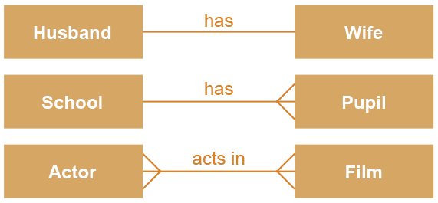
Entity relationship diagrams
An entity relationship (E-R) diagram is a graphical way of representing the relationships between entities
We can say, for example, that one school has many pupils, or many pupils attend one school
One-to-One
One-to-Many
Many-to-Many

Slide 12

E-R diagram
There is a one-to many relationship between Customer and Subscription
One customer may have several subscriptions, but a particular subscription belongs to only one customer
There is a one-to-many relationship between Product and Subscription
One product may appear on several subscriptions, but a subscription is for only one product

Slide 13
Database structure
Each entity is represented by a table
Tables in a relational database are commonly referred to as relations
A database contains one or more relations
A relation has rows, each row containing one record
The columns in the relation each contain one field (i.e. attribute) belonging to the records

Slide 14
Creating a relationship
To create a relationship between Customer and Subscription, we need to include custID in the entity description of Subscription
Subscription (subID, startDate, endDate, custID )
ProductId also needs to be included in the entity description of Subscription
Subscription (subID, startDate, endDate, custID, productID)
custID and productID are foreign keys in Subscription, shown in italics
A foreign key always goes on the “many” side of a relationship

Slide 15
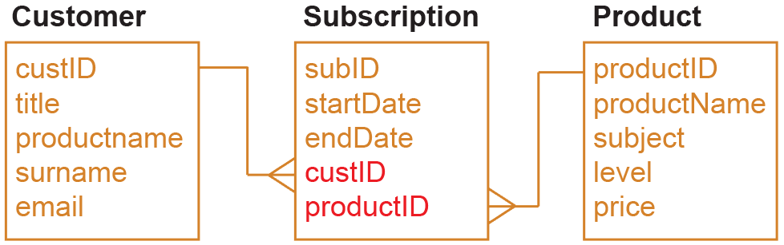
Foreign key: definition
A foreign key is an attribute that creates a join between two tables (relations)
It is the primary key in the first relation
Draw an entity relationship diagram to show the relationships between the three entities

Slide 16
Referential integrity
Referential integrity means that no foreign key in one table can reference a non-existent record in a related table
For example, it should not be possible to add a subscription for a customer with custID C100 if there is no record for customer C100

Slide 17
The RevisionSubs database
The tables (relations) on the next slide represent the three entities described, each with its own attributes
We will use the convention of giving each table name the prefix tbl
Each table contains some sample data

Slide 18
RevisionSubs tables
tblCustomer
custID | title | firstname | surname | email
C111 | Mr | Fred | Carr | fcarr53@gmail.com
C245 | Miss | Mabel | Jenkins | mabel777@bt.com
C364 | Miss | Jasmine | Kumar | jkumar@icloud.com
tblSubscription
subID | startdate | endDate | custID | productID
S1211 | 25/02/2016 | 24/02/2017 | C111 | P36
S1212 | 01/02/2016 | 31/01/2017 | C111 | P47
S1213 | 04/02/2016 | 03/02/2017 | C245 | P36
tblProduct
productID | productName | subject | level | price
P24 | Equations | Maths | 2 | £12.00
P36 | Programming | Comp Science | 4 | £25.00
P47 | Database | Comp Science | 4 | £25.00

Slide 19
Worksheet 2
Do Task 1 and Task 2 on the worksheet

Slide 20

Many-to-many relationships
When there is a many-to-many relationship between tables, they cannot be directly linked
For example, you cannot link the entities Customer and Product directly
Why not?

Slide 21
Many-to-many relationships
You would need several fields in tblCustomer to hold the ProductID of each product a customer has subscribed to
But how many fields would you allow?
How would you find all customers who had subscribed to a particular product?
custID | title | firstname | surname | email | ProdID1 | ProdID2
C111 | Mr | Fred | Carr | fcarr53@gmail.com | P36 | P47
C245 | Miss | Mabel | Jenkins | mabel777@bt.com | P36
C364 | Miss | Jasmine | Kumar | jkumar@icloud.com | P25 | P36

Slide 22
Many-to-many relationships
This configuration does not work
It is impractical to allow several fields ProdID1, ProdID2, etc.
You cannot easily extract information from this table
An alternative way of organising the data is required
custID | title | firstname | surname | email | ProdID1 | ProdID2
C111 | Mr | Fred | Carr | fcarr53@gmail.com | P36 | P47
C245 | Miss | Mabel | Jenkins | mabel777@bt.com | P36
C364 | Miss | Jasmine | Kumar | jkumar@icloud.com | P25 | P36

Slide 23


Linking tables
Suppose you have a table holding details of gym members and the classes they take – yoga, indoor cycling, pilates, interval training, etc.
You need a link table “in the middle” just as the entity Subscription was between Customer and Product

Slide 24

Plenary
Identifying entities and drawing an entity relationship diagram is the first step in designing a database
Many-to-many relationships cannot be represented in database tables; an extra table is required
Note that the “many” side of the two resulting one-to-many relationships is always the link table
The link table will contain the primary keys of the other tables as foreign keys

