Slide 1
CO₂MPAS: User Communication
24-Nov-2016: "Rally" release

Slide 2
Reporting bugs/errors, asking questions to the CO₂MPAS-Team
It is very important that all CO₂MPAS users assist in its further improvement by:
Providing feedback when available
Communicating bugs/errors in the software
Requesting specific guidance when necessary
CO₂MPAS team will support you
and try to find the solution as soon as possible given the availability of resources.
visit co2mpas.io

Slide 3
How to reach us
CO₂MPAS website www.co2mpas.io provides a series of links
To raise issues, visit the CO₂MPAS repository page (GIT-hub page):

Slide 4
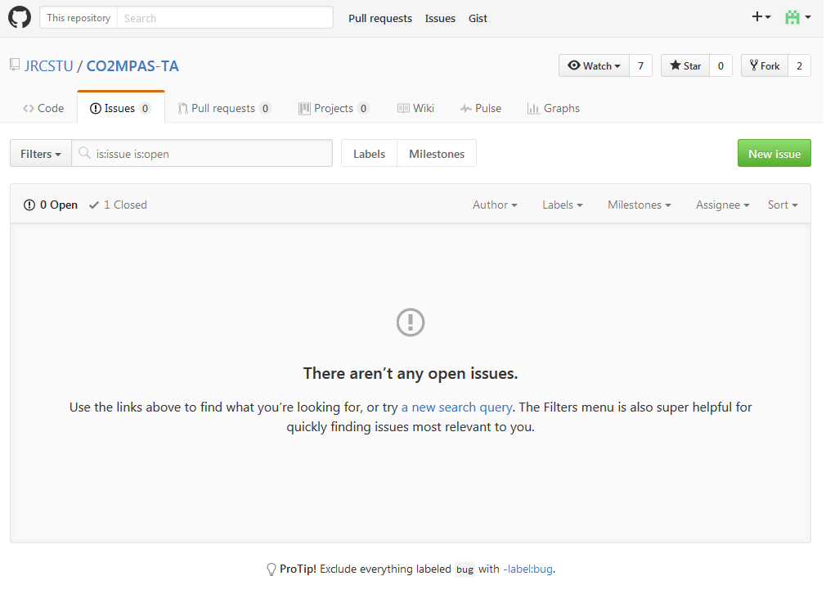
Reporting bugs/errors, asking questions
https://github.com/JRCSTU/CO2MPAS-TA/issues
Either search for an existing issue, that could solve your problem
Or create a new one.
An automatic notification will
be sent to the developers and
you will receive notifications
when an answer is provided.
visit co2mpas.io

Slide 5
Reporting bugs/errors, asking questions
https://github.com/JRCSTU/CO2MPAS-TA/issues
visit co2mpas.io

Slide 6
Reporting bugs/errors, asking questions
Some notes:
Make sure that your question has not yet been asked before by using the search box.
Give as much information as possible regarding the problem faced and, if possible, provide files to the CO₂MPAS-Team to be able to replicate the problem.
Alternatively, you can send an e-mail to the CO₂MPAS functional mailbox: CO2MPAS@jrc.ec.europa.eu
For more information, you can visit the
CO2MPAS user guidelines:
https://github.com/JRCSTU/CO2MPAS-TA/wiki/CO2MPAS-user-guidelines
visit co2mpas.io

Slide 7
Reporting bugs/errors, asking questions
Important links:
https://github.com/JRCSTU/CO2MPAS-TA/issues
CO2MPAS@jrc.ec.europa.eu (functional mailbox)
Useful links:
https://github.com/JRCSTU/CO2MPAS-TA/wiki/CO2MPAS-user-guidelines
https://github.com/adam-p/markdown-here/wiki/Markdown-Cheatsheet
Thank you for your attention
visit co2mpas.io

