Slide 1
The CO₂MPAS tool
G. Fontaras,
V. Arcidiacono, V. Valverde, K. Anagnostopoulos, S. Tsiakmakis, B. Ciuffo, J. Pavlovic, D. Komnos
Ispra, 17/11/2016

Slide 2

Approach – Phasing-in
During the WLTP phasing-in, WLTP measurements will be correlated into NEDC values using CO₂MPAS (CO₂ Model for PAssenger and commercial vehicles Simulation), developed by JRC.
WLTP-based vehicle Type-Approval
CO₂MPAS meta-model
NEDC-equivalent CO₂ emissions
NEDC-based OEM performance

Slide 3

CO₂MPAS data flow overview
Data Entry
Reporting
Veh. characteristics
WLTP Bag CO₂
WLTP time series
Processing
Sub models calibration
NEDC simulation
Simulated time-series
Summary Report
Dice report

Slide 4
Key features
Comprises of 2 main calculation modules
Power – RPM module
Simple longitudinal dynamics (WLTP-GTR)
Engine power and RPM calc’d @ 1hz
Inclusion of Mech or Elec. loads where needed
Generic start-stop logic
A/T and CVT RPM prediction model
Alternator logic calibrated over WLTP
FC module
Calculation of FC
Indicative instantaneous approach
Based on an extended Willans model
Semi-physical empirical cold start model
Calibration - Optimization based on WLTP results
Specific engine technologies included
+Parallel work for HEV control module and optimization
Accurate calculation of average / instantaneous power demand
Very good accuracy when compared with results obtained from the Cruise simulations by LAT and Real test data from 40 vehicles

Slide 5
Power demand @ the wheel
Gearshifting / Engine RPM pred. Logic
Losses Differential
Losses TC / Clutch
Losses GB
Engine RPM Model
Electric power demand
Electrical System Logic
Currents Alternator
CurrentsBattery
Engine
Torque Losses
WLTP measurements
(Bag CO2 & Timeseries signals)
Total Engine Power Demand Model
Engine Temperature model
WLTP CO₂ (Initial estimate)
Fuel Consumption Model
Cycle, Road loads & Vehicle Characteristics
FCM
Optimization
WLTP CO₂ (Calibrated)
Cycle Prediction

Slide 6
CO₂MPAS sub-models
CO₂MPAS includes the following sub-models:
Automatic Transmission model (gear shifting)
Clutch / Torque converter model score
Engine cold start speed model
Engine speed model
Start stop model
Alternator model
Engine coolant temperature model
Engine fuel consumption (CO₂ ) model

Slide 7
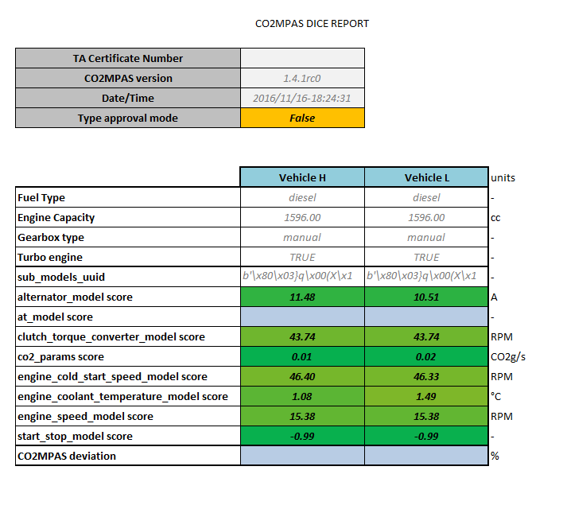
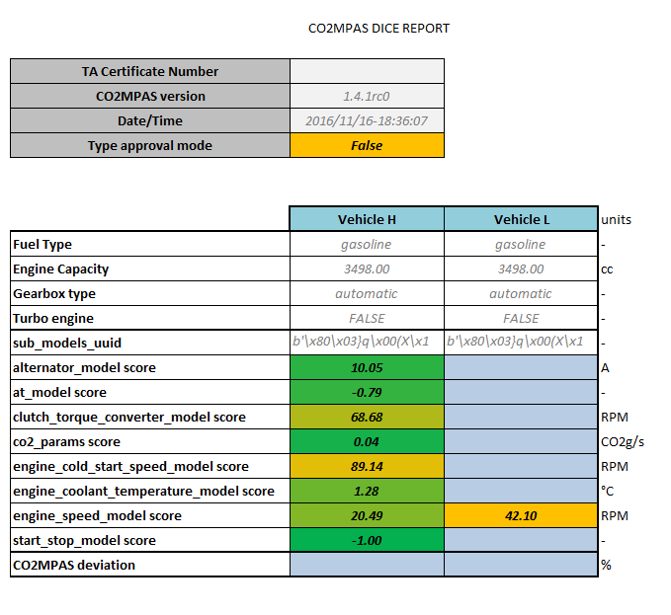
CO₂MPAS self assessment of internal models
Mean absolute error (quantities with units)
Calibration coefficient for unit-less quantities

Slide 8
Automatic Transmission model (gear-shifting 1/2)
There are 2 official options enabled in the A/T model:
Corrected Mean Velocity (CMV) creates a “map” of gear upshifts and down-speeds as a function of vehicle speed.
GearShift Power-Velocity (GSPV) creates a map of gear upshifts as a function of vehicle speed & the power at the gearbox
CO₂MPAS automatically selects the option that better reproduces gear shifting over WLTP
Two sets of gear-shift maps are calculated, hot and cold conditions
In engineering mode the DT option can be also enabled
GSPV example
Power (kw)
Velocity (km/h)

Slide 9
Automatic Transmission model (gear-shifting 2/2)
Final step: Matrix Velocity Limits (MVL) correction model corrects gear-shifting over quasi-steady state conditions ()

Slide 10
Automatic Transmission model (gear-shifting 2/2)
For CVTs a gradient boost regressor is used to predict Engine RPM as a function of vehicle speed, acceleration and power at the gearbox

Slide 11
Clutch / Torque converter model
CO₂MPAS by default calibrates a clutch model (generic or DTC) unless a TC is declared as present on the vehicle:
In both cases an “RPM-slip” model as a function of acceleration is fitted based on experimental data
Efficiency model (predefined non calibrated):
Clutch: linear TC efficiency as a function of RPM ratio
TC: a non-linear efficiency as a function of RPM ratio
For TCs a lock up velocity (48km/h) is used

Slide 12
Engine cold start speed model
The ECSSM increases idling RPMs during the cold start phase
An optimizer is used to calculate the unit less ΔRPM_{idle} [%] function during cold start
ΔRPM is a linear function o f engine temperature capped at a certain value which is also estimated by the optimizer
Examples

Slide 13
Engine speed model
The ESM calculates the exact RPM/Velocity ratios over the specific test
Gear ratios (or default RPM/V ratios) and information on tyre dimensions provided by the user are used as starting values
An optimizer calculates the optimal dynamic radius of the tire based on the dyno velocity and engine RPM data measured over the WLTP

Slide 14
Start stop model
The SS model defines where the engine should be switched off for SS equipped vehicles
CO₂ MPAS uses a classifier in order to associate engine switch off events to vehicle deceleration and velocity.
SS functionality is initiated based on the user provided input on engine SS initiation time

Slide 15
Alternator model
Comprises of 2 parts:
Logic part (when the alternator operates and how)
Electric part (what current is supplied by the alternator)
Logic part identifies different phases (idling, regenerative braking, battery charging, battery depletion) and under what conditions those occur → result: alternator status
Electric part identifies the current per each phase based on other parameters (eg RPM, Battery SOC, deceleration)
A gradient boost regressor is used for predicting the currents based on alt. status, acceleration, power at g/box, SOC at t-1, and initialization time

Slide 16
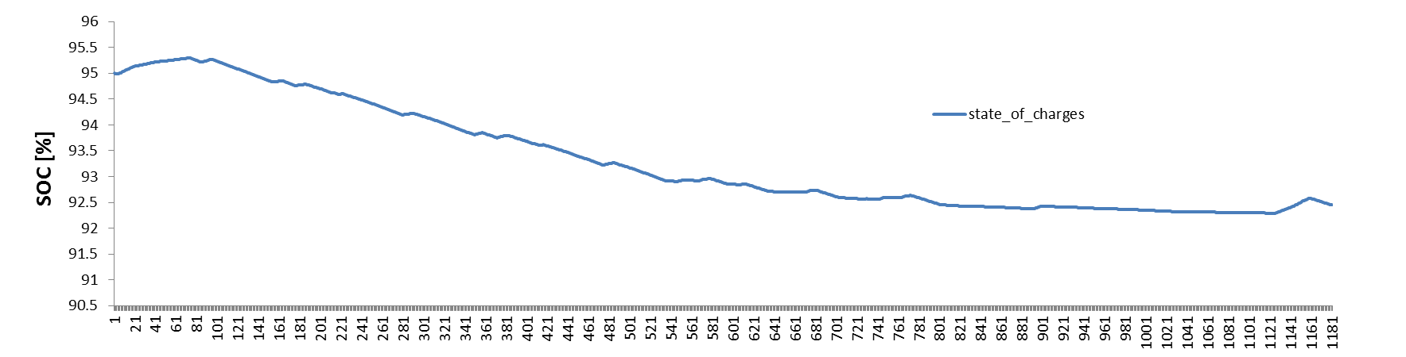
Alternator logic and current prediction

Slide 17
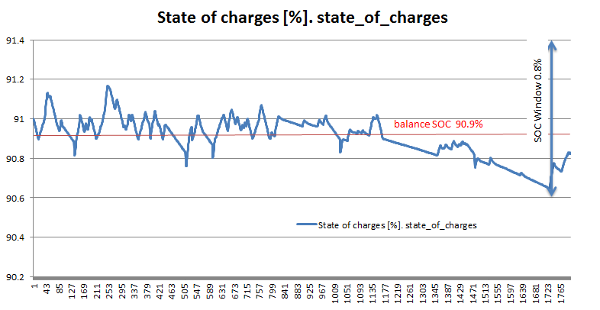
Alternator logic and current prediction -windows

Slide 18
Engine coolant temperature model
CO₂MPAS uses a regressor to predict engine temperature (T) evolution
T_{i} is function of T_{i-1} , RPM, acceleration and the power at the gearbox
The regressor is calibrated based on WLTP recorded time series using Gradient Boost algorithm (ransac algorithm used for inlier and outlier detection)

Slide 19
Engine fuel consumption (CO₂) model
Extended Willans Model approach:
Fitting of a specific non-linear Willans model
BMEP=(a+b×cm+c×c_{m}²)×FuMEP+(a2×FuMEP²)+l₀+l₂×cm²
Where:
BMEP: brake mean effective pressure
cm: mean piston speed
FuMEP: fuel mean effective pressure
a, b, c, a2, l0, l2 are the parameters that are being fitted

Slide 20
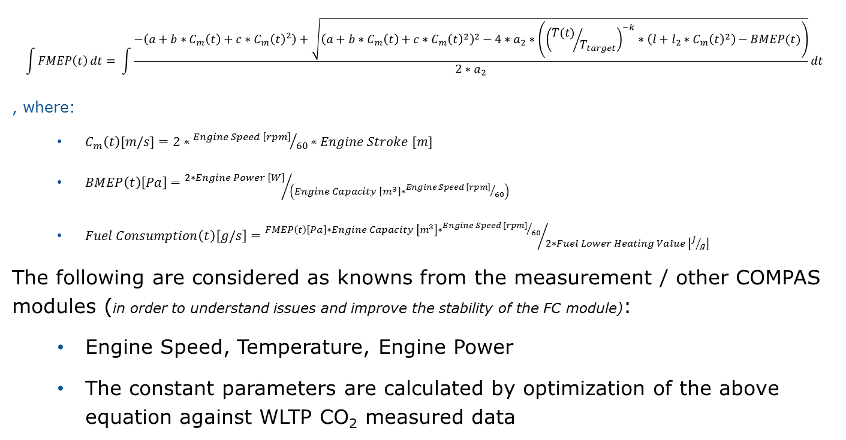
Fuel Consumption (Fc) Calculation Function
Engine fuel consumption (CO₂) model
$$\int{FMEP\left(t\right)}dt= \int{\frac{−\left(a+b∗C_{m}\left(t\right)+c∗{C_{m}\left(t\right)}^{2}\right)+\sqrt{{\left(a+b∗C_{m}\left(t\right)+c∗{C_{m}\left(t\right)}^{2}\right)}^{2}−4∗a_{2}∗\left({\left({T(t)}/{T_{target}}\right)}^{−k}∗\left(l+l_{2}∗{C_{m}\left(t\right)}^{2}\right)−BMEP(t)\right)}}{2∗a_{2}}}dt$$
, where:
$C_{m}\left(t\right)[m/s]=2∗{Engine Speed \left[rpm\right]}/{60}∗Engine Stroke [m]$
$BMEP\left(t\right)\left[Pa\right]={2∗Engine Power \left[W\right]}/{\left(Engine Capacity \left[m^{3}\right]∗{Engine Speed \left[rpm\right]}/{60}\right)}$
$Fuel Consumption\left(t\right)\left[g/s\right]={FMEP\left(t\right)\left[Pa\right]∗Engine Capacity \left[m^{3}\right]∗{Engine Speed [rpm]}/{60}}/{2∗Fuel Lower Heating Value \left[J/g\right]}$
The following are considered as knowns from the measurement / other COMPAS modules (in order to understand issues and improve the stability of the FC module):
Engine Speed, Temperature, Engine Power
The constant parameters are calculated by optimization of the above equation against WLTP CO₂ measured data
Cold start factor

Slide 21
Engine fuel consumption (CO₂) model
Extended Willans Model is calibrated using WLTP CO₂ results
An initial estimate is made based on generic values (categorized per engine and aspiration type)
The model perturbates until the initial and final estimate of the CO₂ time series converge
A final optimization is done in order to reduce the error in the WLTP bag value prediction.
Specific technologies are currently considered using the Extended Willans approach
For Petrol engines: Variable valve actuation, Lean combustion, Aspiration type, Cylinder deactivation (limited validation), External EGR (limited validation)
For Diesel engines: External EGR, Cylinder deactivation (limited validatipn), Selective catalytic reduction (limited validation)

Slide 22
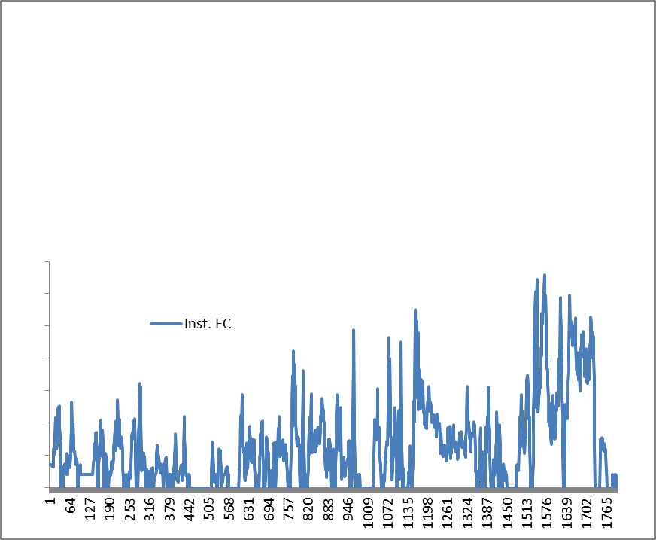
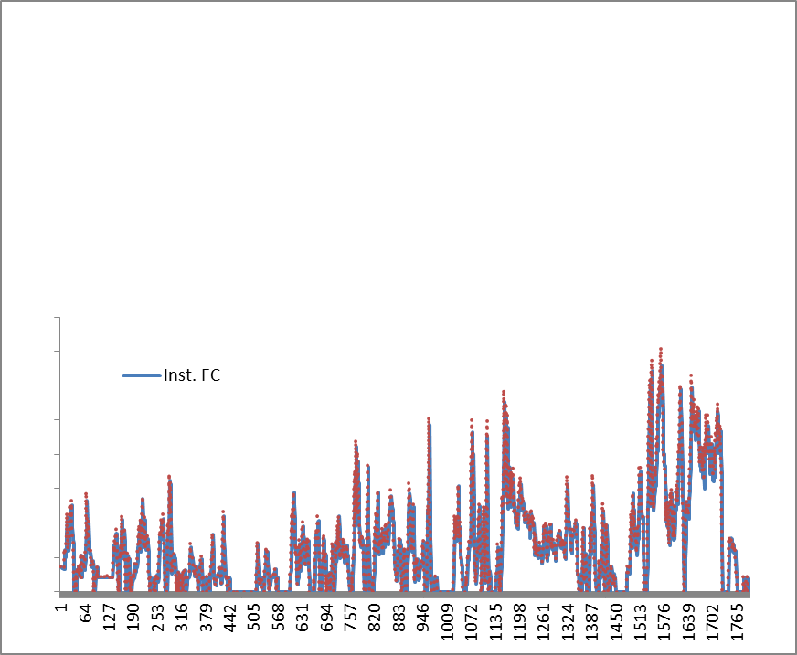
Optimization path
Initial guess
Rescaling
Optimization

Slide 23
Summary

Slide 24


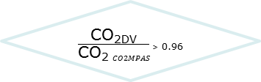
Correlation and CO₂MPAS Process flow chart
TA Report
Input CO₂MPAS GUI
TA data – NEDC DV – TA Doc.
WLTP Test Data
DF & VF
Initial Engine -CO₂ model setup
Generic Values Selection
Physical NEDC Test
NEDC TA
No – Accept DV, Add Hash in TA doc
Engine - CO₂ model calibration / Instantaneous samples
Sub models calibration (Eng. Temp., RPM, G/box, Clutch-TC, Power)
WLTP (prediction) & NEDC Test simulation
Yes - Engine data. update
Yes
NEDC to be tested?
WLTP CO₂ Improving?
Final Engine -Vehicle model setup
WLTP & NEDC sim. data
Dice report emailed to Timestamp Server
No
Engine - CO₂ model trimming / WLTP bag values
Reports (Summary, Dice)
Yes
No
$\frac{\text{CO}\text{2}\text{DV}}{\text{CO}\text{2} CO2MPAS}$ > 0.96

Slide 25
Correlation and CO₂MPAS Process flow chart
TA Report
Input CO₂MPAS GUI
TA data – NEDC DV – TA Doc.
WLTP Test Data
DF & VF
Procedures’ Space
Initial Engine -CO₂ model setup
Generic Values Selection
Physical NEDC Test
NEDC TA
No – Accept DV, Add Hash in TA doc
Engine - CO₂ model calibration / Instantaneous samples
Sub models calibration (Eng. Temp., RPM, G/box, Clutch-TC, Power)
WLTP (prediction) & NEDC Test simulation
Yes - Engine data. update
Yes
NEDC to be tested?
WLTP CO₂ Improving?
Final Engine -Vehicle model setup
WLTP & NEDC sim. data
Dice report emailed to Timestamp Server
No
Engine - CO₂ model trimming / WLTP bag values
Reports (Summary, Dice)
Yes
CO₂CO₂MPAS <1.04 · CO₂DV
No

Slide 26
Correlation and CO₂MPAS Process flow chart
TA Report
Input CO₂MPAS GUI
TA data – NEDC DV – TA Doc.
WLTP Test Data
DF & VF
Initial Engine -CO₂ model setup
Generic Values Selection
Physical NEDC Test
NEDC TA
No – Accept DV, Add Hash in TA doc
Engine - CO₂ model calibration / Instantaneous samples
Sub models calibration (Eng. Temp., RPM, G/box, Clutch-TC, Power)
WLTP (prediction) & NEDC Test simulation
Yes - Engine data. update
Yes
NEDC to be tested?
WLTP CO₂ Improving?
Final Engine -Vehicle model setup
WLTP & NEDC sim. data
Dice report emailed to Timestamp Server
No
Engine - CO₂ model trimming / WLTP bag values
Reports (Summary, Dice)
Yes
No
$\frac{\text{CO}\text{2}\text{DV}}{\text{CO}\text{2} CO2MPAS}$ > 0.96

Slide 27







Stay in touch
JRC Science Hub: www.ec.europa.eu/jrc
Twitter: @EU_ScienceHub
LinkedIn: european-commission-joint-research-centre
YouTube: JRC Audiovisuals
Vimeo: Science@EC
https://co2mpas.io
co2mpas@jrc.ec.europa.eu

Slide 28
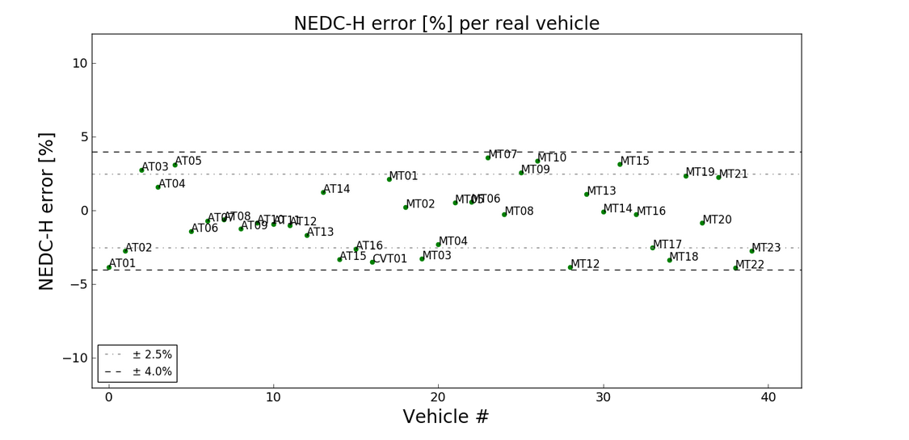
Validation against 39 real cars
Results within +-4%
MT: Manual Transmission, AT: Automatic transmission, CVT: constant variable transmission

Slide 29
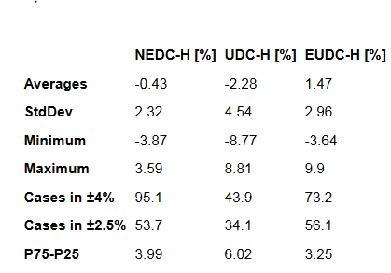
Validation against 39 real cars

Slide 30
Evaluation AT model options
Method | Top Performance | Average Performance | Prediction vs Calibration | Computational Time
Decision Tree | Good | Good | Bad | Good
CMV | Neutral | Good | Good | Bad
GSPV | Neutral | Neutral | Good | Good
GSPV appears to offer the most advantages
Decision tree gives good results but is unstable
JRC proposal is to use the best of CMV – GSPV, identified on
a case by case basis (see ex – post analysis)

Slide 31
CO₂ Results on selected profiles
Vehicle | Cycle | Validation CO2 | Error (g/km) corrected matrix velocity | Error (g/km) corrected matrix power velocity | Error (g/km) corrected matrix velocity hot/cold | Error (g/km) corrected matrix power velocity hot/cold | Error (g/km) decision tree | Error (g/km) decision tree power | Error (g/km) decision tree temperature | Error (g/km) decision tree temperature power
BMW 328i | NEDC | 170.7 | - | 1.4 | - | 1.2 | - | - | 2 | -
 | WLTP | 193.7 | - | -0.7 | - | - | - | - | -0.2 | -
AUDI A8 | NEDC | 169.7 | 3.1 | - | 2.8 | - | - | - | 1.6 | 1.8
 | WLTP | 189.5 | - | - | 0.9 | - | - | - | 0.2 | -
Mercedes E350 | NEDC | 174.6 | 0.4 | 0.6 | - | - | 1.5 | - | - | -
 | WLTP | 203.1 | - | 0.1 | - | - | -0.4 | - | - | -
Opel Mokka | NEDC | 161.9 | - | - | 0.6 | 0.9 | 3.4 | - | - | -
 | WLTP | 171.7 | - | - | -1.4 | - | 0.1 | - | - | -
Smart ForTwo | NEDC | 105.9 | 2.9 | - | 2.8 | - | - | - | 2.9 | 2
 | WLTP | 131 | - | - | 1.9 | - | - | - | 1.7 | -
Volvo V40 | NEDC | 220.9 | 2.3 | - | - | - | 1.6 | - | 1.7 | -
 | WLTP | 222.2 | -1.6 | - | - | - | -0.5 | - | - | -
Average | NEDC |  | 2.2 | 1.0 | 2.1 | 1.1 | 2.2 |  | 2.1 | 1.9
 | WLTP |  | -1.6 | -0.3 | 0.5 |  | -0.3 |  | 0.6
For vehicle the DT was studied separately from the other two methods
The methods with the best score over NEDC and WLTP were selected
Simulations were run with both (WLTP & NEDC best case)
The error introduced from not selecting the best NEDC case but relying solely on WLTP best case is in the order of 0.2-0.4g/km.
NEDC appears to be overestimated by 1.5g/km. An equal compensation can be applied in the final results.

Slide 32
JRC proposal
CMV – CMPV appear to be more stable, all present the same error range in NEDC CO₂ prediction
Proposal to use CMV-CMPV in the batch runs and final compas version, selection to be made based on the best WLTP performance
Based on the current analysis JRC proposes to adopt the following correction
NEDC_{final} = NEDC_{compas predicted} – absolute (Error_{wltp prediction})
Where: Error_{wltp prediction} = CO2compas estimation with OBD RPM – CO2 compas estimation with A/T tool RPM
In all cases COMPAS calibration is done based on OBD recorded RPMs
End results will look like this:
Vehicle | Cycle | Error (g/km) corrected matrix velocity | Error (g/km) corrected matrix power velocity | Error (g/km) corrected matrix velocity hot/cold | Error (g/km) corrected matrix power velocity hot/cold
BMW 328i | NEDC |  | 0.7
AUDI A8 | NEDC |  |  | 1.9
Mercedes E350 | NEDC |  | 0.5
Opel Mokka | NEDC |  |  | -0.8
Smart ForTwo | NEDC |  |  | 0.9
Volvo V40 | NEDC | 0.7
Average | NEDC | 0.7 | 0.6 | 0.7

Slide 33
TC

