Slide 1
CO₂MPAS: Dice Workflow
Ispra, 24-Nov-2016
K. Anagnostopoulos, V. Valverde, J. Pavlovic B. Ciuffo, G. Fontaras, S. Tsiakmakis, D. Komnos

Slide 2
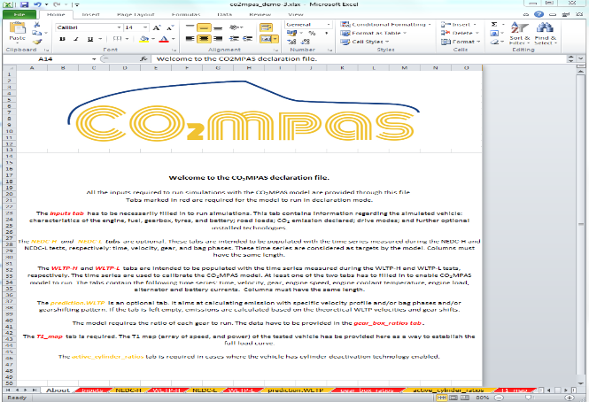
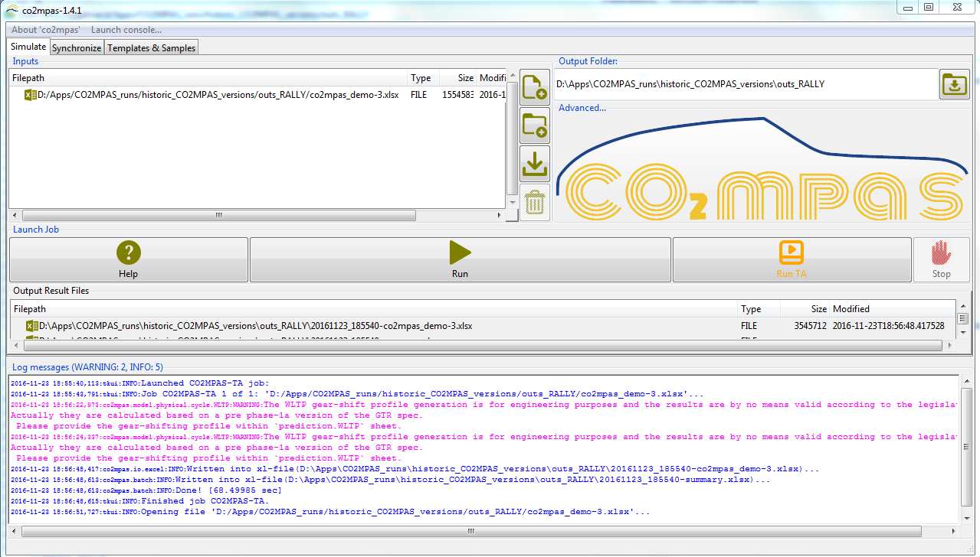
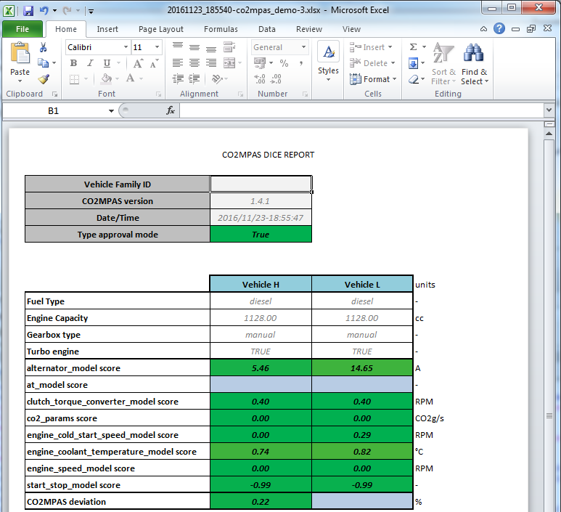

CO₂MPAS Input file (in “declaration mode”)
CO₂MPAS Type Approval command (“Run TA” button)
CO₂MPAS Output file
(includes DICE & OUT Reports)
“fingerprint “ all files
Input + Output => Hash #1: 9fcdef88aea75363aa8e1eb0b75

Slide 3






DICE
copy & paste the random number into CO₂MPAS DICE
(tab in the GUI, under development)
Recipients:
TS (“sender”)
TAA
JRC
DG. CLIMA
DICE Decision:= DICE Report + OK/SAMPLE (to be included in TAA e-files)
DICE stamp :=
DICE email + random number
Timestamp server: generates a time-stamp (random number) of what files are sent when.
Input + Output + Decision => Hash #2: cc805b4772e78f59570bd8883e
The stamp is a “witness” that the files have indeed been sent (sender cannot repudiate later)
TAA report := OUT Report + OK/SAMPLE + HASH 2 (to be included in TA printed docs)
DICE email := Hash #1+ DICE Report
Input + Output => Hash #1: 9fcdef88aea75363aa8e1eb0b75

Slide 4
Hash #2 is sent to TAA along with all e-files, and it is unequivocally associated with:
The CO₂MPAS Input file contents;
The CO₂MPAS Output file contents;
Who sent the file for type approving;
When the file was sent;
What was the result of the dice (OK/SAMPLE).
Input + Output + Decision => Hash #2: cc805b4772e78f59570bd8883e
Timestamp Hash #1 distributed to
Supervising bodies is unequivocally
associated to Input & Output.
The “printed” TAA Report is unequivocally associated with the above Hash #2 and contains all key simulation results.
Input + Output => Hash #1: 9fcdef88aea75363aa8e1eb0b75

Slide 5
OUTPUT report sample
Vehicle Family ID
CO2MPAS version | 1.4.3.dev0
Date/Time | 2016/11/22-15:03:28
Type approval mode | True
NEDC Average Specific CO2 Emissions* | Vehicle H | Vehicle L | units
NEDC CO2 declared value | 147.21 |  | g/km
NEDC CO2MPAS simulated | 141.12 |  | g/km
CO2MPAS deviation | -4.14 |  | %
*Ki factor - corrected
NEDC CO2MPAS CO2 Emissions | Vehicle H | Vehicle L
CO2MPAS simulated NEDC | 141.12 |  | g/km
CO2MPAS simulated UDC | 133.81 |  | g/km
CO2MPAS simulated EUDC | 145.36 |  | g/km
NEDC Inputs | Vehicle H | Vehicle L
F0 | 216.21 |  | N
F1 | 0.8790 |  | N/km/h
F2 | 0.0436 |  | N/(km/h)2
Inertia | 1723.0 |  | kg
WLTP Inputs | Vehicle H | Vehicle L
F0 | 222.21 |  | N
F1 | 0.8920 |  | N/km/h
F2 | 0.0436 |  | N/(km/h)2
Test Mass | 1873.0 |  | kg
CO2 emission phase Low | 156.89 |  | g/km
CO2 emission phase Medium | 150.53 |  | g/km
CO2 emission phase High | 149.54 |  | g/km
CO2 emission phase Extra-High | 195.93 |  | g/km

Slide 6
DICE Report sample
Vehicle Family ID
CO2MPAS version | 1.4.3.dev0
Date/Time | 2016/11/22-15:03:28
Type approval mode | True
 | Vehicle H | Vehicle L | units
Fuel Type | diesel | diesel | -
Engine Capacity | 997.00 | 997.00 | cc
Gearbox type | automatic | automatic | -
Turbo engine | TRUE | TRUE | -
alternator_model score | 4.56 |  | A
at_model score | -0.95 |  | -
clutch_torque_converter_model score | 4.71 |  | RPM
co2_params score | 0.00 |  | CO2g/s
engine_cold_start_speed_model score | 18.74 |  | RPM
engine_coolant_temperature_model score | 0.51 |  | °C
engine_speed_model score | 0.02 | 91.36 | RPM
start_stop_model score | -0.99 |  | -
CO2MPAS deviation | -4.14 |  | %

