Slide 1
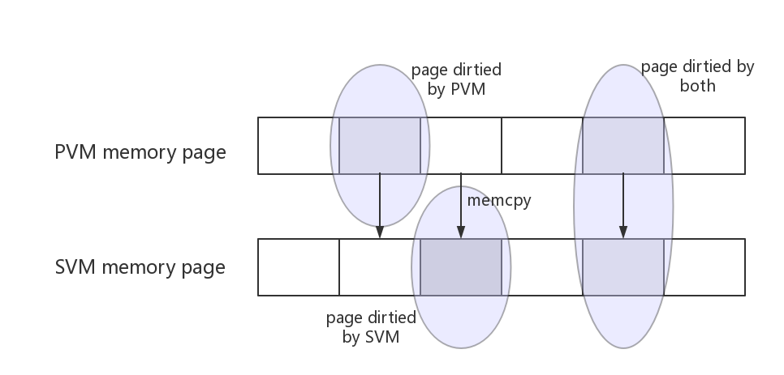
SVM
PVM
Cache the whole memory
first migration
colo_init_ram_cache()
qeme_loadvm_state_mainload()
Flush content of RAM cache into SVM’s memory.
Only flush the pages that be dirtied by PVM or SVM or both
Load the Dirty Page from PVM into colo_cache
while loop
colo_flush_ram_cache()

