Slide 1
Best Street Team Placements for WomenTechWomenYes Annual Summer Gala
Julien Ruvira, Alen Tersakyan & Carissa Sosa/ JAC Data Consulting

Slide 2
Agenda
Background
Objective
Approach
Results
Final Thoughts

Slide 3

Background
In 2015 only 25% of ‘computing occupations’ were held by women₁
WomenTechWomenYes seek to change this problem by promoting awareness and outreach for the Summer Gala
1. National Center for Women & Information Technology (NCWIT)
Notes:
Background – Women Tech Women Yes WTWY is hosting a Gala in the beginning of Summer and we are taske
Beureau of labor statistics: In 2015, only 25 percent of computing occupations were held by women

Slide 4
Objective and Motivation
Goal 1
Goal 2
Goal 3
Optimize Street Teams Placement in NYC
Build Awareness around Cause & Gala
Recruit Attendees and Donors
Notes:
Objective of gala– to both to fill our event space with individuals passionate about increasing the participation of women in technology, and to concurrently build awareness and reach.

Slide 5
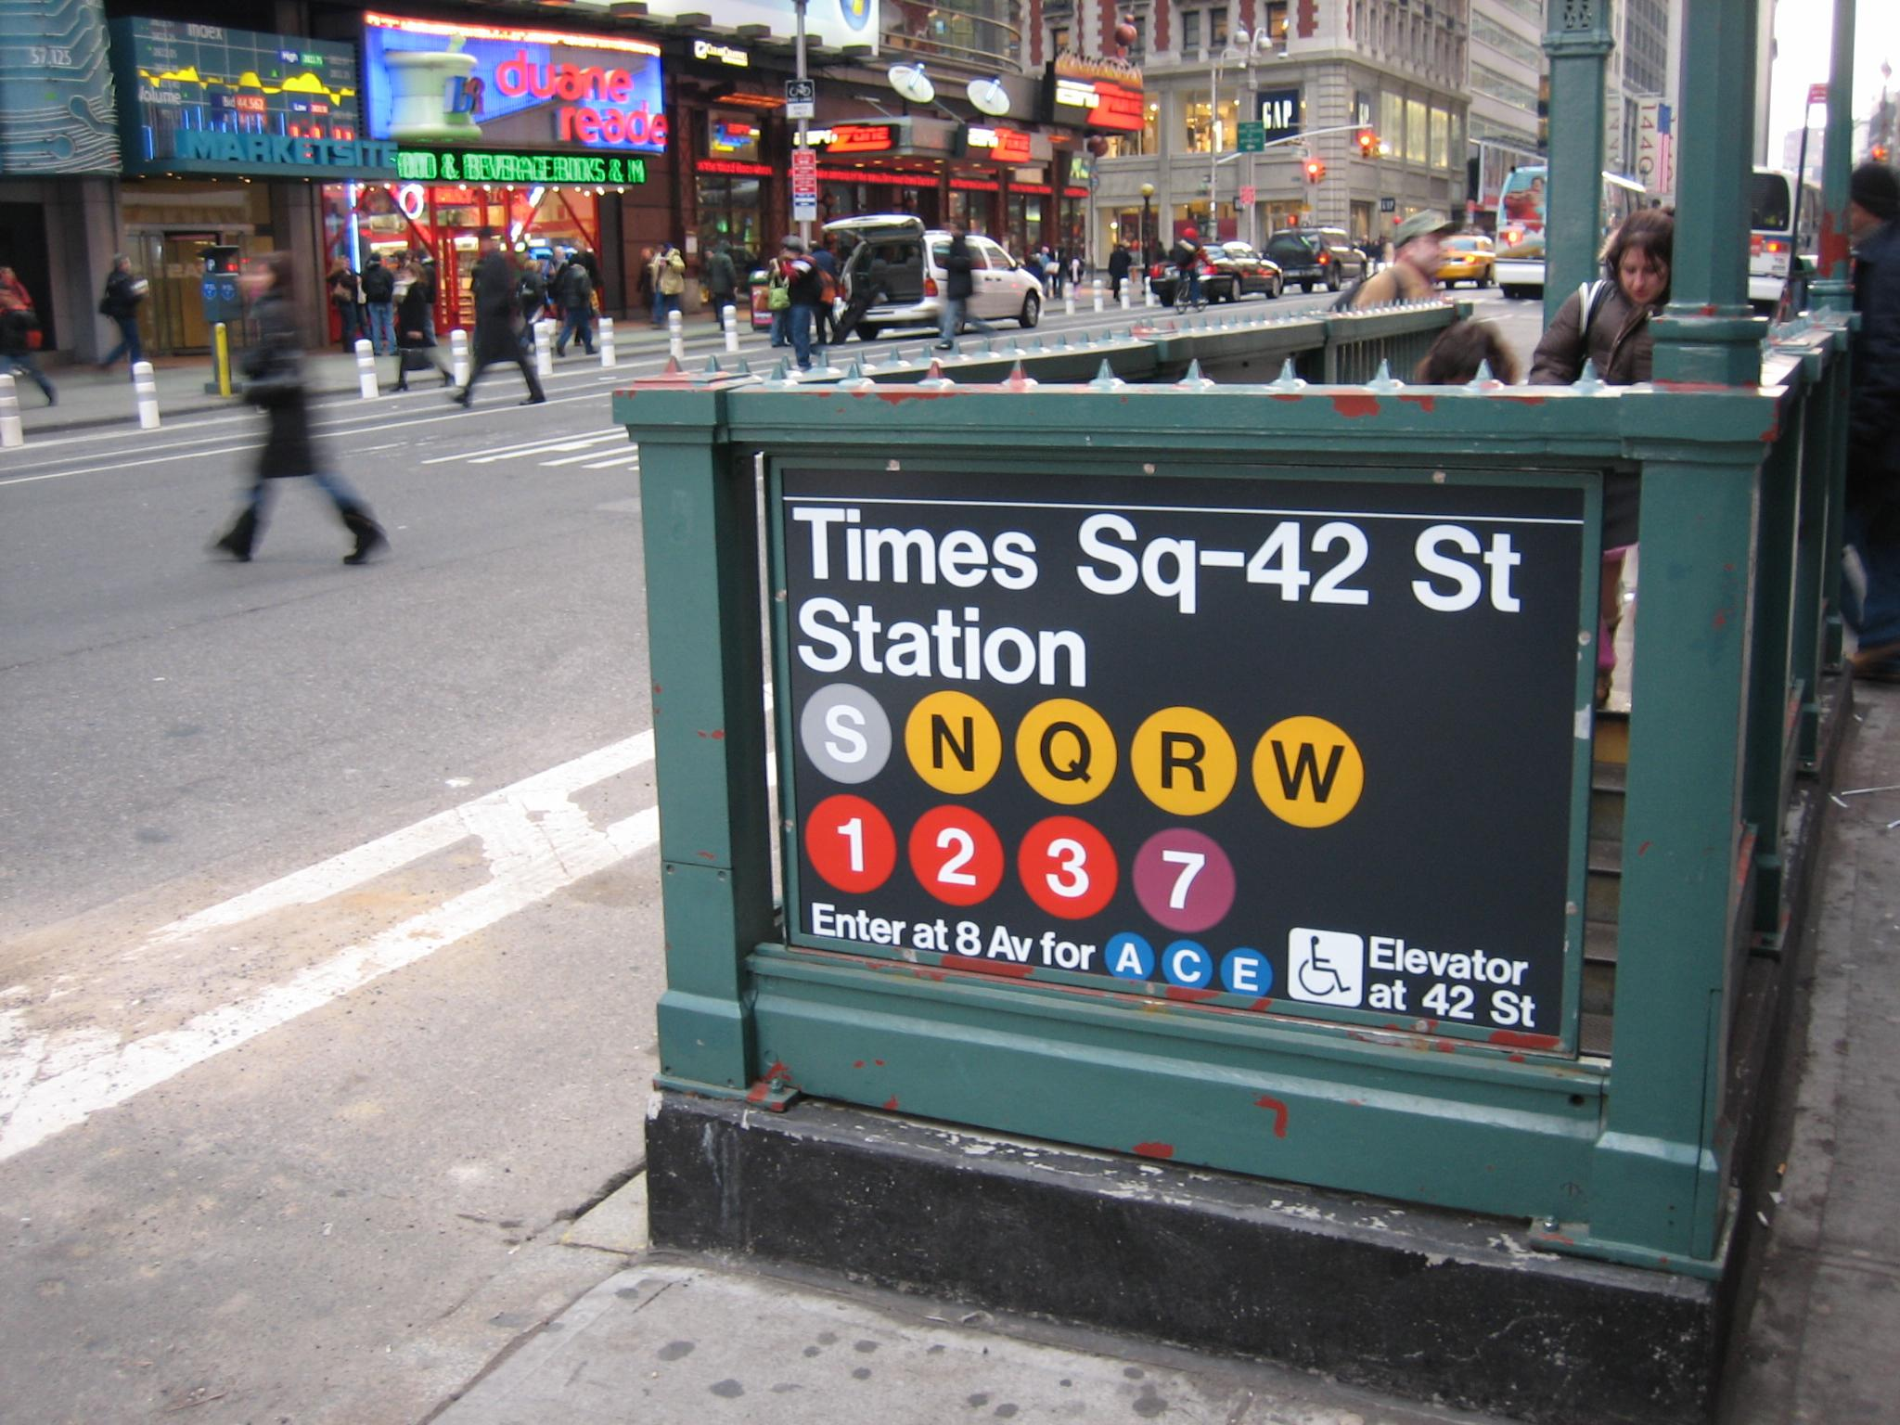
Data Sources
NYC MTA turnstile data
Google Maps API
Census Data - Pypi package
Notes:
One month of data before June
To answer our main questions we used NYC subway data pulled from the MTA website. This gave us information such as entries and exits per station
378 total stations in dataset across all larger NYC area.
In order to help maximize efficiency

Slide 6
Data Sources: Focus
MTA data
Entrances/ Exits per Station
4 Hour windows
Google Maps
Extract zip codes, longitude and latitude
Census Data
Extract median household income
Population density for each station
Notes:
-To help us create a more complete picture, we decided to incorporate supplemental data to pair w/ the NY MTA data.
-Priority targeting potential donors of at least $1,000 as well as gather email addresses of attendees, decided to look into NY Census data and extract median household income and pop density.
-Used google API to find additional information such as zip codes, longitudes and latitudes that could pair with the census data for easier sorting.

Slide 7
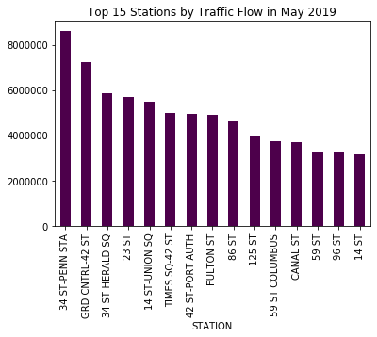
Top 15 Stations
15 busiest stations
Defined by sum of entrances and exits (traffic flow)
Month of May, 2019
Similar results when using entries only
Notes:
ref graph
Sum = entrance and exit sum

Slide 8
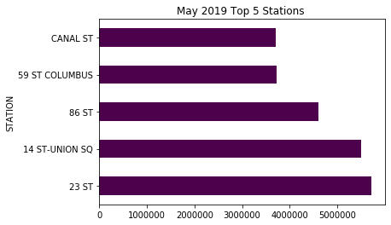
Our Top Five Stations
From top 15 busiest stations we:
Removed heavy tourist and mass transit hubs (i.e. Times Square, Penn Station)
Pulled in median household income
Top five station list is a combination of highest traffic flow and wealthiest zip code
Traffic Flow
Notes:
Average median of ~96k for the ones we chose, much lower for the next five down

Slide 9
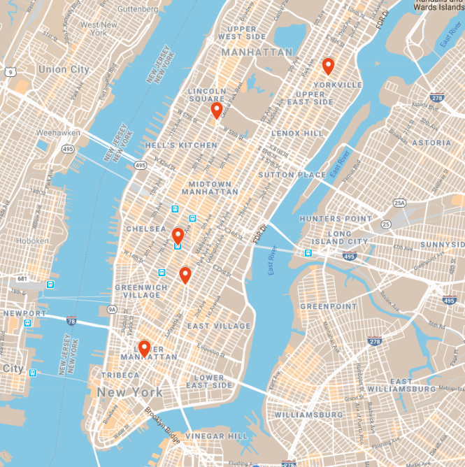
Top Five Stations
23rd Street
86th St
14th St Union Square
59th St Columbus
Canal St
Notes:
Tartgetting different neighborhoods--> getting dif pops and demos

Slide 10
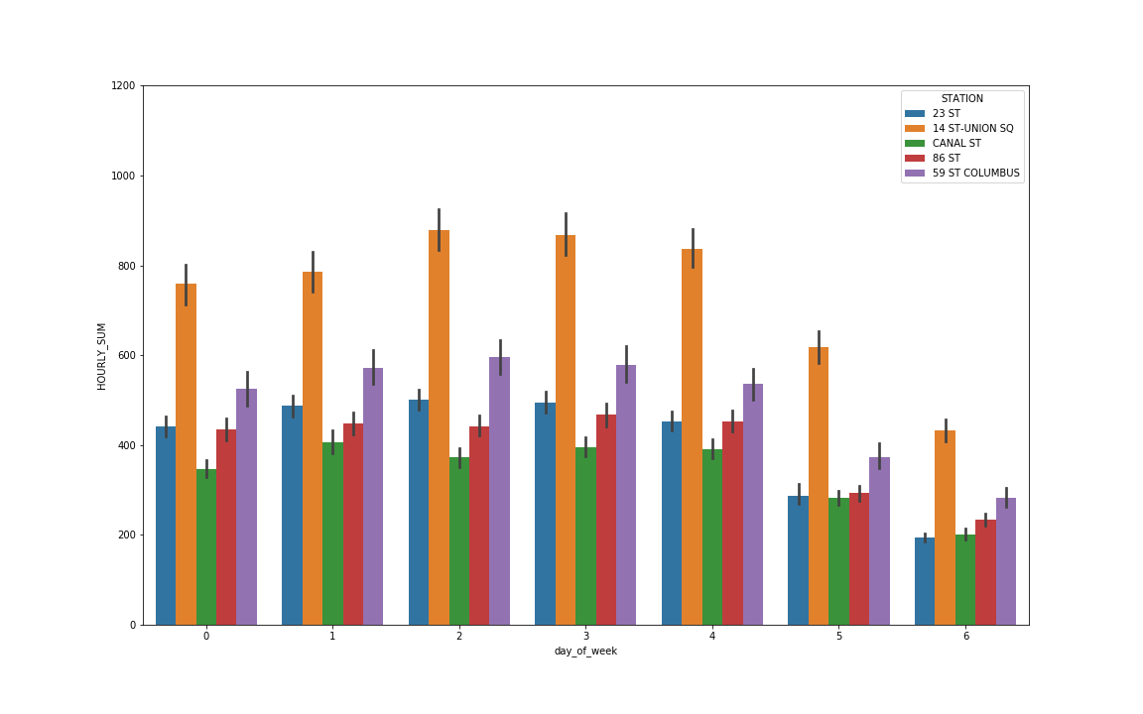
Best Day of Week to Promote
Total Traffic Flow by Day of Week in Highest NY Median Income Areas
Notes:
From the top 5 stations we wanted to optimize the placement of the promoters by day of week.
So we looked at each station’s traffic flow every day
Common trend across all stations WED- FRIDAY the busiest, with weekends

Slide 11
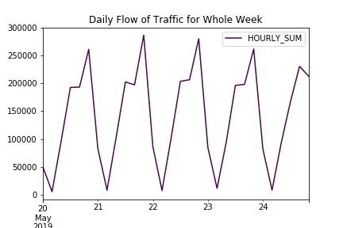
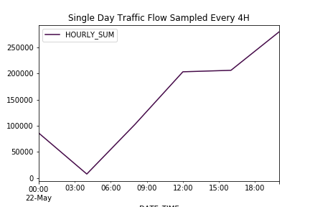
Best Time of Day to Promote
Notes:
Chose the last Wednesday as an example to zoom in on the flow of traffic at all stations during a day
we can see that there is a peak in the morning and then from 6-10pm

Slide 12
Our Recommendations
5 teams of 2 persons:
23rd Street
14th St Union Square
86th St
Canal St
59th St Columbus
Place teams from noon to 8 pm for most foot traffic through stations

Slide 13
Final Thoughts
Look at proximity of stations to tech hubs
Look at Entrances and Exits individually rather than traffic flow sum
Look at Entrances and Exits in the morning versus evening commutes

Slide 14
Questions?

Slide 15
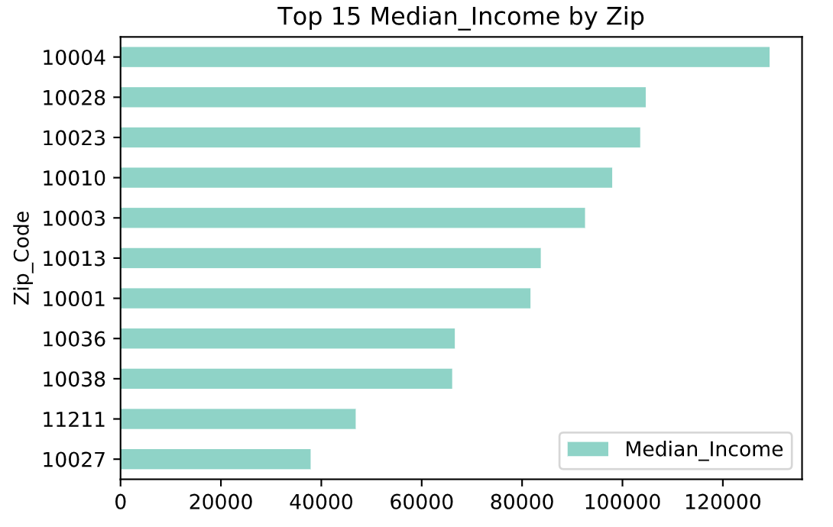
Appendix

Slide 16
NYC Highest Median Income
05
Canal St
Median Income - $83,725
04
14th St Union Square
Median Income - $92,540
03
86th St
Median Income - $97,955
02
59th St Columbus
Median Income - $103,534
01
23rd Street
Median Income - $104,638
Notes:
Median

