Slide 1
IST 722 Group3
FudgeMart & FudgeFlix
Strategic Decision Support System
Kathy Adams Joel Bravo Joseph Hartman Natalia Kuklova

Slide 2
Charter
Executive Summary
This project will complete a data warehouse and business intelligence program for a Fudgemart, Inc (the “Company”) to allow the company to have a more structured data and strategic decision support system. Fudgemart, Inc is a conglomerate with two subsidiary companies Fudgemart, an online retailer, and Fudgeflix, an online DVD-by-mail and video-on-demand service.

Slide 3
Vision & Business Objective
Vision
This project will aim to move the Company to a more structured data and strategic decision support system in order to better leverage the data generated by the Company.
Business Objectives
To make better informed strategic business decisions that will improve the profitability and customer service of the Company and its subsidiaries.

Slide 4
Project Scope
Identify functional requirements of Fudgemart, Inc.
Identify four or more business processes to model in the data warehouse as part of the functional requirements. Justify the value of those business processes.
Implement two business processes in the data warehouse
Implement meaningful, actionable business intelligence for established processes.
Implement an enterprise bus technical architecture according to the Kimball methods.
Ensure the implemented data warehouse exhibits the four characteristics of a data warehouse.
Provide a presentation overview of DW/BI initiative at an executive level

Slide 5
Team Roles
For the purposes of this project, the following individuals have taken on the above roles:
Kathy Adams – Business Analyst
Joel Bravo – Business lead, Project Manager
Joseph Hartman – Data Architect, ETL architect
Natalia Kuklova – BI architect

Slide 6
Functional Requirements for Fudgeflix & Fudgemart SDSS Project
Business users will be able to run descriptive statistics on average rating by movie genre
Business users will be able to run descriptive statistics on Fudgeflix price plans based on zip codes
Business users will be able to analyze sales for Fudgemart based on zip codes.
Business users will be able to analyze order fulfillment
Business users will be able to determine what products customers are purchasing at Fudgemart and if they have a subscription with Fudgeflix.

Slide 7
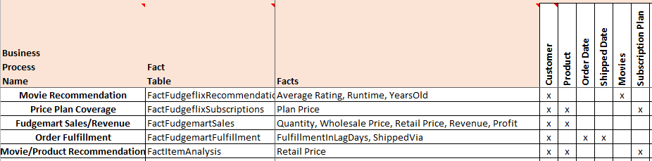
High-level Dimensional Modeling Worksheet

Slide 8
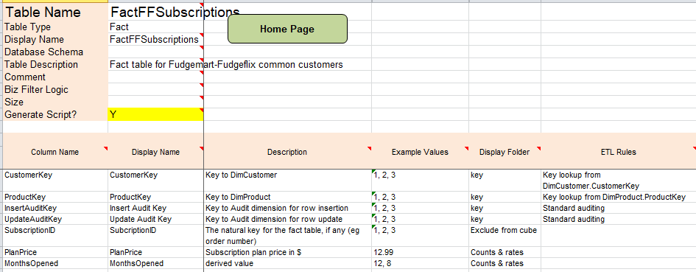
Detail-level Dimensional Modeling Worksheet

Slide 9
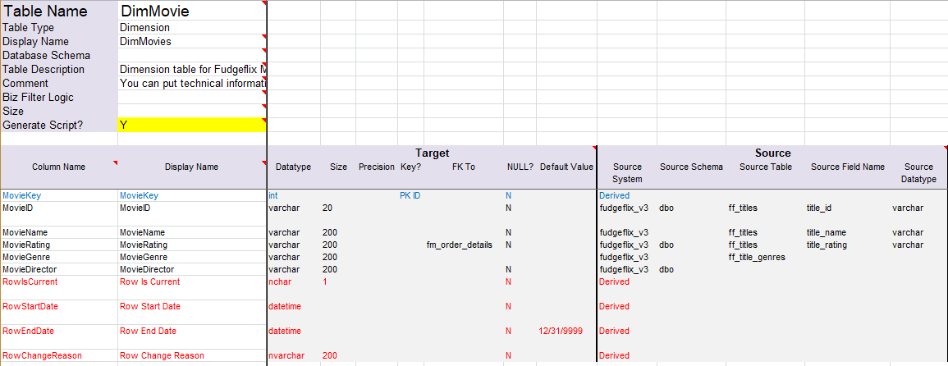
Detail-level Dimensional Modeling Worksheet

Slide 10
Database Diagrams Demo
Joel Bravo

Slide 11
ETL Process Demo
Joseph Hartman

Slide 12
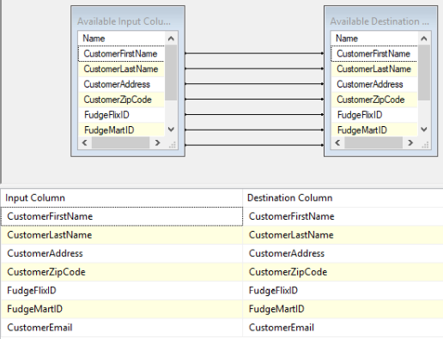
DimCustomer Mapping

Slide 13
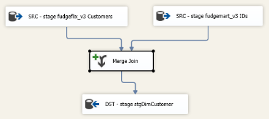
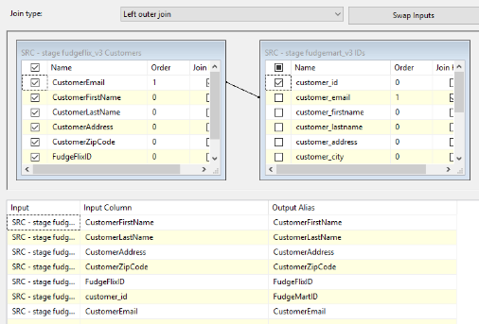
DimCustomer Merge Join

Slide 14
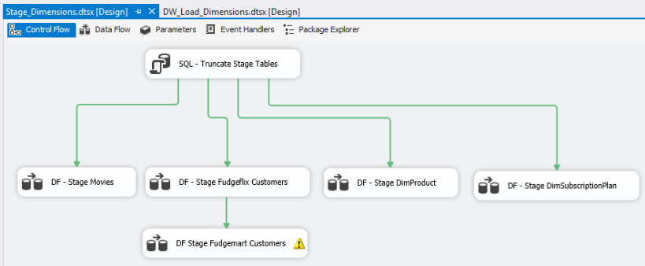
Stage Dimensions – Control Flow

Slide 15
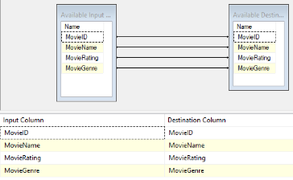
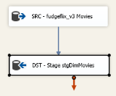
DimMovies Staging

Slide 16
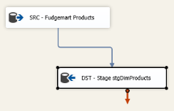
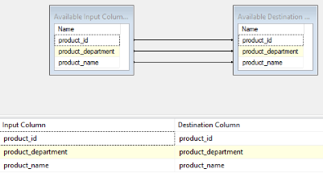
DimProduct Staging

Slide 17
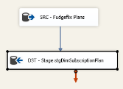
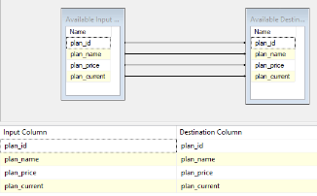
DimSubscriptionPlan Staging

Slide 18
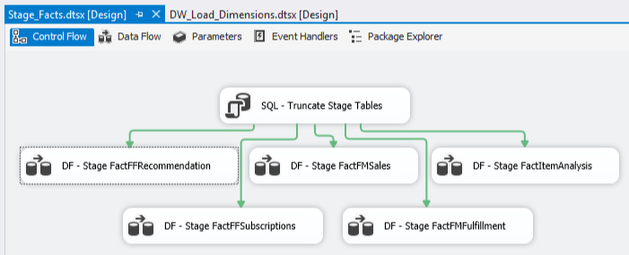
Fact Table Staging

Slide 19
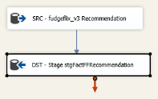
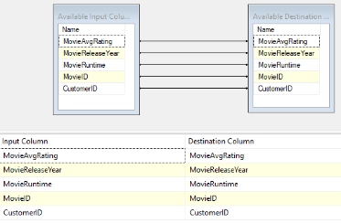
FactFFRecommendation Staging

Slide 20
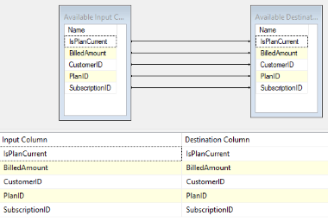
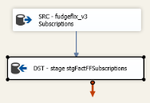
FactFFSubscriptions Staging

Slide 21
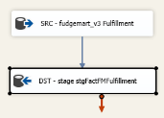
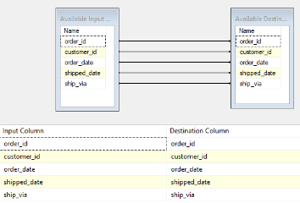
FactFMFulfillment

Slide 22
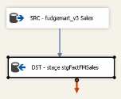
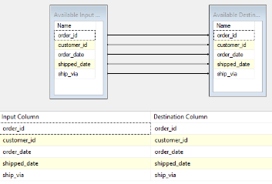
FactFMSales Staging

Slide 23
Business Intelligence
Goals of Analytics:
Provide descriptive statistics of customers and/or products at Fudgeflix and Fudgemart
Analyze and propose short-term improvements either in process or product coverage to executive management
Provide suggestions to further research and analyses to be completed where applicable

Slide 24
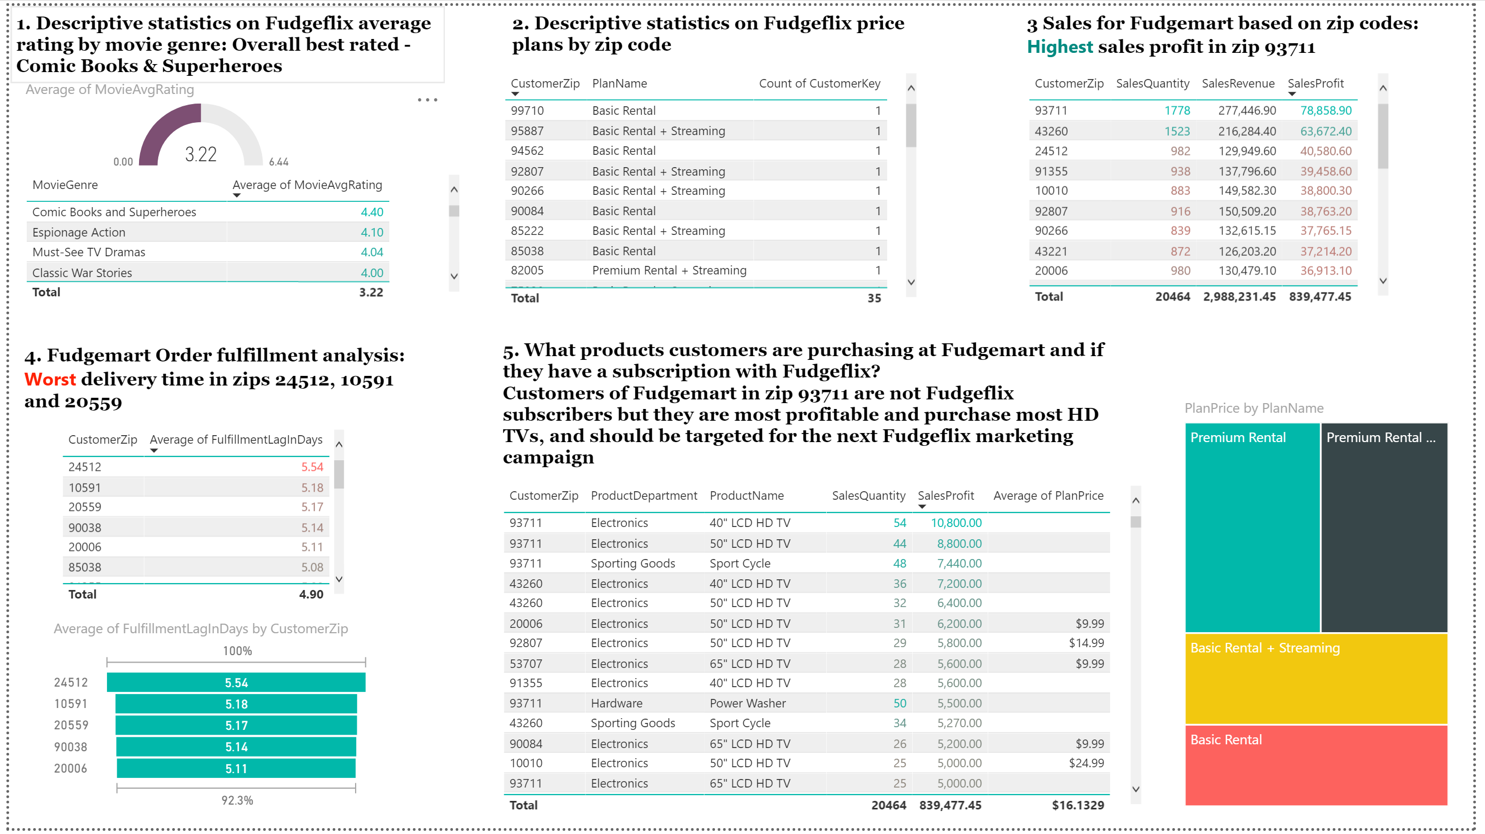
Business Intelligence

Slide 25
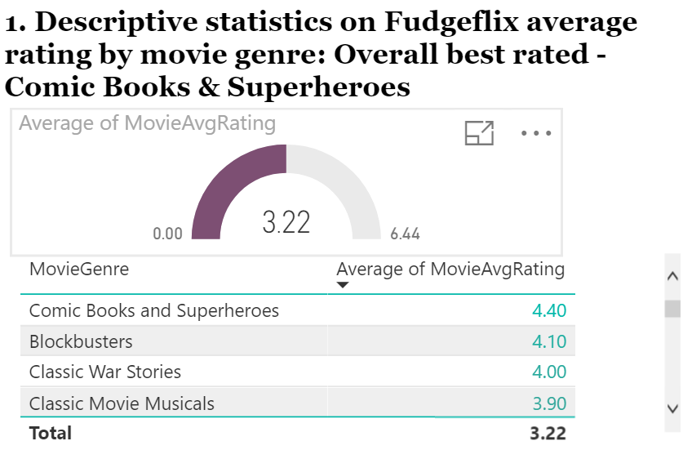
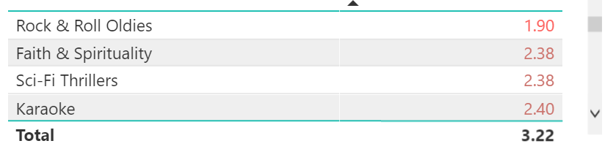
Business Intelligence
Fudgeflix best rated movies Comic Books and Superheroes, Blockbusters, Classic War Stories
Fudgeflix worst rated movies Rock &Roll, Faith and Sci-Fi Thrillers
Recommendation: Invest in expanding top 3 best rated movies genres. Stop investing in the worst rated movie genres

Slide 26
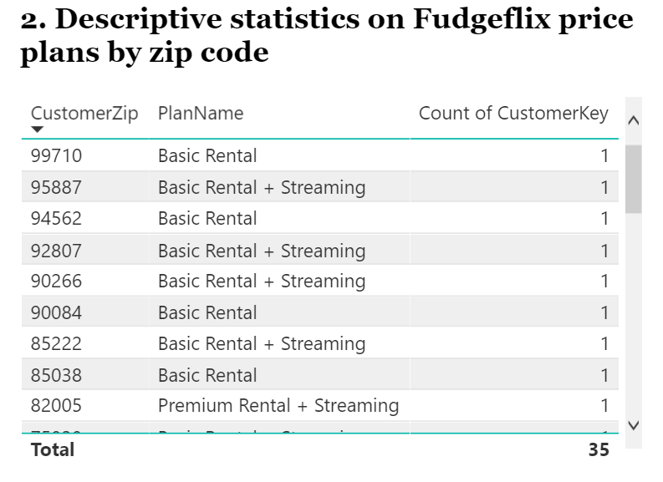
Business Intelligence
The number of Fudgeflix customers is 35.
Each zip code has one Fudgeflix subscriber
Recommendation: Use caution when generalizing buying habits in each zip code due to limited coverage

Slide 27
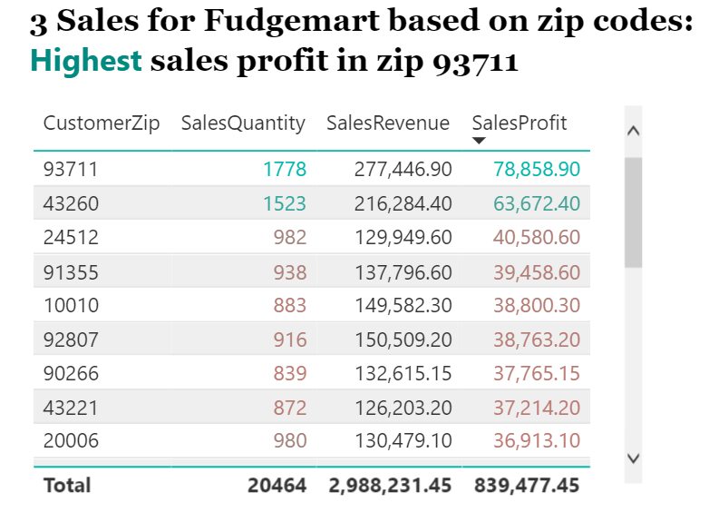
Business Intelligence
The Highest sales profits at Fudgemart are driven by customers in zip code 93711 followed by zip 43260 and 24512
The sales quantities in these zip codes are also highest
Recommendation: Research more about buying habits in the top 3 performing zip codes which provide the highest revenues

Slide 28
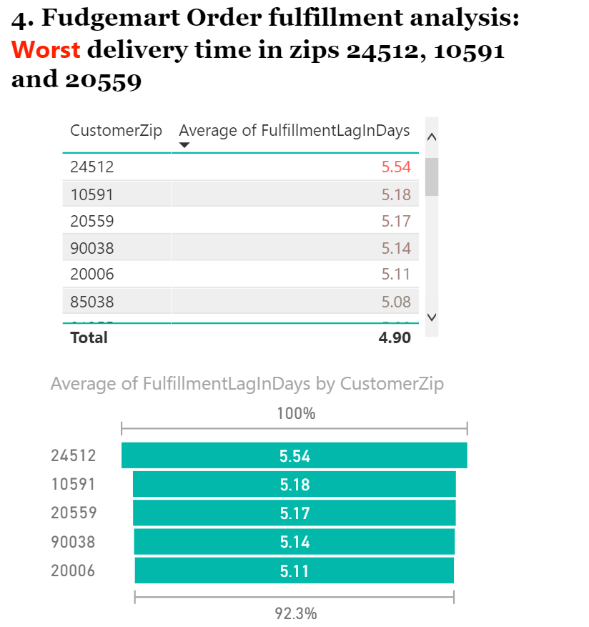
Business Intelligence
The Worst average fulfillment time in Fudgemart in days is in zip code 24512. This zip code provides the third largest sales revenues for the company
Recommendation: Investigate what drives the longest time to deliver in the third best performing zip code 24512 in terms of profits

Slide 29
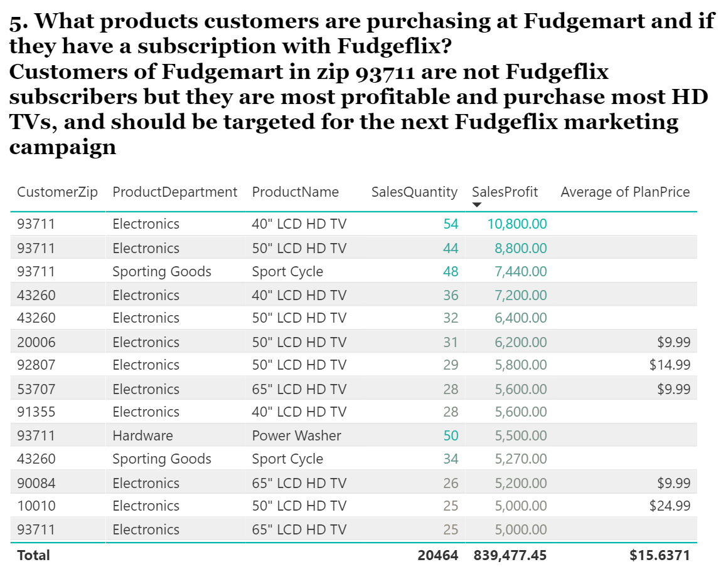
Business Intelligence

