Slide 1
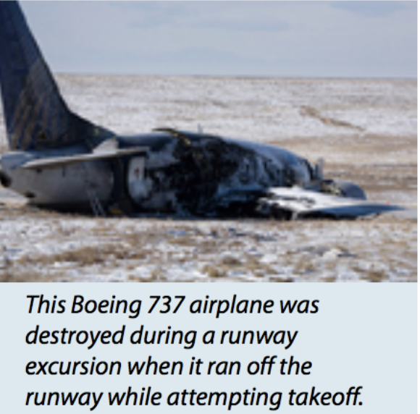
IST 718
Big Data Analytics
Final Project: Aircraft Accident Analysis
Group1:
BreeAna Baker
Editt Gonen-Friedman
Joseph R. Hartman
Hongseok Kim

Slide 2
Specification: The Problem
Given an aircraft incident, what attributes can predict it being fatal?
What can predict the damage?
The problem are we trying to solve:
Team West seeks to help stakeholders such as aircraft manufacturers, insurers, the FAA (Federal Aviation Administration) and the NTSB (National Transportation Safety Board) with risk assessment and analysis related to aircraft crashes.
Why is this problem important to us?
Recent Boeing 737 crashes highlighted a problem in aviation: despite extensive automation in modern aircraft, aircraft still crash, bringing on heavy losses of life and monetary losses.
Isn’t this redundant? Aren’t aircraft crashes already investigated?
The NTSB investigates every incident in the US and many incidents abroad, and then makes safety recommendations to FAA and other authorities. The analysis is done one incident at a time. We want to look at the data as a whole, look for trends, discover factors that might affect fatalities and damage, and see if insight gained from such incident data analysis can be used to make recommendations.

Slide 3
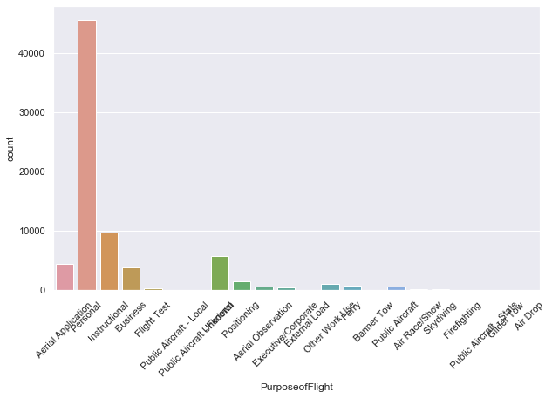
Specification: The Data
What is the data and its source:
AviationData.txt is a large dataset containing information on incidents investigated by NTSB since 1962. This data has been downloaded from: National Transportation Safety Board: Aviation Accident Database & Synopses https://ntsb.gov/_layouts/ntsb.aviation/index.aspx
Basic dataset metrics:
Rows: 83,044 rows, one per incident.
Columns: 32 columns of incident attributes.
Attributes: information about incidents that have been investigated; incident location, data on the aircraft involved, flight details, and fatalities or damage tinformation. The information is categorical. For example, damage has categories such as ‘destroyed’ or ‘substantial’; Location information includes country / state / city and coordinates.
Only using data from the United States for the analysis

Slide 4
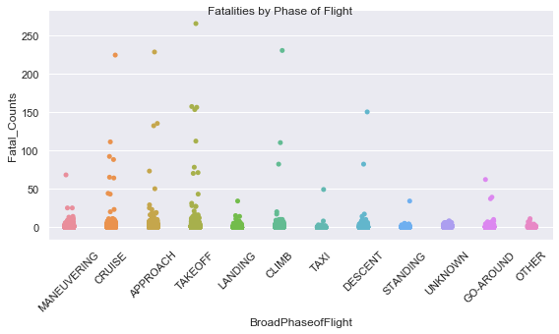
Specification
Hypothesis
We hypothesize that weather conditions, the model of the airplane, and the location play some role in the severity of accidents.
The problem is complex and there are many variables.
We posit that we can determine what
factors affect the severity of an accident
by using Random Forest models and pulling the important features that the model uses
to predict values.

Slide 5
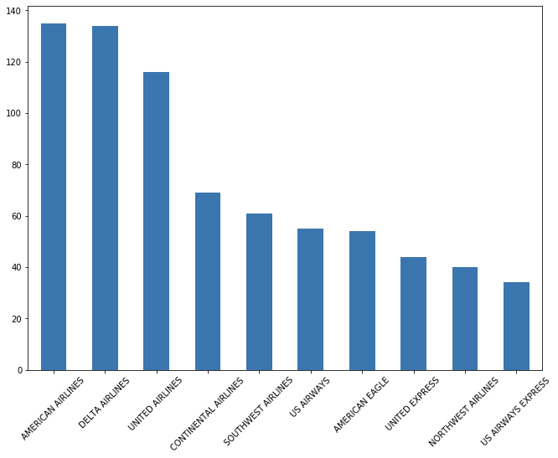
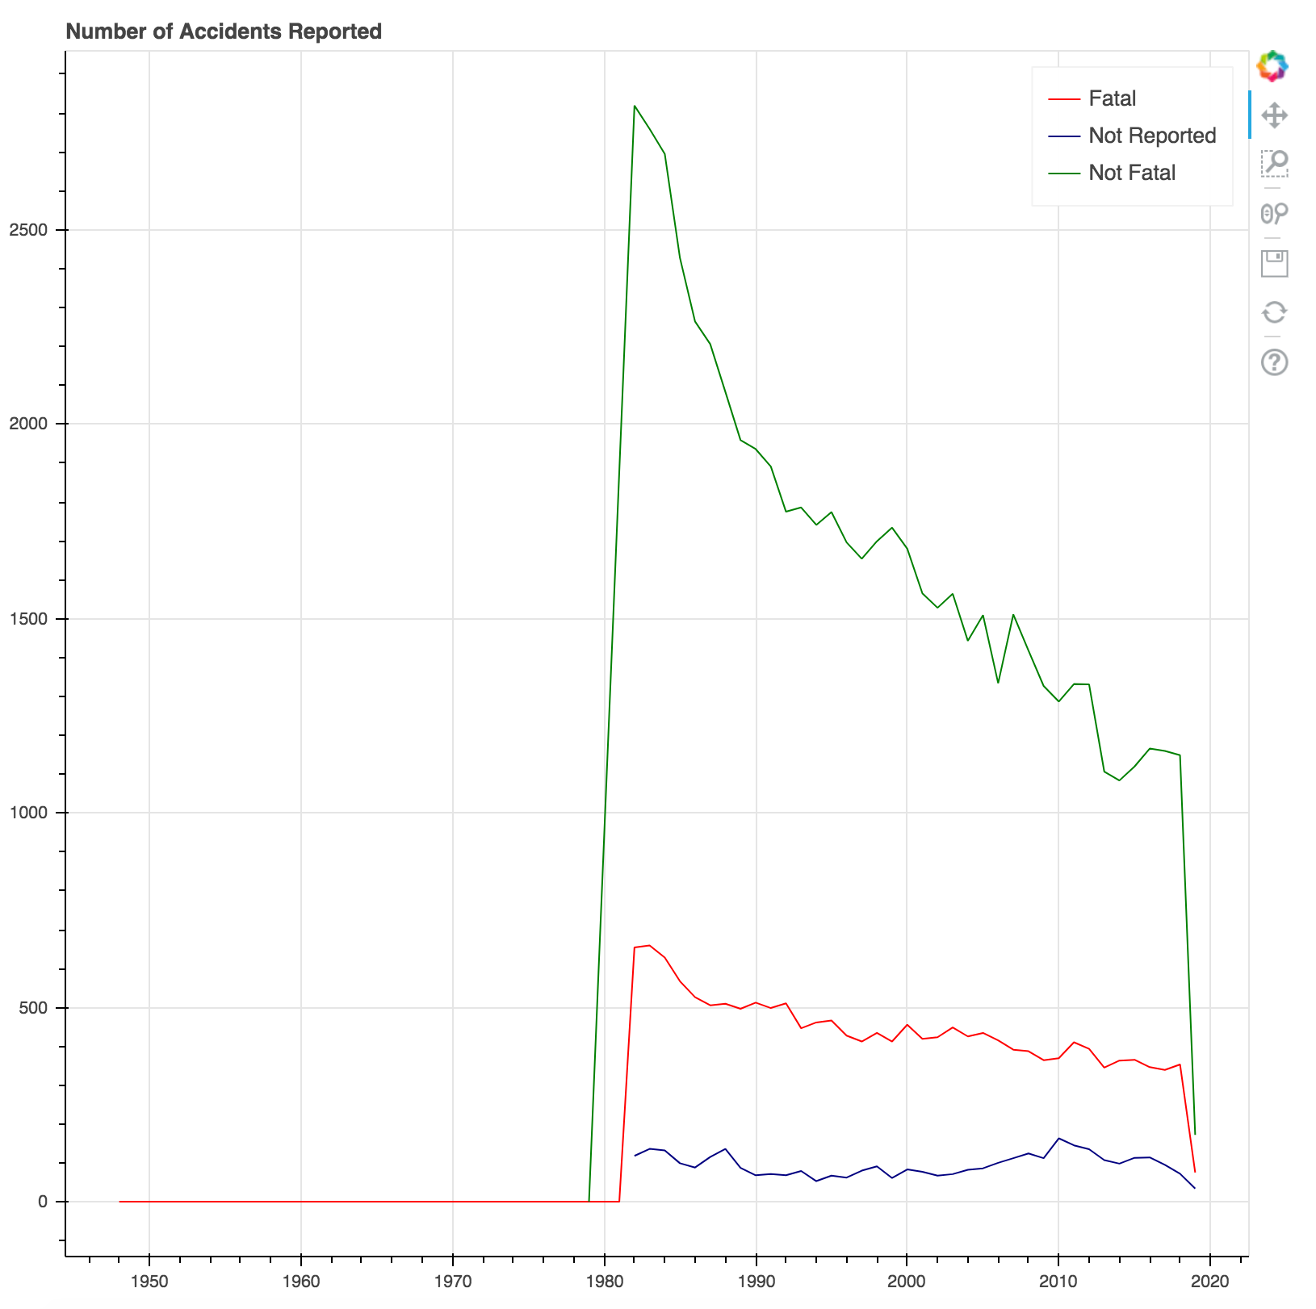
Observation
Number of Accidents Reported
This is the distribution of accidents per airliner 1982-2018

Slide 6
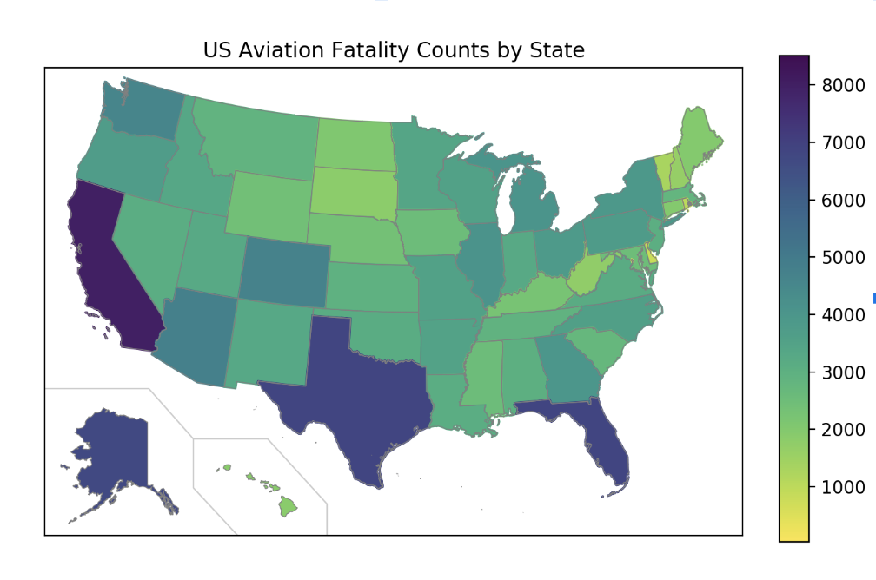
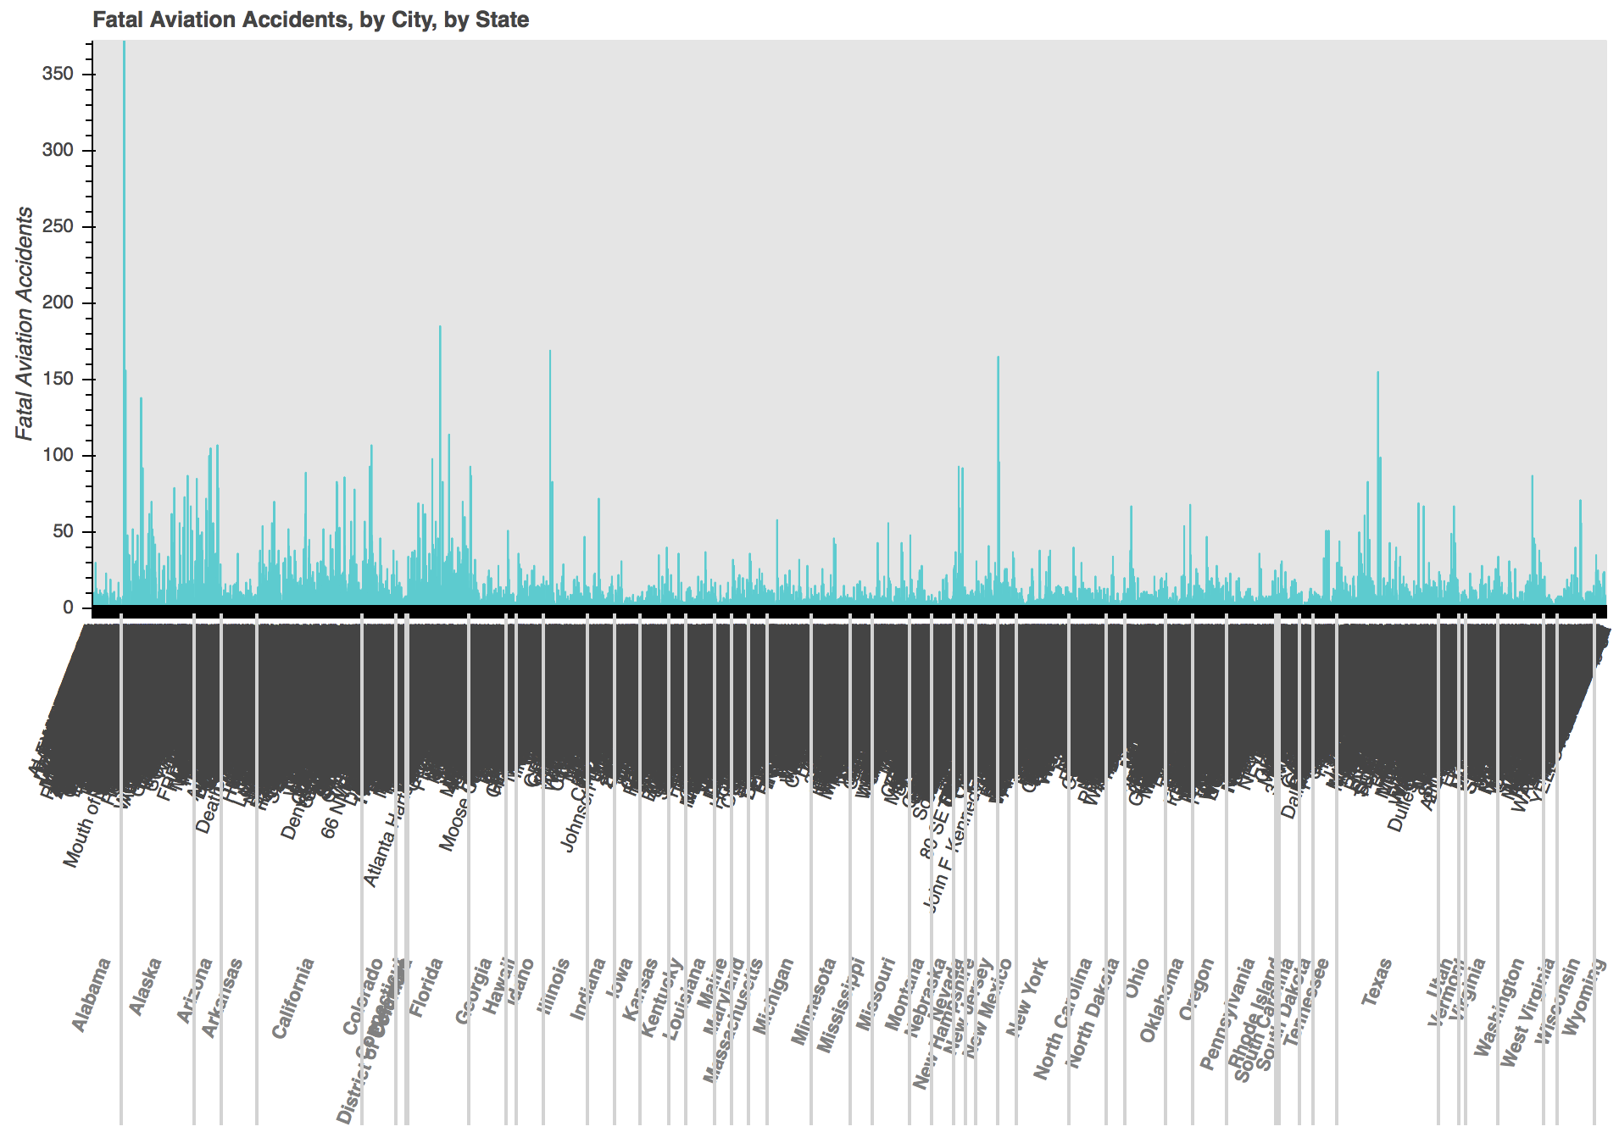
Observation
Location
There are spikes in states that have a lot of air traffic like California and Florida. Alaska also stands out: air traffic covers the great distances, and ice might cover the wings.

Slide 7
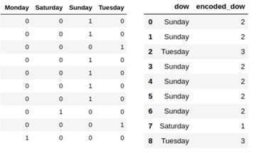
Analysis Data Preprocessing
All the data preprocessing training and testing was done with “pandas” and “scikit-learn/sklearn” in Python 3.
It is important to state before further analysis explanation that unlike R or Weka, Sklearn is incompatible with string elements in our input variables, and thus, must be encoded.
The method we used to encode our discrete elements was “One Hot Encoding”.
This method takes all the unique elements of a variable and turns it into a series of logic (True/False or 1/0) elements showing the presence of that discrete element in an observation. An example of one hot encoding is shown below using days of the week.

Slide 8
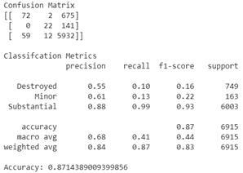
Analysis (Random Forest)
For our RF regression model
we used 25 trees with a total training time of 32.3 minutes.
Compared to our classification model, we used fewer trees as the computation for RF regression is more intensive and we blew through our RAM limit in Google Colab with larger number of trees.
For our RF classification model
We used 100 trees and told the model to weigh the observations while bootstrapping so that in the bootstrapped subsets, classes with smaller number of observations weigh more than classes with bigger number of observations.
This was done to reduce overfitting, which is a common problem with RF models
Metric | Value
Range | 228
Mean Absolute Error | 0.364
Root Mean Squared Error | 2.98
Notes:
There are several reasons we chose to use RF models for this task, some important ones to note are:
Random forest models do well with models with data that has high dimensionality (large number of input variables). Our data has 30 columns and with one hot encoding that number can jump well over 20,000 for our particular problem.
It’s great at handling missing data or if there are large sections of missing data aka null values
There is infrastructure in place to handle unbalanced classes
Most importantly, we can pull informative and important features from the model for interpretability.

Slide 9
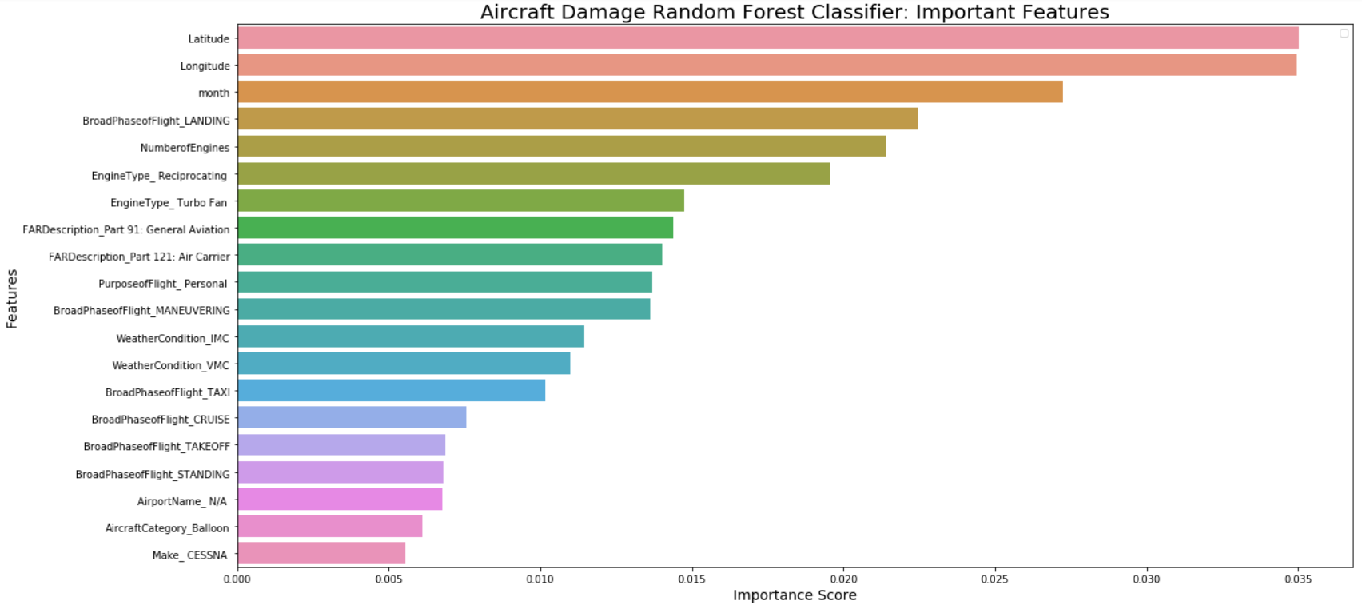
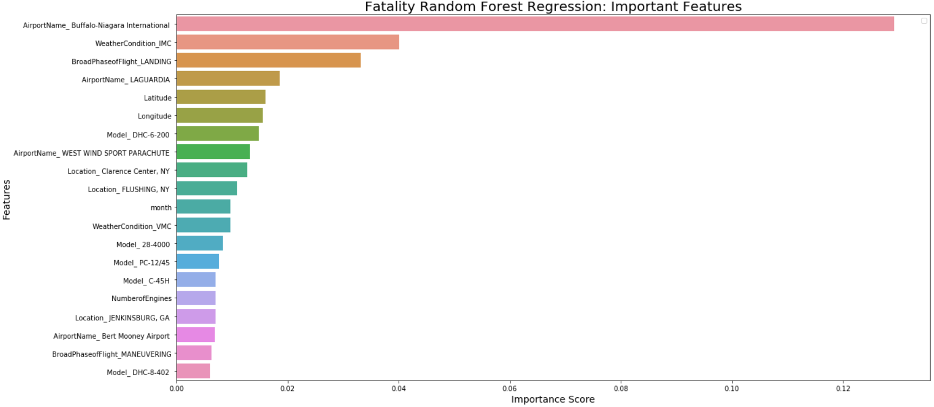
Top 20 features that our RF models deemed important for each model
Notes:
For features labeled like “BroadPhaseofFlight_LANDING”, the RF model is saying that whether or not the aircraft was in the landing phase played an important role in determining aircraft damage.
This is a result of the “One Hot Encoding”. It’s important to note that just because the RF models deem features as important does not mean that certain values of these features lead to certain conclusions,
i.e. just because the Fatality Random Forest Regressor says that Buffalo-Niagra International is important in determining levels of fatality does not mean that that particular airport is a high risk area for fatal aircraft accidents.
However, that isn’t to say that intuitive thought and posits can be made from some of the important features.

Slide 10
Recommendation
We recommend that pilots in training spend more time practicing landings in a variety of conditions.
2. We recommend improving access to real time weather reports, especially for personal aviation enthusiasts as well as pilots of smaller craft.
3. We recommend that more hours are needed and in a variety of conditions before someone can get a Private Pilot’s License (PPL)
Summary of Findings
One key note is that flying has gotten safer over the years. There’s been a steady decline in accidents in the last 3.5 decades covered by our data.
Notes:
Rec 1: Our RF models say that the landing phase for aircrafts play a huge role in determining accident severity. An article in the 2002 Aviation Safety Magazine( found here: http://www.aviationsafetymagazine.com/airplane/landing-accidents-and-runway.html) said that landing account for more than a third of general aviation accidents. The article attributes this to lack of aircraft control by pilots in adverse conditions.
Rec 2: Weather seems to play an impact in determining accident severity. IMC stands for Instrument Meteorological Conditions meaning that the weather where the pilot must use his/her instruments as the primary references rather than visual cues such as cloudy weather. This doesn’t pose a huge threat to commercial airliners and personal jets that have state of the art instruments, but does pose a threat to those personal airplanes and other aircraft, such as helicopters and balloons, where relying on visual reference is needed more.
Rec 3:the DH-6 Twin Otter Airplane (a personal sized airplane) had one of the highest crash rates from 2003-2012 (https://www.prnewswire.com/news-releases/best-and-worst-aircraft-crash-rates-revealed-212040761.html) The fact that the RF model deems that those flying under the authority of “Part 91: General Aviation” is important and that flying for general aviation possibly private transport or recreation is something to keep noted. This makes sense, again, given the lack of technology and support pilots of these airplanes get compared the big commercial airliners.

