Slide 1


Analyzing Facebook Posts:
Joseph Hartman
Ist-736 Text Mining
March 17, 2019

Slide 2
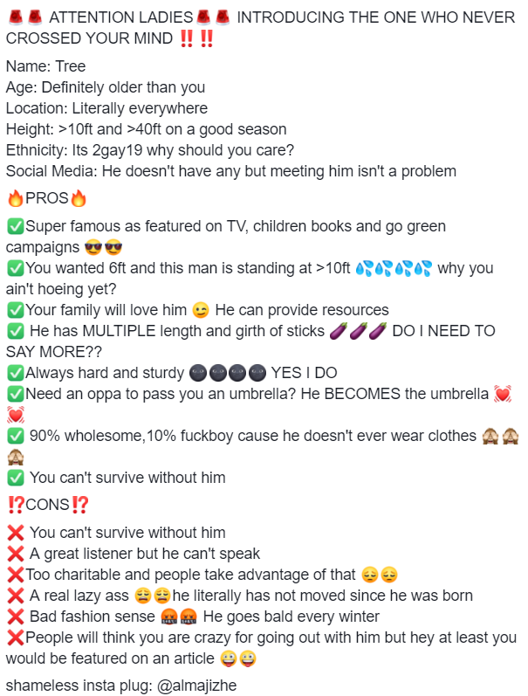
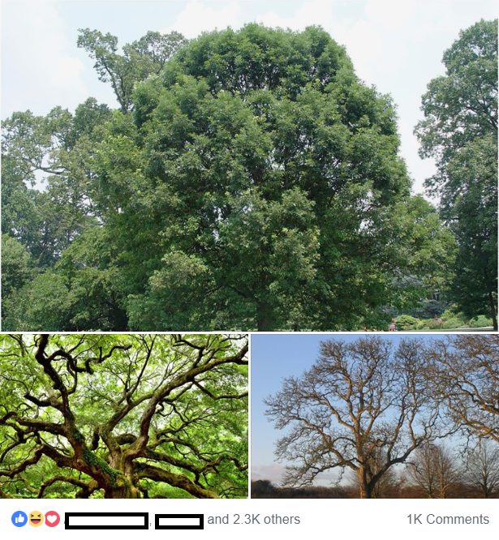
What Is Subtle Asian Dating?
Users “auction off” friends or colleagues by writing a post
Consists of 4 parts:
Opener
Statistics
Pros
Cons
Optional: Plug to Instagram and/or Twitter Handle
Currently 375,859 members

Slide 3
Questions to Answer:
What are common topics that we see across all of these "auction" posts? What interests or qualities do people deem to be desirable?
Can we use informative features from an SVM classifier to determine words or language choices to determine what distinguishes popular posts from not popular posts?

Slide 4
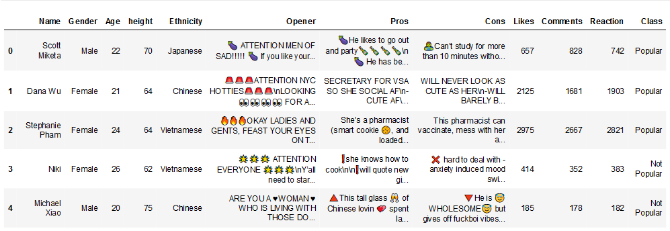
Data View

Slide 5

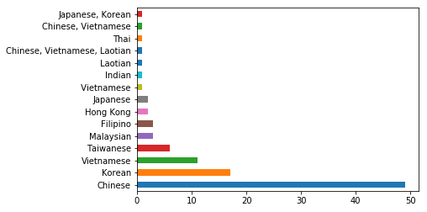


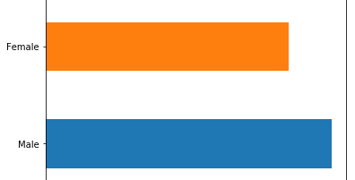

Exploratory Graphs

Slide 6
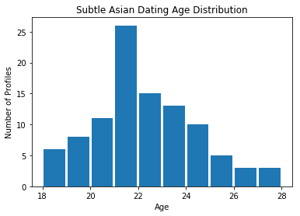
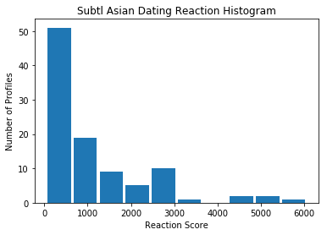
Exploratory Graphs

Slide 7
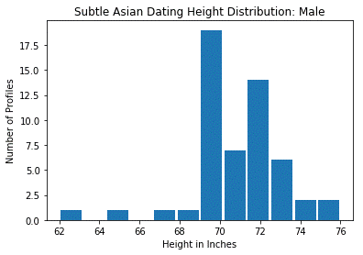
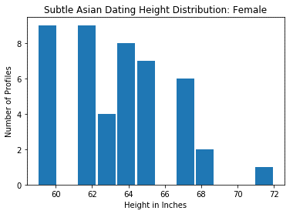
Exploratory Graphs

Slide 8
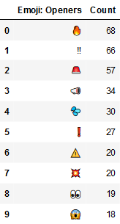
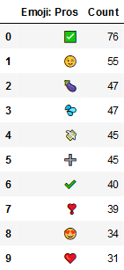
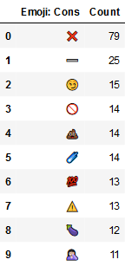
Emoji Counts

Slide 9
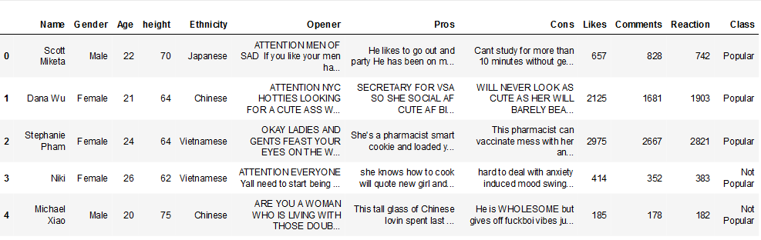
Edited Data Frame

Slide 10
Topic Modeling Using LDA: Opener
Topic 0: boy attention friend meet wholesome texas best ladies know ready hey hello single ya abgs world big come introduce ny
Topic 1: looking attention like ladies man look new need wholesome just girl real time make attention ladies year tired day season single
Topic 2: looking wholesome look korean attention stop like dms sell single tired feeling product scrolling time oppa nyc meet slide girl
Topic 3: studying georgetown university like sad georgetown university looking year east look right sad girls right like bachelor peter wasian namjas studying government korean 21 university looking
Topic 4: friend looking present hello read girl single bois currently wants based wholesome major bois uk life stop highly desirable single wayne ladiesss desirable unfortunately

Slide 11
Topic Modeling Using LDA: Pros
Topic 0: know like love super man parents af good time make big knows dance cute heart ya korean asian great loves
Topic 1: know like make loves good man family likes love mean knows eat going just want super food pro time club
Topic 2: know af good fashion girl smart chinese parents loyal cultured like need talk make asian looking long caring personality likes
Topic 3: like loves af good know wholesome big girl looking boba time super make knows game cook want amazing family just
Topic 4: make knows know fun smart good love girl af multiple like family drinks time life look asian home man tired

Slide 12
Topic Modeling Using LDA: Cons
Topic 0: look little means girl make like high time gotta things know chinese pics type boba right game probably mom speak
Topic 1: likes like probably make glow asian glow drink bed food looks maybe asian time good takes know does lives pictures dates
Topic 2: probably asian like good just make ass drink say shot attention bit game free loves big better mcdonalds mean parents
Topic 3: friends bc like probably hair boba lol female female friends world just stubborn actually thing end able tell best fall shit
Topic 4: really care make boba korean does great week definitely car ass ask like girls start willing spends know shot wonder shot
Topic 5: like know chinese time really heart eats asian new better people af looks pro person girls use chopsticks type asian glow likes

Slide 13
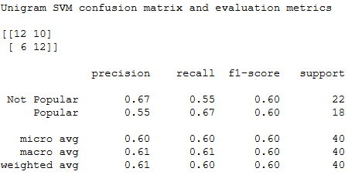
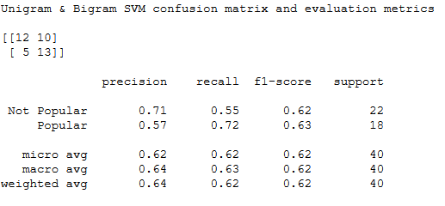
Linear SVM Model Evaluation: Opener

Slide 14
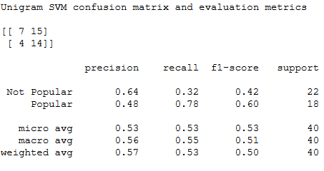
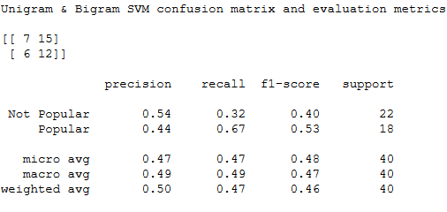
Linear SVM Model Evaluation: Pros

Slide 15
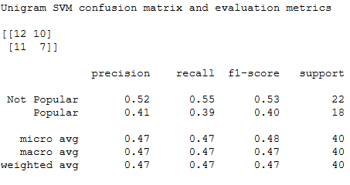

Linear SVM Model Evaluation: Cons

Slide 16
Unigram SVM Informative Features
Opener
Pros
Cons
(0.5217900974263602, 'introducing')
(0.5270201145547114, 'boi')
(0.5391907848437351, 'promote')
(0.5543986828175955, 'auction')
(0.5552436285709914, '22')
(0.5634961460932164, 'east')
(0.5662241332270971, 'oppa')
(0.5878105230568368, 'time')
(0.6851112497544393, 'handsome')
(0.9274018846023598, 'big')
(0.4522647804280073, 'drink')
(0.45742838565611427, 'world')
(0.46125413279570565, 'years')
(0.4660674615448, 'professional')
(0.4686600256190412, 'kinda')
(0.47803896427038284, 'anime')
(0.5303277852848214, 'gym')
(0.5477423760328397, 'knows')
(0.5706996389989633, 'time')
(0.6826158168079073, 'better')
(0.5562571043703501, 'allergies')
(0.5913585974618336, 'short')
(0.6119587233552427, 'probably')
(0.6434667624640709, 'girl')
(0.6518650276586913, 'beat')
(0.6882745771287959, 'girls')
(0.7300165610703471, 'single')
(0.7659327800183859, 'literally')
(0.8751786671590314, 'look')
(0.9303580537249387, 'league')

Slide 17
Multi N-gram SVM Informative Features
Opener
Pros
Cons
(0.5871912799959798, 'abgs')
(0.6045432696007411, 'heart')
(0.6051588496949255, '22')
(0.6113041137679864, 'slide')
(0.6459785226580271, 'wanted')
(0.6502788807533867, 'worry')
(0.6701661234364271, 'beautiful')
(0.6874149451835176, 'texas')
(0.7431887751172056, 'lets')
(1.1150441525282515, 'brains')
(0.47068629411638274, 'hype')
(0.4789773390905656, 'easily')
(0.48857301654494467, 'hold')
(0.5015993882173405, 'play')
(0.5466041348001431, 'glow')
(0.5558794628842625, 'athlete')
(0.5779673719422178, 'reads')
(0.6509851055363763, 'moms')
(0.691235940106224, 'rides')
(0.8328105304235932, 'building')
(0.6081314226119253, 'looks')
(0.6097916397207191, 'away')
(0.6522451347025442, 'unavailable')
(0.6867074717698624, 'works')
(0.6883243385401033, 'loves')
(0.7088744031396601, 'cereal')
(0.7343964871517036, 'lowkey')
(0.8451888724038744, 'shooting')
(0.8473384807908453, 'smaller')
(0.9687453552355453, 'right')

Slide 18

Shameless plug: linkedin.com/in/joseph-r-hartman/

