Slide 1

Live Speech translation
By Jake Risley
28/11/2023

Slide 2
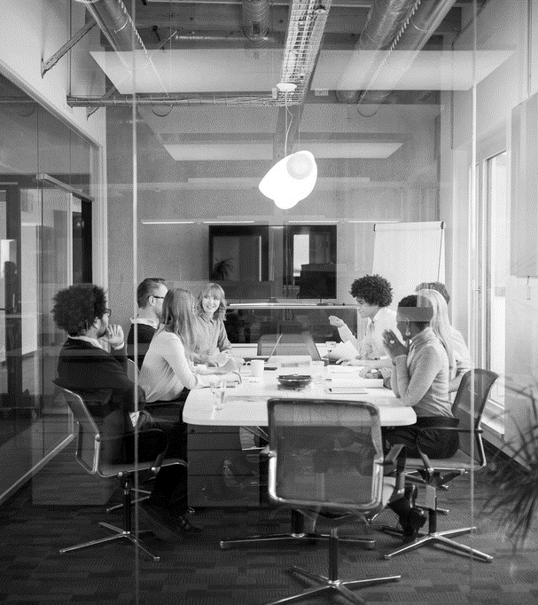
Motivation
It’s a common occurrence when you visit other countries and there is a language barrier.
Therefore, I though it would be a good idea to design something to overcome this

Slide 3
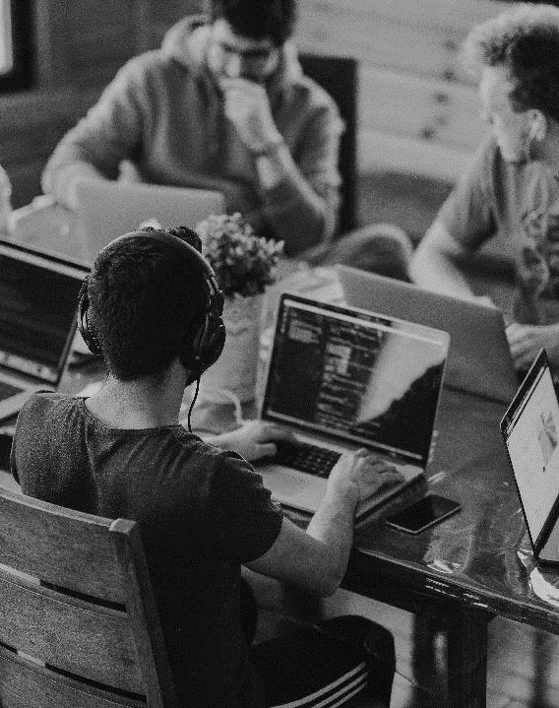
Background
Only about 40% of the world population is estimated to be monolingual
And only 17% of the world population is estimated to be multilingual

Slide 4

Demonstration

Slide 5
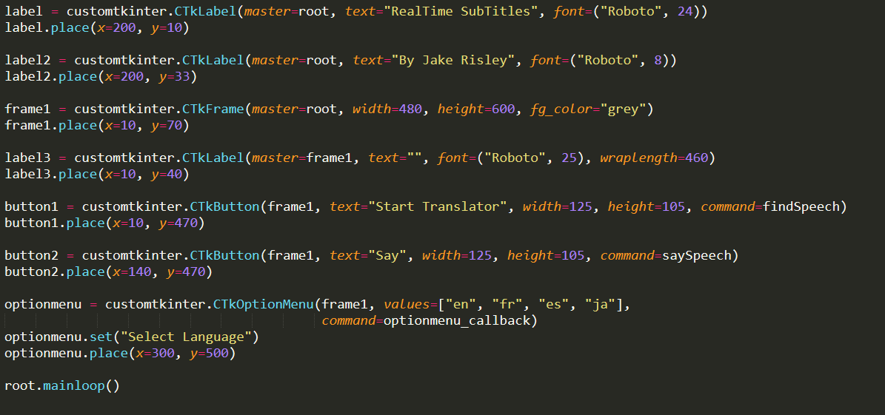
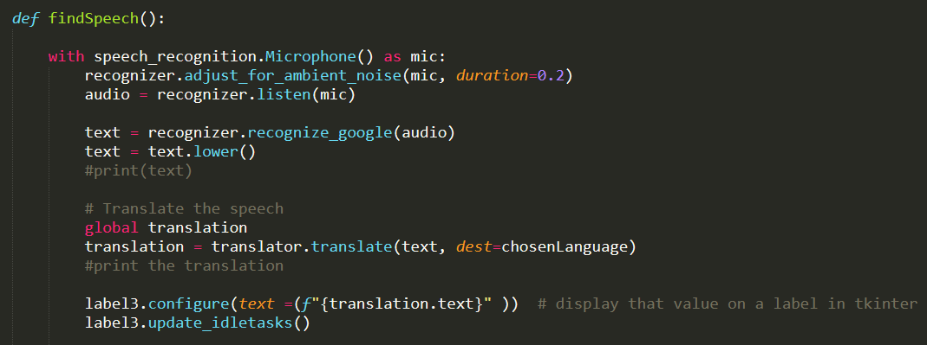
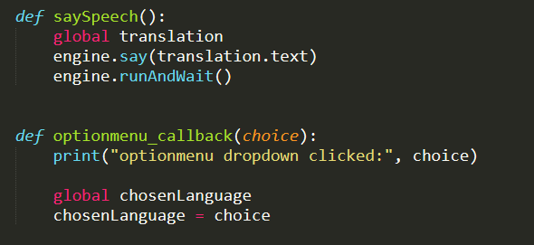
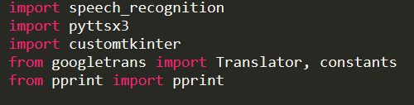
HOW IT WORKS

Slide 6
Key Findings / What can be Improved
The speech recognition is quite accurate
The GUI makes the operation of the program very simple
The response could be a little faster
It would make sense if the text was displayed as the user was talking

Slide 7

Future work
Add compatibility for more languages
Improve the speech synthesizer for the translated text

Slide 8
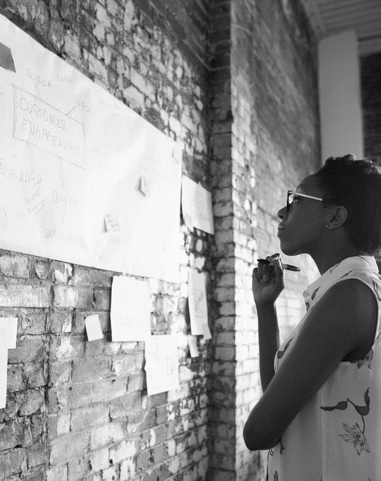
SUMMARY
OUR BUSINESS IS GOOD
Profits are up in the last quarter by 3%
WE’RE GETTING OUR WORK DONE
We finished the consolidation project
WE’RE DELIVERING FOR OUR CUSTOMERS
Customer satisfaction increased from 70 to 80%
OUR CUSTOMERS KEEP COMING BACK
We increased customer retention by 4%

Slide 9
THANK YOU
ANY QUESTIONS

