Slide 1
Finding Source of Rumor in Large Scale Social Network
Under guidance of Anish R. Khobragade
By
Akash Patil
Ganesh Landge
Jayant Kalani

Slide 2
Introduction
Scenarios :
Bomb attack on white house 2013
Presidential election USA
Rumor Definition :In a population network, the rumor is the disease that is transmitted between individuals. In the example of a computer virus spreading in a network, the rumor is the computer virus, while for the case of a misinformation spreading in a social network, the rumor is the misinformation.

Slide 3

Introduction
Mafia Chain - If one of the member is found
everyone is accessible.
Same is not true with complex network.
Earlier if every node is infected by rumor it
was not possible to find the source.
There is indeed a need for efficient technology to address this problem of finding the source of rumor.

Slide 4
Research Methods
To achieve the goal researchers apply different mathematical computation to find source of rumor in network.
Methods
Centrality measures - degree, betweenness, closeness, jordan centrality, eigenvector, etc.
Community detection - Reducing network to community.
Epidemic Model : SI, SIR, SIS also called diffusion methods.

Slide 5
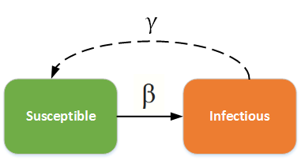
Diffusion Model
SI -model
Individuals are born into the simulation with no immunity (susceptible). Once infected and with no treatment, individuals stay infected and infectious throughout their life, and remain in contact with the susceptible population

Slide 6
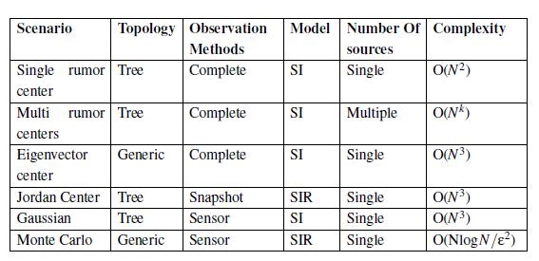
Findings

Slide 7
Literature Review
Timeline | Description
2012 | Earliest idea on source localization given by Pedro C. Pinto, Patrick Thiran, Martin Vetterli . They presented a strategy that is optimal for arbitrary trees, achieving maximum probability of correct localization.
2013 | Different Epidemic Spread model were used to study the dissemination of rumor in social networks.Kai Zhu, Lei Ying followed the popular Susceptible-Infected-Recovered (SIR) model to study the problem of detecting the information source in a network.
2014 | Studies were done on static-internode relationship networks. Jiang et al. described state-of-the-art and conducted comparative studies. One of their conclusions is that current methods are too computationally expensive and they can not be use for a quick identification of the propagation source
History :

Slide 8
Literature Review
Base Paper by Alireza Louni and K. P. Subbalakshmi
Abstract :
The problem of estimating the source of a rumor in large-scale social networks
The uncertainty is solved by using random, non-homogenous edge weights
The paper proposed a novel two-stage algorithm that uses the modularity of the social network

Slide 9
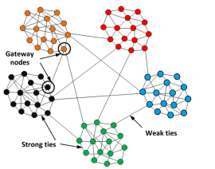
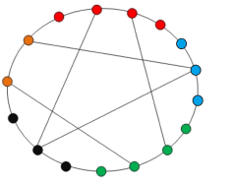
Literature Review
Most likely candidate cluster and sensor nodes :

Slide 10
Literature Review
First Stage : Find the Most Likely Candidate Cluster. We first need to discover the clusters/communities existing in the network. We use the Louvain method to find the clusters. The method is a greedy algorithm with
Time Complexity : O(|V| log |V|)
Input : Graph of sensor nodes ( Each sensor node indicates a cluster )
Output : A sensor node indicating most likely candidate cluster

Slide 11
Literature Review
Second Stage : Find the Source of Rumor
This stage uses the Betweenness Centrality Scores (BCS), the node that maximizes the likelihood value is chosen as the source of the rumor
Time Complexity : O( a |V|³) where |V| = number of nodes in candidate cluster a = the ratio of of the nodes acting as the sensor in each stage
Input : Most likely candidate cluster from stage one
Output : source node ( node having maximum likelihood )

Slide 12
Literature Review
Conclusion :
The two-stage algorithm improves
Computation : Improvement in terms of computational complexity
Accuracy : Detects source within two hops 69% to 80% of the time
Finally, we could say that the two-stage method leads to significant improvement in terms of the accuracy of locating the source compared to existing approaches.

Slide 13
Methods and Materials
Data Pre-processing:
Search and Collect
Searching for appropriate datasets related to the topic of interest i.e consisting of data related to the problem and collecting it using data mining algorithms
Analyse
Analysing the various attributes of dataset such as size, structure and complexity; studying how accuracy can be improved
Represent
Graphically representing the dataset as a social network for observing patterns and clusters
Validate
Checking whether dataset can be fed as input to an existing algorithm; if not formatting it to make it compatible

Slide 14
Materials
PHEME Rumour scheme Twitter dataset: Journalism use case
9 different breaking news
330 conversational threads
Each thread contains:
source-tweet | The source of the rumour
reactions | json files of re-tweeters
url content | web pages pointed to from the tweets
structure.json | Structure of the conversation
retweets.json | Tweets that re-tweeted the rumour
who-follows-whom.dat | Relationship between users

Slide 15
2) SNAP ego-Twitter dataset
Textual data network
Dataset each for retweet, replies, mentions and social relationships
Re-tweet dataset more prevalent than others
User-ids have been anonymized
Retweet network
RETWEET NETWORK STATISTICS
Nodes | 256491
Edges | 328132
Average clustering coefficient | 0.0156
Number of triangles | 13082506
Fraction of closed triangles | 0.0001085
Diameter (Longest shortest path) | 19

Slide 16
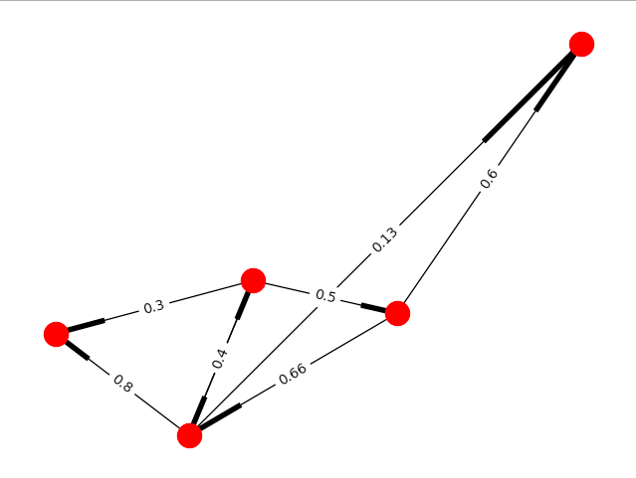
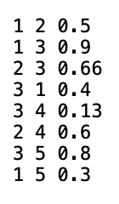

Slide 17
Conclusion
Scope of our research can be :
Continuous Time-varying Networks
Multiple Rumors on the Same Topic
Interconnected Networks
Dataset
Machine learning
Deep neural network

