Slide 1

8/16/15
1
Estimating the Source of a Rumor in Large-scale Social Networks
Alireza Louni
Advisor: Dr. K.P. (Suba) Subbalakshmi
Department of Electrical and Computer Engineering
Stevens Institute of Technology
October 28, 2015

Slide 2
Presentation Outline
Motivation
Background
Previous works
Network Model
Contributions
Two-stage Algorithm
Missing Measurements
Conclusion
Evaluation
Remaining Work

Slide 3
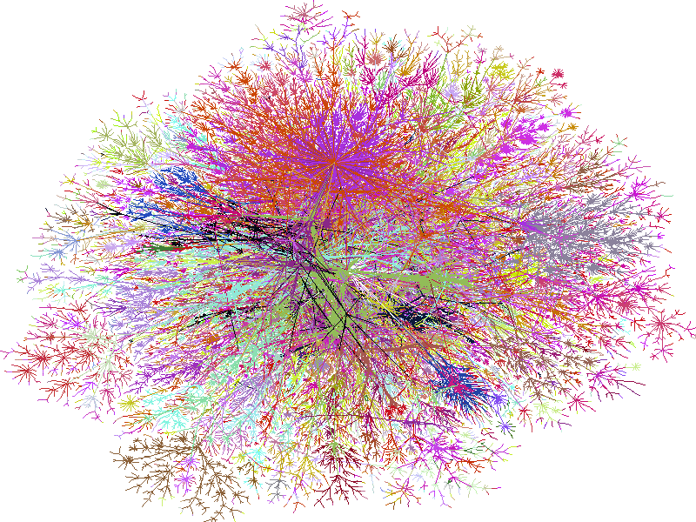
Social Media Networks: Overview
Social networks becoming very popular in everyday life
Incredibly large with a large amount of on-line interaction
Well suited to viral and rapid information diffusion
A sampled Twitter network of Justin Bieber

Slide 4
Rumors in Social Networks
A recent rumor on Twitter caused stocks to fall
[1] G. Strauss, A. Shell, R. Yu, and B. Acohido, “SEC, FBI probe fake tweet that rocked stocks,” Apr. 2013.
RT@ Susan: : Two Explosions in the White House and Barak Obama is injured
Breaking : Two Explosions in the White House and Barak Obama is injured [1]
RT@ Susan: : Two Explosions in the White House and Barak Obama is injured
Can we detect the source of rumors?

Slide 5
Two Important Questions
Predicting the diffusion of a trend or information
Finding source of rumor (the reverse problem)
?
1- The source is known.
2- Who is the source?

Slide 6
Presentation Outline
Motivation
Background
Previous works
Network Model
Contributions
Two-stage Algorithm
Missing Measurements
Conclusion
Evaluation
Remaining Work

Slide 7
Modeling of Social Networks
B
D
B
D
A
C
E
A
C
E
Undirected, binary
directed, binary
0.1
B
0.3
0.1
D
0.2
Network Centrality Measures
e.g. Degree/Betweeness centrality
A
C
E
0.4
Undirected, weighted
Betweenness Centrality
F
D
A
C
E
G
Degree Centrality
H

Slide 8
Presentation Outline
Motivation
Background
Previous works
Network Model
Contributions
Two-stage Algorithm
Missing Measurements
Conclusion
Evaluation
Remaining Work

Slide 9
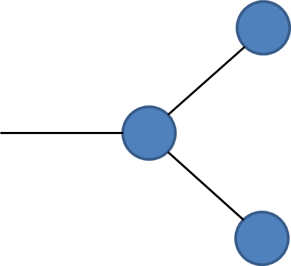
Finding Sources of Rumors
First Generation Techniques: use network centrality [2]
But: Which network centrality?
Source not always the node with highest centrality
Degree Centrality
Betweenness Centrality
[2] C. H. Comin and L. da Fontoura Costa, “Identifying the starting point of a spreading process in complex networks,” Phys. Rev. E, vol. 84, p. 056105, Nov. 2011.

Slide 10
Rumor Source Estimation
Estimation Theory: Estimate the source using ML [3]
Observe the ``infected” nodes.
Find most likely node using a maximum likelihood (ML) estimator
New problem: full observation of a very large network!
[3]D. Shah and T. Zaman, “Rumors in a network: Who’s the culprit?,” IEEE Transactions on Information Theory, vol. 57, no. 8, pp. 5163–5181, 2011.

Slide 11
Reduced Complexity Source Estimator
Can we predict the source of diffusion with lower complexity?
monitor only a subset of nodes (called sensors)
Observe arrival times of information at different sensor locations.
Monitoring 20% of the network, an average localization error of less than 4 hops can be achieved.
[4] P. C. Pinto, P. Thiran, and M. Vetterli, “Locating the source of diffusion in large-scale networks,” Phys. Rev. Lett., vol. 109, pp. 06870-1 to 06870-5, Aug.2012.
Sensor2
Sensor1
But 20% is still a lot of sensors

Slide 12
Presentation Outline
Motivation
Background
Previous Work
Network Model
Contributions
Two-stage Algorithm
Missing Measurements
Conclusion
Evaluation
Remaining Work

Slide 13
Contributions
Can we reduce the number of sensors further without sacrificing accuracy of localization?
Two-stage algorithm
Rationale: Social media networks typically exhibit highly clustered topography
The ``trick”:
First locate the most likely cluster
Then find the most likely source within the cluster

Slide 14
Modularity in Social Networks
Weak Ties
Gateway node
Strong Ties

Slide 15
The Social Network Model
Source is uniformly distributed
Breadth-first-search (BFS) spanning tree
Sensors:
Nodes with highest betweenness centrality
Time taken for neighbor to become infected is Gaussian distributed.
Use the modified Newman algorithm [5] to find clusters in the social network.
Weighted graph
[5]M. E. J. Newman, “Fast algorithm for detecting community structure in networks,” Phys. Rev. E, vol. 69, p. 066133, Jun 2004.

Slide 16
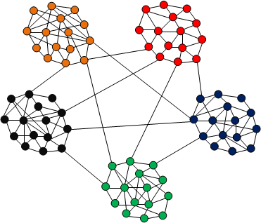
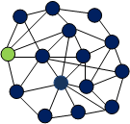

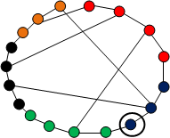
Two-Stage Algorithm
Get estimated source location
Example clustered network graph with 5 clusters.
Construct a new graph using gateway nodes only
Extract clusters & gateway nodes
( )
Use second stage ML estimator on candidate cluster (one sensor in green)
Pick three sensors, measure arrival time at them
Arrival time
at sensor2:
Get candidate
cluster
Arrival time at
sensor1:
Calc. ML cluster

Slide 17
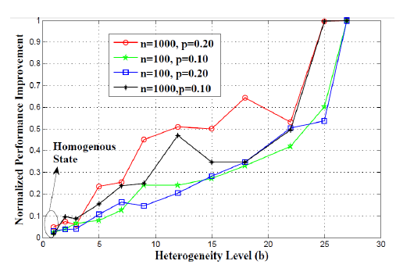
Simulation
The network is more heterogeneous if the average time delay takes on more diverse values for different edges in the network.
The performance of the proposed algorithm improves as the network heterogeneity increases.

Slide 18
Results on Twitter
Network graph:
By a snowball sampling from a seed set of computer scientists/statisticians and tracing followers links up to three hops.
Data
Network monitored within the month of February 2014.
3479 nodes.

Slide 19
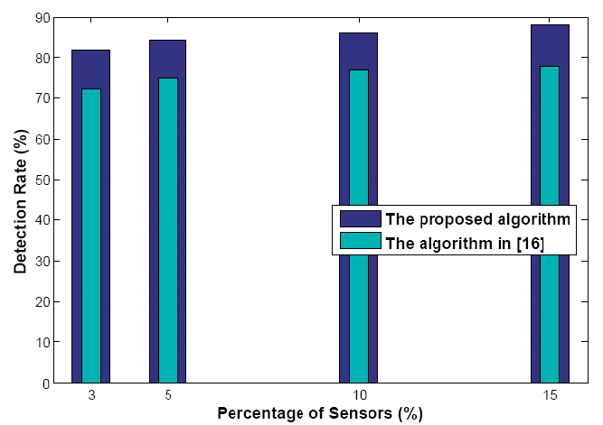
Results on Twitter
Detection accuracy increases with number of sensors
The two-stage method does better by 10% in terms of accuracy for same number of sensors

Slide 20
Presentation Outline
Motivation
Background
Previous Work
Network Model
Two-stage Algorithm
Contribution
Missing Measurements
Conclusion
Evaluation
Remaining Work

Slide 21
Missing Data at the Sensors
Reasons:
Not public access to the full stream of tweets.
Many users keep their activities or profiles private.
Natural and man-made disasters
Network Information diffusion
complete data incomplete data
data about node c missing
a
a
a
b
b
b
c
c
c
d
d
d
Trick: to estimate missing values from incomplete measurements

Slide 22
Estimation Methods
The missing information at the sensors are estimated using [6]:
Compressed sensing to estimate sporadically missing information.
Doubly non-negative (DN) matrix completion to estimate information missing in burst.
DN matrix completion with renewal theory argument.
[6] Z. Dong, S. Anand, and R. Chandramouli, Estimation of missing RTTs in large computer networks: Matrix completion vs compressed sensing," Elsevier Jl. on Computer Networks, vol. 55, no. 15, pp. 3364-3375, Oct.2011.

Slide 23
Method1: Compressed Sensing
- Correlation
The rumor spread along the common paths(the shortest paths in the social network).
Trick: A sparse representation of the observation vector D
Some math: Complete information: D and Incomplete information(observed): y
Two-stage algorithm

Slide 24
Method2 : Doubly non-negative (DN) Completion
DN completion:
Two assumptions:
Missing of measurements in burst.
The statistical average of missing data is known.
Find X such that makes D a DN matrix and minimizes the estimation error
Renewal theory: first two moments are used
Which is a better approximation to any random process than the first moment alone
[6] Z. Dong, S. Anand, and R. Chandramouli, Estimation of missing RTTs in large computer networks: Matrix completion vs compressed sensing," Elsevier Jl. on Computer Networks, vol. 55, no. 15, pp. 3364-3375, Oct.2011.
[7] J.H. Drew, C.R. Johnson, The completely positive and doubly nonnegative completion problems, Linear Multilinear Alg. 44 (1998) 85–92.
Iterative equations
Two-stage algorithm

Slide 25
Simulation Results
Data [8]:
A Sina Weibo followership network
# nodes is 58,655,849
# edges is 265,580,802
The retweeting path (with their time-stamps) provided.
Selected 100 tweets (or equally 100 diffusion networks)
[8] http://www.wise2012.cs.ucy.ac.cy/challenge.html

Slide 26
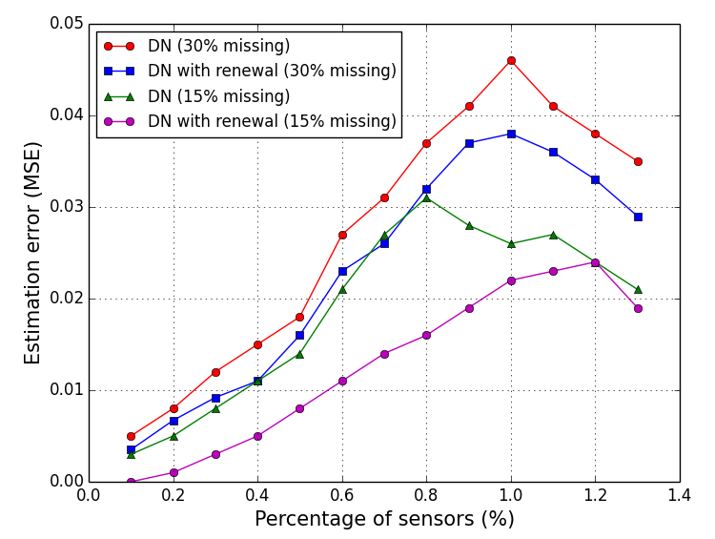
Simulation Results-DN
Accuracy of recovering of missing values versus % sensors (DN completion).
The renewal-based method improved the accuracy.
The accuracy improvement is larger when the missing rate is 15%.

Slide 27
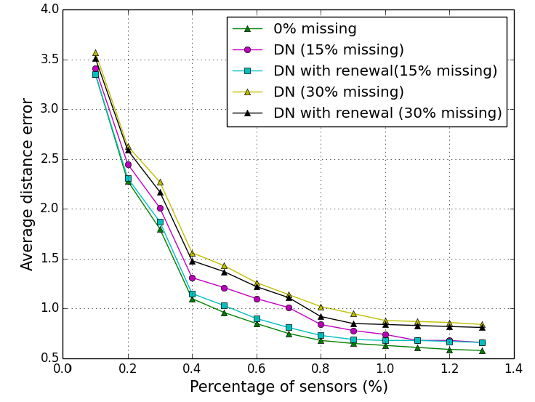
Simulation Results-DN
Accuracy of the source estimation versus % sensors(DN completion).
The performance is almost good as a ML estimator with complete information.

Slide 28
Summary
Proposed a two-stage algorithm to locate a source of rumor in social networks.
Results on Twitter indicate: 10% or so improvement in accuracy for same # sensors
As the heterogeneity of the network increases, the localization accuracy increases greatly.
Employed the compressed sensing to estimate sporadically missing measurements at the sensors.
Employed the DN completion to recover measurements missing in burst.
The renewal theory-based model increased the accuracy improvement of the DN completion.
Simulation results on Sina Weibo indicate: less estimation error when the percentage of sensors is less.
The improvement is the accuracy of estimating the missing measurements when the missing rate is smaller
The performance is almost good as a ML estimator with complete information.

Slide 29
Publications
[1] Alireza Louni, Anand Santhanakrishnan and K.P. Subbalakshmi. (Aug 19, 2015). "Identification of Source of Rumors in Social Networks with Incomplete Information", SocialCom 2015 [acceptance rate: 9%]
[2] Alireza Louni and K.P. Subbalakshmi. (Apr 2014). "A Two-stage Algorithm to Estimate the Source of Information Diffusion in Social Media Networks", IEEE INFOCOM Workshop on Dynamic Social Networks.
[3] Alireza Louni and K.P. Subbalakshmi. (2014). "Diffusion of Information in Social Networks", Social Networking: Mining, Visualization and Security, Springer-Verlag GmbH. XXII.

