Slide 1
Challenge
Can we build a system that:
recommends the next career step for a person…
based on the past career steps of people with a similar profile?
… Can we do this using Machine Learning and / or Knowledge Engineering?

Slide 2
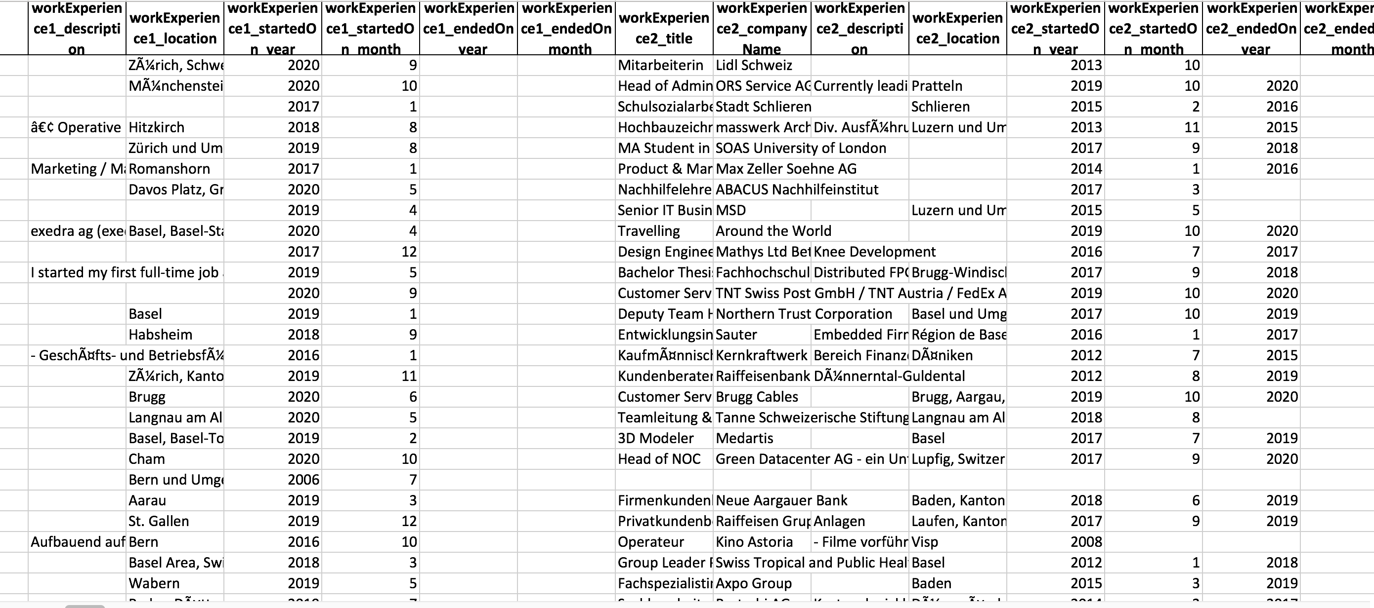
How it started
Which of this data can we use as inputs?
What do we want to predict?

Slide 3
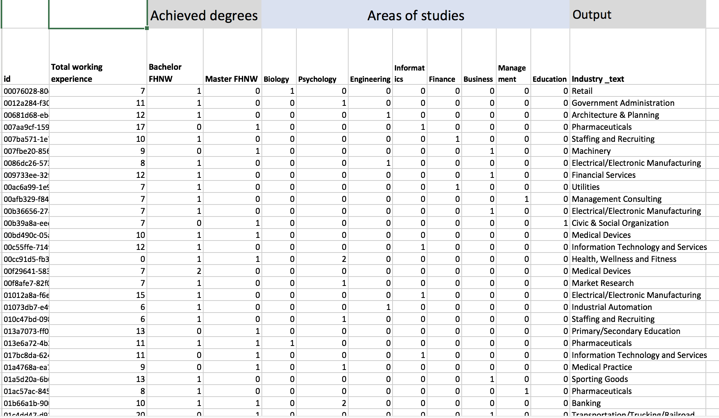
We needed to transform the data
Narrow it down to 1 output variable (industry)
Categorical variables
Aggregation of multiple inputs(e.g. years of experience)

Slide 4
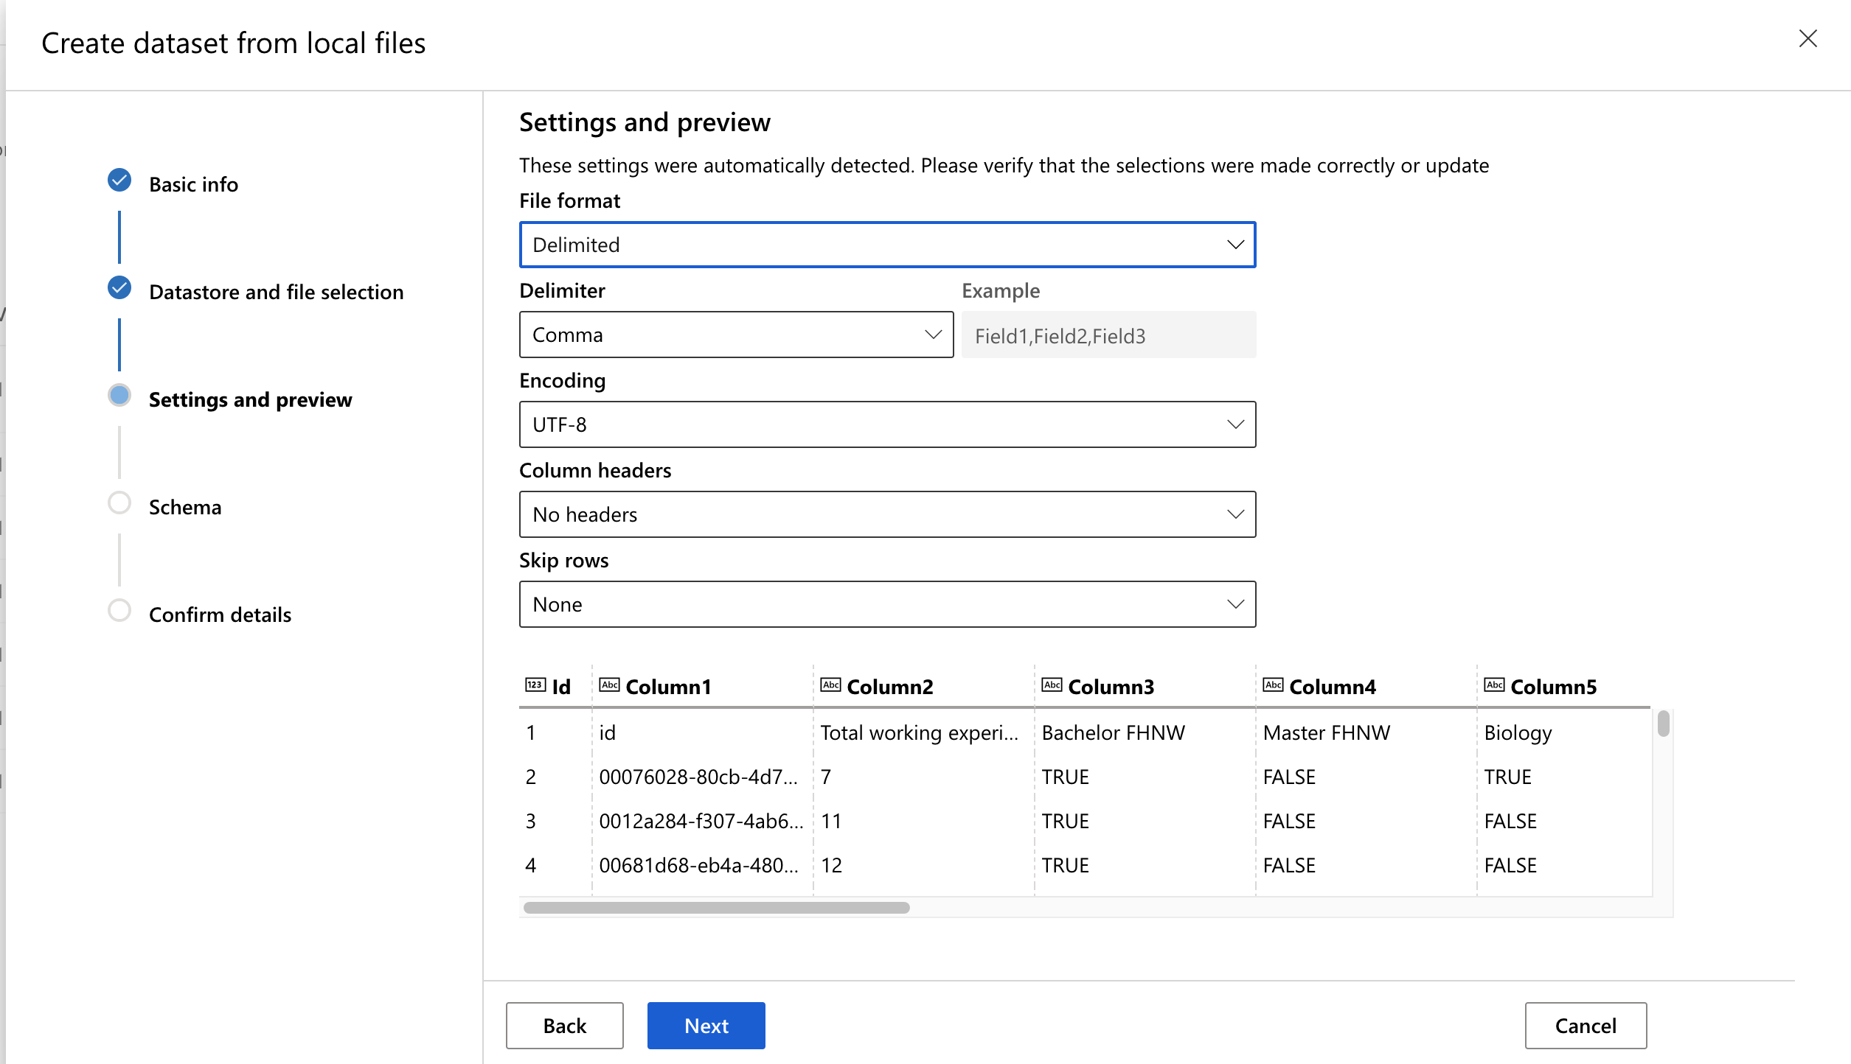
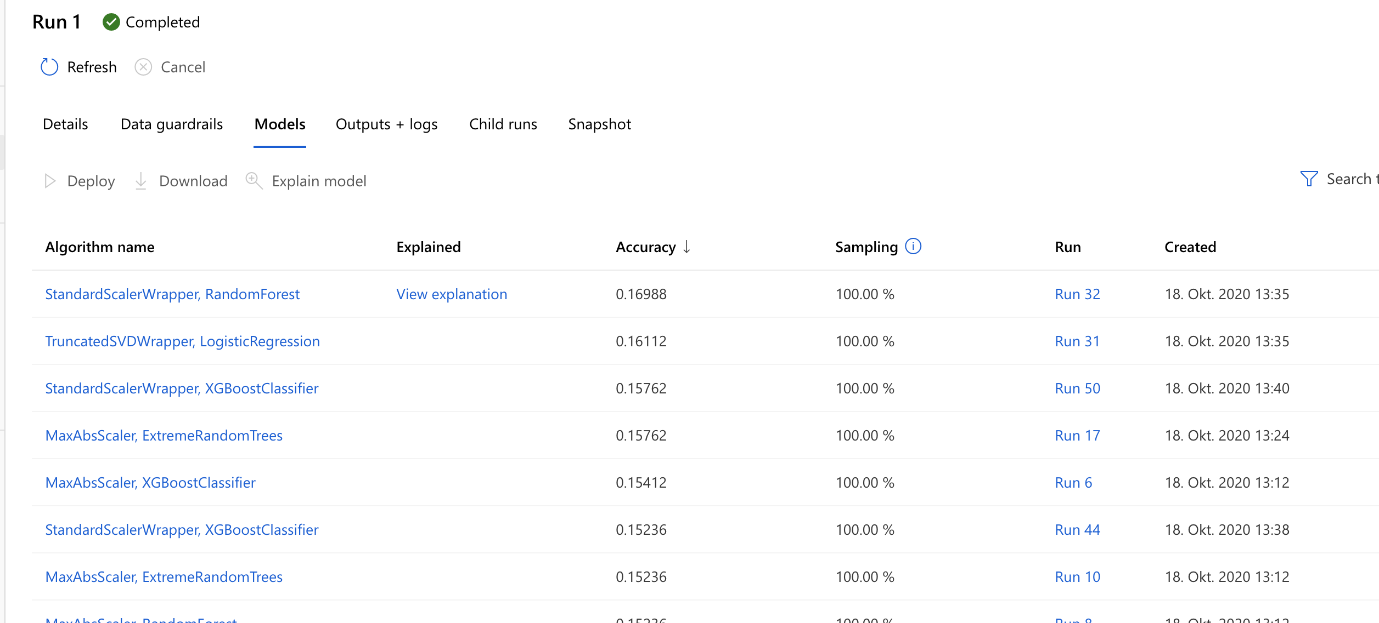
Now we can upload it to Azure ☺
We have a winner algorithm!

Slide 5
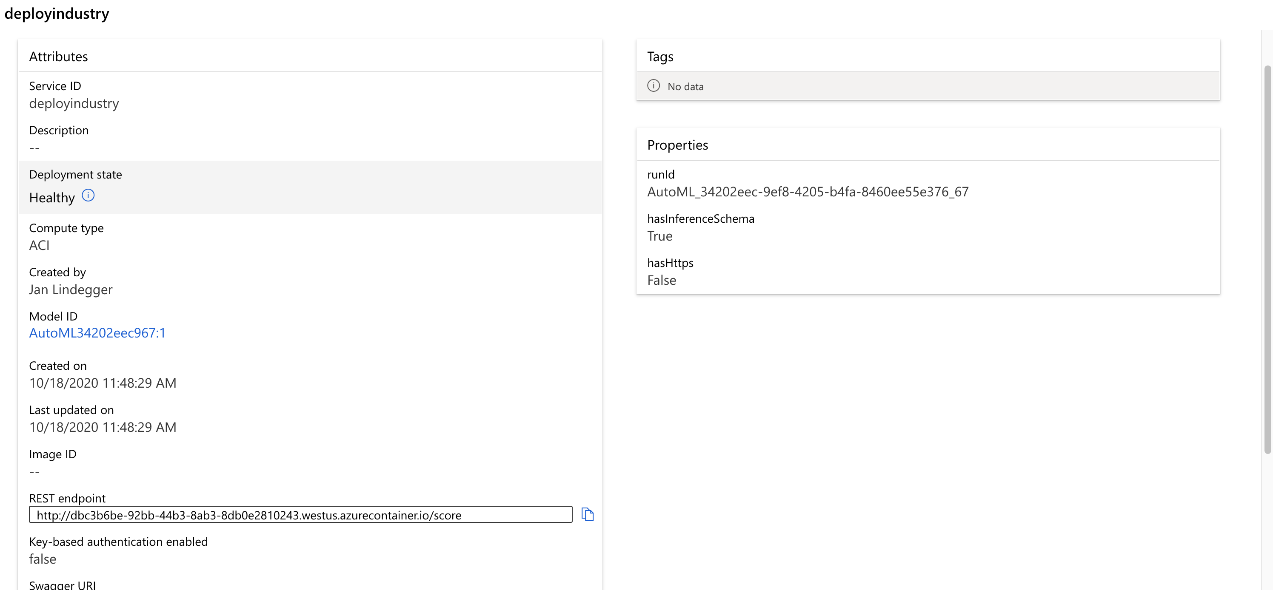
We were able to deploy it but…
…unfortunately were not able to integrate it into an app, due to time
¯\_(ツ)_/¯

Slide 6
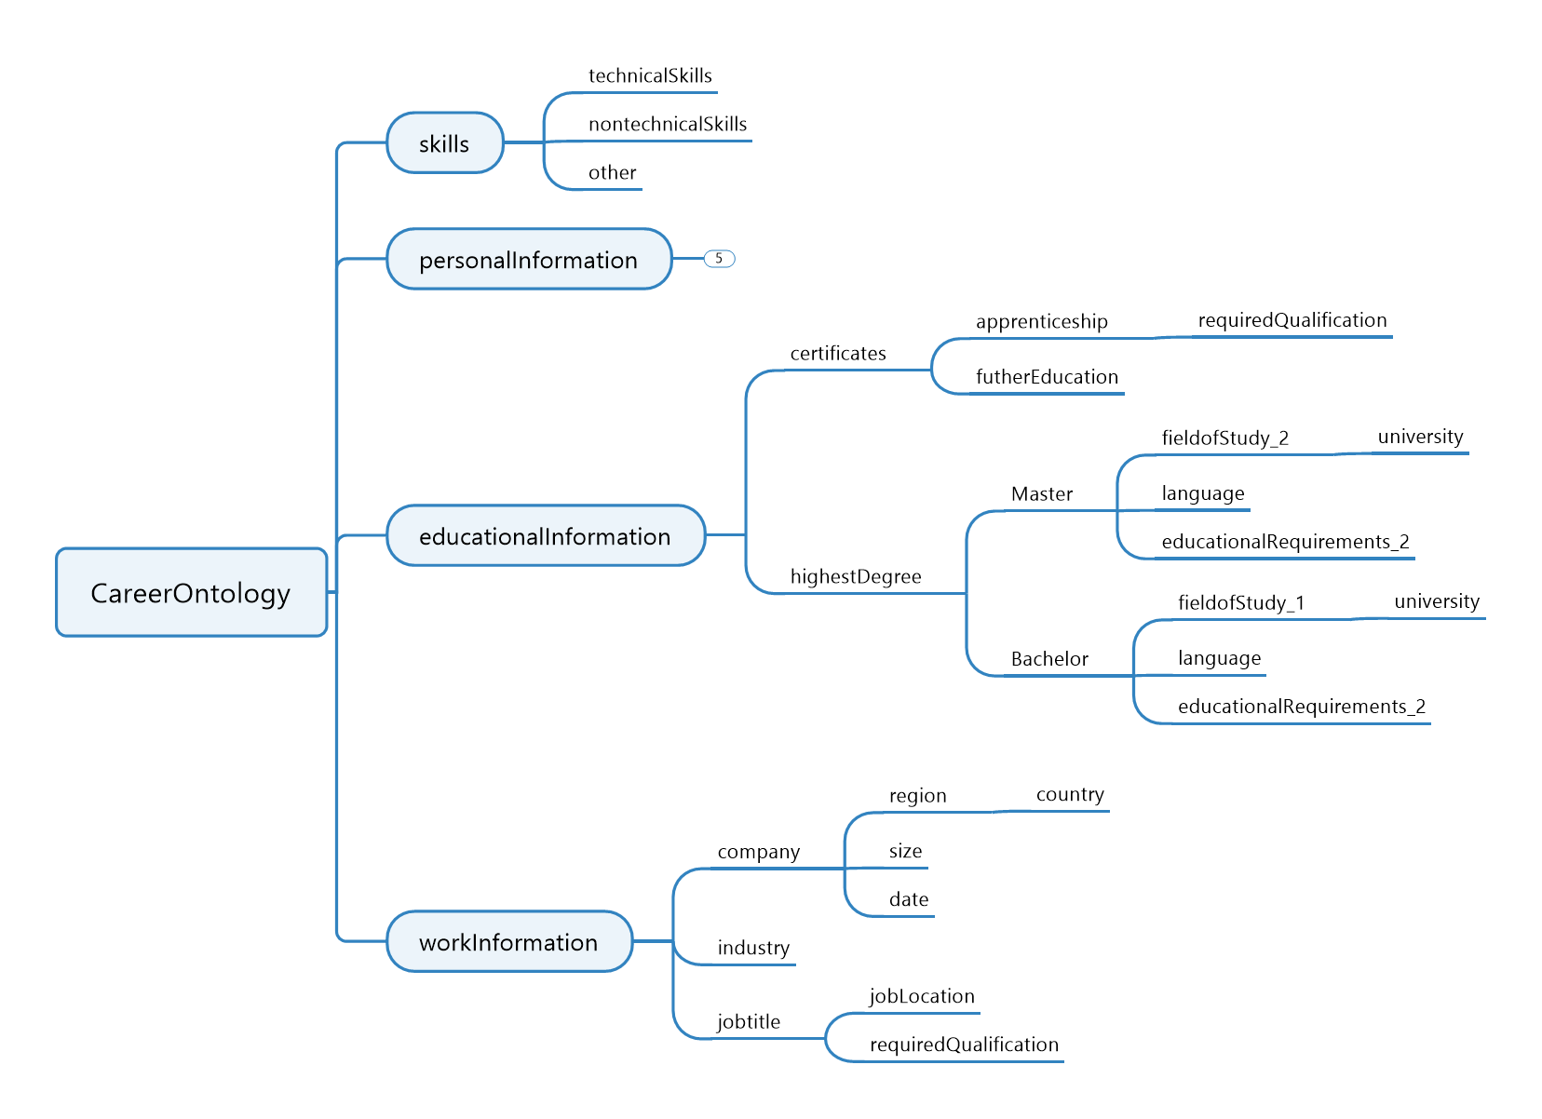
Ontology
Create Knowledge Base with Neo4j
Implementing rules
Started with TopBraid-Editor to design Ontology (due to time issues)

Slide 7
Next steps
Integrate AI-Solution and knowledge-engineering part into webservice
Goal is to evaluate the results from ML-part
Futher develop model to integrate more input/output fields

