Slide 1
Automatic Speech Recognition:
Gaussians and
Neural Nets and
Markov Models…
Oh my!
@_josh_meyer_

Slide 2
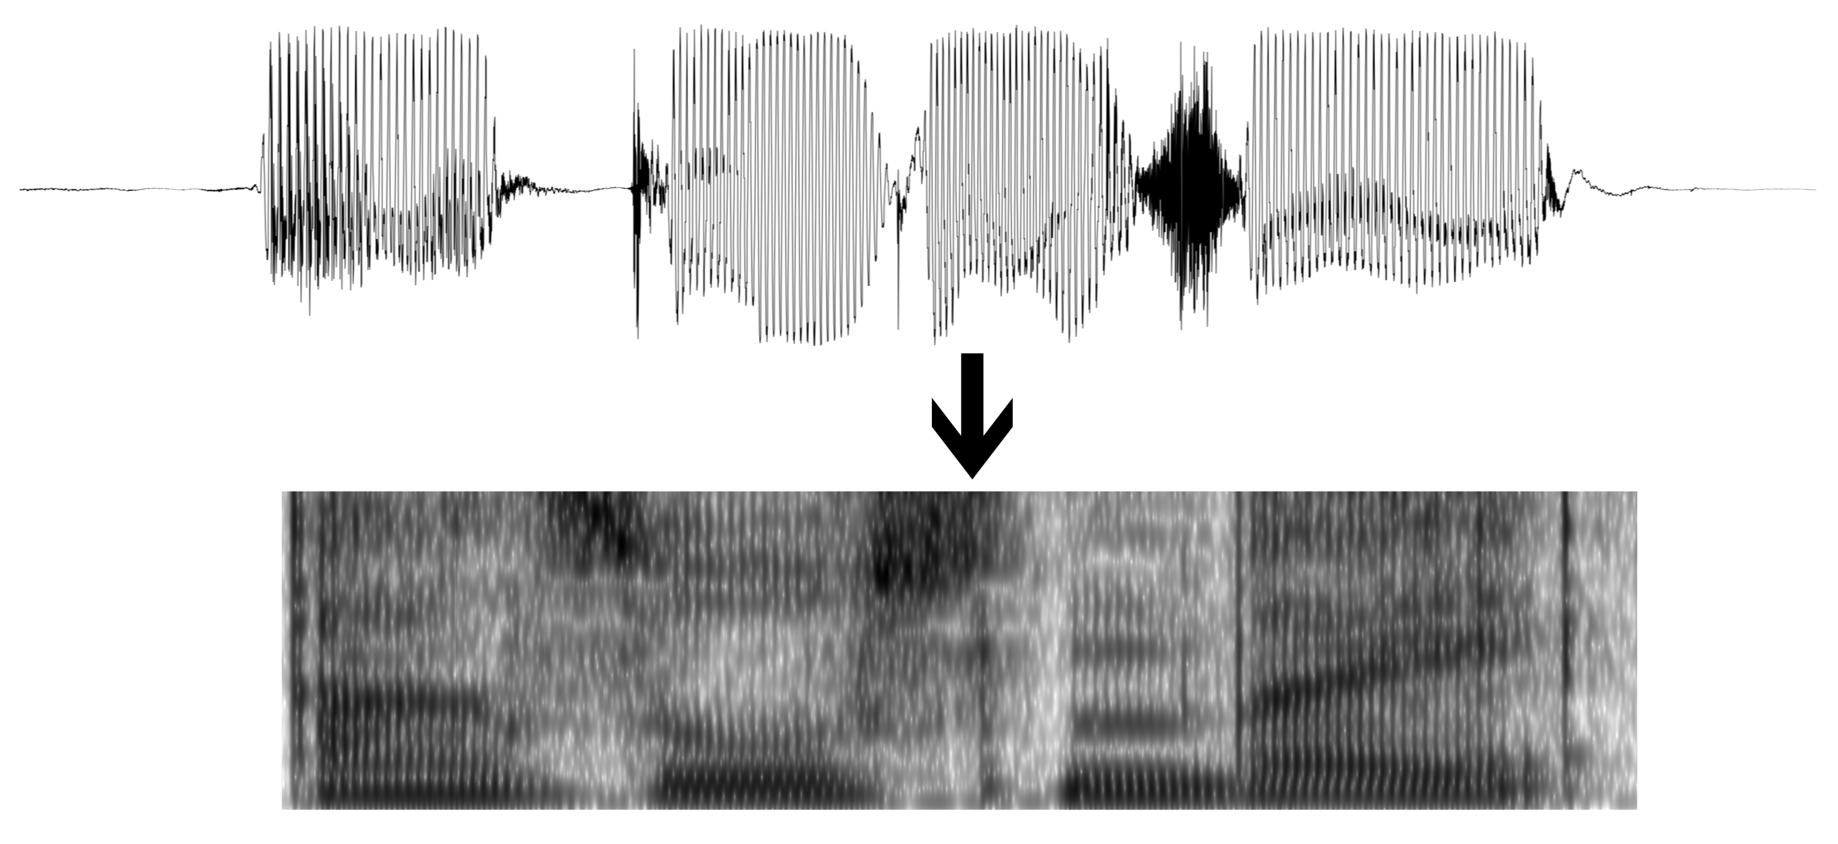



T th uh d ah g
The dog

Slide 3
T th uh d ah g
The dog

Slide 4
FEATURE EXTRACTION
GMM MONOPHONE TRAINING
GMM TRIPHONE TRAINING
DNN TRAINING
DECODING

Slide 5
FEATURE EXTRACTION
- Sliding window feature extraction
GMM MONOPHONE TRAINING
GMM TRIPHONE TRAINING
DNN TRAINING
DECODING

Slide 6
FEATURE EXTRACTION
- Sliding window feature extraction
GMM MONOPHONE TRAINING
GMM TRIPHONE TRAINING
DNN TRAINING
DECODING

Slide 7
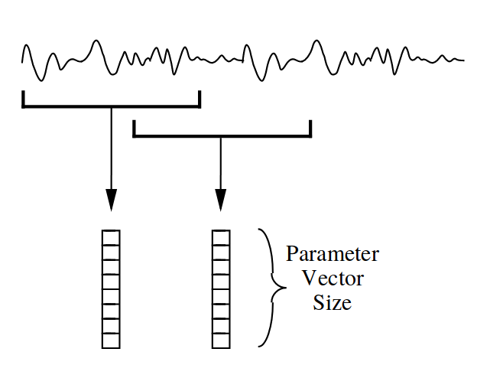
FEATURE EXTRACTION
- Sliding window feature extraction
GMM MONOPHONE TRAINING
GMM TRIPHONE TRAINING
DNN TRAINING
DECODING
Figure credit
HTK Book

Slide 8
FEATURE EXTRACTION
- Sliding window feature extraction
GMM MONOPHONE TRAINING
- Flat-start
- Baum-Welch re-estimation
GMM TRIPHONE TRAINING
DNN TRAINING
DECODING

Slide 9
FEATURE EXTRACTION
- Sliding window feature extraction
GMM MONOPHONE TRAINING
GMM TRIPHONE TRAINING
DNN TRAINING
DECODING
Figure credit
HTK Book

Slide 10
FEATURE EXTRACTION
- Sliding window feature extraction
GMM MONOPHONE TRAINING
GMM TRIPHONE TRAINING
DNN TRAINING
DECODING
[d]
Figure credit
HTK Book

Slide 11
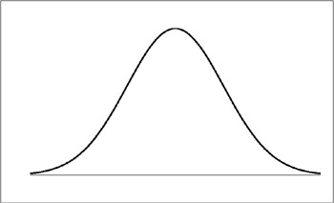
FEATURE EXTRACTION
- Sliding window feature extraction
GMM MONOPHONE TRAINING
GMM TRIPHONE TRAINING
DNN TRAINING
DECODING
[d]
Figure credit
HTK Book

Slide 12
[t] ==
[p] ==
[k] ==
[a] ==
[i] ==
[u] ==

Slide 13
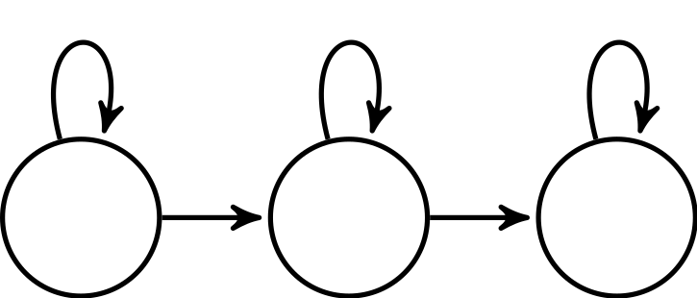
GMM MONOPHONE TRAINING
FEATURE EXTRACTION
- Sliding window feature extraction
GMM TRIPHONE TRAINING
DNN TRAINING
DECODING

Slide 14
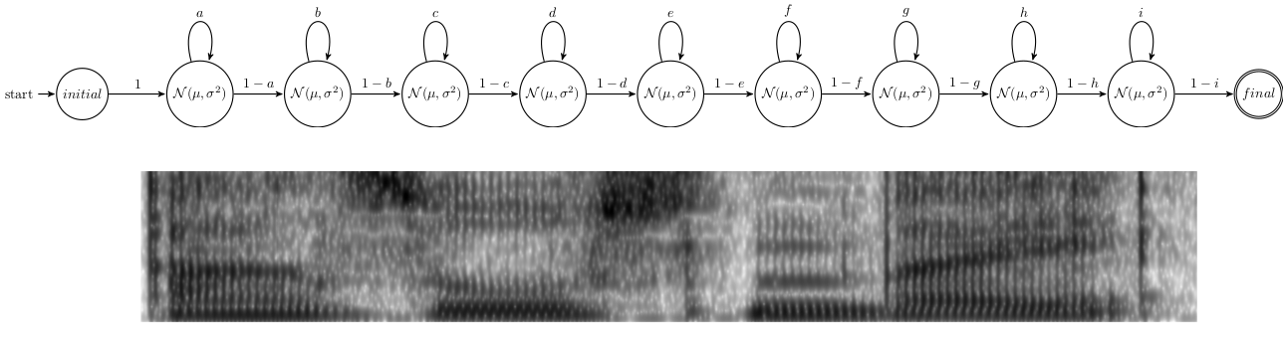

GMM MONOPHONE TRAINING
- Flat-start
FEATURE EXTRACTION
- Sliding window feature extraction
GMM TRIPHONE TRAINING
DNN TRAINING
DECODING

Slide 15
GMM MONOPHONE TRAINING
- Flat-start
- Baum-Welch Re-estimation
FEATURE EXTRACTION
- Sliding window feature extraction
GMM TRIPHONE TRAINING
DNN TRAINING
DECODING

Slide 16
GMM MONOPHONE TRAINING
- Flat-start
- Baum-Welch Re-estimation
FEATURE EXTRACTION
- Sliding window feature extraction
GMM TRIPHONE TRAINING
DNN TRAINING
DECODING

Slide 17
GMM MONOPHONE TRAINING
- Flat-start
- Baum-Welch Re-estimation
FEATURE EXTRACTION
- Sliding window feature extraction
GMM TRIPHONE TRAINING
DNN TRAINING
DECODING

Slide 18
GMM MONOPHONE TRAINING
- Flat-start
- Baum-Welch Re-estimation
FEATURE EXTRACTION
- Sliding window feature extraction
GMM TRIPHONE TRAINING
DNN TRAINING
DECODING

Slide 19
GMM MONOPHONE TRAINING
- Flat-start
- Baum-Welch Re-estimation
FEATURE EXTRACTION
- Sliding window feature extraction
GMM TRIPHONE TRAINING
DNN TRAINING
DECODING

Slide 20
FEATURE EXTRACTION
- Sliding window feature extraction
GMM MONOPHONE TRAINING
- Flat-start
- Baum-Welch re-estimation
GMM TRIPHONE TRAINING
- Phonetic decision tree
- Baum-Welch re-estimation
DNN TRAINING
DECODING

Slide 21
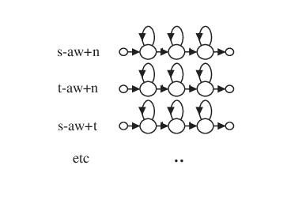
GMM TRIPHONE TRAINING
- Phonetic decision tree
- Baum-Welch re-estimation
DNN TRAINING
DNN TRAINING
DNN TRAINING
DNN TRAINING
DNN TRAINING
- Baum-Welch re-estimation
Figure credit:
The HTK Book
DECODING
*-aw-*

Slide 22
GMM TRIPHONE TRAINING
- Phonetic decision tree
- Baum-Welch re-estimation
DNN TRAINING
DNN TRAINING
DNN TRAINING
DNN TRAINING
DNN TRAINING
- Baum-Welch re-estimation
Figure credit:
The HTK Book
DECODING
*-aw-*

Slide 23
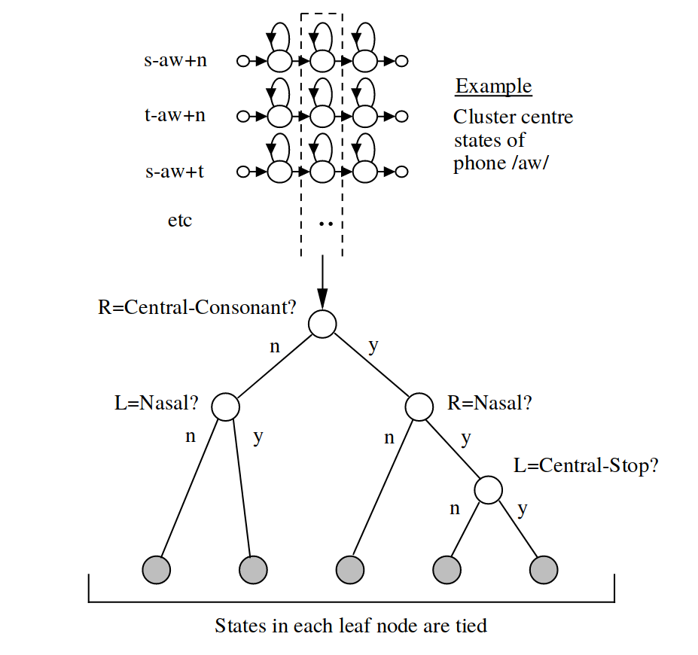
GMM TRIPHONE TRAINING
- Phonetic decision tree
- Baum-Welch re-estimation
DNN TRAINING
DNN TRAINING
DNN TRAINING
DNN TRAINING
DNN TRAINING
- Baum-Welch re-estimation
Figure credit:
The HTK Book
DECODING

Slide 24
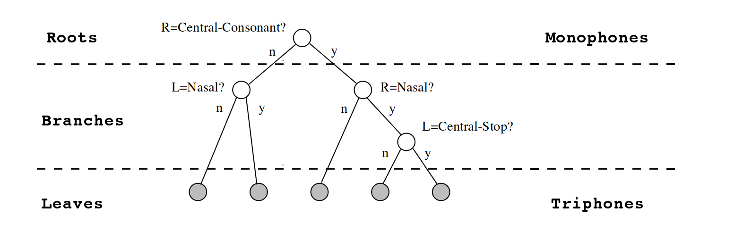
GMM TRIPHONE TRAINING
- Phonetic decision tree
DNN TRAINING
DNN TRAINING
DNN TRAINING
DNN TRAINING
DNN TRAINING
- Baum-Welch re-estimation
DECODING
Figure credit
HTK Book

Slide 25
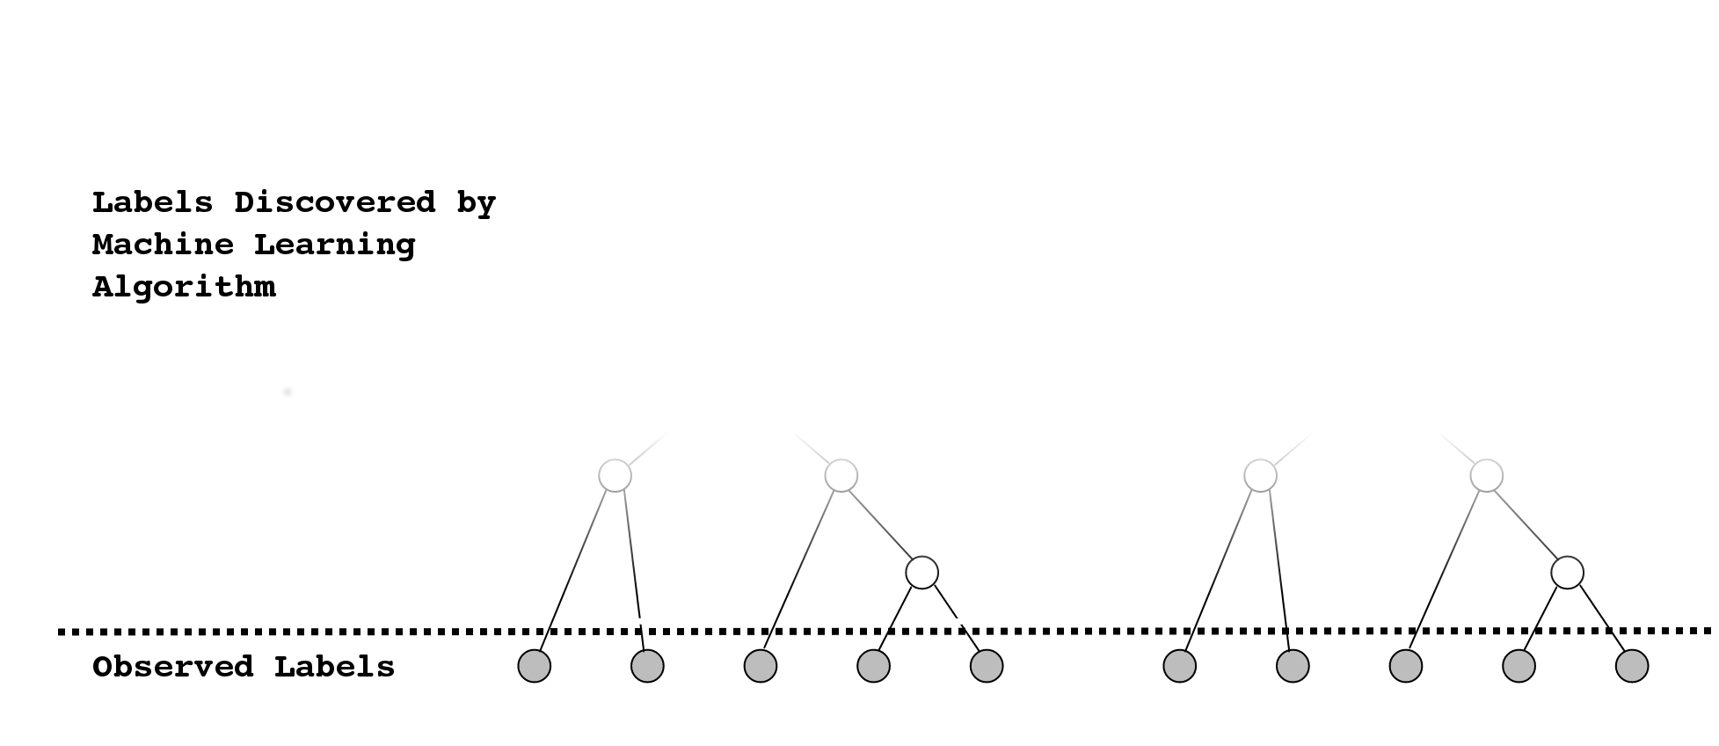
GMM TRIPHONE TRAINING
- Phonetic decision tree
- Baum-Welch re-estimation
Figure credit
HTK Book

Slide 26
FEATURE EXTRACTION
- Sliding window feature extraction
GMM MONOPHONE TRAINING
- Flat-start
- Baum-Welch re-estimation
GMM TRIPHONE TRAINING
- Phonetic decision tree
- Baum-Welch re-estimation
DNN TRAINING
- Labeled Data
- Gradient descent via backprop
DECODING

Slide 27
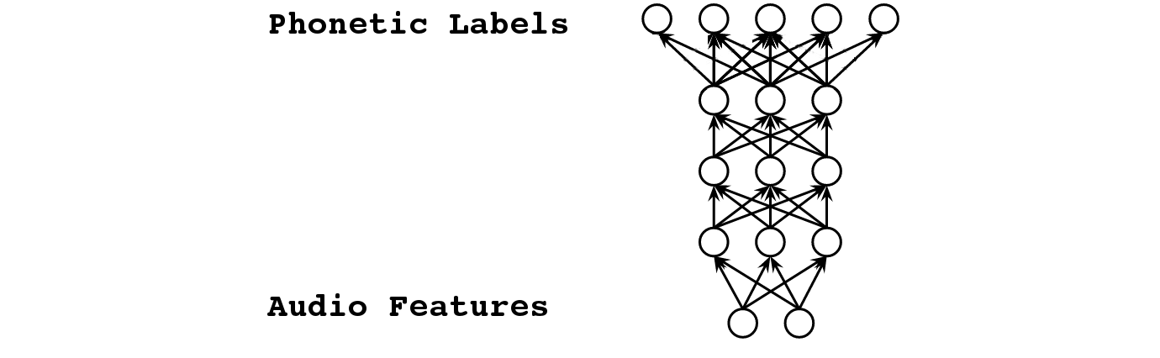
DNN TRAINING
- Labeled Data
FEATURE EXTRACTION
- Sliding window feature extraction
GMM MONOPHONE TRAINING
- Flat-start
- Baum-Welch re-estimation
GMM TRIPHONE TRAINING
- Phonetic decisi/home/josh/git/thesis/figs/tree-net.pngon tree
- Baum-Welch re-estimation
DECODING
Figure credit
Heigold 2013

Slide 28
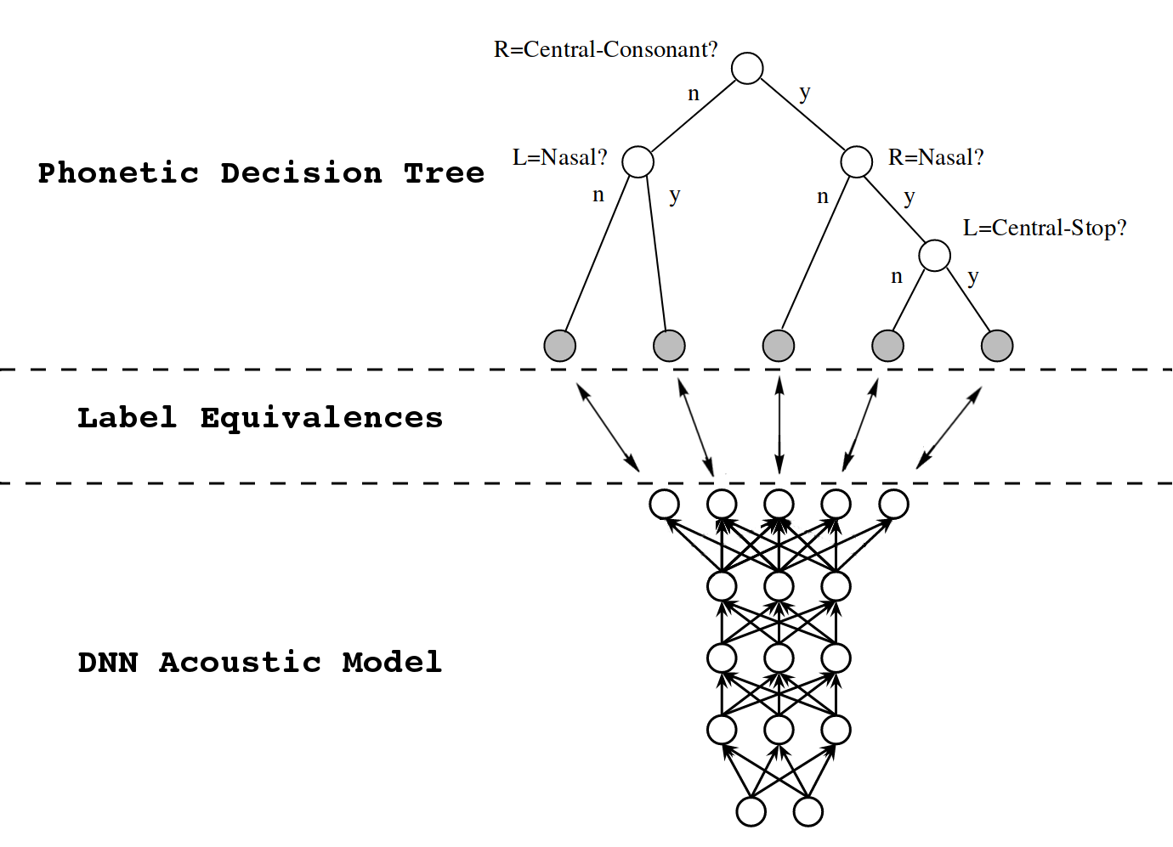
DNN TRAINING
- Labeled Data
FEATURE EXTRACTION
- Sliding window feature extraction
GMM MONOPHONE TRAINING
- Flat-start
- Baum-Welch re-estimation
GMM TRIPHONE TRAINING
- Phonetic decisi/home/josh/git/thesis/figs/tree-net.pngon tree
- Baum-Welch re-estimation
DECODING
Figure credit
Heigold 2013 +
HTK Book

Slide 29

DNN TRAINING
- Labeled Data
- Gradient descent via backprop
FEATURE EXTRACTION
- Sliding window feature extraction
GMM MONOPHONE TRAINING
- Flat-start
- Baum-Welch re-estimation
GMM TRIPHONE TRAINING
- Phonetic decisi/home/josh/git/thesis/figs/tree-net.pngon tree
- Baum-Welch re-estimation
DECODING
[VOWEL_b_LIQUID]
Figure credit
Heigold 2013

Slide 30
FEATURE EXTRACTION
- Sliding window feature extraction
GMM MONOPHONE TRAINING
- Flat-start
- Baum-Welch re-estimation
GMM TRIPHONE TRAINING
- Phonetic decision tree
- Baum-Welch re-estimation
DNN TRAINING
- Labeled Data
- Gradient descent via backprop
DECODING
- WFST Graph compilation
- Viterbi decoding

Slide 31
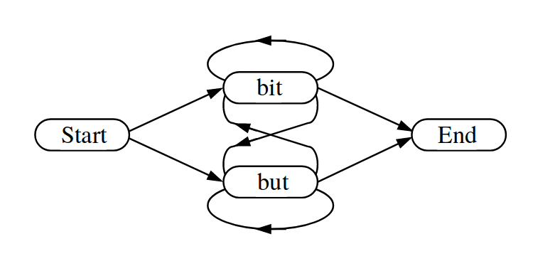
DECODING
- WFST Graph compilation
FEATURE EXTRACTION
- Sliding window feature extraction
GMM MONOPHONE TRAINING
- Flat-start
- Baum-Welch re-estimation
GMM TRIPHONE TRAINING
- Phonetic decision tree
- Baum-Welch re-estimation
Figure credit
The HTK Book
- Gradient descent via backprop

Slide 32
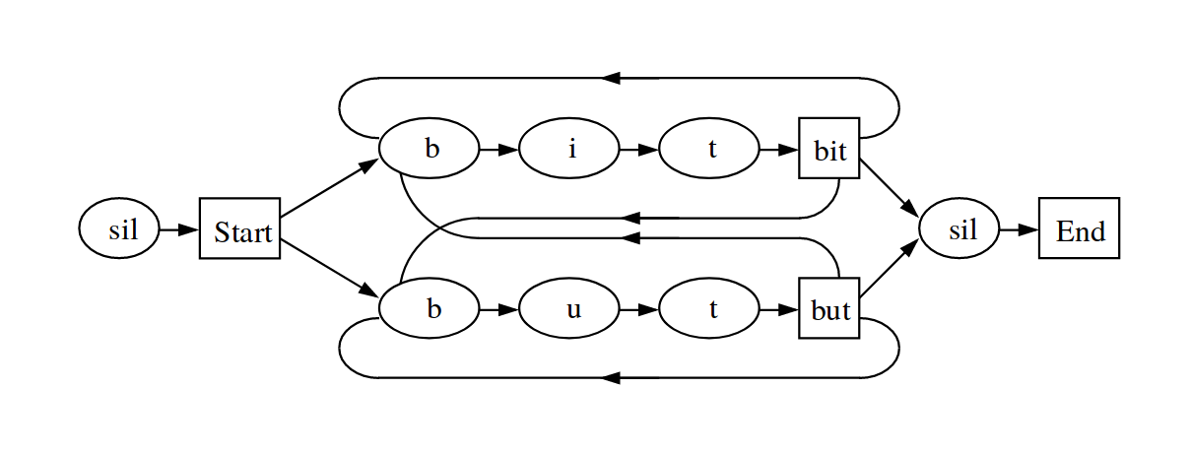
DECODING
- WFST Graph compilation
FEATURE EXTRACTION
- Sliding window feature extraction
GMM MONOPHONE TRAINING
- Flat-start
- Baum-Welch re-estimation
GMM TRIPHONE TRAINING
- Phonetic decision tree
- Baum-Welch re-estimation
Figure credit
The HTK Book
- Gradient descent via backprop

Slide 33
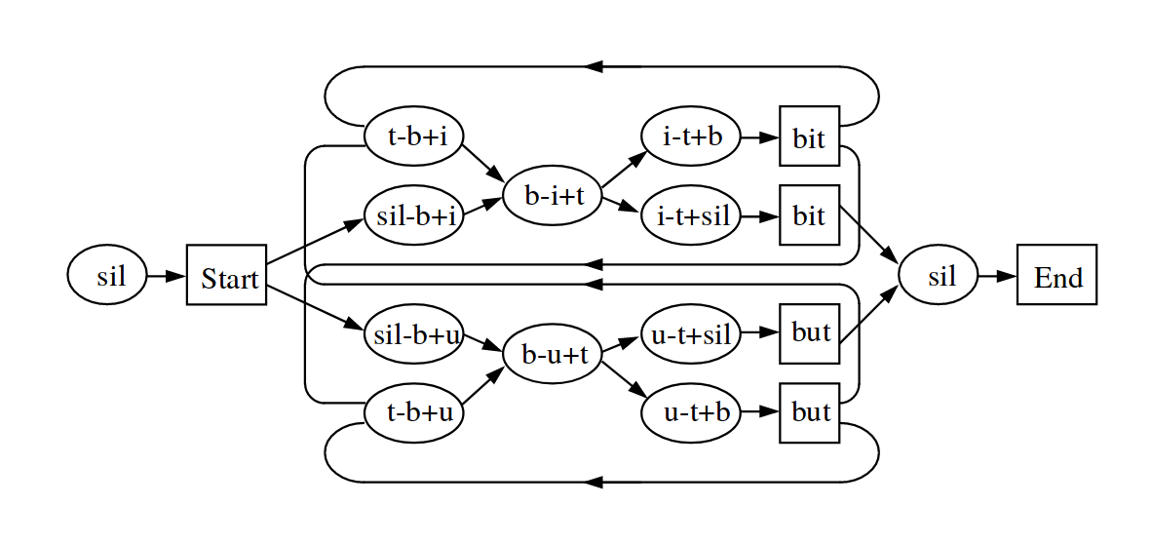
DECODING
- WFST Graph compilation
FEATURE EXTRACTION
- Sliding window feature extraction
GMM MONOPHONE TRAINING
- Flat-start
- Baum-Welch re-estimation
GMM TRIPHONE TRAINING
- Phonetic decision tree
- Baum-Welch re-estimation
Figure credit
The HTK Book
- Gradient descent via backprop

Slide 34
DECODING
- WFST Graph compilation
- Viterbi decoding
FEATURE EXTRACTION
- Sliding window feature extraction
GMM MONOPHONE TRAINING
- Flat-start
- Baum-Welch re-estimation
GMM TRIPHONE TRAINING
- Phonetic decision tree
- Baum-Welch re-estimation
Figure credit
The HTK Book
- Gradient descent via backprop

Slide 35
DECODING
- WFST Graph compilation
- Viterbi decoding
FEATURE EXTRACTION
- Sliding window feature extraction
GMM MONOPHONE TRAINING
- Flat-start
- Baum-Welch re-estimation
GMM TRIPHONE TRAINING
- Phonetic decision tree
- Baum-Welch re-estimation
Figure credit
The HTK Book
- Gradient descent via backprop

Slide 36
DECODING
- WFST Graph compilation
- Viterbi decoding
FEATURE EXTRACTION
- Sliding window feature extraction
GMM MONOPHONE TRAINING
- Flat-start
- Baum-Welch re-estimation
GMM TRIPHONE TRAINING
- Phonetic decision tree
- Baum-Welch re-estimation
Figure credit
The HTK Book
- Gradient descent via backprop

Slide 37
DECODING
- WFST Graph compilation
- Viterbi decoding
FEATURE EXTRACTION
- Sliding window feature extraction
GMM MONOPHONE TRAINING
- Flat-start
- Baum-Welch re-estimation
GMM TRIPHONE TRAINING
- Phonetic decision tree
- Baum-Welch re-estimation
Figure credit
The HTK Book
- Gradient descent via backprop

Slide 38
DECODING
- WFST Graph compilation
- Viterbi decoding
FEATURE EXTRACTION
- Sliding window feature extraction
GMM MONOPHONE TRAINING
- Flat-start
- Baum-Welch re-estimation
GMM TRIPHONE TRAINING
- Phonetic decision tree
- Baum-Welch re-estimation
Figure credit
The HTK Book
- Gradient descent via backprop

Slide 39
DECODING
- WFST Graph compilation
- Viterbi decoding
FEATURE EXTRACTION
- Sliding window feature extraction
GMM MONOPHONE TRAINING
- Flat-start
- Baum-Welch re-estimation
GMM TRIPHONE TRAINING
- Phonetic decision tree
- Baum-Welch re-estimation
Figure credit
The HTK Book
- Gradient descent via backprop

Slide 40
DECODING
- WFST Graph compilation
- Viterbi decoding
FEATURE EXTRACTION
- Sliding window feature extraction
GMM MONOPHONE TRAINING
- Flat-start
- Baum-Welch re-estimation
GMM TRIPHONE TRAINING
- Phonetic decision tree
- Baum-Welch re-estimation
Figure credit
The HTK Book
- Gradient descent via backprop

Slide 41
DECODING
- WFST Graph compilation
- Viterbi decoding
FEATURE EXTRACTION
- Sliding window feature extraction
GMM MONOPHONE TRAINING
- Flat-start
- Baum-Welch re-estimation
GMM TRIPHONE TRAINING
- Phonetic decision tree
- Baum-Welch re-estimation
Figure credit
The HTK Book
- Gradient descent via backprop

Slide 42
DECODING
- WFST Graph compilation
- Viterbi decoding
FEATURE EXTRACTION
- Sliding window feature extraction
GMM MONOPHONE TRAINING
- Flat-start
- Baum-Welch re-estimation
GMM TRIPHONE TRAINING
- Phonetic decision tree
- Baum-Welch re-estimation
Figure credit
The HTK Book
- Gradient descent via backprop

Slide 43
FEATURE EXTRACTION
- Sliding window feature extraction
GMM MONOPHONE TRAINING
- Flat-start
- Baum-Welch re-estimation
GMM TRIPHONE TRAINING
- Phonetic decision tree
- Baum-Welch re-estimation
DNN TRAINING
- Labeled Data
- Gradient descent via backprop
DECODING
- WFST Graph compilation
- Viterbi decoding

Slide 44
Thanks for your attention:)
@joshmeyerphd
jrmeyer.github.io

