Slide 1
Joshua Meyer
^{PhD Candidate}
^{Department of Linguistics}
University of Arizona

Slide 2
Roadmap
Introduction

Slide 3
Roadmap
Introduction
Quick Overview of Mozilla’s DeepSpeech

Slide 4
Roadmap
Introduction
Quick Overview of Mozilla’s DeepSpeech
Transfer Studies in ASR
- Data
- Frozen Transfer Results
- Fine-Tuned Transfer Results
- Summary

Slide 5
Roadmap
Introduction
Quick Overview of Mozilla’s DeepSpeech
Transfer Studies in ASR
- Data
- Frozen Transfer Results
- Fine-Tuned Transfer Results
- Summary
Interpretability Studies in Discrimination
- Noise vs. Speech discrimination
- Language discrimination

Slide 6
Roadmap
Introduction
Quick Overview of Mozilla’s DeepSpeech
Transfer Studies in ASR
- Data
- Frozen Transfer Results
- Fine-Tuned Transfer Results
- Summary
Interpretability Studies in Discrimination
- Noise vs. Speech discrimination
- Language discrimination
Discussion

Slide 7
Introduction

Slide 8
Introduction
What am I talking about?

Slide 9
Introduction
What am I talking about?
- “Copy-paste” Transfer Learning for CTC ASR
- Cross-lingual transfer
- Interpretability of embedding spaces

Slide 10
Introduction
What am I talking about?
- “Copy-paste” Transfer Learning for CTC ASR
- Cross-lingual transfer
- Interpretability of embedding spaces
Why should you care?

Slide 11
Introduction
What am I talking about?
- “Copy-paste” Transfer Learning for CTC ASR
- Cross-lingual transfer
- Interpretability of embedding spaces
Why should you care?
  - Benchmarking well-known technique
  against open code / model / data
  - Results from (most!) multilingual, open corpus
  - Insights as to what the model learns

Slide 12
Quick Overview of DeepSpeech

Slide 13
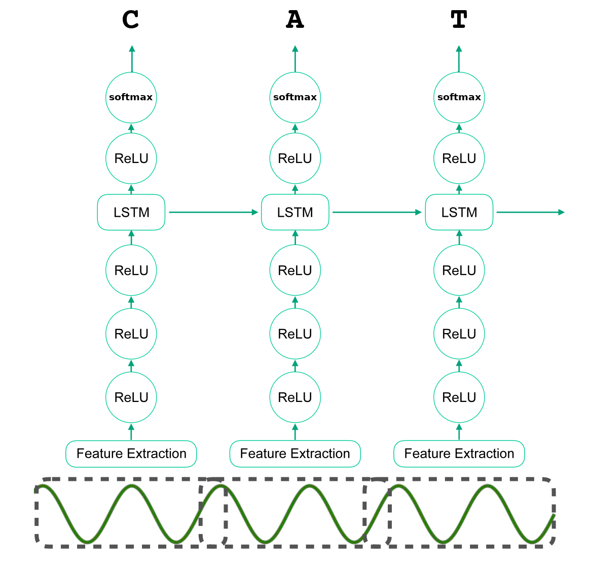
Model Architecture

Slide 14
Model Architecture
19 spliced frames
26 MFCCs / frame
32ms Hamming windows
20ms timestep

Slide 15
Model Architecture
Fully connected
Feed-Forward
2048 dims
ReLU activiations

Slide 16
Model Architecture
Unidirectional LSTM
2048 dims

Slide 17
Model Architecture
2048 dim FC Layer

Slide 18
Model Architecture
N+1 dims Softmax
N == num characters
in target alphabet
1 == blank symbol

Slide 19
Transfer Experiments on ASR

Slide 20
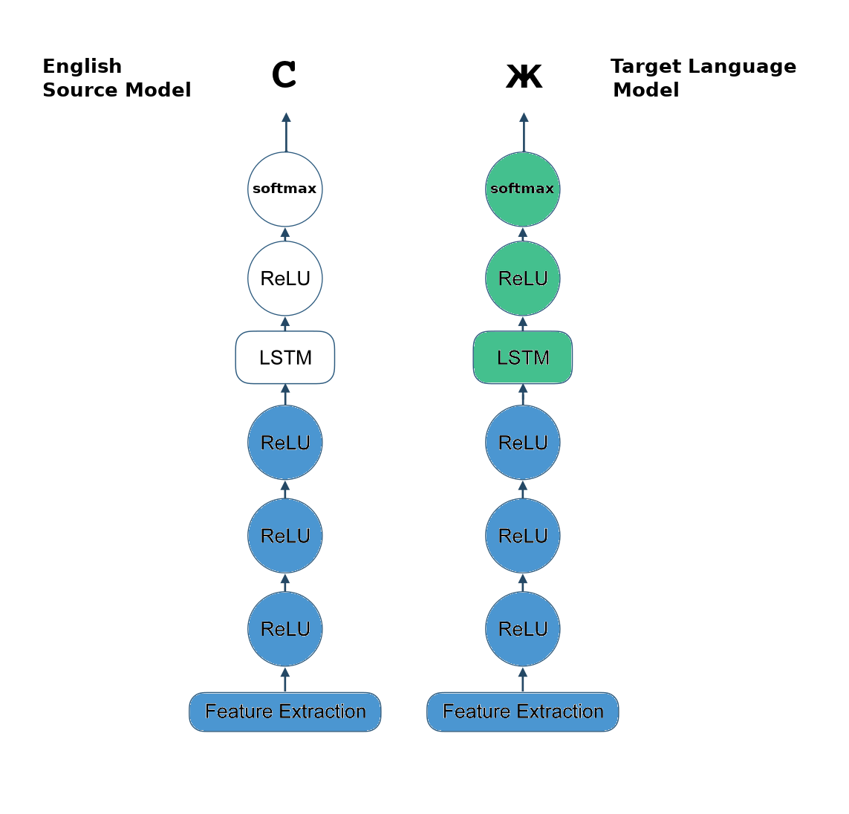
CTC Transfer Experiments

Slide 21

CTC Transfer Experiments

Slide 22
CTC Transfer Experiments

Slide 23
CTC Transfer Experiments

Slide 24
Experimental Design
5 depths for slicing source model
x 2 update scenarios (frozen vs. fine-tuned)
x 12 target languages
TOTAL == 120 experiments

Slide 25
Hyperparameters
- Single GPU training
- 24 train batch, 48 dev batch
- 20% dropout rate
- 0.0001 learning rate with ADAM
- Early stopping based on last 5 steps

Slide 26
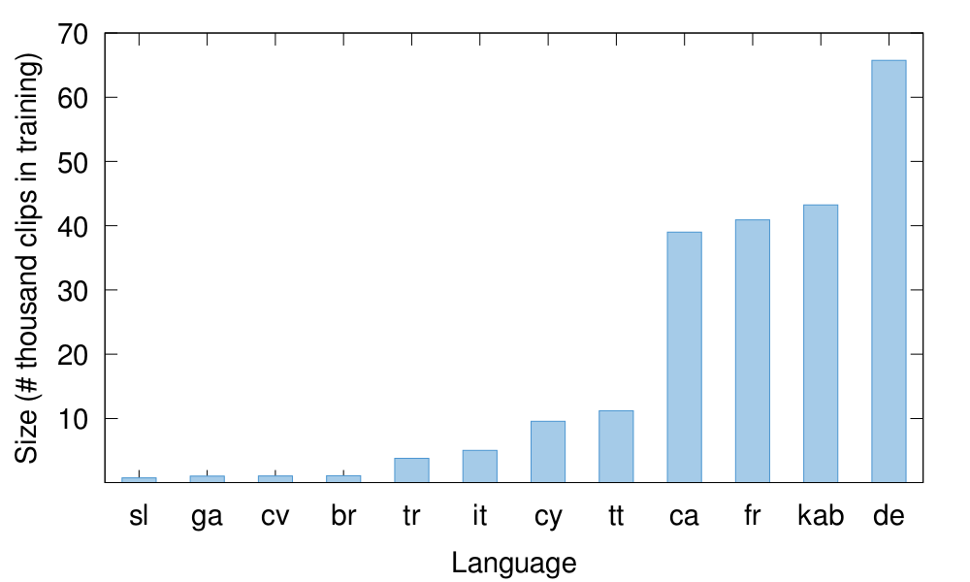
Data (Spoken Corpora)

Slide 27
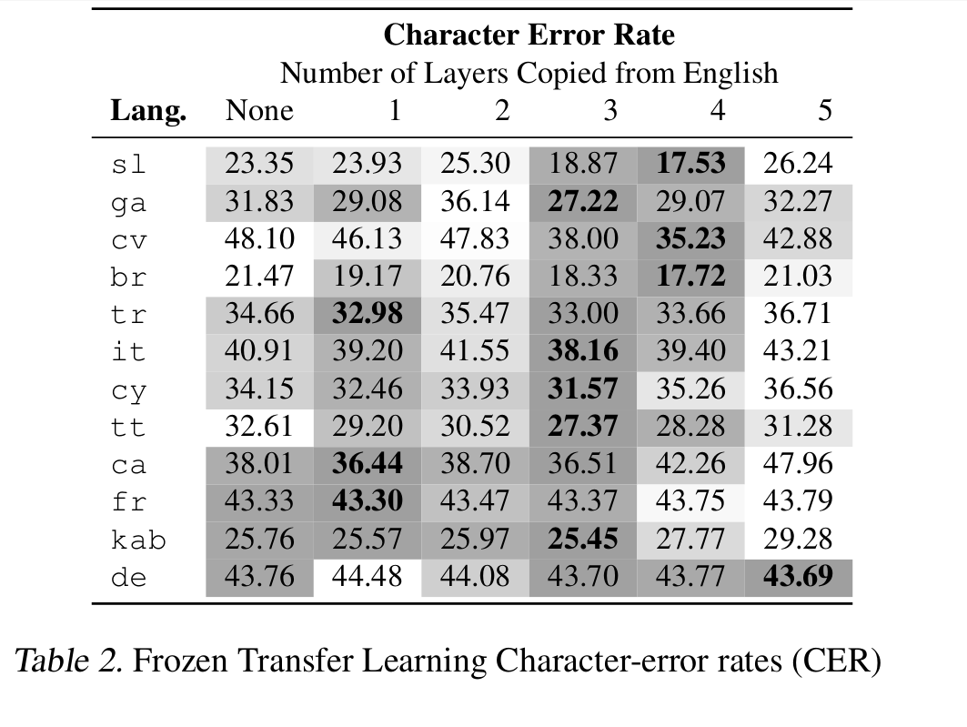
Frozen Transfer Results

Slide 28
Frozen Transfer Results

Slide 29
Frozen Transfer Results

Slide 30
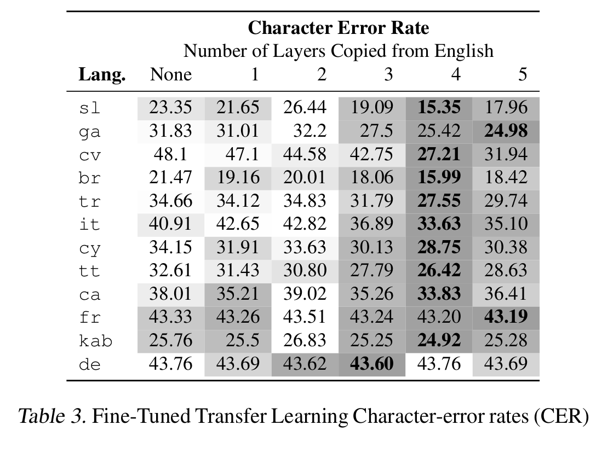
Fine-Tuning Transfer Results

Slide 31
Fine-Tuning Transfer Results

Slide 32
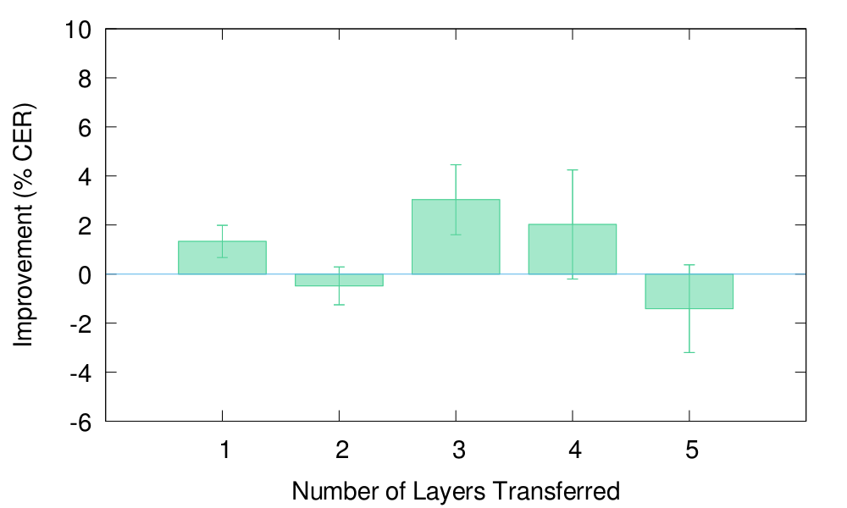
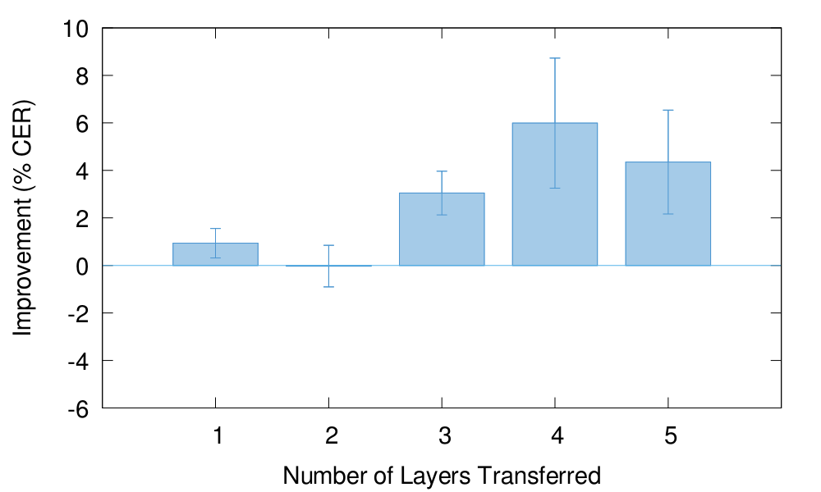
Frozen vs. Fine-Tuned

Slide 33
Frozen vs. Fine-Tuned

Slide 34
Frozen vs. Fine-Tuned
LSTM!

Slide 35
Frozen vs. Fine-Tuned

Slide 36
Interpretability Experiments

Slide 37
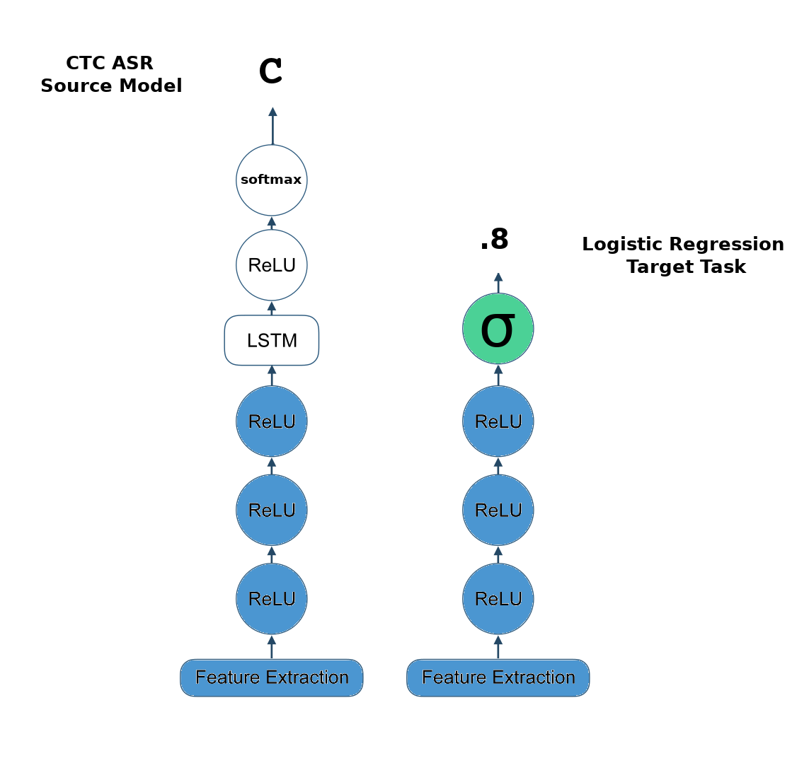
Regression on Embeddings

Slide 38
Regression on Embeddings

Slide 39
Regression on Embeddings
Trained for 3 epochs w/ Cross Entropy Loss

Slide 40
Regression Results
Speech vs. Noise
- Copied layers, added final FC layer with single output and logistic activation
- 13 languages vs. UrbanSound8k
- 5,005 train clips, 442 test clips per class

Slide 41
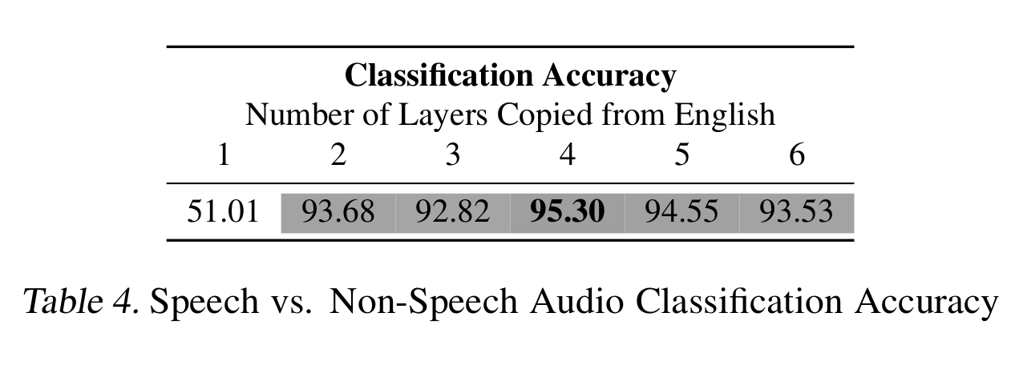
Regression Results
- Copied layers, added final FC layer with single output and logistic activation
- 13 languages vs. UrbanSound8k
- 5,005 train clips, 442 test clips per class

Slide 42
Regression Results
- Copied layers, added final FC layer with single output and logistic activation
- 13 languages vs. UrbanSound8k
- 5,005 train clips, 442 test clips per class

Slide 43
Regression Results
English vs. German

Slide 44
Regression Results
English vs. German
- Copied layers, added final FC layer with single output and logistic activation
- English vs. German
- 5,000 train clips, 500 test clips per class

Slide 45
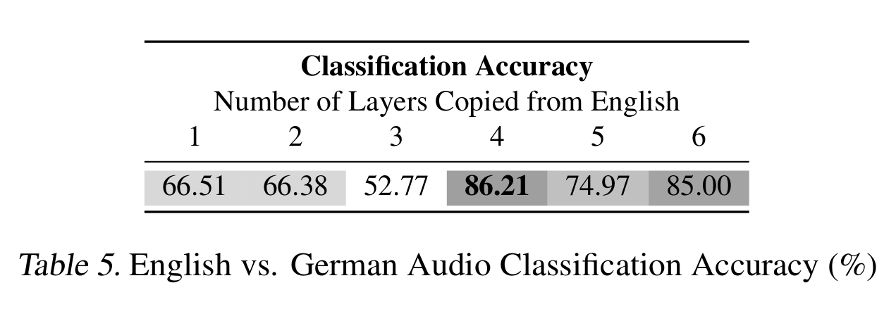
Regression Results
English vs. German

Slide 46
Regression Results

Slide 47
Discussion

Slide 48
Discussion
Transfer in ASR

Slide 49
Discussion
Transfer in ASR
- Fine-tuning always helps
- LSTM transfer is best, but only with fine-tuning

Slide 50
Discussion
Transfer in ASR
- Fine-tuning always helps
- LSTM transfer is best, but only with fine-tuning
Interpretability Studies

Slide 51
Discussion
Transfer in ASR
- Fine-tuning always helps
- LSTM transfer is best, but only with fine-tuning
Interpretability Studies
- At the third layer, the model has learned
general speech, but language-agnostic representations

Slide 52
Thank you for your attention!

Slide 53
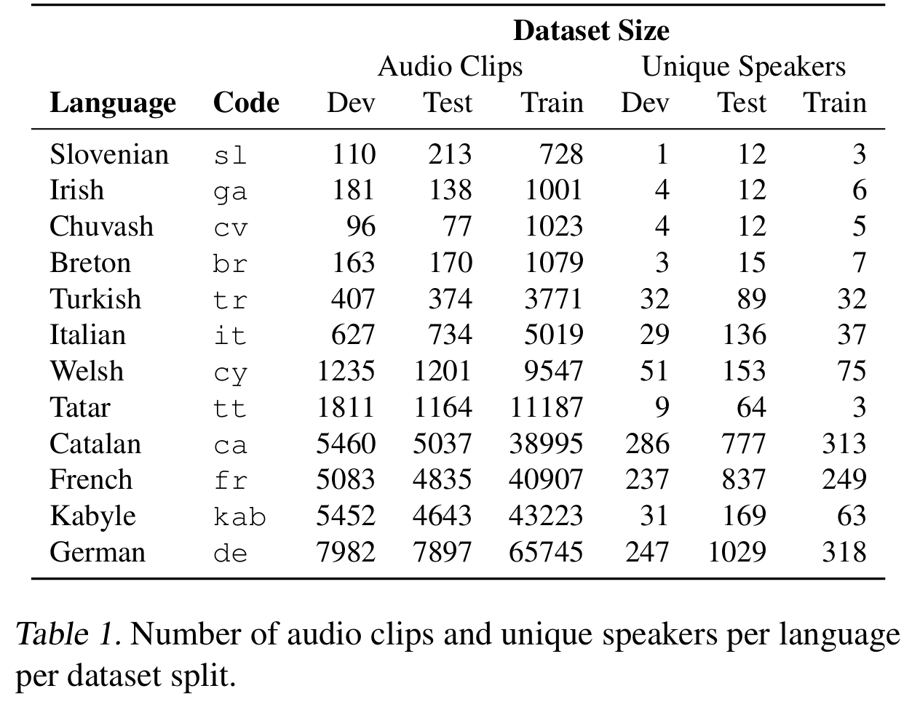
Appendix A: Data Details

Slide 54
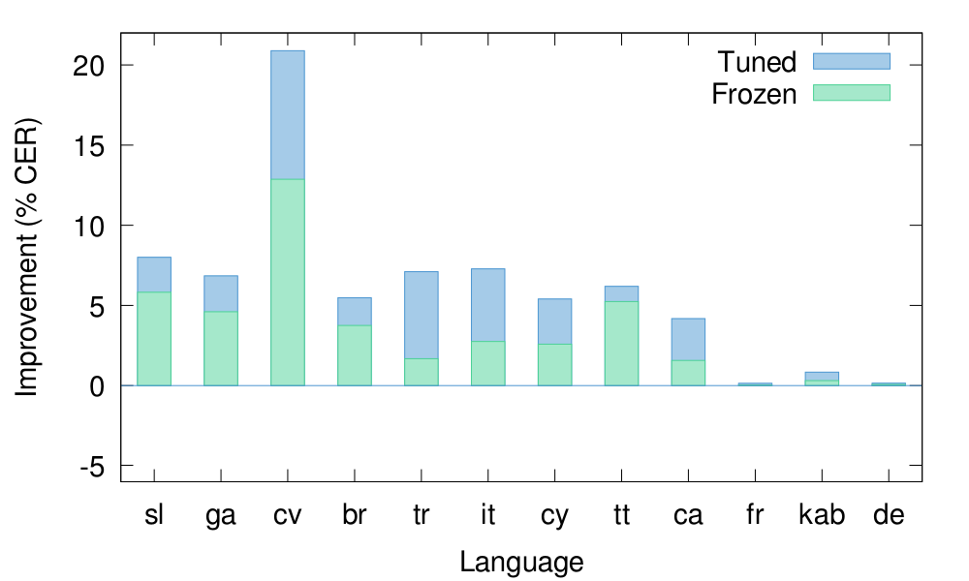
Appendix B: Effect of Data Size

