Slide 1
Multi-Task Learning in ASR
Josh Meyer - Mozilla Machine Learning

Slide 2
Definition of Multi-Task Learning
Multi-Task Learning (MTL)
  Training a model to perform multiple tasks, where a subset of parameters are shared among tasks.

Slide 3
Definition of Multi-Task Learning
Task:
  X, a sample of data from a certain domain
  Y , a sample of targets from a certain domain
  f : X → Y , a function which maps data to targets

Slide 4
Example of Multi-Task Learning
Task:
  X1 , a collection of photos of dogs from one camera
  Y1 , a set of dog_breed labels
  f1 : X1→ Y1 , a conv neural network

Slide 5
Example of Multi-Task Learning
Creating New Tasks:
  X2 , photos from new camera
  Y2 , a set of dog_size labels
  f2 : X1→ Y1 , an RNN

Slide 6
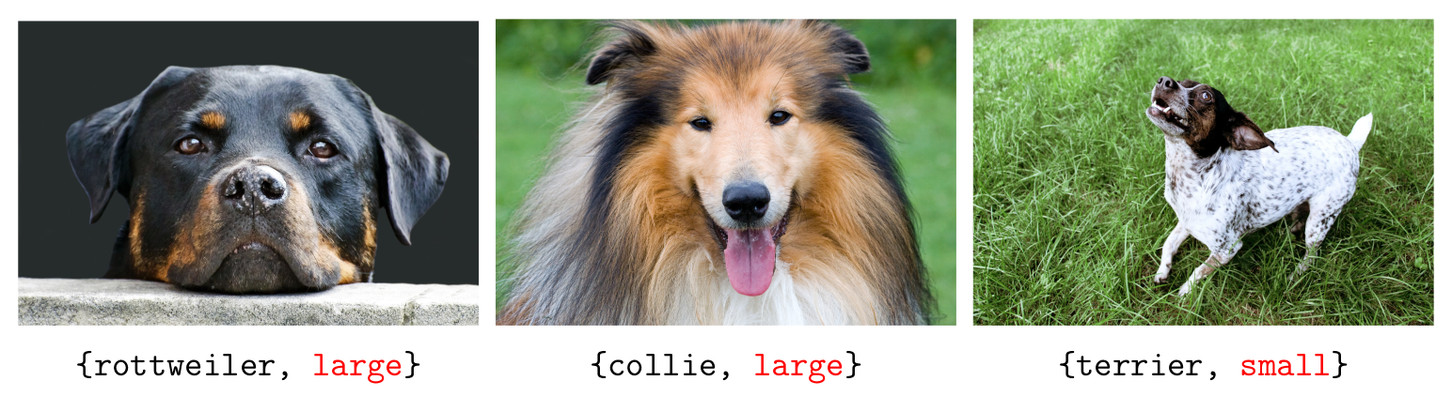
Example of Multi-Task Learning
{old_task, new_task}

Slide 7
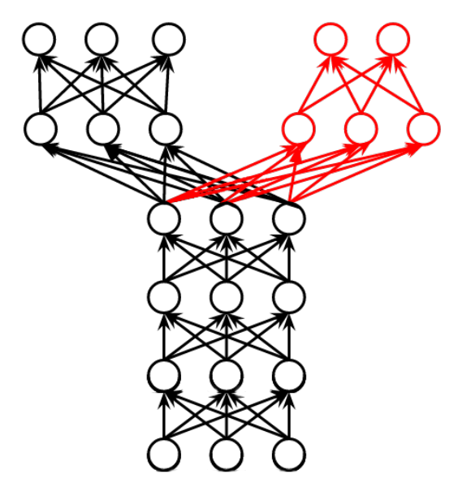
Example of Multi-Task Learning

Slide 8
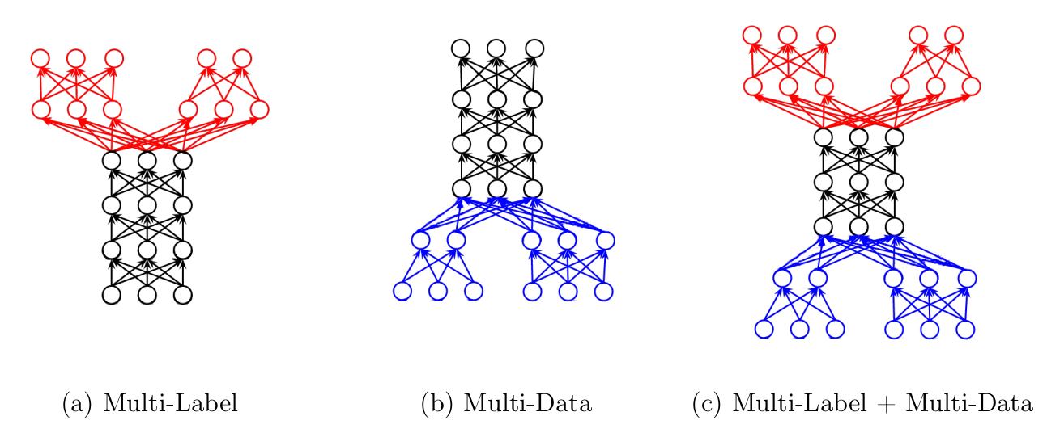
Examples of Multi-Task Learning

Slide 9
Multi-Task Learning in ASR
Two Broad Categories:
  Multi-lingual
  Mono-lingual

Slide 10
Multi-Task Learning in ASR
Two Broad Categories:
  Multi-lingual
    Use data from more than one language
  Mono-lingual

Slide 11
Multi-Task Learning in ASR
Two Broad Categories:
  Multi-lingual
    Use data from more than one language
    Typically in a low-resource scenario
  Mono-lingual

Slide 12
Multi-Task Learning in ASR
Two Broad Categories:
  Multi-lingual
    Use data from more than one language
    Typically in a low-resource scenario
    Language transfer
  Mono-lingual

Slide 13
Multi-Task Learning in ASR
Two Broad Categories:
  Multi-lingual
    Use data from more than one language
    Typically in a low-resource scenario
    Language transfer
  Mono-lingual
    Use data from only one language

Slide 14
Multi-Task Learning in ASR
Two Broad Categories:
  Multi-lingual
    Use data from more than one language
    Typically in a low-resource scenario
    Language transfer
  Mono-lingual
    Use data from only one language
    Not only low-resource

Slide 15
Multi-Task Learning in ASR
Two Broad Categories:
  Multi-lingual
    Use data from more than one language
    Typically in a low-resource scenario
    Language transfer
  Mono-lingual
    Use data from only one language
    Not only low-resource
    Model robustness

