Slide 1
Speech Synthesis Workshop
@ Higher School of Economics
Moscow
Josh Meyer
@joshmeyerphd
jrmeyer.github.io

Slide 2
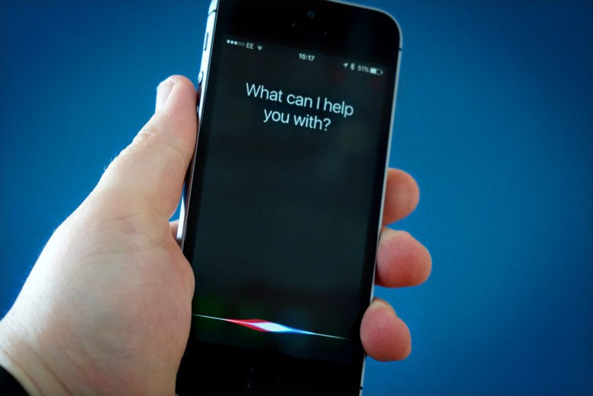
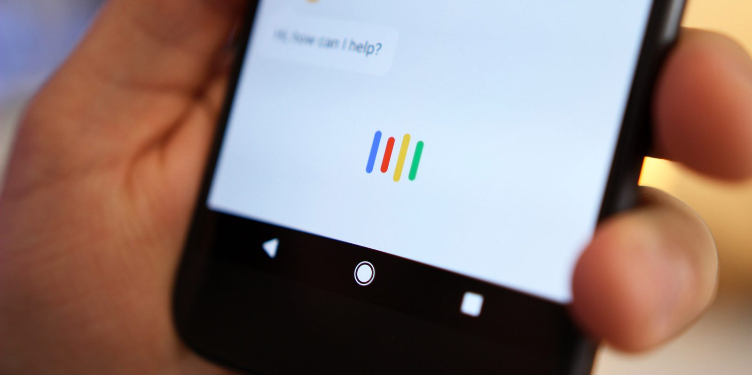

Slide 3
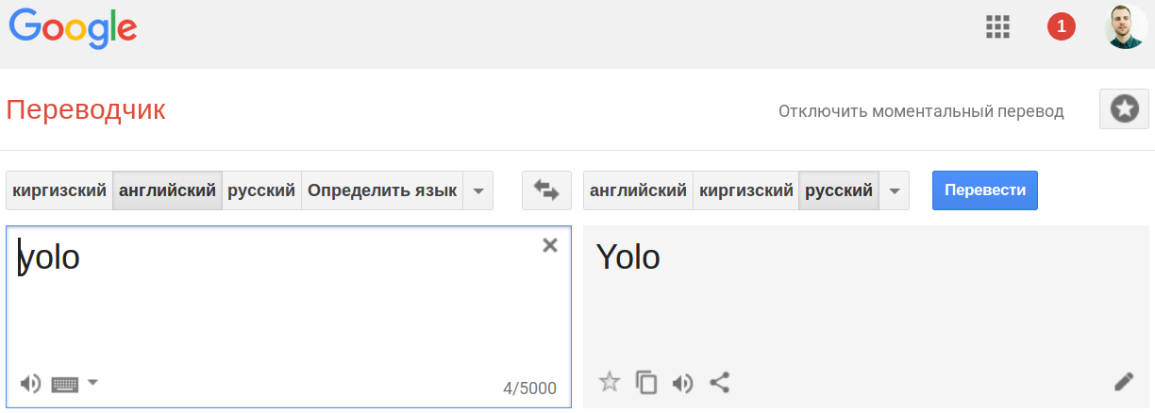

Slide 4


Slide 5
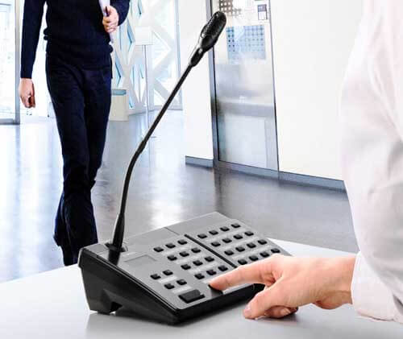
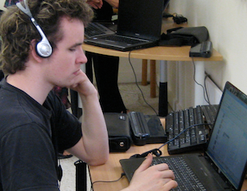

Slide 6

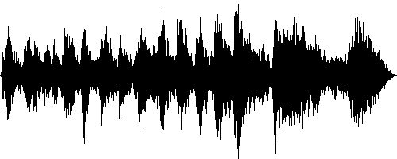

Moscow always has traffic jams.

Slide 7
RAW TEXT
RAW AUDIO
Moscow always has traffic jams.

Slide 8
RAW TEXT
SPEECH
SYNTHESIZER
RAW AUDIO
Moscow always has traffic jams.

Slide 9
Moscow always has traffic jams.

Slide 10
Moscow always has traffic jams.
HARD

Slide 11

Moscow always has traffic jams.
HARD

Slide 12
Moscow always has traffic jams.
EASIER

Slide 13
REGRESSION
Moscow always has traffic jams.

Slide 14
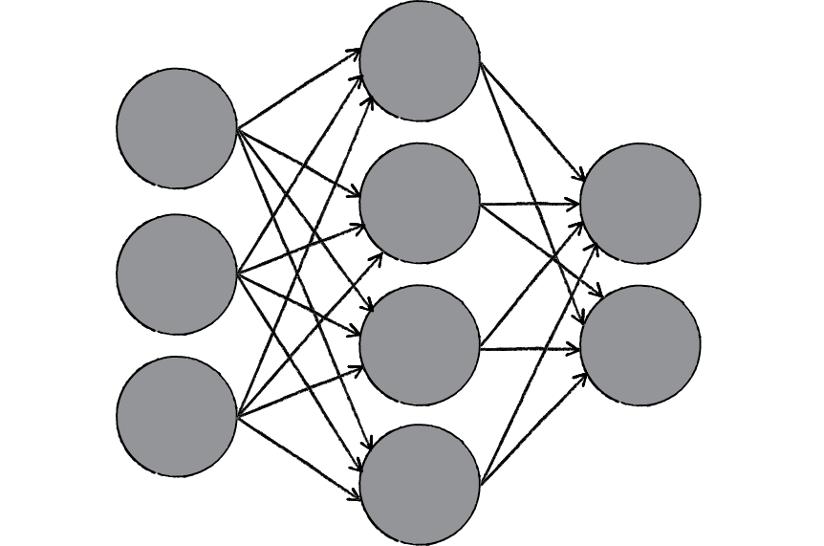
Moscow always has traffic jams.
BECAUSE DNNs

Slide 15
Moscow always has traffic jams.

Slide 16
[ 0 0 1 0 0 0 0 0 0 7 0 0 0 2 3 0 1 0 0 0 0 0 0 0 0 0 9 0 0 ]
[ 6 0 1 0 0 0 0 0 0 0 0 0 0 0 8 ]
Moscow always has traffic jams.

Slide 17
BACKEND
FRONTEND
[ 0 0 1 0 0 0 0 0 0 7 0 0 0 2 3 0 1 0 0 0 0 0 0 0 0 0 9 0 0 ]
[ 6 0 1 0 0 0 0 0 0 0 0 0 0 0 8 ]
Moscow always has traffic jams.

Slide 18
THE FRONTEND
(text feature extraction)

Slide 19
THE FRONTEND
1) MOTIVATION

Slide 20
Moscow always has traffic jams.

Slide 21
Moscow always has traffic jams .
WORDS
Moscow always has traffic jams.

Slide 22
M o s c o w a l w a y s h a s t r a f f i c j a m s .
LETTERS
Moscow always has traffic jams.

Slide 23
M ah s k o ah L w ei z h ae z chr ae f I k dj ae m z
PHONEMES
Moscow always has traffic jams.

Slide 24
[M ah s k o] [ah L w ei z] [h ae z] [chr ae f I k]
[dj ae m z]
PHONEMES + WORDS
Moscow always has traffic jams.

Slide 25
[NOUN M ah s k o] [ADVERB ah L w ei z] [VERB h ae z]
[NOUN chr ae f I k] [NOUN dj ae m z]
PHONEMES + WORDS + POS
Moscow always has traffic jams.

Slide 26
[NOUN [M ah][s k o]] [ADVERB [ah L][w ei z]]
[VERB [h ae z]] [NOUN [chr ae][f I k]]
[NOUN [dj ae m z]]
PHONEMES + WORDS + POS + SYLLABLES
Moscow always has traffic jams.

Slide 27
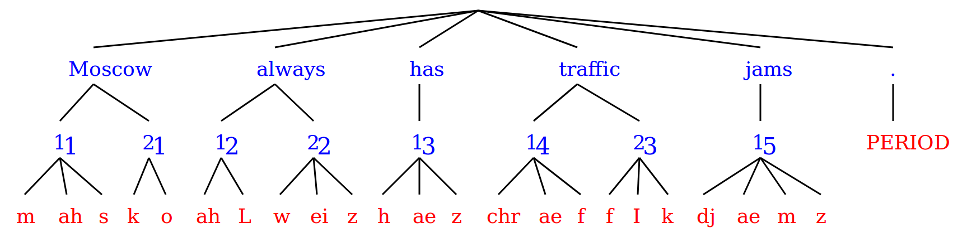
Moscow always has traffic jams.

Slide 28
Moscow always has traffic jams.

Slide 29
i+/0:_NA_/1:sil/2:ah/3:f/4:y/5:0/6:8/7:4/8:1/9:8/10:0/11:9/12:0/13:0/14:76/15:0/16:1/17:76/18:1/19:9/20:2/21:1/22:1/23:78/24:9/25:1/26:79/27:9/28:1/29:0.630101876438/30:0.685195227915/31:0.895005526298/32:0.0169384207386/33:0.0696863228001/34:0.184964316317/35:0.0535076519465/36:0.0302087596484/37:-0.148247666767/38:0.0110183463862/39:0.00683717786986/40:0.103955351166/41:0.0182739382836/[6]

Slide 30
i+/0:_NA_/1:sil/2:ah/3:f/4:y/5:0/6:8/7:4/8:1/9:8/10:0/11:9/12:0/13:0/14:76/15:0/16:1/17:76/18:1/19:9/20:2/21:1/22:1/23:78/24:9/25:1/26:79/27:9/28:1/29:0.630101876438/30:0.685195227915/31:0.895005526298/32:0.0169384207386/33:0.0696863228001/34:0.184964316317/35:0.0535076519465/36:0.0302087596484/37:-0.148247666767/38:0.0110183463862/39:0.00683717786986/40:0.103955351166/41:0.0182739382836/[6]
[0 0 0 0 0 1 0 0 0 0 0 0 0 0 0 0 0 1 0 0 0 0 0 0 0 0 0 0 0 0 1 0 0 0 0 0 0 0 0 0 0 0 ]

Slide 31
[0 0 0 0 0 1 0 0 0 0 0 0 0 0 0 0 0 1 0 0 0 0 0 0 0 0 0 0 0 0 1 0 0 0 0 0 0 0 0 0 0 0 ]

Slide 32
[0 0 0 0 0 1 0 0 0 0 0 0 0 0 0 0 0 1 0 0 0 0 0 0 0 0 0 0 0 0 1 0 0 0 0 0 0 0 0 0 0 0 ]

Slide 33
[0 0 0 0 0 1 0 0 0 0 0 0 0 0 0 0 0 1 0 0 0 0 0 0 0 0 0 0 0 0 1 0 0 0 0 0 0 0 0 0 0 0 ]

Slide 34
THE FRONTEND
1) MOTIVATION
2) TEXT → XML

Slide 35
Фильмсем 13 е 13:30 сехетре пуҫланӗҫ.

Slide 36
Фильмсем 13 е 13:30 сехетре пуҫланӗҫ.
<utt text="Фильмсем 13 е 13:30 сехетре пуҫланӗҫ." waveform="/home/ubuntu/Ossian/corpus/chv/speakers/news/wav/17448-0006.wav" utterance_name="17448-0006" processors_used=",word_splitter,segment_adder,word_vector_tagger,feature_dumper,acoustic_feature_extractor,aligner">
<token text="_END_" token_class="_END_"> </token>
<token text="Фильмсем" token_class="word"> </token>
<token text=" " token_class="space"> </token>
<token text="13" token_class="word"> </token>
<token text=" " token_class="space"> </token>
<token text="е" token_class="word"> </token>
<token text=" " token_class="space"> </token>
<token text="13:30" token_class="word"> </token>
<token text=" " token_class="space"> </token>
<token text="сехетре" token_class="word"> </token>
<token text=" " token_class="space"> </token>
<token text="пуҫланӗҫ" token_class="word"> </token>
<token text="." token_class="punctuation"> </token>
<token text="_END_" token_class="_END_"> </token>
</utt>

Slide 37
Фильмсем 13 е 13:30 сехетре пуҫланӗҫ.
UTTERANCE →
<utt text="Фильмсем 13 е 13:30 сехетре пуҫланӗҫ." waveform="/home/ubuntu/Ossian/corpus/chv/speakers/news/wav/17448-0006.wav" utterance_name="17448-0006" processors_used=",word_splitter,segment_adder,word_vector_tagger,feature_dumper,acoustic_feature_extractor,aligner">
<token text="_END_" token_class="_END_"> </token>
<token text="Фильмсем" token_class="word"> </token>
<token text=" " token_class="space"> </token>
<token text="13" token_class="word"> </token>
<token text=" " token_class="space"> </token>
<token text="е" token_class="word"> </token>
<token text=" " token_class="space"> </token>
<token text="13:30" token_class="word"> </token>
<token text=" " token_class="space"> </token>
<token text="сехетре" token_class="word"> </token>
<token text=" " token_class="space"> </token>
<token text="пуҫланӗҫ" token_class="word"> </token>
<token text="." token_class="punctuation"> </token>
<token text="_END_" token_class="_END_"> </token>
</utt>

Slide 38
Фильмсем 13 е 13:30 сехетре пуҫланӗҫ.
UTTERANCE →
<utt text="Фильмсем 13 е 13:30 сехетре пуҫланӗҫ." waveform="/home/ubuntu/Ossian/corpus/chv/speakers/news/wav/17448-0006.wav" utterance_name="17448-0006" processors_used=",word_splitter,segment_adder,word_vector_tagger,feature_dumper,acoustic_feature_extractor,aligner">
<token text="_END_" token_class="_END_"> </token>
<token text="Фильмсем" token_class="word"> </token>
<token text=" " token_class="space"> </token>
<token text="13" token_class="word"> </token>
<token text=" " token_class="space"> </token>
<token text="е" token_class="word"> </token>
<token text=" " token_class="space"> </token>
<token text="13:30" token_class="word"> </token>
<token text=" " token_class="space"> </token>
<token text="сехетре" token_class="word"> </token>
<token text=" " token_class="space"> </token>
<token text="пуҫланӗҫ" token_class="word"> </token>
<token text="." token_class="punctuation"> </token>
<token text="_END_" token_class="_END_"> </token>
</utt>
PROCESS →

Slide 39
Фильмсем 13 е 13:30 сехетре пуҫланӗҫ.
UTTERANCE →
<utt text="Фильмсем 13 е 13:30 сехетре пуҫланӗҫ." waveform="/home/ubuntu/Ossian/corpus/chv/speakers/news/wav/17448-0006.wav" utterance_name="17448-0006" processors_used=",word_splitter,segment_adder,word_vector_tagger,feature_dumper,acoustic_feature_extractor,aligner">
<token text="_END_" token_class="_END_"> </token>
<token text="Фильмсем" token_class="word"> </token>
<token text=" " token_class="space"> </token>
<token text="13" token_class="word"> </token>
<token text=" " token_class="space"> </token>
<token text="е" token_class="word"> </token>
<token text=" " token_class="space"> </token>
<token text="13:30" token_class="word"> </token>
<token text=" " token_class="space"> </token>
<token text="сехетре" token_class="word"> </token>
<token text=" " token_class="space"> </token>
<token text="пуҫланӗҫ" token_class="word"> </token>
<token text="." token_class="punctuation"> </token>
<token text="_END_" token_class="_END_"> </token>
</utt>
PROCESS →
TOKENS →

Slide 40
Фильмсем 13 е 13:30 сехетре пуҫланӗҫ.
<utt text="Фильмсем 13 е 13:30 сехетре пуҫланӗҫ." waveform="/home/ubuntu/Ossian/corpus/chv/speakers/news/wav/17448-0006.wav" utterance_name="17448-0006" processors_used=",word_splitter,segment_adder,word_vector_tagger,feature_dumper,acoustic_feature_extractor,aligner">
<token text="_END_" token_class="_END_"> </token>
<token text="Фильмсем" token_class="word"> </token>
<token text=" " token_class="space"> </token>
<token text="13" token_class="word"> </token>
<token text=" " token_class="space"> </token>
<token text="е" token_class="word"> </token>
<token text=" " token_class="space"> </token>
<token text="13:30" token_class="word"> </token>
<token text=" " token_class="space"> </token>
<token text="сехетре" token_class="word"> </token>
<token text=" " token_class="space"> </token>
<token text="пуҫланӗҫ" token_class="word"> </token>
<token text="." token_class="punctuation"> </token>
<token text="_END_" token_class="_END_"> </token>
</utt>

Slide 41
Фильмсем 13 е 13:30 сехетре пуҫланӗҫ.
<token text="Фильмсем" token_class="word"
safetext="_CYRILLICCAPITALLETTEREF__CYRILLICSMALLLETTERI__CYRILLICSMALLLETTEREL__CYRILLICSMALLLETTERSOFTSIGN__CYRILLICSMALLLETTEREM__CYRILLICSMALLLETTERES__CYRILLICSMALLLETTERIE__CYRILLICSMALLLETTEREM_"
vsm_d1="0.685195227915" vsm_d2="0.0696863228001" vsm_d3="0.0302087596484" vsm_d4="0.00683717786986" vsm_d5="0.0432880400823" vsm_d6="0.0132148537813" vsm_d7="-0.0021566008158" vsm_d8="0.000630974819014" vsm_d9="0.00734826504532" vsm_d10="0.00938971254099"
>
<segment pronunciation="_CYRILLICSMALLLETTEREF_"/>
<segment pronunciation="_CYRILLICSMALLLETTERI_"/>
<segment pronunciation="_CYRILLICSMALLLETTEREL_"/>
<segment pronunciation="_CYRILLICSMALLLETTERSOFTSIGN_"/>
<segment pronunciation="_CYRILLICSMALLLETTEREM_"/>
<segment pronunciation="_CYRILLICSMALLLETTERES_"/>
<segment pronunciation="_CYRILLICSMALLLETTERIE_"/>
<segment pronunciation="_CYRILLICSMALLLETTEREM_"/>
</token>

Slide 42
Фильмсем 13 е 13:30 сехетре пуҫланӗҫ.
<token text="Фильмсем" token_class="word"
safetext="_CYRILLICCAPITALLETTEREF__CYRILLICSMALLLETTERI__CYRILLICSMALLLETTEREL__CYRILLICSMALLLETTERSOFTSIGN__CYRILLICSMALLLETTEREM__CYRILLICSMALLLETTERES__CYRILLICSMALLLETTERIE__CYRILLICSMALLLETTEREM_"
vsm_d1="0.685195227915" vsm_d2="0.0696863228001" vsm_d3="0.0302087596484" vsm_d4="0.00683717786986" vsm_d5="0.0432880400823" vsm_d6="0.0132148537813" vsm_d7="-0.0021566008158" vsm_d8="0.000630974819014" vsm_d9="0.00734826504532" vsm_d10="0.00938971254099"
>
<segment pronunciation="_CYRILLICSMALLLETTEREF_"/>
<segment pronunciation="_CYRILLICSMALLLETTERI_"/>
<segment pronunciation="_CYRILLICSMALLLETTEREL_"/>
<segment pronunciation="_CYRILLICSMALLLETTERSOFTSIGN_"/>
<segment pronunciation="_CYRILLICSMALLLETTEREM_"/>
<segment pronunciation="_CYRILLICSMALLLETTERES_"/>
<segment pronunciation="_CYRILLICSMALLLETTERIE_"/>
<segment pronunciation="_CYRILLICSMALLLETTEREM_"/>
</token>
SAFETXT →

Slide 43
Фильмсем 13 е 13:30 сехетре пуҫланӗҫ.
<token text="Фильмсем" token_class="word"
safetext="_CYRILLICCAPITALLETTEREF__CYRILLICSMALLLETTERI__CYRILLICSMALLLETTEREL__CYRILLICSMALLLETTERSOFTSIGN__CYRILLICSMALLLETTEREM__CYRILLICSMALLLETTERES__CYRILLICSMALLLETTERIE__CYRILLICSMALLLETTEREM_"
vsm_d1="0.685195227915" vsm_d2="0.0696863228001" vsm_d3="0.0302087596484" vsm_d4="0.00683717786986" vsm_d5="0.0432880400823" vsm_d6="0.0132148537813" vsm_d7="-0.0021566008158" vsm_d8="0.000630974819014" vsm_d9="0.00734826504532" vsm_d10="0.00938971254099"
>
<segment pronunciation="_CYRILLICSMALLLETTEREF_"/>
<segment pronunciation="_CYRILLICSMALLLETTERI_"/>
<segment pronunciation="_CYRILLICSMALLLETTEREL_"/>
<segment pronunciation="_CYRILLICSMALLLETTERSOFTSIGN_"/>
<segment pronunciation="_CYRILLICSMALLLETTEREM_"/>
<segment pronunciation="_CYRILLICSMALLLETTERES_"/>
<segment pronunciation="_CYRILLICSMALLLETTERIE_"/>
<segment pronunciation="_CYRILLICSMALLLETTEREM_"/>
</token>
SAFETXT →
VECTORS →

Slide 44
Фильмсем 13 е 13:30 сехетре пуҫланӗҫ.
<token text="Фильмсем" token_class="word"
safetext="_CYRILLICCAPITALLETTEREF__CYRILLICSMALLLETTERI__CYRILLICSMALLLETTEREL__CYRILLICSMALLLETTERSOFTSIGN__CYRILLICSMALLLETTEREM__CYRILLICSMALLLETTERES__CYRILLICSMALLLETTERIE__CYRILLICSMALLLETTEREM_"
vsm_d1="0.685195227915" vsm_d2="0.0696863228001" vsm_d3="0.0302087596484" vsm_d4="0.00683717786986" vsm_d5="0.0432880400823" vsm_d6="0.0132148537813" vsm_d7="-0.0021566008158" vsm_d8="0.000630974819014" vsm_d9="0.00734826504532" vsm_d10="0.00938971254099"
>
<segment pronunciation="_CYRILLICSMALLLETTEREF_"/>
<segment pronunciation="_CYRILLICSMALLLETTERI_"/>
<segment pronunciation="_CYRILLICSMALLLETTEREL_"/>
<segment pronunciation="_CYRILLICSMALLLETTERSOFTSIGN_"/>
<segment pronunciation="_CYRILLICSMALLLETTEREM_"/>
<segment pronunciation="_CYRILLICSMALLLETTERES_"/>
<segment pronunciation="_CYRILLICSMALLLETTERIE_"/>
<segment pronunciation="_CYRILLICSMALLLETTEREM_"/>
</token>
SAFETXT →
VECTORS →
PHONES →

Slide 45
Фильмсем 13 е 13:30 сехетре пуҫланӗҫ.
<token text="13" token_class="word"
safetext="_DIGITONE__DIGITTHREE_"
vsm_d1="0.175666404262" vsm_d2="0.152223466799" vsm_d3="-0.0307015100812" vsm_d4="0.0999614943211" vsm_d5="0.0698700498727" vsm_d6="0.25982222856" vsm_d7="0.0213851732067" vsm_d8="-0.00852679385956" vsm_d9="-0.0024125017034" vsm_d10="0.0225874466051"
>
<segment pronunciation="_DIGITONE_"/>
<segment pronunciation="_DIGITTHREE_"/>
</token>
SAFETXT →
VECTORS →
PHONES →

Slide 46
THE BACKEND
(audio feature extraction)

Slide 48
↑
dB
↓
← time →

Slide 49
↑
dB
↓
↑
Hz
↓
dB
↓
← time →

Slide 50
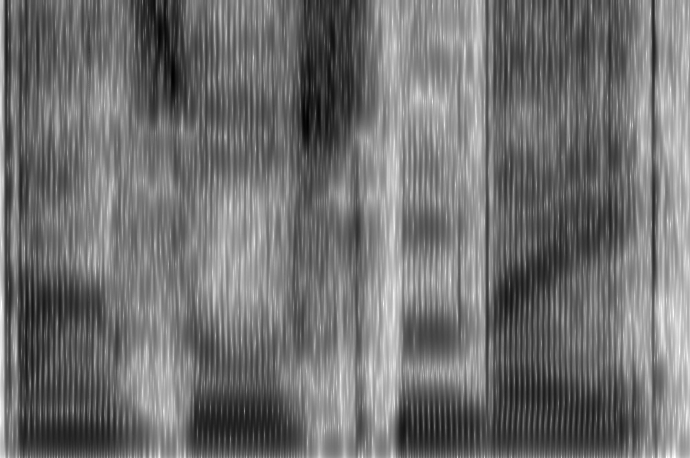
↑
dB
↓
↑
Hz
↓
dB
↓
← time →

Slide 52
[ 0 0 1 0 0 0 0 0 0 0 0 0 0 0 0 1 0 0 0 0 0 0 0 ]

Slide 53
REGRESSION

Slide 54
REGRESSION
1) LABELED DATA

Slide 55
Moscow always has traffic jams.

Slide 56
Moscow always has traffic jams.

Slide 57
Moscow always has traffic jams.

Slide 58
Moscow always has traffic jams.

Slide 59
Moscow always has traffic jams.

Slide 60
Moscow always has traffic jams.

Slide 61
Moscow always has traffic jams.

Slide 62
Moscow always has traffic jams.

Slide 63
[ 0 0 1 0 0 0 0 1 0 0 0 0 0 0 0 ]
[ 0 0 2 0 0 0 3 0 0 0 7 0 0 0 2 ]
[ 3 0 1 0 0 0 0 0 0 0 0 0 9 0 0 ]
[ 0 0 5 0 9 0 0 1 0 0 0 4 0 0 0 ]
[ 6 0 1 0 0 0 0 1 0 0 0 0 0 0 8 ]
[ 0 0 2 0 0 0 3 0 0 9 0 0 0 0 0 ]
[ 0 0 1 0 0 0 0 0 0 0 0 0 1 0 0 ]
[ 0 3 0 0 0 0 0 1 0 0 7 0 0 0 2 ]
[ 3 0 1 0 0 0 0 9 0 0 0 0 0 0 0 ]
[ 0 0 5 0 9 0 4 0 0 0 0 4 0 0 0 ]
[ 6 0 1 0 0 0 0 0 0 0 0 0 0 0 8 ]
[ 0 0 2 0 0 0 3 0 0 9 0 0 0 0 0 ]
[ 0 0 0 0 0 0 0 1 0 0 0 0 0 0 0 ]
[ 0 0 2 0 0 0 0 1 0 0 7 0 0 0 2 ]
[ 3 0 1 0 0 0 0 9 0 0 0 0 0 0 0 ]
[ 0 0 5 0 9 0 4 1 0 0 0 4 0 0 0 ]
[ 6 0 1 0 0 0 0 1 0 0 0 0 0 0 8 ]
[ 0 0 2 0 0 0 0 1 0 0 0 0 0 0 0 ]
[ 0 0 0 0 0 0 0 1 0 0 0 0 0 0 0 ]
[ 0 3 0 0 0 0 0 1 0 0 7 0 0 0 2 ]
[ 3 0 1 0 0 0 0 9 0 0 0 0 0 0 0 ]
[ 0 0 5 0 9 0 4 1 0 0 0 4 0 0 0 ]
[ 6 0 1 0 0 0 0 1 0 0 0 0 0 0 8 ]
[ 0 0 2 0 0 0 3 1 0 0 0 0 0 0 0 ]
Moscow always has traffic jams.

Slide 64
[ 0 0 1 0 0 0 0 1 0 0 0 0 0 0 0 ]
[ 0 0 2 0 0 0 3 0 0 0 7 0 0 0 2 ]
[ 3 0 1 0 0 0 0 0 0 0 0 0 9 0 0 ]
[ 0 0 5 0 9 0 0 1 0 0 0 4 0 0 0 ]
[ 6 0 1 0 0 0 0 1 0 0 0 0 0 0 8 ]
[ 0 0 2 0 0 0 3 0 0 9 0 0 0 0 0 ]
[ 0 0 1 0 0 0 0 0 0 0 0 0 1 0 0 ]
[ 0 3 0 0 0 0 0 1 0 0 7 0 0 0 2 ]
[ 3 0 1 0 0 0 0 9 0 0 0 0 0 0 0 ]
[ 0 0 5 0 9 0 4 0 0 0 0 4 0 0 0 ]
[ 6 0 1 0 0 0 0 0 0 0 0 0 0 0 8 ]
[ 0 0 2 0 0 0 3 0 0 9 0 0 0 0 0 ]
[ 0 0 0 0 0 0 0 1 0 0 0 0 0 0 0 ]
[ 0 0 2 0 0 0 0 1 0 0 7 0 0 0 2 ]
[ 3 0 1 0 0 0 0 9 0 0 0 0 0 0 0 ]
[ 0 0 5 0 9 0 4 1 0 0 0 4 0 0 0 ]
[ 6 0 1 0 0 0 0 1 0 0 0 0 0 0 8 ]
[ 0 0 2 0 0 0 0 1 0 0 0 0 0 0 0 ]
[ 0 0 0 0 0 0 0 1 0 0 0 0 0 0 0 ]
[ 0 3 0 0 0 0 0 1 0 0 7 0 0 0 2 ]
[ 3 0 1 0 0 0 0 9 0 0 0 0 0 0 0 ]
[ 0 0 5 0 9 0 4 1 0 0 0 4 0 0 0 ]
[ 6 0 1 0 0 0 0 1 0 0 0 0 0 0 8 ]
[ 0 0 2 0 0 0 3 1 0 0 0 0 0 0 0 ]

Slide 65
i+/0:_NA_/1:sil/2:ah/3:f/4:y/5:0/6:8/7:4/8:1/9:8/10:0/11:9/12:0/13:0/14:76/15:0/16:1/17:76/18:1/19:9/20:2/21:1/22:1/23:78/24:9/25:1/26:79/27:9/28:1/29:0.630101876438/30:0.685195227915/31:0.895005526298/32:0.0169384207386/33:0.0696863228001/34:0.18496
i+/0:_NA_/1:sil/2:ah/3:f/4:y/5:0/6:8/7:4/8:1/9:8/10:0/11:9/12:0/13:0/14:76/15:0/16:1/17:76/18:1/19:9/20:2/21:1/22:1/23:78/24:9/25:1/26:79/27:9/28:1/29:0.630101876438/30:0.685195227915/31:0.895005526298/32:0.0169384207386/33:0.0696863228001/34:0.18496
i+/0:_NA_/1:sil/2:ah/3:f/4:y/5:0/6:8/7:4/8:1/9:8/10:0/11:9/12:0/13:0/14:76/15:0/16:1/17:76/18:1/19:9/20:2/21:1/22:1/23:78/24:9/25:1/26:79/27:9/28:1/29:0.630101876438/30:0.685195227915/31:0.895005526298/32:0.0169384207386/33:0.0696863228001/34:0.18496
.
.
[ 0 0 1 0 0 0 0 1 0 0 0 0 0 0 0 ]
[ 0 0 2 0 0 0 3 0 0 0 7 0 0 0 2 ]
[ 3 0 1 0 0 0 0 0 0 0 0 0 9 0 0 ]
[ 0 0 5 0 9 0 0 1 0 0 0 4 0 0 0 ]
[ 6 0 1 0 0 0 0 1 0 0 0 0 0 0 8 ]
[ 0 0 2 0 0 0 3 0 0 9 0 0 0 0 0 ]
[ 0 0 1 0 0 0 0 0 0 0 0 0 1 0 0 ]
[ 0 3 0 0 0 0 0 1 0 0 7 0 0 0 2 ]
[ 3 0 1 0 0 0 0 9 0 0 0 0 0 0 0 ]
[ 0 0 5 0 9 0 4 0 0 0 0 4 0 0 0 ]
[ 6 0 1 0 0 0 0 0 0 0 0 0 0 0 8 ]
[ 0 0 2 0 0 0 3 0 0 9 0 0 0 0 0 ]
[ 0 0 0 0 0 0 0 1 0 0 0 0 0 0 0 ]
[ 0 0 2 0 0 0 0 1 0 0 7 0 0 0 2 ]
[ 3 0 1 0 0 0 0 9 0 0 0 0 0 0 0 ]
[ 0 0 5 0 9 0 4 1 0 0 0 4 0 0 0 ]
[ 6 0 1 0 0 0 0 1 0 0 0 0 0 0 8 ]
[ 0 0 2 0 0 0 0 1 0 0 0 0 0 0 0 ]
[ 0 0 0 0 0 0 0 1 0 0 0 0 0 0 0 ]
[ 0 3 0 0 0 0 0 1 0 0 7 0 0 0 2 ]
[ 3 0 1 0 0 0 0 9 0 0 0 0 0 0 0 ]
[ 0 0 5 0 9 0 4 1 0 0 0 4 0 0 0 ]
[ 6 0 1 0 0 0 0 1 0 0 0 0 0 0 8 ]
[ 0 0 2 0 0 0 3 1 0 0 0 0 0 0 0 ]

Slide 66
[ 0 0 0 0 0 1 0 0 0 0 0 0 0 0 0 0 0 1 0 0 0 0 8 0 0 0 0 5 0 0 1 0 0 0 0 0 0 0 0 0 0 0 ]
[ 0 0 0 0 0 1 0 0 4 0 0 0 0 0 0 0 0 1 0 0 0 0 7 0 0 0 0 0 0 0 1 0 0 0 0 0 0 0 0 0 0 0 ]
[ 0 0 0 0 0 1 0 0 0 0 5 0 0 0 0 0 0 1 0 0 0 0 0 0 0 0 9 0 0 0 1 0 0 0 0 0 0 0 0 0 0 0 ]
.
.
[ 0 0 1 0 0 0 0 1 0 0 0 0 0 0 0 ]
[ 0 0 2 0 0 0 3 0 0 0 7 0 0 0 2 ]
[ 3 0 1 0 0 0 0 0 0 0 0 0 9 0 0 ]
[ 0 0 5 0 9 0 0 1 0 0 0 4 0 0 0 ]
[ 6 0 1 0 0 0 0 1 0 0 0 0 0 0 8 ]
[ 0 0 2 0 0 0 3 0 0 9 0 0 0 0 0 ]
[ 0 0 1 0 0 0 0 0 0 0 0 0 1 0 0 ]
[ 0 3 0 0 0 0 0 1 0 0 7 0 0 0 2 ]
[ 3 0 1 0 0 0 0 9 0 0 0 0 0 0 0 ]
[ 0 0 5 0 9 0 4 0 0 0 0 4 0 0 0 ]
[ 6 0 1 0 0 0 0 0 0 0 0 0 0 0 8 ]
[ 0 0 2 0 0 0 3 0 0 9 0 0 0 0 0 ]
[ 0 0 0 0 0 0 0 1 0 0 0 0 0 0 0 ]
[ 0 0 2 0 0 0 0 1 0 0 7 0 0 0 2 ]
[ 3 0 1 0 0 0 0 9 0 0 0 0 0 0 0 ]
[ 0 0 5 0 9 0 4 1 0 0 0 4 0 0 0 ]
[ 6 0 1 0 0 0 0 1 0 0 0 0 0 0 8 ]
[ 0 0 2 0 0 0 0 1 0 0 0 0 0 0 0 ]
[ 0 0 0 0 0 0 0 1 0 0 0 0 0 0 0 ]
[ 0 3 0 0 0 0 0 1 0 0 7 0 0 0 2 ]
[ 3 0 1 0 0 0 0 9 0 0 0 0 0 0 0 ]
[ 0 0 5 0 9 0 4 1 0 0 0 4 0 0 0 ]
[ 6 0 1 0 0 0 0 1 0 0 0 0 0 0 8 ]
[ 0 0 2 0 0 0 3 1 0 0 0 0 0 0 0 ]

Slide 67
[ 0 0 0 0 0 1 0 0 0 0 0 0 0 0 0 0 0 1 0 0 0 0 8 0 0 0 0 5 0 0 1 0 0 0 0 0 0 0 0 0 0 0 ]
[ 0 0 0 0 0 1 0 0 4 0 0 0 0 0 0 0 0 1 0 0 0 0 7 0 0 0 0 0 0 0 1 0 0 0 0 0 0 0 0 0 0 0 ]
[ 0 0 0 0 0 1 0 0 0 0 5 0 0 0 0 0 0 1 0 0 0 0 0 0 0 0 9 0 0 0 1 0 0 0 0 0 0 0 0 0 0 0 ]
.
.
[ 0 0 1 0 0 0 0 1 0 0 0 0 0 0 0 ]
[ 0 0 2 0 0 0 3 0 0 0 7 0 0 0 2 ]
[ 3 0 1 0 0 0 0 0 0 0 0 0 9 0 0 ]
[ 0 0 5 0 9 0 0 1 0 0 0 4 0 0 0 ]
[ 6 0 1 0 0 0 0 1 0 0 0 0 0 0 8 ]
[ 0 0 2 0 0 0 3 0 0 9 0 0 0 0 0 ]
[ 0 0 1 0 0 0 0 0 0 0 0 0 1 0 0 ]
[ 0 3 0 0 0 0 0 1 0 0 7 0 0 0 2 ]
[ 3 0 1 0 0 0 0 9 0 0 0 0 0 0 0 ]
[ 0 0 5 0 9 0 4 0 0 0 0 4 0 0 0 ]
[ 6 0 1 0 0 0 0 0 0 0 0 0 0 0 8 ]
[ 0 0 2 0 0 0 3 0 0 9 0 0 0 0 0 ]
[ 0 0 0 0 0 0 0 1 0 0 0 0 0 0 0 ]
[ 0 0 2 0 0 0 0 1 0 0 7 0 0 0 2 ]
[ 3 0 1 0 0 0 0 9 0 0 0 0 0 0 0 ]
[ 0 0 5 0 9 0 4 1 0 0 0 4 0 0 0 ]
[ 6 0 1 0 0 0 0 1 0 0 0 0 0 0 8 ]
[ 0 0 2 0 0 0 0 1 0 0 0 0 0 0 0 ]
[ 0 0 0 0 0 0 0 1 0 0 0 0 0 0 0 ]
[ 0 3 0 0 0 0 0 1 0 0 7 0 0 0 2 ]
[ 3 0 1 0 0 0 0 9 0 0 0 0 0 0 0 ]
[ 0 0 5 0 9 0 4 1 0 0 0 4 0 0 0 ]
[ 6 0 1 0 0 0 0 1 0 0 0 0 0 0 8 ]
[ 0 0 2 0 0 0 3 1 0 0 0 0 0 0 0 ]

Slide 68
[ 0 0 0 0 0 1 0 0 0 0 0 0 0 0 0 0 0 1 0 0 0 0 8 0 0 0 0 5 0 0 1 0 0 0 0 0 0 0 0 0 0 0 ]
[ 0 0 0 0 0 1 0 0 4 0 0 0 0 0 0 0 0 1 0 0 0 0 7 0 0 0 0 0 0 0 1 0 0 0 0 0 0 0 0 0 0 0 ]
[ 0 0 0 0 0 1 0 0 0 0 5 0 0 0 0 0 0 1 0 0 0 0 0 0 0 0 9 0 0 0 1 0 0 0 0 0 0 0 0 0 0 0 ]
.
.
[ 0 0 1 0 0 0 0 1 0 0 0 0 0 0 0 ]
[ 0 0 2 0 0 0 3 0 0 0 7 0 0 0 2 ]
[ 3 0 1 0 0 0 0 0 0 0 0 0 9 0 0 ]
[ 0 0 5 0 9 0 0 1 0 0 0 4 0 0 0 ]
[ 6 0 1 0 0 0 0 1 0 0 0 0 0 0 8 ]
[ 0 0 2 0 0 0 3 0 0 9 0 0 0 0 0 ]
[ 0 0 1 0 0 0 0 0 0 0 0 0 1 0 0 ]
[ 0 3 0 0 0 0 0 1 0 0 7 0 0 0 2 ]
[ 3 0 1 0 0 0 0 9 0 0 0 0 0 0 0 ]
[ 0 0 5 0 9 0 4 0 0 0 0 4 0 0 0 ]
[ 6 0 1 0 0 0 0 0 0 0 0 0 0 0 8 ]
[ 0 0 2 0 0 0 3 0 0 9 0 0 0 0 0 ]
[ 0 0 0 0 0 0 0 1 0 0 0 0 0 0 0 ]
[ 0 0 2 0 0 0 0 1 0 0 7 0 0 0 2 ]
[ 3 0 1 0 0 0 0 9 0 0 0 0 0 0 0 ]
[ 0 0 5 0 9 0 4 1 0 0 0 4 0 0 0 ]
[ 6 0 1 0 0 0 0 1 0 0 0 0 0 0 8 ]
[ 0 0 2 0 0 0 0 1 0 0 0 0 0 0 0 ]
[ 0 0 0 0 0 0 0 1 0 0 0 0 0 0 0 ]
[ 0 3 0 0 0 0 0 1 0 0 7 0 0 0 2 ]
[ 3 0 1 0 0 0 0 9 0 0 0 0 0 0 0 ]
[ 0 0 5 0 9 0 4 1 0 0 0 4 0 0 0 ]
[ 6 0 1 0 0 0 0 1 0 0 0 0 0 0 8 ]
[ 0 0 2 0 0 0 3 1 0 0 0 0 0 0 0 ]
HTK ALIGNMENT

Slide 69
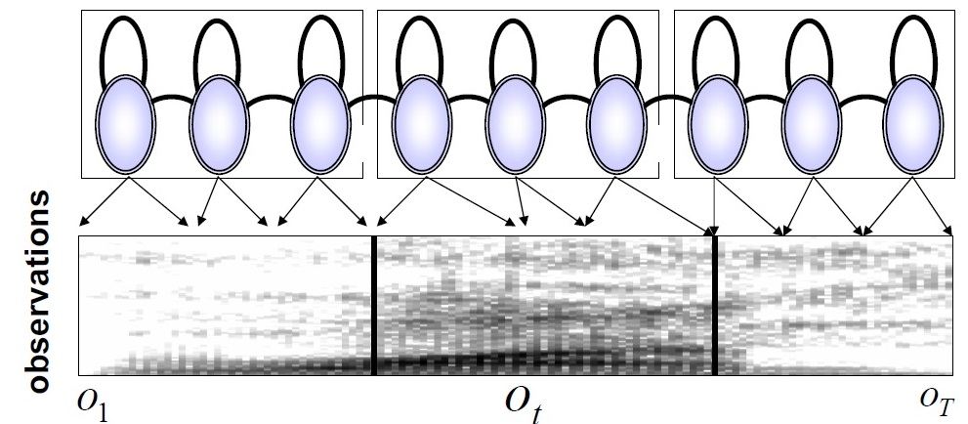
<vsooda.github.io>

Slide 70
WORD →
<token text="илнӗ" token_class="word" safetext="_CYRILLICSMALLLETTERI__CYRILLICSMALLLETTEREL__CYRILLICSMALLLETTEREN__CYRILLICSMALLLETTERIEWITHBREVE_" vsm_d1="0.718258053926" vsm_d2="0.84356178952" vsm_d3="0.245865192265" vsm_d4="-0.154229921545" vsm_d5="0.0666986423832" vsm_d6="-0.0339937700926" vsm_d7="-0.0034077854402" vsm_d8="-0.0167915876804" vsm_d9="-0.00178861541477" vsm_d10="-0.00551910881847" start="2455" end="2765" has_silence="no" phrase_start="False" phrase_end="True">
<segment pronunciation="_CYRILLICSMALLLETTERI_" start="2455" end="2510">
<state start="2455" end="2460"/>
<state start="2460" end="2475"/>
<state start="2475" end="2500"/>
<state start="2500" end="2505"/>
<state start="2505" end="2510"/>
</segment>
<segment pronunciation="_CYRILLICSMALLLETTEREL_" start="2510" end="2565">
<state start="2510" end="2515"/>
<state start="2515" end="2520"/>
<state start="2520" end="2525"/>
<state start="2525" end="2550"/>
<state start="2550" end="2565"/>
</segment>
<segment pronunciation="_CYRILLICSMALLLETTEREN_" start="2565" end="2665">
<state start="2565" end="2645"/>
<state start="2645" end="2650"/>
<state start="2650" end="2655"/>
<state start="2655" end="2660"/>
<state start="2660" end="2665"/>
</segment>
<segment pronunciation="_CYRILLICSMALLLETTERIEWITHBREVE_" start="2665" end="2765">
<state start="2665" end="2730"/>
<state start="2730" end="2750"/>
<state start="2750" end="2755"/>
<state start="2755" end="2760"/>
<state start="2760" end="2765"/>
</segment>
</token>

Slide 71
WORD →
<token text="илнӗ" token_class="word" safetext="_CYRILLICSMALLLETTERI__CYRILLICSMALLLETTEREL__CYRILLICSMALLLETTEREN__CYRILLICSMALLLETTERIEWITHBREVE_" vsm_d1="0.718258053926" vsm_d2="0.84356178952" vsm_d3="0.245865192265" vsm_d4="-0.154229921545" vsm_d5="0.0666986423832" vsm_d6="-0.0339937700926" vsm_d7="-0.0034077854402" vsm_d8="-0.0167915876804" vsm_d9="-0.00178861541477" vsm_d10="-0.00551910881847" start="2455" end="2765" has_silence="no" phrase_start="False" phrase_end="True">
<segment pronunciation="_CYRILLICSMALLLETTERI_" start="2455" end="2510">
<state start="2455" end="2460"/>
<state start="2460" end="2475"/>
<state start="2475" end="2500"/>
<state start="2500" end="2505"/>
<state start="2505" end="2510"/>
</segment>
<segment pronunciation="_CYRILLICSMALLLETTEREL_" start="2510" end="2565">
<state start="2510" end="2515"/>
<state start="2515" end="2520"/>
<state start="2520" end="2525"/>
<state start="2525" end="2550"/>
<state start="2550" end="2565"/>
</segment>
<segment pronunciation="_CYRILLICSMALLLETTEREN_" start="2565" end="2665">
<state start="2565" end="2645"/>
<state start="2645" end="2650"/>
<state start="2650" end="2655"/>
<state start="2655" end="2660"/>
<state start="2660" end="2665"/>
</segment>
<segment pronunciation="_CYRILLICSMALLLETTERIEWITHBREVE_" start="2665" end="2765">
<state start="2665" end="2730"/>
<state start="2730" end="2750"/>
<state start="2750" end="2755"/>
<state start="2755" end="2760"/>
<state start="2760" end="2765"/>
</segment>
</token>
PHONEME →
PHONEME →
PHONEME →
PHONEME →

Slide 72
WORD →
<token text="илнӗ" token_class="word" safetext="_CYRILLICSMALLLETTERI__CYRILLICSMALLLETTEREL__CYRILLICSMALLLETTEREN__CYRILLICSMALLLETTERIEWITHBREVE_" vsm_d1="0.718258053926" vsm_d2="0.84356178952" vsm_d3="0.245865192265" vsm_d4="-0.154229921545" vsm_d5="0.0666986423832" vsm_d6="-0.0339937700926" vsm_d7="-0.0034077854402" vsm_d8="-0.0167915876804" vsm_d9="-0.00178861541477" vsm_d10="-0.00551910881847" start="2455" end="2765" has_silence="no" phrase_start="False" phrase_end="True">
<segment pronunciation="_CYRILLICSMALLLETTERI_" start="2455" end="2510">
<state start="2455" end="2460"/>
<state start="2460" end="2475"/>
<state start="2475" end="2500"/>
<state start="2500" end="2505"/>
<state start="2505" end="2510"/>
</segment>
<segment pronunciation="_CYRILLICSMALLLETTEREL_" start="2510" end="2565">
<state start="2510" end="2515"/>
<state start="2515" end="2520"/>
<state start="2520" end="2525"/>
<state start="2525" end="2550"/>
<state start="2550" end="2565"/>
</segment>
<segment pronunciation="_CYRILLICSMALLLETTEREN_" start="2565" end="2665">
<state start="2565" end="2645"/>
<state start="2645" end="2650"/>
<state start="2650" end="2655"/>
<state start="2655" end="2660"/>
<state start="2660" end="2665"/>
</segment>
<segment pronunciation="_CYRILLICSMALLLETTERIEWITHBREVE_" start="2665" end="2765">
<state start="2665" end="2730"/>
<state start="2730" end="2750"/>
<state start="2750" end="2755"/>
<state start="2755" end="2760"/>
<state start="2760" end="2765"/>
</segment>
</token>
PHONEME →
← TIME STAMPS
PHONEME →
← TIME STAMPS
PHONEME →
← TIME STAMPS
PHONEME →
← TIME STAMPS

Slide 73
[ 0 0 0 0 0 1 0 0 0 0 0 0 0 0 0 0 0 1 0 0 0 0 8 0 0 0 0 5 0 0 1 0 0 0 0 0 0 0 0 0 0 0 ]
[ 0 0 0 0 0 1 0 0 4 0 0 0 0 0 0 0 0 1 0 0 0 0 7 0 0 0 0 0 0 0 1 0 0 0 0 0 0 0 0 0 0 0 ]
[ 0 0 0 0 0 1 0 0 0 0 5 0 0 0 0 0 0 1 0 0 0 0 0 0 0 0 9 0 0 0 1 0 0 0 0 0 0 0 0 0 0 0 ]
.
.
[ 0 0 1 0 0 0 0 1 0 0 0 0 0 0 0 ]
[ 0 0 2 0 0 0 3 0 0 0 7 0 0 0 2 ]
[ 3 0 1 0 0 0 0 0 0 0 0 0 9 0 0 ]
[ 0 0 5 0 9 0 0 1 0 0 0 4 0 0 0 ]
[ 6 0 1 0 0 0 0 1 0 0 0 0 0 0 8 ]
[ 0 0 2 0 0 0 3 0 0 9 0 0 0 0 0 ]
[ 0 0 1 0 0 0 0 0 0 0 0 0 1 0 0 ]
[ 0 3 0 0 0 0 0 1 0 0 7 0 0 0 2 ]
[ 3 0 1 0 0 0 0 9 0 0 0 0 0 0 0 ]
[ 0 0 5 0 9 0 4 0 0 0 0 4 0 0 0 ]
[ 6 0 1 0 0 0 0 0 0 0 0 0 0 0 8 ]
[ 0 0 2 0 0 0 3 0 0 9 0 0 0 0 0 ]
[ 0 0 0 0 0 0 0 1 0 0 0 0 0 0 0 ]
[ 0 0 2 0 0 0 0 1 0 0 7 0 0 0 2 ]
[ 3 0 1 0 0 0 0 9 0 0 0 0 0 0 0 ]
[ 0 0 5 0 9 0 4 1 0 0 0 4 0 0 0 ]
[ 6 0 1 0 0 0 0 1 0 0 0 0 0 0 8 ]
[ 0 0 2 0 0 0 0 1 0 0 0 0 0 0 0 ]
[ 0 0 0 0 0 0 0 1 0 0 0 0 0 0 0 ]
[ 0 3 0 0 0 0 0 1 0 0 7 0 0 0 2 ]
[ 3 0 1 0 0 0 0 9 0 0 0 0 0 0 0 ]
[ 0 0 5 0 9 0 4 1 0 0 0 4 0 0 0 ]
[ 6 0 1 0 0 0 0 1 0 0 0 0 0 0 8 ]
[ 0 0 2 0 0 0 3 1 0 0 0 0 0 0 0 ]

Slide 74
[ 0 0 0 0 0 1 0 0 0 0 0 0 0 0 0 0 0 1 0 0 0 0 8 0 0 0 0 5 0 0 1 0 0 0 0 0 0 0 0 0 0 0 ]
.
.
[ 0 0 1 0 0 0 0 1 0 0 0 0 0 0 0 ]
[ 0 0 2 0 0 0 3 0 0 0 7 0 0 0 2 ]
[ 3 0 1 0 0 0 0 0 0 0 0 0 9 0 0 ]
[ 0 0 5 0 9 0 0 1 0 0 0 4 0 0 0 ]
[ 6 0 1 0 0 0 0 1 0 0 0 0 0 0 8 ]

Slide 75
[ 0 0 0 0 0 1 0 0 0 0 0 0 0 0 0 0 0 1 0 0 0 0 8 0 0 0 0 5 0 0 1 0 0 0 0 0 0 0 0 0 0 0 ]
[ 0 0 0 0 0 1 0 0 0 0 0 0 0 0 0 0 0 1 0 0 0 0 8 0 0 0 0 5 0 0 1 0 0 0 0 0 0 0 0 0 0 0 ]
[ 0 0 0 0 0 1 0 0 0 0 0 0 0 0 0 0 0 1 0 0 0 0 8 0 0 0 0 5 0 0 1 0 0 0 0 0 0 0 0 0 0 0 ]
[ 0 0 0 0 0 1 0 0 0 0 0 0 0 0 0 0 0 1 0 0 0 0 8 0 0 0 0 5 0 0 1 0 0 0 0 0 0 0 0 0 0 0 ]
[ 0 0 0 0 0 1 0 0 0 0 0 0 0 0 0 0 0 1 0 0 0 0 8 0 0 0 0 5 0 0 1 0 0 0 0 0 0 0 0 0 0 0 ]
[ 0 0 1 0 0 0 0 1 0 0 0 0 0 0 0 ]
[ 0 0 2 0 0 0 3 0 0 0 7 0 0 0 2 ]
[ 3 0 1 0 0 0 0 0 0 0 0 0 9 0 0 ]
[ 0 0 5 0 9 0 0 1 0 0 0 4 0 0 0 ]
[ 6 0 1 0 0 0 0 1 0 0 0 0 0 0 8 ]

Slide 76
[ 0 0 0 0 0 1 0 0 0 0 0 0 0 0 0 0 0 1 0 0 0 0 8 0 0 0 0 5 0 0 1 0 0 0 0 0 0 0 0 0 0 0 ]
[ 0 0 0 0 0 1 0 0 0 0 0 0 0 0 0 0 0 1 0 0 0 0 8 0 0 0 0 5 0 0 1 0 0 0 0 0 0 0 0 0 0 0 ]
[ 0 0 0 0 0 1 0 0 0 0 0 0 0 0 0 0 0 1 0 0 0 0 8 0 0 0 0 5 0 0 1 0 0 0 0 0 0 0 0 0 0 0 ]
[ 0 0 0 0 0 1 0 0 0 0 0 0 0 0 0 0 0 1 0 0 0 0 8 0 0 0 0 5 0 0 1 0 0 0 0 0 0 0 0 0 0 0 ]
[ 0 0 0 0 0 1 0 0 0 0 0 0 0 0 0 0 0 1 0 0 0 0 8 0 0 0 0 5 0 0 1 0 0 0 0 0 0 0 0 0 0 0 ]
[ 0 0 1 0 0 0 0 1 0 0 0 0 0 0 0 ]
[ 0 0 2 0 0 0 3 0 0 0 7 0 0 0 2 ]
[ 3 0 1 0 0 0 0 0 0 0 0 0 9 0 0 ]
[ 0 0 5 0 9 0 0 1 0 0 0 4 0 0 0 ]
[ 6 0 1 0 0 0 0 1 0 0 0 0 0 0 8 ]

Slide 77
[ 0 0 0 0 0 1 0 0 0 0 0 0 0 0 0 0 0 1 0 0 0 0 8 0 0 0 0 5 0 0 1 0 0 0 0 0 0 0 0 0 0 0 ]
[ 0 0 0 0 0 1 0 0 0 0 0 0 0 0 0 0 0 1 0 0 0 0 8 0 0 0 0 5 0 0 1 0 0 0 0 0 0 0 0 0 0 0 ]
[ 0 0 0 0 0 1 0 0 0 0 0 0 0 0 0 0 0 1 0 0 0 0 8 0 0 0 0 5 0 0 1 0 0 0 0 0 0 0 0 0 0 0 ]
[ 0 0 0 0 0 1 0 0 0 0 0 0 0 0 0 0 0 1 0 0 0 0 8 0 0 0 0 5 0 0 1 0 0 0 0 0 0 0 0 0 0 0 ]
[ 0 0 0 0 0 1 0 0 0 0 0 0 0 0 0 0 0 1 0 0 0 0 8 0 0 0 0 5 0 0 1 0 0 0 0 0 0 0 0 0 0 0 ]
[ 0 0 1 0 0 0 0 1 0 0 0 0 0 0 0 ]
[ 0 0 2 0 0 0 3 0 0 0 7 0 0 0 2 ]
[ 3 0 1 0 0 0 0 0 0 0 0 0 9 0 0 ]
[ 0 0 5 0 9 0 0 1 0 0 0 4 0 0 0 ]
[ 6 0 1 0 0 0 0 1 0 0 0 0 0 0 8 ]

Slide 78
[ 0 0 0 0 0 1 0 0 0 0 0 0 0 0 0 0 0 1 0 0 0 0 8 0 0 0 0 5 0 0 1 0 0 0 0 0 0 0 0 0 0 0 ]
[ 0 0 0 0 0 1 0 0 0 0 0 0 0 0 0 0 0 1 0 0 0 0 8 0 0 0 0 5 0 0 1 0 0 0 0 0 0 0 0 0 0 0 ]
[ 0 0 0 0 0 1 0 0 0 0 0 0 0 0 0 0 0 1 0 0 0 0 8 0 0 0 0 5 0 0 1 0 0 0 0 0 0 0 0 0 0 0 ]
[ 0 0 0 0 0 1 0 0 0 0 0 0 0 0 0 0 0 1 0 0 0 0 8 0 0 0 0 5 0 0 1 0 0 0 0 0 0 0 0 0 0 0 ]
[ 0 0 0 0 0 1 0 0 0 0 0 0 0 0 0 0 0 1 0 0 0 0 8 0 0 0 0 5 0 0 1 0 0 0 0 0 0 0 0 0 0 0 ]
[ 0 0 1 0 0 0 0 1 0 0 0 0 0 0 0 ]
[ 0 0 2 0 0 0 3 0 0 0 7 0 0 0 2 ]
[ 3 0 1 0 0 0 0 0 0 0 0 0 9 0 0 ]
[ 0 0 5 0 9 0 0 1 0 0 0 4 0 0 0 ]
[ 6 0 1 0 0 0 0 1 0 0 0 0 0 0 8 ]

Slide 79
[ 0 0 0 0 0 1 0 0 0 0 0 0 0 0 0 0 0 1 0 0 0 0 8 0 0 0 0 5 0 0 1 0 0 0 0 0 0 0 0 0 0 0 ]
[ 0 0 0 0 0 1 0 0 0 0 0 0 0 0 0 0 0 1 0 0 0 0 8 0 0 0 0 5 0 0 1 0 0 0 0 0 0 0 0 0 0 0 ]
[ 0 0 0 0 0 1 0 0 0 0 0 0 0 0 0 0 0 1 0 0 0 0 8 0 0 0 0 5 0 0 1 0 0 0 0 0 0 0 0 0 0 0 ]
[ 0 0 0 0 0 1 0 0 0 0 0 0 0 0 0 0 0 1 0 0 0 0 8 0 0 0 0 5 0 0 1 0 0 0 0 0 0 0 0 0 0 0 ]
[ 0 0 0 0 0 1 0 0 0 0 0 0 0 0 0 0 0 1 0 0 0 0 8 0 0 0 0 5 0 0 1 0 0 0 0 0 0 0 0 0 0 0 ]
[ 0 0 1 0 0 0 0 1 0 0 0 0 0 0 0 ]
[ 0 0 2 0 0 0 3 0 0 0 7 0 0 0 2 ]
[ 3 0 1 0 0 0 0 0 0 0 0 0 9 0 0 ]
[ 0 0 5 0 9 0 0 1 0 0 0 4 0 0 0 ]
[ 6 0 1 0 0 0 0 1 0 0 0 0 0 0 8 ]

Slide 80
[ 0 0 0 0 0 1 0 0 0 0 0 0 0 0 0 0 0 1 0 0 0 0 8 0 0 0 0 5 0 0 1 0 0 0 0 0 0 0 0 0 0 0 ]
[ 0 0 0 0 0 1 0 0 0 0 0 0 0 0 0 0 0 1 0 0 0 0 8 0 0 0 0 5 0 0 1 0 0 0 0 0 0 0 0 0 0 0 ]
[ 0 0 0 0 0 1 0 0 0 0 0 0 0 0 0 0 0 1 0 0 0 0 8 0 0 0 0 5 0 0 1 0 0 0 0 0 0 0 0 0 0 0 ]
[ 0 0 0 0 0 1 0 0 0 0 0 0 0 0 0 0 0 1 0 0 0 0 8 0 0 0 0 5 0 0 1 0 0 0 0 0 0 0 0 0 0 0 ]
[ 0 0 0 0 0 1 0 0 0 0 0 0 0 0 0 0 0 1 0 0 0 0 8 0 0 0 0 5 0 0 1 0 0 0 0 0 0 0 0 0 0 0 ]
[ 0 0 1 0 0 0 0 1 0 0 0 0 0 0 0 ]
[ 0 0 2 0 0 0 3 0 0 0 7 0 0 0 2 ]
[ 3 0 1 0 0 0 0 0 0 0 0 0 9 0 0 ]
[ 0 0 5 0 9 0 0 1 0 0 0 4 0 0 0 ]
[ 6 0 1 0 0 0 0 1 0 0 0 0 0 0 8 ]

Slide 81
[ 0 0 0 0 0 1 0 0 0 0 0 0 0 0 0 0 0 1 0 0 0 0 8 0 0 0 0 5 0 0 1 0 0 0 0 0 0 0 0 0 0 0 ]
[ 0 0 0 0 0 1 0 0 0 0 0 0 0 0 0 0 0 1 0 0 0 0 8 0 0 0 0 5 0 0 1 0 0 0 0 0 0 0 0 0 0 0 ]
[ 0 0 0 0 0 1 0 0 0 0 0 0 0 0 0 0 0 1 0 0 0 0 8 0 0 0 0 5 0 0 1 0 0 0 0 0 0 0 0 0 0 0 ]
[ 0 0 0 0 0 1 0 0 0 0 0 0 0 0 0 0 0 1 0 0 0 0 8 0 0 0 0 5 0 0 1 0 0 0 0 0 0 0 0 0 0 0 ]
[ 0 0 0 0 0 1 0 0 0 0 0 0 0 0 0 0 0 1 0 0 0 0 8 0 0 0 0 5 0 0 1 0 0 0 0 0 0 0 0 0 0 0 ]
[ 0 0 1 0 0 0 0 1 0 0 0 0 0 0 0 ]
[ 0 0 2 0 0 0 3 0 0 0 7 0 0 0 2 ]
[ 3 0 1 0 0 0 0 0 0 0 0 0 9 0 0 ]
[ 0 0 5 0 9 0 0 1 0 0 0 4 0 0 0 ]
[ 6 0 1 0 0 0 0 1 0 0 0 0 0 0 8 ]

Slide 82
Moscow always has traffic jams.

Slide 83
References / Resources
CSTR slides: speech.zone
Ossian: github.com/CSTR-Edinburgh/Ossian
Merlin: github.com/CSTR-Edinburgh

