Slide 1

Mozilla’s Common Voice

Slide 2
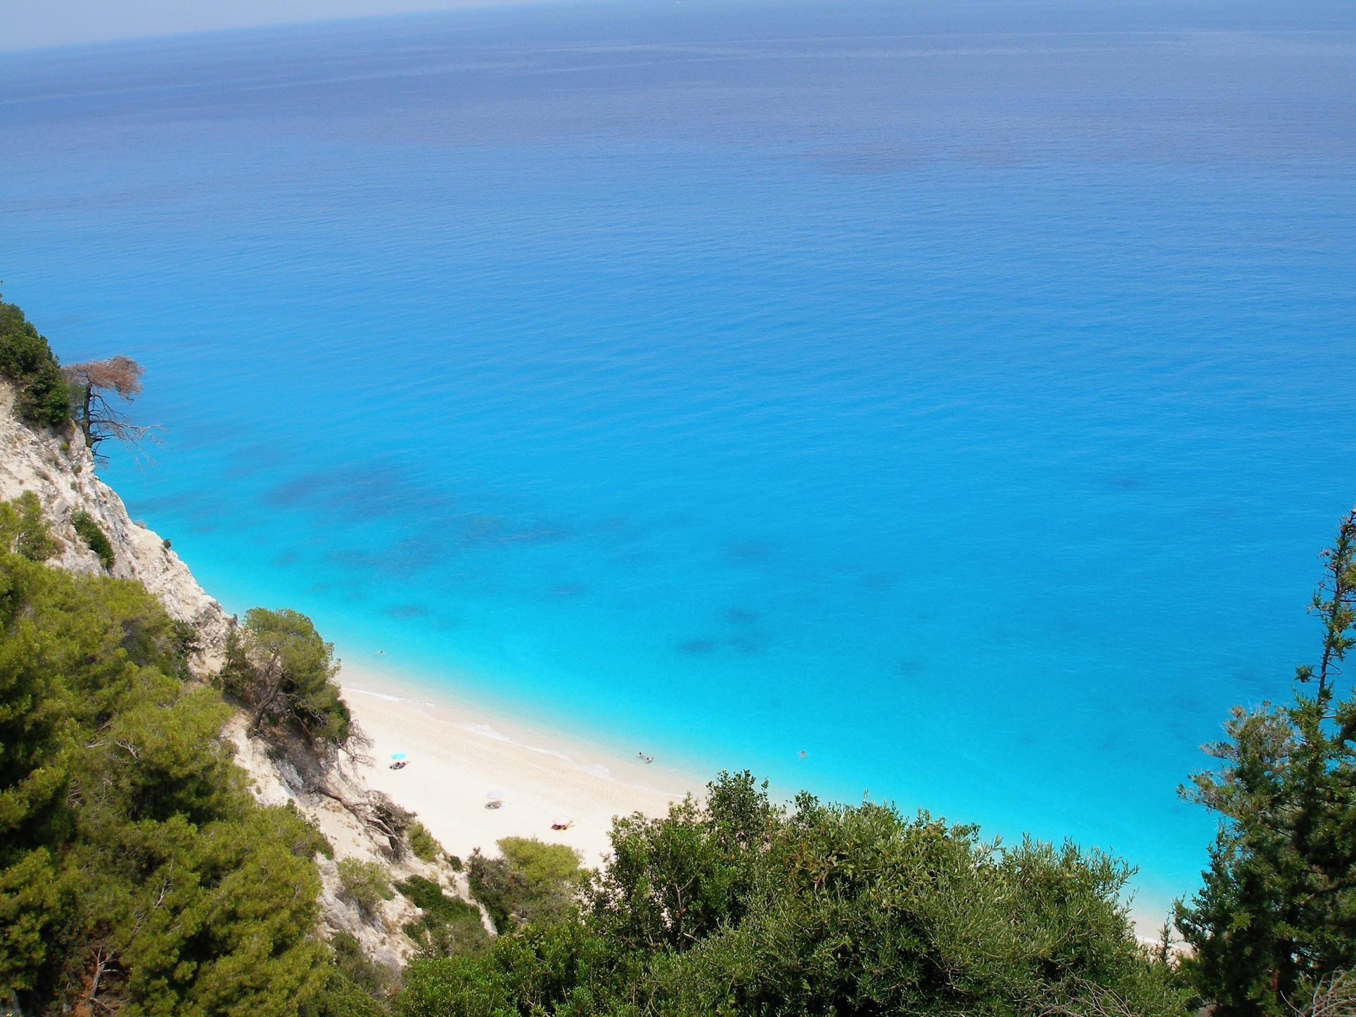
Outline
1 Intro
2 Speech Corpora
3 Common Voice
4 Future of Common Voice

Slide 3
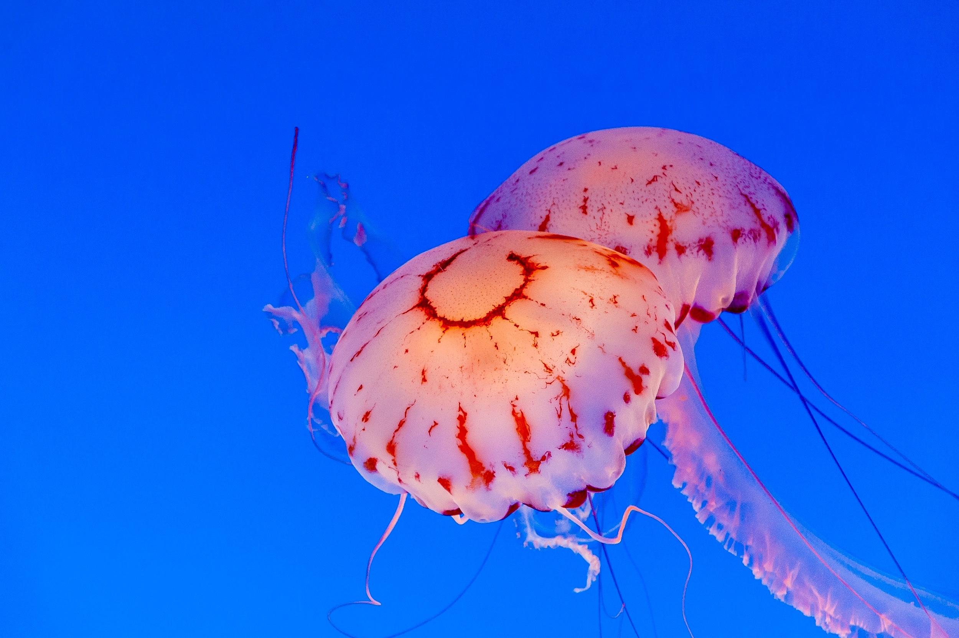
1 Intro

Slide 4

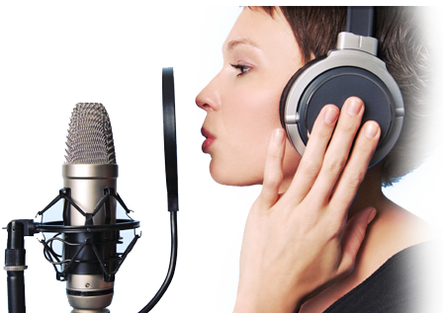
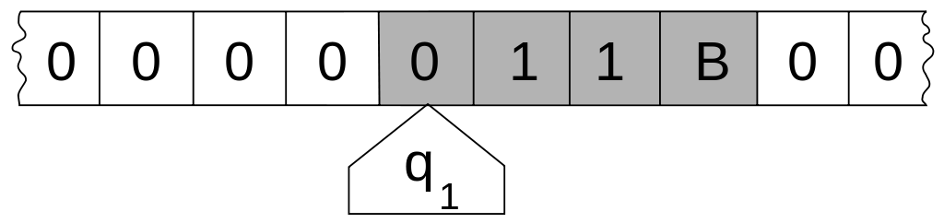
Intro: Speech-to-Text
"Mr. Watson, come here. I want to see you."
Speech
Computation
Text

Slide 5
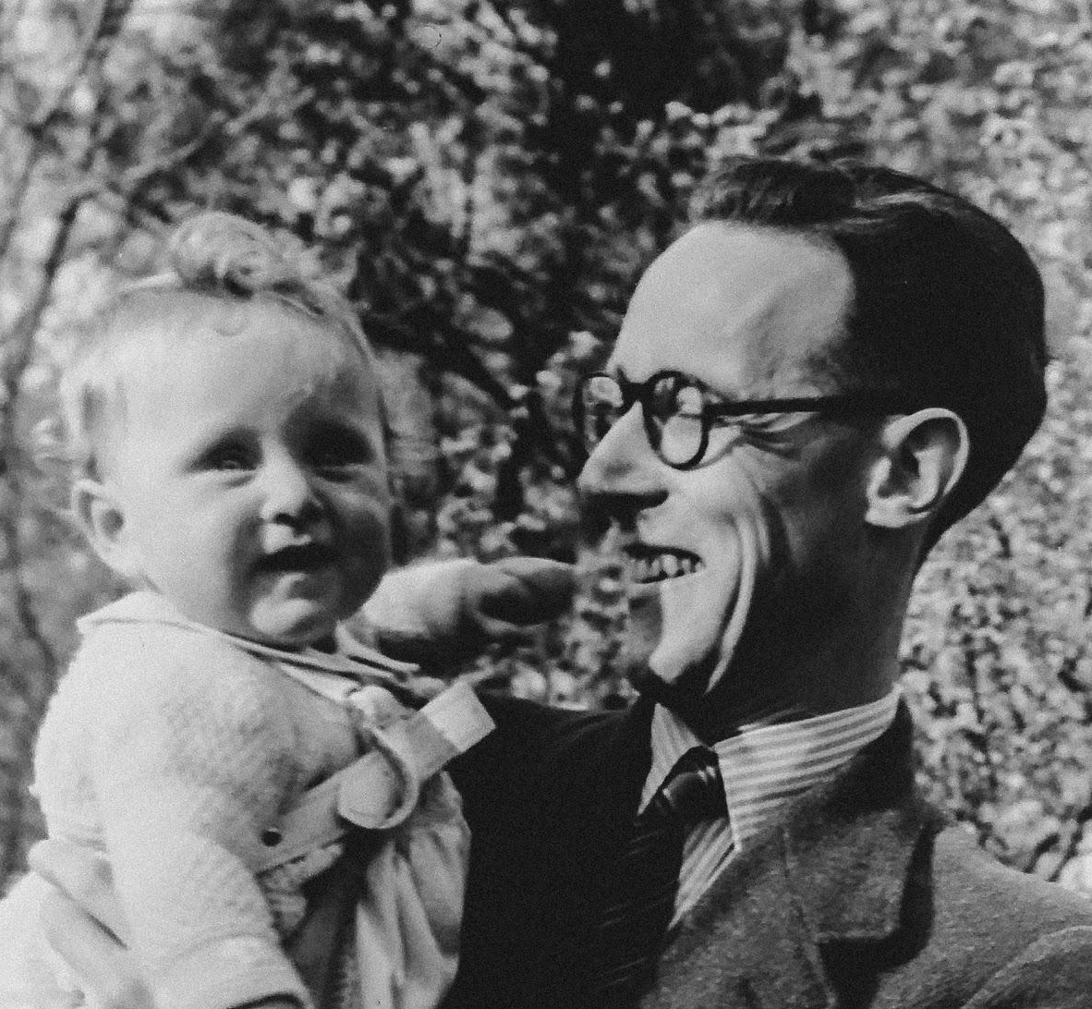
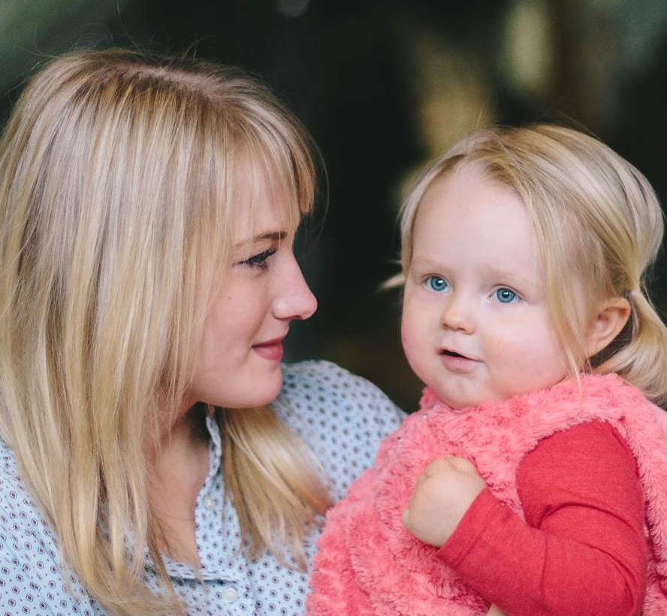
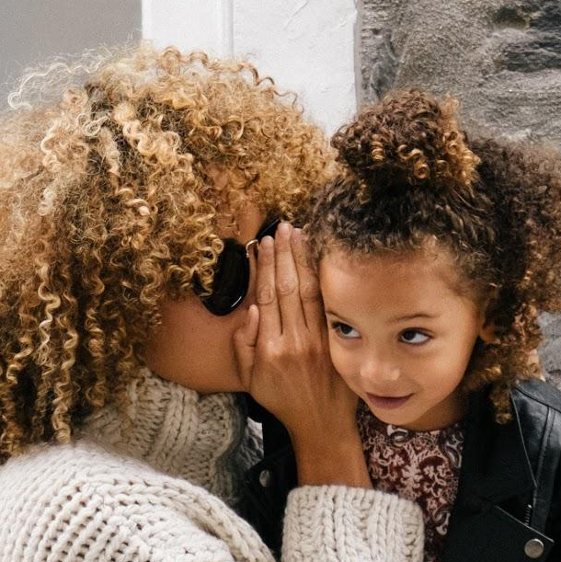
Intro: Speech Corpora
Speech
Speech
Speech

Slide 6
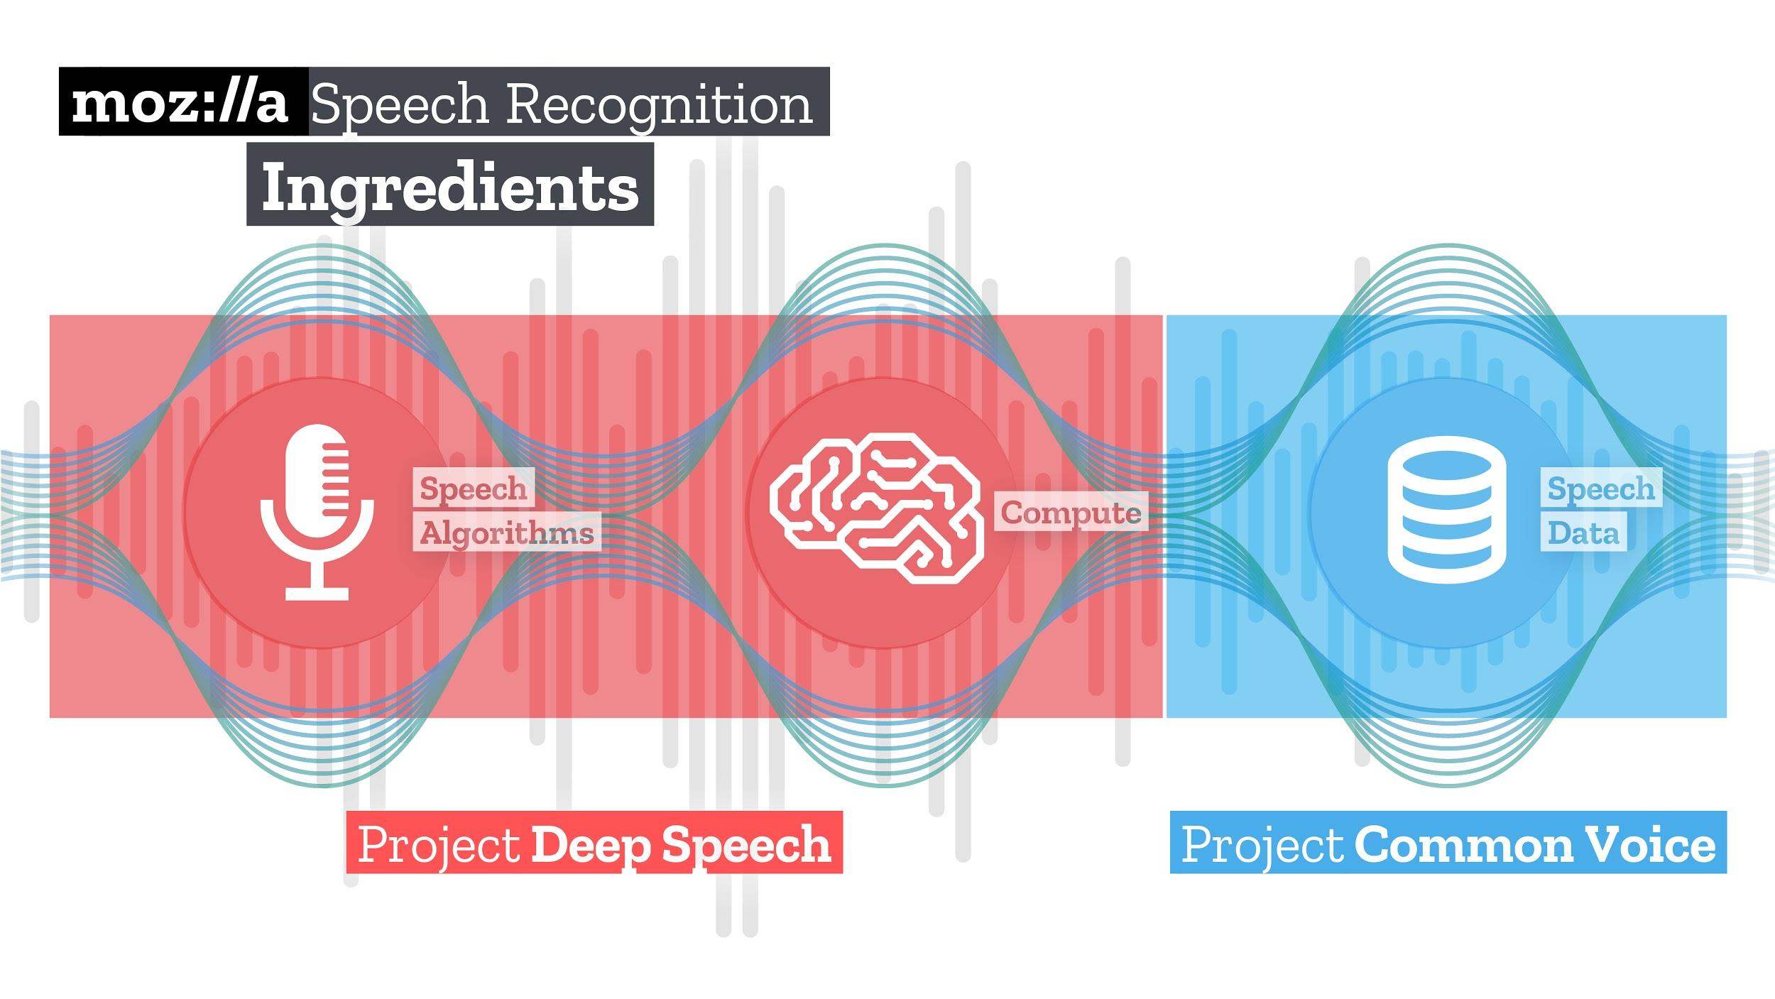
Intro: Common Voice

Slide 7
2 Speech Corpora

Slide 8


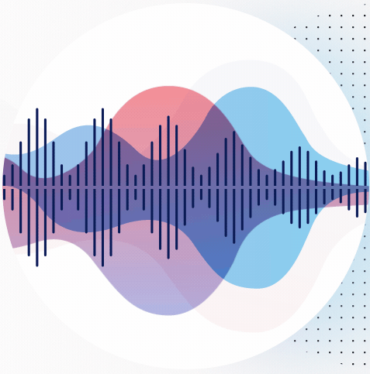


Speech Corpora: English Data
LibriSpeech
Common Voice
Fisher Corpus
Switchboard Corpus

Slide 9
Speech Corpora: Open Non-English Data

Slide 10
Speech Corpora: Open Non-English Data
Common Voice

Slide 11
3 Common Voice

Slide 12

3.1 Frontend

Slide 13

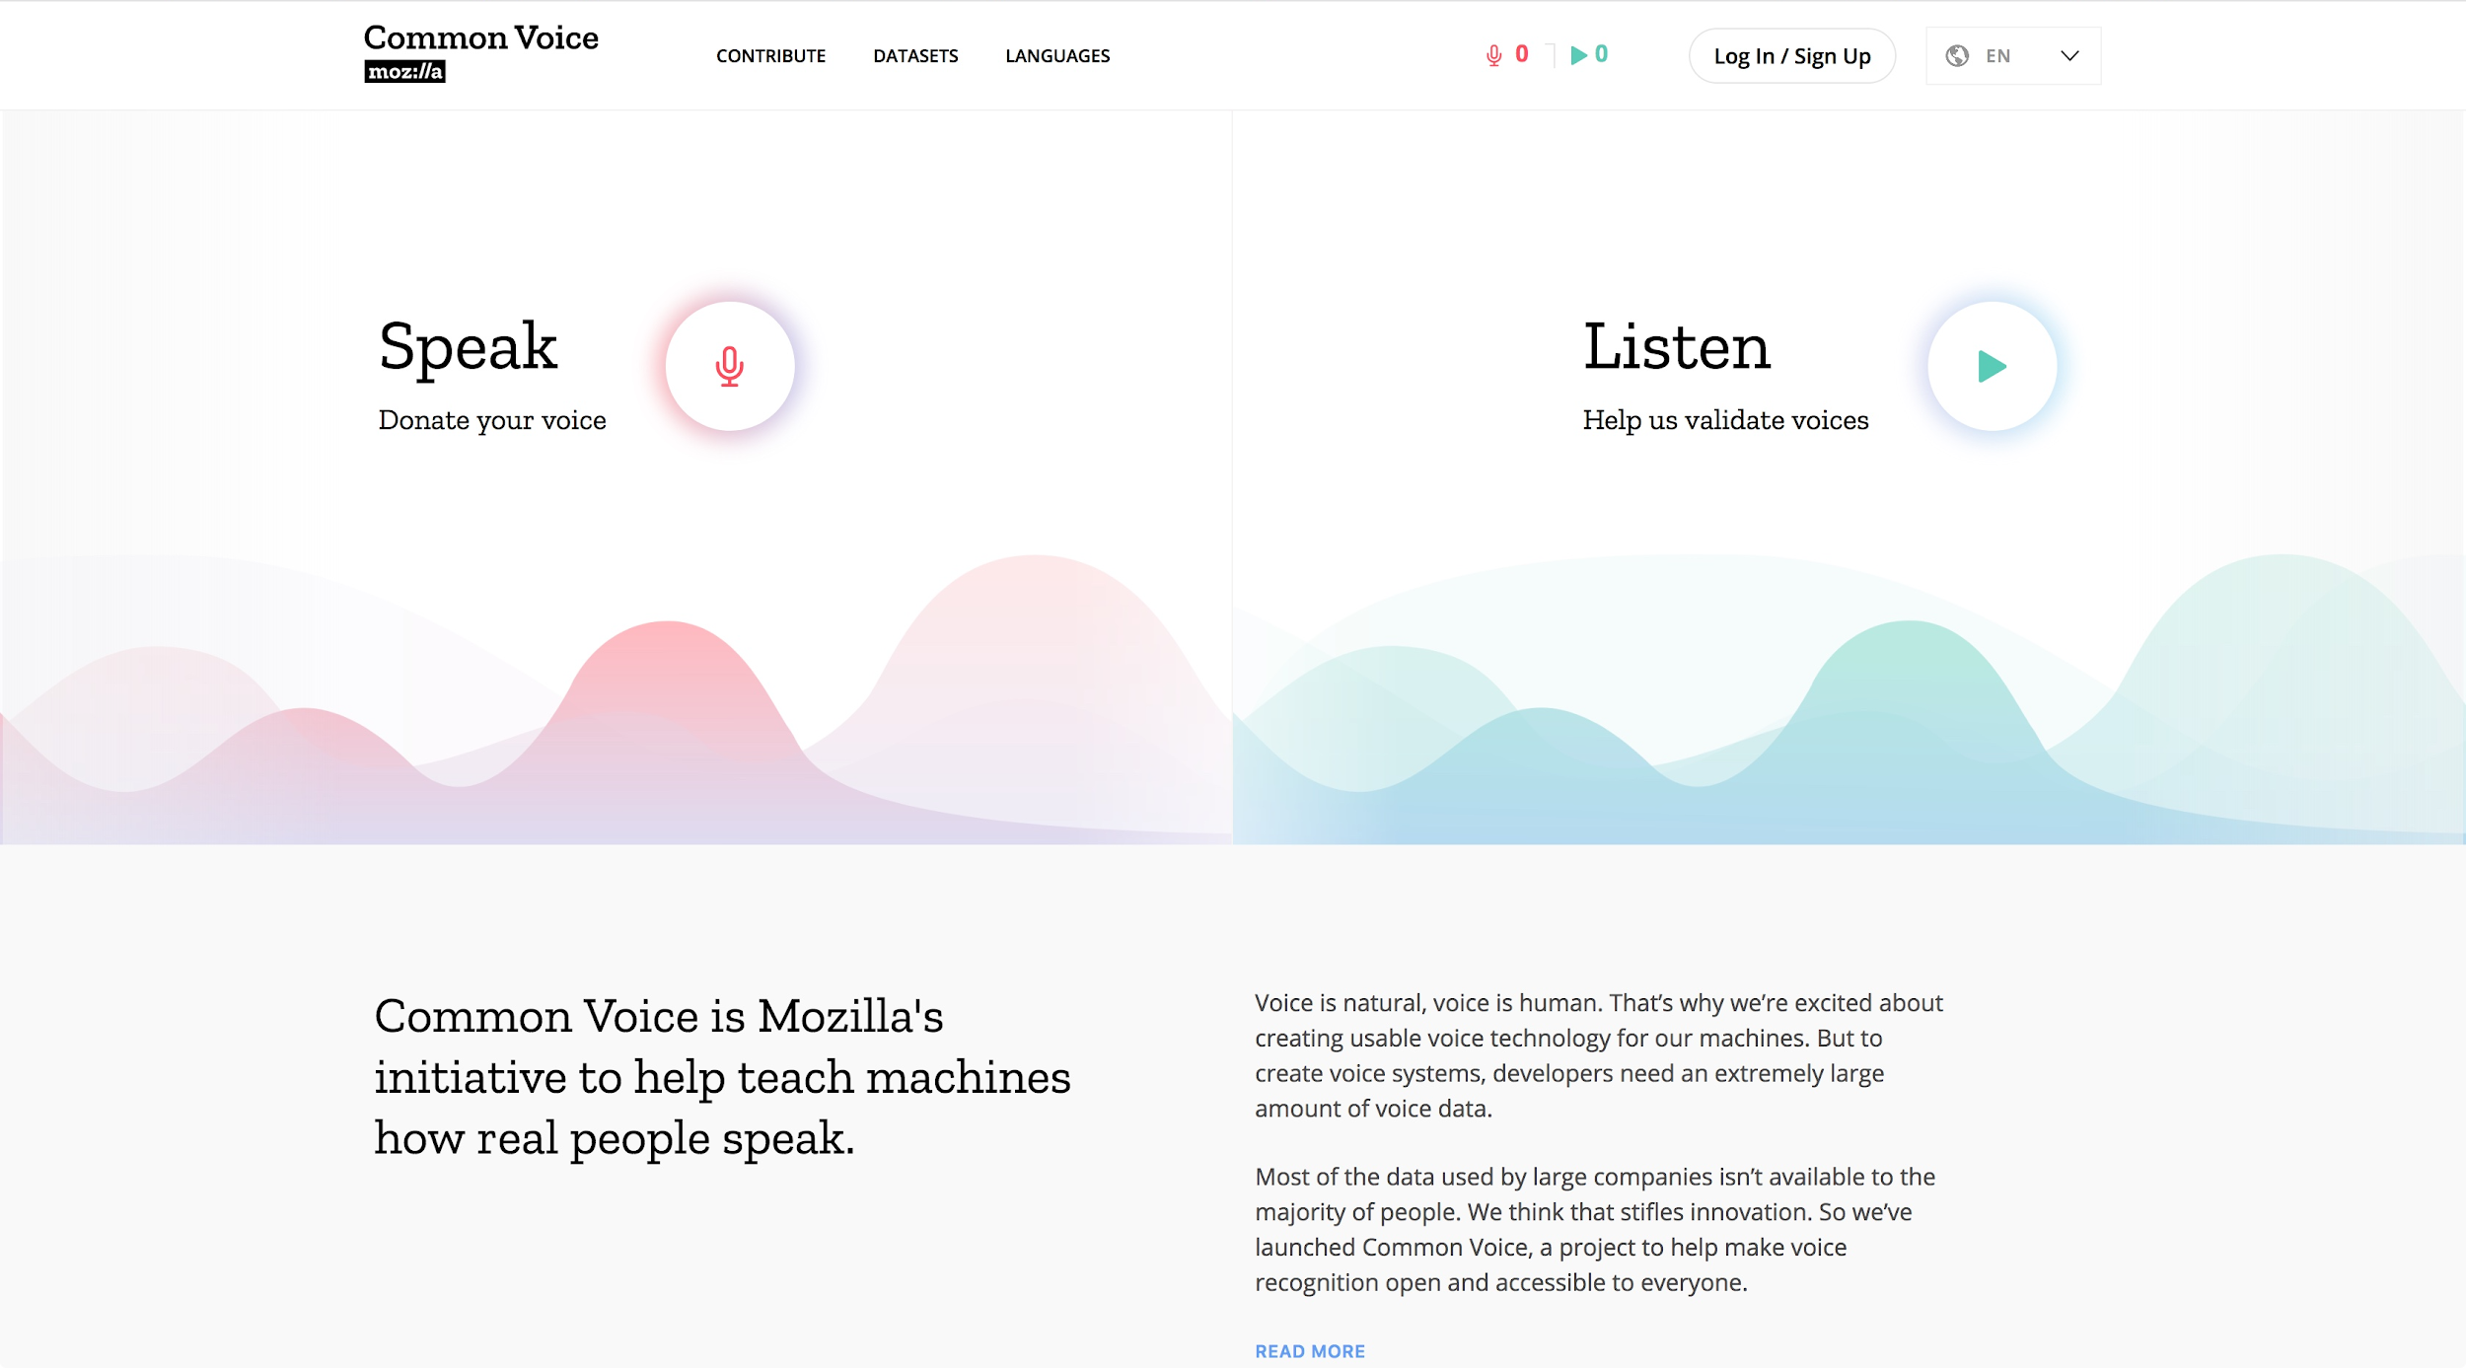
Frontend: Homepage

Slide 14
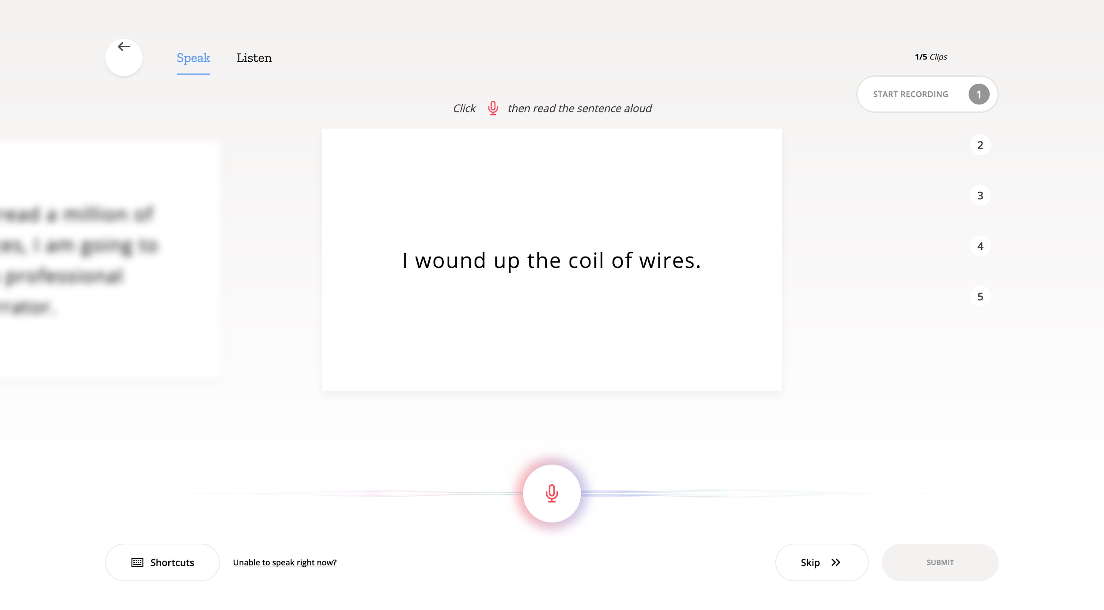
Frontend: Speak

Slide 15
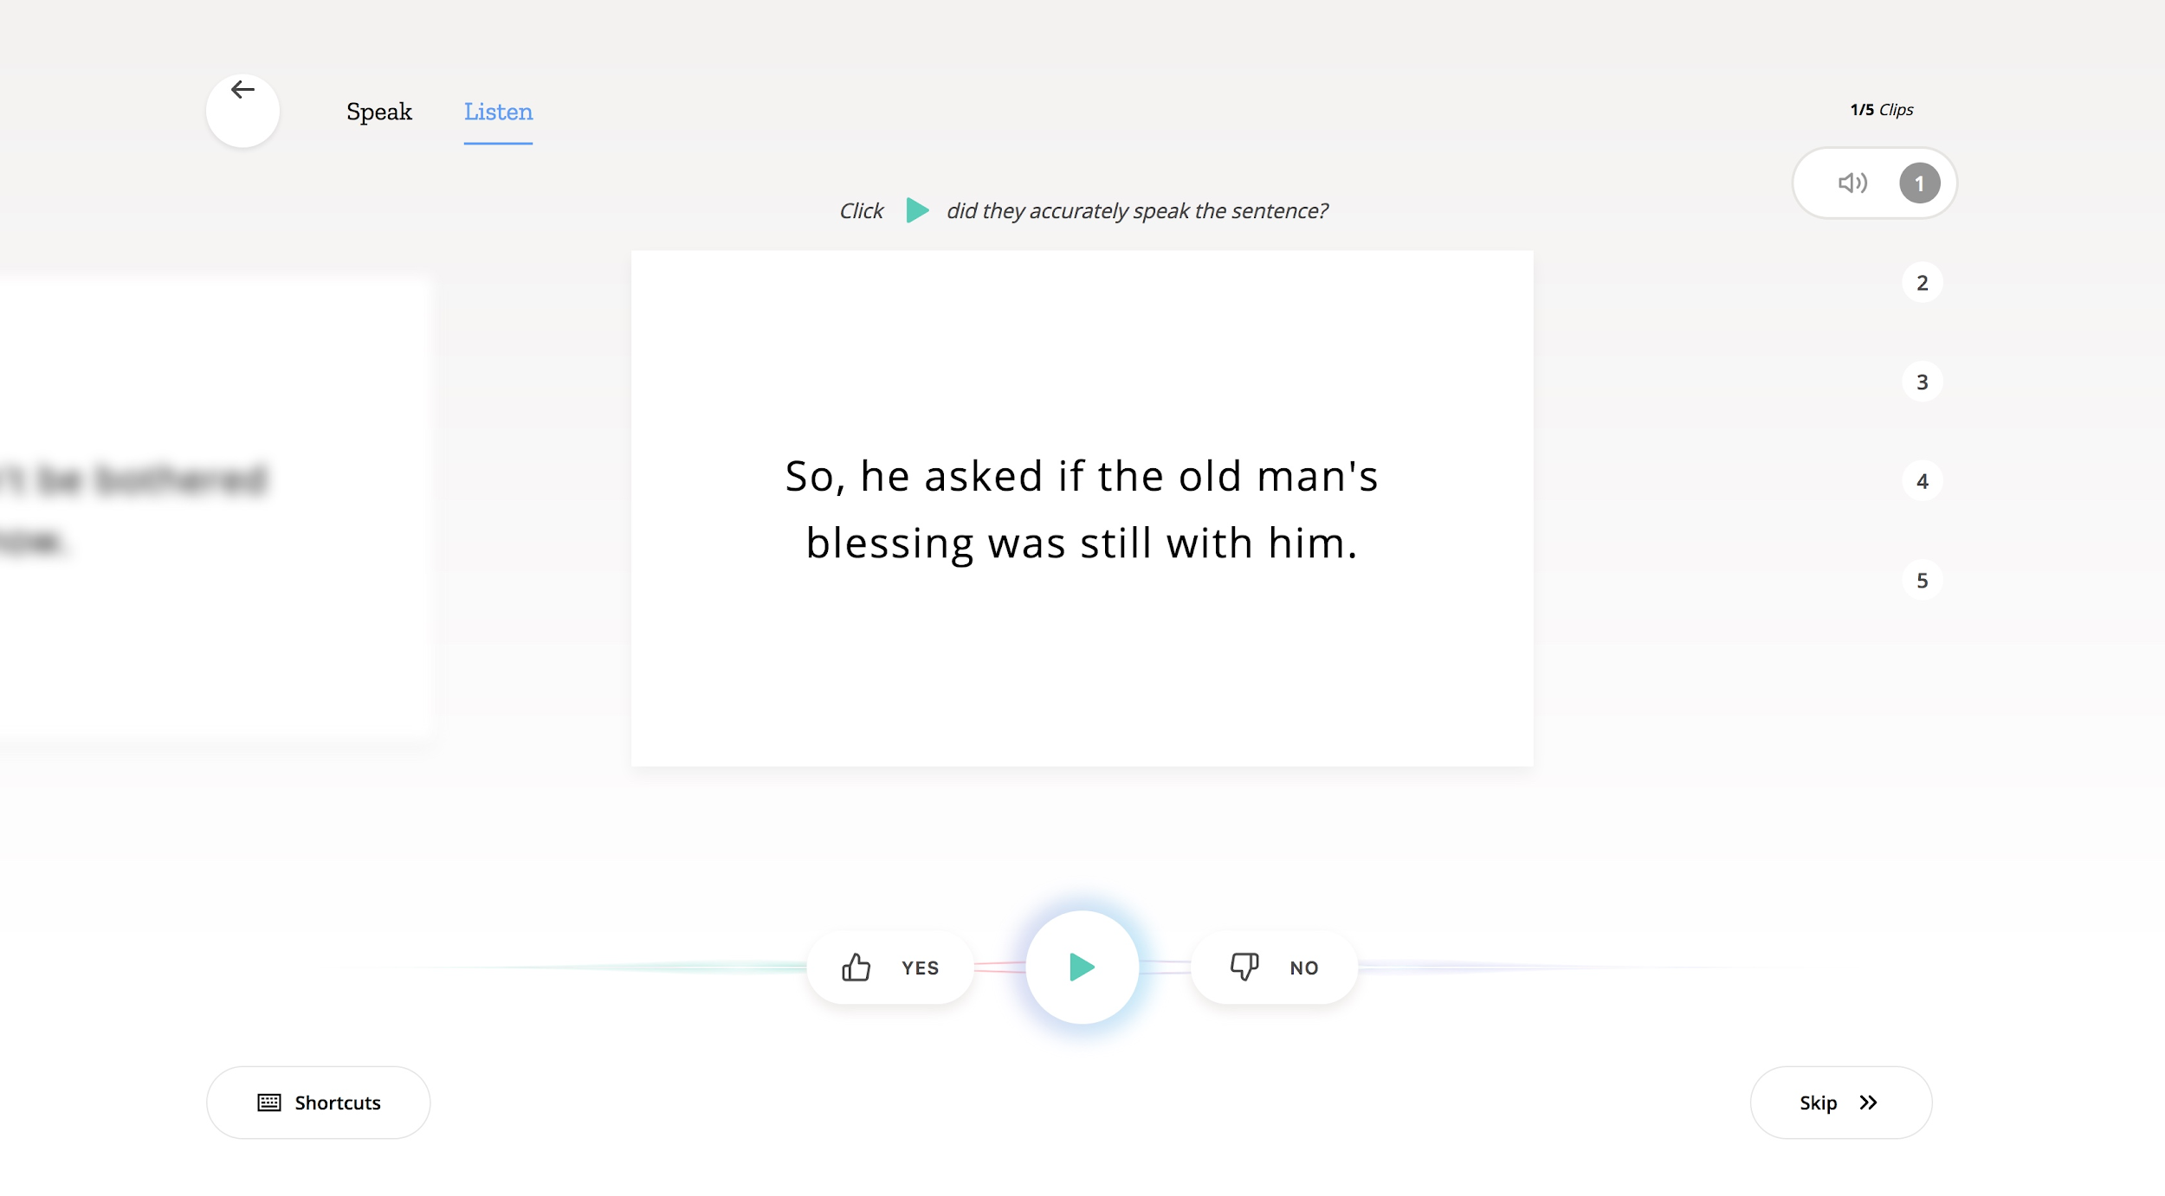
Frontend: Listen

Slide 16
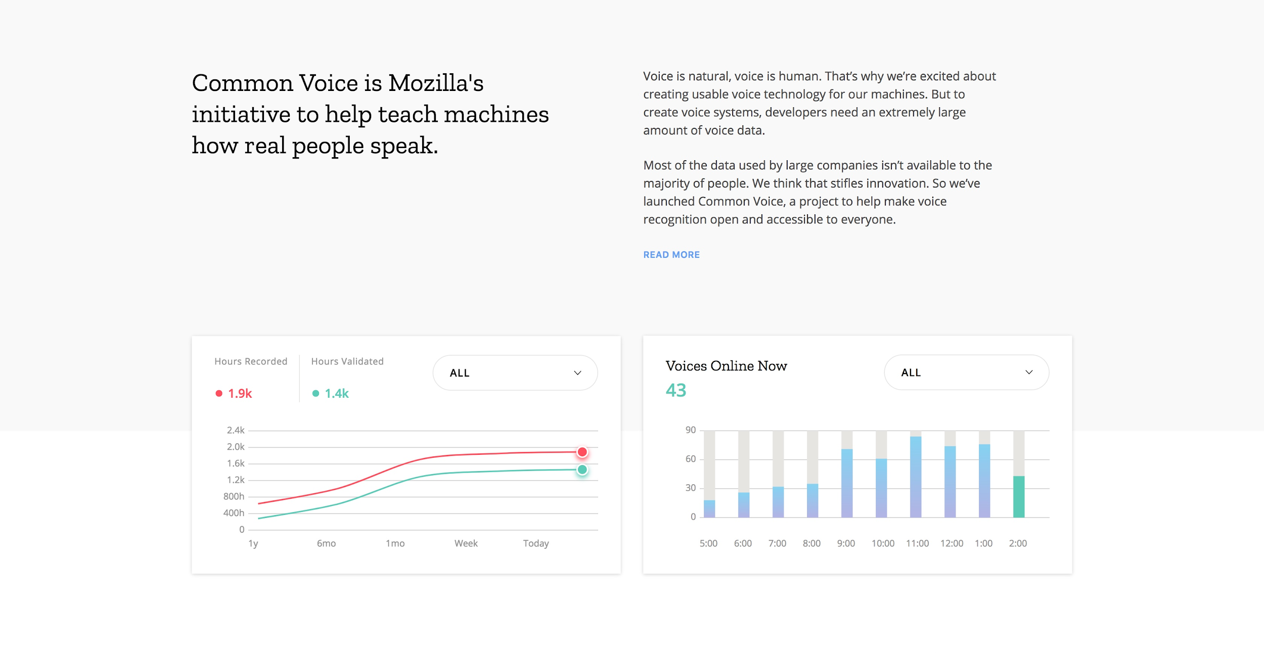
Frontend: General Statistics

Slide 17
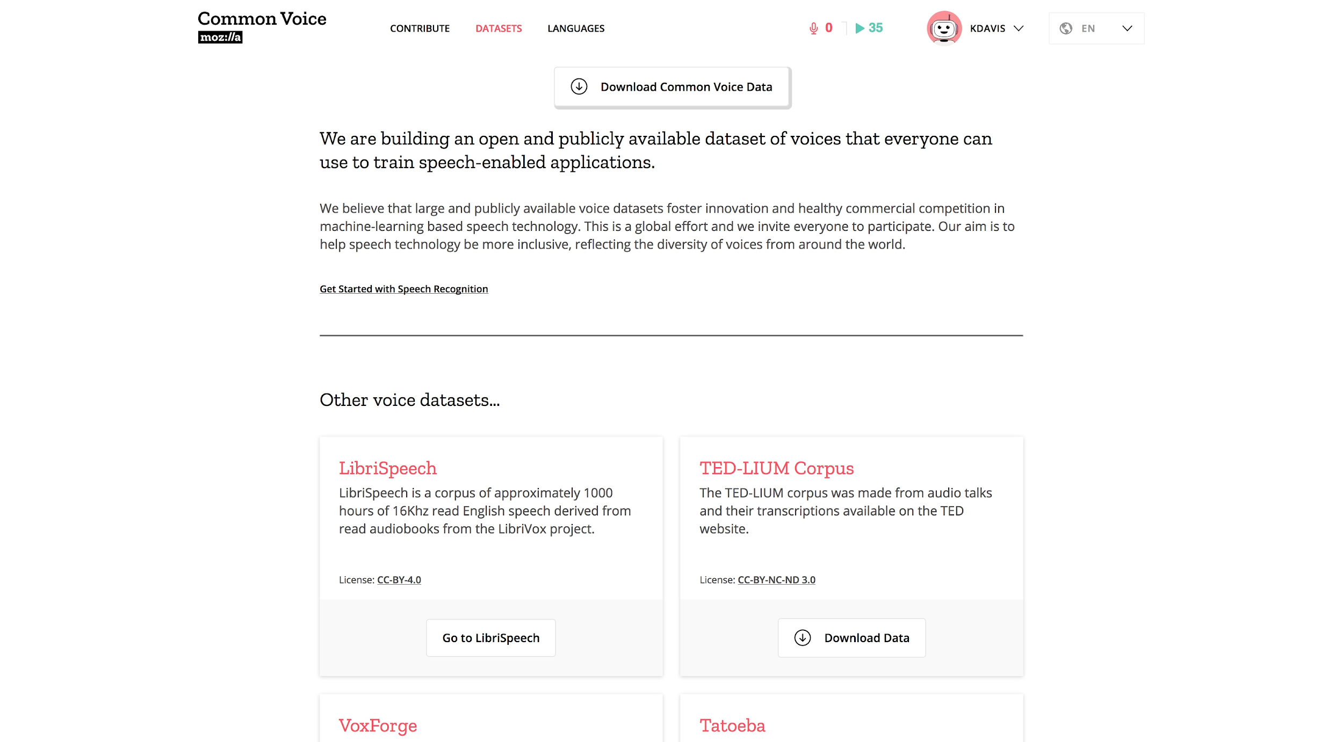
Frontend: Datasets

Slide 18
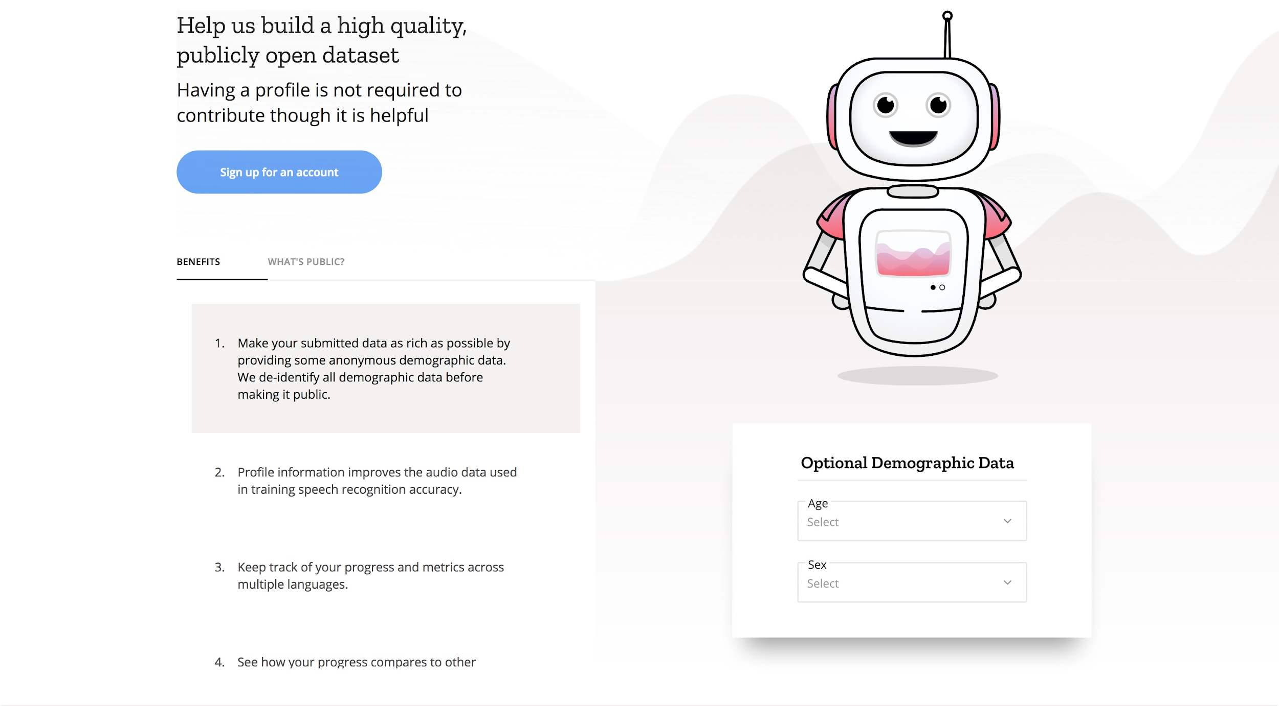
Frontend: Profile Sign-Up

Slide 19
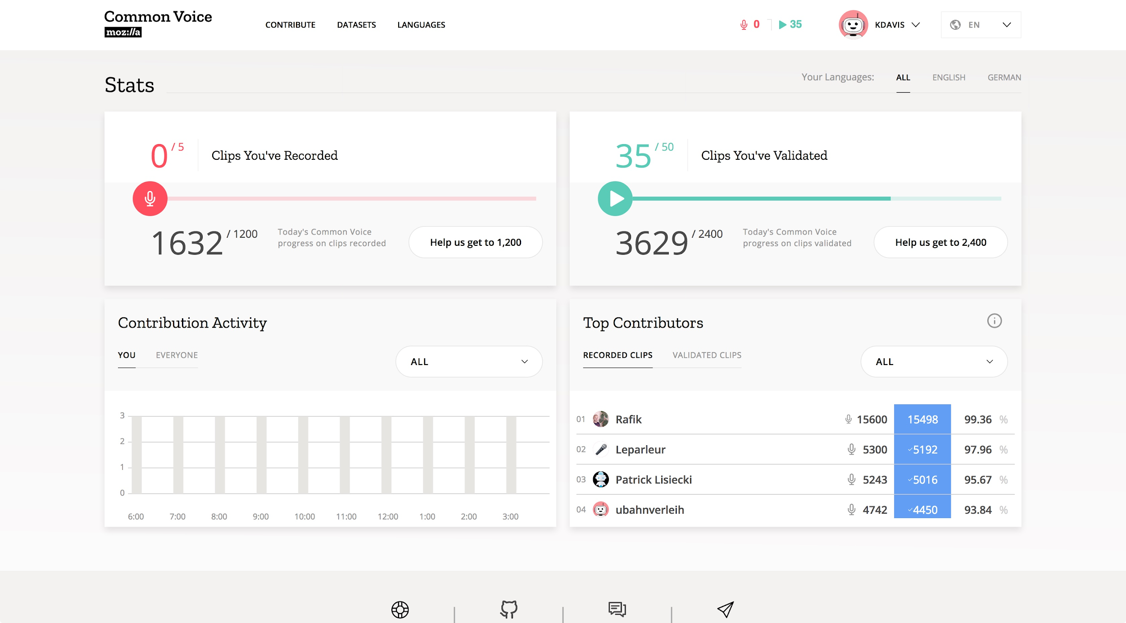
Frontend: Dashboard

Slide 20
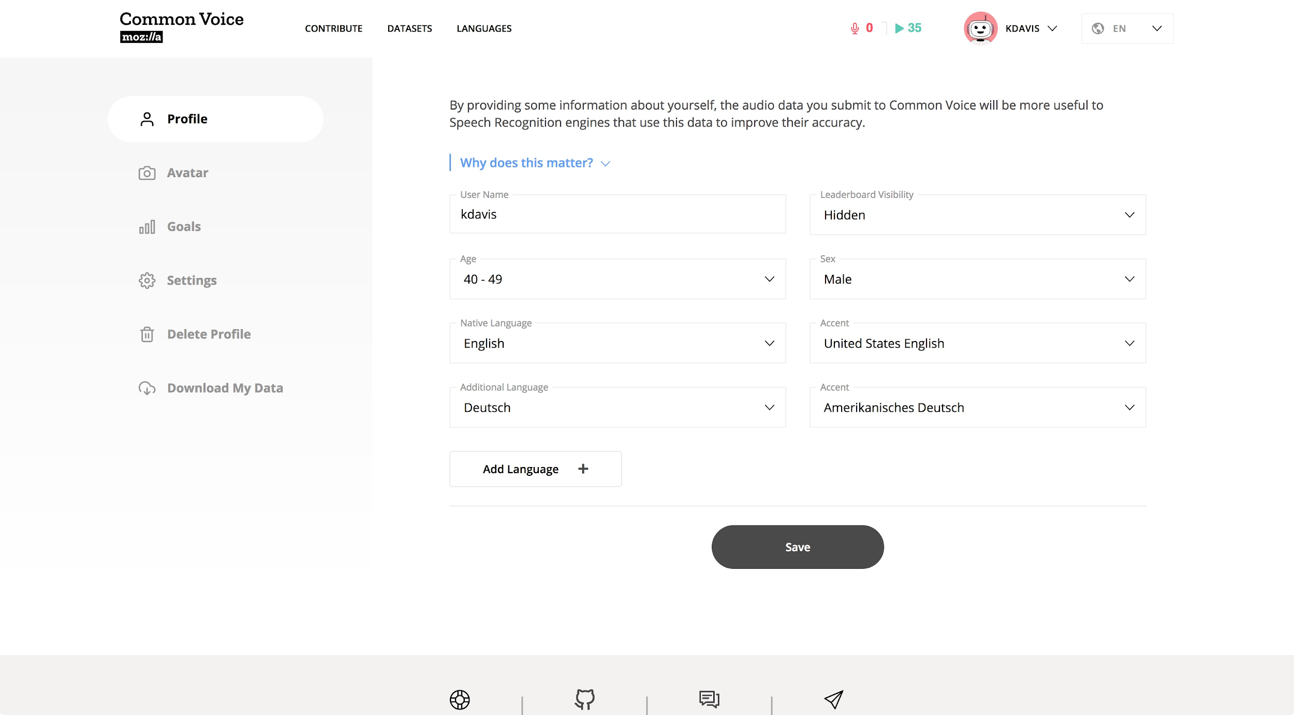
Frontend: Profile: Demographics

Slide 21
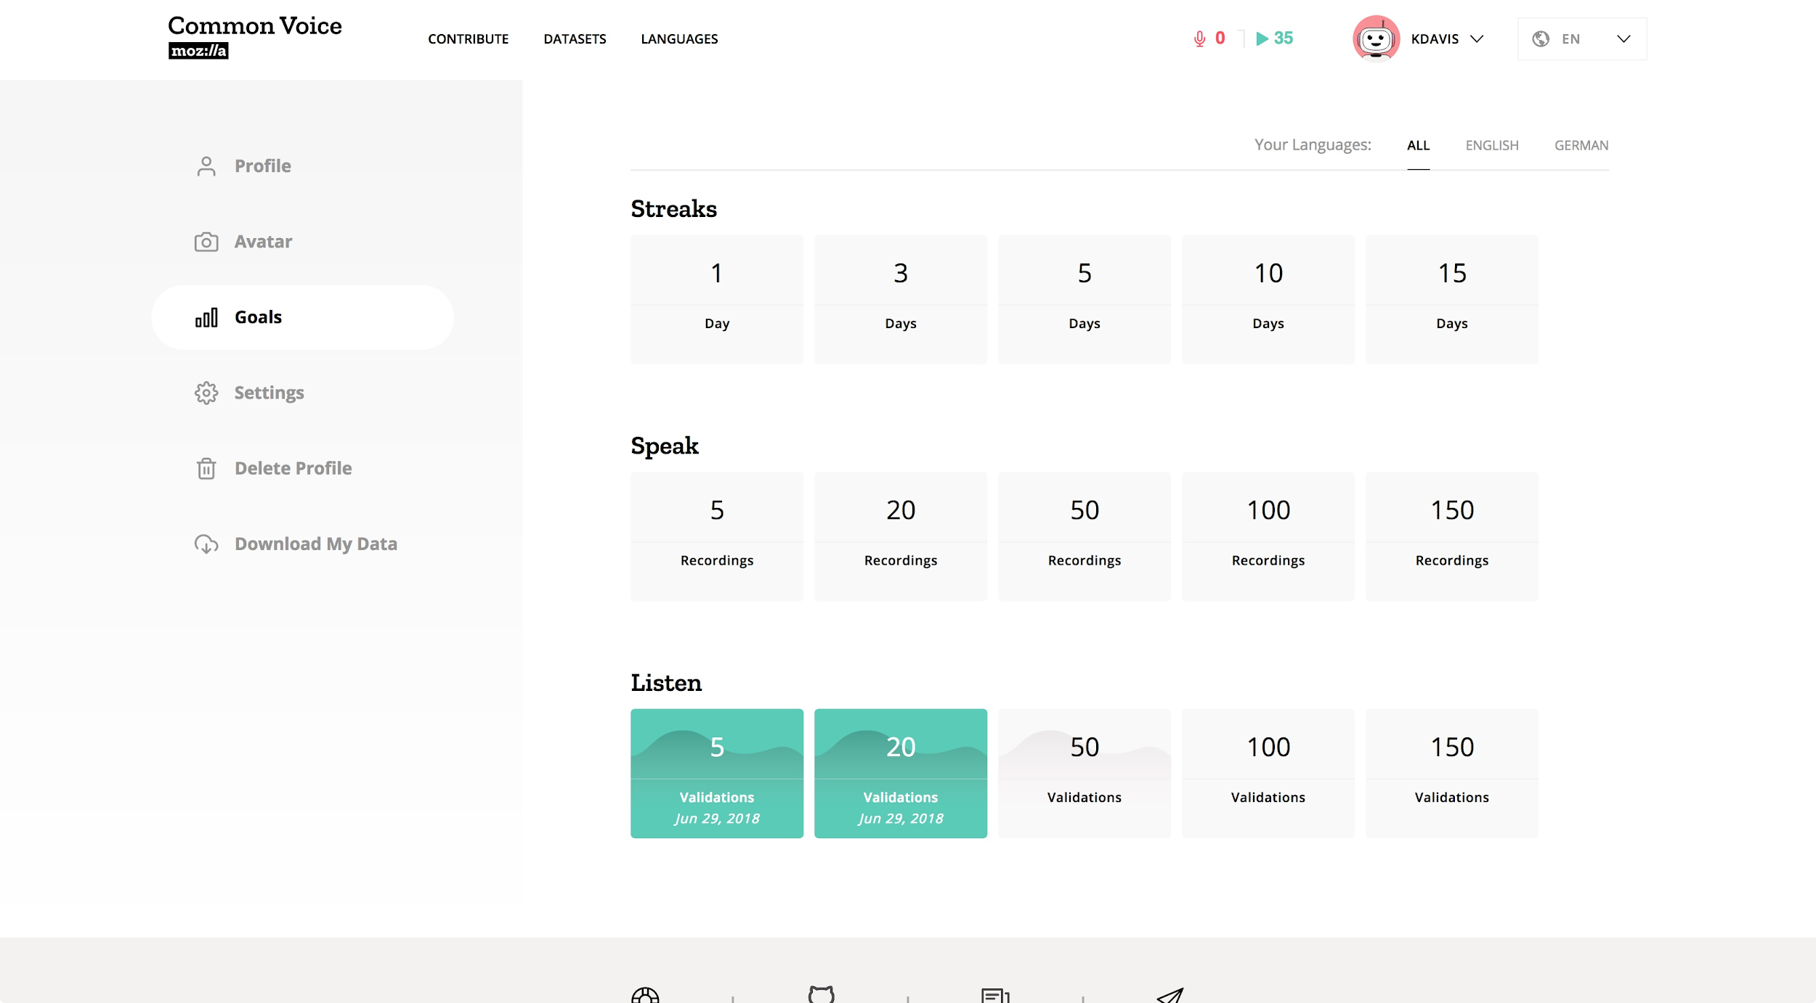
Frontend: Profile: Goals

Slide 22
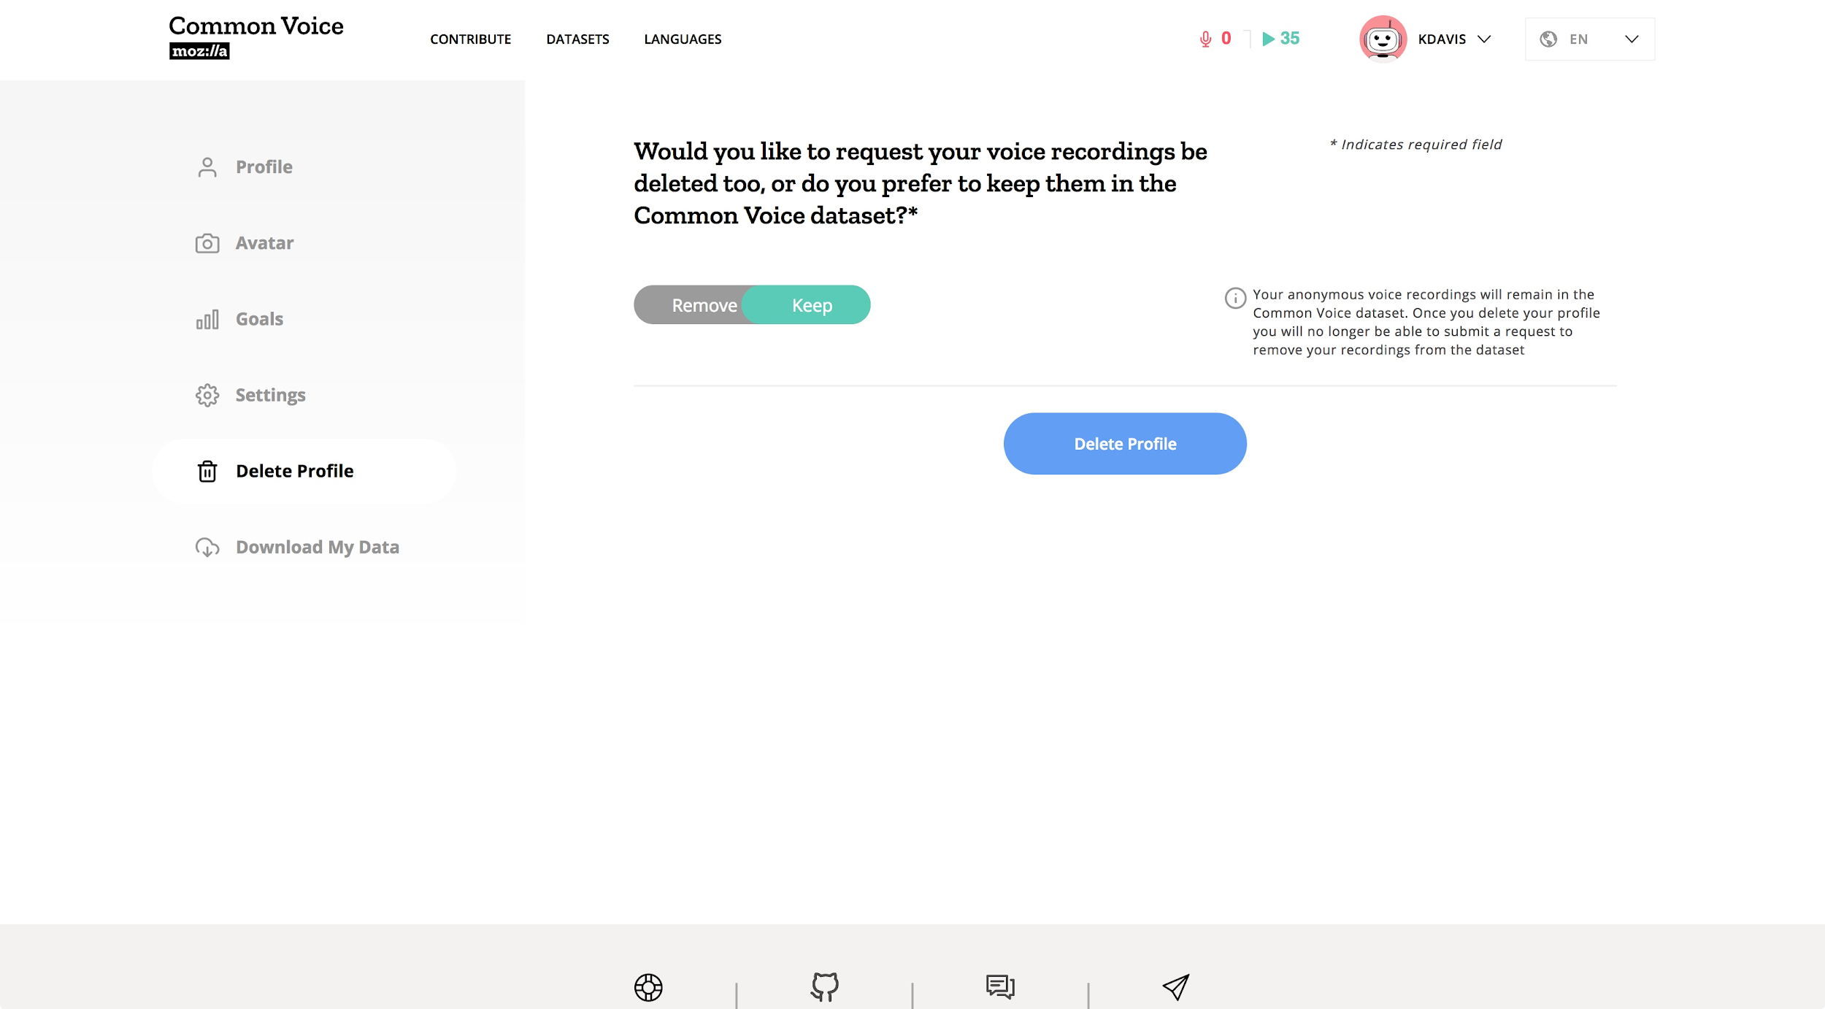
Frontend: Profile: Delete Profile

Slide 23
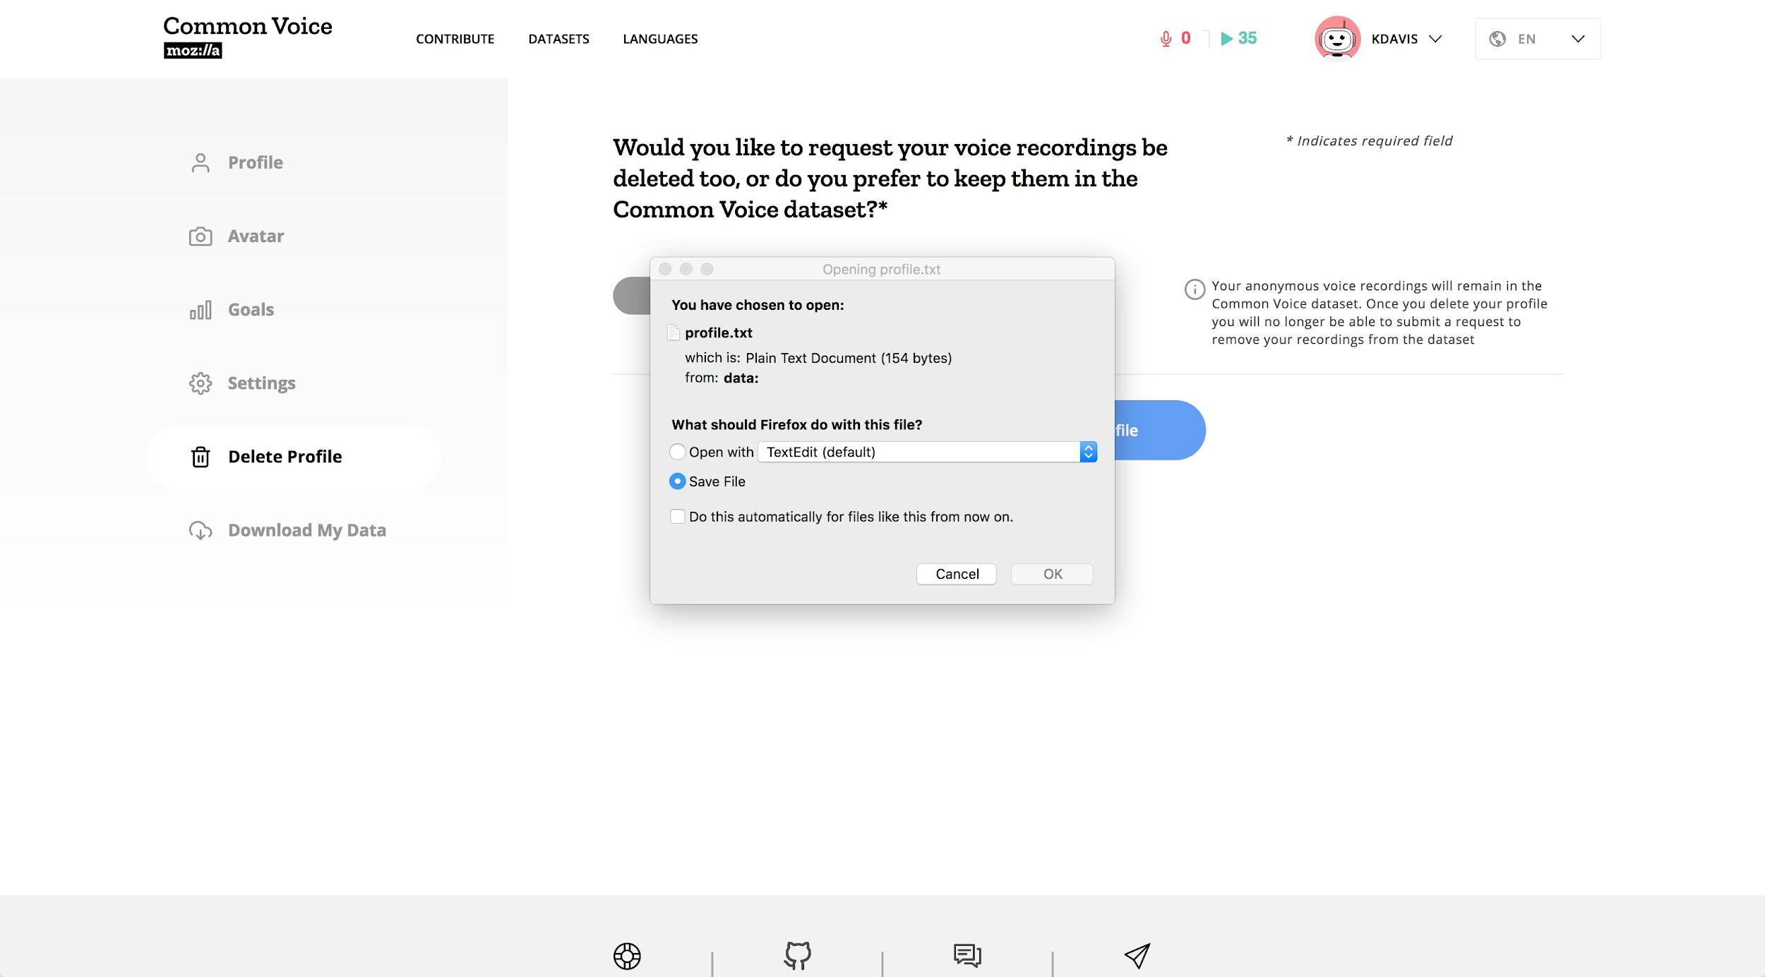
Frontend: Profile: Download My Data

Slide 24
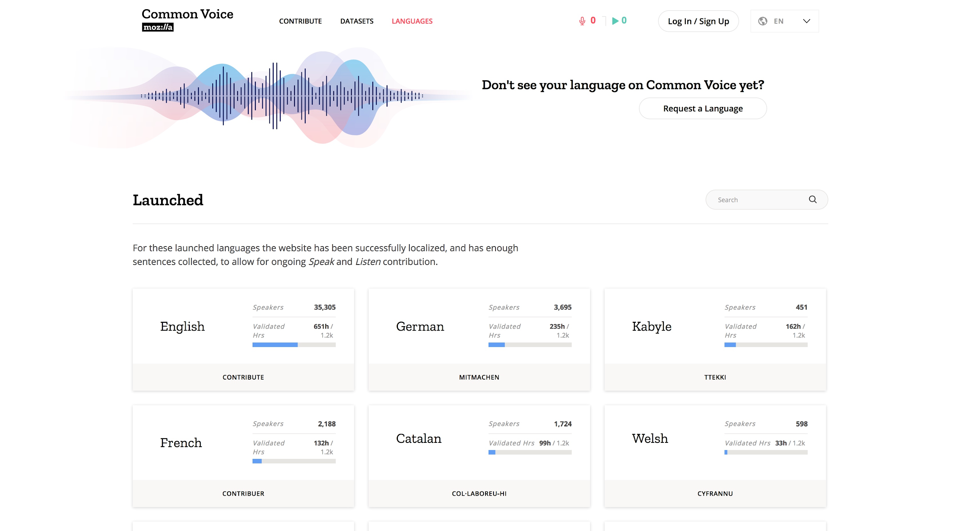
Frontend: Languages...

Slide 25
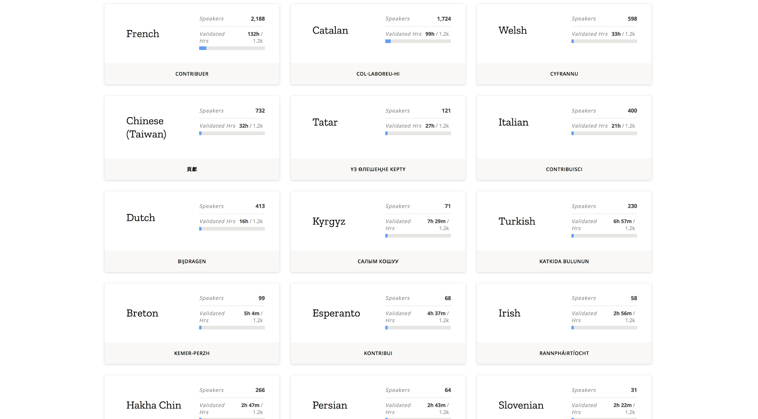
Frontend: Languages...

Slide 26
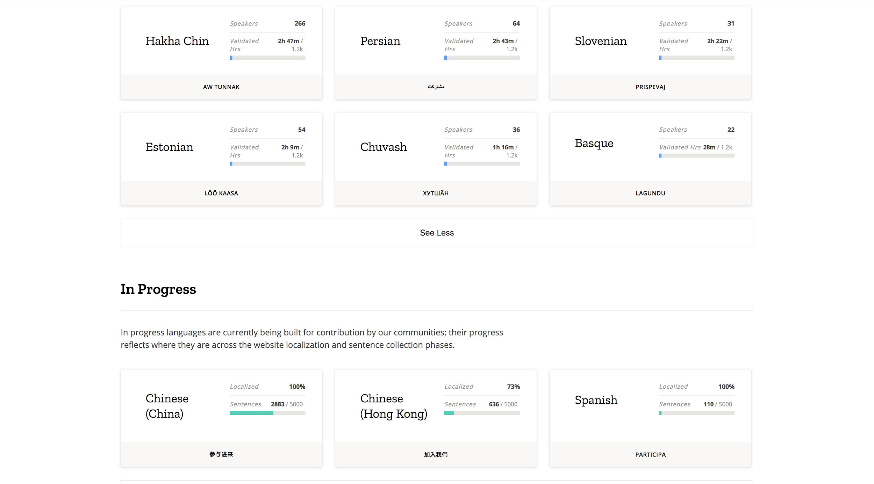
Frontend: Languages...

Slide 27
3.2 Localization

Slide 28
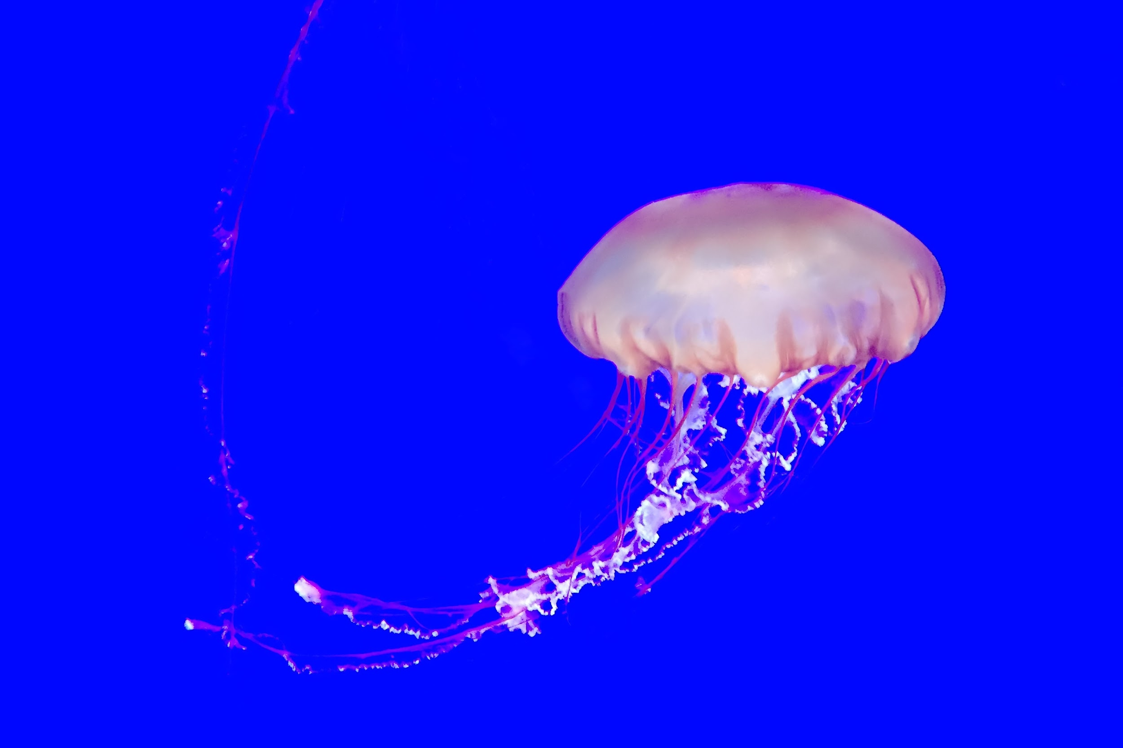
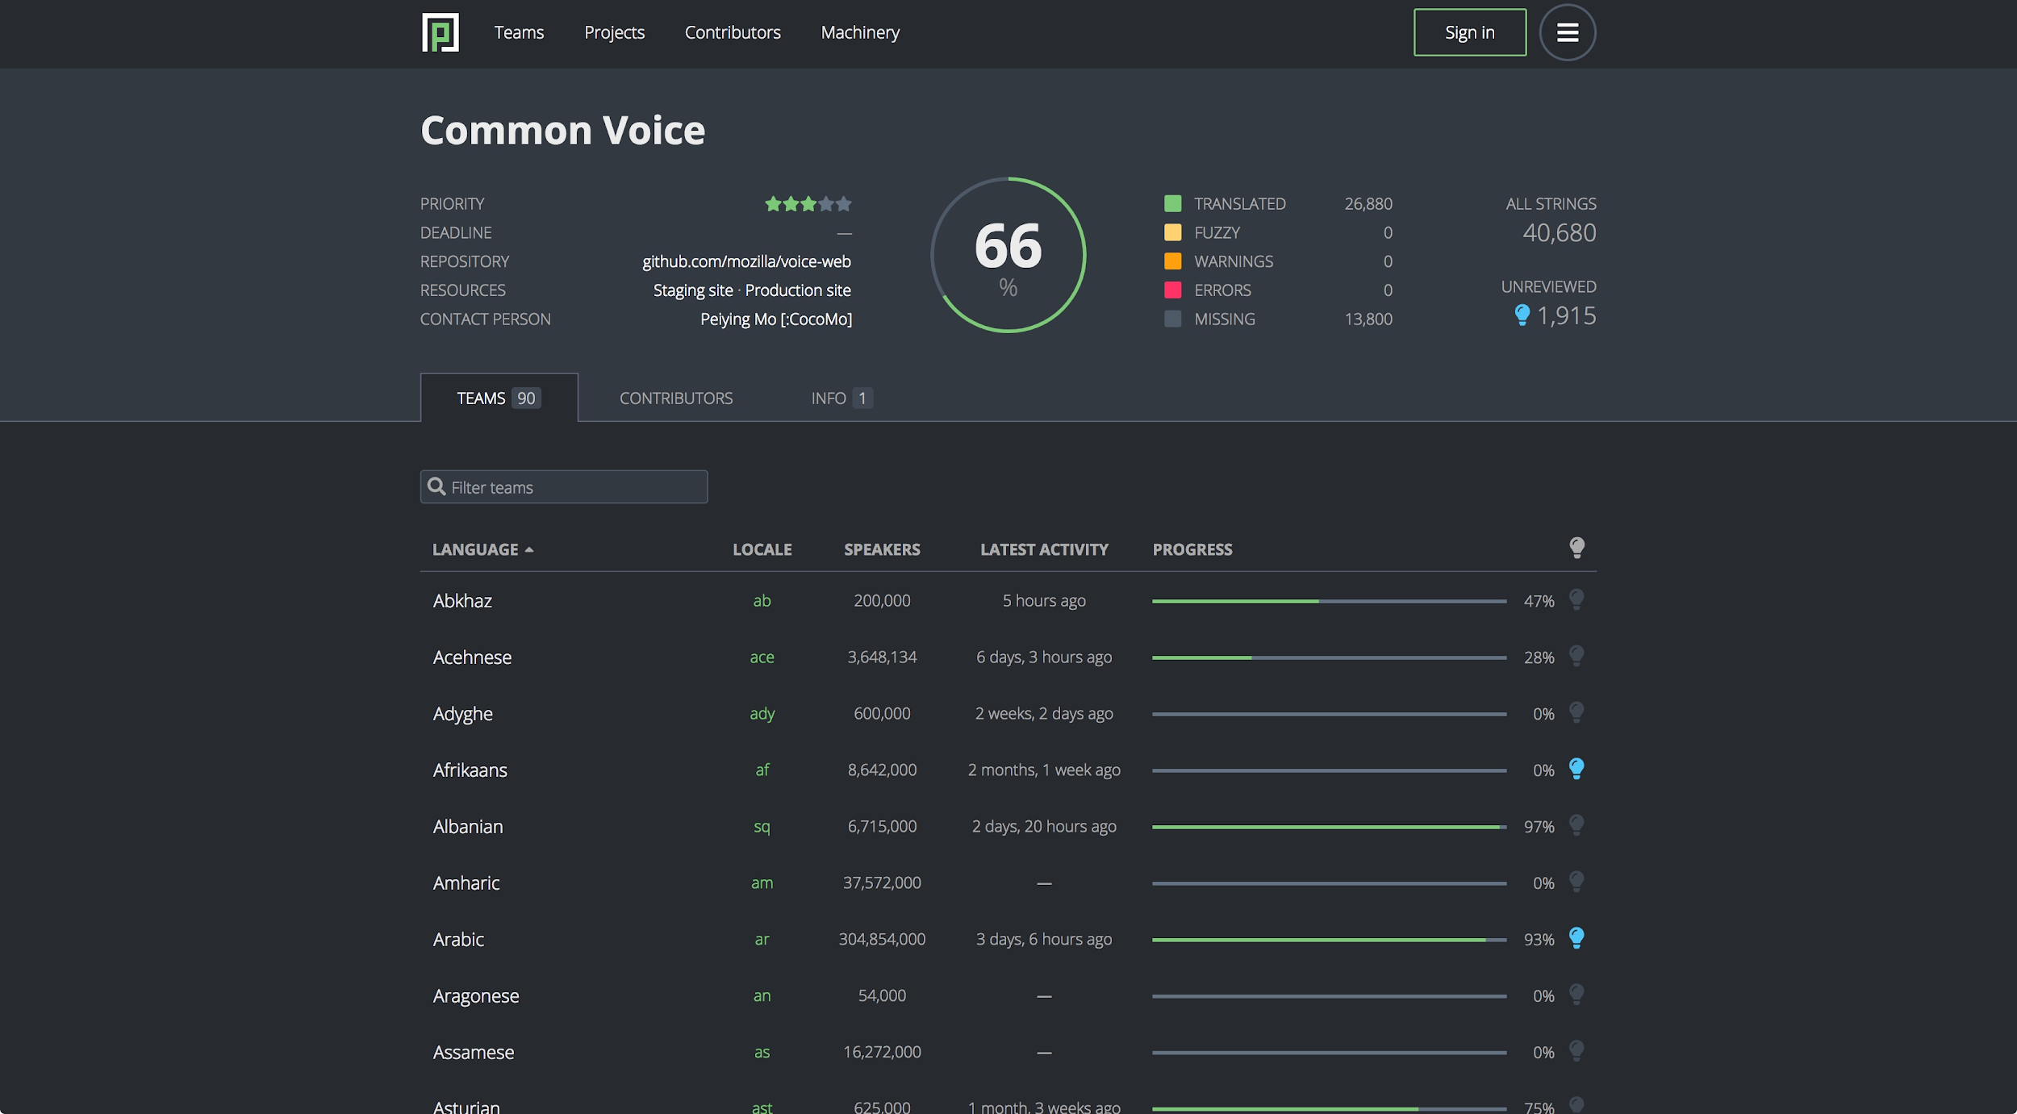
Localization: Pontoon

Slide 29
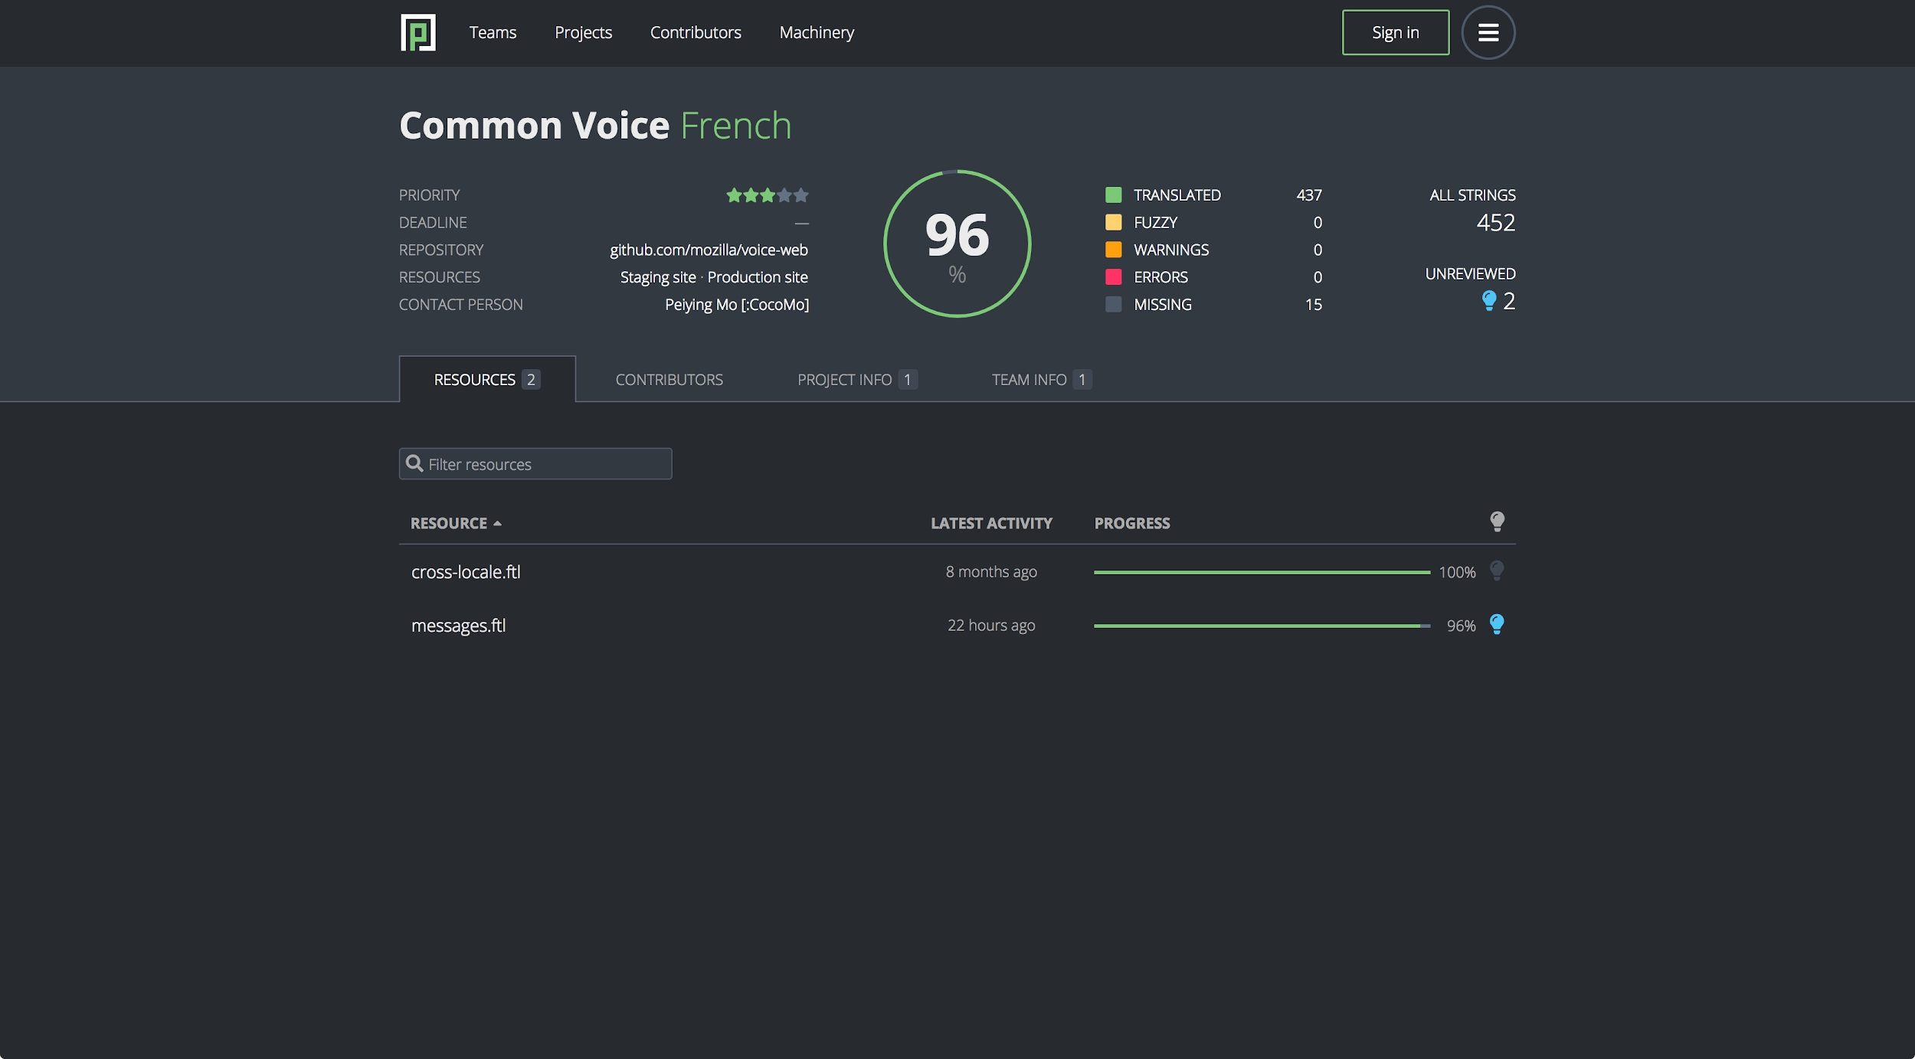
Localization: Pontoon: Resources

Slide 30
3.3 Sentence Collection

Slide 31

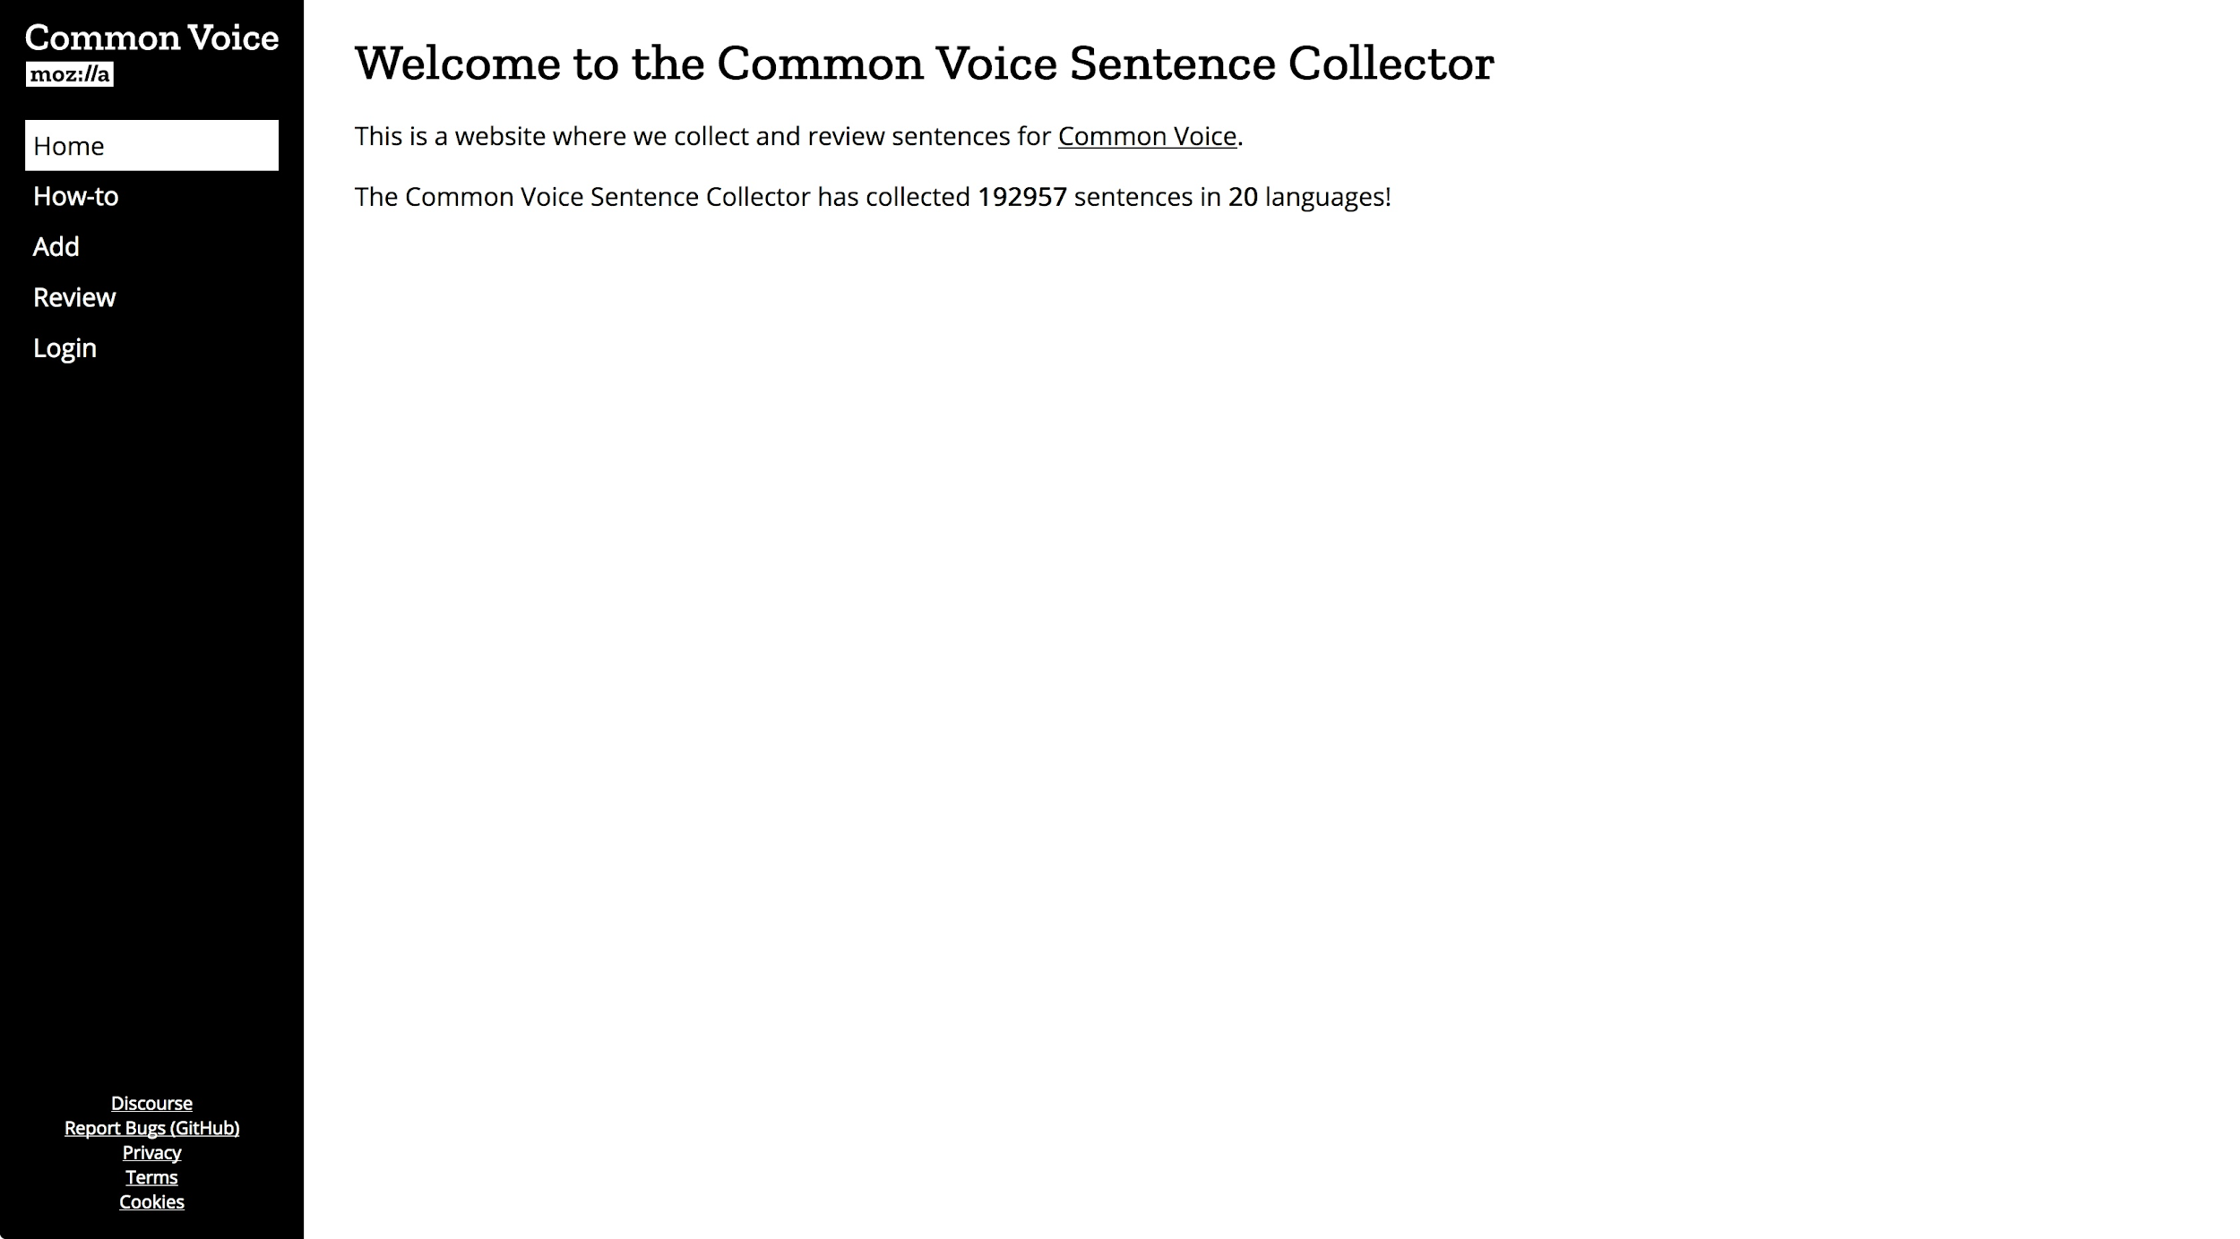
Sentence Collection: Homepage

Slide 32
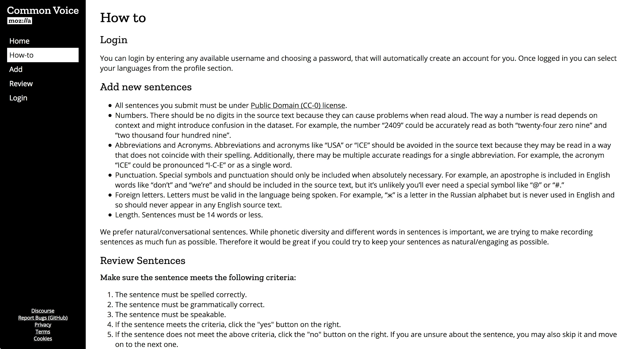
Sentence Collection: How To

Slide 33
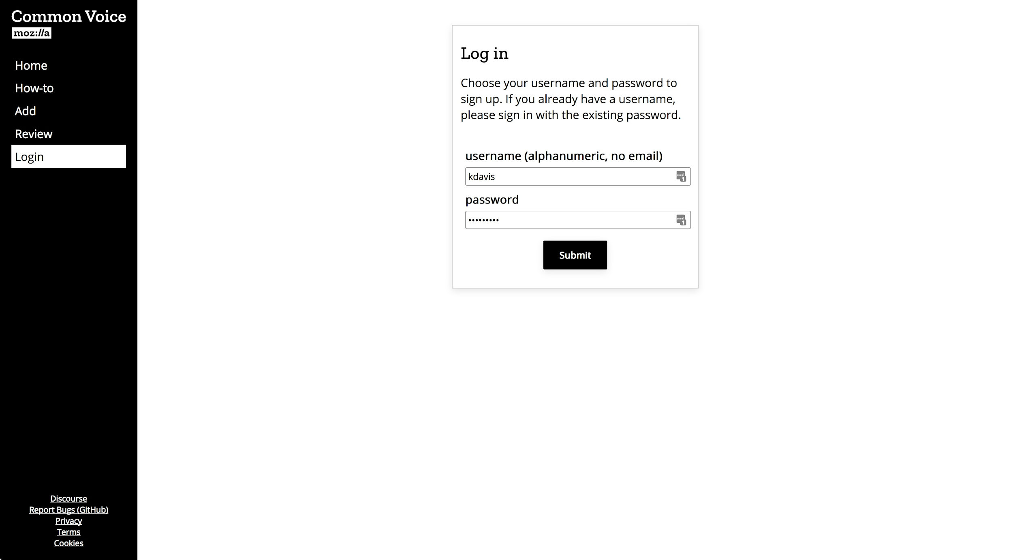
Sentence Collection: Login

Slide 34
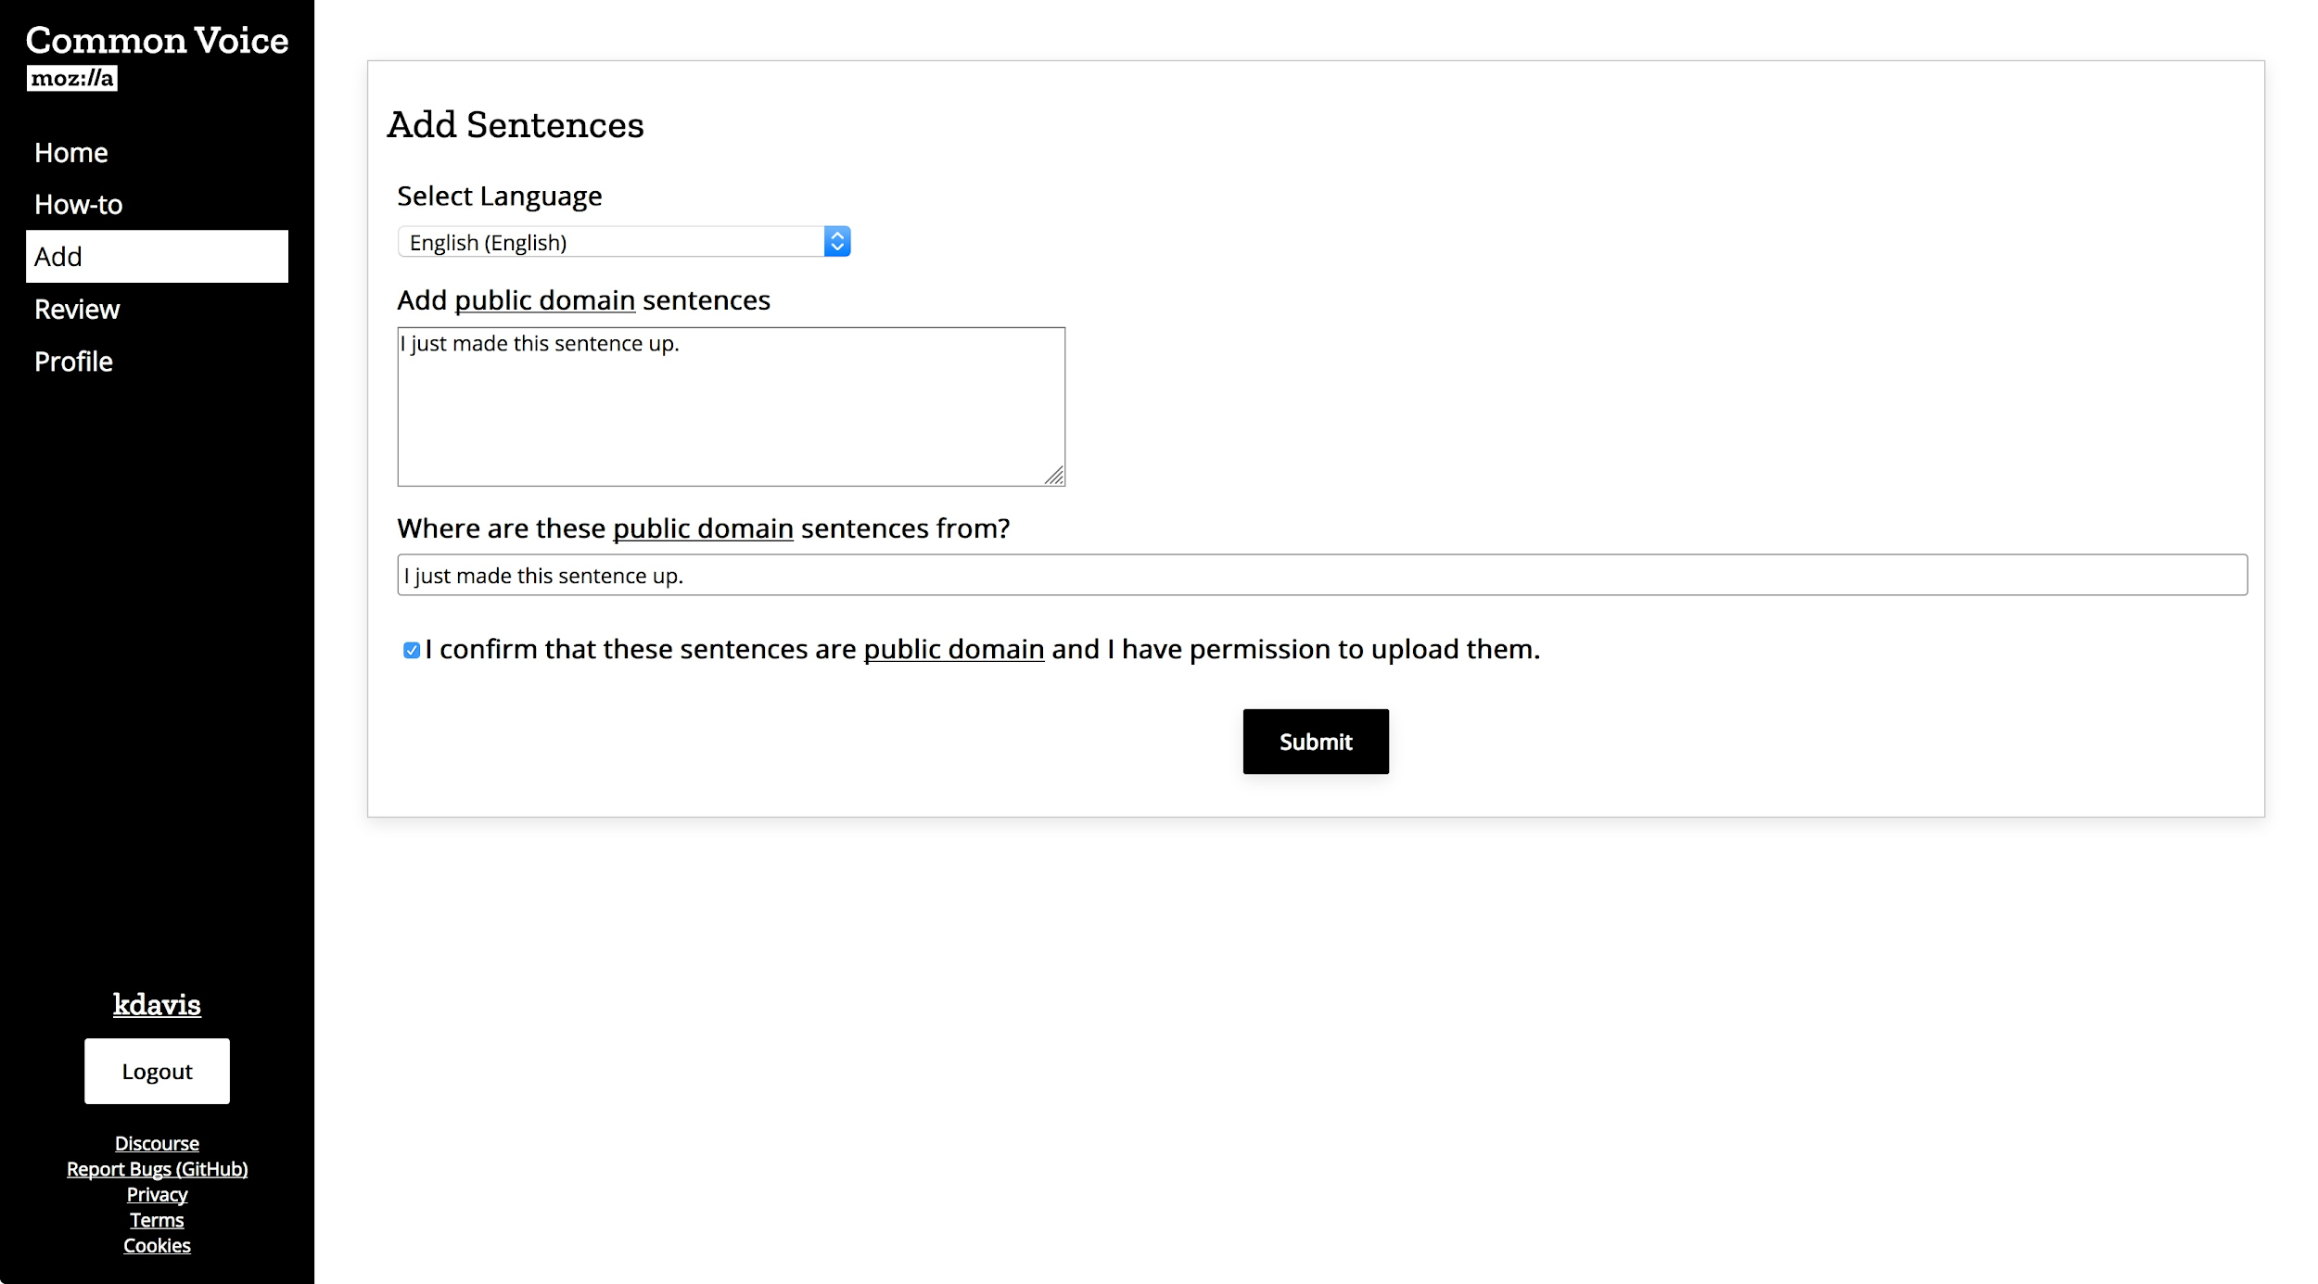
Sentence Collection: Add

Slide 35
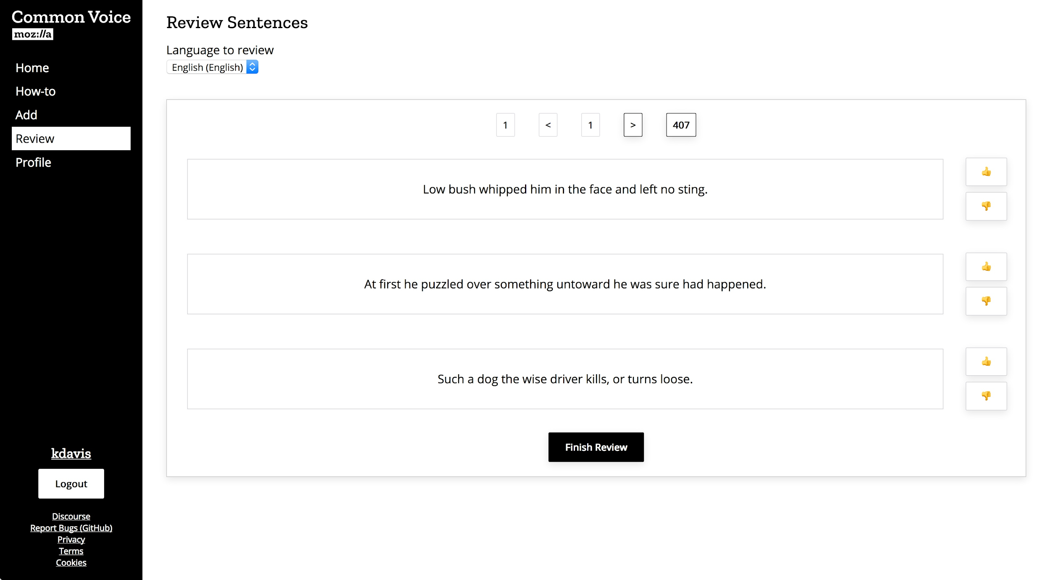
Sentence Collection: Review

Slide 36
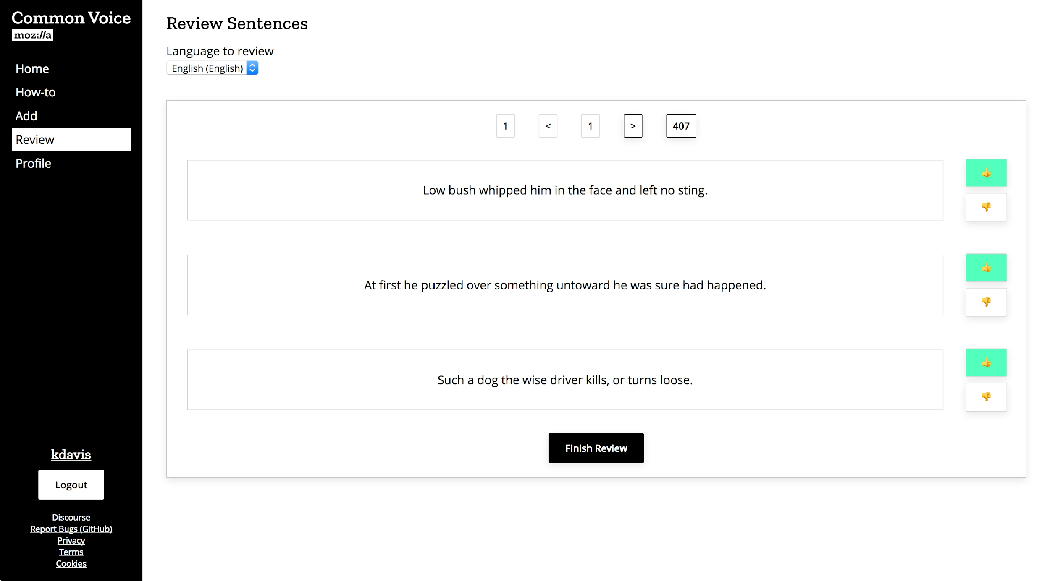
Sentence Collection: Review

Slide 37
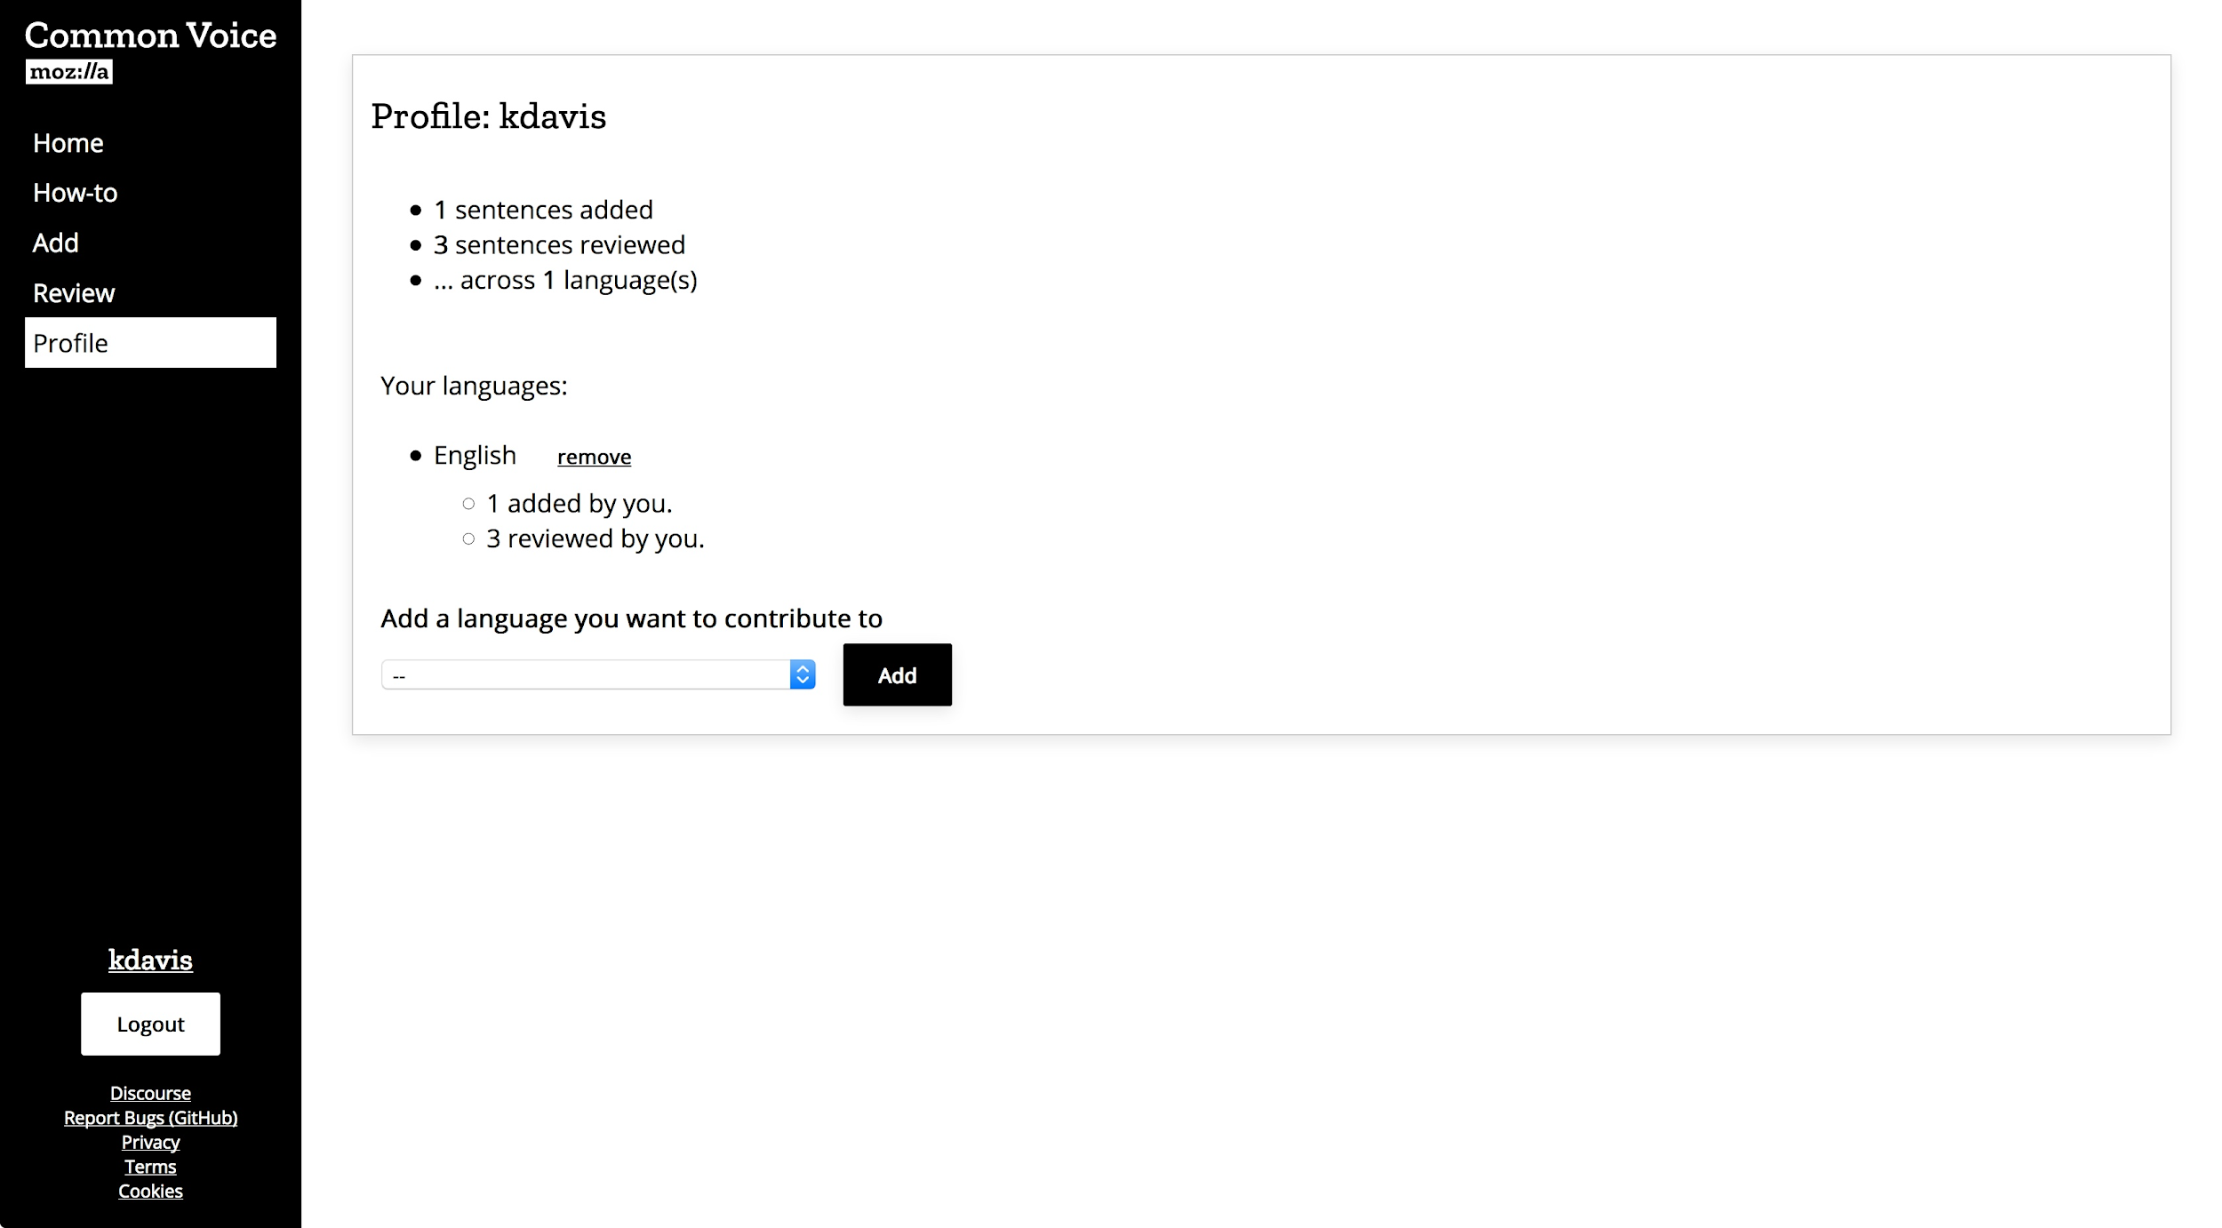
Sentence Collection: Profile

Slide 38
4 Future of Common Voice

Slide 39
4.1 Non-Corporate Partnerships

Slide 40


Non-Corporate Partnerships

Slide 41
4.2 Corporate Partnerships

Slide 42


Corporate Partnerships

Slide 43

Рахмат!

