Slide 1
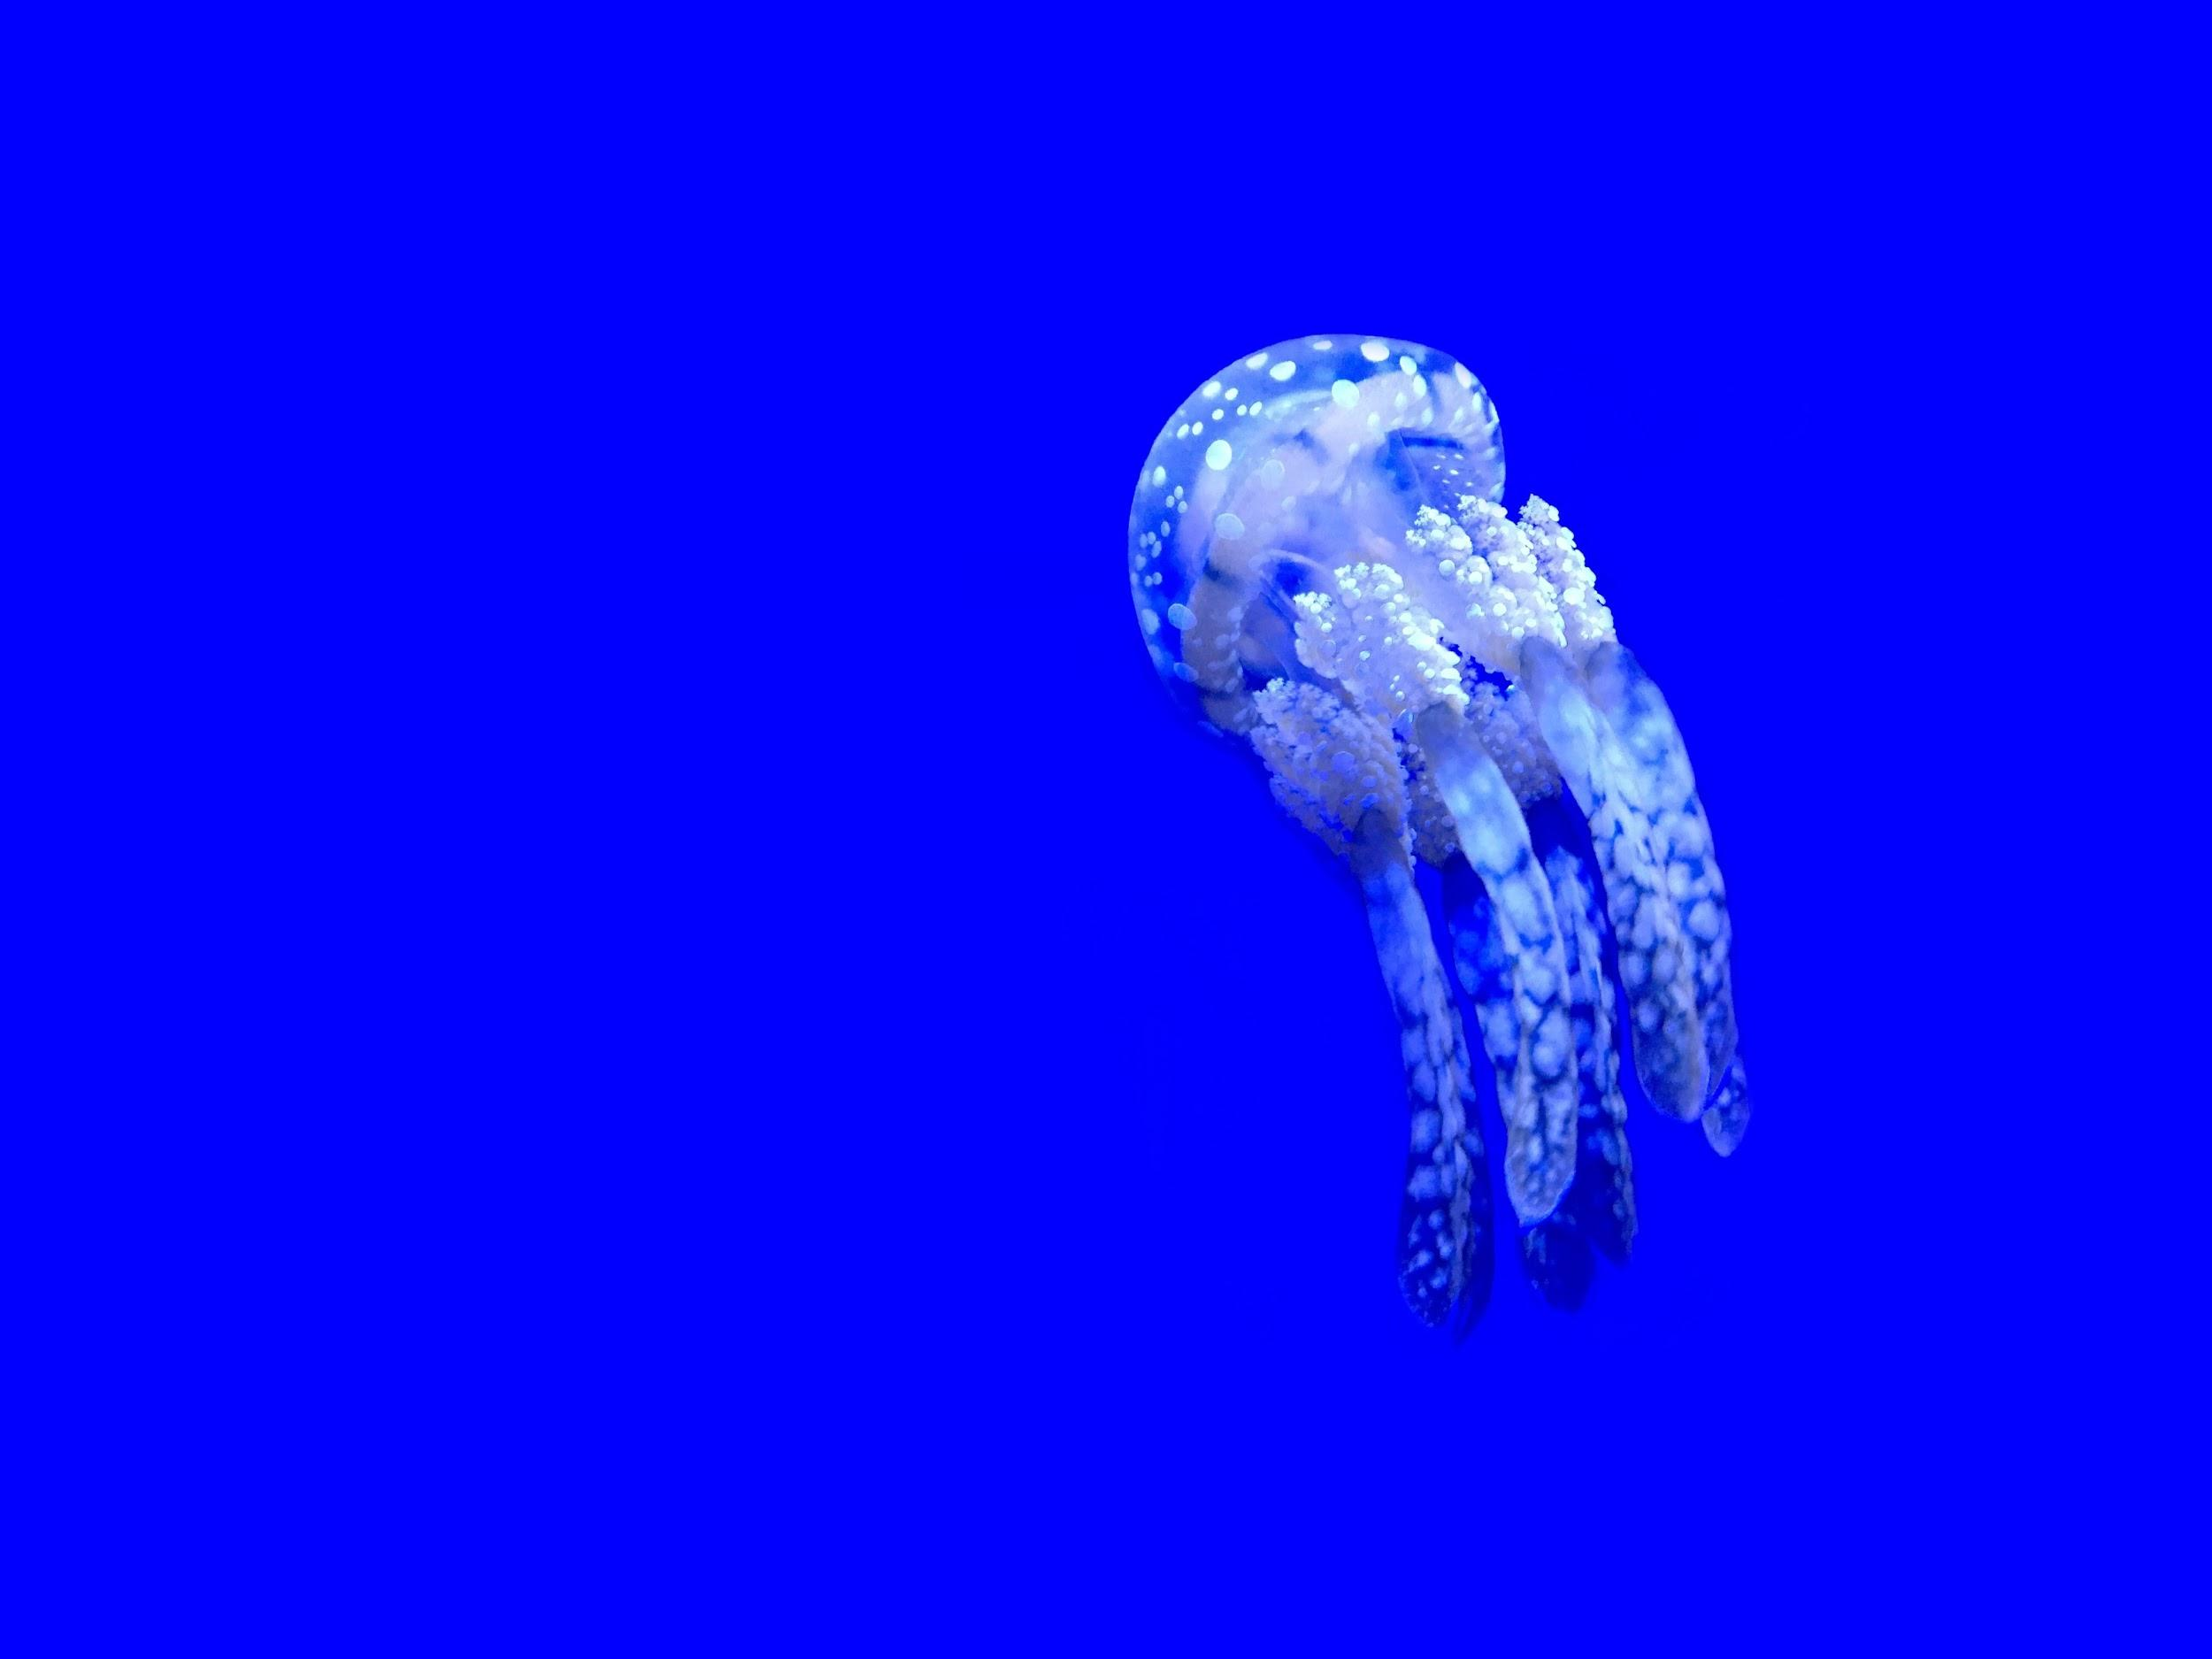
Mozilla’s Deep Speech

Slide 2

Outline
1 Intro
2 Deep Learning
3 Deep Speech
4 Future of Deep Speech

Slide 3
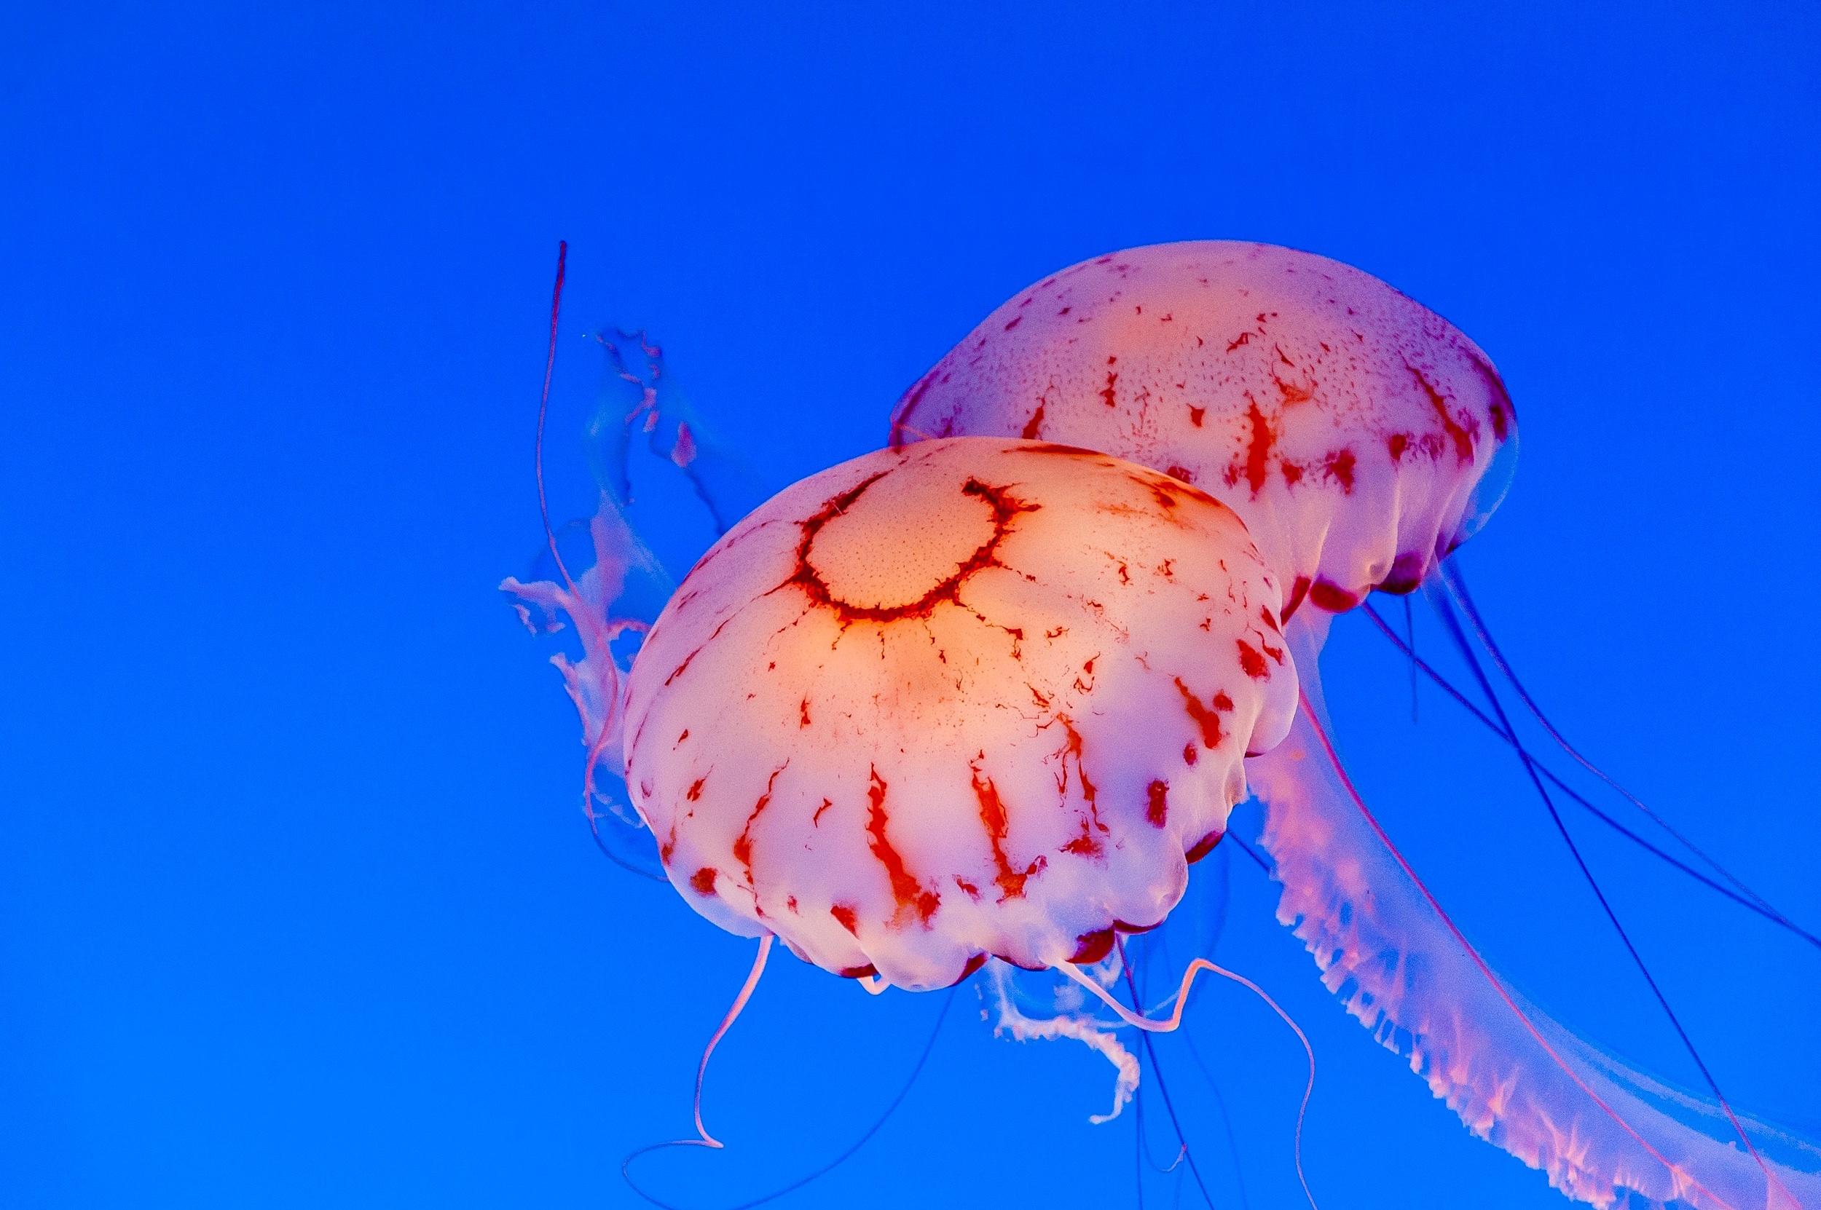
1 Intro

Slide 4

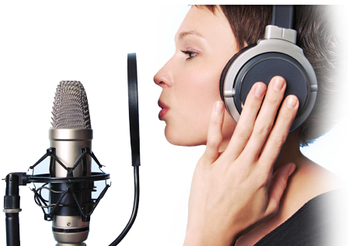
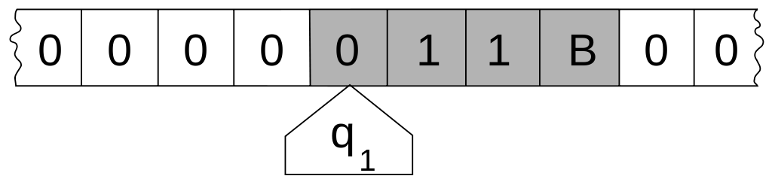
Intro: Speech-to-Text
"Mr. Watson, come here. I want to see you."
Computation
Speech
Text

Slide 5
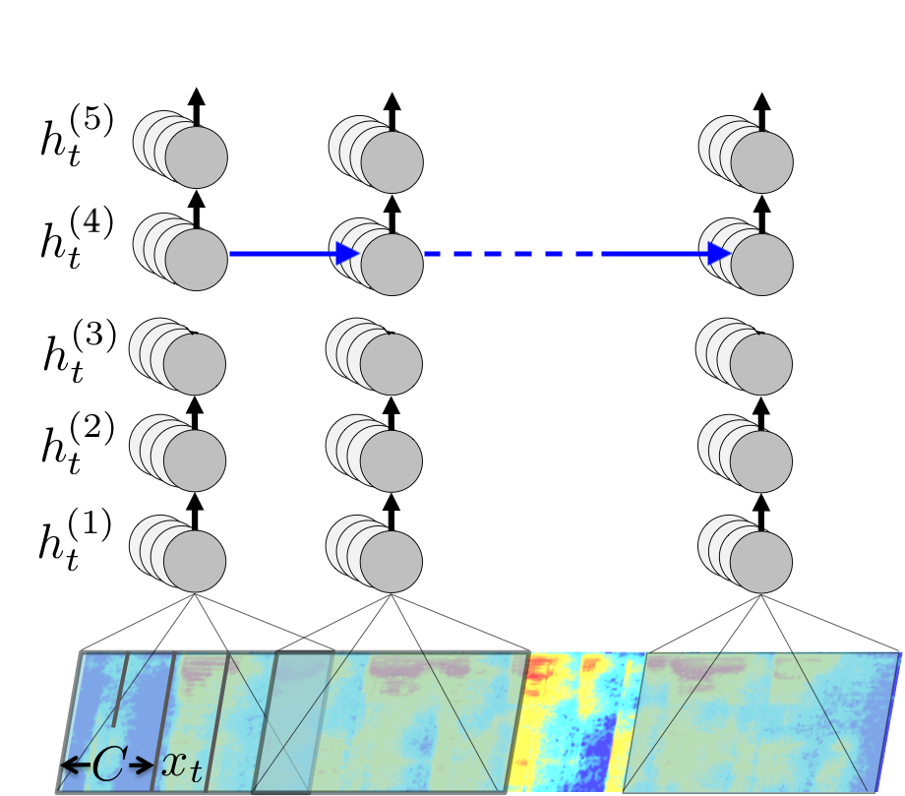
Intro: Deep Learning
Deep Learning

Slide 6

Intro: Speech-to-Text ∩ Deep Learning
Speech-to-Text
Deep Learning

Slide 7
2 Deep Learning

Slide 8

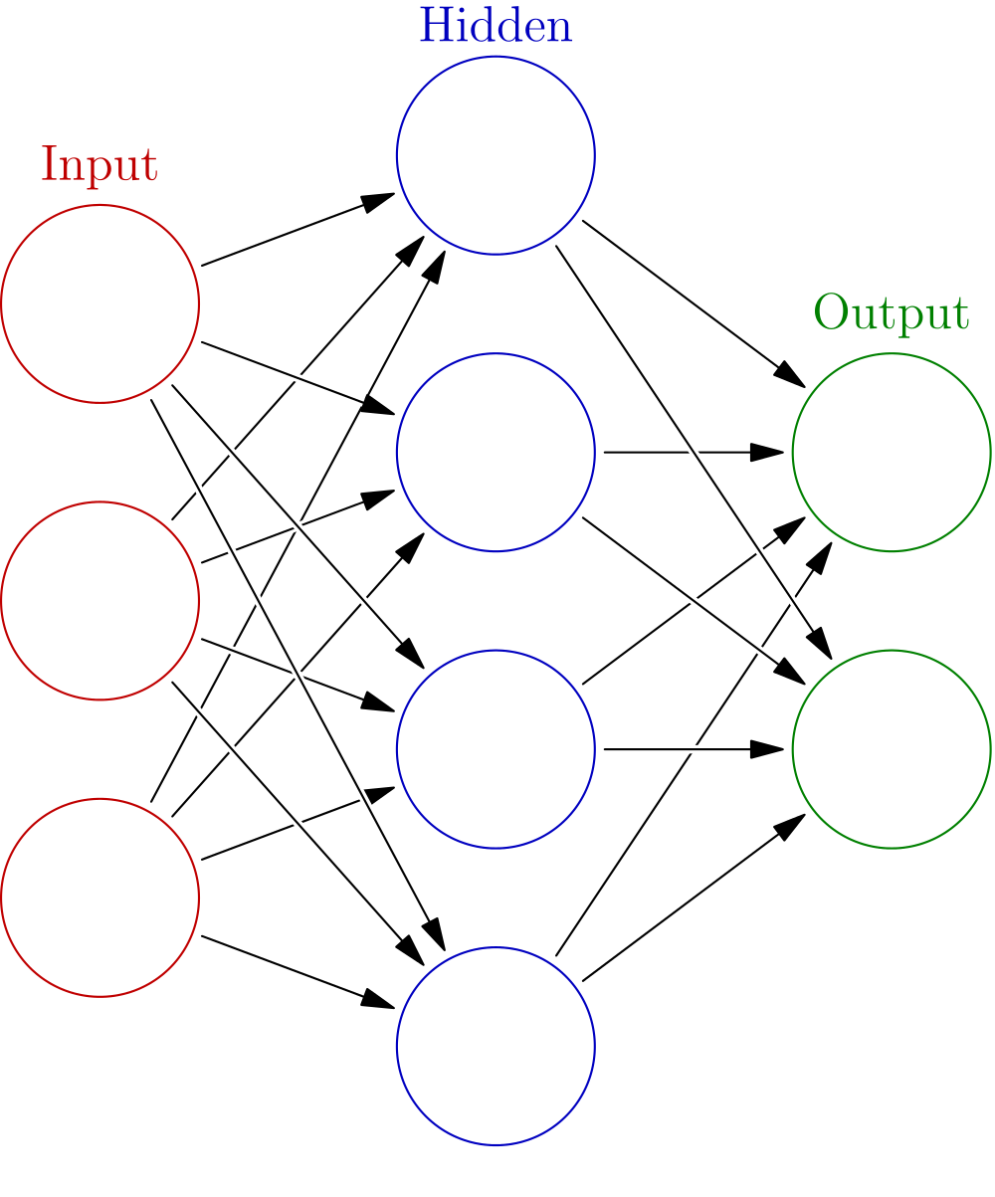
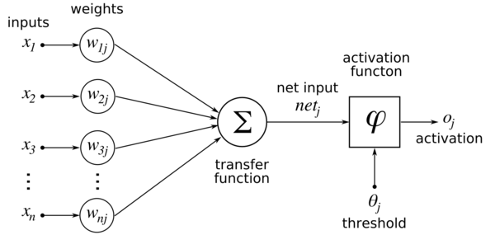
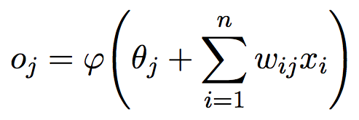
Deep Learning: Feed Forward Networks

Slide 9
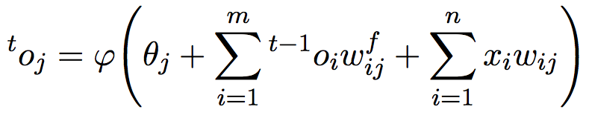
Deep Learning: Recurrent Neural Networks

Slide 10
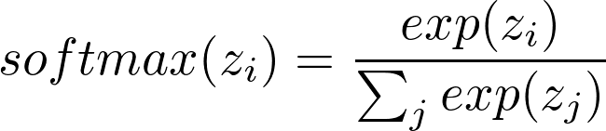
Deep Learning: Softmax

Slide 11
3 Deep Speech

Slide 12
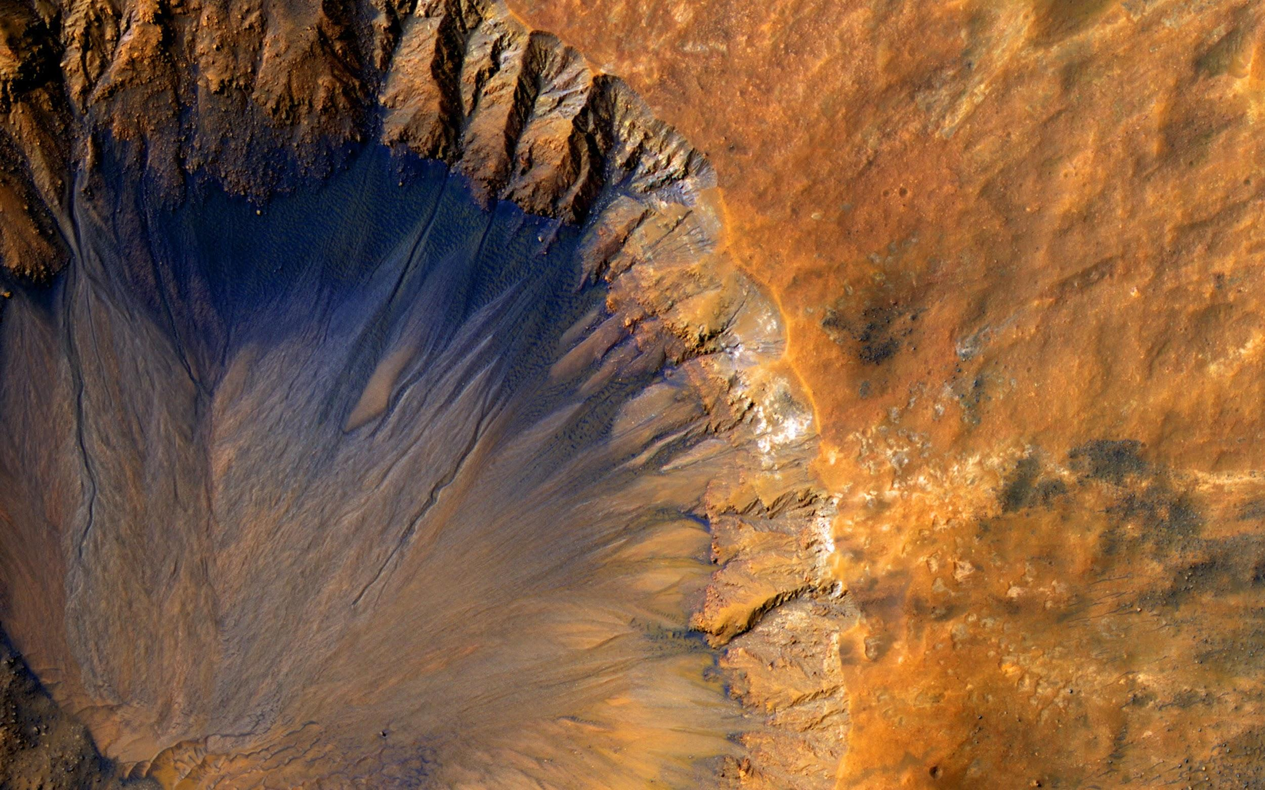
3.1 Deep Speech Architecture

Slide 13


Deep Speech Architecture: Overview
SoftMax
Softmax Layer
Feedforward Layer
Recurrent Layer
Feedforward Layers
Input Features

Slide 14
Deep Speech Architecture: Input Features
SoftMax
Mel-Frequency Cepstrum Coefficients
• 16 bit audio input at 16kHz
• 32ms audio window every 20ms
• 26 Cepstral Coefficients
• Context window width 9

Slide 15
Deep Speech Architecture: Feedforward Layers
SoftMax
Feedforward Layers
• 3 layers
• Layer width 2048
• RELU cells
• RELU clipped at 20
• Dropout 0.20 to 0.30

Slide 16
Deep Speech Architecture: Bidirectional RNN Layer
SoftMax
Recurrent Layer
• 1 layer
• Layer width 2048
• LSTM cells
• No clipping
• Dropout 0.20 to 0.30

Slide 17
Deep Speech Architecture: Feedforward Layer
SoftMax
Feedforward Layer
• 1 layer
• Layer width 2048
• RELU cells
• RELU clipped at 20
• Dropout 0.20 to 0.30

Slide 18
Deep Speech Architecture: Softmax Layer
SoftMax
Softmax Layer
• L ≡ Alphabet
• Output width k ≡ |L| + 1
• Extra for a “blank label”

Slide 19
3.2 Performance

Slide 20

Performance: WER
Training Data
• Fisher (2000 hours)
• Switchboard (240 hours)
• Librivox (1000 hours)
• Common Voice (600 hours)

Slide 21
Performance: WER
Training Data
• Fisher (2000 hours)
• Switchboard (240 hours)
• Librivox (1000 hours)
• Common Voice (600 hours)
On Librivox clean test 8.26% WER

Slide 22
Performance: WER
Human
5.8% WER
Training Data
• Fisher (2000 hours)
• Switchboard (240 hours)
• Librivox (1000 hours)
• Common Voice (600 hours)
On Librivox clean test 8.26% WER
Google
12.1% WER
¹Dernoncourt et. al, A Framework for Speech Recognition Benchmarking

Slide 23
4 Future of Deep Speech

Slide 24
4.1 UTF-8

Slide 25
UTF-8: Softmax Layer
SoftMax
Softmax Layer
• L ≡ 256
• Output width k ≡ |L| + 1
• Extra for a “blank label”

Slide 26
4.2 Non-English Languages

Slide 27
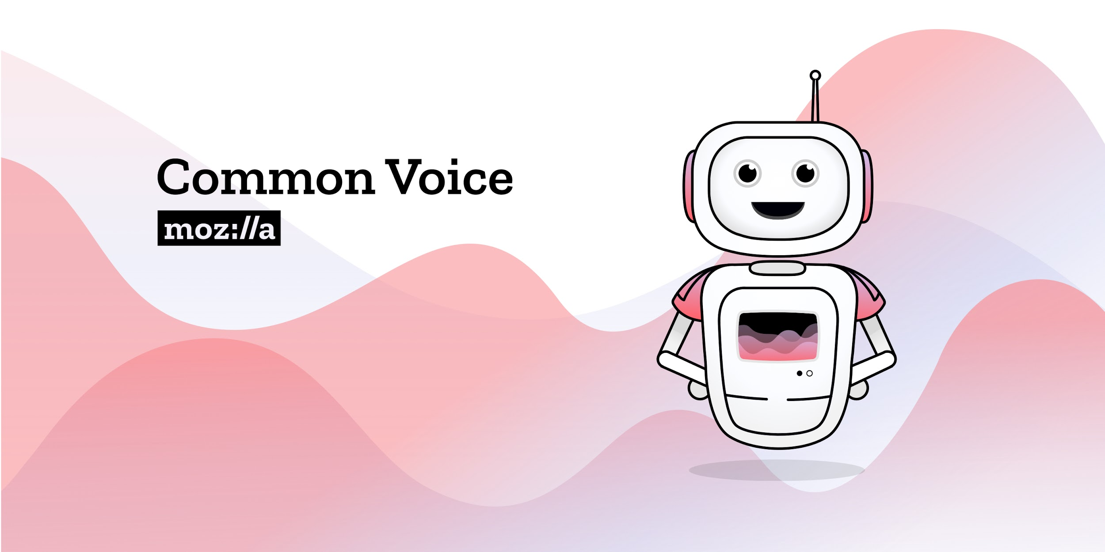
Non-English Languages: Common Voice

Slide 28
4.3 Small Platform Devices

Slide 29
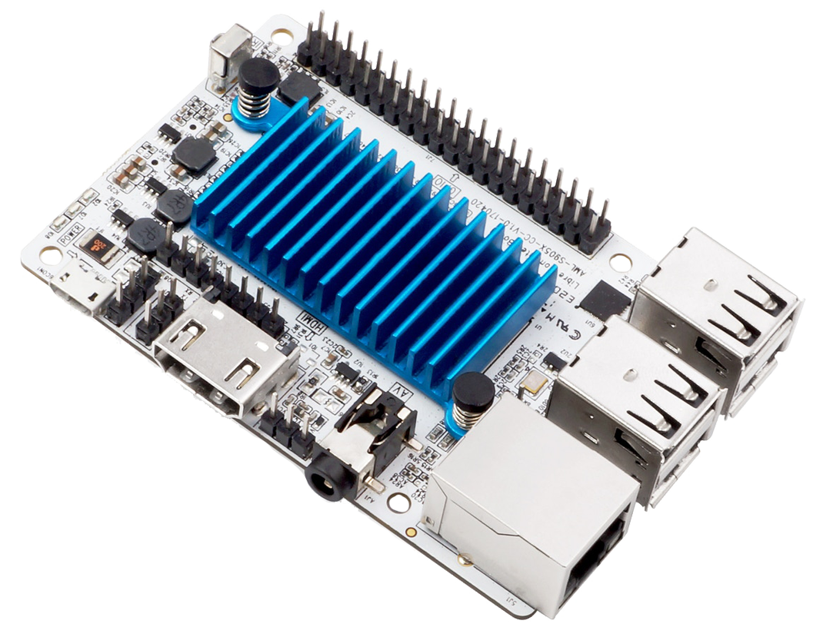
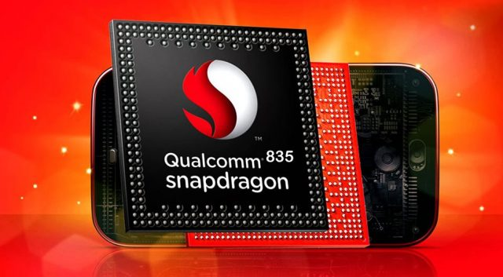
Small Platform Devices
Snapdragon 835
Le Potato

Slide 30
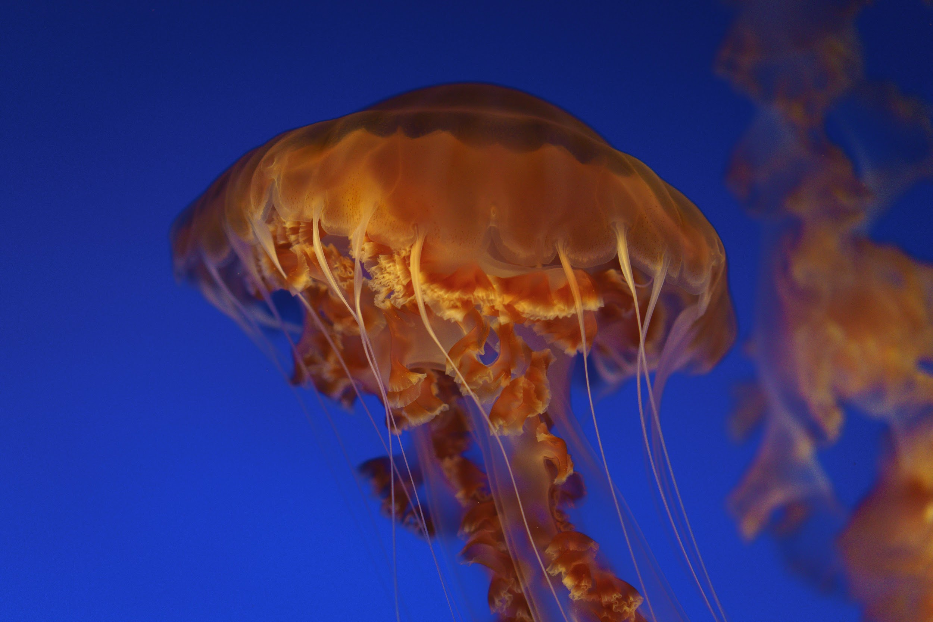
Рахмат!

