Slide 1
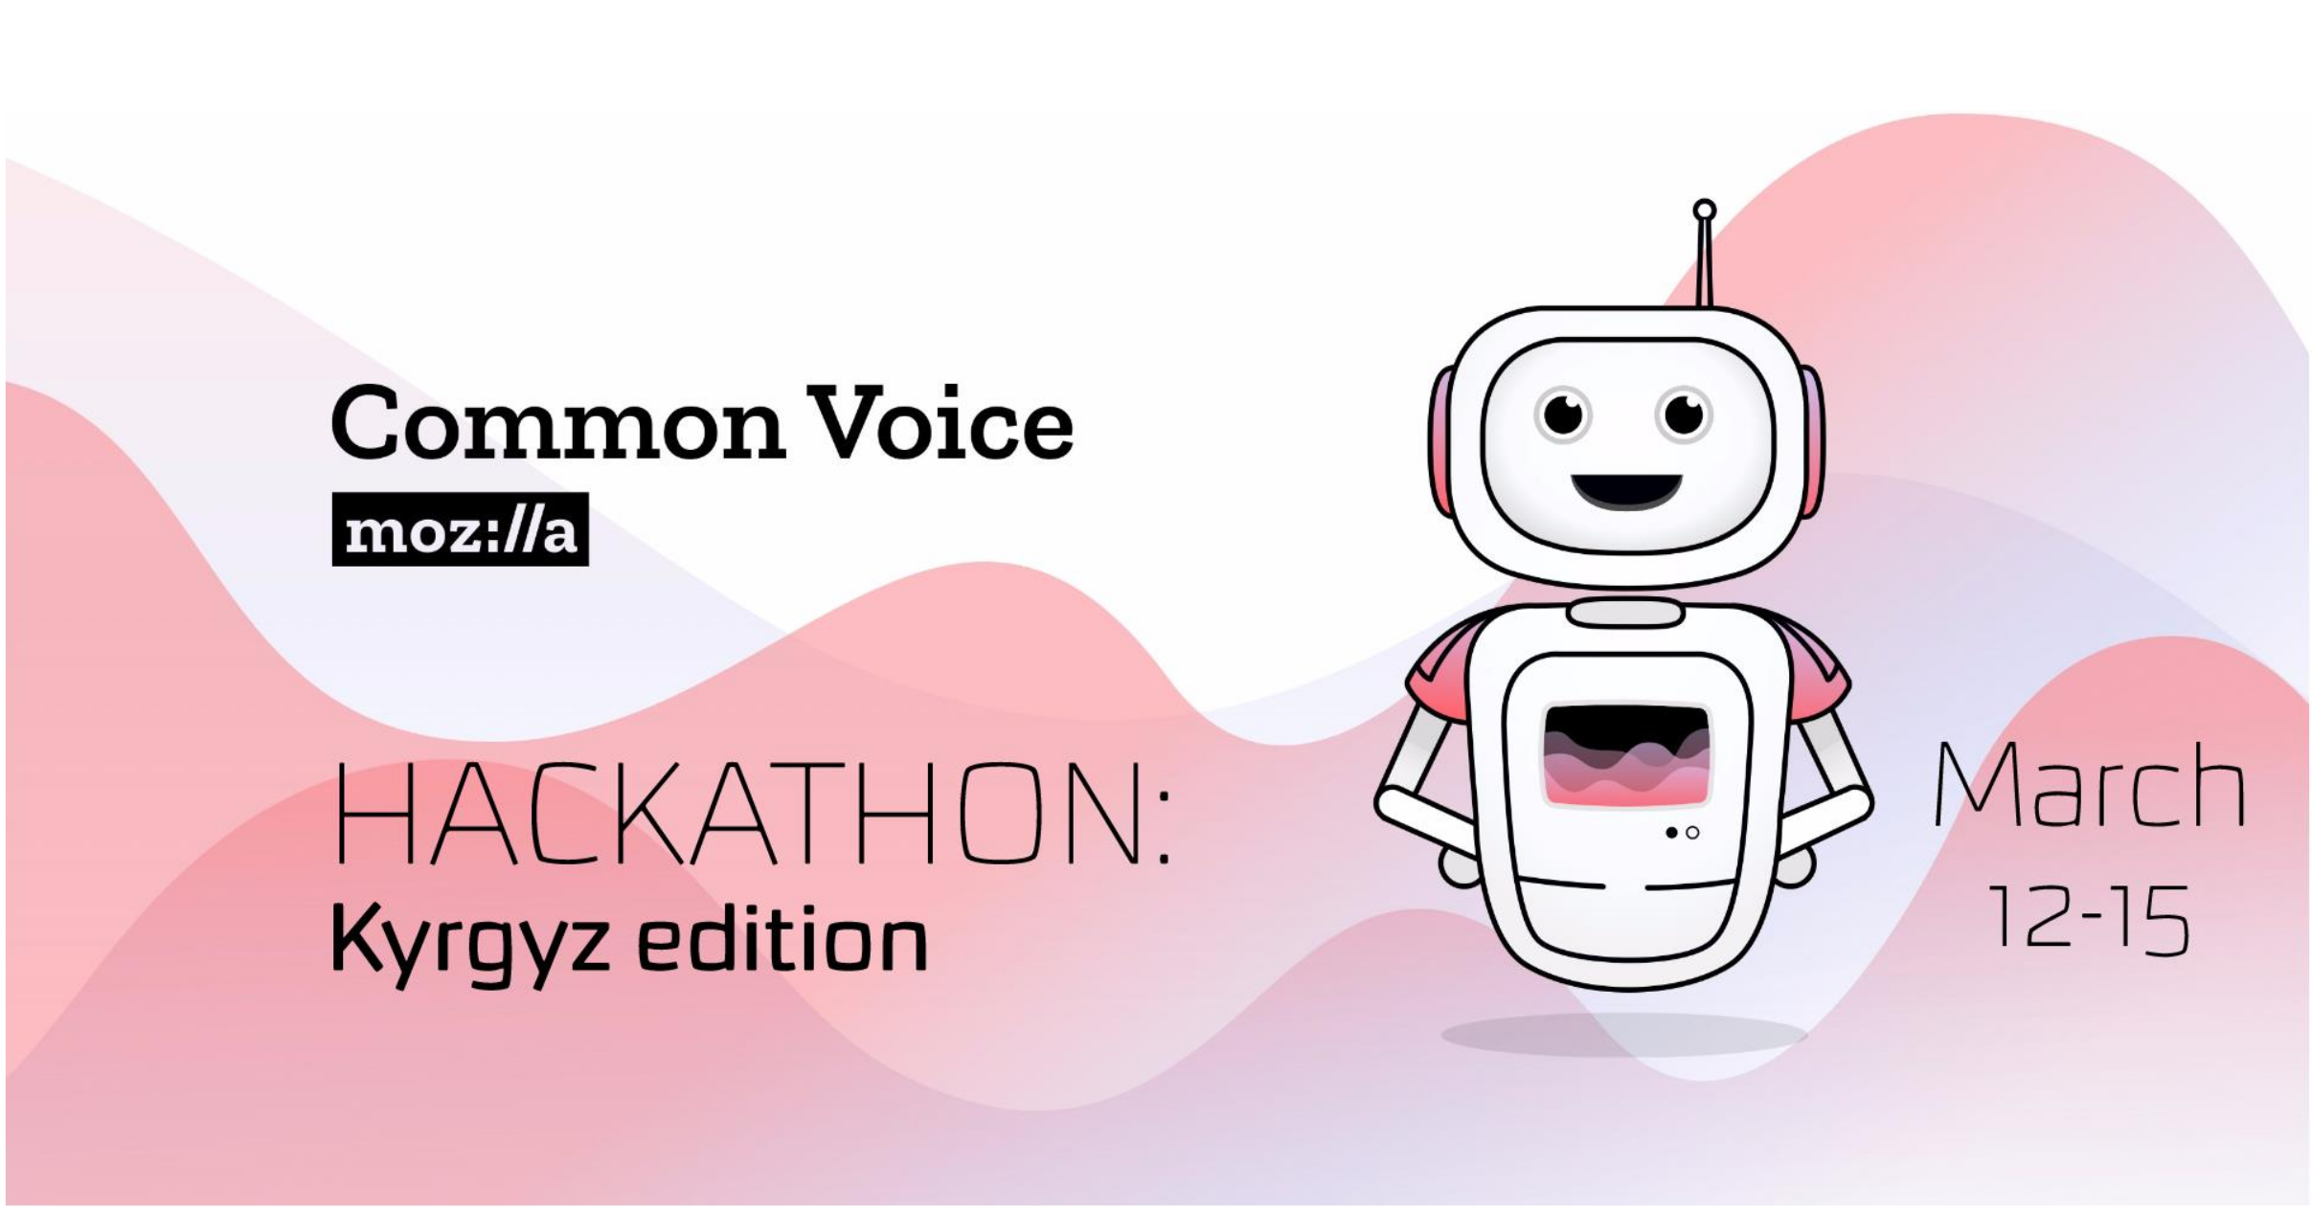

A gentle introduction
to Mozilla’s DeepSpeech

Slide 2
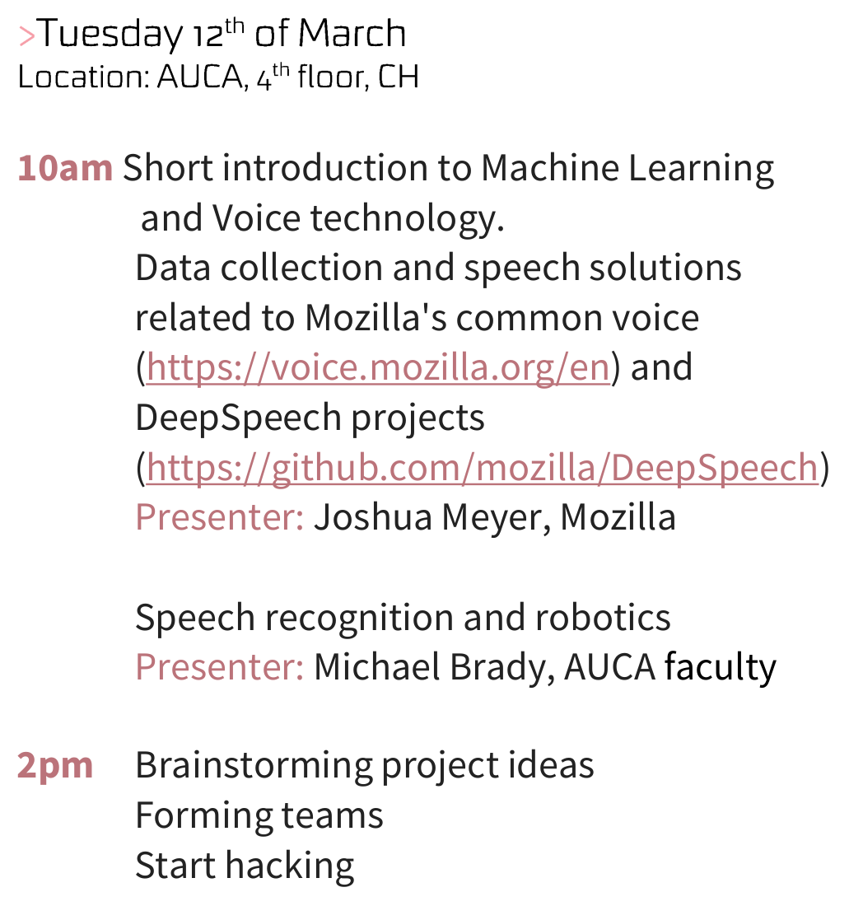

Slide 3
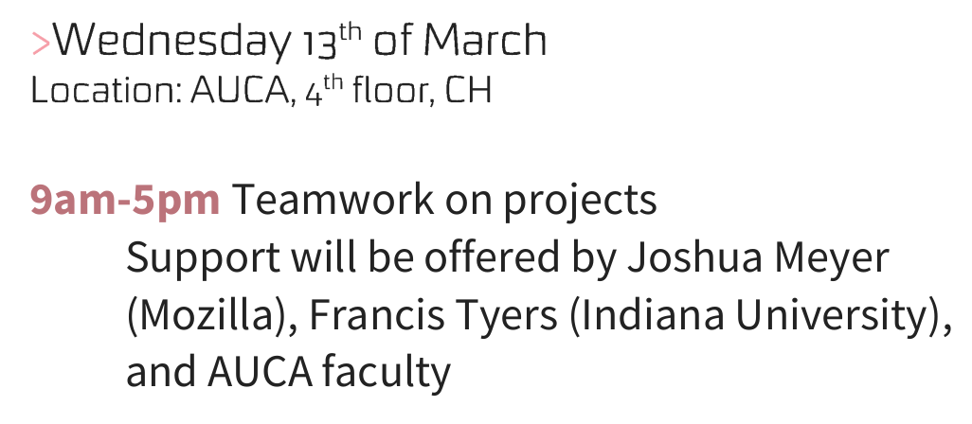

Slide 4
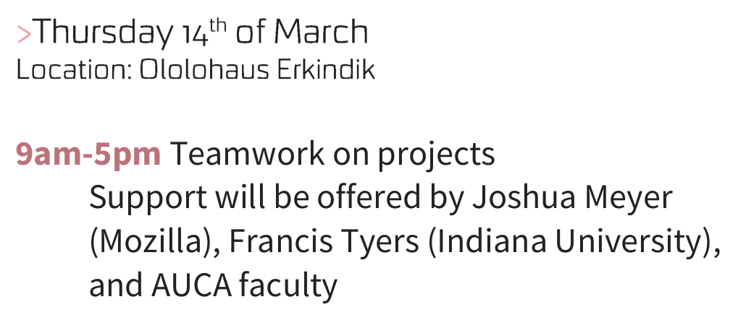

Slide 5
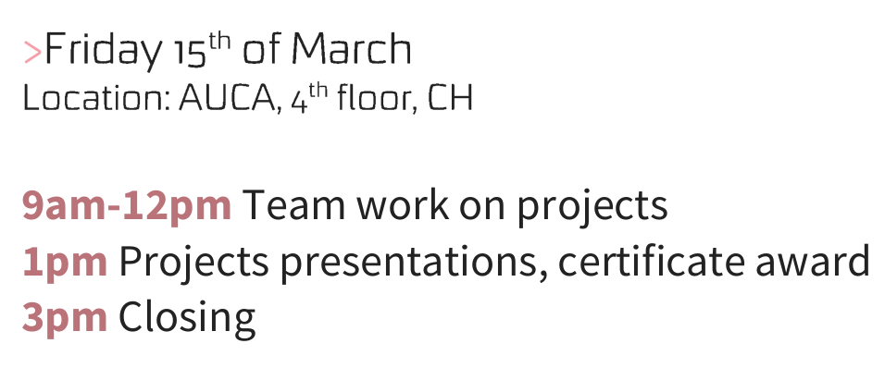

Slide 6
Code of Conduct
www.github.com/JRMeyer/kyrgyz-voice-hackathon/blob/master/CODE_OF_CONDUCT.md

Slide 7
Code of Conduct
We take this
*very* seriously

Slide 8

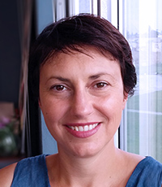
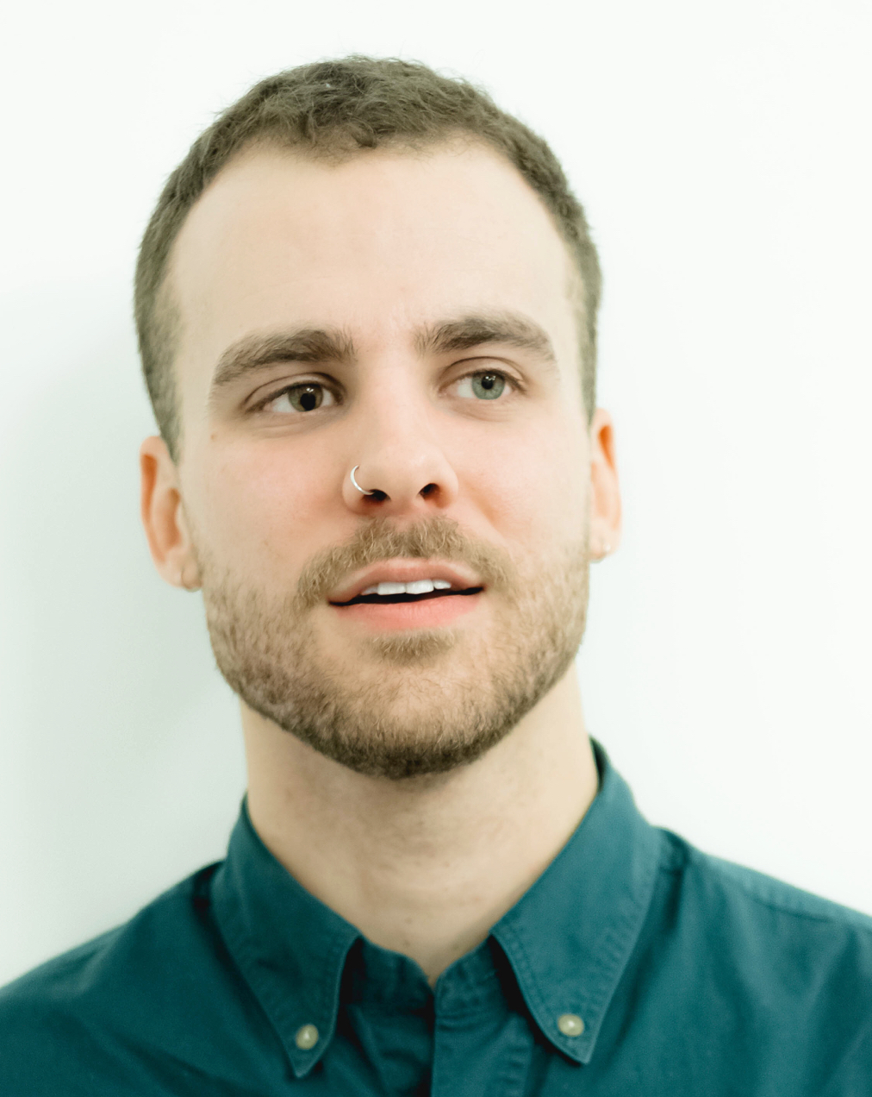
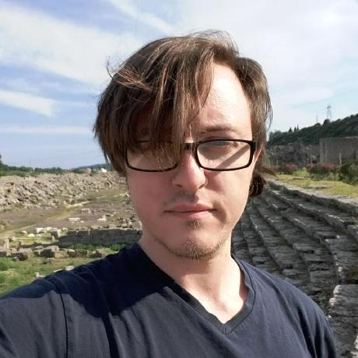
Josh Meyer, MA
NSF Research Intern
Mozilla Machine Learning Group
&
PhD Candidate
University of Arizona
who are we?
Dr. Angie Popova, PhD
Director
AUCA Center for
Teaching, Learning,
And Technology
Dr. Fran Tyers, PhD
Assistant Professor
Computational Linguistics
Indiana University
Bloomington

Slide 9
Josh
Can cook
Cactus tacos
who are we?
Angie
Is a
long-distance
bicyclist
Fran
Sang in a
Norwegian
Choir

Slide 10
who are you?
why are you here?

Slide 11
Prizes?
Yes:)

Slide 12
Thanks for your attention:)
Рахмат)))

