Slide 1
Automatic Speech Recognition:
A gentle introduction
to Mozilla’s DeepSpeech
Josh Meyer + Fran Tyers
@_josh_meyer_ + @ezesanlasai

Slide 2
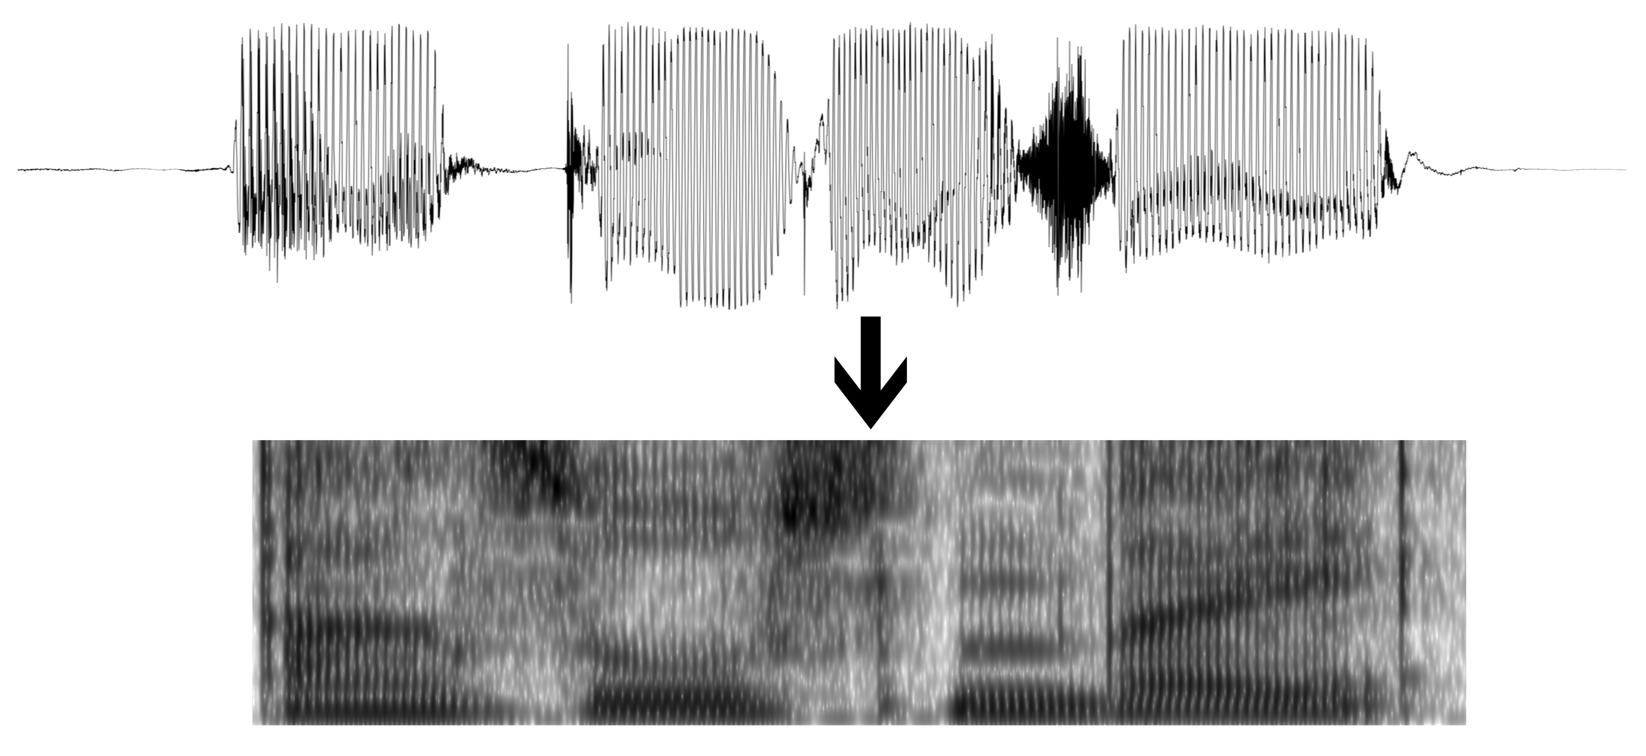



T th uh d ah g
The dog

Slide 3
T th uh d ah g
“The dog”
DATA
MODEL

Slide 4
T t h e d o g
The dog

Slide 5
FEATURE EXTRACTION
- Sliding window feature extraction
GMM MONOPHONE TRAINING
GMM TRIPHONE TRAINING
DNN TRAINING
DECODING

Slide 6
FEATURE EXTRACTION
- Sliding window feature extraction
GMM MONOPHONE TRAINING
GMM TRIPHONE TRAINING
DNN TRAINING
DECODING
* a feature is measurable characteristic of the data
(e.g. loudness of a certain frequency )

Slide 7
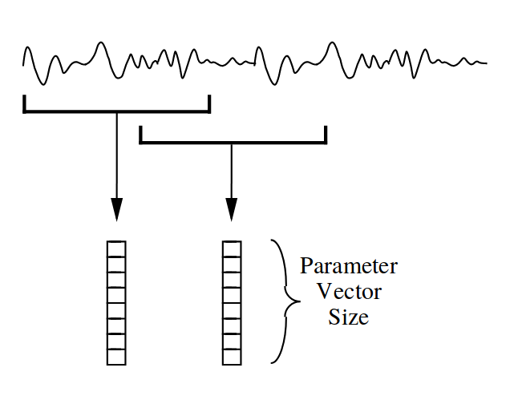
FEATURE EXTRACTION
- Sliding window feature extraction
GMM MONOPHONE TRAINING
GMM TRIPHONE TRAINING
DNN TRAINING
DECODING
←Feature Vector
Figure credit
HTK Book

Slide 8
FEATURE EXTRACTION
- Sliding window feature extraction
GMM MONOPHONE TRAINING
GMM TRIPHONE TRAINING
DNN TRAINING
DECODING
←Feature Vector
* the sliding window will make overlapping audio snapshots at a moment in time
Figure credit
HTK Book

Slide 9
FEATURE EXTRACTION
- Sliding window feature extraction
GMM MONOPHONE TRAINING
GMM TRIPHONE TRAINING
DNN TRAINING
DECODING
Figure credit
HTK Book

Slide 10
FEATURE EXTRACTION
- Sliding window feature extraction
GMM MONOPHONE TRAINING
GMM TRIPHONE TRAINING
DNN TRAINING
DECODING
[d]
Figure credit
HTK Book

Slide 11
FEATURE EXTRACTION
- Sliding window feature extraction
GMM MONOPHONE TRAINING
GMM TRIPHONE TRAINING
DNN TRAINING
DECODING
[d]
INPUT OUTPUT
Figure credit
HTK Book

Slide 12
FEATURE EXTRACTION
- Sliding window feature extraction
GMM MONOPHONE TRAINING
GMM TRIPHONE TRAINING
DNN TRAINING
DECODING
PREDICTION
[d]
INPUT OUTPUT
Figure credit
HTK Book

Slide 13

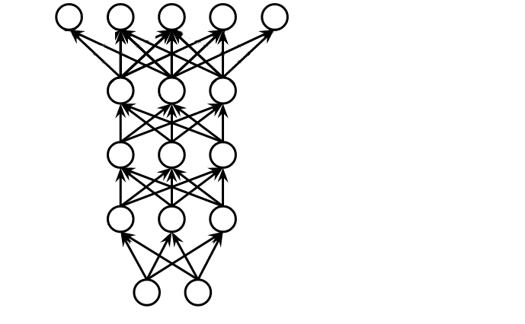
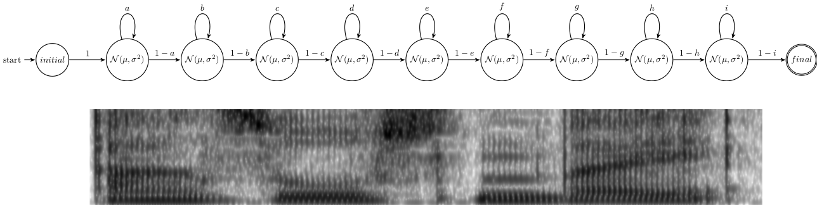
DeepSpeech TRAINING
- Labeled Data
- Parameter Search
FEATURE EXTRACTION
- Sliding window feature extraction
GMM MONOPHONE TRAINING
- Flat-start
- Baum-Welch re-estimation
GMM TRIPHONE TRAINING
- Phonetic decisi/home/josh/git/thesis/figs/tree-net.pngon tree
DECODING
[d]
Figure credit
Heigold 2013

Slide 14
DeepSpeech TRAINING
- Labeled Data
- Parameter Search
FEATURE EXTRACTION
- Sliding window feature extraction
GMM MONOPHONE TRAINING
- Flat-start
- Baum-Welch re-estimation
GMM TRIPHONE TRAINING
- Phonetic decisi/home/josh/git/thesis/figs/tree-net.pngon tree
- Baum-Welch re-estimation
DECODING
[d]
* parameters are the connection weights
Figure credit
Heigold 2013

Slide 15
DeepSpeech TRAINING
- Labeled Data
- Parameter Search
FEATURE EXTRACTION
- Sliding window feature extraction
GMM MONOPHONE TRAINING
- Flat-start
- Baum-Welch re-estimation
GMM TRIPHONE TRAINING
- Phonetic decisi/home/josh/git/thesis/figs/tree-net.pngon tree
DECODING
[d]
* search is finding best connection
weights for the given data
Figure credit
Heigold 2013

Slide 16
DeepSpeech TRAINING
- Labeled Data
- Iterative Parameter Search
FEATURE EXTRACTION
- Sliding window feature extraction
GMM MONOPHONE TRAINING
- Flat-start
- Baum-Welch re-estimation
GMM TRIPHONE TRAINING
- Phonetic decisi/home/josh/git/thesis/figs/tree-net.pngon tree
DECODING
[d]
* we will iterate over the data, updating
parameters incrementally
Figure credit
Heigold 2013

Slide 17
DeepSpeech TRAINING
- Labeled Data
- Good Parameter Search
FEATURE EXTRACTION
- Sliding window feature extraction
GMM MONOPHONE TRAINING
- Flat-start
- Baum-Welch re-estimation
GMM TRIPHONE TRAINING
- Phonetic decisi/home/josh/git/thesis/figs/tree-net.pngon tree
DECODING
[d]
* good parameters will maximize
the probability of predicting letters
found in unseen data
Figure credit
Heigold 2013

Slide 18
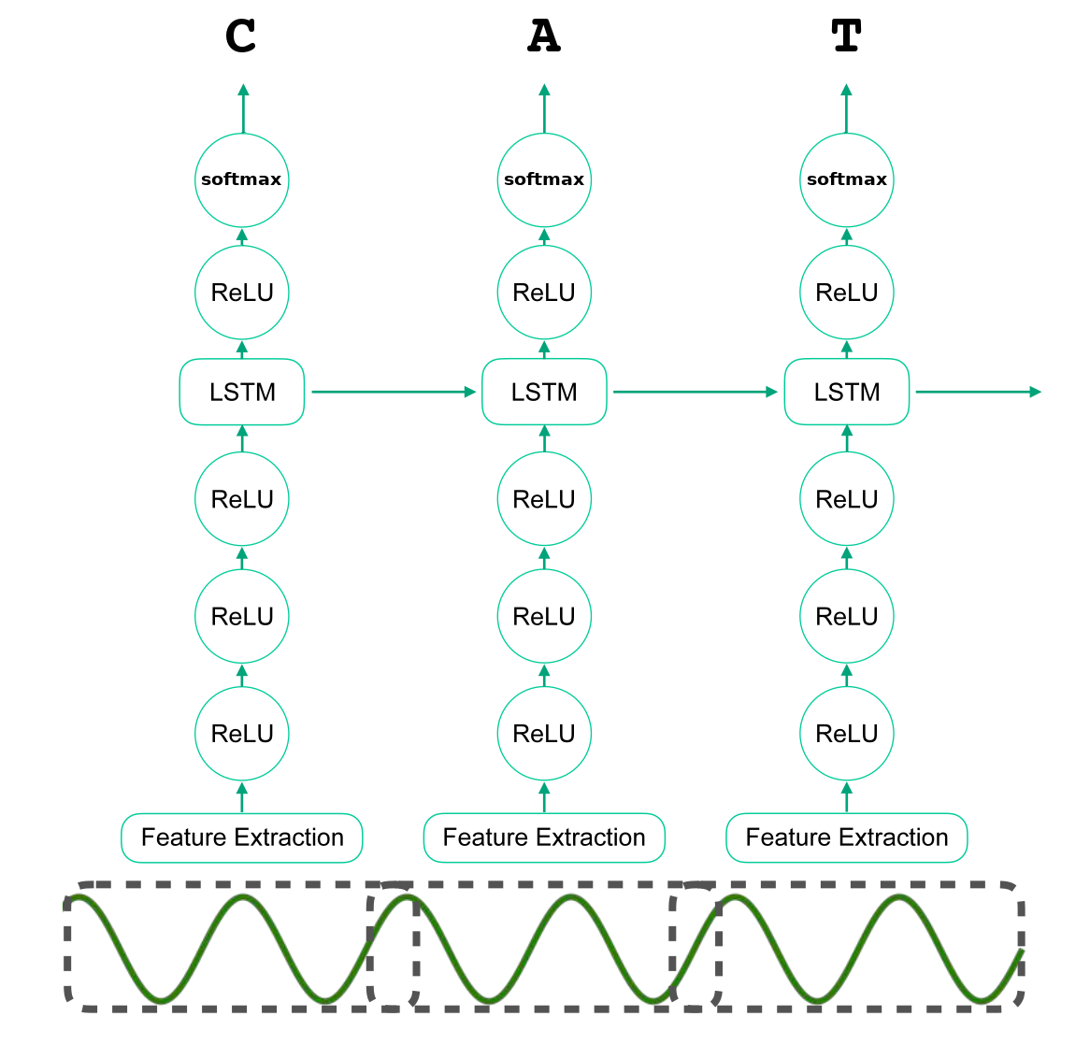
For more information* on DeepSpeech architecture...
FEATURE EXTRACTION
- Sliding window feature extraction
GMM MONOPHONE TRAINING
- Flat-start
- Baum-Welch re-estimation
GMM TRIPHONE TRAINING
- Phonetic decisi/home/josh/git/thesis/figs/tree-net.pngon tree
- Baum-Welch re-estimation
DECODING
* check out Reuben’s blog post
<URL>

Slide 19
Thanks for your attention:)
Рахмат)))

