Slide 1
Text-to-Speech:
A gentle introduction
Josh Meyer + Fran Tyers
@_josh_meyer_ + @ezesanlasai

Slide 2



Slide 3
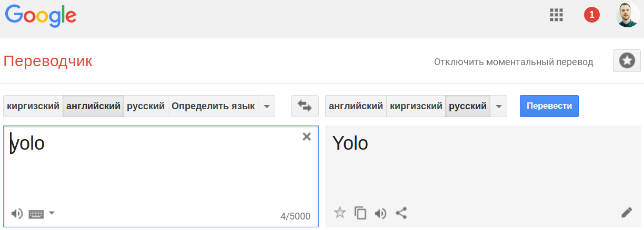

Slide 4


Slide 5
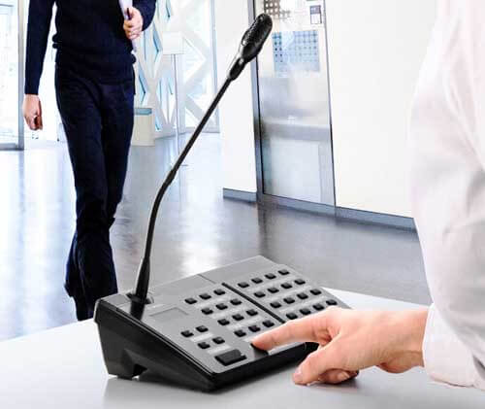
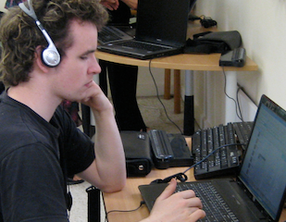

Slide 6



Moscow always has traffic jams.

Slide 7
RAW TEXT
RAW AUDIO
Moscow always has traffic jams.

Slide 8
RAW TEXT
SPEECH
SYNTHESIZER
RAW AUDIO
Moscow always has traffic jams.

Slide 9
Moscow always has traffic jams.

Slide 10
Moscow always has traffic jams.
HARD

Slide 11

Moscow always has traffic jams.
HARD

Slide 12
Moscow always has traffic jams.
EASIER

Slide 13
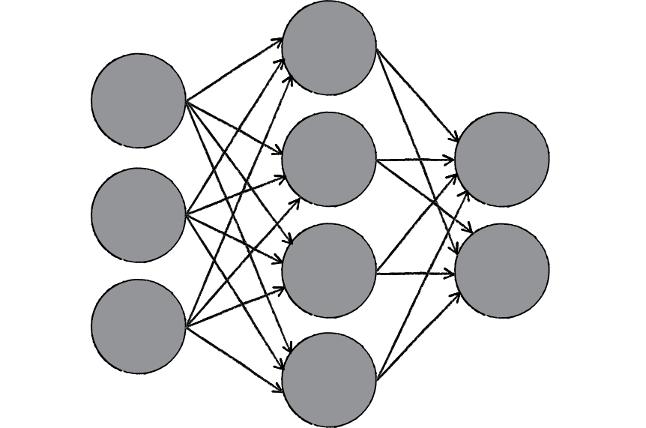
Moscow always has traffic jams.
Neural Networks

Slide 14
Moscow always has traffic jams.

Slide 15
[ 0 0 0 0 0 0 0 0 0 0 0 1 0 0 0 0 0 0 0 0 0 0 0 ]
[ 6 0 1 0 9 0 0 5 0 0 3 3 0 0 8 ]
Moscow always has traffic jams.

Slide 16
TEXT
FEATURE
EXTRACTION
AUDIO
FEATURE
EXTRACTION
[ 0 0 0 0 0 0 0 0 0 0 0 1 0 0 0 0 0 0 0 0 0 0 0 ]
[ 6 0 1 0 9 0 0 5 0 0 3 3 0 0 8 ]
Moscow always has traffic jams.

Slide 17
INPUT OUTPUT
[ 0 0 0 0 0 0 0 0 0 0 0 1 0 0 0 0 0 0 0 0 0 0 0 ]
[ 6 0 1 0 9 0 0 5 0 0 3 3 0 0 8 ]
Moscow always has traffic jams.

Slide 18
Text Feature Extraction

Slide 19
Moscow always has traffic jams.

Slide 20
Moscow always has traffic jams .
WORDS
Moscow always has traffic jams.

Slide 21
M o s c o w a l w a y s h a s t r a f f i c j a m s .
LETTERS
Moscow always has traffic jams.

Slide 22
[ 0 0 0 0 0 0 0 0 0 0 0 1 0 0 0 0 0 0 0 0 0 0 0 ]

Slide 23
[ 0 0 0 0 0 0 0 0 0 0 0 1 0 0 0 0 0 0 0 0 0 0 0 ]

Slide 24
[ 0 0 0 0 0 0 0 0 0 0 0 1 0 0 0 0 0 0 0 0 0 0 0 ]

Slide 25
Audio Feature Extraction

Slide 27
↑
dB
↓
← time →

Slide 28
↑
dB
↓
↑
Hz
↓
dB
↓
← time →

Slide 29
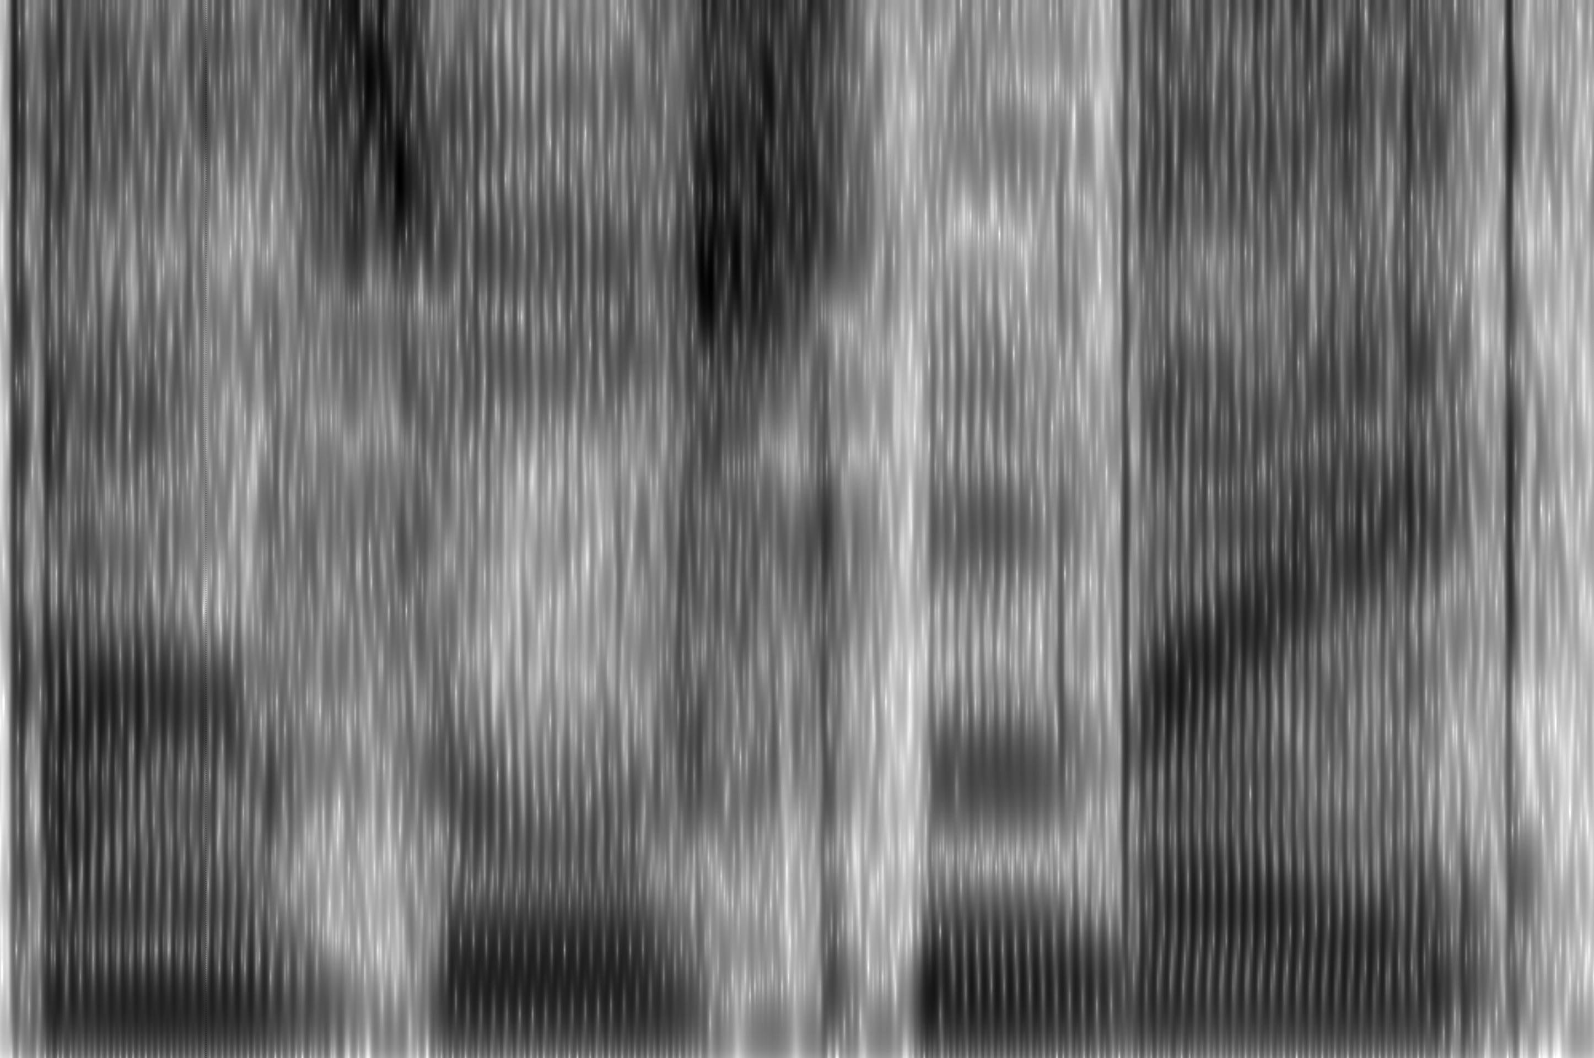
↑
dB
↓
↑
Hz
↓
dB
↓
← time →

Slide 31
[ 6 0 1 0 9 0 0 5 0 0 3 3 0 0 8 ]
Audio Features
Fixed Window of Audio Frames

Slide 32
REGRESSION

Slide 33
REGRESSION
1) LABELED DATA

Slide 34
Moscow always has traffic jams.

Slide 35
Moscow always has traffic jams.

Slide 36
Moscow always has traffic jams.

Slide 37
Moscow always has traffic jams.

Slide 38
Moscow always has traffic jams.

Slide 39
Moscow always has traffic jams.

Slide 40
Moscow always has traffic jams.

Slide 41
Moscow always has traffic jams.

Slide 42
[ 0 0 1 0 0 0 0 1 0 0 0 0 0 0 0 ]
[ 0 0 2 0 0 0 3 0 0 0 7 0 0 0 2 ]
[ 3 0 1 0 0 0 0 0 0 0 0 0 9 0 0 ]
[ 0 0 5 0 9 0 0 1 0 0 0 4 0 0 0 ]
[ 6 0 1 0 0 0 0 1 0 0 0 0 0 0 8 ]
[ 0 0 2 0 0 0 3 0 0 9 0 0 0 0 0 ]
[ 0 0 1 0 0 0 0 0 0 0 0 0 1 0 0 ]
[ 0 3 0 0 0 0 0 1 0 0 7 0 0 0 2 ]
[ 3 0 1 0 0 0 0 9 0 0 0 0 0 0 0 ]
[ 0 0 5 0 9 0 4 0 0 0 0 4 0 0 0 ]
[ 6 0 1 0 0 0 0 0 0 0 0 0 0 0 8 ]
[ 0 0 2 0 0 0 3 0 0 9 0 0 0 0 0 ]
[ 0 0 0 0 0 0 0 1 0 0 0 0 0 0 0 ]
[ 0 0 2 0 0 0 0 1 0 0 7 0 0 0 2 ]
[ 3 0 1 0 0 0 0 9 0 0 0 0 0 0 0 ]
[ 0 0 5 0 9 0 4 1 0 0 0 4 0 0 0 ]
[ 6 0 1 0 0 0 0 1 0 0 0 0 0 0 8 ]
[ 0 0 2 0 0 0 0 1 0 0 0 0 0 0 0 ]
[ 0 0 0 0 0 0 0 1 0 0 0 0 0 0 0 ]
[ 0 3 0 0 0 0 0 1 0 0 7 0 0 0 2 ]
[ 3 0 1 0 0 0 0 9 0 0 0 0 0 0 0 ]
[ 0 0 5 0 9 0 4 1 0 0 0 4 0 0 0 ]
[ 6 0 1 0 0 0 0 1 0 0 0 0 0 0 8 ]
[ 0 0 2 0 0 0 3 1 0 0 0 0 0 0 0 ]
Moscow always has traffic jams.

Slide 43
[ 0 0 0 0 0 1 0 0 0 0 0 0 0 0 0 0 0 0 0 0 0 0 0 0 0 0 0 0 0 0 0 0 0 0 0 ]
[ 0 0 0 0 0 0 0 0 0 0 0 0 0 0 0 0 0 0 0 0 0 0 1 0 0 0 0 0 0 0 0 0 0 0 0 ]
[ 0 0 0 0 0 0 0 0 0 0 0 0 0 0 0 1 0 0 0 0 0 0 0 0 0 0 0 0 0 0 0 0 0 0 0 ]
.
.
[ 0 0 1 0 0 0 0 1 0 0 0 0 0 0 0 ]
[ 0 0 2 0 0 0 3 0 0 0 7 0 0 0 2 ]
[ 3 0 1 0 0 0 0 0 0 0 0 0 9 0 0 ]
[ 0 0 5 0 9 0 0 1 0 0 0 4 0 0 0 ]
[ 6 0 1 0 0 0 0 1 0 0 0 0 0 0 8 ]
[ 0 0 2 0 0 0 3 0 0 9 0 0 0 0 0 ]
[ 0 0 1 0 0 0 0 0 0 0 0 0 1 0 0 ]
[ 0 3 0 0 0 0 0 1 0 0 7 0 0 0 2 ]
[ 3 0 1 0 0 0 0 9 0 0 0 0 0 0 0 ]
[ 0 0 5 0 9 0 4 0 0 0 0 4 0 0 0 ]
[ 6 0 1 0 0 0 0 0 0 0 0 0 0 0 8 ]
[ 0 0 2 0 0 0 3 0 0 9 0 0 0 0 0 ]
[ 0 0 0 0 0 0 0 1 0 0 0 0 0 0 0 ]
[ 0 0 2 0 0 0 0 1 0 0 7 0 0 0 2 ]
[ 3 0 1 0 0 0 0 9 0 0 0 0 0 0 0 ]
[ 0 0 5 0 9 0 4 1 0 0 0 4 0 0 0 ]
[ 6 0 1 0 0 0 0 1 0 0 0 0 0 0 8 ]
[ 0 0 2 0 0 0 0 1 0 0 0 0 0 0 0 ]
[ 0 0 0 0 0 0 0 1 0 0 0 0 0 0 0 ]
[ 0 3 0 0 0 0 0 1 0 0 7 0 0 0 2 ]
[ 3 0 1 0 0 0 0 9 0 0 0 0 0 0 0 ]
[ 0 0 5 0 9 0 4 1 0 0 0 4 0 0 0 ]
[ 6 0 1 0 0 0 0 1 0 0 0 0 0 0 8 ]
[ 0 0 2 0 0 0 3 1 0 0 0 0 0 0 0 ]

Slide 44
[ 0 0 0 0 0 1 0 0 0 0 0 0 0 0 0 0 0 0 0 0 0 0 0 0 0 0 0 0 0 0 0 0 0 0 0 ]
[ 0 0 0 0 0 0 0 0 0 0 0 0 0 0 0 0 0 0 0 0 0 0 1 0 0 0 0 0 0 0 0 0 0 0 0 ]
[ 0 0 0 0 0 0 0 0 0 0 0 0 0 0 0 1 0 0 0 0 0 0 0 0 0 0 0 0 0 0 0 0 0 0 0 ]
.
.
[ 0 0 1 0 0 0 0 1 0 0 0 0 0 0 0 ]
[ 0 0 2 0 0 0 3 0 0 0 7 0 0 0 2 ]
[ 3 0 1 0 0 0 0 0 0 0 0 0 9 0 0 ]
[ 0 0 5 0 9 0 0 1 0 0 0 4 0 0 0 ]
[ 6 0 1 0 0 0 0 1 0 0 0 0 0 0 8 ]
[ 0 0 2 0 0 0 3 0 0 9 0 0 0 0 0 ]
[ 0 0 1 0 0 0 0 0 0 0 0 0 1 0 0 ]
[ 0 3 0 0 0 0 0 1 0 0 7 0 0 0 2 ]
[ 3 0 1 0 0 0 0 9 0 0 0 0 0 0 0 ]
[ 0 0 5 0 9 0 4 0 0 0 0 4 0 0 0 ]
[ 6 0 1 0 0 0 0 0 0 0 0 0 0 0 8 ]
[ 0 0 2 0 0 0 3 0 0 9 0 0 0 0 0 ]
[ 0 0 0 0 0 0 0 1 0 0 0 0 0 0 0 ]
[ 0 0 2 0 0 0 0 1 0 0 7 0 0 0 2 ]
[ 3 0 1 0 0 0 0 9 0 0 0 0 0 0 0 ]
[ 0 0 5 0 9 0 4 1 0 0 0 4 0 0 0 ]
[ 6 0 1 0 0 0 0 1 0 0 0 0 0 0 8 ]
[ 0 0 2 0 0 0 0 1 0 0 0 0 0 0 0 ]
[ 0 0 0 0 0 0 0 1 0 0 0 0 0 0 0 ]
[ 0 3 0 0 0 0 0 1 0 0 7 0 0 0 2 ]
[ 3 0 1 0 0 0 0 9 0 0 0 0 0 0 0 ]
[ 0 0 5 0 9 0 4 1 0 0 0 4 0 0 0 ]
[ 6 0 1 0 0 0 0 1 0 0 0 0 0 0 8 ]
[ 0 0 2 0 0 0 3 1 0 0 0 0 0 0 0 ]

Slide 45
[ 0 0 0 0 0 1 0 0 0 0 0 0 0 0 0 0 0 1 0 0 0 0 8 0 0 0 0 5 0 0 1 0 0 0 0 0 0 0 0 0 0 0 ]
[ 0 0 0 0 0 1 0 0 0 0 0 0 0 0 0 0 0 1 0 0 0 0 8 0 0 0 0 5 0 0 1 0 0 0 0 0 0 0 0 0 0 0 ]
[ 0 0 0 0 0 1 0 0 0 0 0 0 0 0 0 0 0 1 0 0 0 0 8 0 0 0 0 5 0 0 1 0 0 0 0 0 0 0 0 0 0 0 ]
[ 0 0 0 0 0 1 0 0 0 0 0 0 0 0 0 0 0 1 0 0 0 0 8 0 0 0 0 5 0 0 1 0 0 0 0 0 0 0 0 0 0 0 ]
[ 0 0 0 0 0 1 0 0 0 0 0 0 0 0 0 0 0 1 0 0 0 0 8 0 0 0 0 5 0 0 1 0 0 0 0 0 0 0 0 0 0 0 ]
[ 0 0 1 0 0 0 0 1 0 0 0 0 0 0 0 ]
[ 0 0 2 0 0 0 3 0 0 0 7 0 0 0 2 ]
[ 3 0 1 0 0 0 0 0 0 0 0 0 9 0 0 ]
[ 0 0 5 0 9 0 0 1 0 0 0 4 0 0 0 ]
[ 6 0 1 0 0 0 0 1 0 0 0 0 0 0 8 ]

Slide 46
References / Resources
CSTR slides: speech.zone
Ossian: github.com/CSTR-Edinburgh/Ossian
Merlin: github.com/CSTR-Edinburgh

