Slide 1
Competition

Slide 2
Hackathon:
Teams <5 people
Friday == presentations
Top 2 teams get prizes

Slide 3
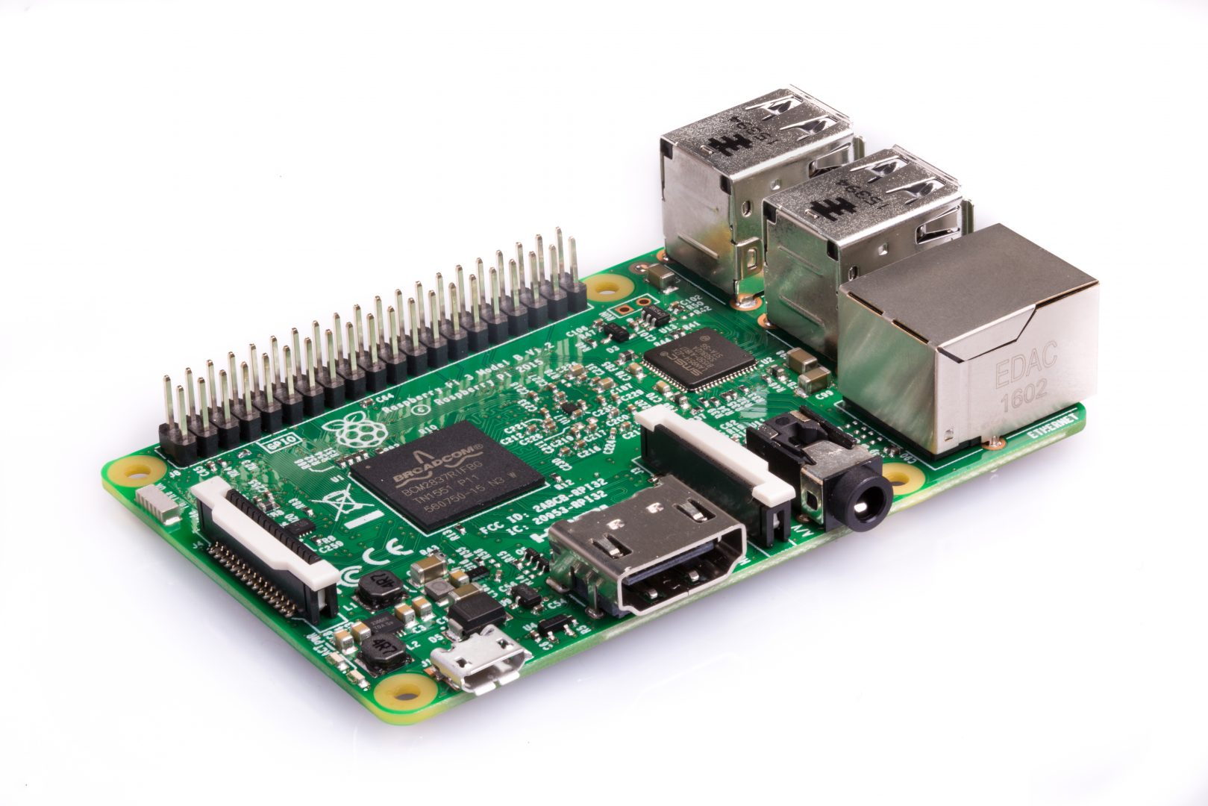
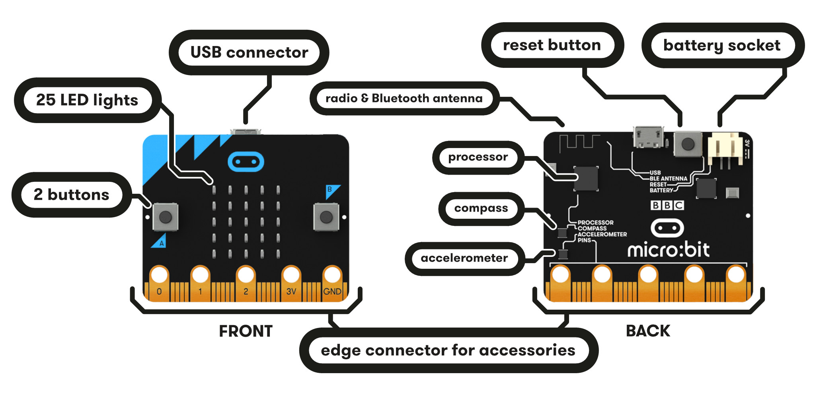
Prizes for Hackathon

Slide 4
Data Collection Sprint
Every registered participant
# minutes recorded
Top 3 voice donors get prizes

Slide 5
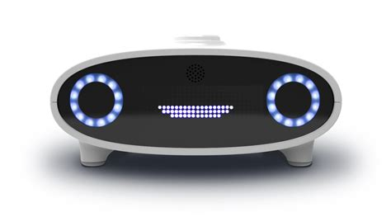

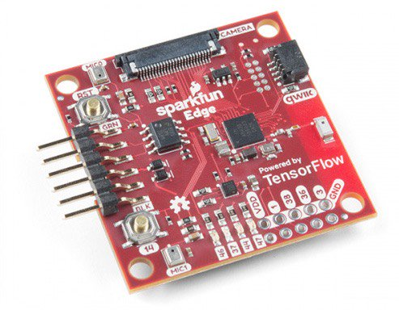
Prizes for Data Collection

Slide 6
Рахмат!

